Slide 1

Notes:
Asymptotic Time Complexity
https://www.polleverywhere.com/competitions/m5H1jlYTIBoPVNhkkNFym?display_state=welcome&controls=none&onscreen=persist

Slide 2
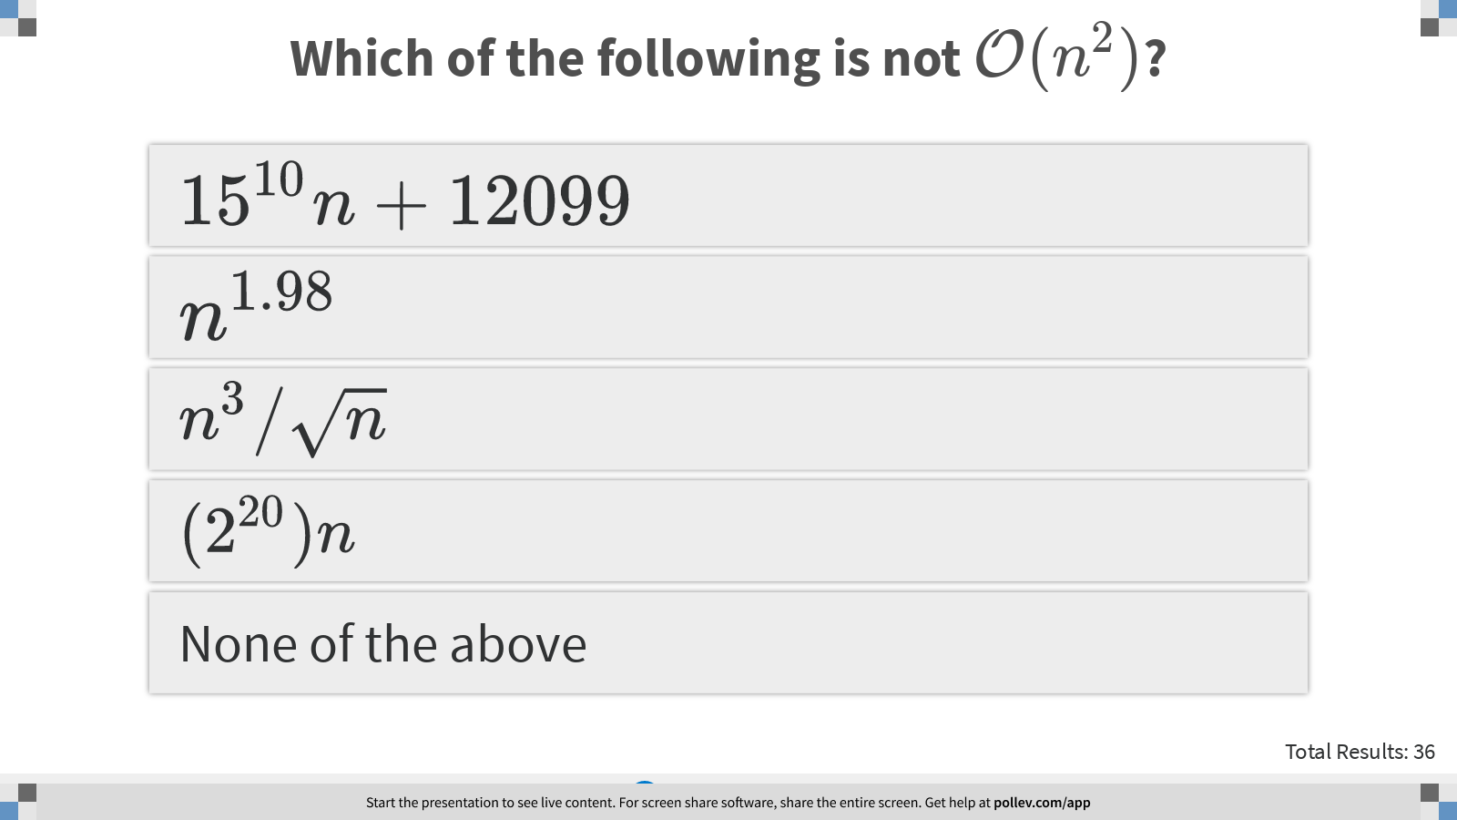
Notes:
Which of the following is not $$\mathcal{O}(n^2)$$?
https://www.polleverywhere.com/multiple_choice_polls/erKlXyz3i91liehhhmOo4?display_state=instructions&controls=none&onscreen=persist

Slide 3
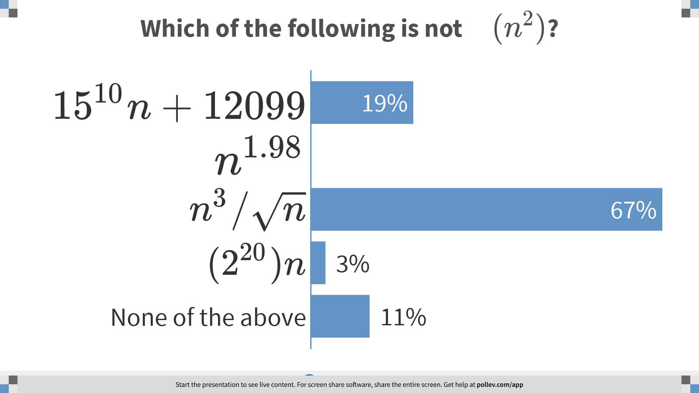
Notes:
Which of the following is not $$\mathcal{O}(n^2)$$?
https://www.polleverywhere.com/multiple_choice_polls/erKlXyz3i91liehhhmOo4?display_state=chart&display=correctness&controls=none&onscreen=persist

Slide 4
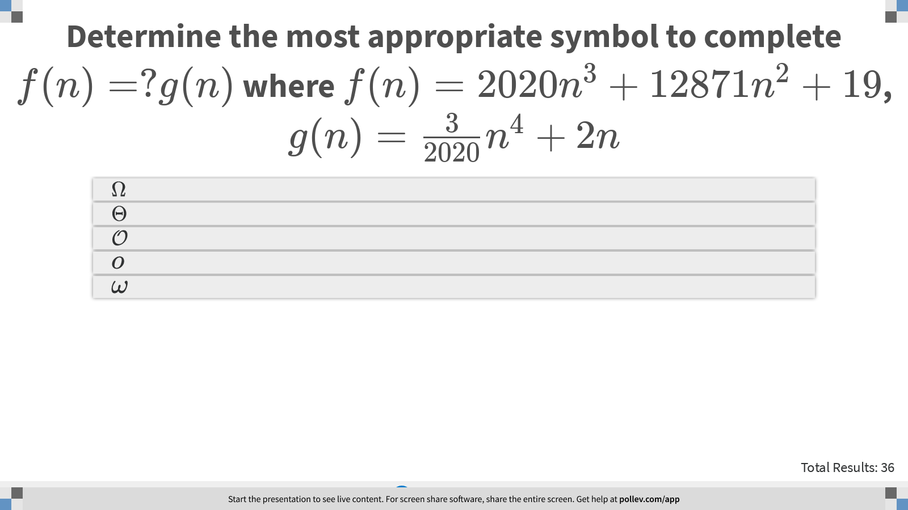
Notes:
Determine the most appropriate symbol to complete $$f(n)=?g(n)$$ where $$f(n)= 2020 n^3 + 12871 n^2 + 19$$, $$g(n)=\frac{3}{2020} n^4 + 2n$$
https://www.polleverywhere.com/multiple_choice_polls/hzOS9W1afyoA7LFrMhBjn?display_state=instructions&controls=none&onscreen=persist

Slide 5
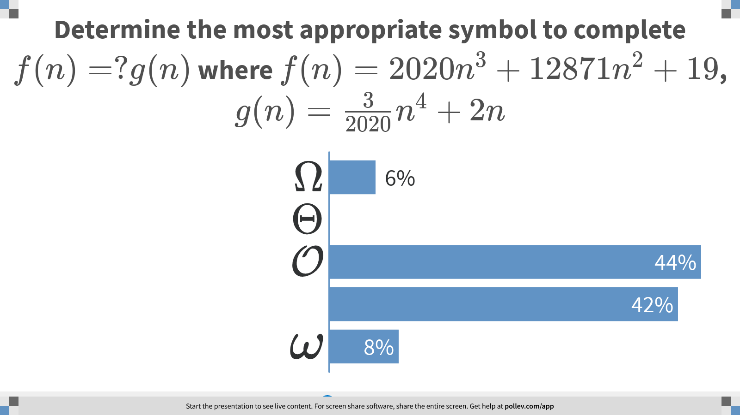
Notes:
Determine the most appropriate symbol to complete $$f(n)=?g(n)$$ where $$f(n)= 2020 n^3 + 12871 n^2 + 19$$, $$g(n)=\frac{3}{2020} n^4 + 2n$$
https://www.polleverywhere.com/multiple_choice_polls/hzOS9W1afyoA7LFrMhBjn?display_state=chart&display=correctness&controls=none&onscreen=persist

Slide 6
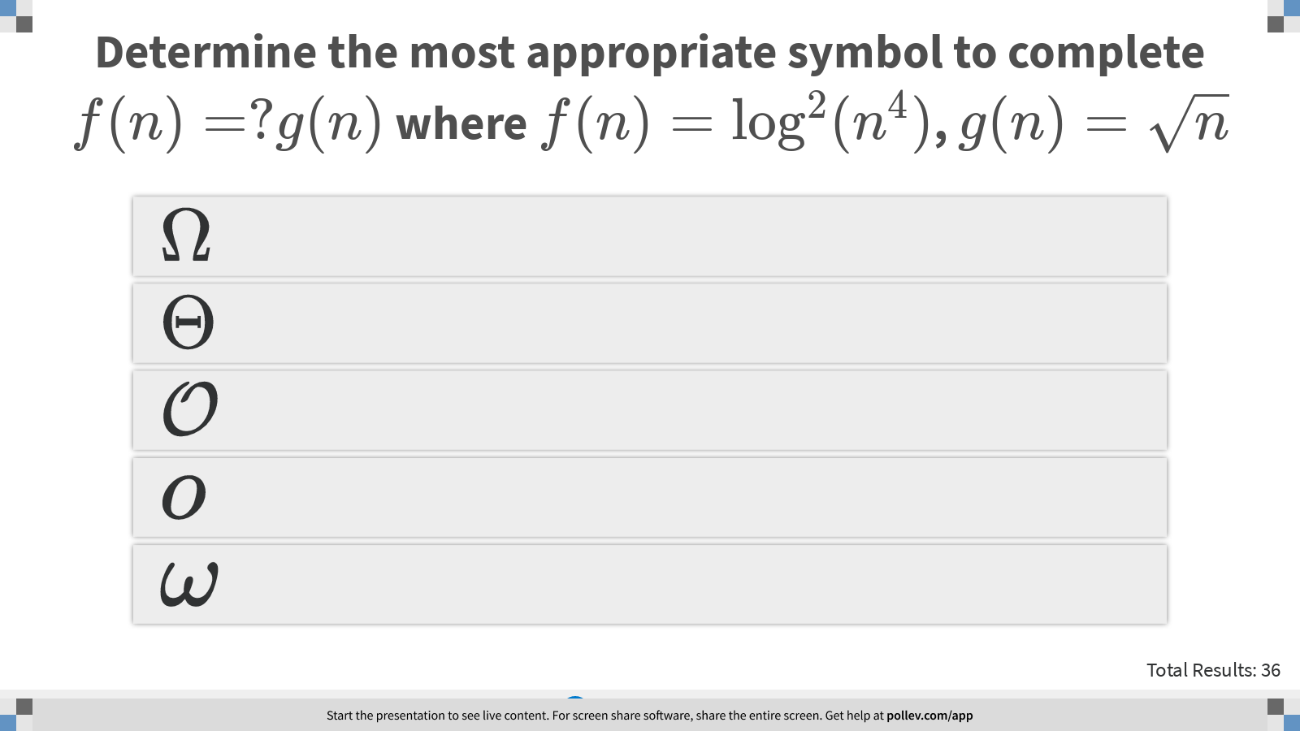
Notes:
Determine the most appropriate symbol to complete $$f(n)=?g(n) $$ where $$f(n)= \log^2(n^4)$$, $$g(n)=\sqrt{n}$$
https://www.polleverywhere.com/multiple_choice_polls/GPPO8u4RM1tcaFxQDdVqi?display_state=instructions&controls=none&onscreen=persist

Slide 7
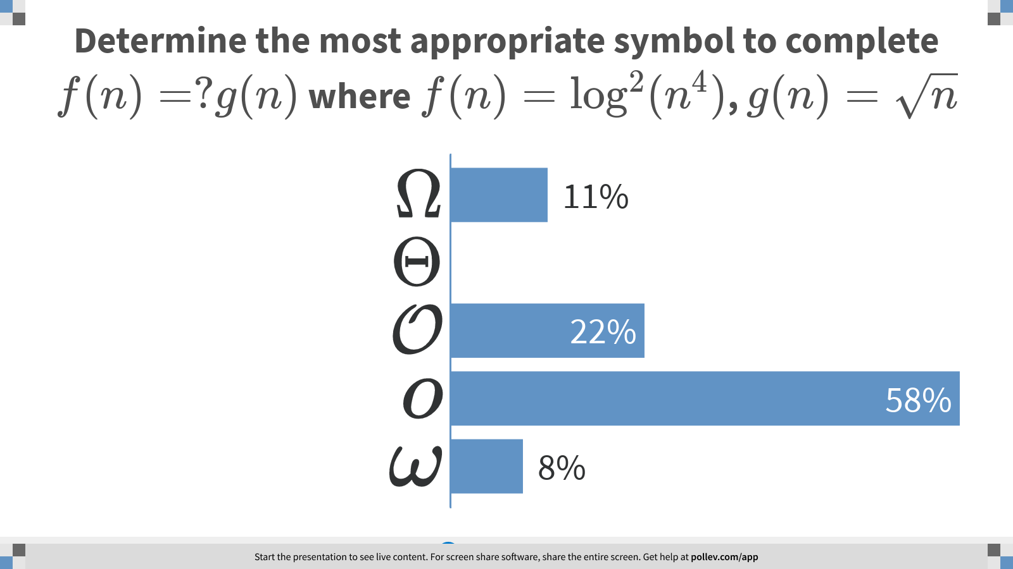
Notes:
Determine the most appropriate symbol to complete $$f(n)=?g(n) $$ where $$f(n)= \log^2(n^4)$$, $$g(n)=\sqrt{n}$$
https://www.polleverywhere.com/multiple_choice_polls/GPPO8u4RM1tcaFxQDdVqi?display_state=chart&display=correctness&controls=none&onscreen=persist

Slide 8
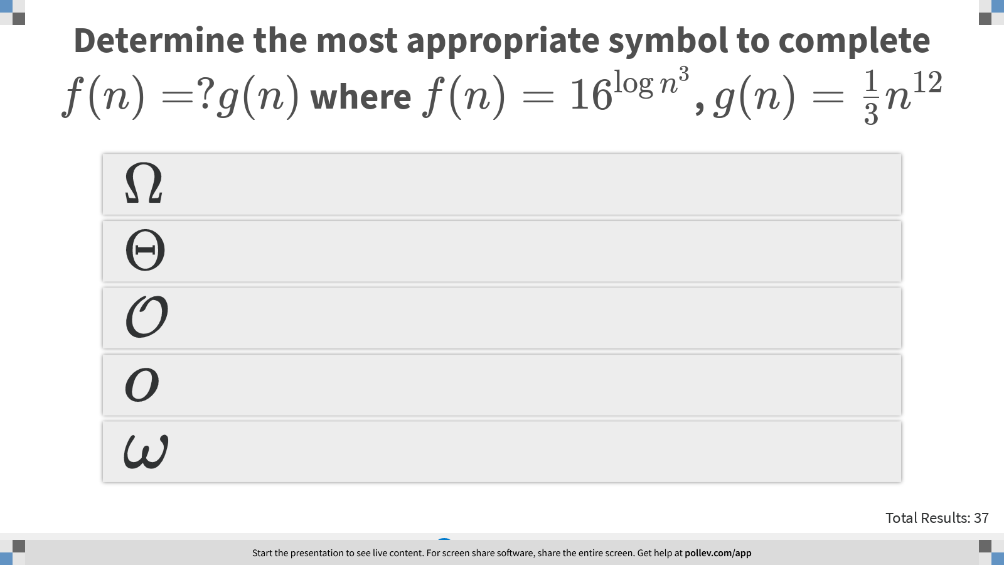
Notes:
Determine the most appropriate symbol to complete $$f(n)=?g(n) $$ where $$f(n)= 16^{\log n^3}$$, $$g(n)=\frac{1}{3} n^{12}$$
https://www.polleverywhere.com/multiple_choice_polls/gYBljqeFcJHpEWgKrNXFJ?display_state=instructions&controls=none&onscreen=persist

Slide 9
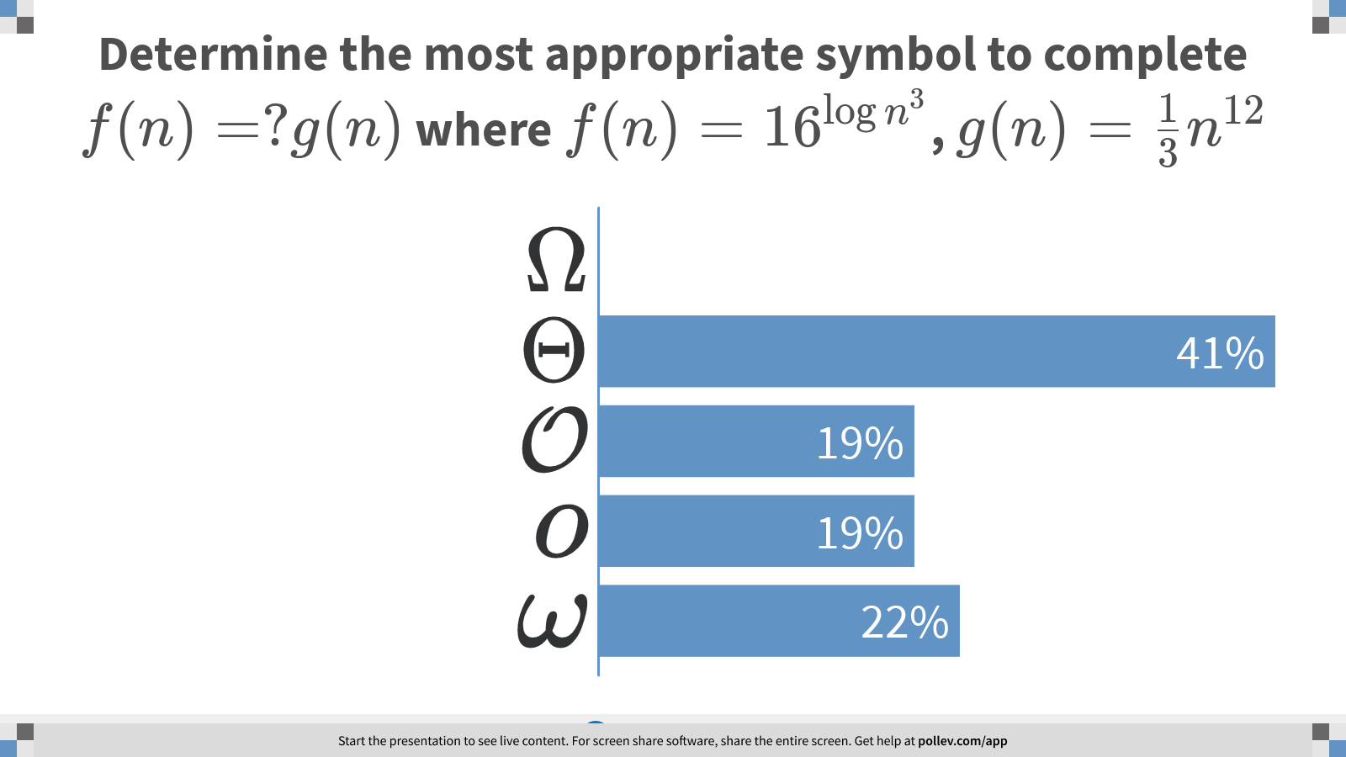
Notes:
Determine the most appropriate symbol to complete $$f(n)=?g(n) $$ where $$f(n)= 16^{\log n^3}$$, $$g(n)=\frac{1}{3} n^{12}$$
https://www.polleverywhere.com/multiple_choice_polls/gYBljqeFcJHpEWgKrNXFJ?display_state=chart&display=correctness&controls=none&onscreen=persist

Slide 10
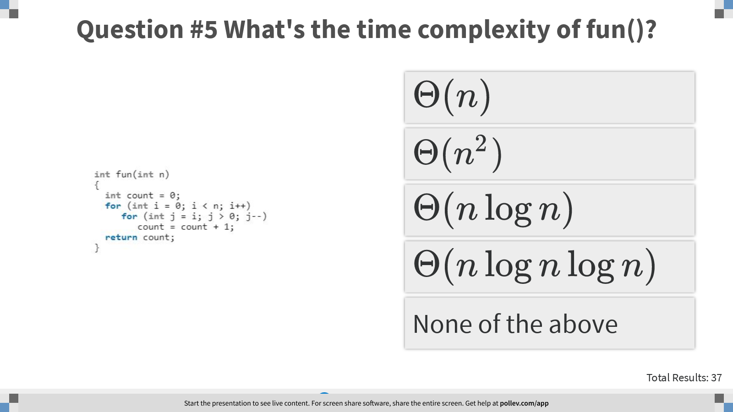
Notes:
Question #5 What's the time complexity of fun()?
https://www.polleverywhere.com/multiple_choice_polls/OyTOecrqQ8JC6rU3hiLDX?display_state=instructions&controls=none&onscreen=persist

Slide 11
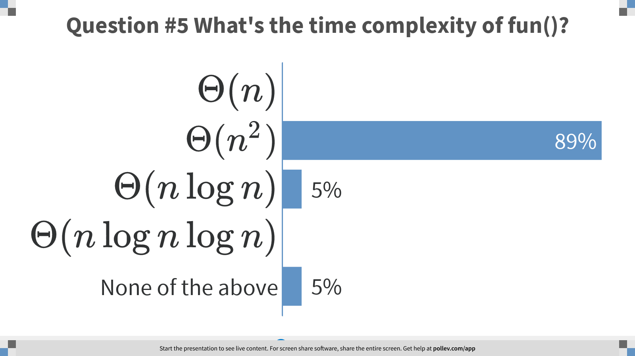
Notes:
Question #5 What's the time complexity of fun()?
https://www.polleverywhere.com/multiple_choice_polls/OyTOecrqQ8JC6rU3hiLDX?display_state=chart&display=correctness&controls=none&onscreen=persist

Slide 12
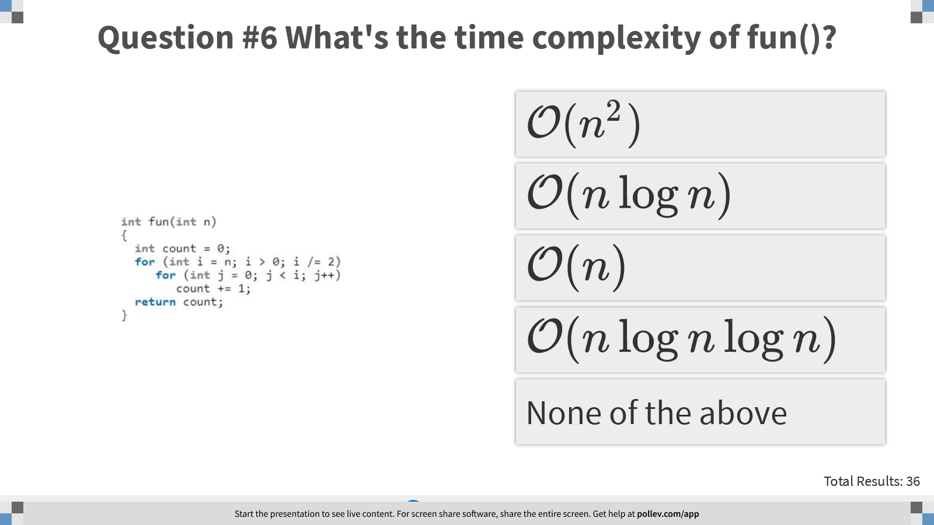
Notes:
Question #6 What's the time complexity of fun()?
https://www.polleverywhere.com/multiple_choice_polls/SLGn6qLUFUg569wnI4y19?display_state=instructions&controls=none&onscreen=persist

Slide 13
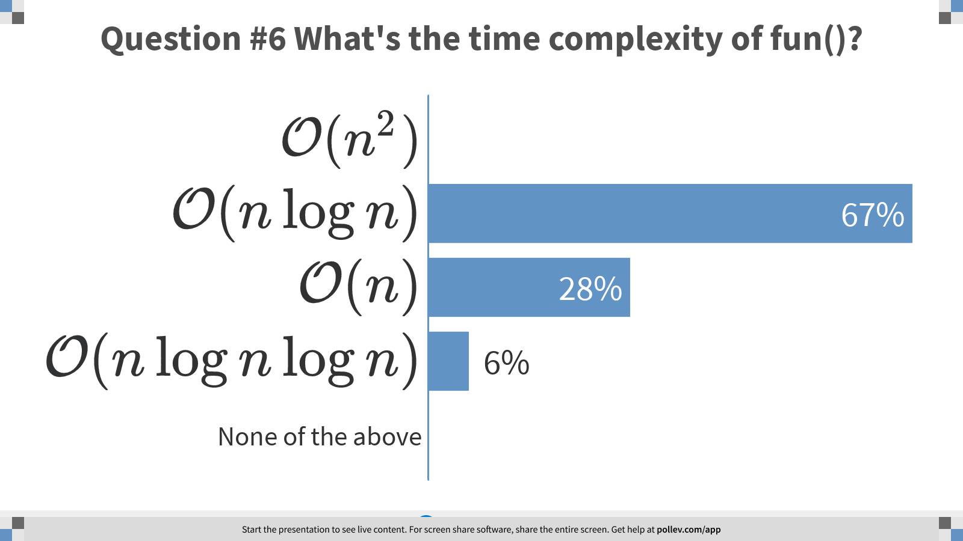
Notes:
Question #6 What's the time complexity of fun()?
https://www.polleverywhere.com/multiple_choice_polls/SLGn6qLUFUg569wnI4y19?display_state=chart&display=correctness&controls=none&onscreen=persist

Slide 14
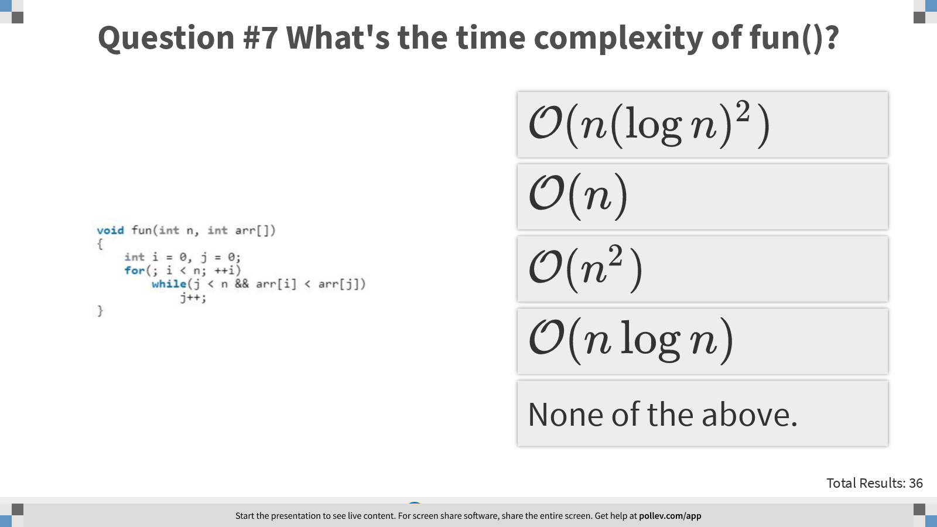
Notes:
Question #7 What's the time complexity of fun()?
https://www.polleverywhere.com/multiple_choice_polls/JhG2qetNpQDNQcpRrpb9F?display_state=instructions&controls=none&onscreen=persist

Slide 15
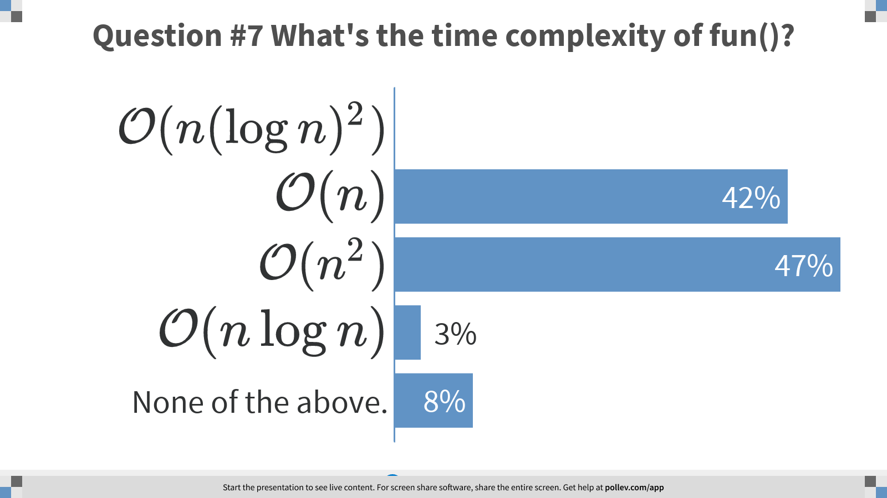
Notes:
Question #7 What's the time complexity of fun()?
https://www.polleverywhere.com/multiple_choice_polls/JhG2qetNpQDNQcpRrpb9F?display_state=chart&display=correctness&controls=none&onscreen=persist

Slide 16
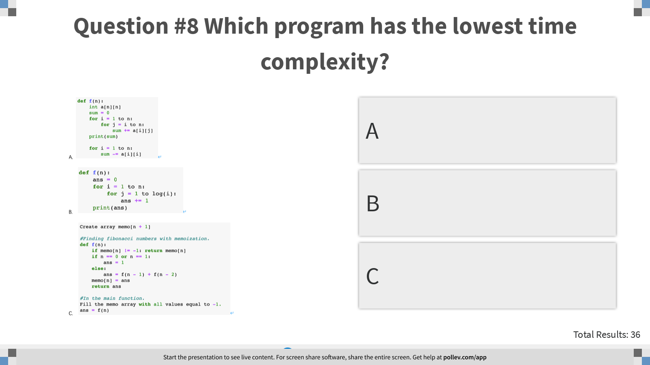
Notes:
Question #8 Which program has the lowest time complexity?
https://www.polleverywhere.com/multiple_choice_polls/ydbgRRAVszI2Hr6Vi9qd0?display_state=instructions&controls=none&onscreen=persist

Slide 17
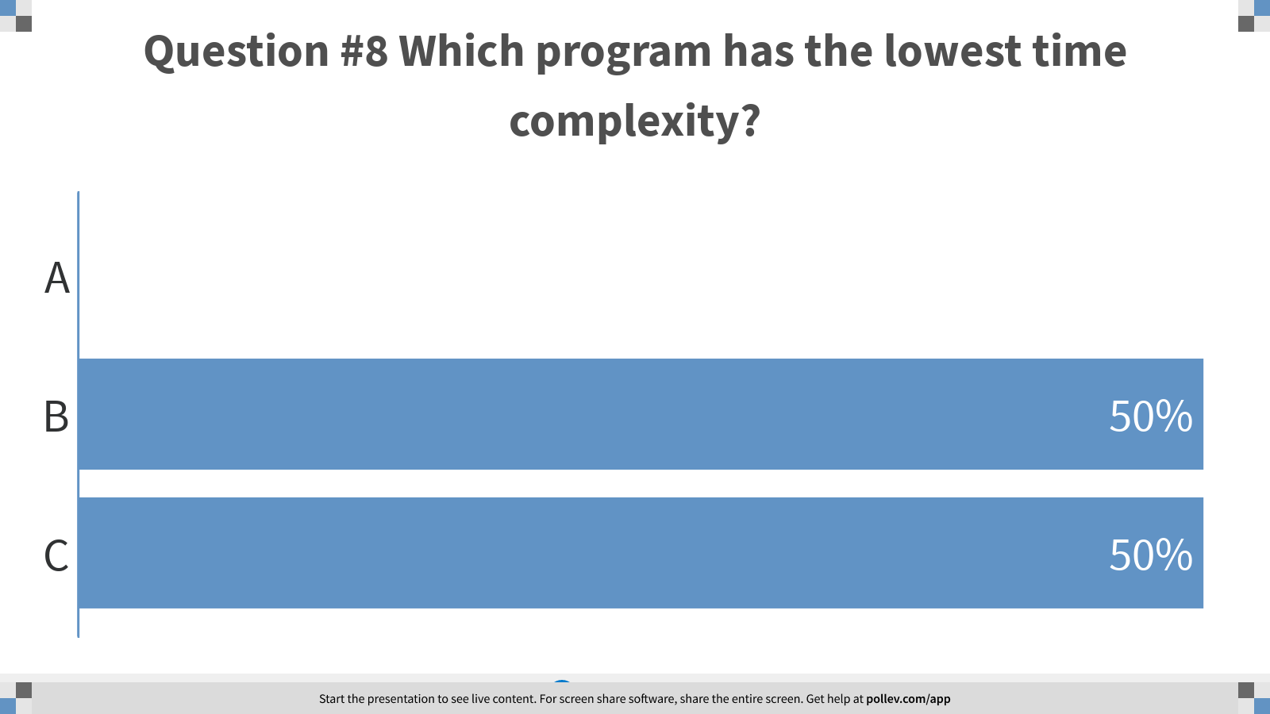
Notes:
Question #8 Which program has the lowest time complexity?
https://www.polleverywhere.com/multiple_choice_polls/ydbgRRAVszI2Hr6Vi9qd0?display_state=chart&display=correctness&controls=none&onscreen=persist

Slide 18
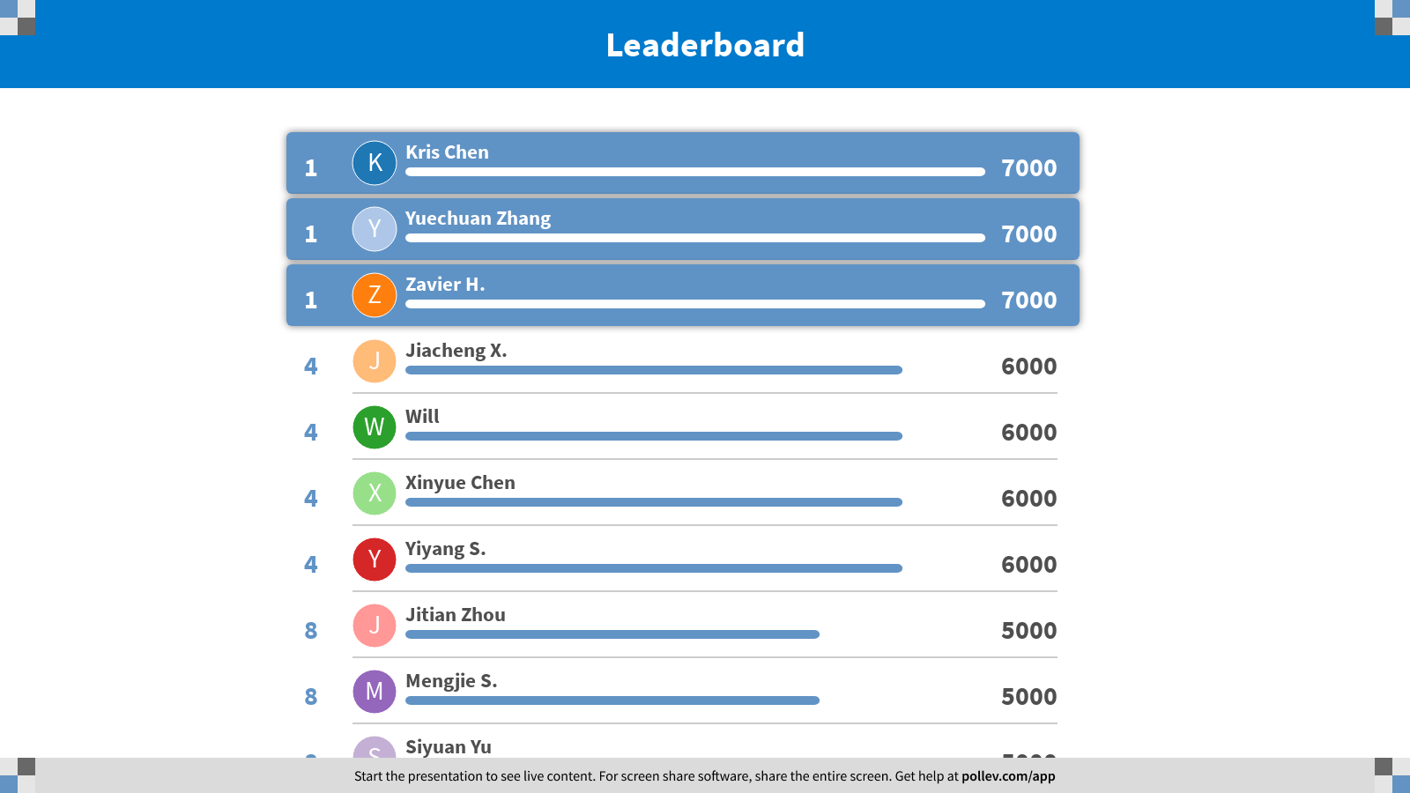
Notes:
Asymptotic Time Complexity
https://www.polleverywhere.com/competitions/m5H1jlYTIBoPVNhkkNFym?display_state=finale&onscreen=persist

Slide 19

Notes:
Recurrence
https://www.polleverywhere.com/competitions/gRwVK5FjQz4w2FVP0h7zl?display_state=welcome&controls=none&onscreen=persist

Slide 20
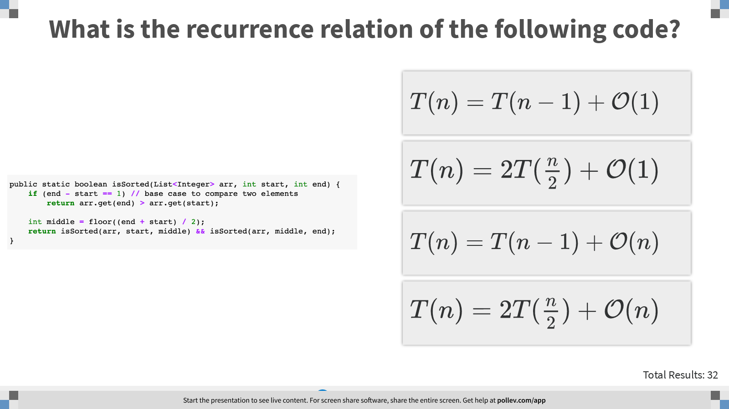
Notes:
What is the recurrence relation of the following code?
https://www.polleverywhere.com/multiple_choice_polls/da2umxIICnTkNeT0bnXIX?display_state=instructions&controls=none&onscreen=persist

Slide 21
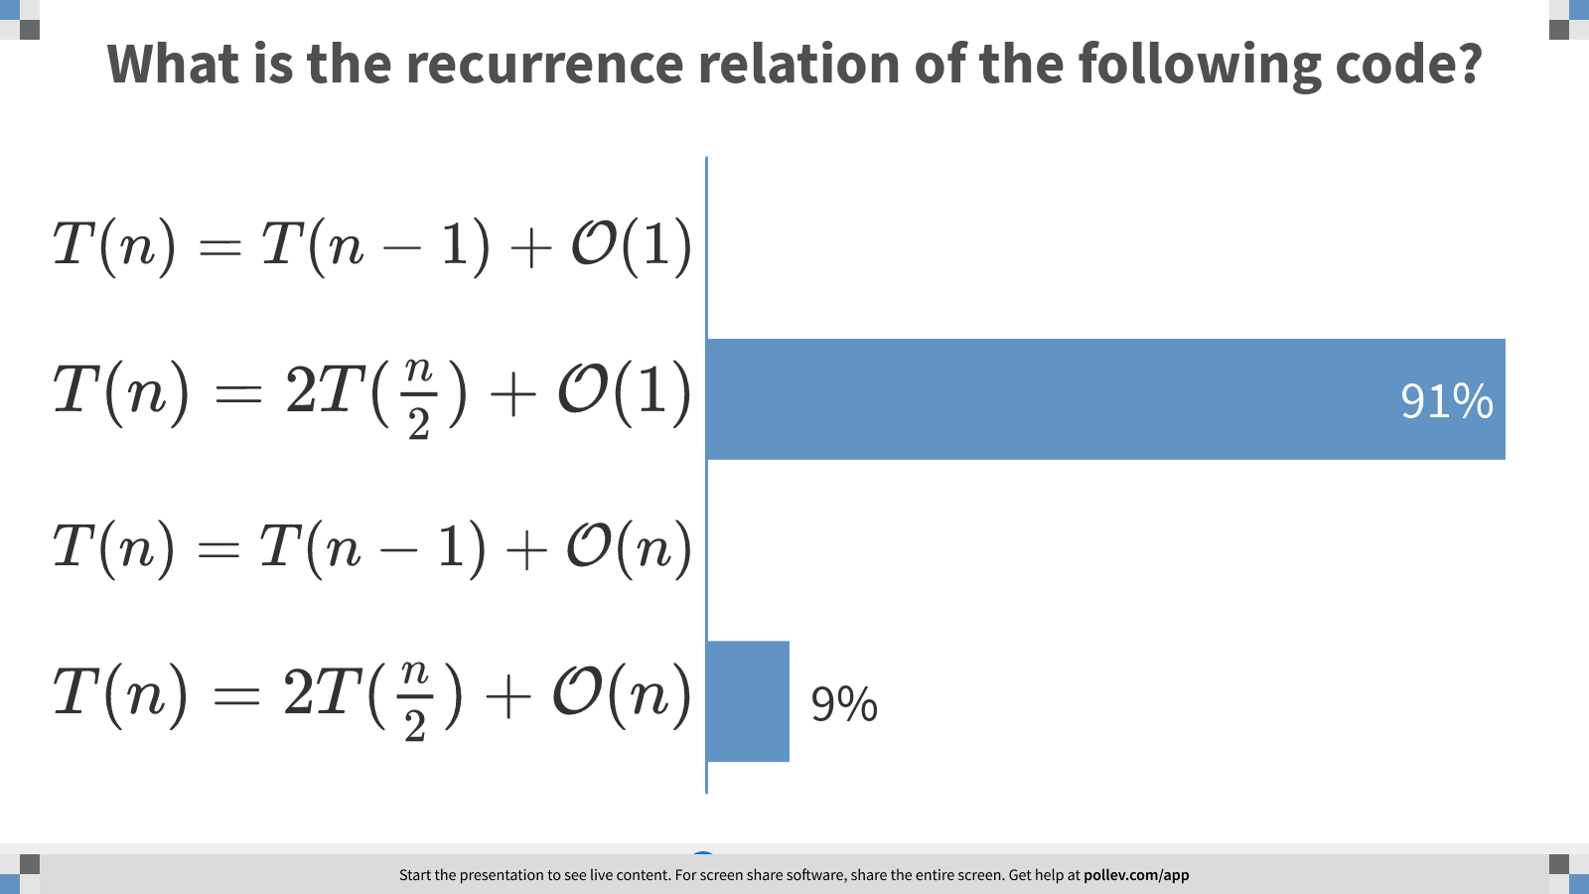
Notes:
What is the recurrence relation of the following code?
https://www.polleverywhere.com/multiple_choice_polls/da2umxIICnTkNeT0bnXIX?display_state=chart&display=correctness&controls=none&onscreen=persist

Slide 22
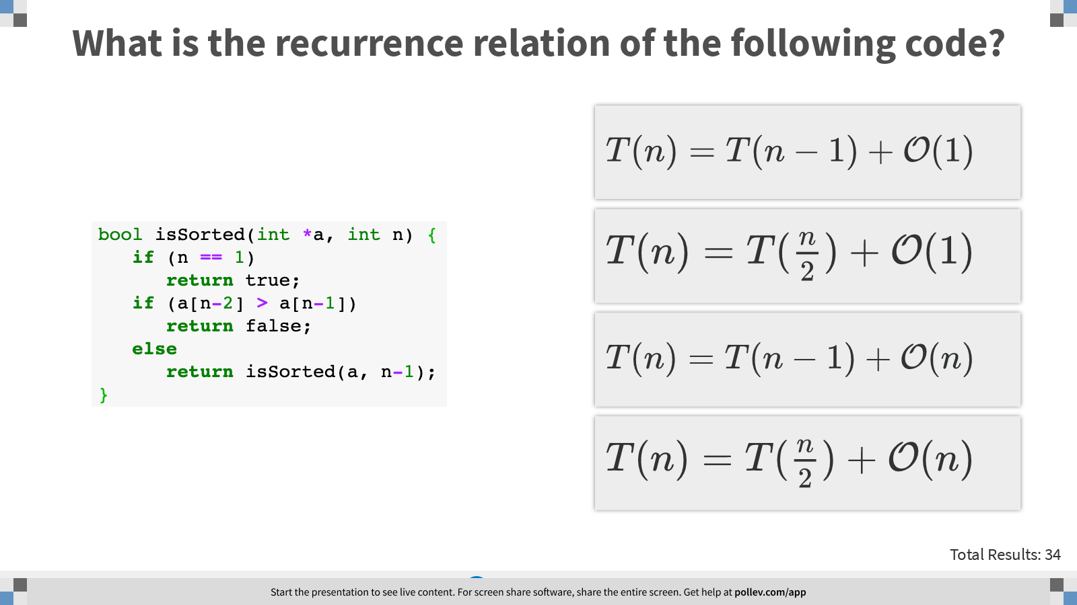
Notes:
What is the recurrence relation of the following code?
https://www.polleverywhere.com/multiple_choice_polls/iZNmNkfS3CniyStsARoQM?display_state=instructions&controls=none&onscreen=persist

Slide 23
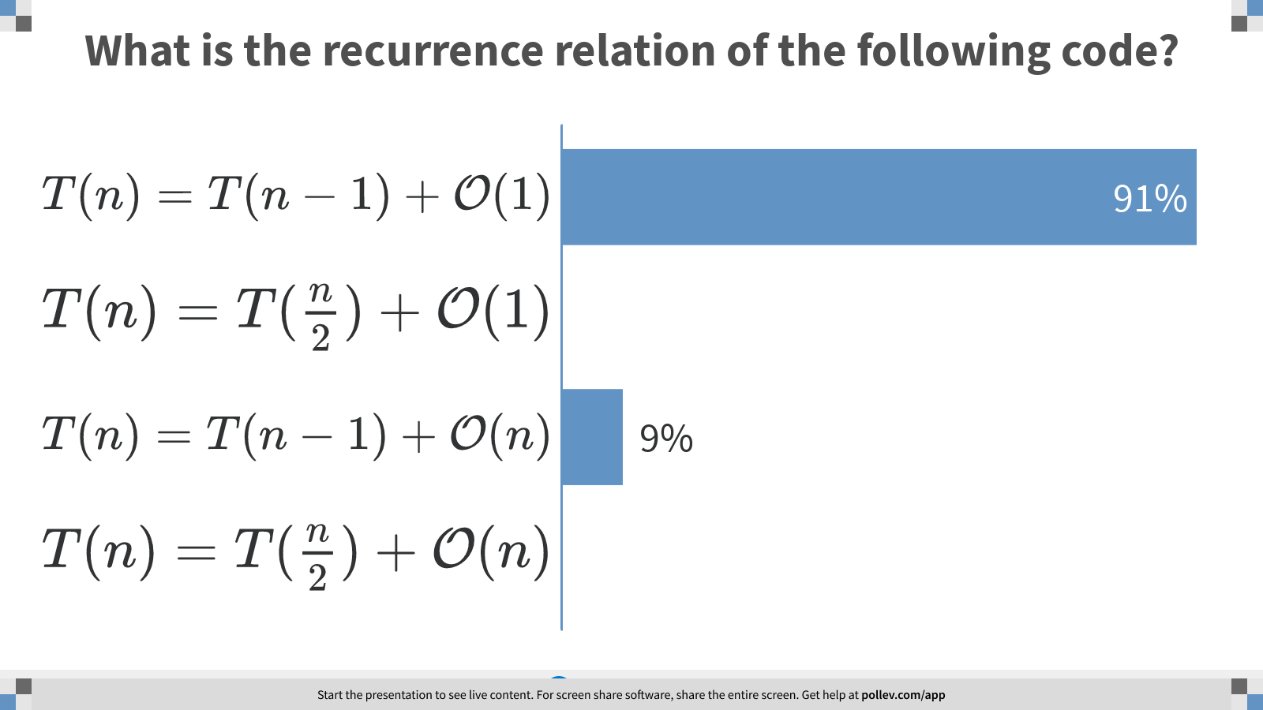
Notes:
What is the recurrence relation of the following code?
https://www.polleverywhere.com/multiple_choice_polls/iZNmNkfS3CniyStsARoQM?display_state=chart&display=correctness&controls=none&onscreen=persist

Slide 24
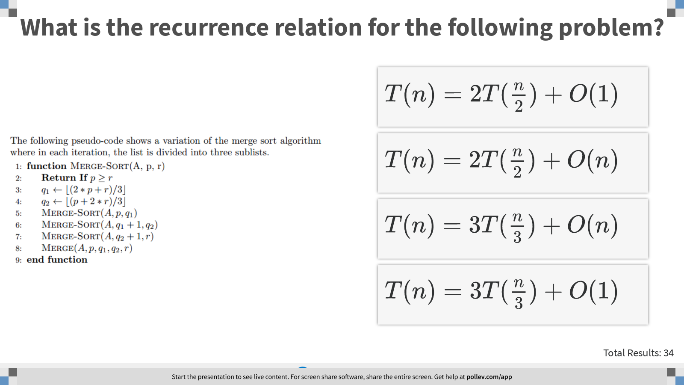
Notes:
What is the recurrence relation for the following problem?
https://www.polleverywhere.com/multiple_choice_polls/Ez8DSiHVtLbb8xJyo3yv1?display_state=instructions&controls=none&onscreen=persist

Slide 25
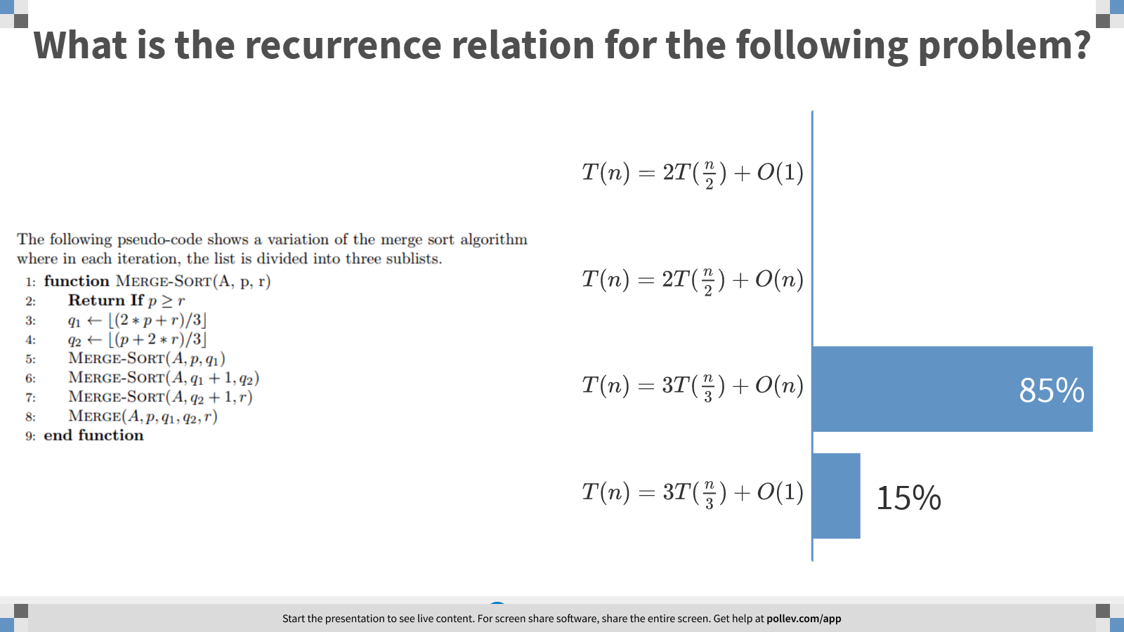
Notes:
What is the recurrence relation for the following problem?
https://www.polleverywhere.com/multiple_choice_polls/Ez8DSiHVtLbb8xJyo3yv1?display_state=chart&display=correctness&controls=none&onscreen=persist

Slide 26
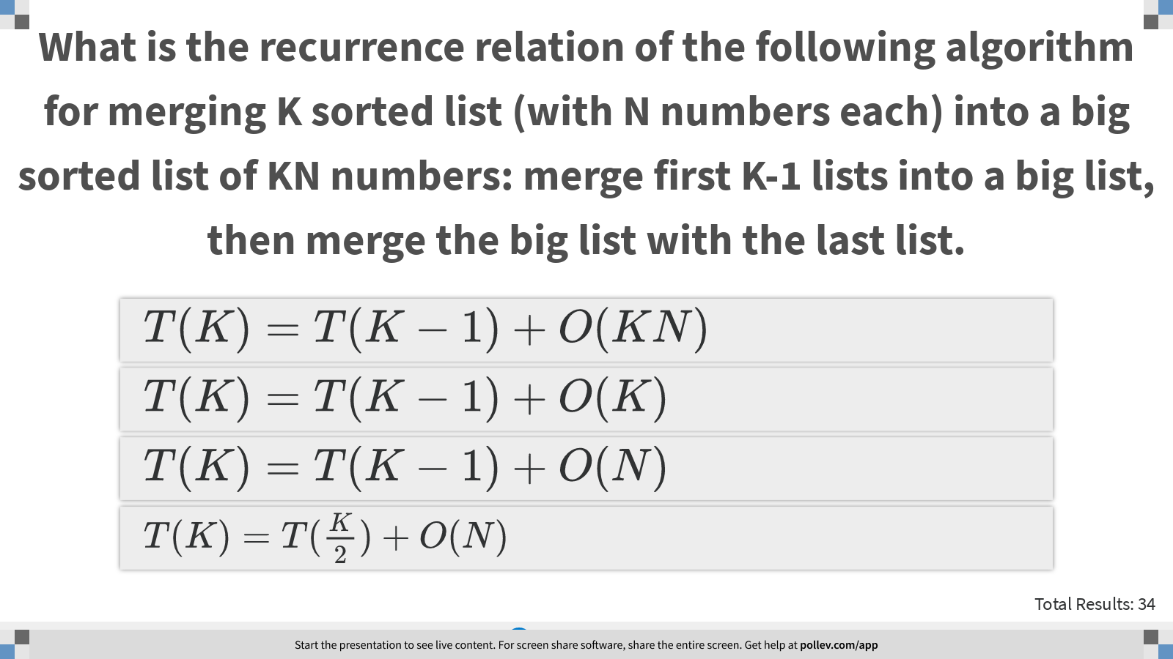
Notes:
What is the recurrence relation of the following algorithm for merging K sorted list (with N numbers each) into a big sorted list of KN numbers: merge first K-1 lists into a big list, then merge the big list with the last list.
https://www.polleverywhere.com/multiple_choice_polls/olskPyyD2iMKRZ0OU84pM?display_state=instructions&controls=none&onscreen=persist

Slide 27
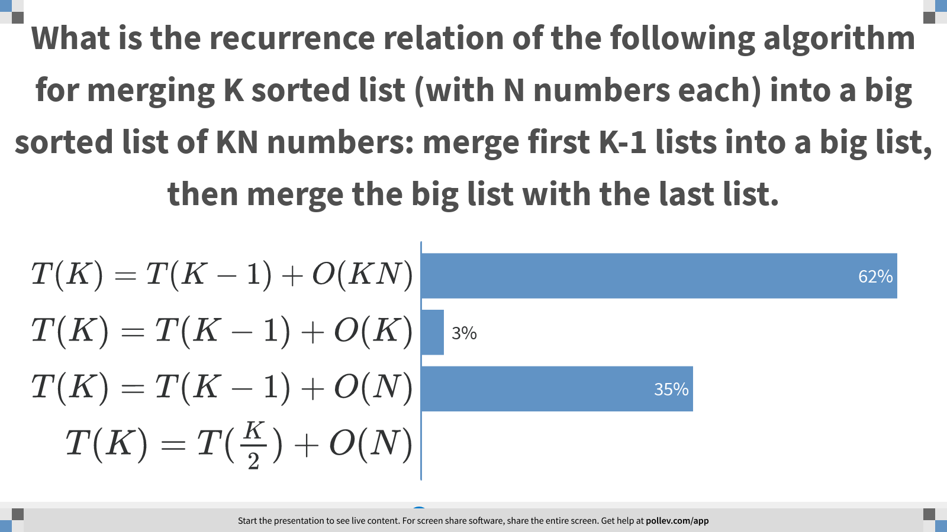
Notes:
What is the recurrence relation of the following algorithm for merging K sorted list (with N numbers each) into a big sorted list of KN numbers: merge first K-1 lists into a big list, then merge the big list with the last list.
https://www.polleverywhere.com/multiple_choice_polls/olskPyyD2iMKRZ0OU84pM?display_state=chart&display=correctness&controls=none&onscreen=persist

Slide 28
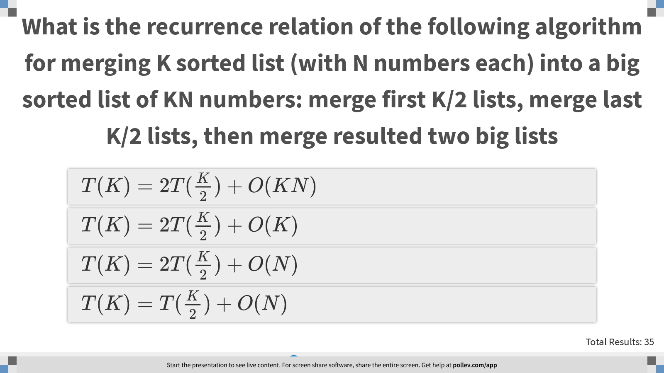
Notes:
What is the recurrence relation of the following algorithm for merging K sorted list (with N numbers each) into a big sorted list of KN numbers: merge first K/2 lists, merge last K/2 lists, then merge resulted two big lists
https://www.polleverywhere.com/multiple_choice_polls/TxvdIUQItS6Kph7EvNW1h?display_state=instructions&controls=none&onscreen=persist

Slide 29
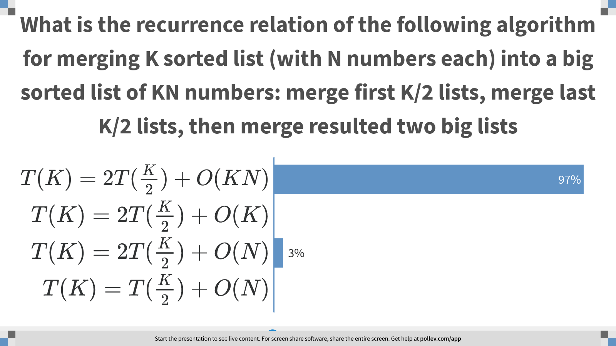
Notes:
What is the recurrence relation of the following algorithm for merging K sorted list (with N numbers each) into a big sorted list of KN numbers: merge first K/2 lists, merge last K/2 lists, then merge resulted two big lists
https://www.polleverywhere.com/multiple_choice_polls/TxvdIUQItS6Kph7EvNW1h?display_state=chart&display=correctness&controls=none&onscreen=persist

Slide 30
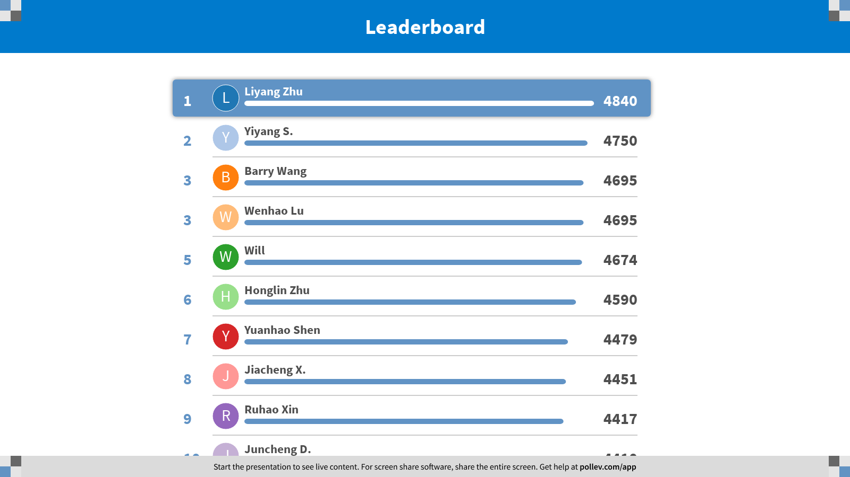
Notes:
Recurrence
https://www.polleverywhere.com/competitions/gRwVK5FjQz4w2FVP0h7zl?display_state=finale&onscreen=persist

