Slide 1

Notes:
Finding Median
https://www.polleverywhere.com/competitions/fToVkutZqCBTFuWzQo2Is?display_state=welcome&controls=none&onscreen=persist

Slide 2
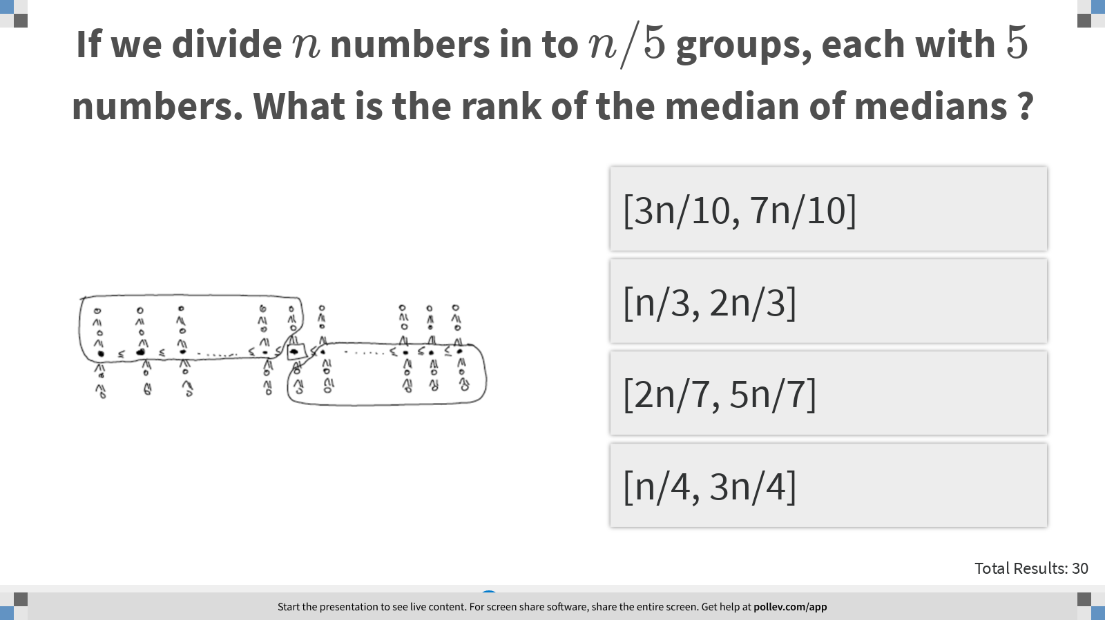
Notes:
If we divide $$n$$ numbers in to $$n/5$$ groups, each with $$5$$ numbers. What is the rank of the median of medians ?
https://www.polleverywhere.com/multiple_choice_polls/sRePnC5ZE3OiKGM3nhDND?display_state=instructions&controls=none&onscreen=persist

Slide 3
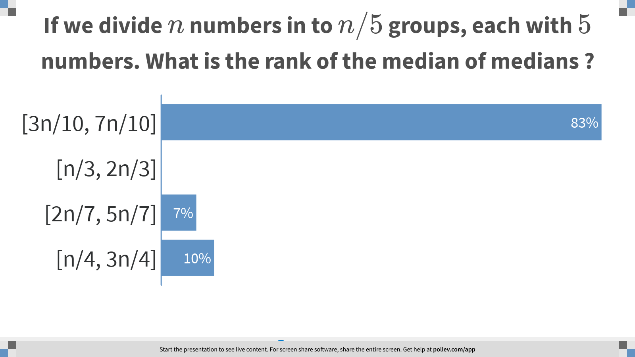
Notes:
If we divide $$n$$ numbers in to $$n/5$$ groups, each with $$5$$ numbers. What is the rank of the median of medians ?
https://www.polleverywhere.com/multiple_choice_polls/sRePnC5ZE3OiKGM3nhDND?display_state=chart&display=correctness&controls=none&onscreen=persist

Slide 4
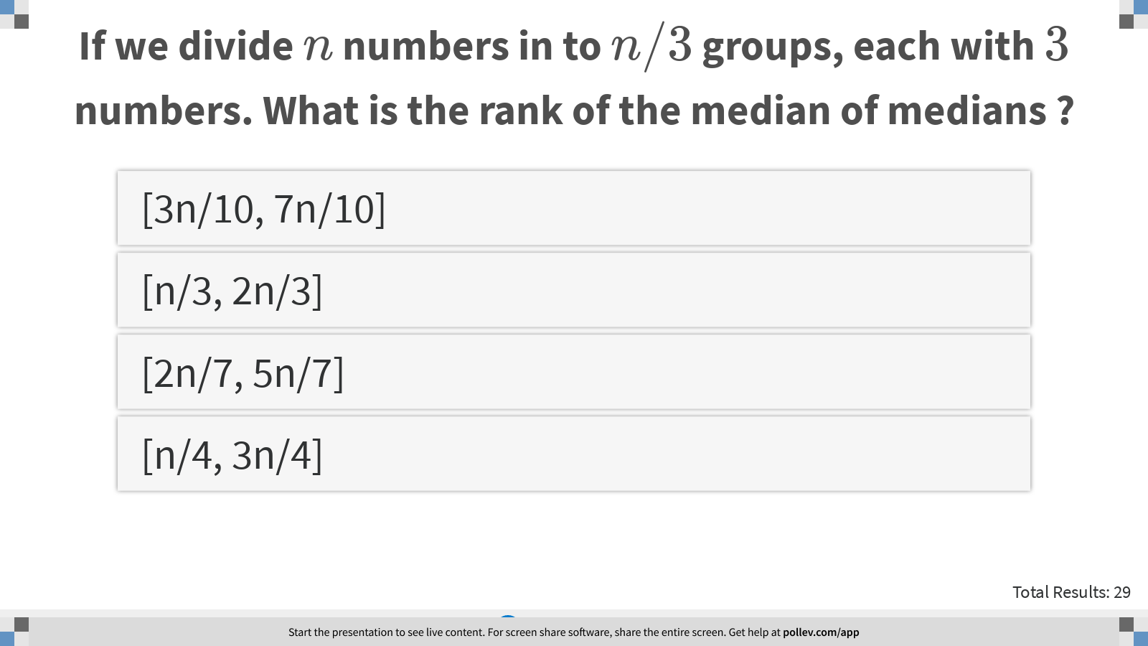
Notes:
If we divide $$n$$ numbers in to $$n/3$$ groups, each with $$3$$ numbers. What is the rank of the median of medians ?
https://www.polleverywhere.com/multiple_choice_polls/W8T54KuOSpXihrKw0Os38?display_state=instructions&controls=none&onscreen=persist

Slide 5
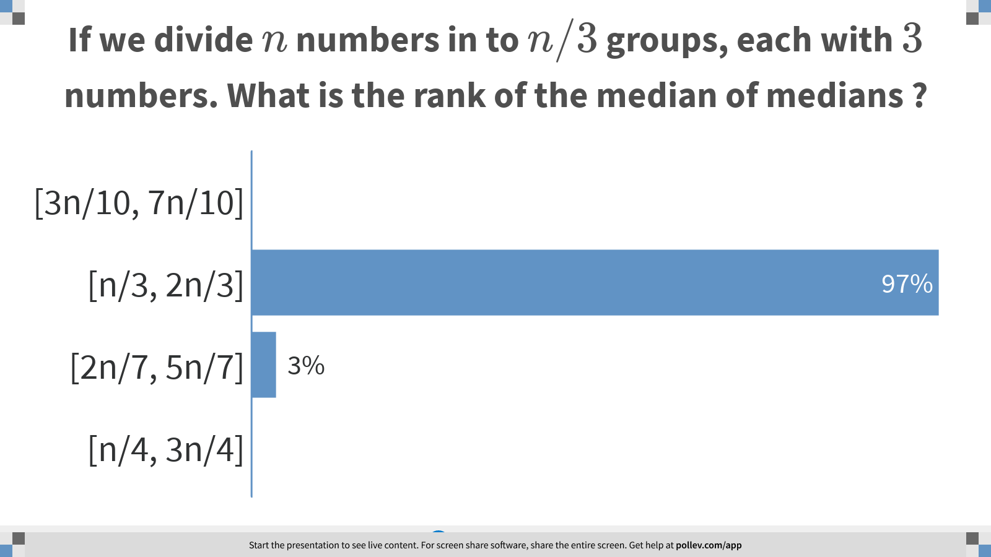
Notes:
If we divide $$n$$ numbers in to $$n/3$$ groups, each with $$3$$ numbers. What is the rank of the median of medians ?
https://www.polleverywhere.com/multiple_choice_polls/W8T54KuOSpXihrKw0Os38?display_state=chart&display=correctness&controls=none&onscreen=persist

Slide 6
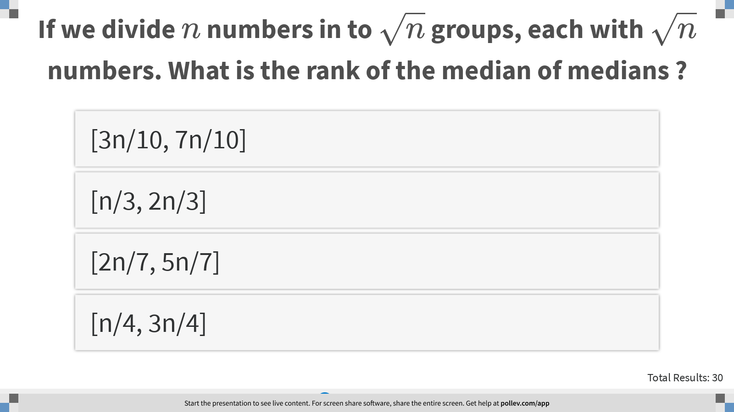
Notes:
If we divide $$n$$ numbers in to $$\sqrt{n}$$ groups, each with $$\sqrt{n}$$ numbers. What is the rank of the median of medians ?
https://www.polleverywhere.com/multiple_choice_polls/xWkFs5cljpB0bcKXOpTz9?display_state=instructions&controls=none&onscreen=persist

Slide 7
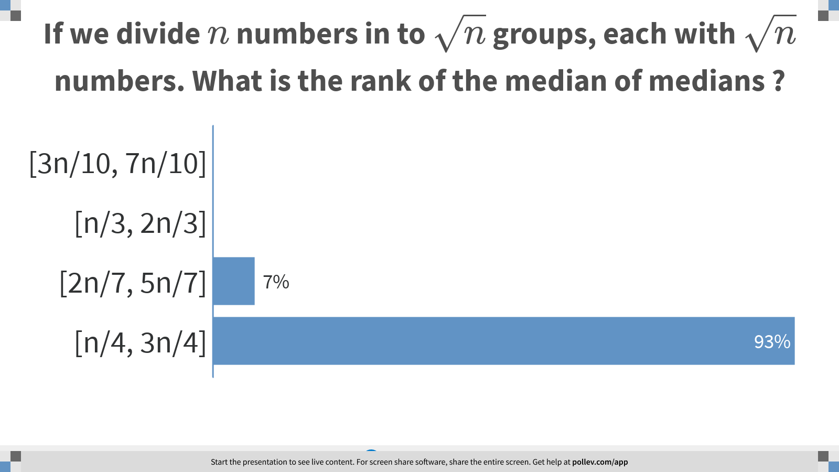
Notes:
If we divide $$n$$ numbers in to $$\sqrt{n}$$ groups, each with $$\sqrt{n}$$ numbers. What is the rank of the median of medians ?
https://www.polleverywhere.com/multiple_choice_polls/xWkFs5cljpB0bcKXOpTz9?display_state=chart&display=correctness&controls=none&onscreen=persist

Slide 8
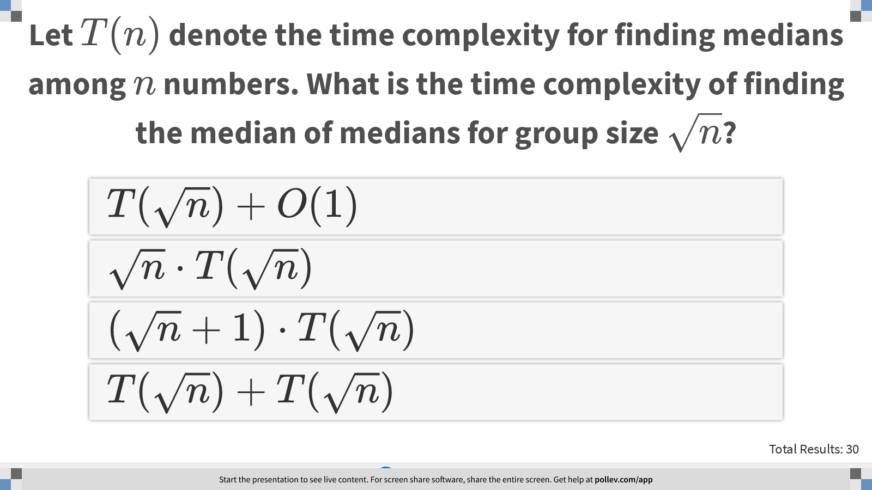
Notes:
Let $$T(n)$$ denote the time complexity for finding medians among $$n$$ numbers. What is the time complexity of finding the median of medians for group size $$\sqrt{n}$$?
https://www.polleverywhere.com/multiple_choice_polls/uGbaSxixVN6hAEMs43MZa?display_state=instructions&controls=none&onscreen=persist

Slide 9
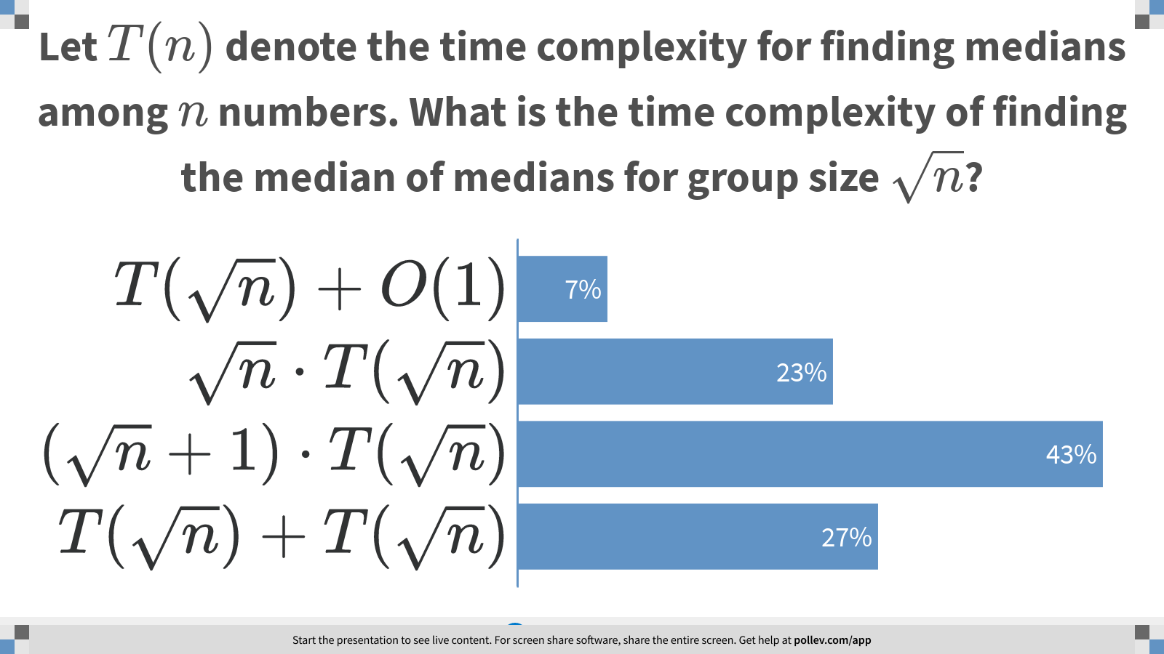
Notes:
Let $$T(n)$$ denote the time complexity for finding medians among $$n$$ numbers. What is the time complexity of finding the median of medians for group size $$\sqrt{n}$$?
https://www.polleverywhere.com/multiple_choice_polls/uGbaSxixVN6hAEMs43MZa?display_state=chart&display=correctness&controls=none&onscreen=persist

Slide 10
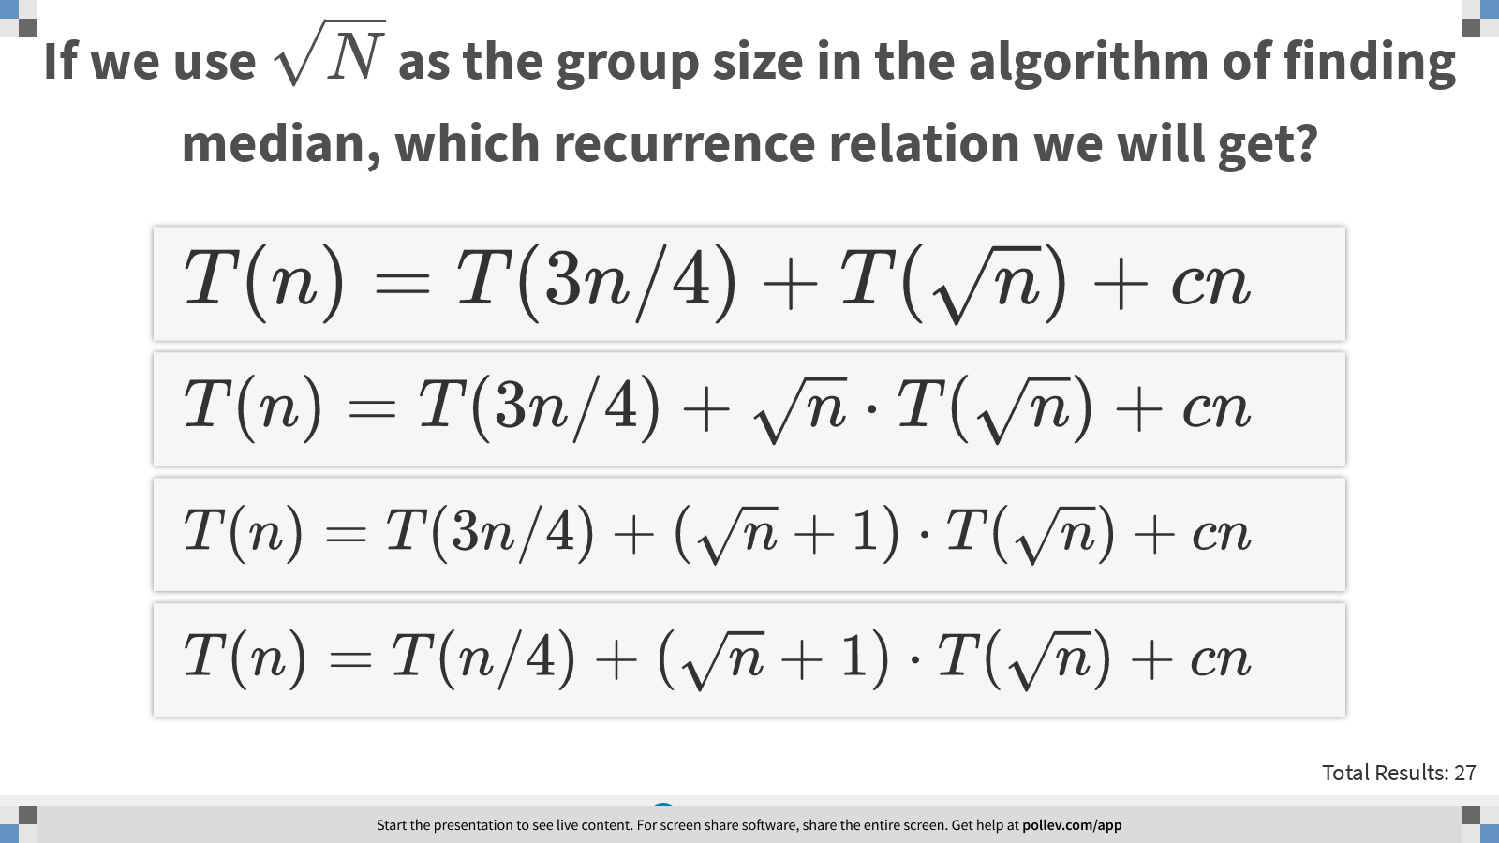
Notes:
If we use $$\sqrt{N}$$ as the group size in the algorithm of finding median, which recurrence relation we will get?
https://www.polleverywhere.com/multiple_choice_polls/ZWV9CCb4UIAUBgUWI5b6I?display_state=instructions&controls=none&onscreen=persist

Slide 11
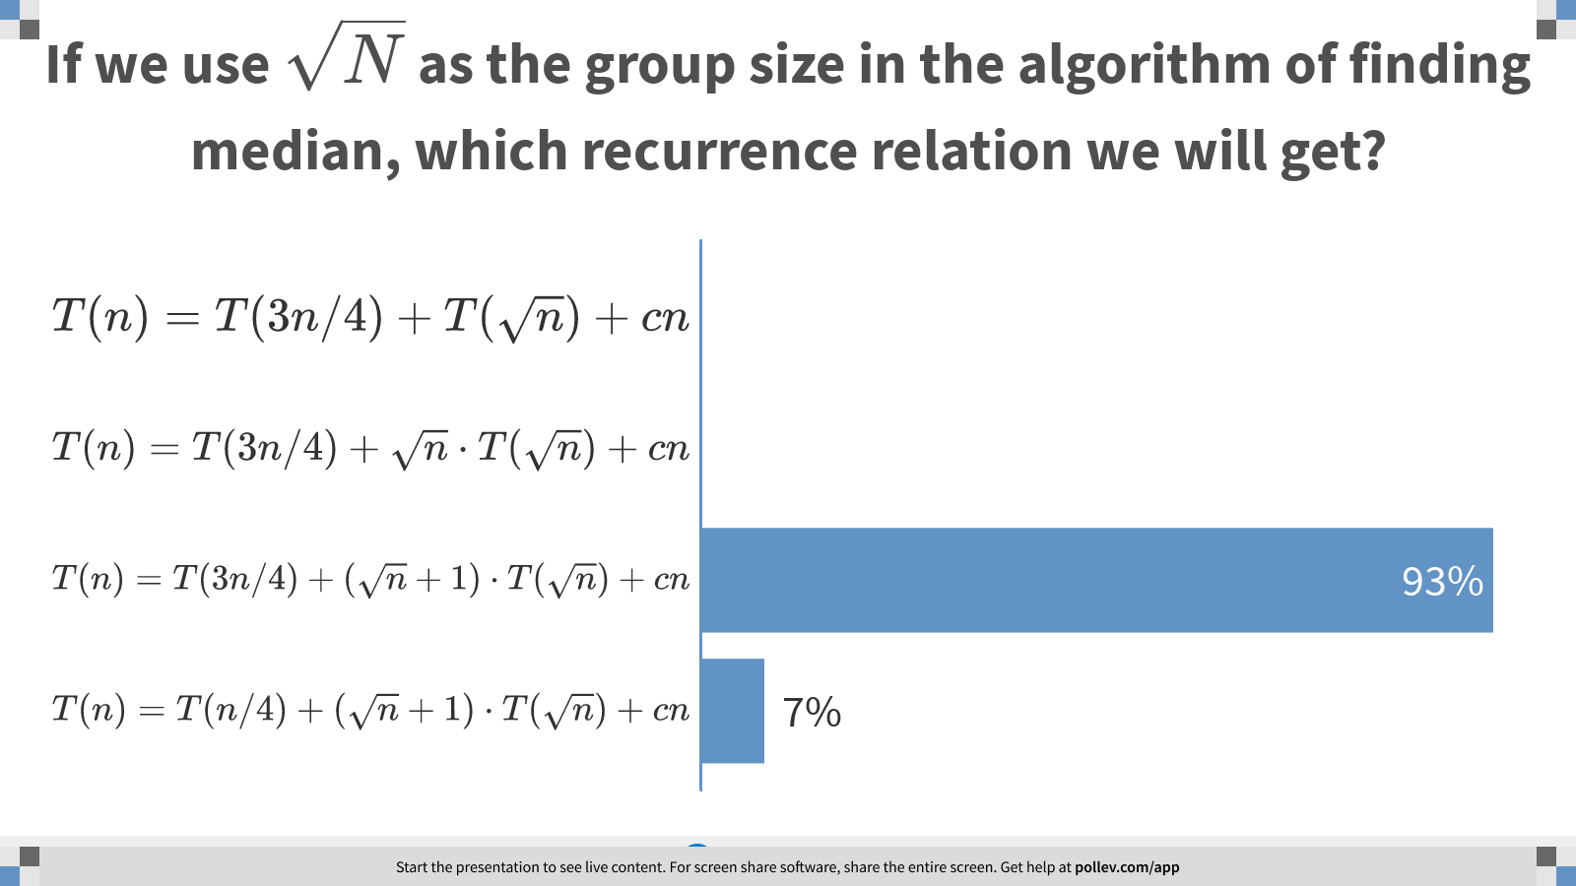
Notes:
If we use $$\sqrt{N}$$ as the group size in the algorithm of finding median, which recurrence relation we will get?
https://www.polleverywhere.com/multiple_choice_polls/ZWV9CCb4UIAUBgUWI5b6I?display_state=chart&display=correctness&controls=none&onscreen=persist

Slide 12
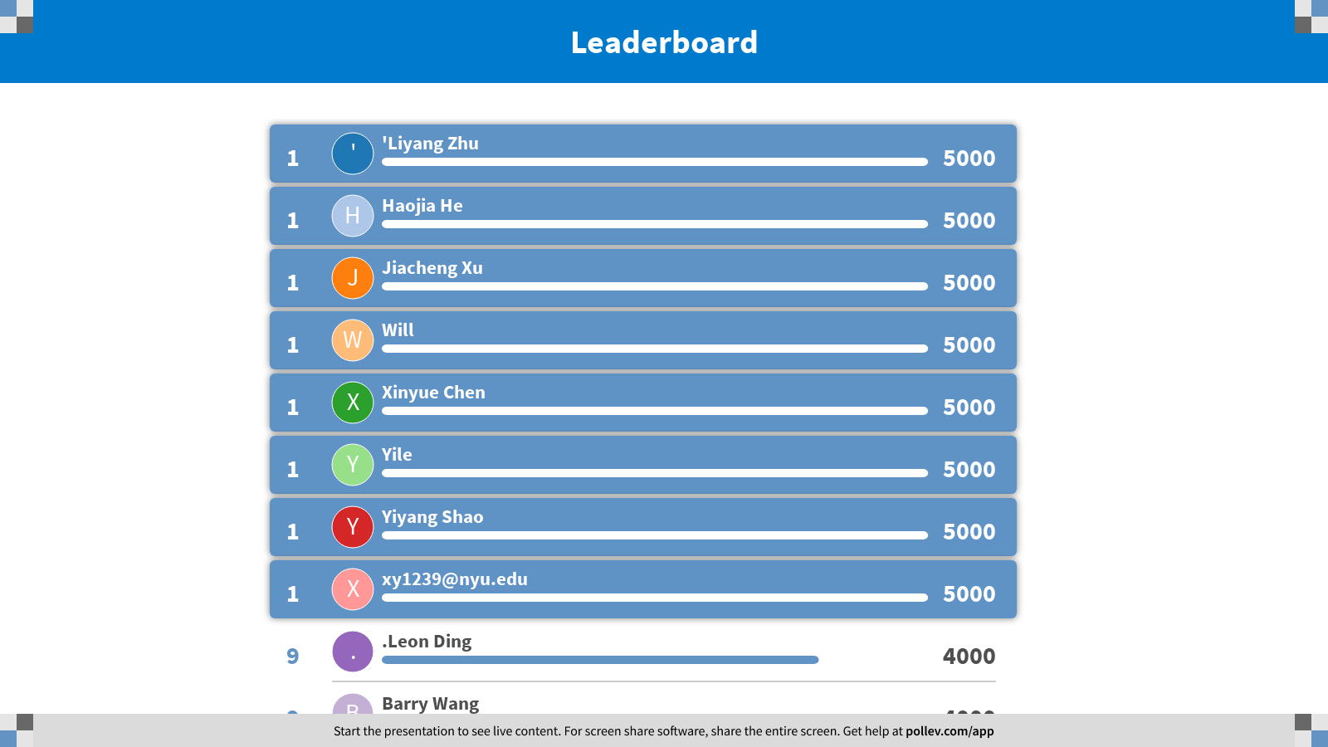
Notes:
Finding Median
https://www.polleverywhere.com/competitions/fToVkutZqCBTFuWzQo2Is?display_state=finale&onscreen=persist

Slide 13

Notes:
Sorting
https://www.polleverywhere.com/competitions/keWwr2PhCSE12ZBneCUvz?display_state=welcome&controls=none&onscreen=persist

Slide 14
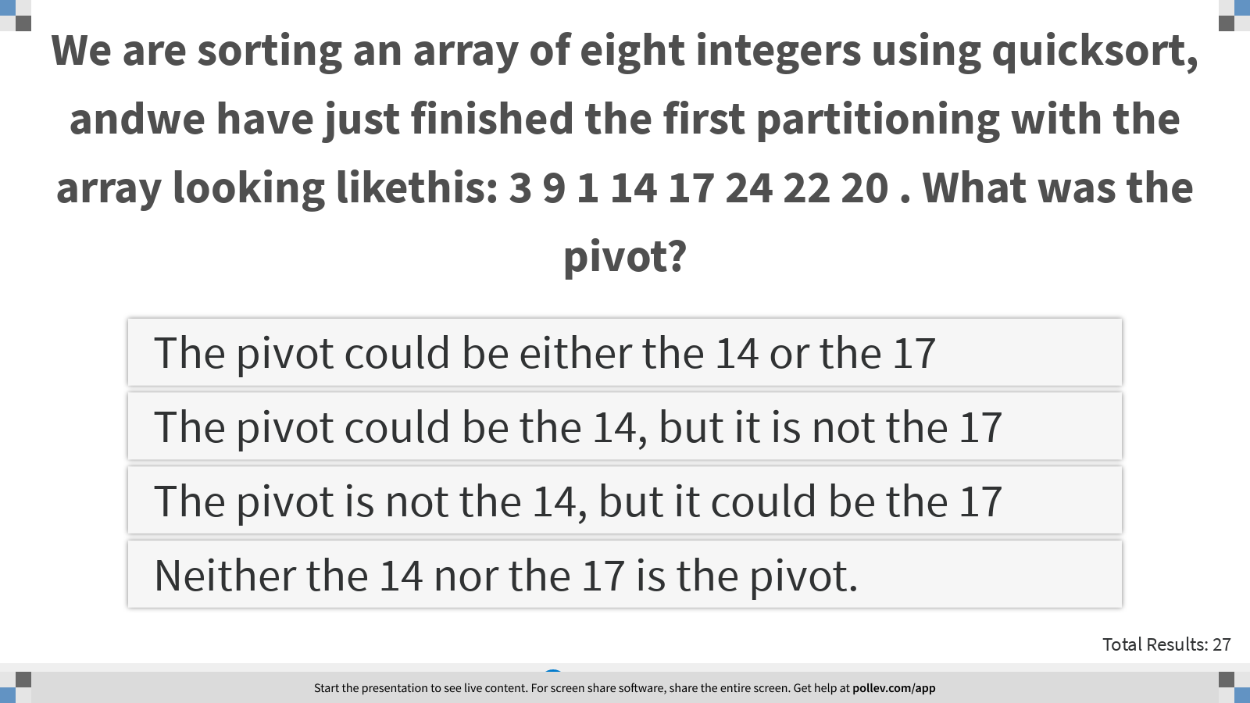
Notes:
We are sorting an array of eight integers using quicksort, andwe have just finished the first partitioning with the array looking likethis: 3 9 1 14 17 24 22 20 . What was the pivot?
https://www.polleverywhere.com/multiple_choice_polls/8CSb3YDjHs1XlWom4CS03?display_state=instructions&controls=none&onscreen=persist

Slide 15
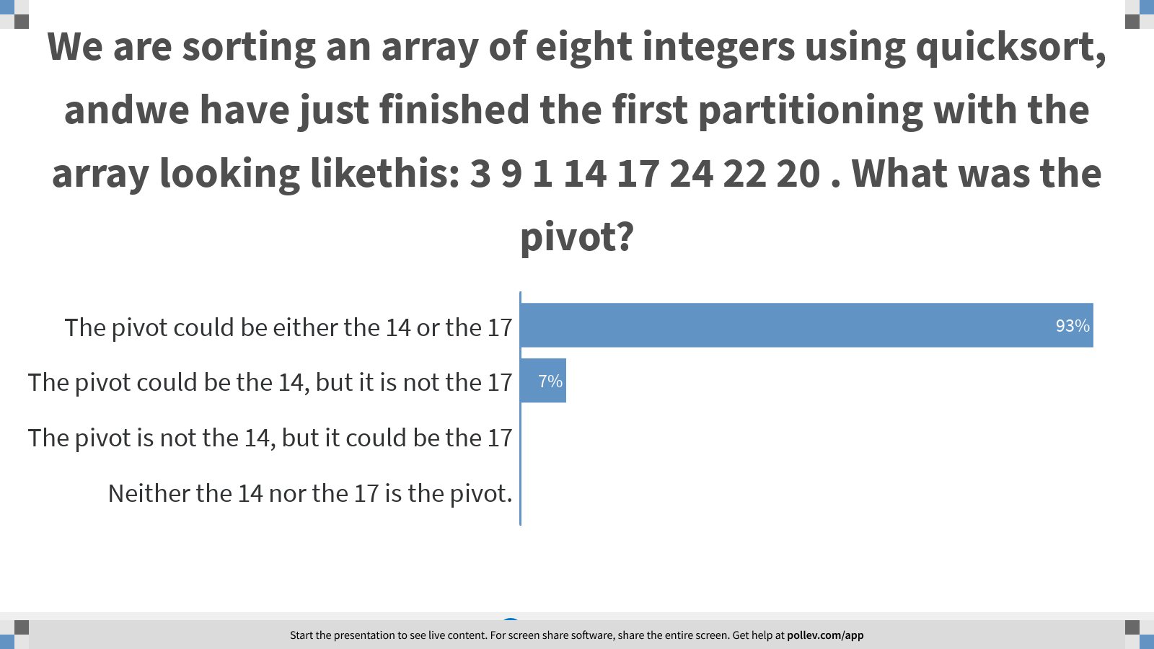
Notes:
We are sorting an array of eight integers using quicksort, andwe have just finished the first partitioning with the array looking likethis: 3 9 1 14 17 24 22 20 . What was the pivot?
https://www.polleverywhere.com/multiple_choice_polls/8CSb3YDjHs1XlWom4CS03?display_state=chart&display=correctness&controls=none&onscreen=persist

Slide 16
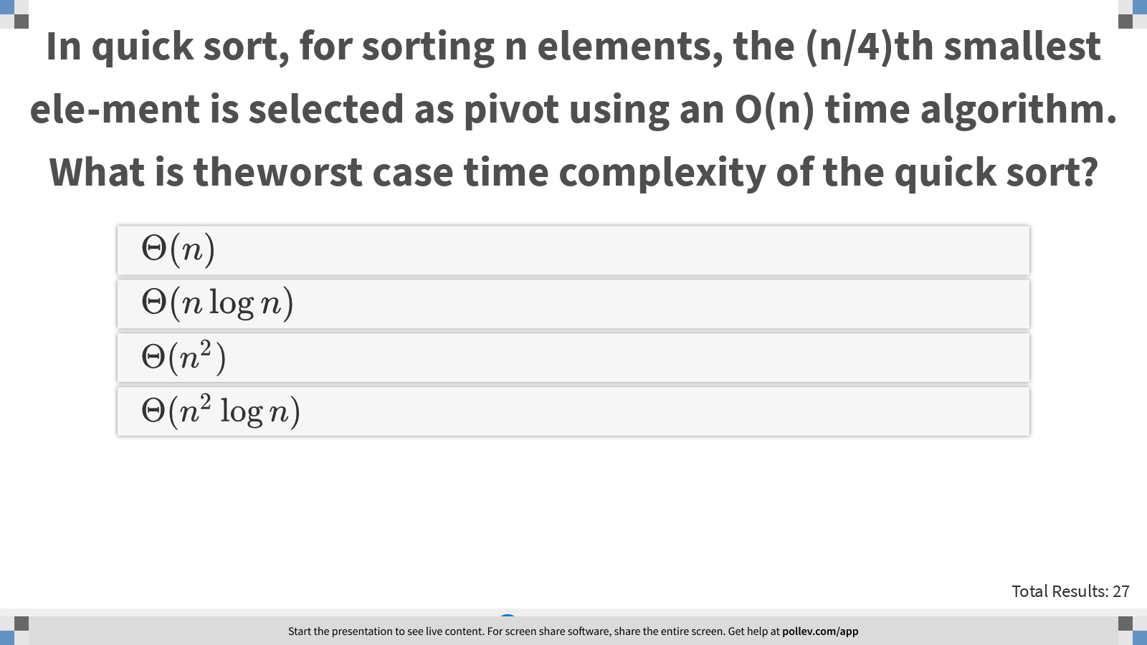
Notes:
In quick sort, for sorting n elements, the (n/4)th smallest ele-ment is selected as pivot using an O(n) time algorithm. What is theworst case time complexity of the quick sort?
https://www.polleverywhere.com/multiple_choice_polls/g5zLNtsxCQAvWVrXqEnoK?display_state=instructions&controls=none&onscreen=persist

Slide 17
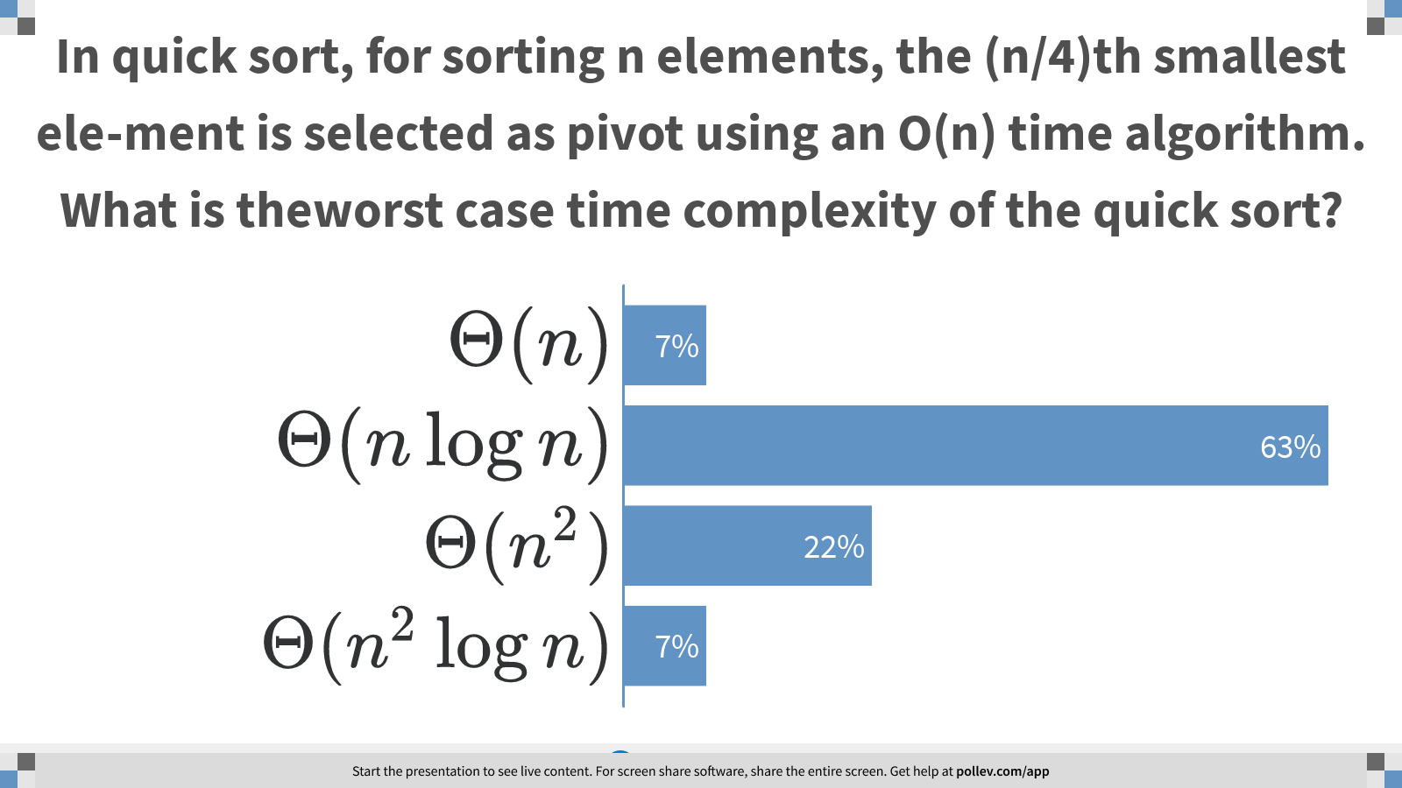
Notes:
In quick sort, for sorting n elements, the (n/4)th smallest ele-ment is selected as pivot using an O(n) time algorithm. What is theworst case time complexity of the quick sort?
https://www.polleverywhere.com/multiple_choice_polls/g5zLNtsxCQAvWVrXqEnoK?display_state=chart&display=correctness&controls=none&onscreen=persist

Slide 18
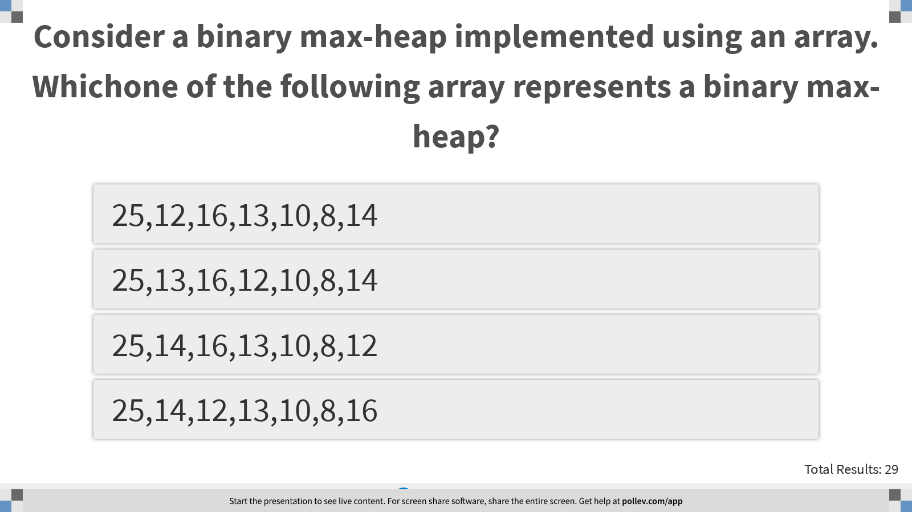
Notes:
Consider a binary max-heap implemented using an array. Whichone of the following array represents a binary max-heap?
https://www.polleverywhere.com/multiple_choice_polls/mAbdg4rwCGKJ2c4vKeMOv?display_state=instructions&controls=none&onscreen=persist

Slide 19
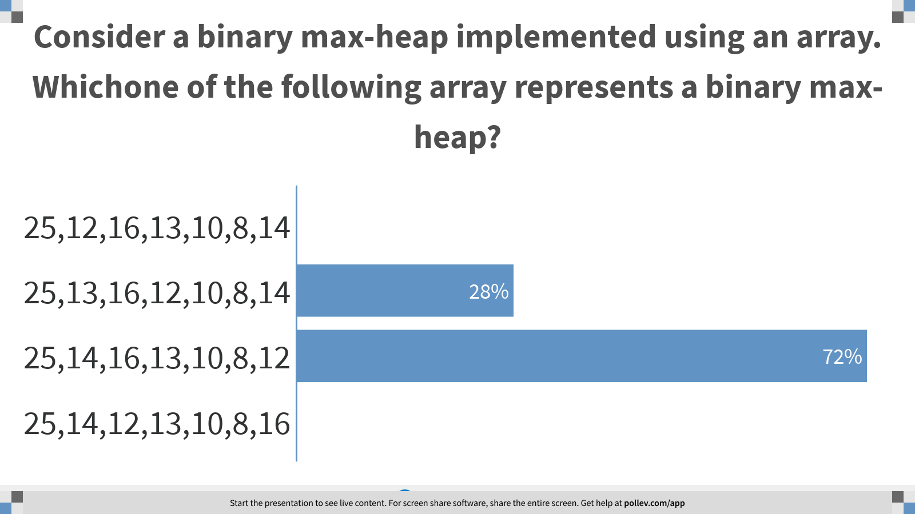
Notes:
Consider a binary max-heap implemented using an array. Whichone of the following array represents a binary max-heap?
https://www.polleverywhere.com/multiple_choice_polls/mAbdg4rwCGKJ2c4vKeMOv?display_state=chart&display=correctness&controls=none&onscreen=persist

Slide 20
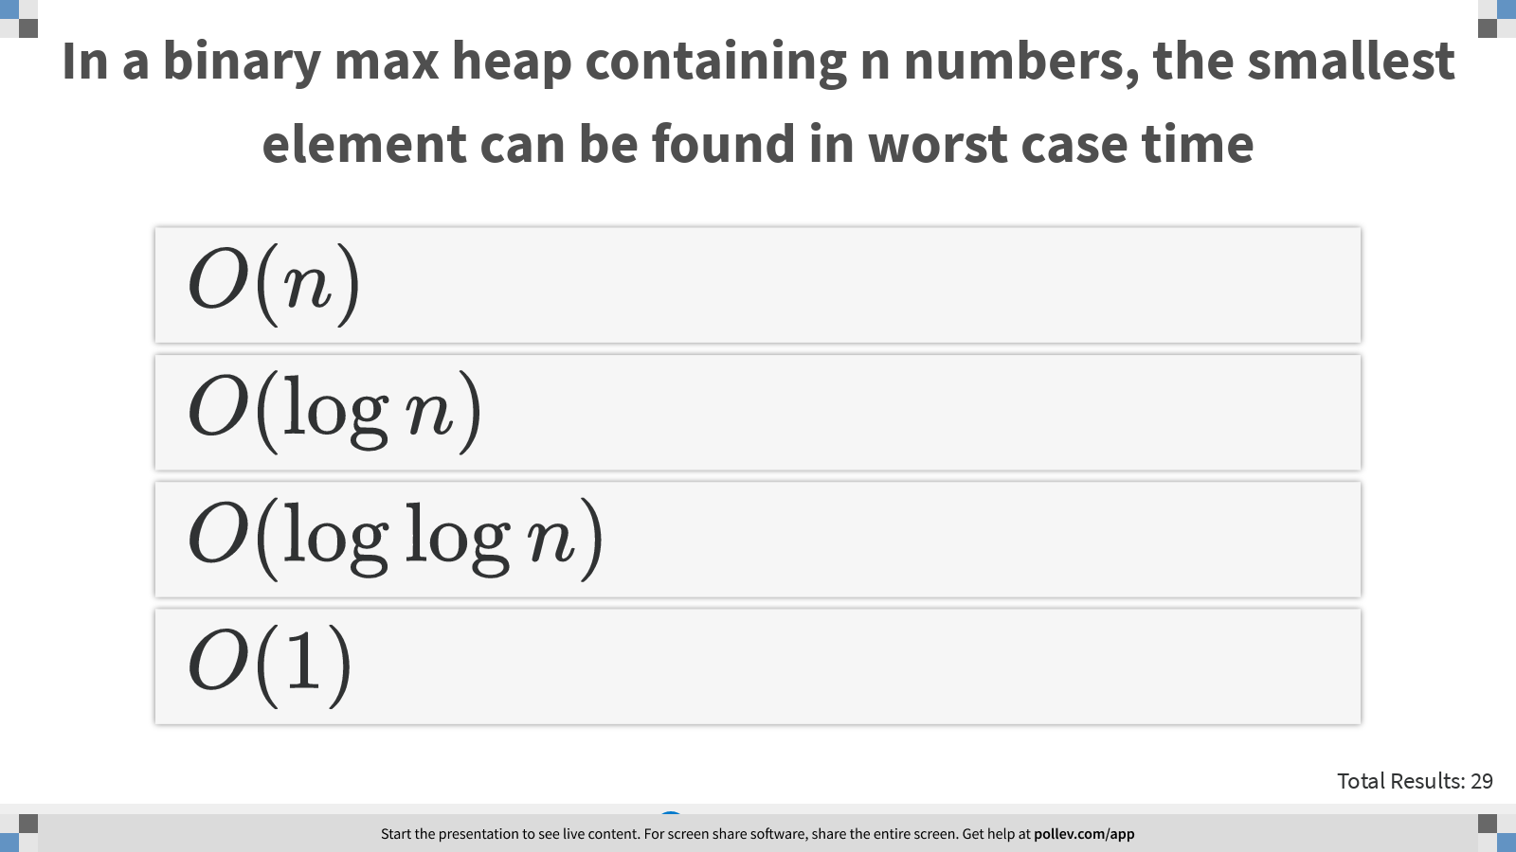
Notes:
In a binary max heap containing n numbers, the smallest element can be found in worst case time
https://www.polleverywhere.com/multiple_choice_polls/9DE6GiE8xZMOVLkeNrjHh?display_state=instructions&controls=none&onscreen=persist

Slide 21
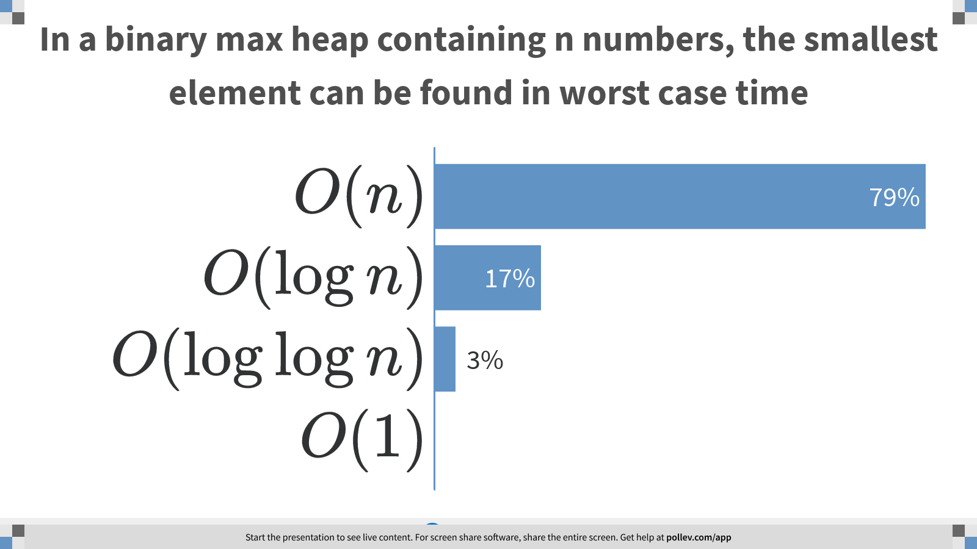
Notes:
In a binary max heap containing n numbers, the smallest element can be found in worst case time
https://www.polleverywhere.com/multiple_choice_polls/9DE6GiE8xZMOVLkeNrjHh?display_state=chart&display=correctness&controls=none&onscreen=persist

Slide 22
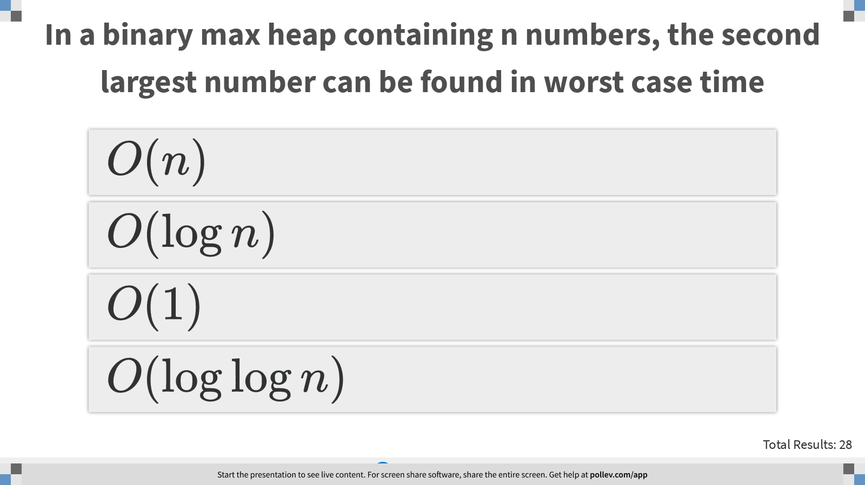
Notes:
In a binary max heap containing n numbers, the second largest number can be found in worst case time
https://www.polleverywhere.com/multiple_choice_polls/nDAJaJIqegXeZRhvyheS4?display_state=instructions&controls=none&onscreen=persist

Slide 23
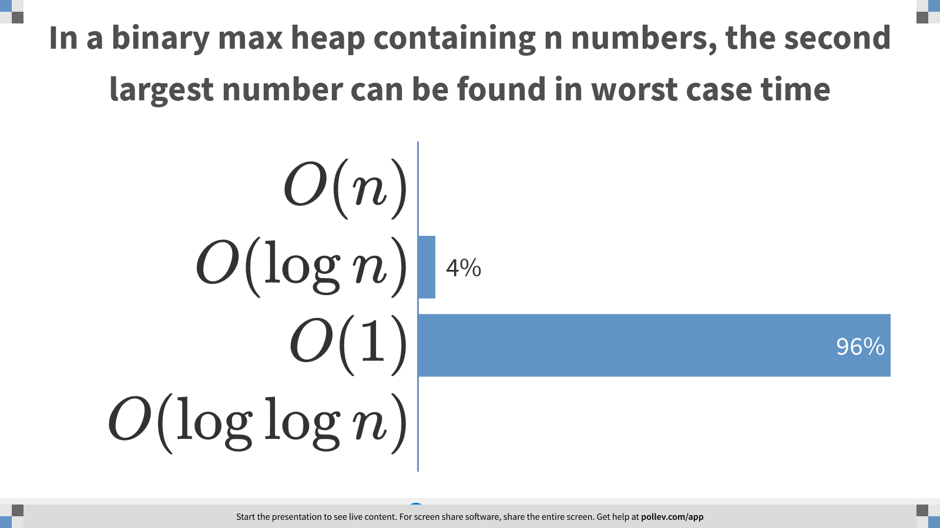
Notes:
In a binary max heap containing n numbers, the second largest number can be found in worst case time
https://www.polleverywhere.com/multiple_choice_polls/nDAJaJIqegXeZRhvyheS4?display_state=chart&display=correctness&controls=none&onscreen=persist

Slide 24
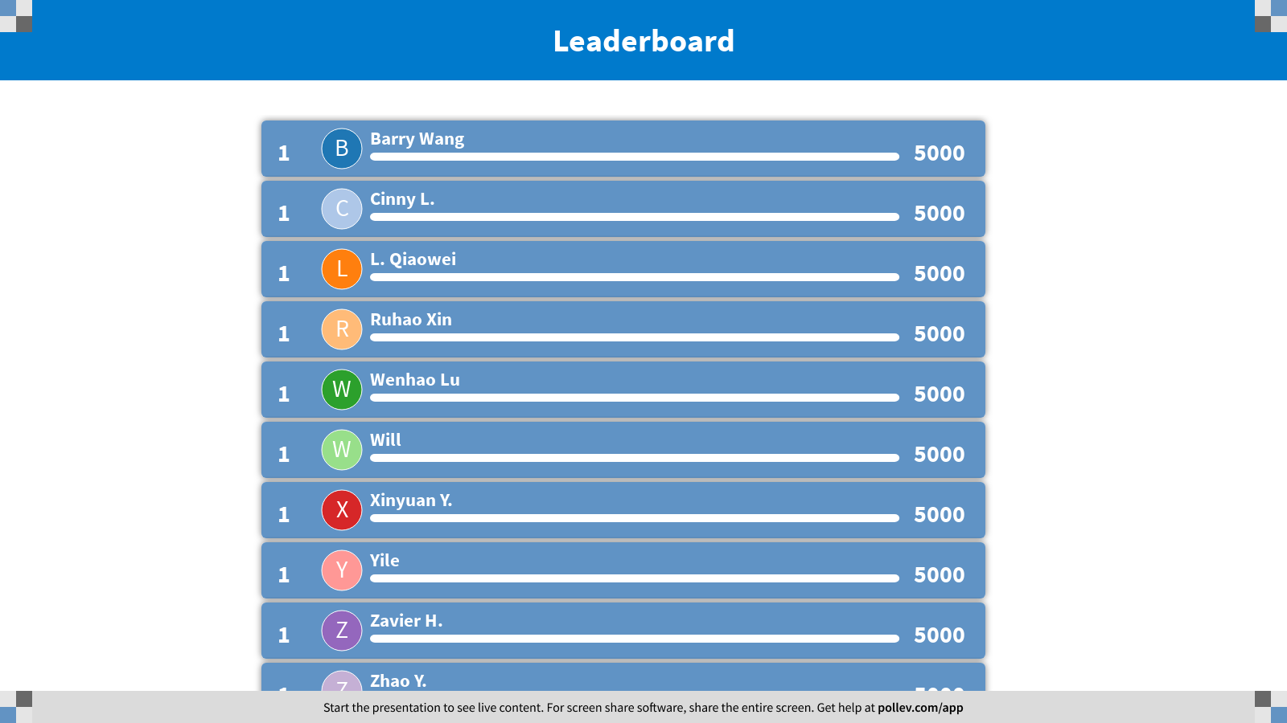
Notes:
Sorting
https://www.polleverywhere.com/competitions/keWwr2PhCSE12ZBneCUvz?display_state=finale&onscreen=persist

