Slide 1

Notes:
Heap and Sorting
https://www.polleverywhere.com/competitions/vxEFSRSke3XugUXBVEXiK?display_state=welcome&controls=none&onscreen=persist

Slide 2
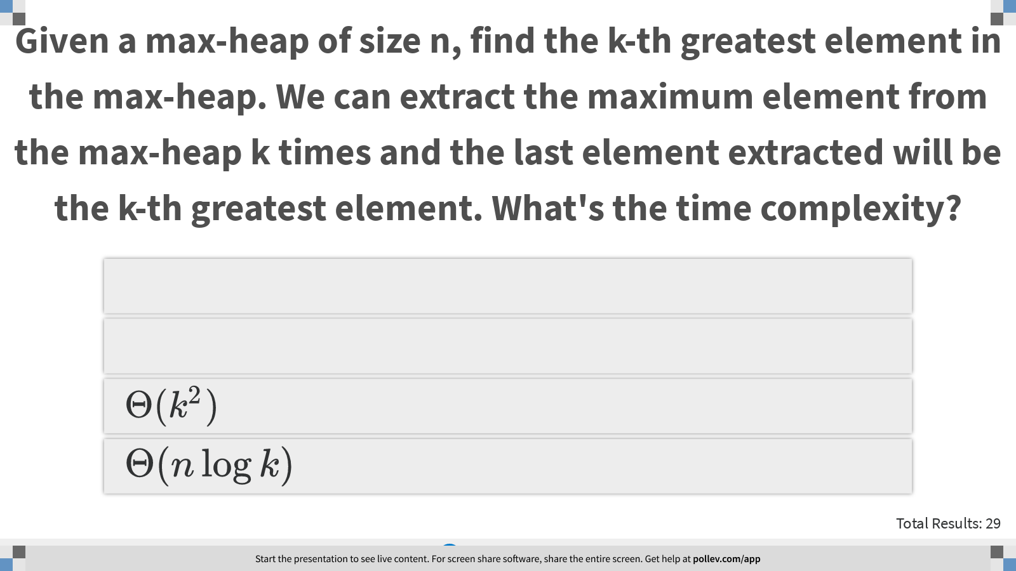
Notes:
Given a max-heap of size n, find the k-th greatest element in the max-heap. We can extract the maximum element from the max-heap k times and the last element extracted will be the k-th greatest element. What's the time complexity?
https://www.polleverywhere.com/multiple_choice_polls/aNvNIYZ99BTnI1gCCw9CC?display_state=instructions&controls=none&onscreen=persist

Slide 3
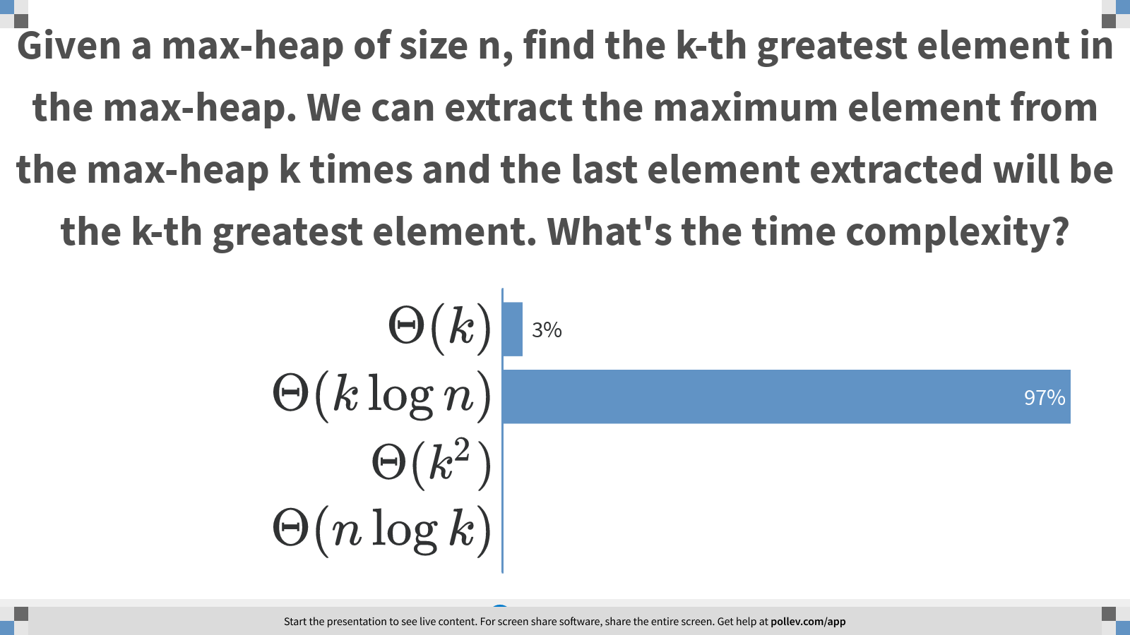
Notes:
Given a max-heap of size n, find the k-th greatest element in the max-heap. We can extract the maximum element from the max-heap k times and the last element extracted will be the k-th greatest element. What's the time complexity?
https://www.polleverywhere.com/multiple_choice_polls/aNvNIYZ99BTnI1gCCw9CC?display_state=chart&display=correctness&controls=none&onscreen=persist

Slide 4
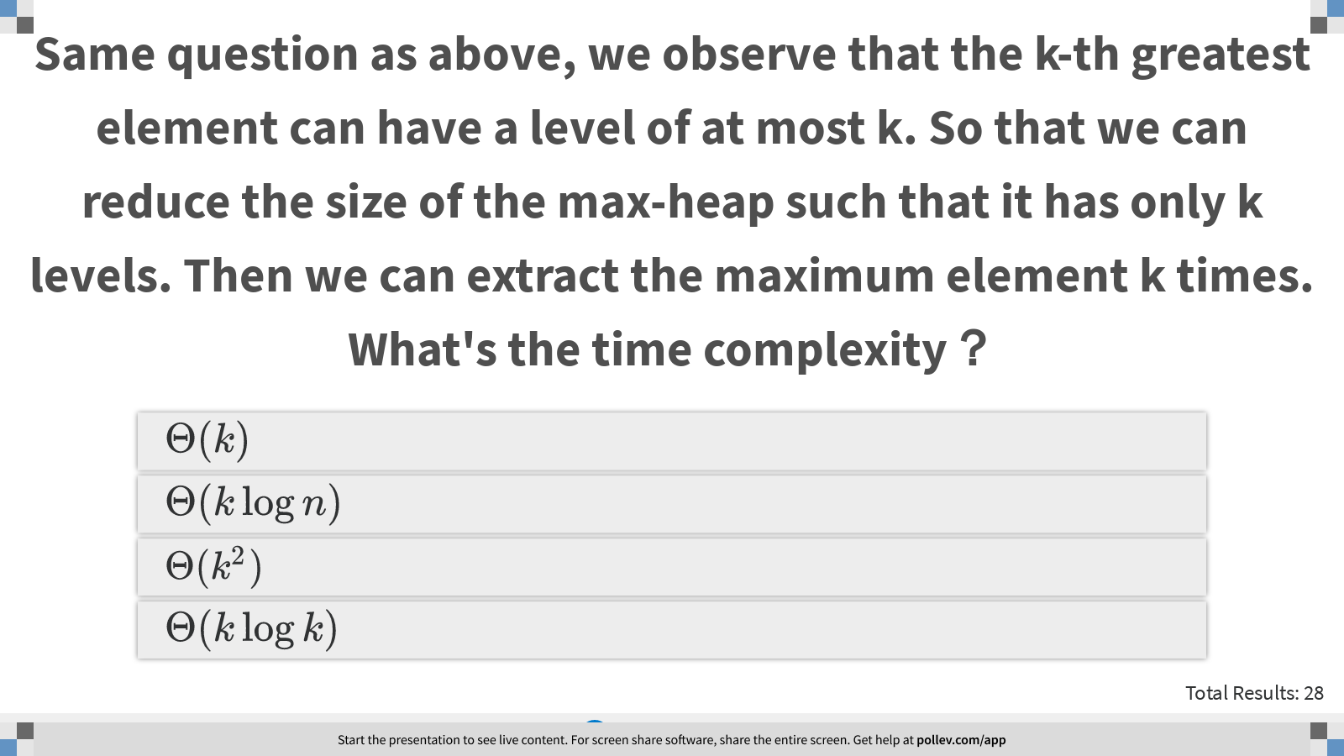
Notes:
Same question as above, we observe that the k-th greatest element can have a level of at most k. So that we can reduce the size of the max-heap such that it has only k levels. Then we can extract the maximum element k times. What's the time complexity？
https://www.polleverywhere.com/multiple_choice_polls/FcUBi0Uv3ILikWS8bwVfn?display_state=instructions&controls=none&onscreen=persist

Slide 5
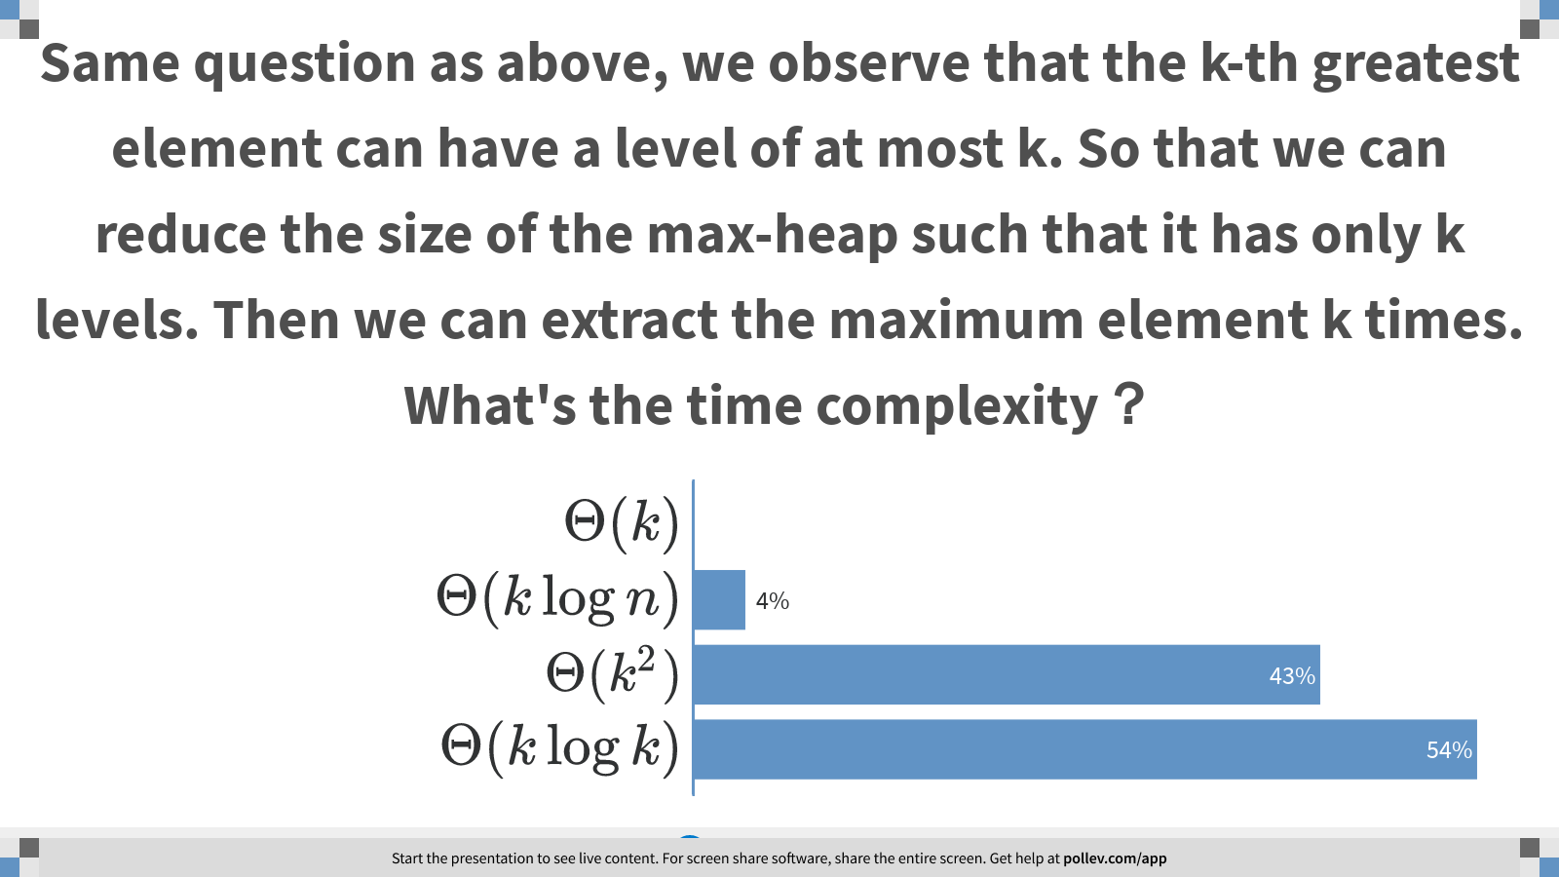
Notes:
Same question as above, we observe that the k-th greatest element can have a level of at most k. So that we can reduce the size of the max-heap such that it has only k levels. Then we can extract the maximum element k times. What's the time complexity？
https://www.polleverywhere.com/multiple_choice_polls/FcUBi0Uv3ILikWS8bwVfn?display_state=chart&display=correctness&controls=none&onscreen=persist

Slide 6
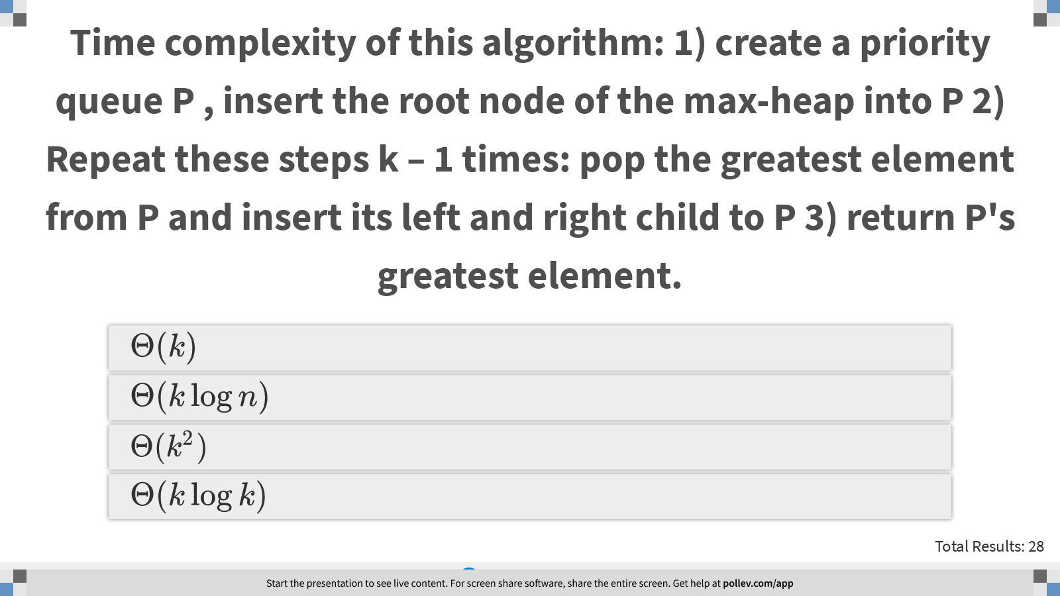
Notes:
Time complexity of this algorithm: 1) create a priority queue P , insert the root node of the max-heap into P 2) Repeat these steps k – 1 times: pop the greatest element from P and insert its left and right child to P 3) return P's greatest element.
https://www.polleverywhere.com/multiple_choice_polls/i2hlvzwGyO2VsTgxT3dyY?display_state=instructions&controls=none&onscreen=persist

Slide 7
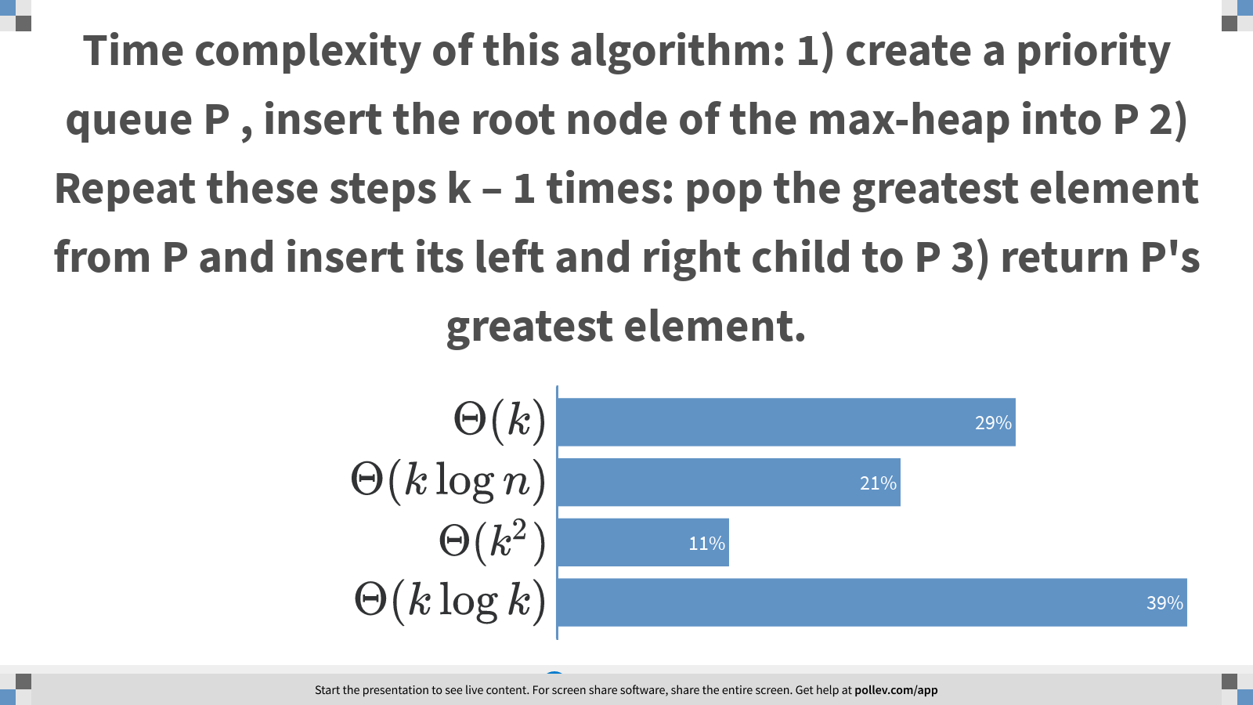
Notes:
Time complexity of this algorithm: 1) create a priority queue P , insert the root node of the max-heap into P 2) Repeat these steps k – 1 times: pop the greatest element from P and insert its left and right child to P 3) return P's greatest element.
https://www.polleverywhere.com/multiple_choice_polls/i2hlvzwGyO2VsTgxT3dyY?display_state=chart&display=correctness&controls=none&onscreen=persist

Slide 8
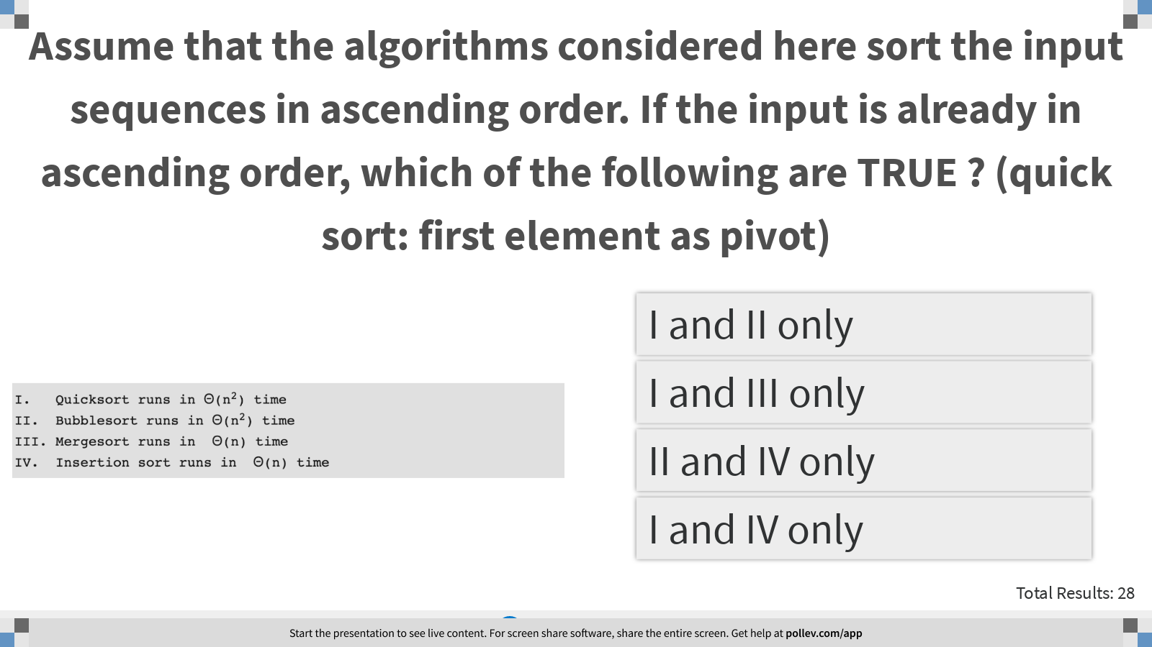
Notes:
Assume that the algorithms considered here sort the input sequences in ascending order. If the input is already in ascending order, which of the following are TRUE ? (quick sort: first element as pivot)
https://www.polleverywhere.com/multiple_choice_polls/f60639HowYwHgyqI4aOm9?display_state=instructions&controls=none&onscreen=persist

Slide 9
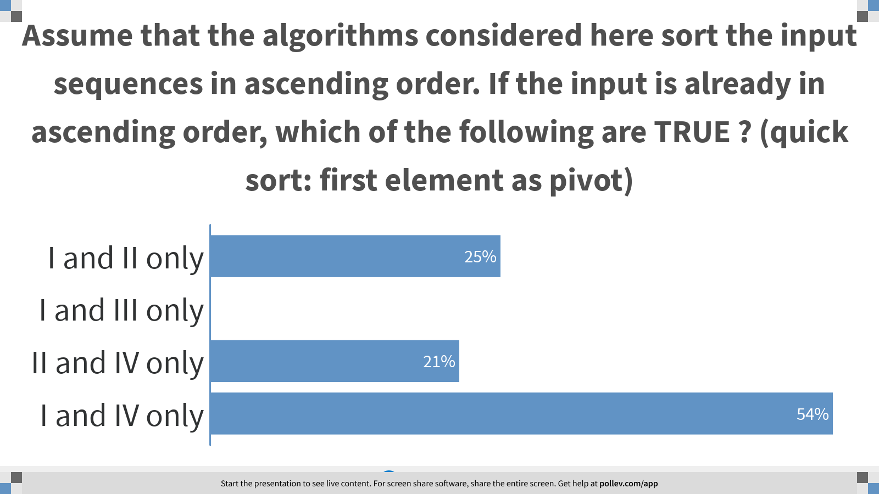
Notes:
Assume that the algorithms considered here sort the input sequences in ascending order. If the input is already in ascending order, which of the following are TRUE ? (quick sort: first element as pivot)
https://www.polleverywhere.com/multiple_choice_polls/f60639HowYwHgyqI4aOm9?display_state=chart&display=correctness&controls=none&onscreen=persist

Slide 10
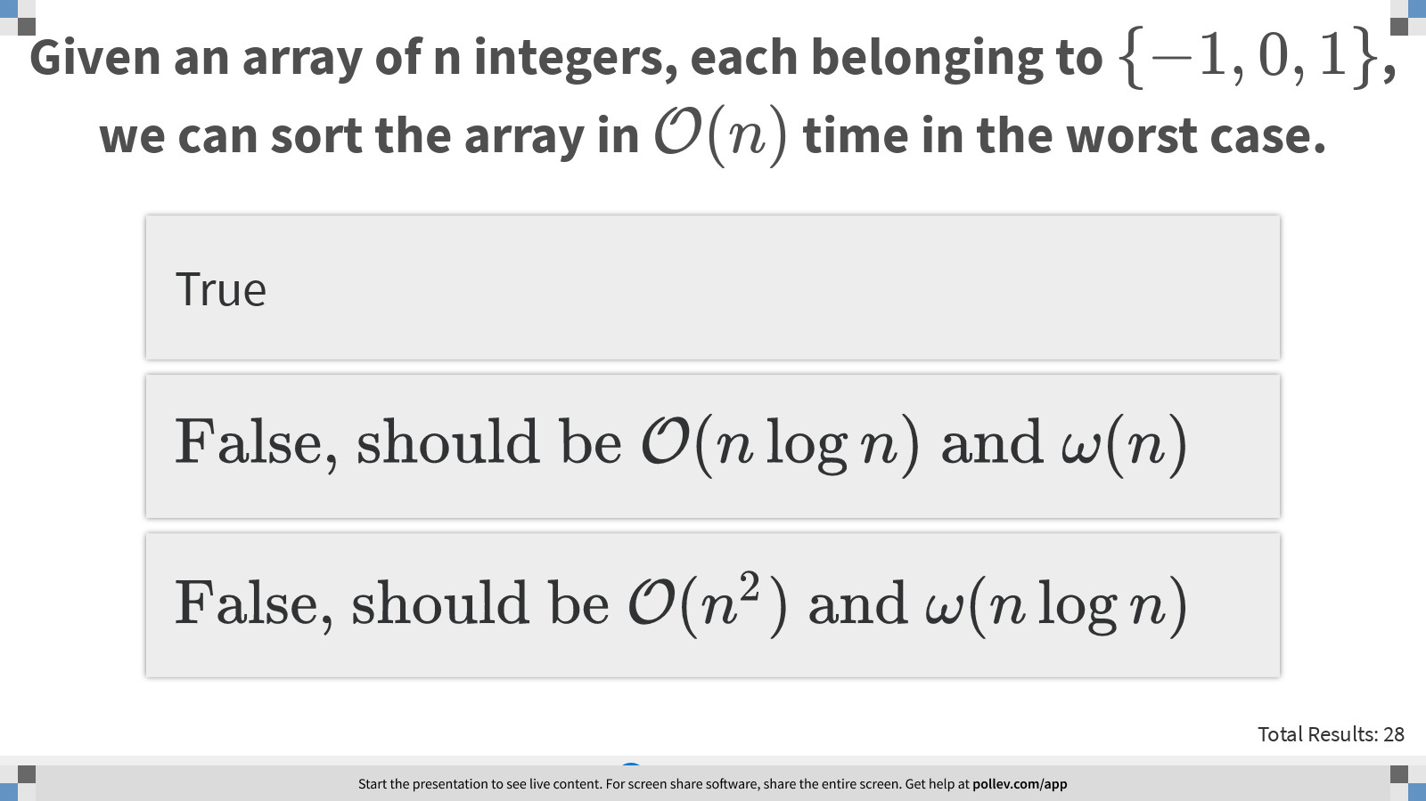
Notes:
Given an array of n integers, each belonging to $$\{-1, 0, 1\}$$, we can sort the array in $$\mathcal{O} (n)$$ time in the worst case.
https://www.polleverywhere.com/multiple_choice_polls/OYmV6SOmaEbSZ1rJrOmSV?display_state=instructions&controls=none&onscreen=persist

Slide 11
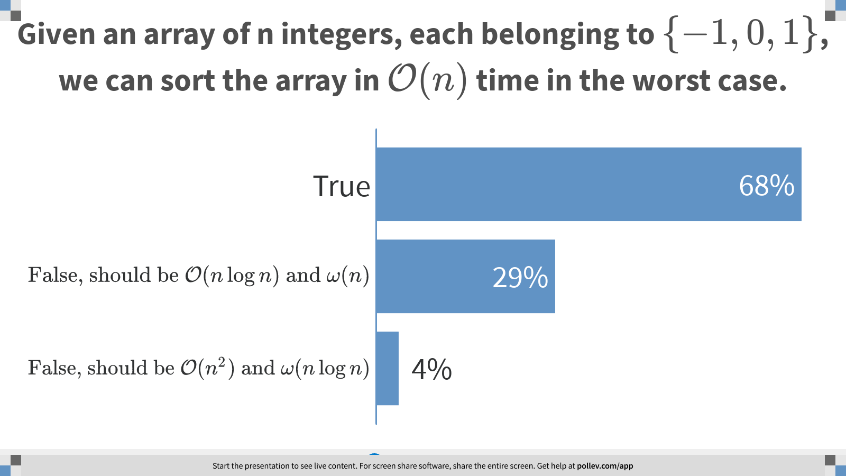
Notes:
Given an array of n integers, each belonging to $$\{-1, 0, 1\}$$, we can sort the array in $$\mathcal{O} (n)$$ time in the worst case.
https://www.polleverywhere.com/multiple_choice_polls/OYmV6SOmaEbSZ1rJrOmSV?display_state=chart&display=correctness&controls=none&onscreen=persist

Slide 12
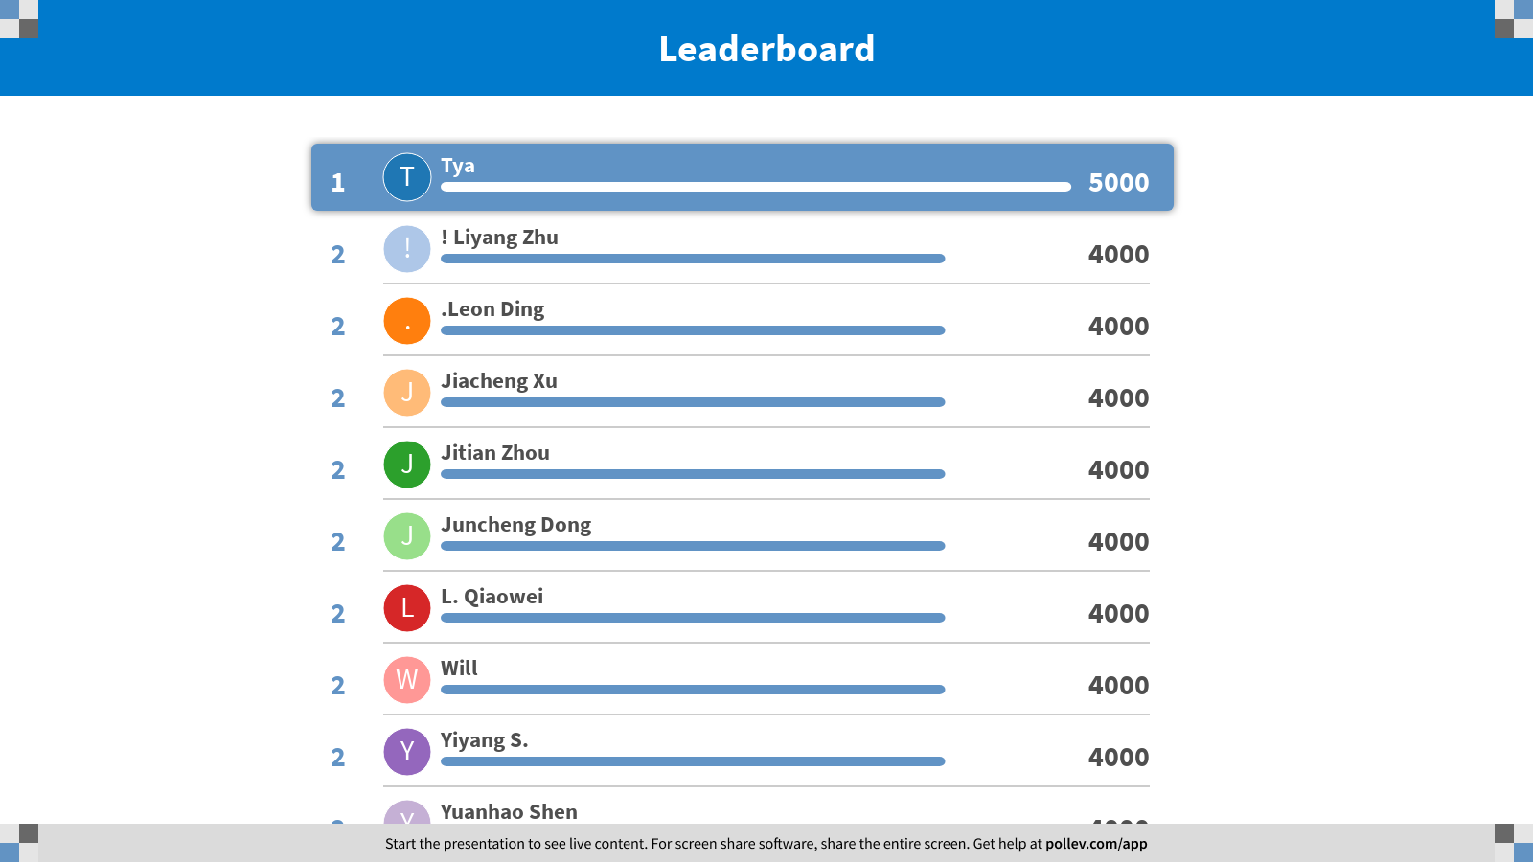
Notes:
Heap and Sorting
https://www.polleverywhere.com/competitions/vxEFSRSke3XugUXBVEXiK?display_state=finale&onscreen=persist

Slide 13

Notes:
Scheduling Problems
https://www.polleverywhere.com/competitions/h447KeA66pWHtDz8w6zdB?display_state=welcome&controls=none&onscreen=persist

Slide 14
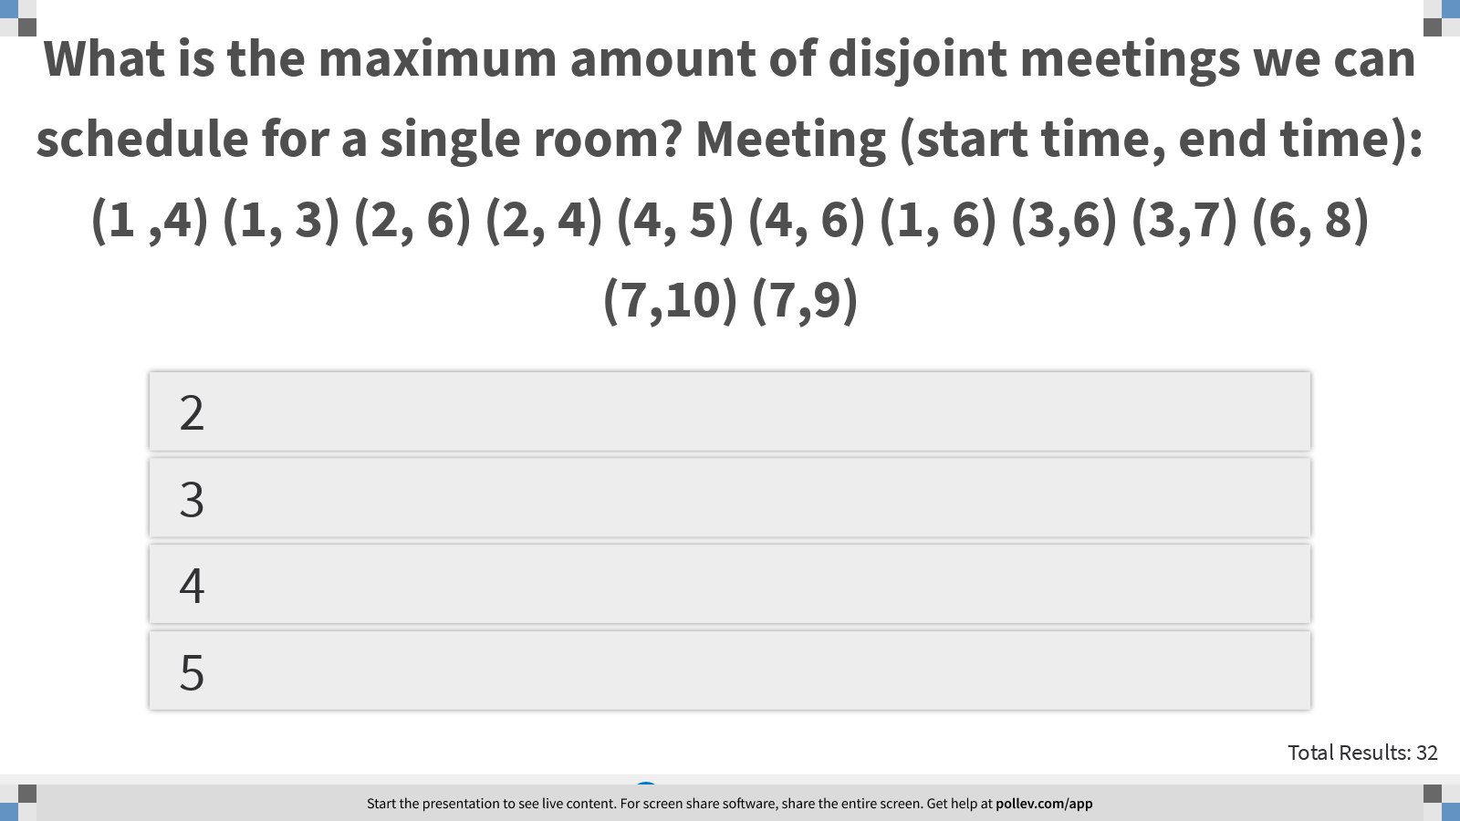
Notes:
What is the maximum amount of disjoint meetings we can schedule for a single room? Meeting (start time, end time): (1 ,4) (1, 3) (2, 6) (2, 4) (4, 5) (4, 6) (1, 6) (3,6) (3,7) (6, 8) (7,10) (7,9)
https://www.polleverywhere.com/multiple_choice_polls/2LIiac6MaZDf8fIOBMgb5?display_state=instructions&controls=none&onscreen=persist

Slide 15
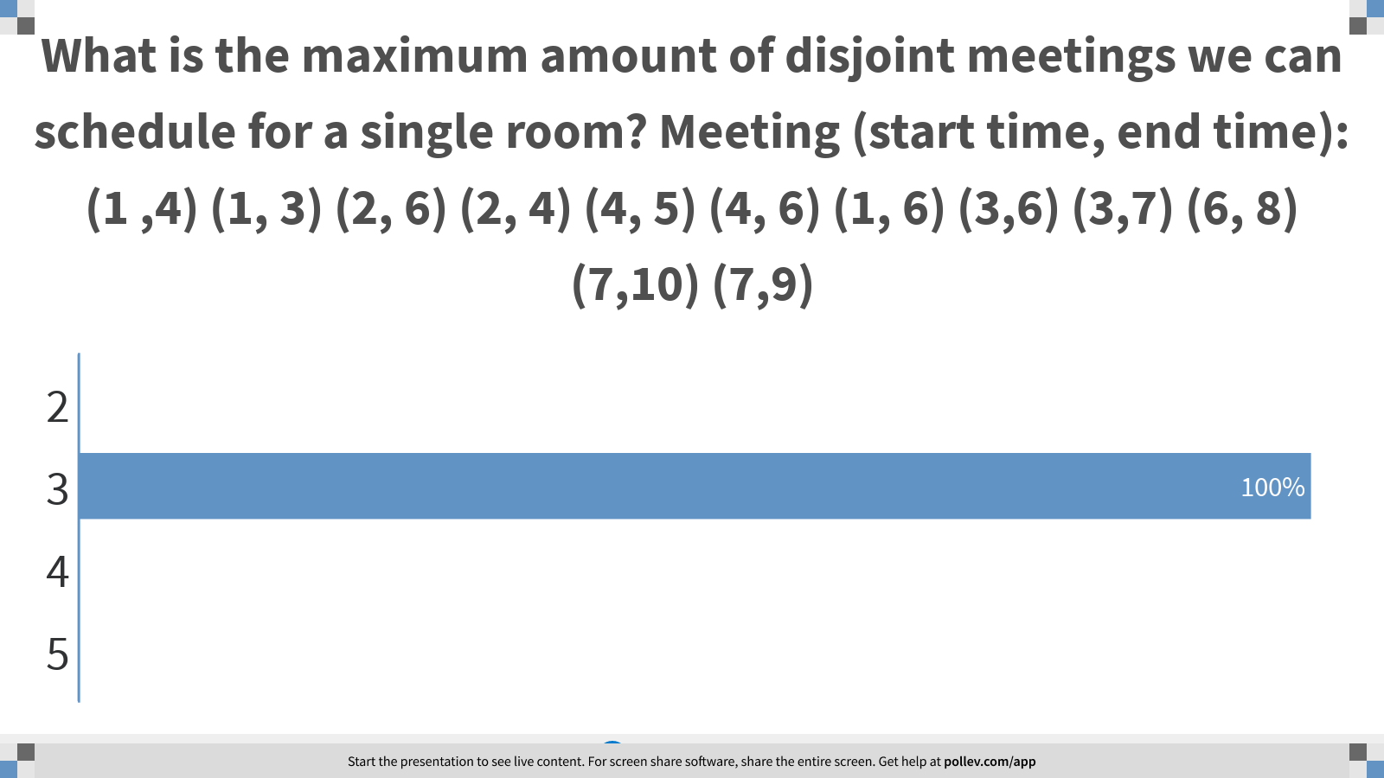
Notes:
What is the maximum amount of disjoint meetings we can schedule for a single room? Meeting (start time, end time): (1 ,4) (1, 3) (2, 6) (2, 4) (4, 5) (4, 6) (1, 6) (3,6) (3,7) (6, 8) (7,10) (7,9)
https://www.polleverywhere.com/multiple_choice_polls/2LIiac6MaZDf8fIOBMgb5?display_state=chart&display=correctness&controls=none&onscreen=persist

Slide 16
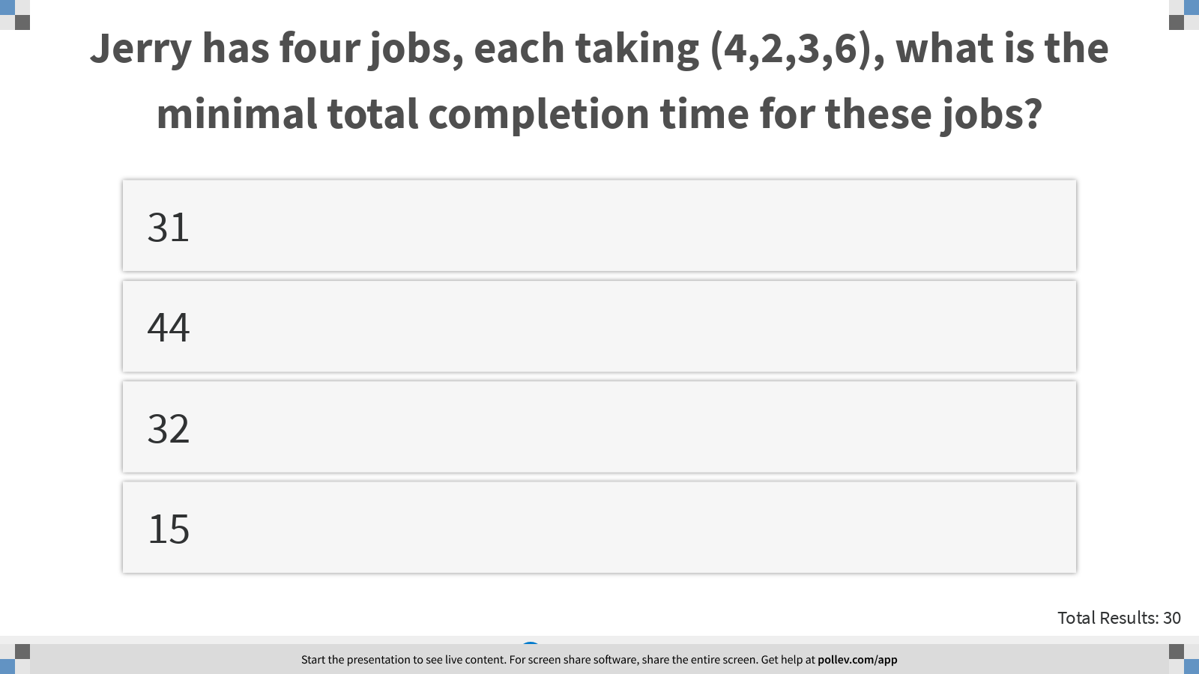
Notes:
Jerry has four jobs, each taking (4,2,3,6), what is the minimal total completion time for these jobs?
https://www.polleverywhere.com/multiple_choice_polls/qec78e6ZjXjuLHzURF0SR?display_state=instructions&controls=none&onscreen=persist

Slide 17
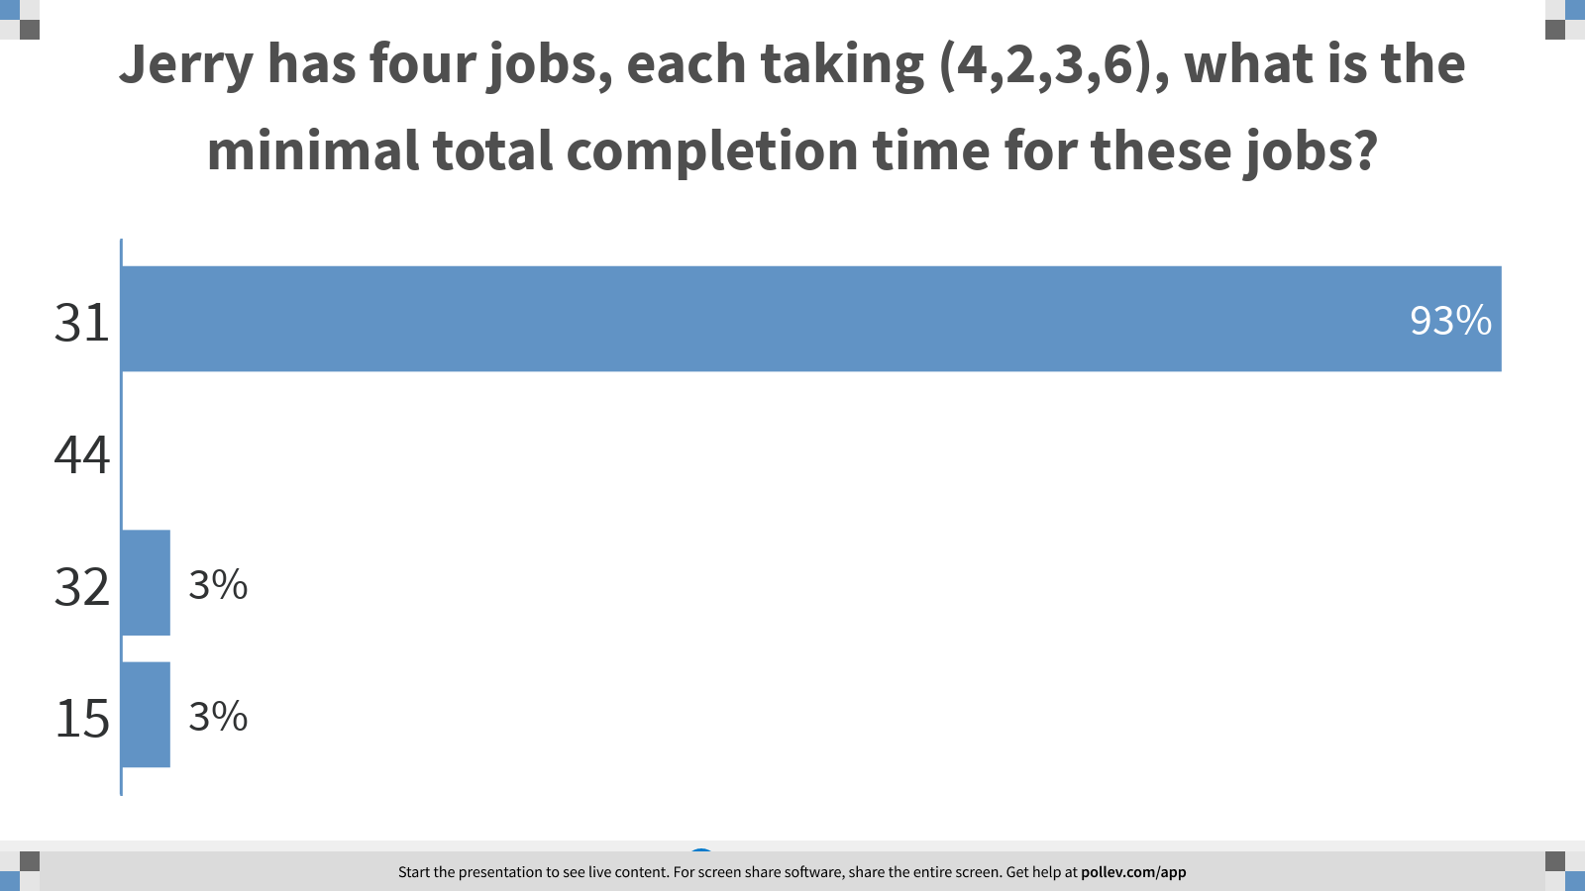
Notes:
Jerry has four jobs, each taking (4,2,3,6), what is the minimal total completion time for these jobs?
https://www.polleverywhere.com/multiple_choice_polls/qec78e6ZjXjuLHzURF0SR?display_state=chart&display=correctness&controls=none&onscreen=persist

Slide 18

Notes:
Jerry has four jobs, each taking (4,2,3,6), what is the maximal total completion time for these jobs?
https://www.polleverywhere.com/multiple_choice_polls/ChxwZxYqvd9rSWcZKNEPL?display_state=instructions&controls=none&onscreen=persist

Slide 19
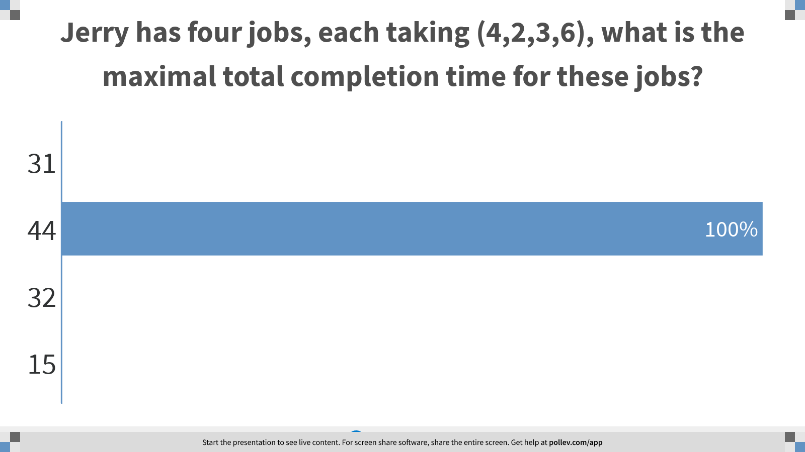
Notes:
Jerry has four jobs, each taking (4,2,3,6), what is the maximal total completion time for these jobs?
https://www.polleverywhere.com/multiple_choice_polls/ChxwZxYqvd9rSWcZKNEPL?display_state=chart&display=correctness&controls=none&onscreen=persist

Slide 20
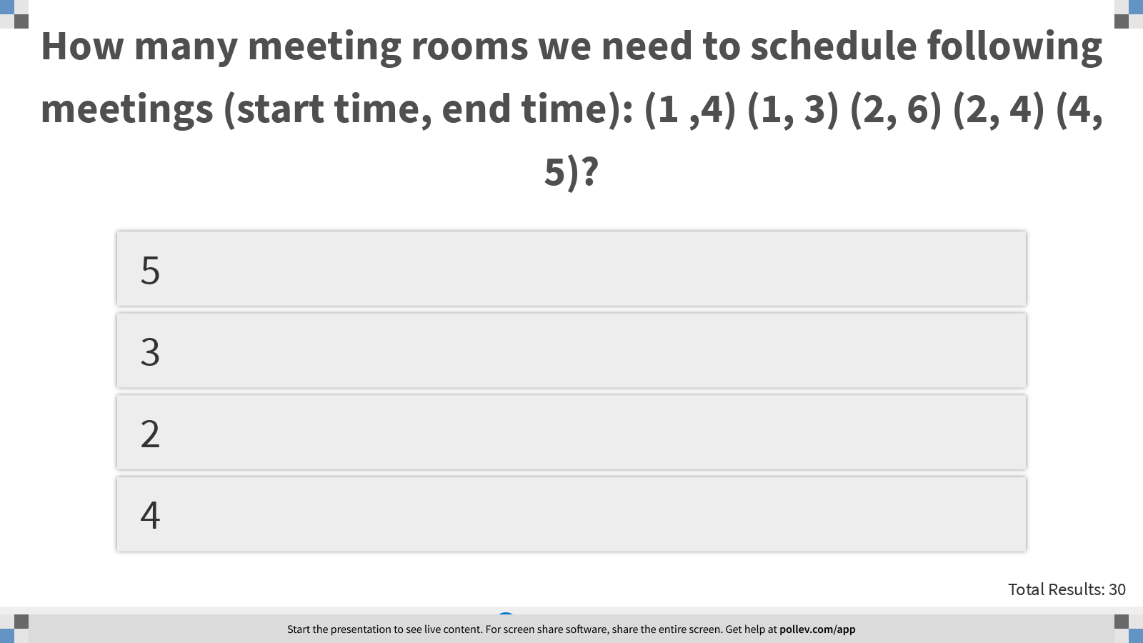
Notes:
How many meeting rooms we need to schedule following meetings (start time, end time): (1 ,4) (1, 3) (2, 6) (2, 4) (4, 5)?
https://www.polleverywhere.com/multiple_choice_polls/1q7RbT7Q7NAAJu93UQQ4Z?display_state=instructions&controls=none&onscreen=persist

Slide 21
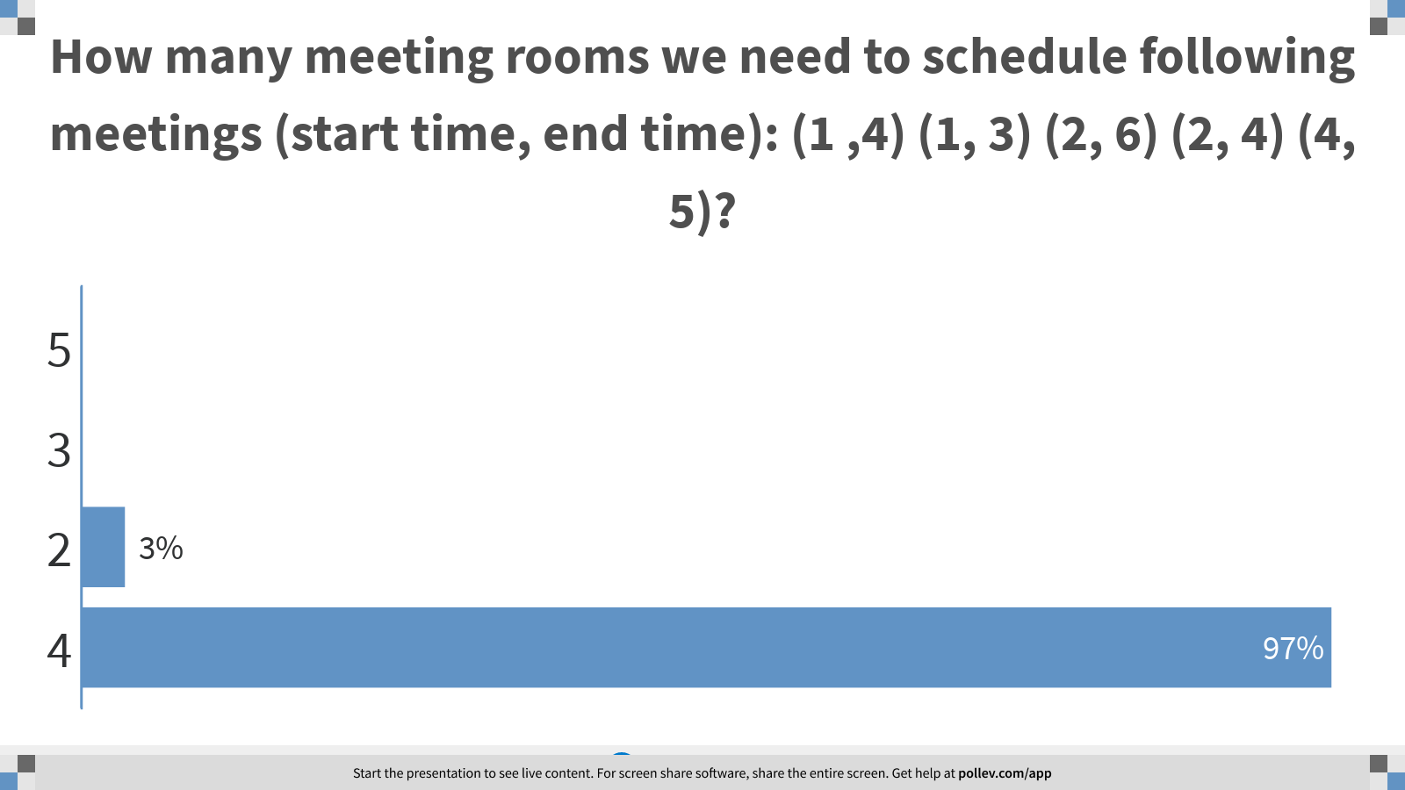
Notes:
How many meeting rooms we need to schedule following meetings (start time, end time): (1 ,4) (1, 3) (2, 6) (2, 4) (4, 5)?
https://www.polleverywhere.com/multiple_choice_polls/1q7RbT7Q7NAAJu93UQQ4Z?display_state=chart&display=correctness&controls=none&onscreen=persist

Slide 22
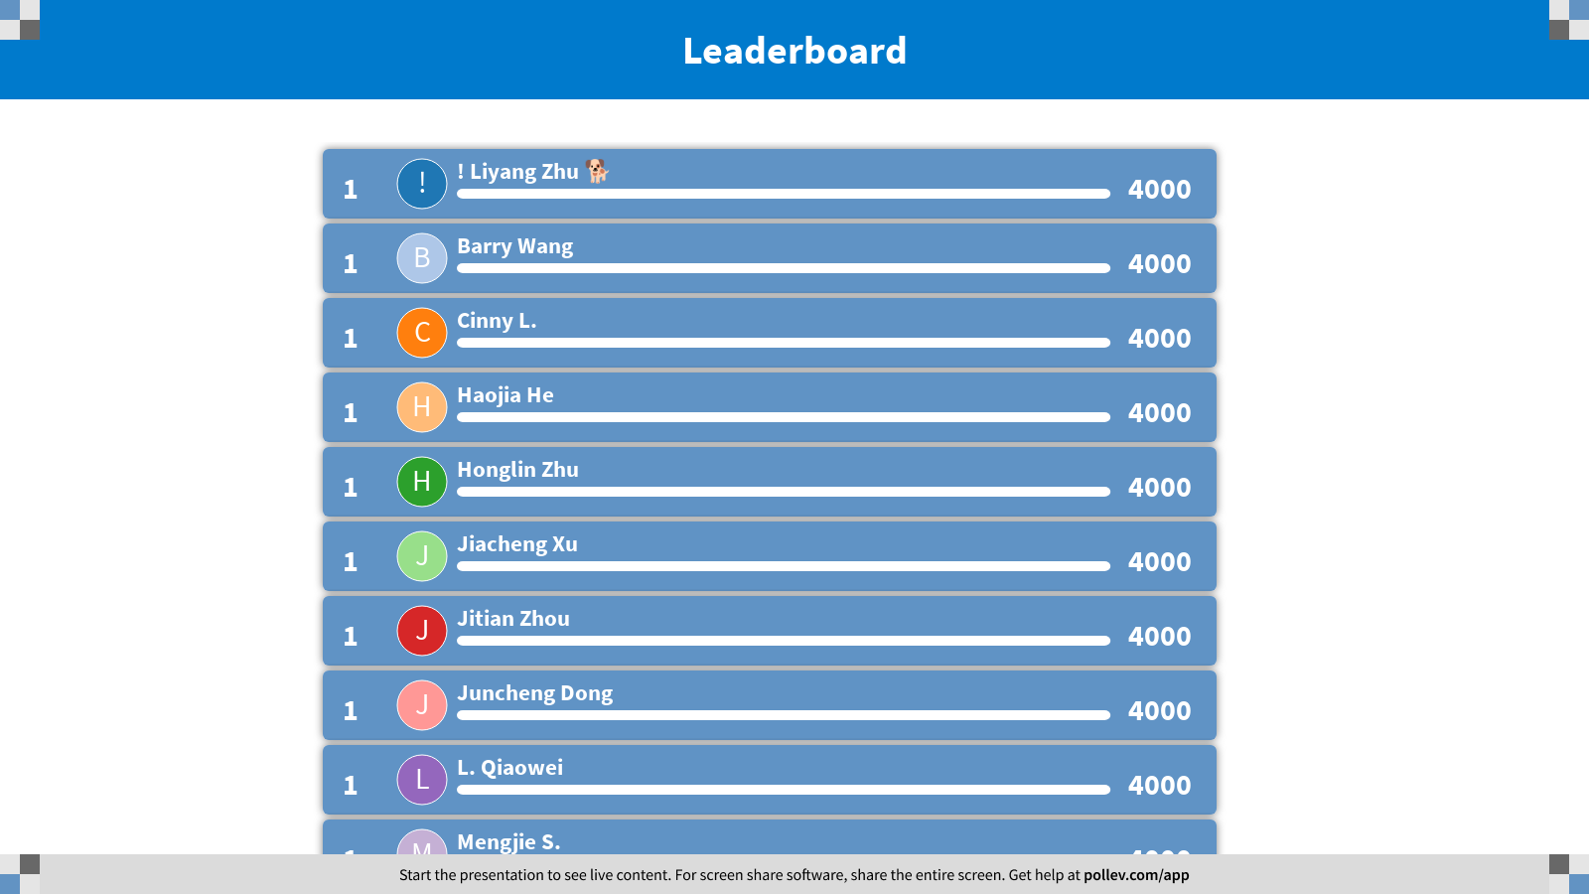
Notes:
Scheduling Problems
https://www.polleverywhere.com/competitions/h447KeA66pWHtDz8w6zdB?display_state=finale&onscreen=persist

