Slide 1

Notes:
Scheduling Problems
https://www.polleverywhere.com/competitions/ffRNZU6n4x70vMfmjIJLS?display_state=welcome&controls=none&onscreen=persist

Slide 2
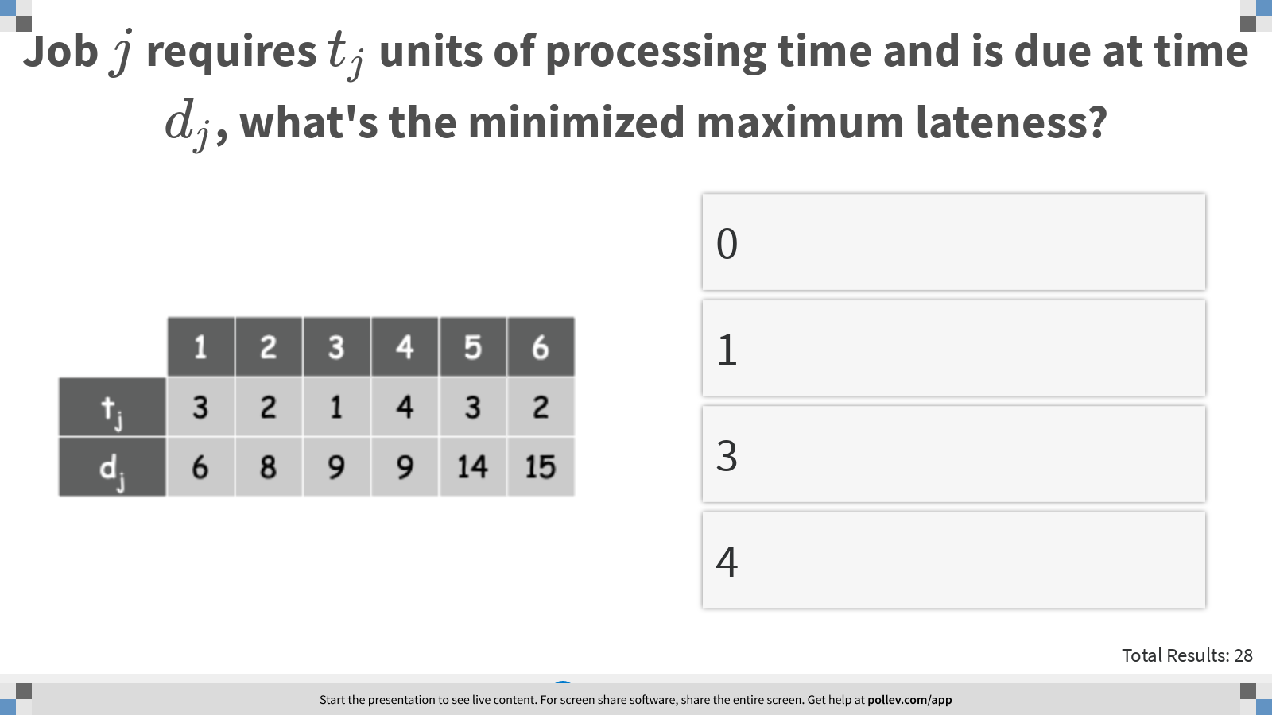
Notes:
Job $$j$$ requires $$t_j$$ units of processing time and is due at time $$d_j$$, what's the minimized maximum lateness?
https://www.polleverywhere.com/multiple_choice_polls/ik49KnYL4xPAERpPHbeLO?display_state=instructions&controls=none&onscreen=persist

Slide 3
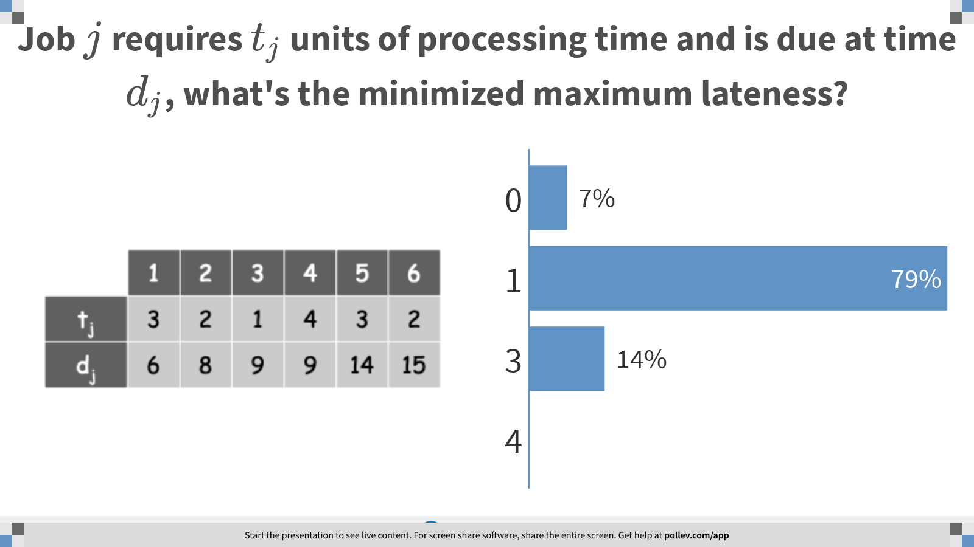
ç
Notes:
Job $$j$$ requires $$t_j$$ units of processing time and is due at time $$d_j$$, what's the minimized maximum lateness?
https://www.polleverywhere.com/multiple_choice_polls/ik49KnYL4xPAERpPHbeLO?display_state=chart&display=correctness&controls=none&onscreen=persist

Slide 4
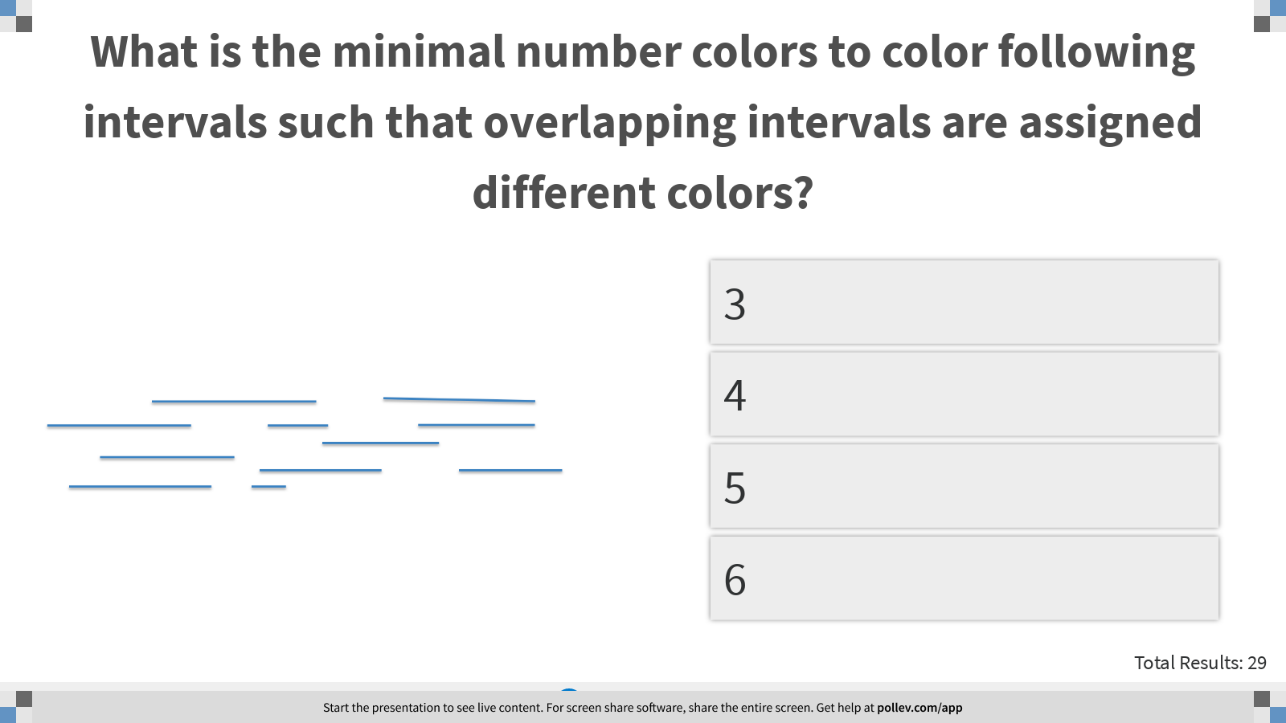
Notes:
What is the minimal number colors to color following intervals such that overlapping intervals are assigned different colors?
https://www.polleverywhere.com/multiple_choice_polls/p9Vld5CBIAfJ77iKuc0x3?display_state=instructions&controls=none&onscreen=persist

Slide 5
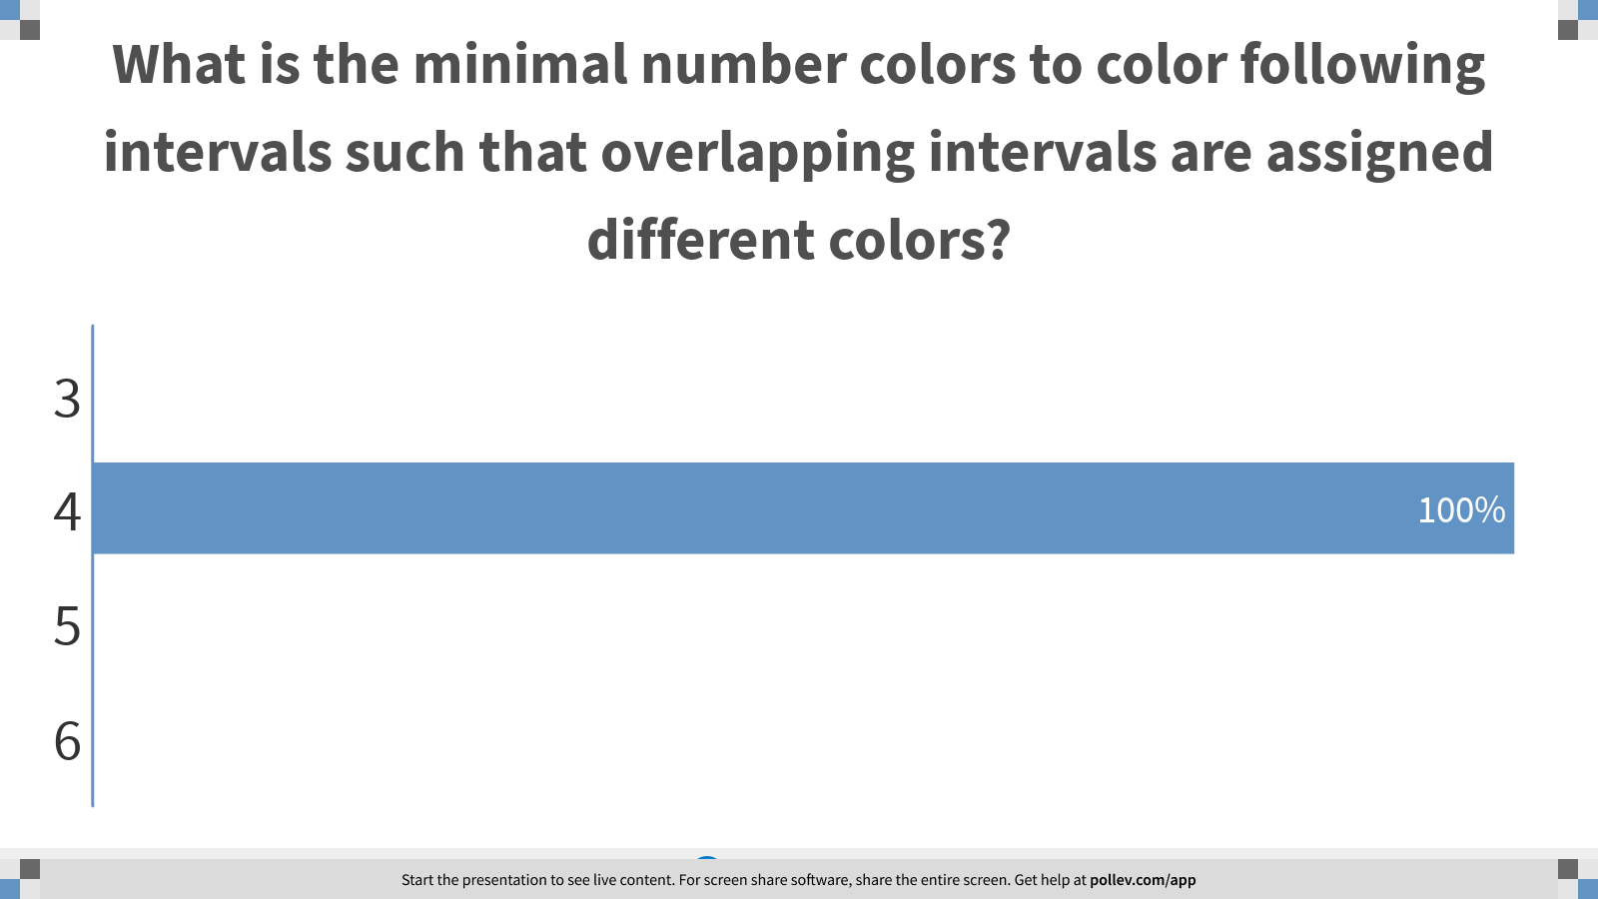
Notes:
What is the minimal number colors to color following intervals such that overlapping intervals are assigned different colors?
https://www.polleverywhere.com/multiple_choice_polls/p9Vld5CBIAfJ77iKuc0x3?display_state=chart&display=correctness&controls=none&onscreen=persist

Slide 6
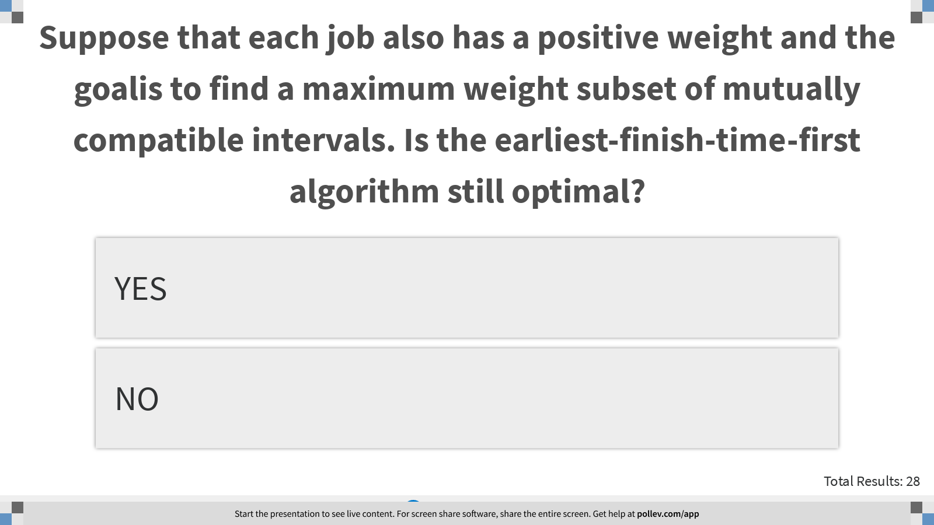
Notes:
Suppose that each job also has a positive weight and the goalis to find a maximum weight subset of mutually compatible intervals. Is the earliest-finish-time-first algorithm still optimal?
https://www.polleverywhere.com/multiple_choice_polls/7QaI7IwaKNdRrqjRwxZqH?display_state=instructions&controls=none&onscreen=persist

Slide 7
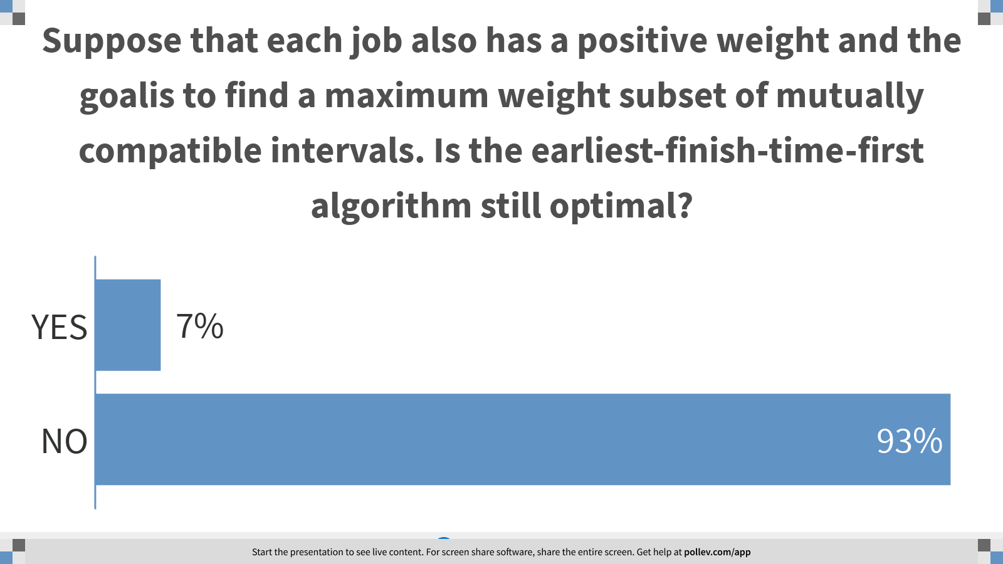
Notes:
Suppose that each job also has a positive weight and the goalis to find a maximum weight subset of mutually compatible intervals. Is the earliest-finish-time-first algorithm still optimal?
https://www.polleverywhere.com/multiple_choice_polls/7QaI7IwaKNdRrqjRwxZqH?display_state=chart&display=correctness&controls=none&onscreen=persist

Slide 8
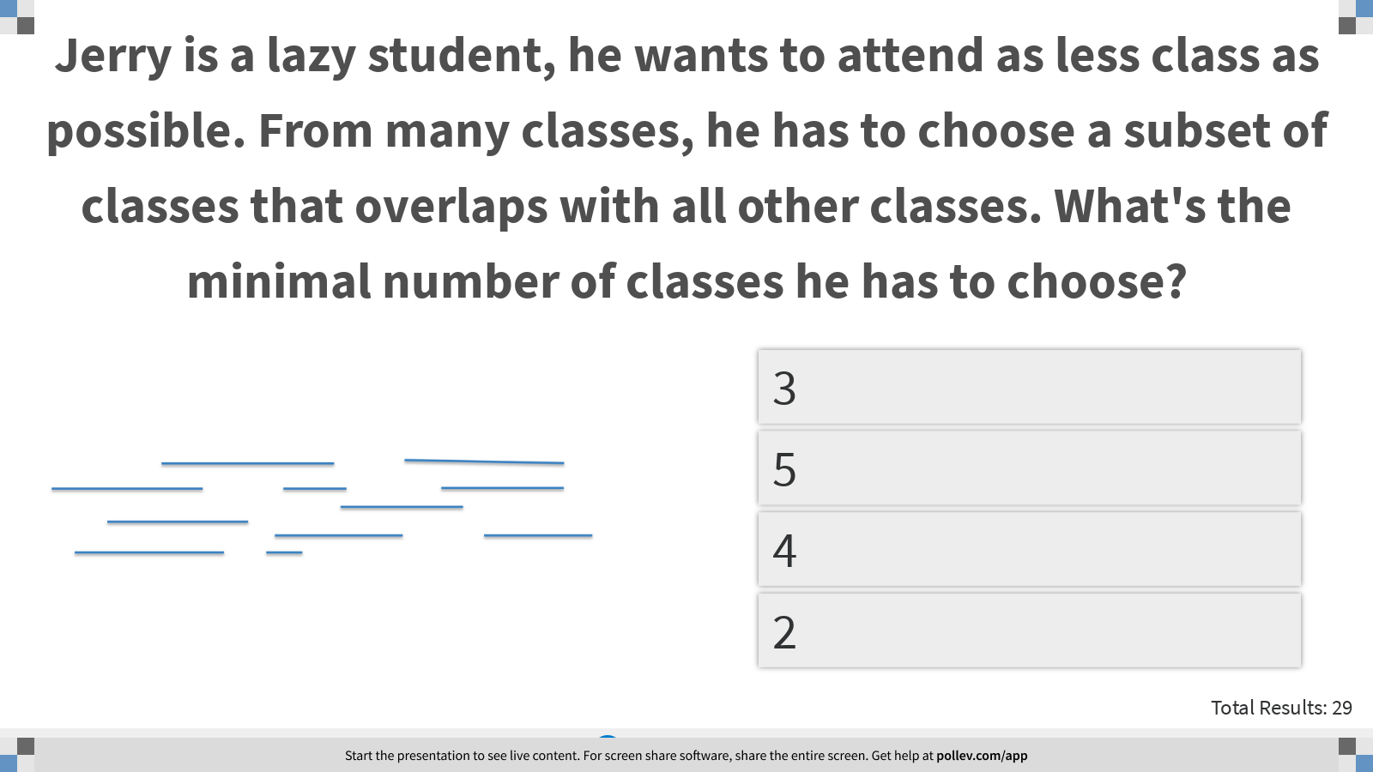
Notes:
Jerry is a lazy student, he wants to attend as less class as possible. From many classes, he has to choose a subset of classes that overlaps with all other classes. What's the minimal number of classes he has to choose?
https://www.polleverywhere.com/multiple_choice_polls/KWCQYGz7gIp9XrdCbPCPT?display_state=instructions&controls=none&onscreen=persist

Slide 9
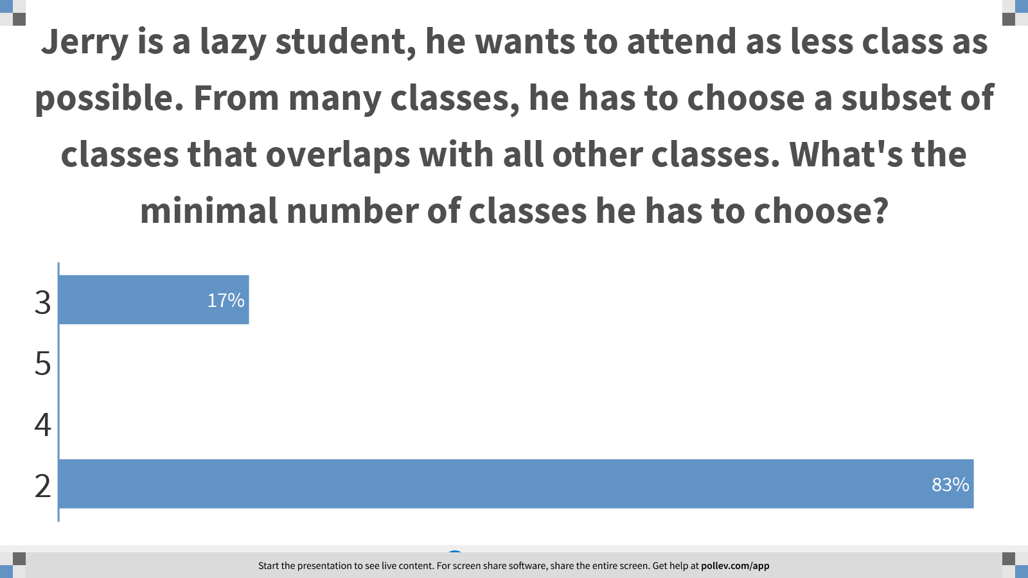
Notes:
Jerry is a lazy student, he wants to attend as less class as possible. From many classes, he has to choose a subset of classes that overlaps with all other classes. What's the minimal number of classes he has to choose?
https://www.polleverywhere.com/multiple_choice_polls/KWCQYGz7gIp9XrdCbPCPT?display_state=chart&display=correctness&controls=none&onscreen=persist

Slide 10
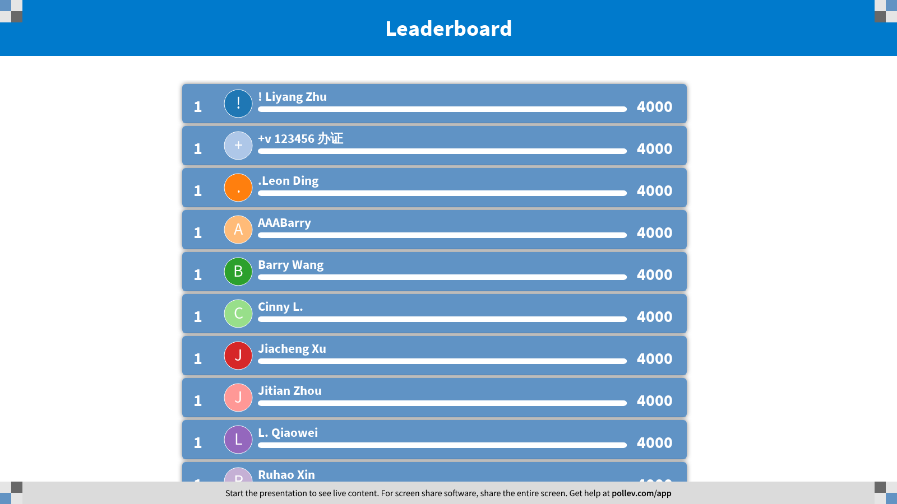
Notes:
Scheduling Problems
https://www.polleverywhere.com/competitions/ffRNZU6n4x70vMfmjIJLS?display_state=finale&onscreen=persist

Slide 11

Notes:
Huffman Coding
https://www.polleverywhere.com/competitions/dsRvLmbuMFrorT3hmib5h?display_state=welcome&controls=none&onscreen=persist

Slide 12
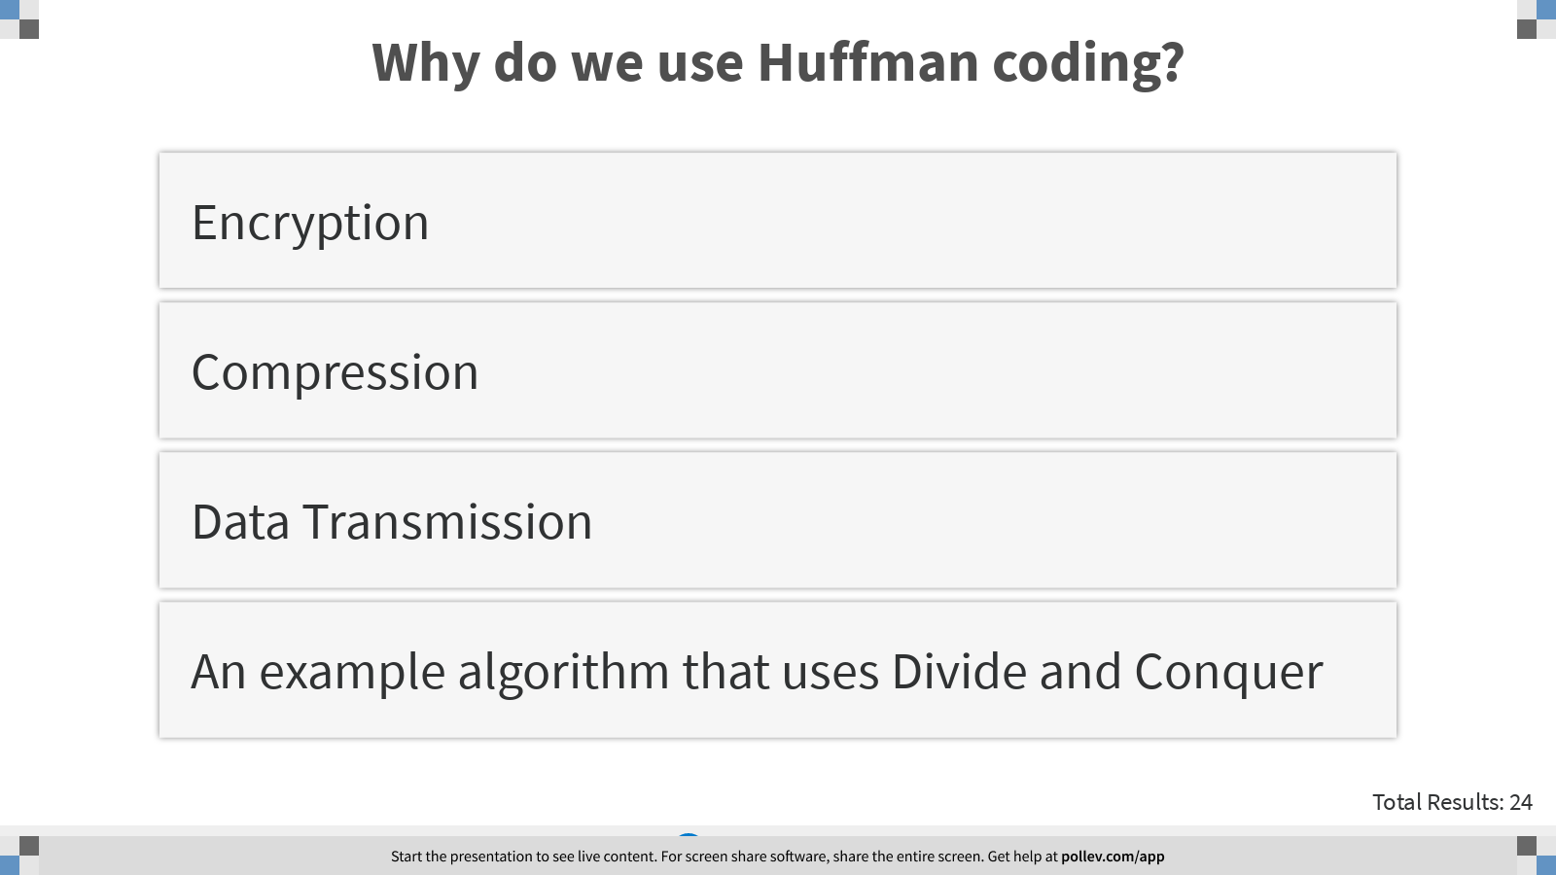
Notes:
Why do we use Huffman coding?
https://www.polleverywhere.com/multiple_choice_polls/57vNZ0ngX6nJ4RHJj49fj?display_state=instructions&controls=none&onscreen=persist

Slide 13
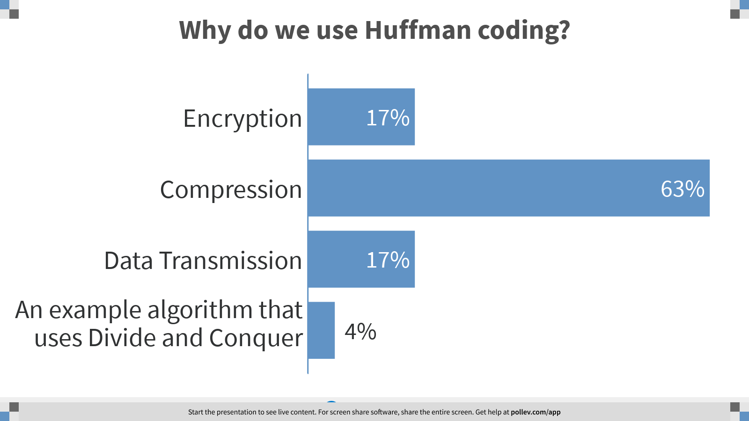
Notes:
Why do we use Huffman coding?
https://www.polleverywhere.com/multiple_choice_polls/57vNZ0ngX6nJ4RHJj49fj?display_state=chart&display=correctness&controls=none&onscreen=persist

Slide 14
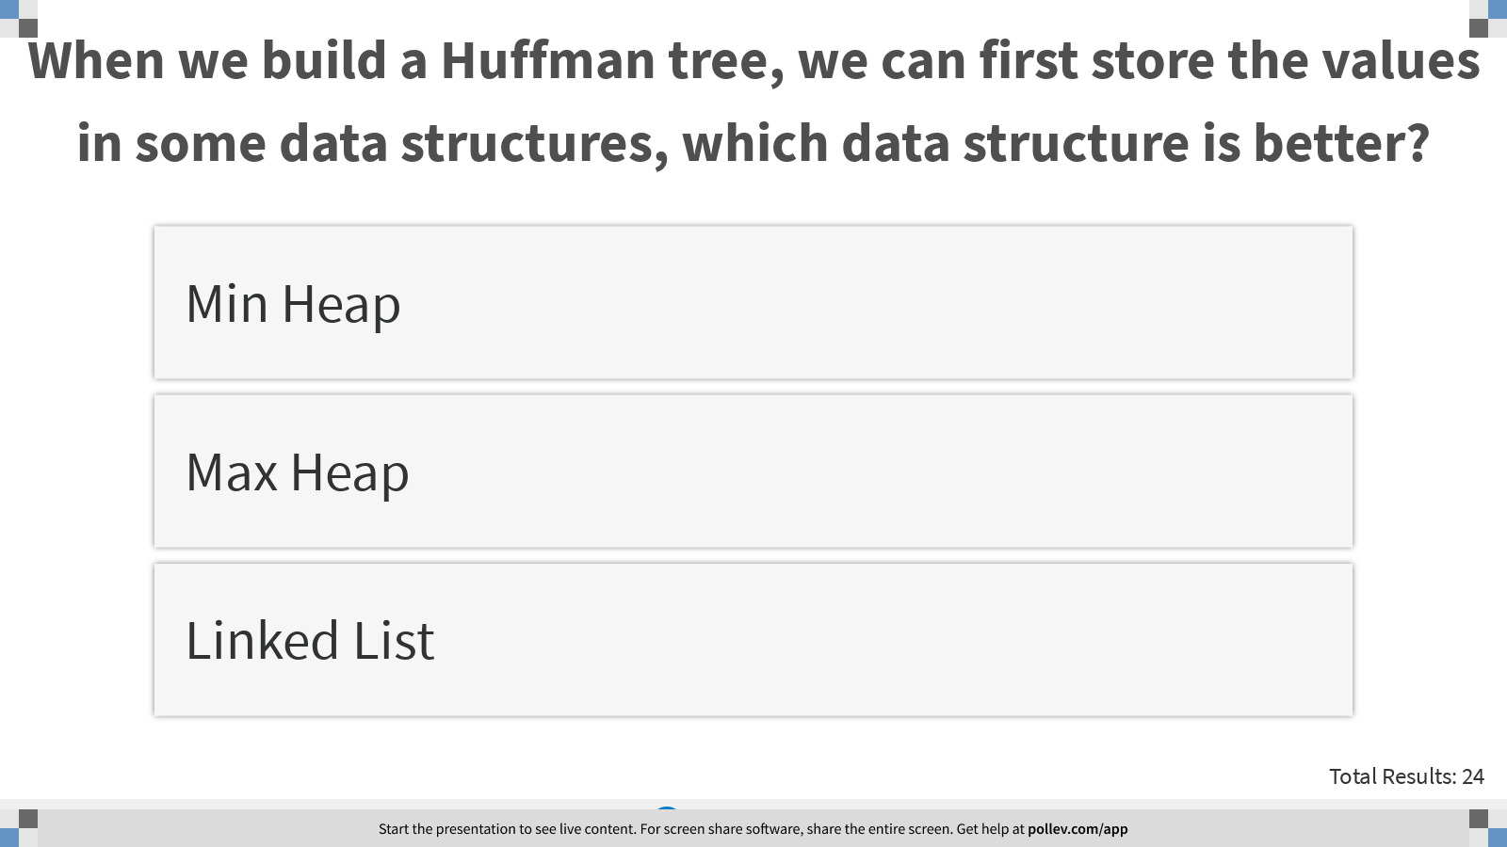
Notes:
When we build a Huffman tree, we can first store the values in some data structures, which data structure is better?
https://www.polleverywhere.com/multiple_choice_polls/69PlsmVYGDZ3iC55IjXJg?display_state=instructions&controls=none&onscreen=persist

Slide 15
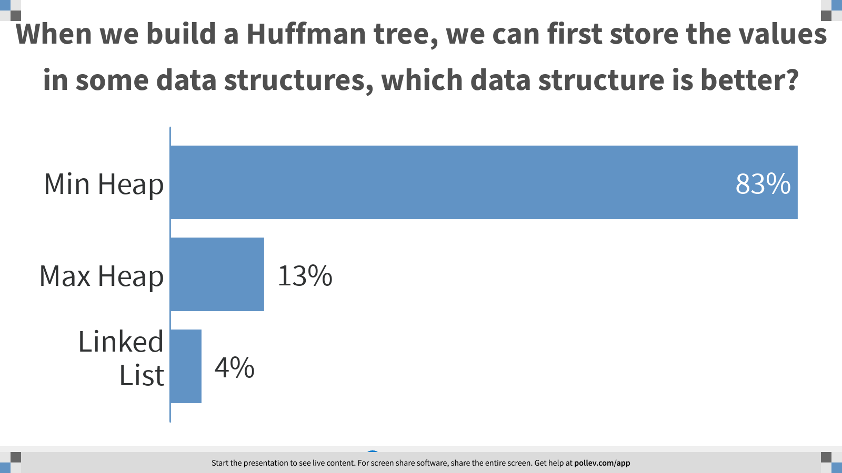
Notes:
When we build a Huffman tree, we can first store the values in some data structures, which data structure is better?
https://www.polleverywhere.com/multiple_choice_polls/69PlsmVYGDZ3iC55IjXJg?display_state=chart&display=correctness&controls=none&onscreen=persist

Slide 16
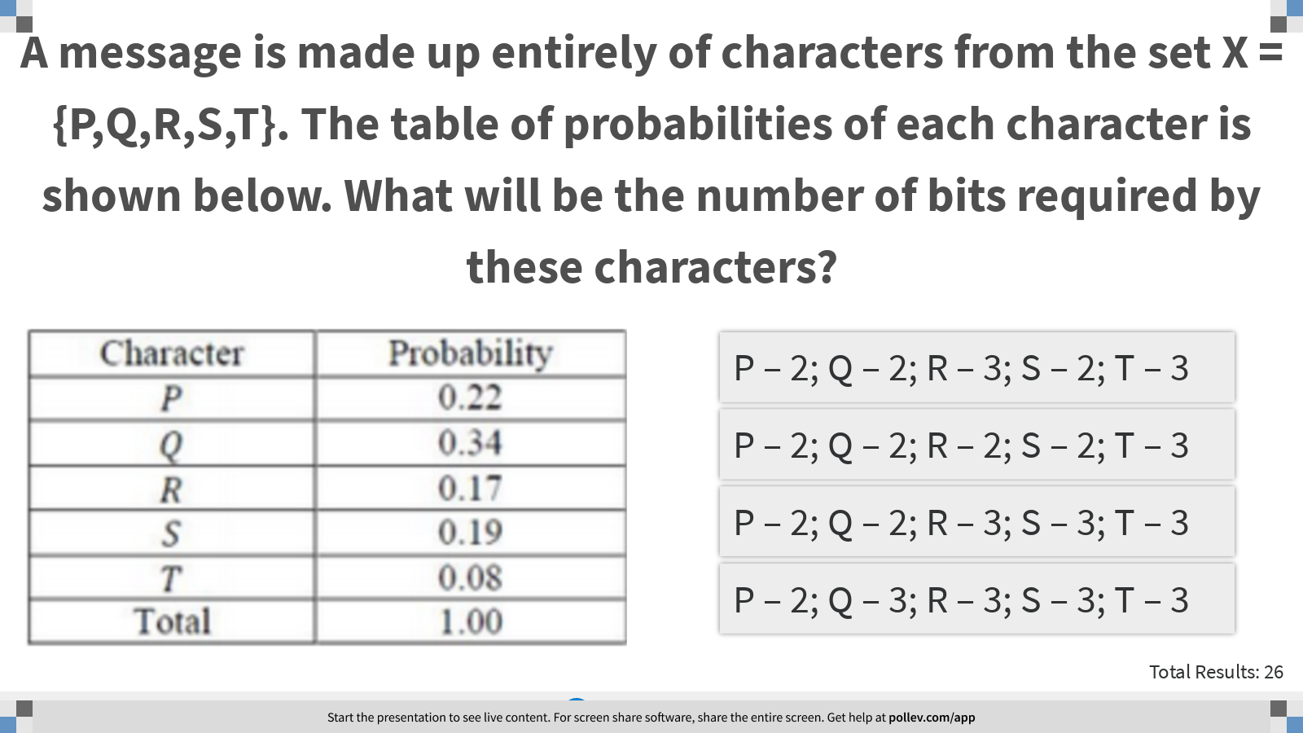
Notes:
A message is made up entirely of characters from the set X ={P,Q,R,S,T}. The table of probabilities of each character is shown below. What will be the number of bits required by these characters?
https://www.polleverywhere.com/multiple_choice_polls/pejz2PXMt0xkR9iOJaxDy?display_state=instructions&controls=none&onscreen=persist

Slide 17
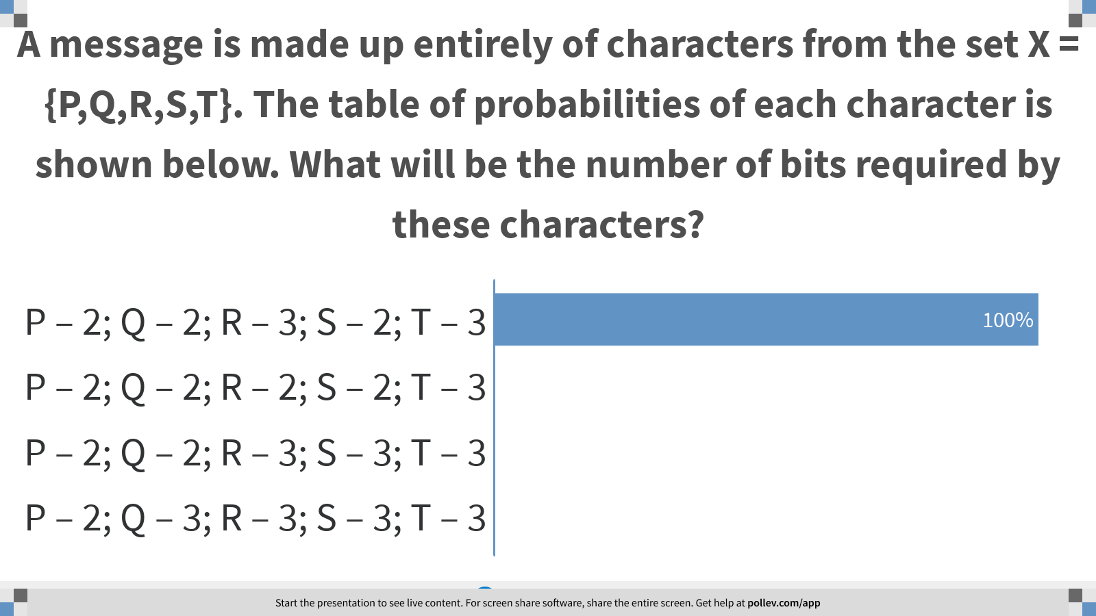
Notes:
A message is made up entirely of characters from the set X ={P,Q,R,S,T}. The table of probabilities of each character is shown below. What will be the number of bits required by these characters?
https://www.polleverywhere.com/multiple_choice_polls/pejz2PXMt0xkR9iOJaxDy?display_state=chart&display=correctness&controls=none&onscreen=persist

Slide 18
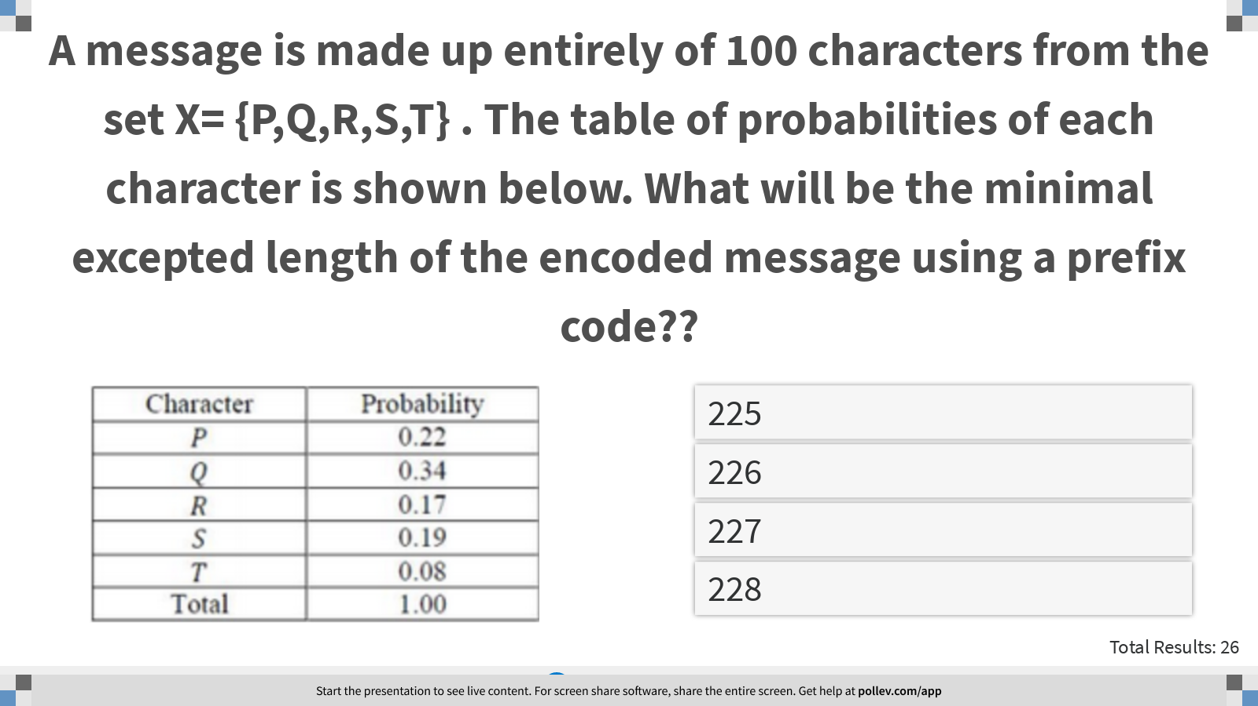
Notes:
A message is made up entirely of 100 characters from the set X= {P,Q,R,S,T} . The table of probabilities of each character is shown below. What will be the minimal excepted length of the encoded message using a prefix code??
https://www.polleverywhere.com/multiple_choice_polls/lAxGAXRyAobV0cwr0051w?display_state=instructions&controls=none&onscreen=persist

Slide 19
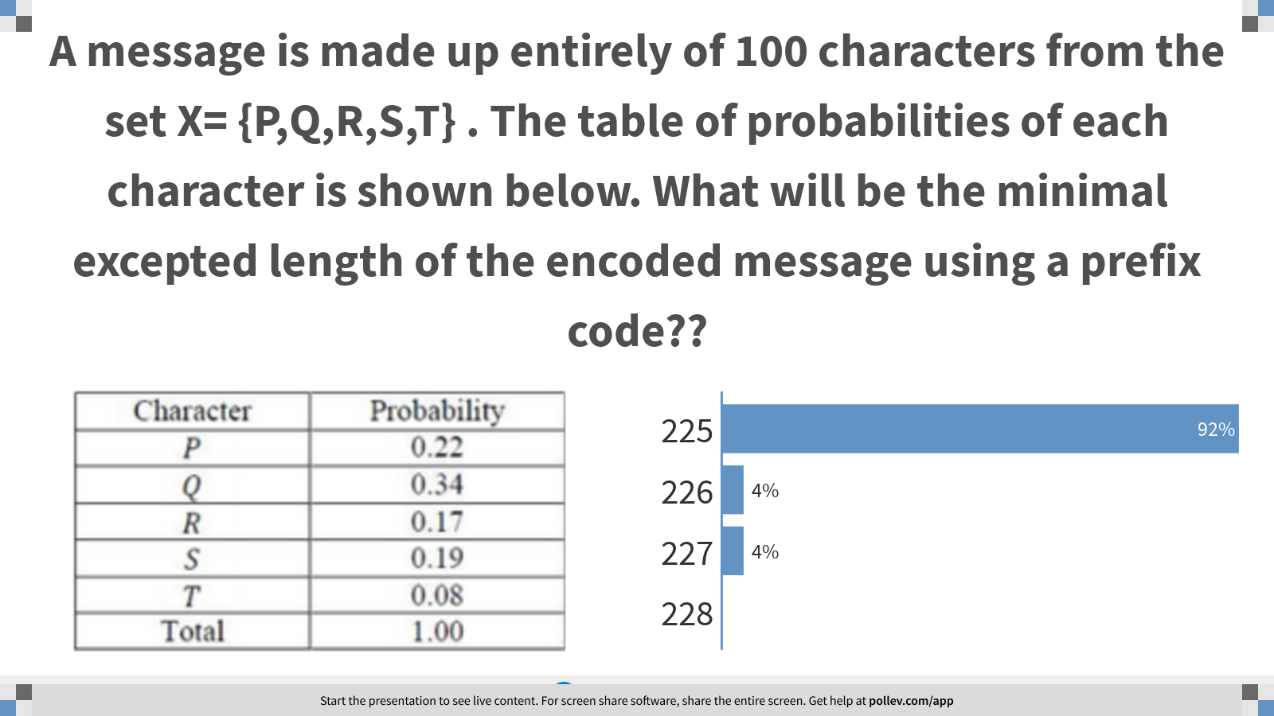
Notes:
A message is made up entirely of 100 characters from the set X= {P,Q,R,S,T} . The table of probabilities of each character is shown below. What will be the minimal excepted length of the encoded message using a prefix code??
https://www.polleverywhere.com/multiple_choice_polls/lAxGAXRyAobV0cwr0051w?display_state=chart&display=correctness&controls=none&onscreen=persist

Slide 20
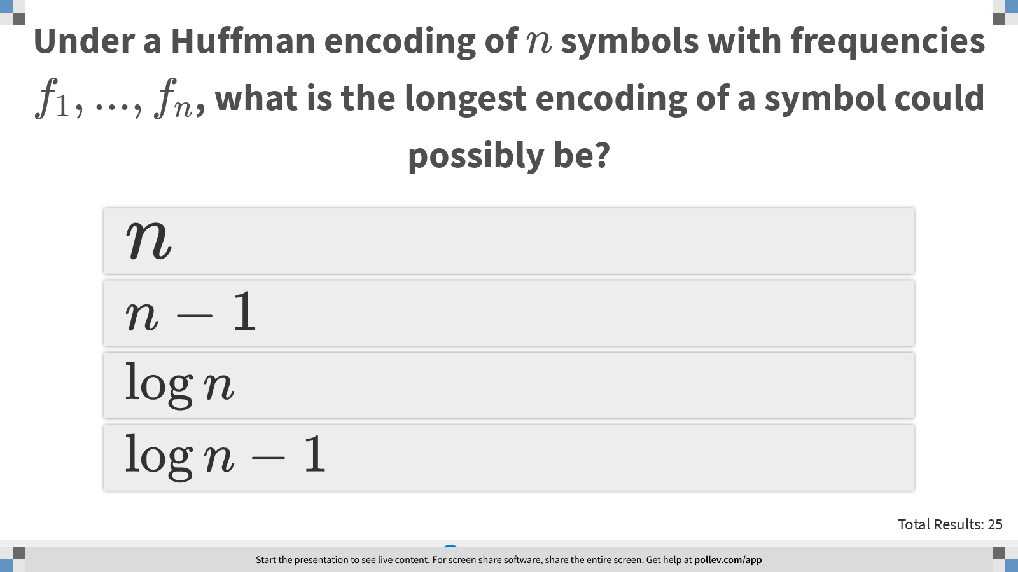
Notes:
Under a Huffman encoding of $$n$$ symbols with frequencies $$f_1,...,f_n$$, what is the longest encoding of a symbol could possibly be?
https://www.polleverywhere.com/multiple_choice_polls/6h1tcscfpkXxU8bPePg1y?display_state=instructions&controls=none&onscreen=persist

Slide 21
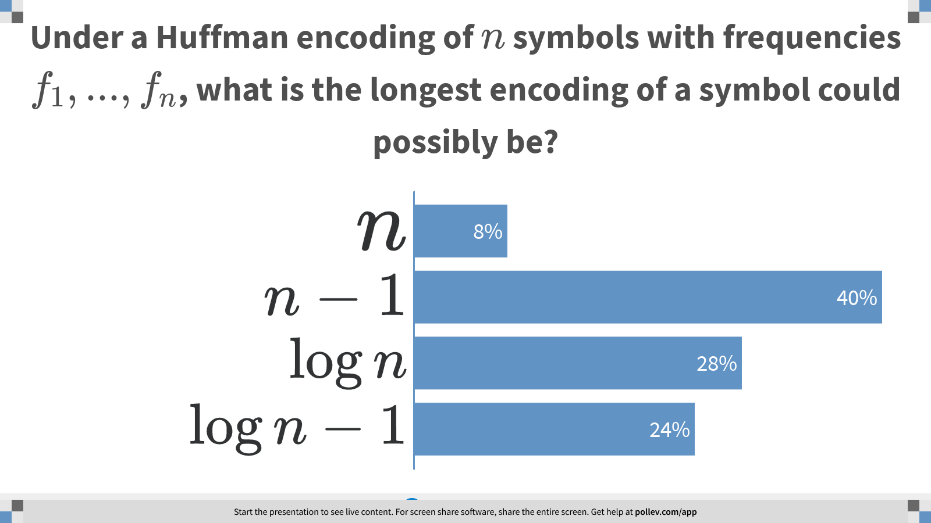
Notes:
Under a Huffman encoding of $$n$$ symbols with frequencies $$f_1,...,f_n$$, what is the longest encoding of a symbol could possibly be?
https://www.polleverywhere.com/multiple_choice_polls/6h1tcscfpkXxU8bPePg1y?display_state=chart&display=correctness&controls=none&onscreen=persist

Slide 22
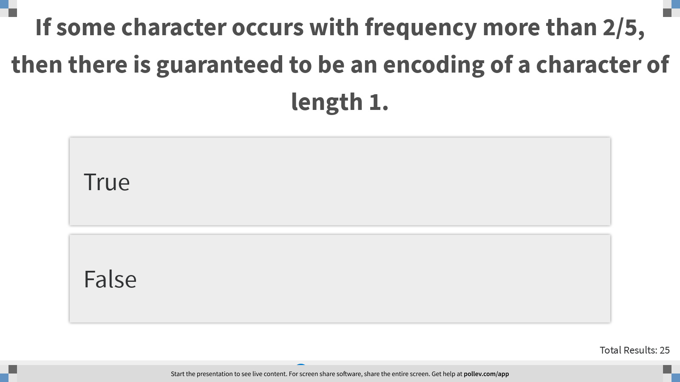
Notes:
If some character occurs with frequency more than 2/5, then there is guaranteed to be an encoding of a character of length 1.
https://www.polleverywhere.com/multiple_choice_polls/P1jMx5x3W69mRupi4rl7b?display_state=instructions&controls=none&onscreen=persist

Slide 23
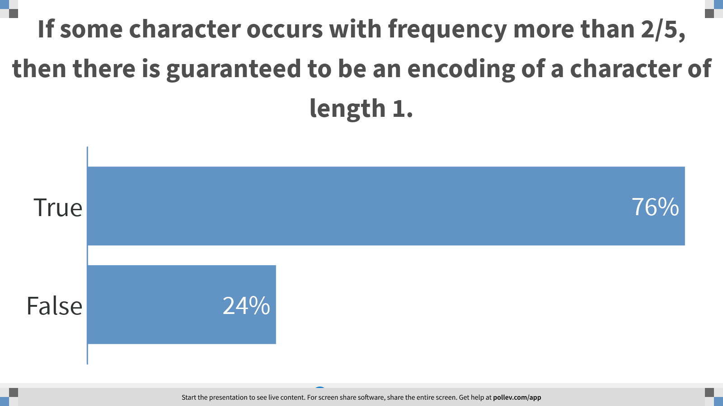
Notes:
If some character occurs with frequency more than 2/5, then there is guaranteed to be an encoding of a character of length 1.
https://www.polleverywhere.com/multiple_choice_polls/P1jMx5x3W69mRupi4rl7b?display_state=chart&display=correctness&controls=none&onscreen=persist

Slide 24
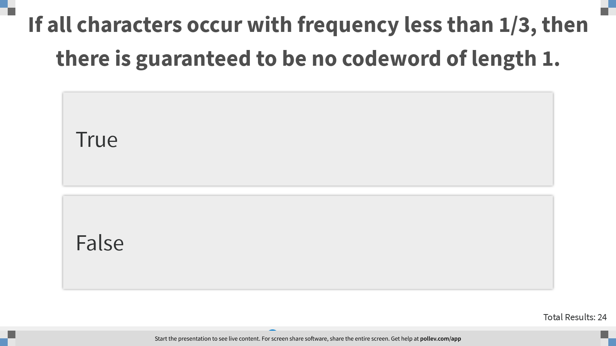
Notes:
If all characters occur with frequency less than 1/3, then there is guaranteed to be no codeword of length 1.
https://www.polleverywhere.com/multiple_choice_polls/qLMXuRzIrtdWZ5COHFty7?display_state=instructions&controls=none&onscreen=persist

Slide 25
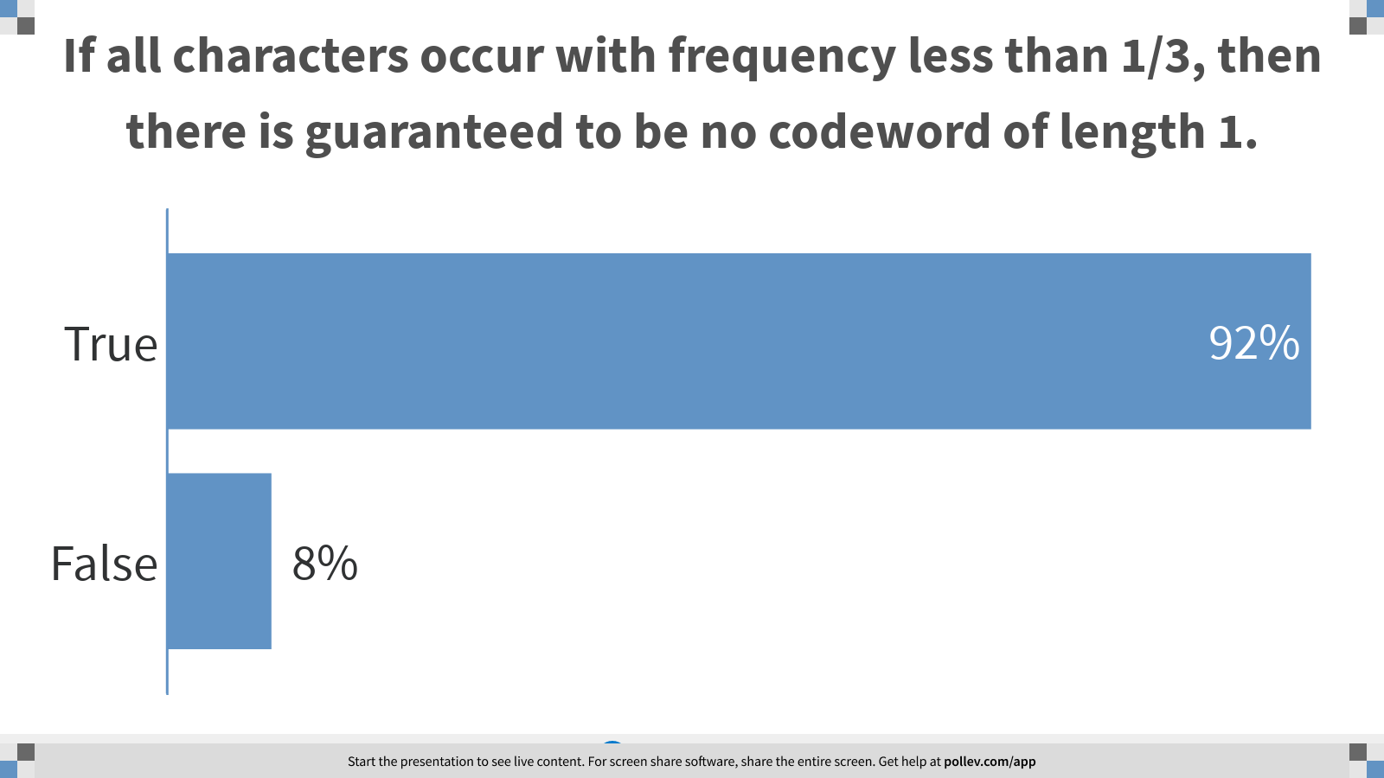
Notes:
If all characters occur with frequency less than 1/3, then there is guaranteed to be no codeword of length 1.
https://www.polleverywhere.com/multiple_choice_polls/qLMXuRzIrtdWZ5COHFty7?display_state=chart&display=correctness&controls=none&onscreen=persist

Slide 26
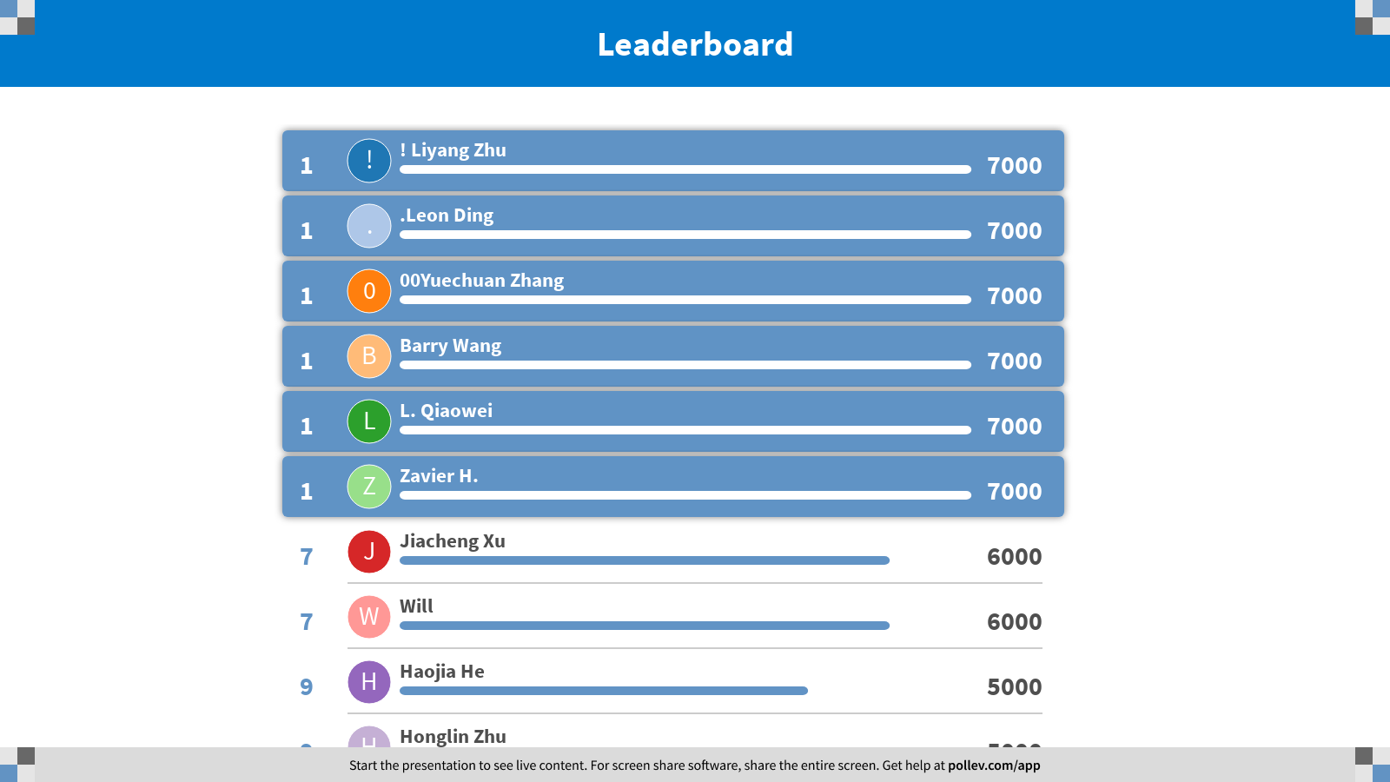
Notes:
Huffman Coding
https://www.polleverywhere.com/competitions/dsRvLmbuMFrorT3hmib5h?display_state=finale&onscreen=persist

