Slide 1

Notes:
Dynamic Programming
https://www.polleverywhere.com/competitions/xdfzg2dj1L0V1FklutO0e?display_state=welcome&controls=none&onscreen=persist

Slide 2
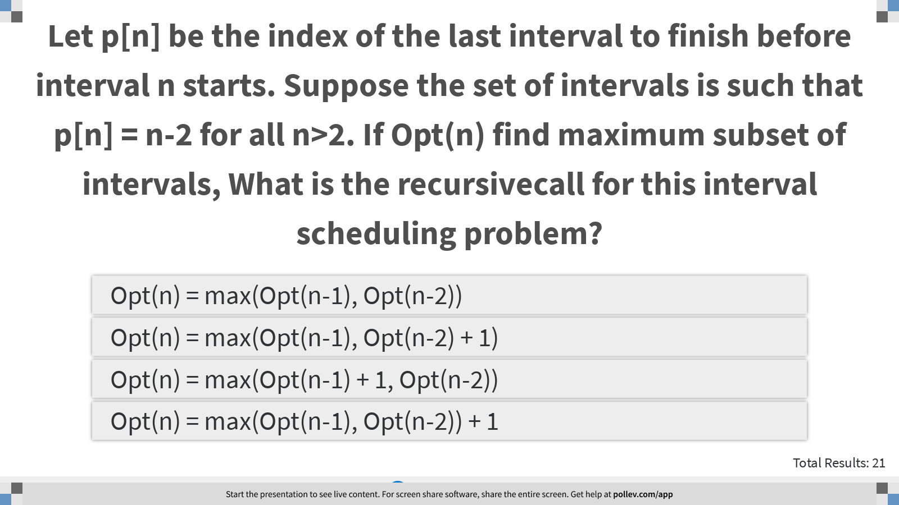
Notes:
Let p[n] be the index of the last interval to finish before interval n starts. Suppose the set of intervals is such that p[n] = n-2 for all n>2. If Opt(n) find maximum subset of intervals, What is the recursivecall for this interval scheduling problem?
https://www.polleverywhere.com/multiple_choice_polls/W2WqGUbKnTrTS5H0S24i7?display_state=instructions&controls=none&onscreen=persist

Slide 3
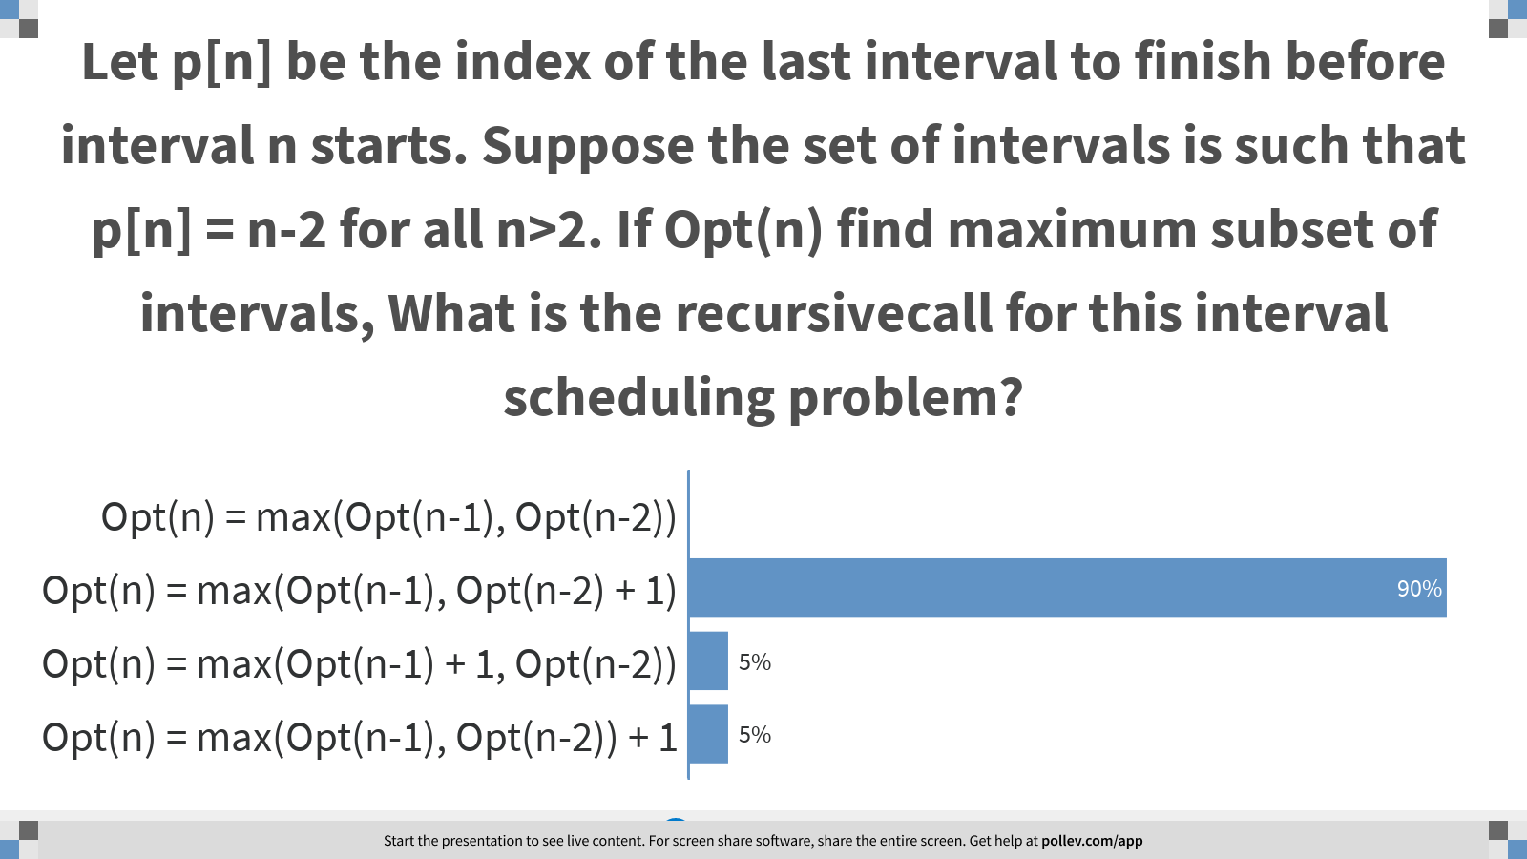
Notes:
Let p[n] be the index of the last interval to finish before interval n starts. Suppose the set of intervals is such that p[n] = n-2 for all n>2. If Opt(n) find maximum subset of intervals, What is the recursivecall for this interval scheduling problem?
https://www.polleverywhere.com/multiple_choice_polls/W2WqGUbKnTrTS5H0S24i7?display_state=chart&display=correctness&controls=none&onscreen=persist

Slide 4
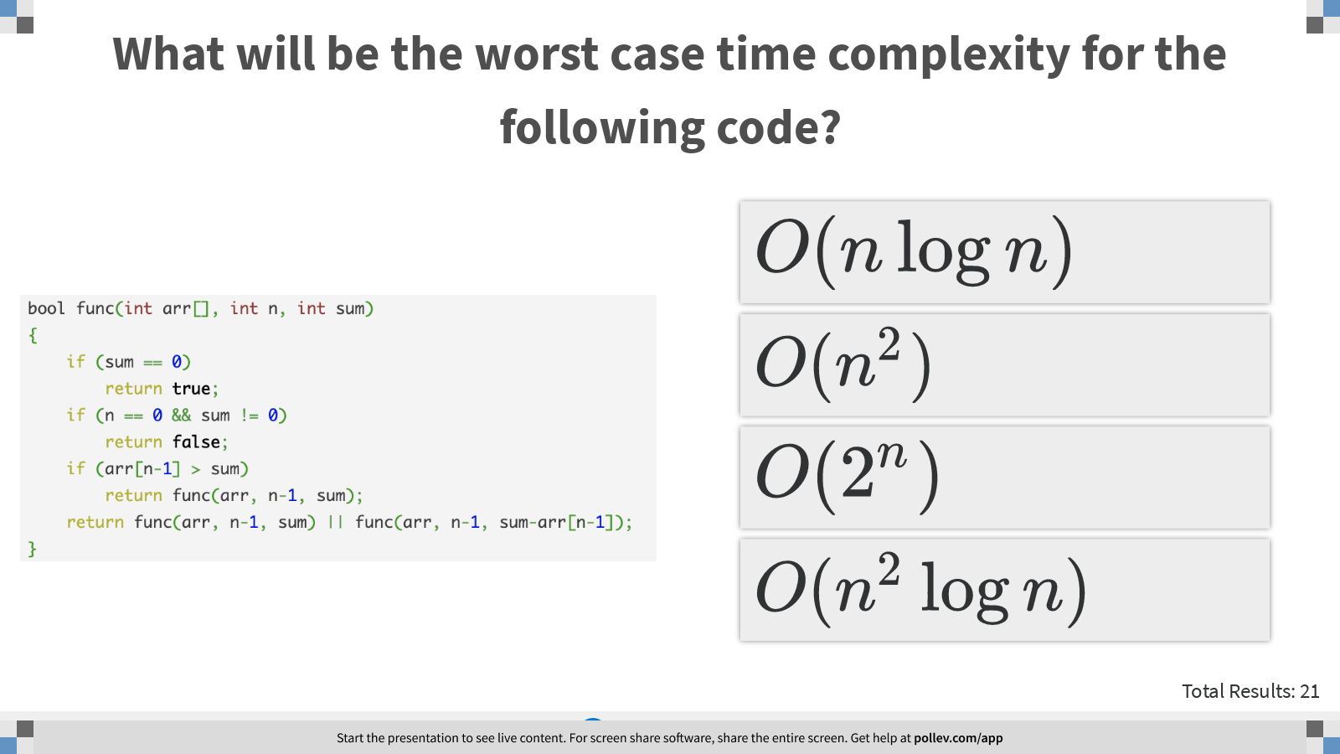
Notes:
What will be the worst case time complexity for the following code?
https://www.polleverywhere.com/multiple_choice_polls/LERG59M0pEMbZGyWcDSAn?display_state=instructions&controls=none&onscreen=persist

Slide 5
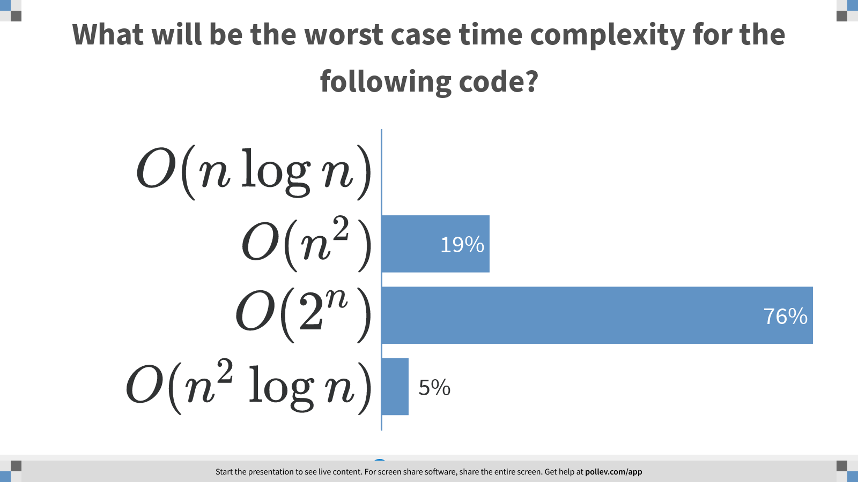
Notes:
What will be the worst case time complexity for the following code?
https://www.polleverywhere.com/multiple_choice_polls/LERG59M0pEMbZGyWcDSAn?display_state=chart&display=correctness&controls=none&onscreen=persist

Slide 6
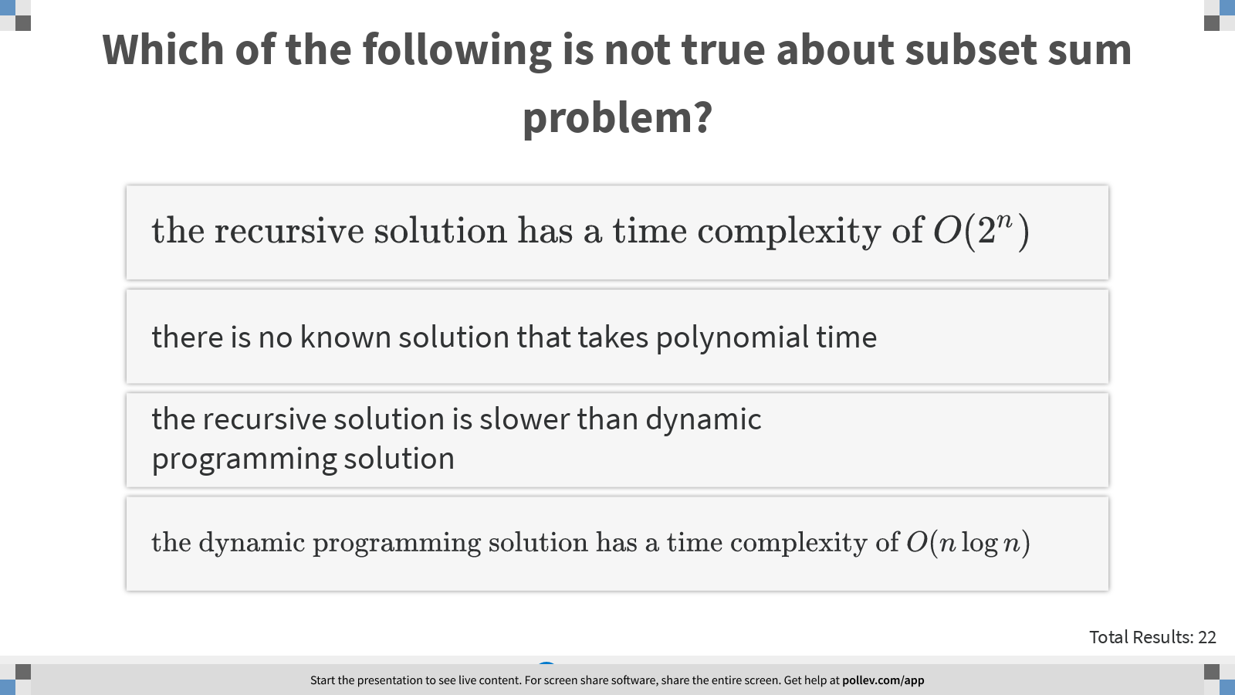
Notes:
Which of the following is not true about subset sum problem?
https://www.polleverywhere.com/multiple_choice_polls/FdpmVYtf0vjX2Drau7Agm?display_state=instructions&controls=none&onscreen=persist

Slide 7
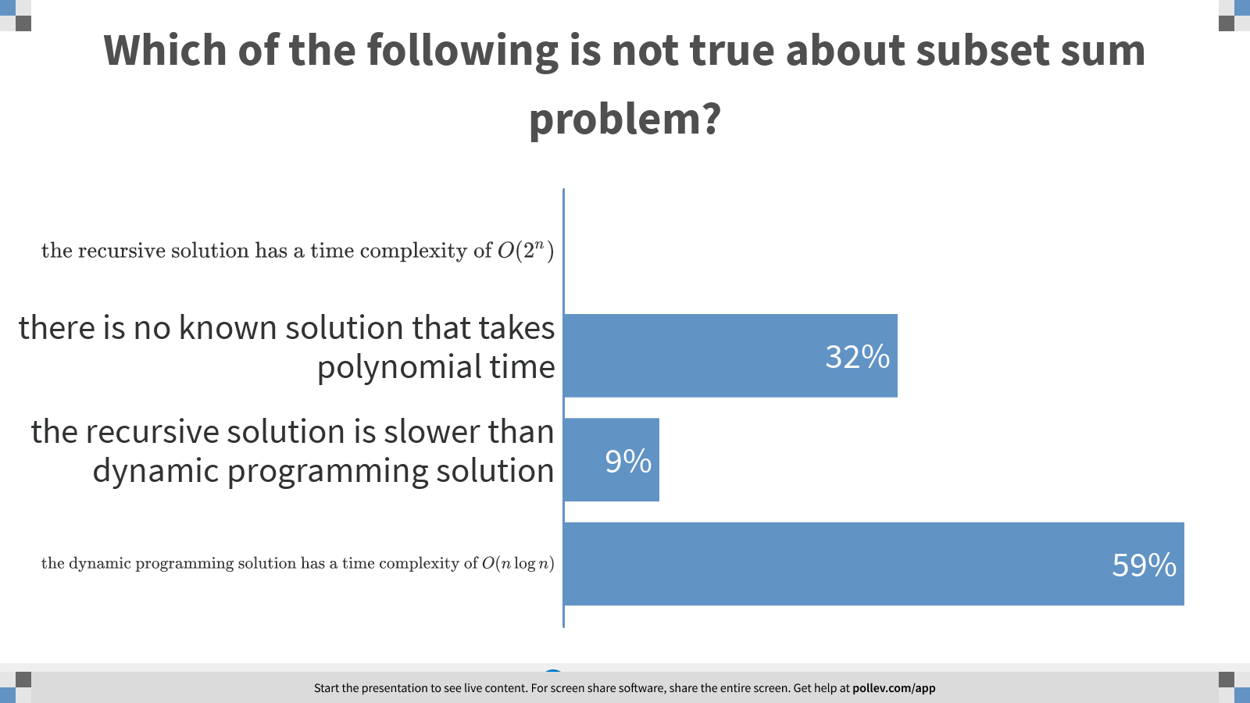
Notes:
Which of the following is not true about subset sum problem?
https://www.polleverywhere.com/multiple_choice_polls/FdpmVYtf0vjX2Drau7Agm?display_state=chart&display=correctness&controls=none&onscreen=persist

Slide 8
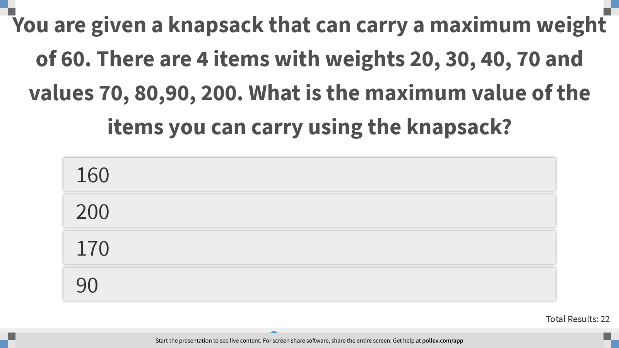
Notes:
You are given a knapsack that can carry a maximum weight of 60. There are 4 items with weights 20, 30, 40, 70 and values 70, 80,90, 200. What is the maximum value of the items you can carry using the knapsack?
https://www.polleverywhere.com/multiple_choice_polls/HkSMonsa6PfYJnG7hbzva?display_state=instructions&controls=none&onscreen=persist

Slide 9
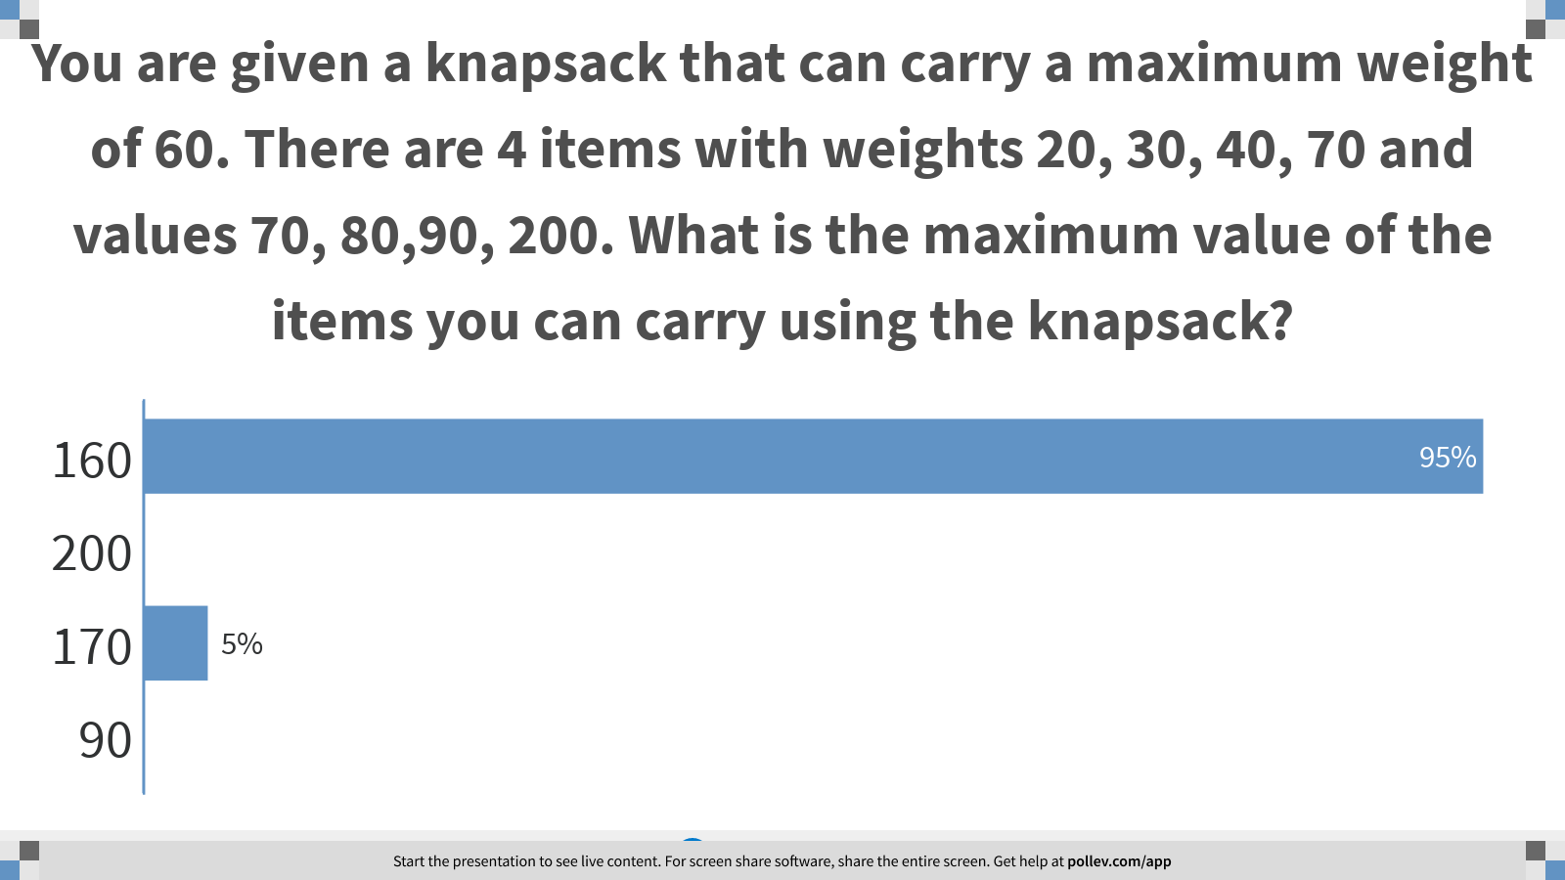
Notes:
You are given a knapsack that can carry a maximum weight of 60. There are 4 items with weights 20, 30, 40, 70 and values 70, 80,90, 200. What is the maximum value of the items you can carry using the knapsack?
https://www.polleverywhere.com/multiple_choice_polls/HkSMonsa6PfYJnG7hbzva?display_state=chart&display=correctness&controls=none&onscreen=persist

Slide 10
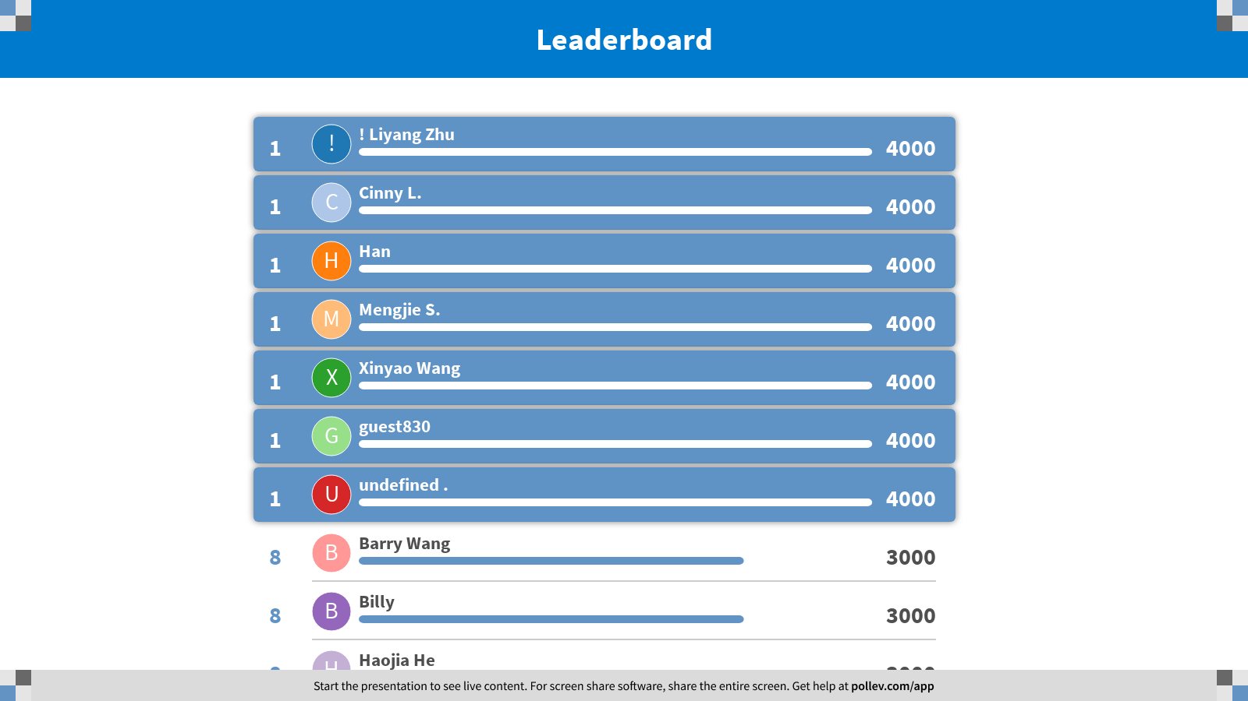
Notes:
Dynamic Programming
https://www.polleverywhere.com/competitions/xdfzg2dj1L0V1FklutO0e?display_state=finale&onscreen=persist

