Slide 1

Notes:
Dynamic Programming II
https://www.polleverywhere.com/competitions/iMkSM01e2RT3fwDzLno55?display_state=welcome&controls=none&onscreen=persist

Slide 2
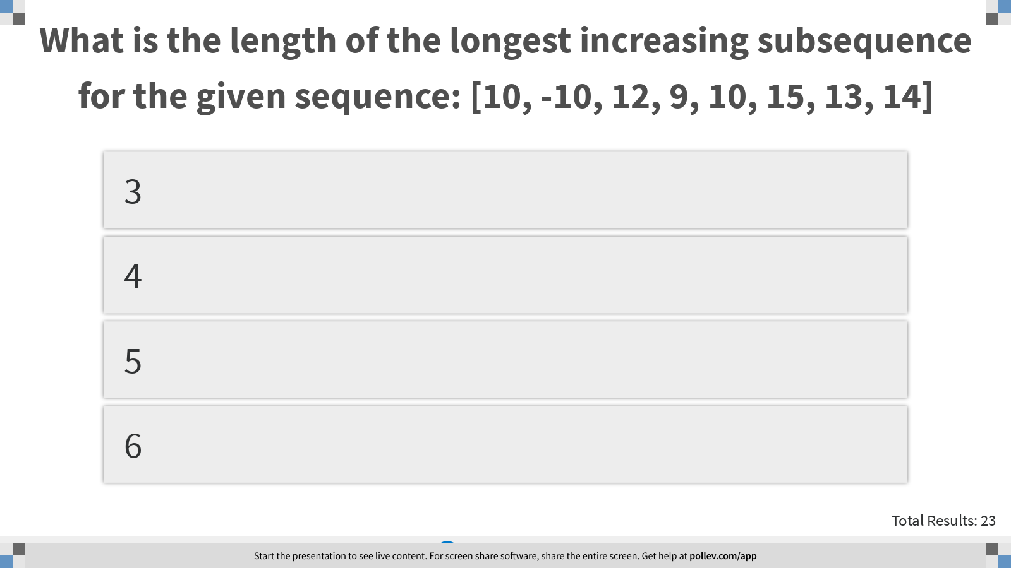
Notes:
What is the length of the longest increasing subsequence for the given sequence: [10, -10, 12, 9, 10, 15, 13, 14]
https://www.polleverywhere.com/multiple_choice_polls/dKDcf4pH2KS7kNJv2PLkS?display_state=instructions&controls=none&onscreen=persist

Slide 3
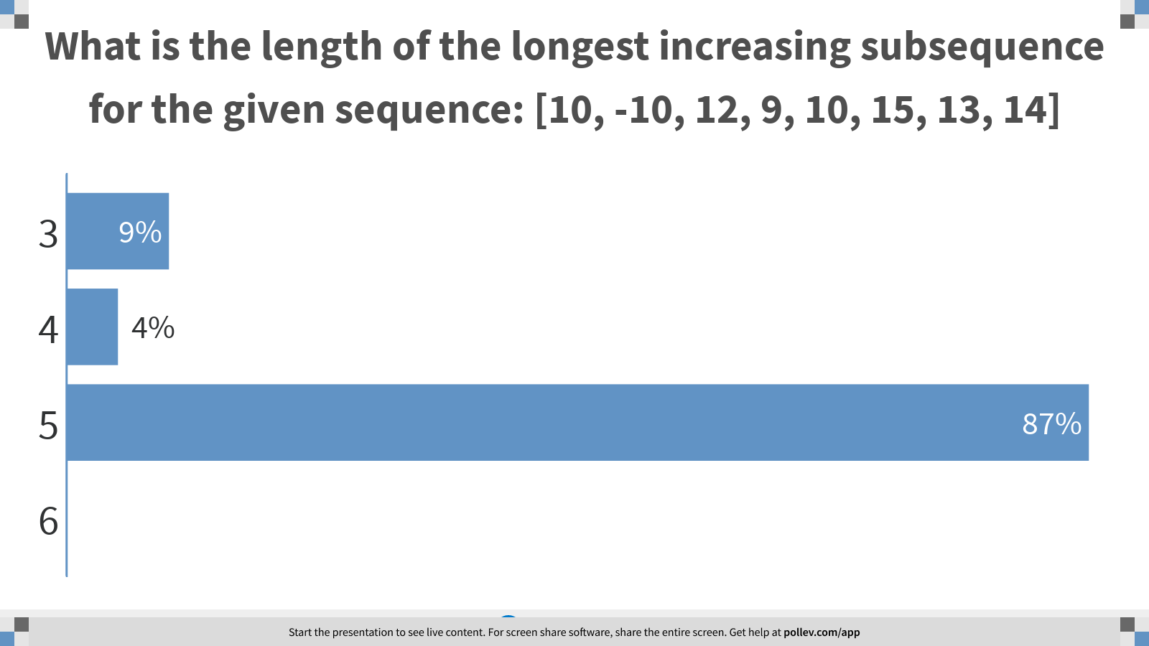
Notes:
What is the length of the longest increasing subsequence for the given sequence: [10, -10, 12, 9, 10, 15, 13, 14]
https://www.polleverywhere.com/multiple_choice_polls/dKDcf4pH2KS7kNJv2PLkS?display_state=chart&display=correctness&controls=none&onscreen=persist

Slide 4
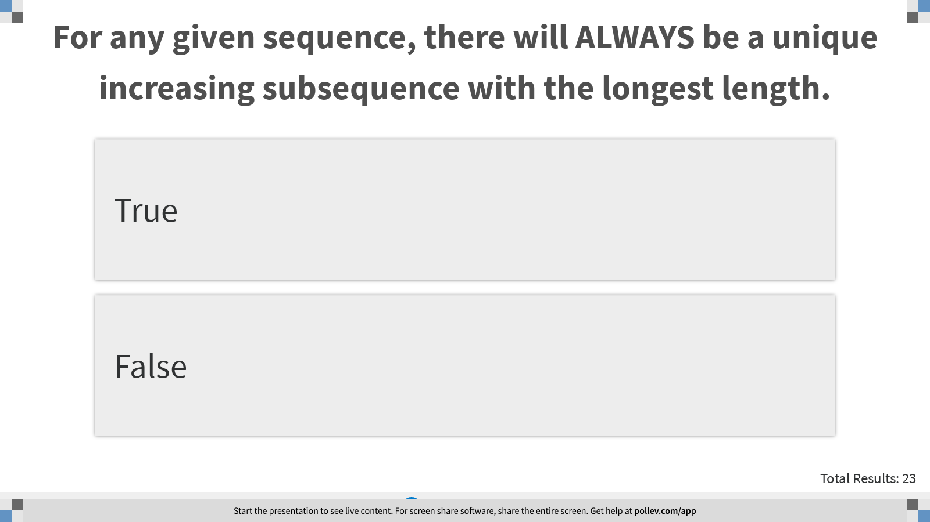
Notes:
For any given sequence, there will ALWAYS be a unique increasing subsequence with the longest length.
https://www.polleverywhere.com/multiple_choice_polls/ermWWDm6teIetrSyoiGuH?display_state=instructions&controls=none&onscreen=persist

Slide 5
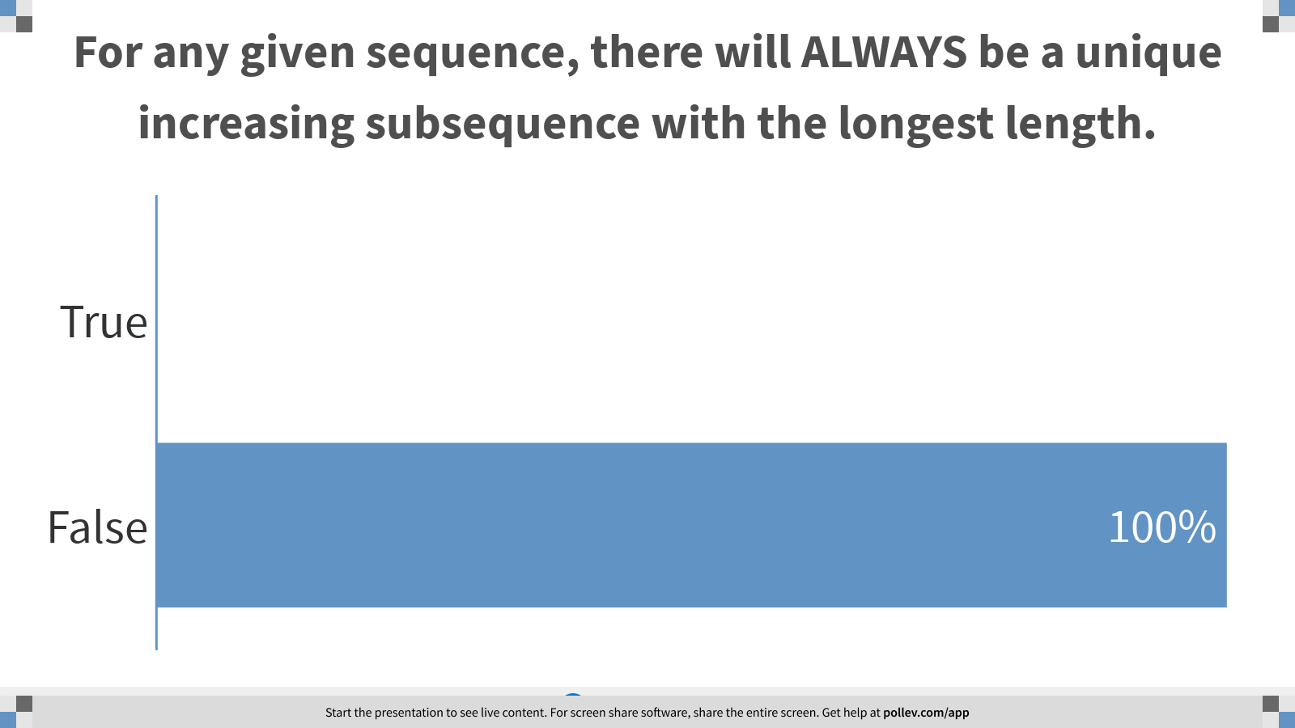
Notes:
For any given sequence, there will ALWAYS be a unique increasing subsequence with the longest length.
https://www.polleverywhere.com/multiple_choice_polls/ermWWDm6teIetrSyoiGuH?display_state=chart&display=correctness&controls=none&onscreen=persist

Slide 6
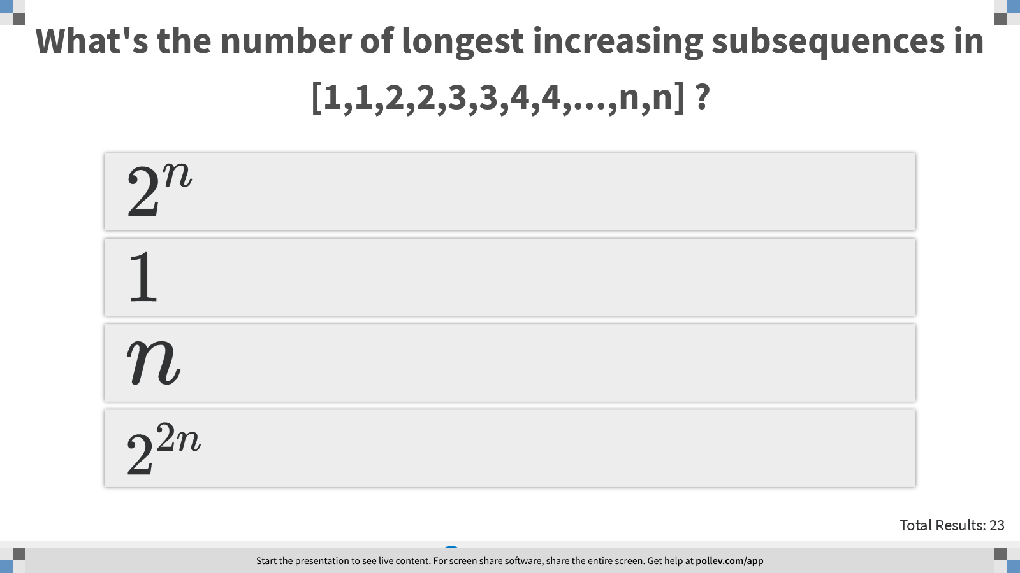
Notes:
What's the number of longest increasing subsequences in [1,1,2,2,3,3,4,4,...,n,n] ?
https://www.polleverywhere.com/multiple_choice_polls/OXUCn5JPYKR6adFKCiinm?display_state=instructions&controls=none&onscreen=persist

Slide 7
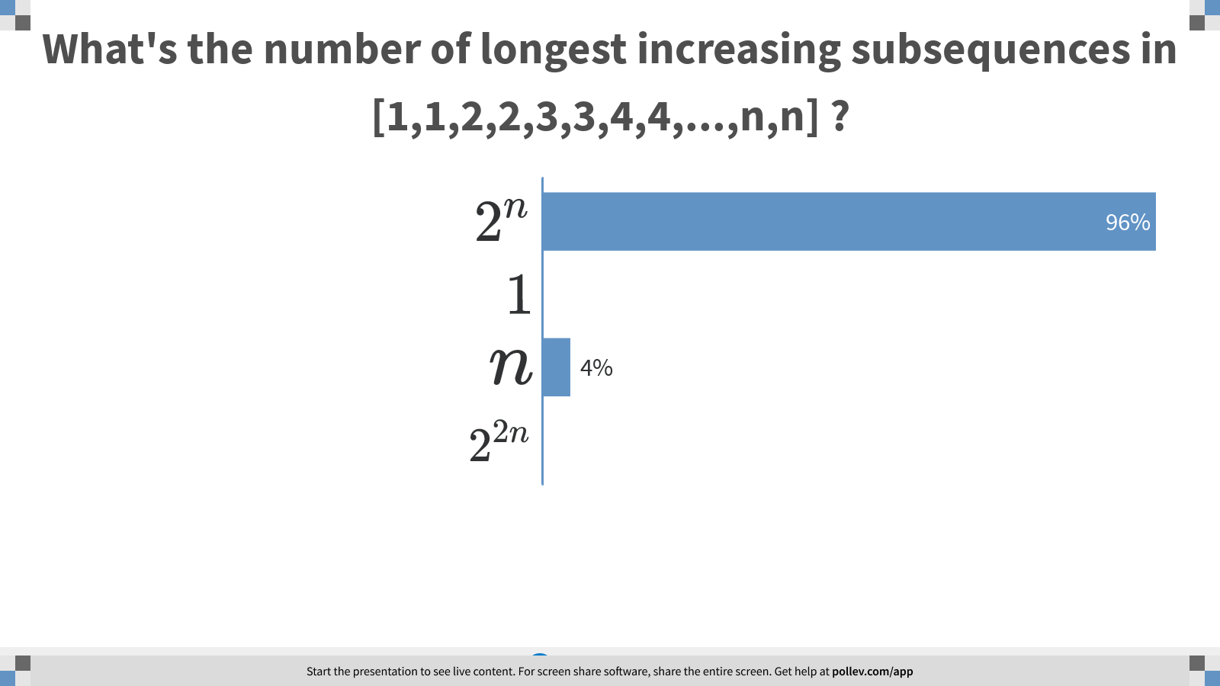
Notes:
What's the number of longest increasing subsequences in [1,1,2,2,3,3,4,4,...,n,n] ?
https://www.polleverywhere.com/multiple_choice_polls/OXUCn5JPYKR6adFKCiinm?display_state=chart&display=correctness&controls=none&onscreen=persist

Slide 8
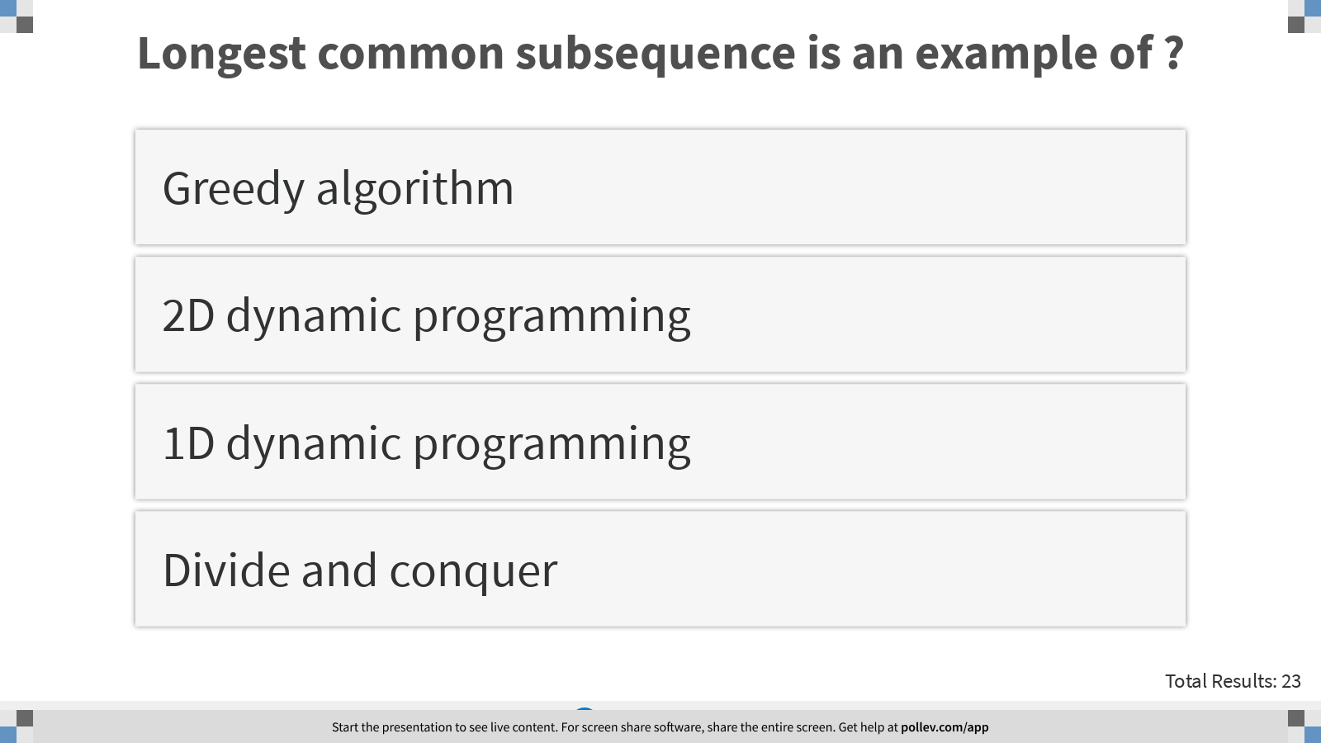
Notes:
Longest common subsequence is an example of ?
https://www.polleverywhere.com/multiple_choice_polls/5vbjoPEOu1KCNcJyUr7yp?display_state=instructions&controls=none&onscreen=persist

Slide 9
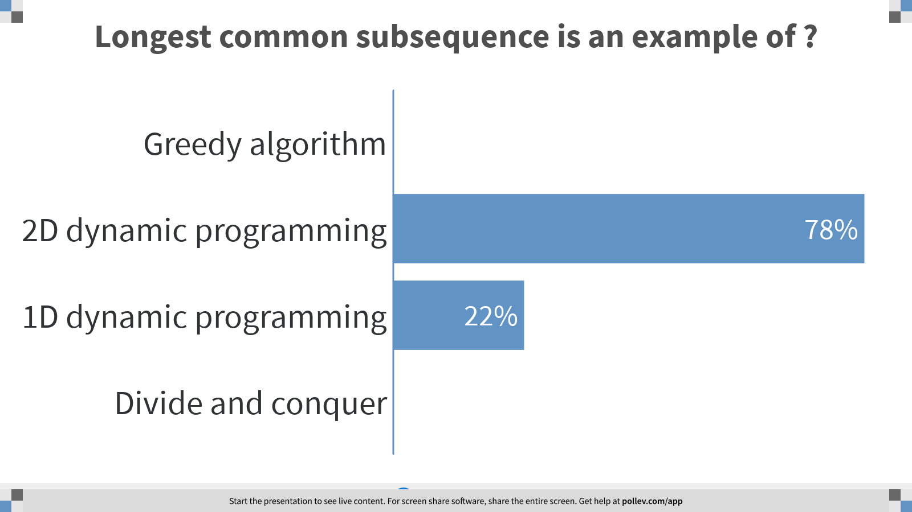
Notes:
Longest common subsequence is an example of ?
https://www.polleverywhere.com/multiple_choice_polls/5vbjoPEOu1KCNcJyUr7yp?display_state=chart&display=correctness&controls=none&onscreen=persist

Slide 10
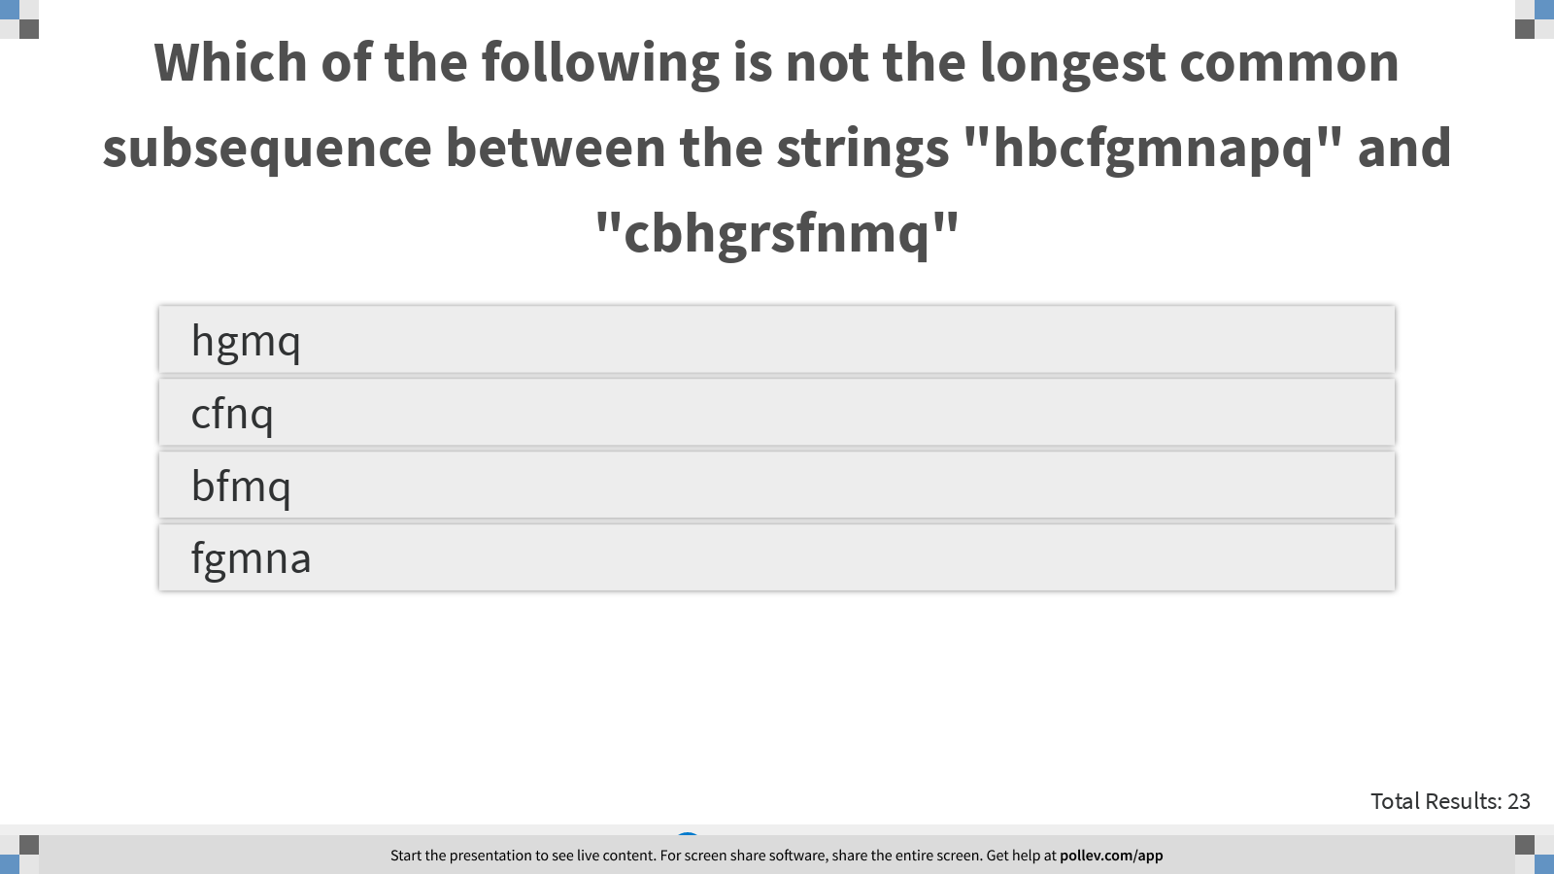
Notes:
Which of the following is not the longest common subsequence between the strings "hbcfgmnapq" and "cbhgrsfnmq"
https://www.polleverywhere.com/multiple_choice_polls/MXKCljE9R8u8ntxyZC7yV?display_state=instructions&controls=none&onscreen=persist

Slide 11
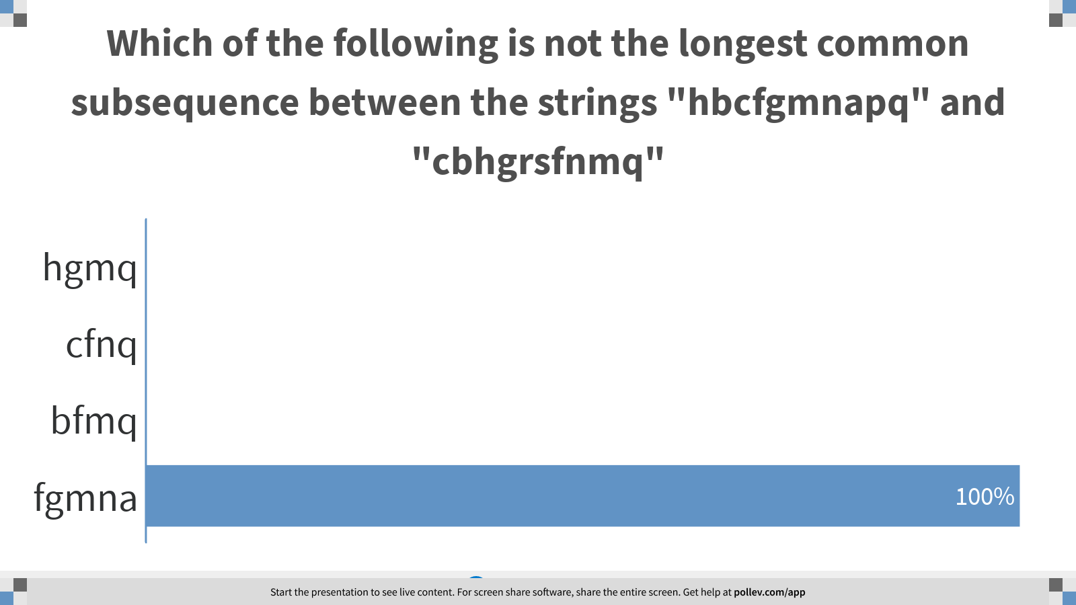
Notes:
Which of the following is not the longest common subsequence between the strings "hbcfgmnapq" and "cbhgrsfnmq"
https://www.polleverywhere.com/multiple_choice_polls/MXKCljE9R8u8ntxyZC7yV?display_state=chart&display=correctness&controls=none&onscreen=persist

Slide 12
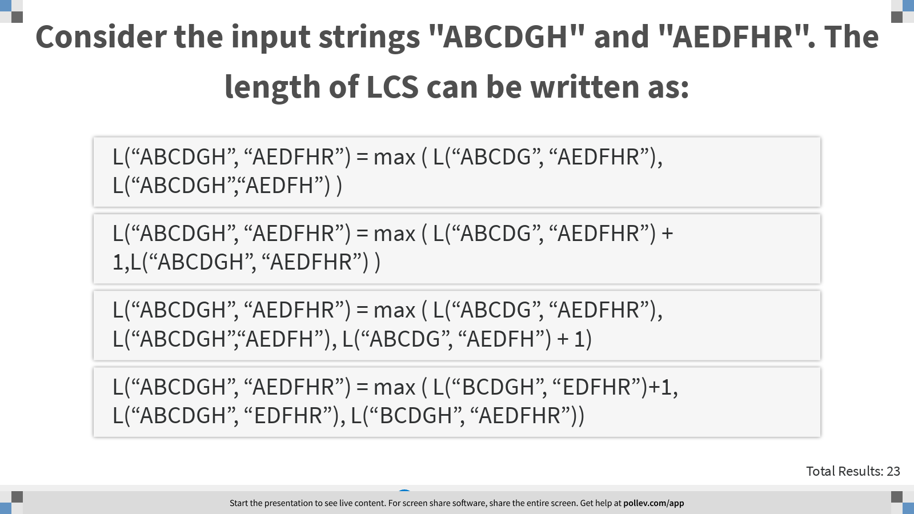
Notes:
Consider the input strings "ABCDGH" and "AEDFHR". The length of LCS can be written as:
https://www.polleverywhere.com/multiple_choice_polls/yoQ2DIjeZUT7PYxgbHX1d?display_state=instructions&controls=none&onscreen=persist

Slide 13
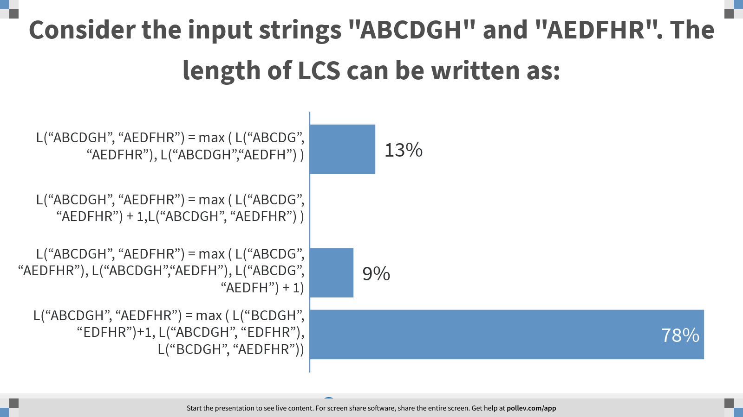
Notes:
Consider the input strings "ABCDGH" and "AEDFHR". The length of LCS can be written as:
https://www.polleverywhere.com/multiple_choice_polls/yoQ2DIjeZUT7PYxgbHX1d?display_state=chart&display=correctness&controls=none&onscreen=persist

Slide 14
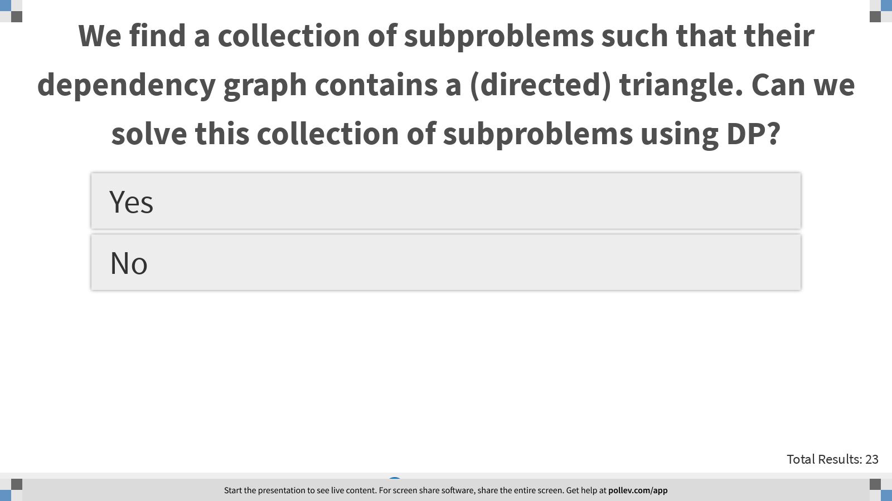
Notes:
We find a collection of subproblems such that their dependency graph contains a (directed) triangle. Can we solve this collection of subproblems using DP?
https://www.polleverywhere.com/multiple_choice_polls/lfztFHbQcxnSpnPXQ9WUp?display_state=instructions&controls=none&onscreen=persist

Slide 15
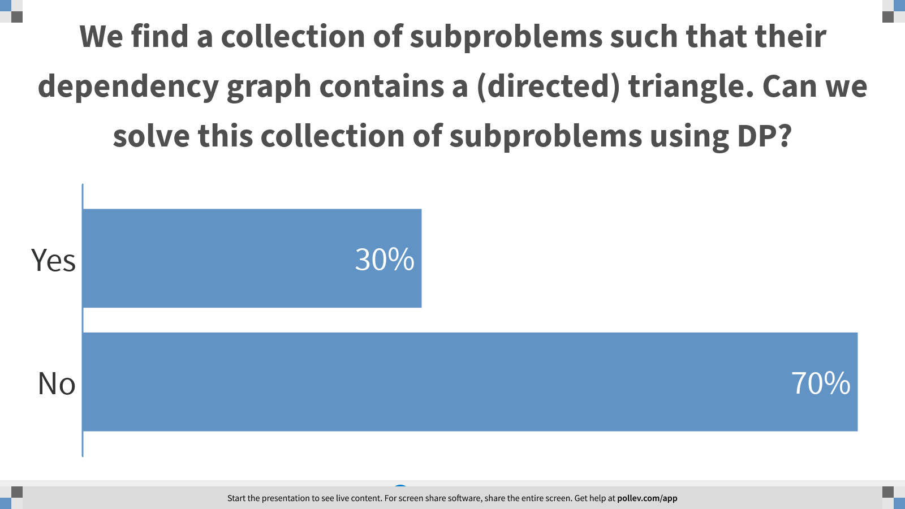
Notes:
We find a collection of subproblems such that their dependency graph contains a (directed) triangle. Can we solve this collection of subproblems using DP?
https://www.polleverywhere.com/multiple_choice_polls/lfztFHbQcxnSpnPXQ9WUp?display_state=chart&display=correctness&controls=none&onscreen=persist

Slide 16
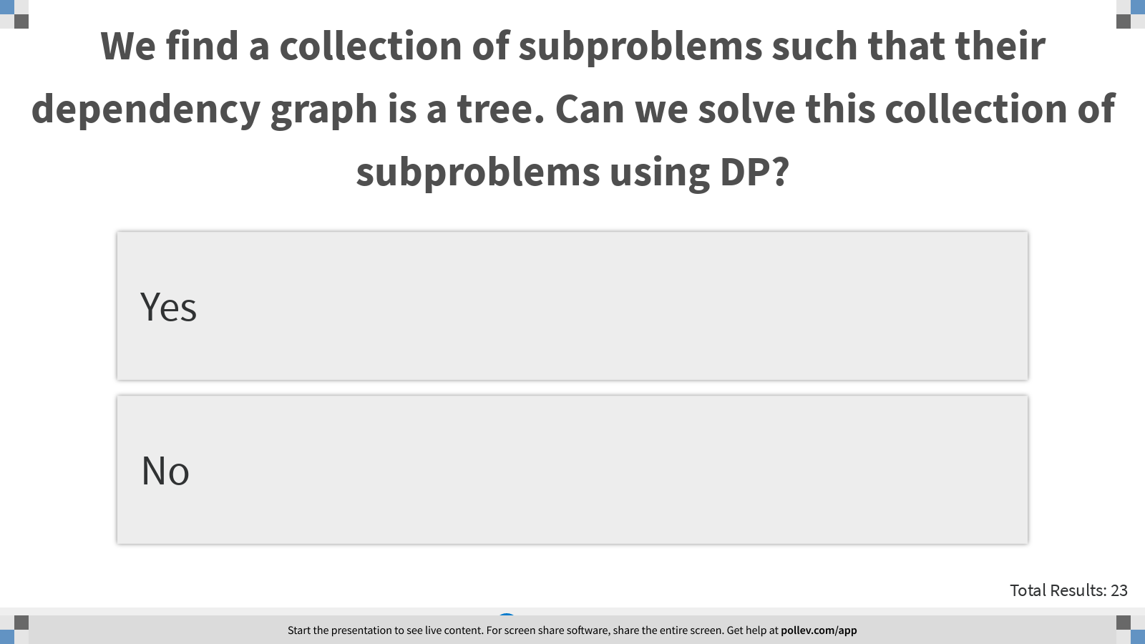
Notes:
We find a collection of subproblems such that their dependency graph is a tree. Can we solve this collection of subproblems using DP?
https://www.polleverywhere.com/multiple_choice_polls/idiArEydnhx0uK6QNNisT?display_state=instructions&controls=none&onscreen=persist

Slide 17
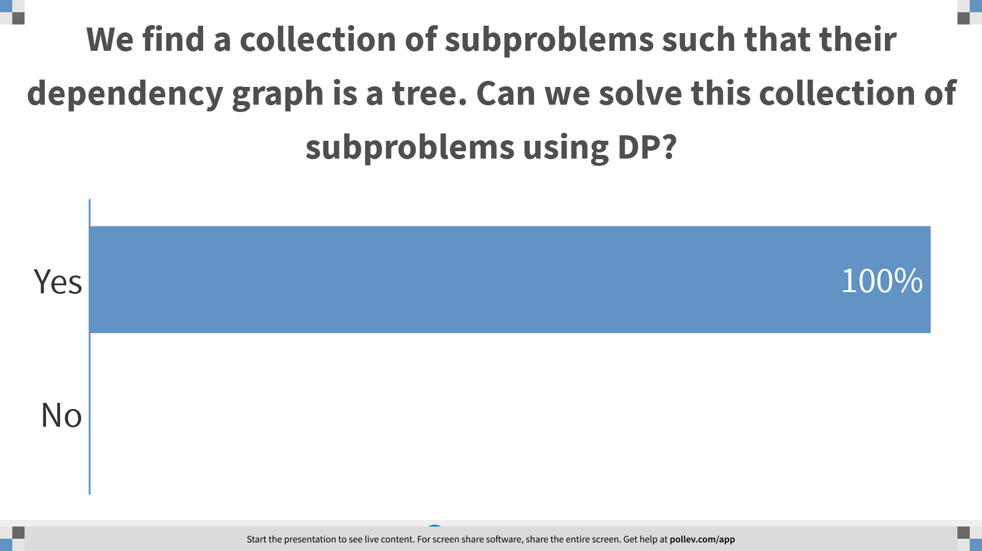
Notes:
We find a collection of subproblems such that their dependency graph is a tree. Can we solve this collection of subproblems using DP?
https://www.polleverywhere.com/multiple_choice_polls/idiArEydnhx0uK6QNNisT?display_state=chart&display=correctness&controls=none&onscreen=persist

Slide 18
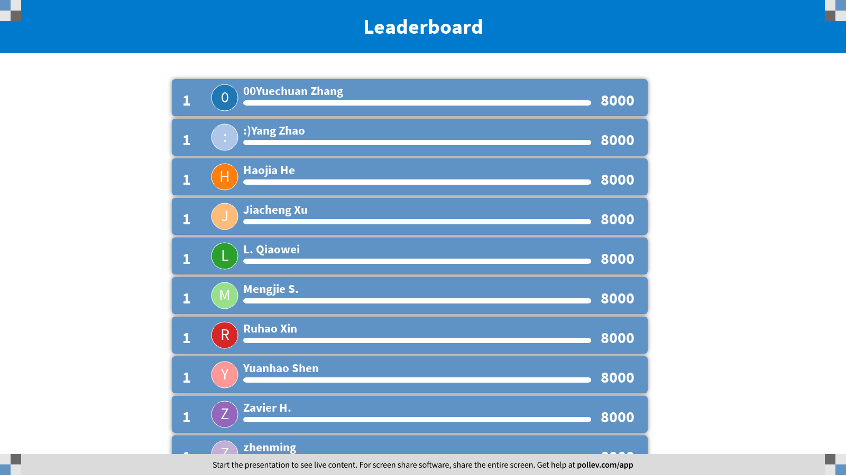
Notes:
Dynamic Programming II
https://www.polleverywhere.com/competitions/iMkSM01e2RT3fwDzLno55?display_state=finale&onscreen=persist

Slide 19

Notes:
Edit Distance
https://www.polleverywhere.com/competitions/4qWPCZkmgx5nlQsXWCjjW?display_state=welcome&controls=none&onscreen=persist

Slide 20
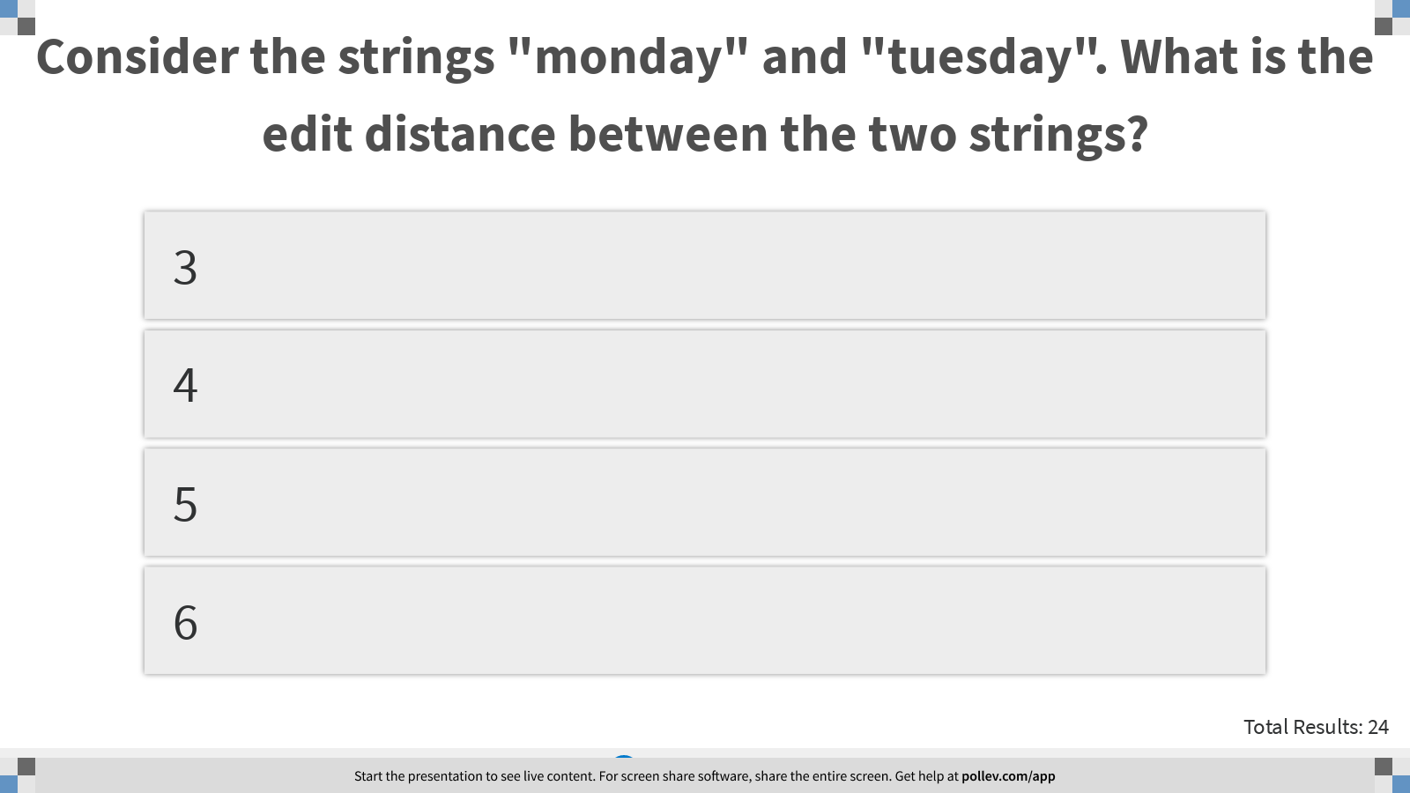
Notes:
Consider the strings "monday" and "tuesday". What is the edit distance between the two strings?
https://www.polleverywhere.com/multiple_choice_polls/0W4071yOJsLtRPCYmQGVz?display_state=instructions&controls=none&onscreen=persist

Slide 21
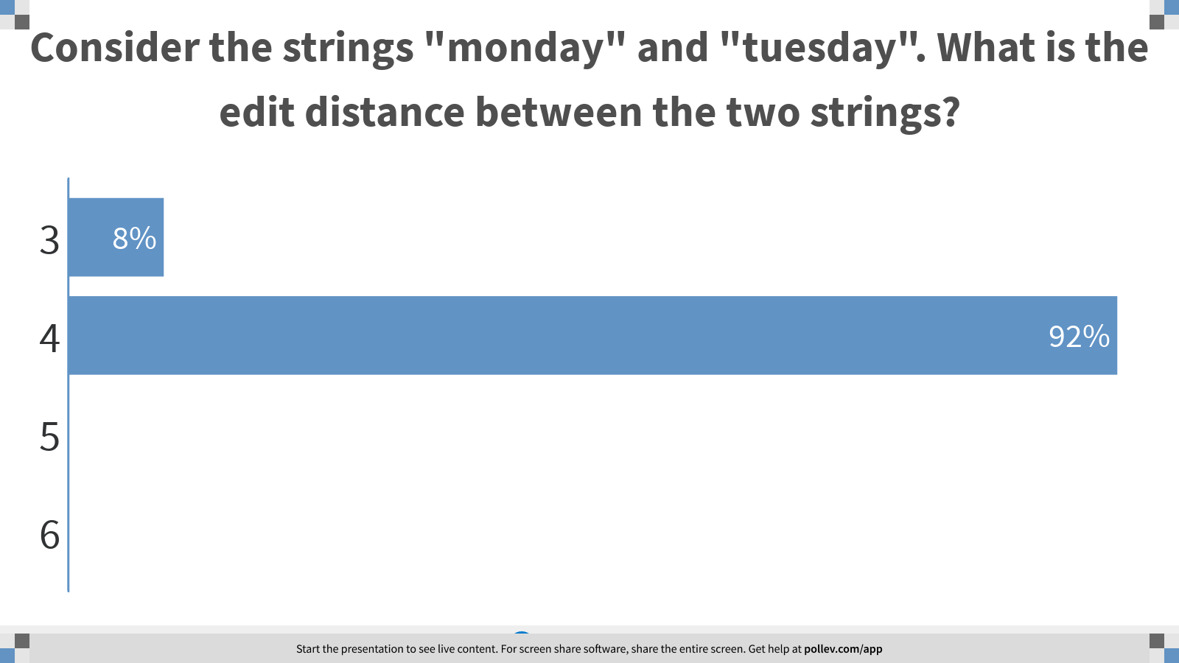
Notes:
Consider the strings "monday" and "tuesday". What is the edit distance between the two strings?
https://www.polleverywhere.com/multiple_choice_polls/0W4071yOJsLtRPCYmQGVz?display_state=chart&display=correctness&controls=none&onscreen=persist

Slide 22
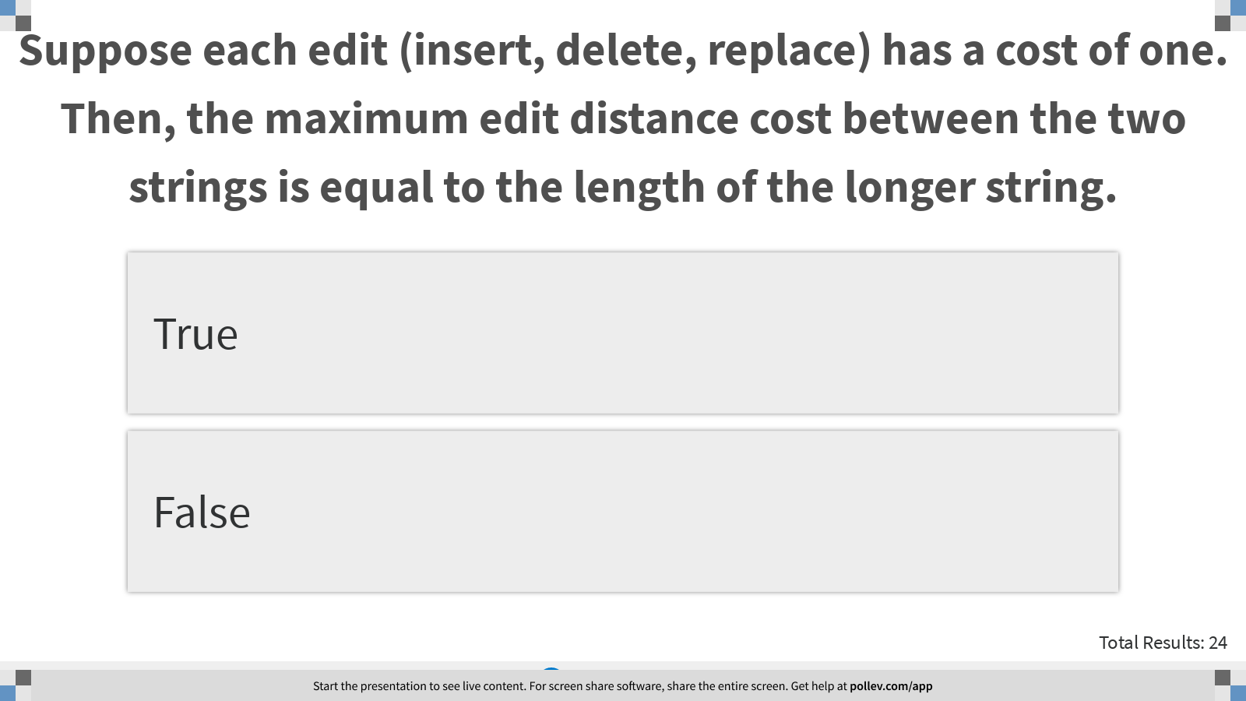
Notes:
Suppose each edit (insert, delete, replace) has a cost of one. Then, the maximum edit distance cost between the two strings is equal to the length of the longer string.
https://www.polleverywhere.com/multiple_choice_polls/lcsWnCyKH0egbzrTXEu7F?display_state=instructions&controls=none&onscreen=persist

Slide 23
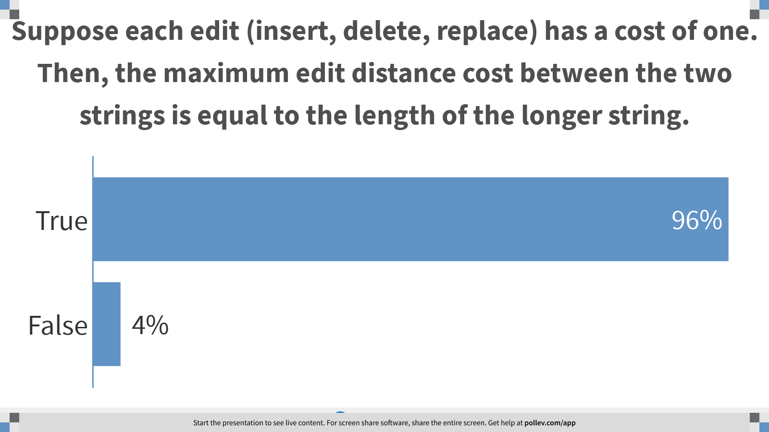
Notes:
Suppose each edit (insert, delete, replace) has a cost of one. Then, the maximum edit distance cost between the two strings is equal to the length of the longer string.
https://www.polleverywhere.com/multiple_choice_polls/lcsWnCyKH0egbzrTXEu7F?display_state=chart&display=correctness&controls=none&onscreen=persist

Slide 24
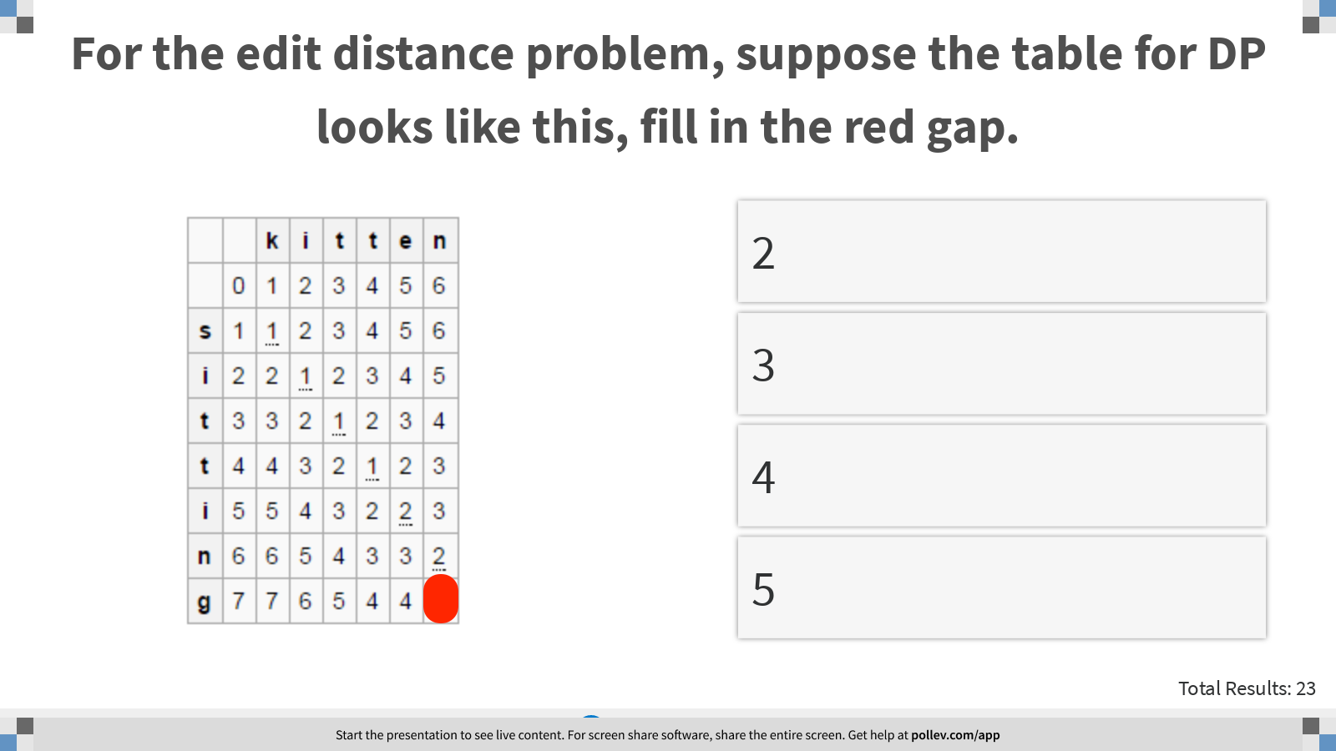
Notes:
For the edit distance problem, suppose the table for DP looks like this, fill in the red gap.
https://www.polleverywhere.com/multiple_choice_polls/7XmX1WtCqlUihdyDsXWUB?display_state=instructions&controls=none&onscreen=persist

Slide 25
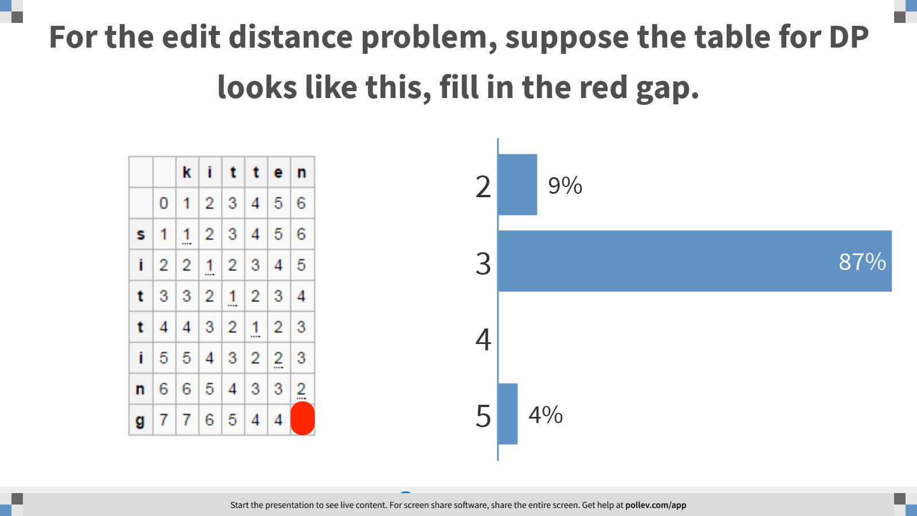
Notes:
For the edit distance problem, suppose the table for DP looks like this, fill in the red gap.
https://www.polleverywhere.com/multiple_choice_polls/7XmX1WtCqlUihdyDsXWUB?display_state=chart&display=correctness&controls=none&onscreen=persist

Slide 26
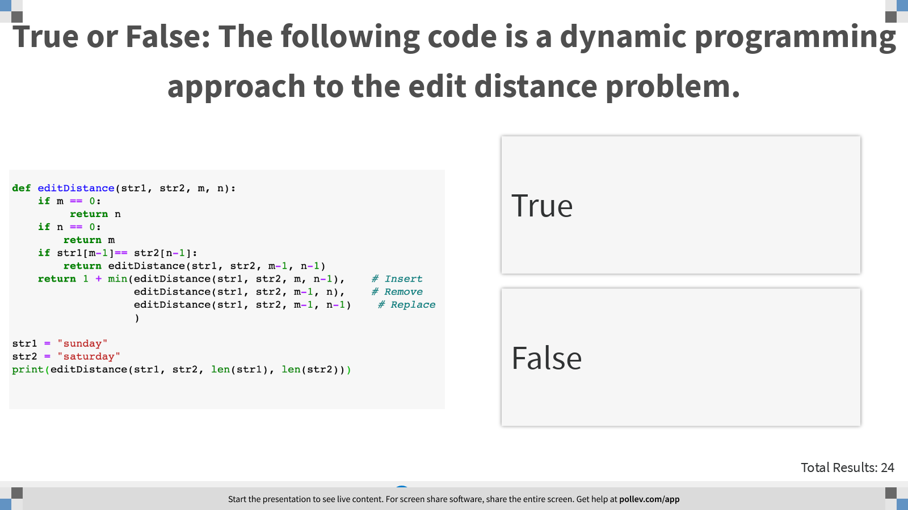
Notes:
True or False: The following code is a dynamic programming approach to the edit distance problem.
https://www.polleverywhere.com/multiple_choice_polls/imA4WpTUPKdW70fRTBHxL?display_state=instructions&controls=none&onscreen=persist

Slide 27
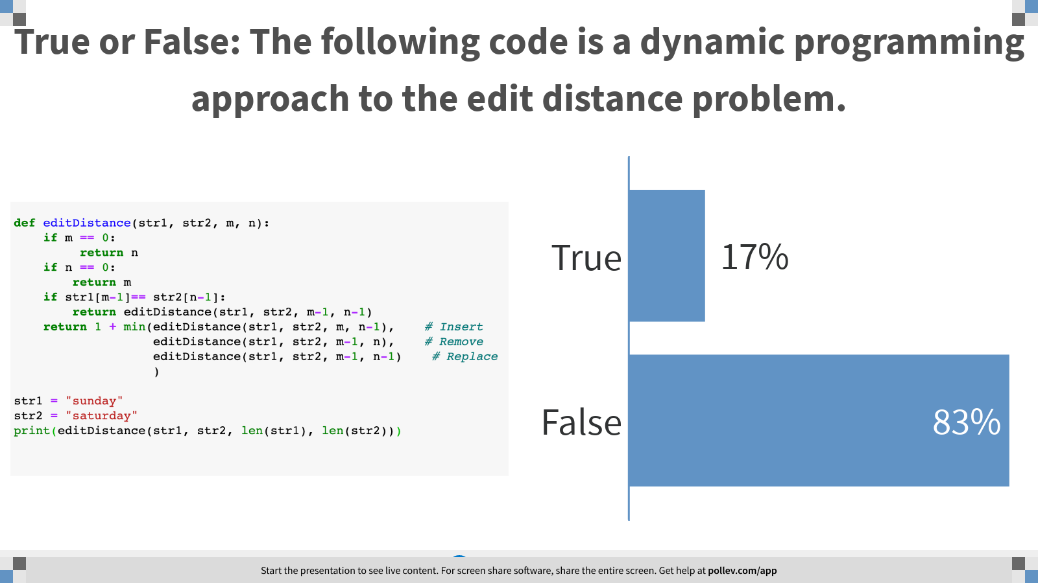
Notes:
True or False: The following code is a dynamic programming approach to the edit distance problem.
https://www.polleverywhere.com/multiple_choice_polls/imA4WpTUPKdW70fRTBHxL?display_state=chart&display=correctness&controls=none&onscreen=persist

Slide 28
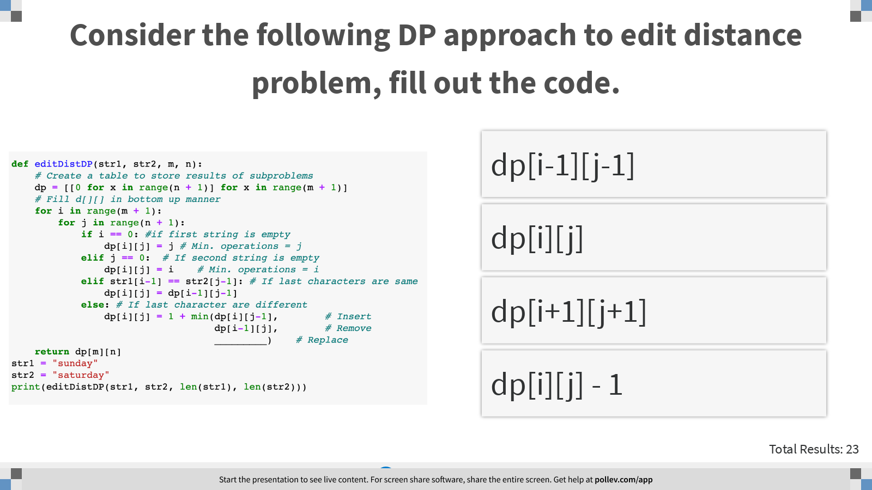
Notes:
Consider the following DP approach to edit distance problem, fill out the code.
https://www.polleverywhere.com/multiple_choice_polls/Hn49VEUJQYpXarMGvtglh?display_state=instructions&controls=none&onscreen=persist

Slide 29
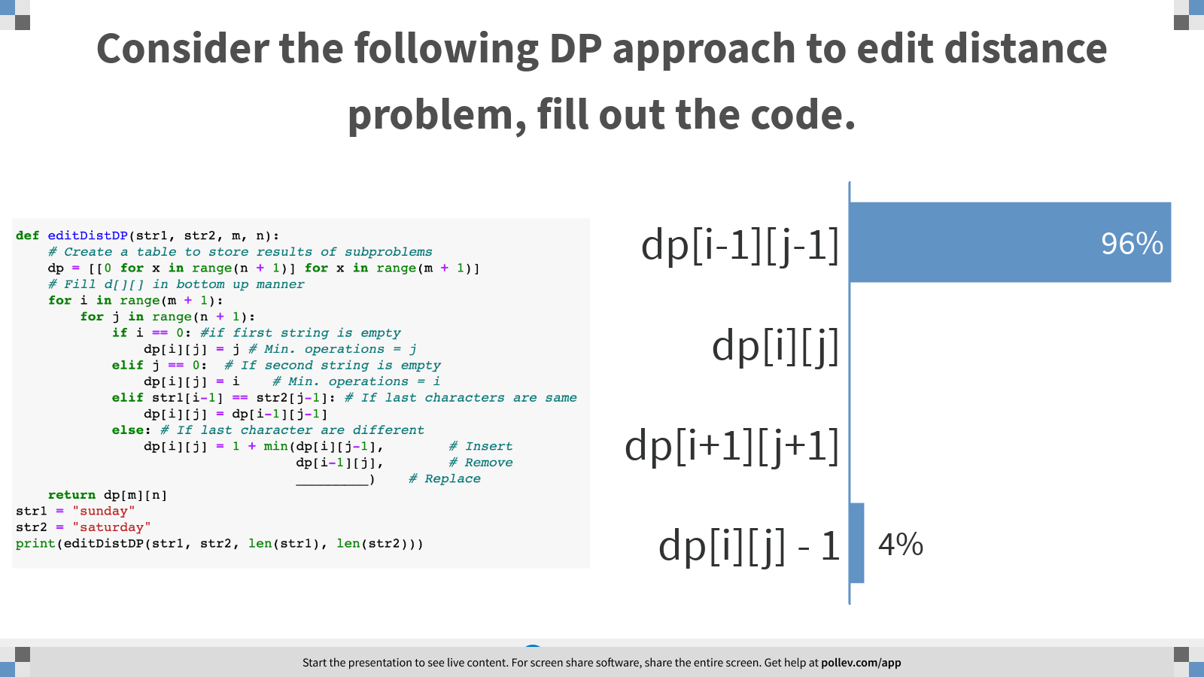
Notes:
Consider the following DP approach to edit distance problem, fill out the code.
https://www.polleverywhere.com/multiple_choice_polls/Hn49VEUJQYpXarMGvtglh?display_state=chart&display=correctness&controls=none&onscreen=persist

Slide 30
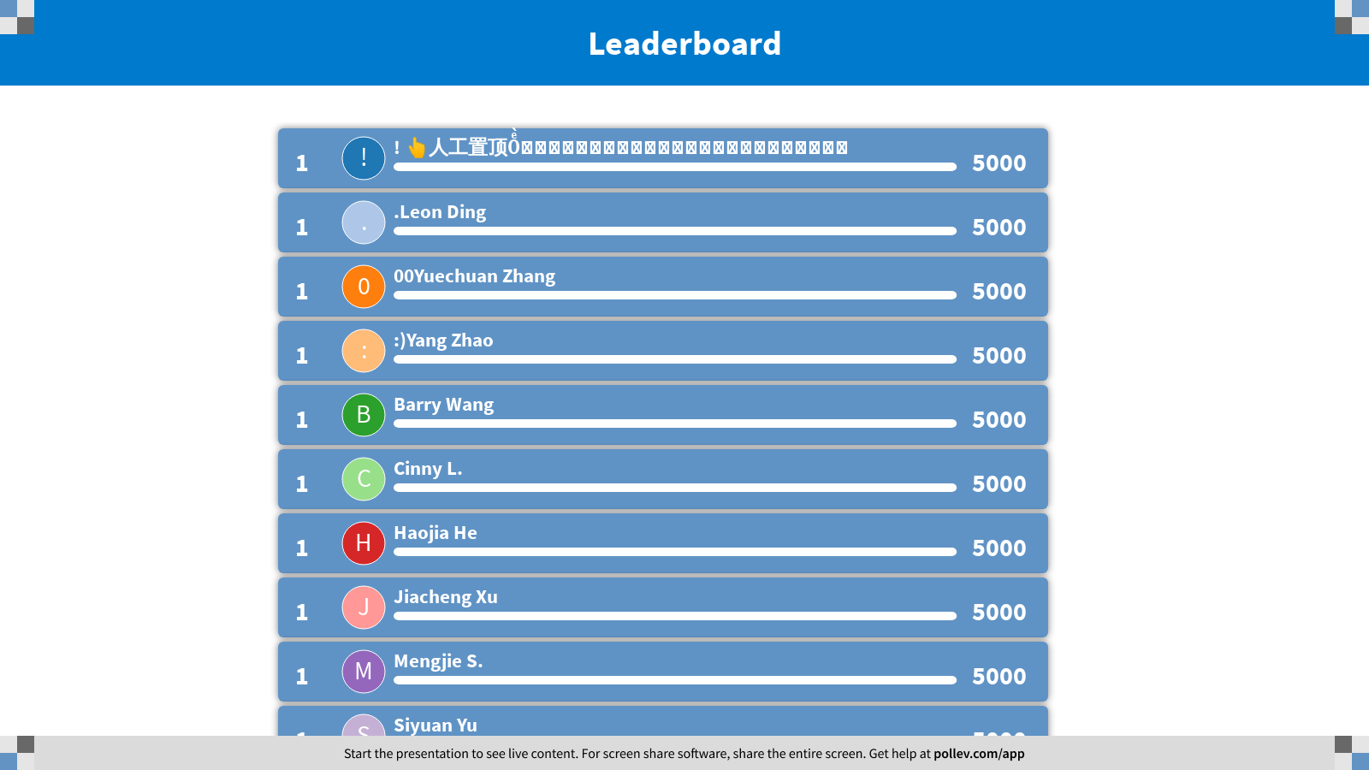
Notes:
Edit Distance
https://www.polleverywhere.com/competitions/4qWPCZkmgx5nlQsXWCjjW?display_state=finale&onscreen=persist

