Slide 1
CSCI-SHU 220: Algorithms
Midterm Review II
Fall 2020 @ NYU Shanghai

Slide 2
Part 0: Two D&C Algorithms

Slide 3
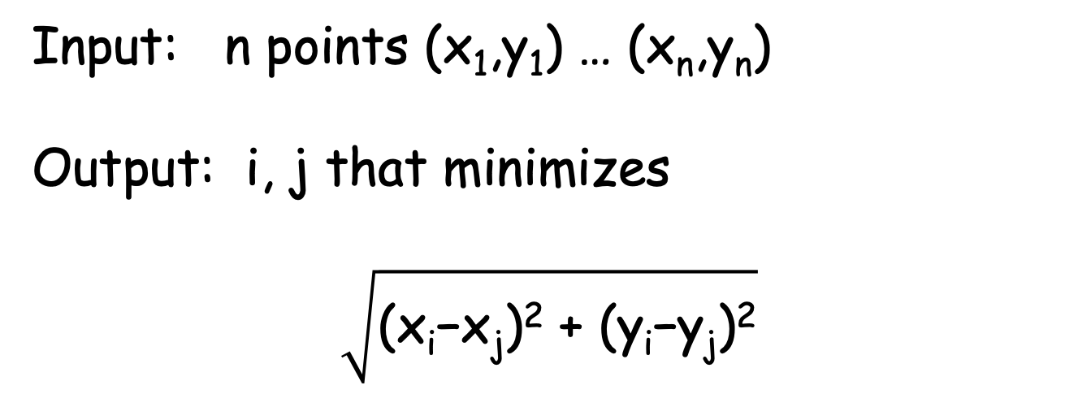
Problem 1: Closest Pair
Input: n points (x₁,y₁) … (x_{n},y_{n})
Output: i, j that minimizes
$$\sqrt{\text{(}\text{xi}\text{−}\text{xj}\text{)}\text{2} \text{+} \text{(}\text{yi}\text{−}\text{yj}\text{)}\text{2}}$$
The Naïve Solution: O(n²)

Slide 4



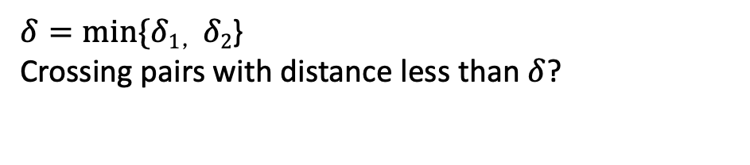

Divide and Conquer
x
x
$$δ$$
$$δ$$
x
Divide
x
$$δ1$$
x
x
$$δ2$$
Conquer
x
x
For each point
x
x
Check 11 points above it (with a larger y value)
x
Combine
$δ=min⁡\{δ1，δ2$}
Crossing pairs with distance less than $δ$?

Slide 5
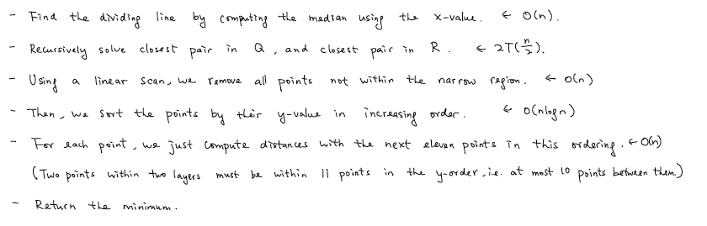
The Algorithm
*The sorting (4-th step) can be done just once (outside of the recursion)
** The algorithm implicitly assumes that x-values are distinct.

Slide 6
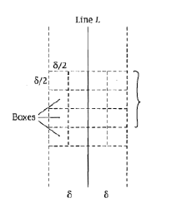


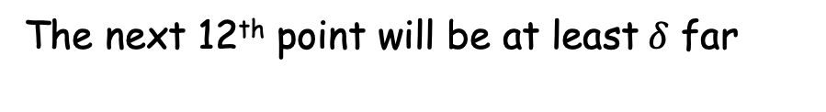
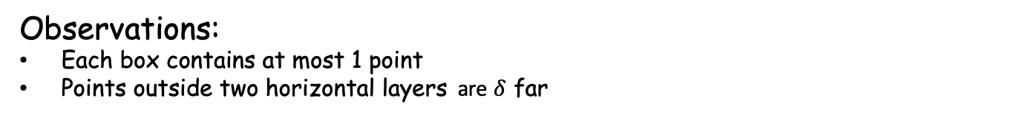
Why Only Next 11 Points?
The next 12th point will be at least$δ$ far
Observations:
Each box contains at most 1 point
Points outside two horizontal layers are $δ$ far
x
x
x
x
x
x
x
x
x
x
x
At most next 11 points are within distance$δ$
(overchecking simplifies the algorithm)

Slide 7
Problem 2: k-th smallest number
Input: n distinct numbers a₁,…,a_{n} and k
Output: return the k-th smallest number
A special case: Finding median (k=n/2)

Slide 8
Divide and Conquer
k-th smallest number?
Divide:
find a pivot a_{i}
partition
a₁, …, a_{n}
k-th smallest number?
(k-r)-th smallest number?
Conquer:
if r=k, done
if r>k
if r<k
< a_{i}
a_{i}
> a_{i}
a_{i} is the r-th smallest number

Slide 9
The Algorithm
Find-Number(S,k) //return the k-th smallest number in S
//the base case
if |S| <=5, return the k-th smallest number by brute force
//divide: find the pivot (median of medians) and partition
partition S into groups of size 5
compute median of each group, forming S’
v = Find-Number(S’, |S’|/2)
r=|A<|+1
A>={a_{i} : i> v }
A< ={a_{i}: i < v }
partition S\{v}
//conquer (& combine)
if r=k, return v
if r>k, return Find-Number(A<, k)
if r<k, return Find-Number(A>, k-r)

Slide 10
Why Median of Medians?
Time complexity:
T(n) <= T(n/5) + max{T(r-1), T(n-r)} + O(n)
Median of Medians: 3n/10 <= r <= 7n/10
Overall: T(n) <= T(n/5) + T(7n/10) + O(n)
Solve recurrence (substitution method): T(n) = O(n)

Slide 11
Part I: Sorting

Slide 12
List of Sorting Algorithms
Insertion sort
Merge sort
Quick sort
Heapsort
Counting sort
Bucket sort

Slide 13
About Sorting Algorithms
Which algorithms
are based on divide and conquer?
are based on data structures?
are fast for small instance size?
are comparison based?
cannot run in linear time in the worst case?
are counting inversions based on?
are in place?

Slide 14
About Heap
What is a heap?
How to use an array to implement a heap?
How many types of heap do we have?
What are basic operations for a heap?
How much time do they take?
When do we use heap?

Slide 15
Part II: Greedy Algorithm

Slide 16
List of Problems
Interval Scheduling
Interval Coloring
Minimize Total Completion Time
Minimize Maximal Lateness
Huffman Coding

Slide 17
Coming Up with the Greedy Strategies
Propose Candidate Strategies
Test Them by Small Cases
Try to Prove Correctness

Slide 18
Greedy Strategies For Following Problems?
There are n customers, requiring time t_{1,} t_{2,…,}t_{n.} Design an ordering to minimize the total waiting time*.
There are 3 type of coins 10,5,1. Given a positive
integer P, use as few coins as possible to represent P.
*the same greedy strategy may not work for other set of coins. E.g. {30,25,10,5,1} and P=50

Slide 19
Techniques For Proving Correctness
Greedy Stays Ahead
Label your algorithm’s partial solution, and a general solution
Find a measure
Prove greedy stays ahead
Prove optimality
Exchange Argument
Define solutions: X (your algorithm) and X* (optimal).
Compare solutions: X and X* differ in some way.
Exchange pieces: transform X* into a different optimal solution.
Iterate: transform X* into X by iteration.
(more details can be founded here)

Slide 20
Greedy Stays Ahead: Interval Scheduling
Label your algorithm’s partial solution, and a general solution:
greedy algorithm’s solution: A={i₁,…,i_{k}} (in the order in which they were added)
an optimal solution: O={j₁,…,j_{m}} (ordered by finish time)
Find a measure f():
f(S): the last finish time of jobs in a set S
Prove greedy stays ahead:
(base case) f(i₁) <= f(j₁)
(by induction) f(i₁,…,i_{t}) <= f(j₁,…,j_{t}) for any t<=k
Prove optimality:
If A is not optimal, then must be the case m>k, so there exists j_{k+1} in O but not in A
But j_{k+1} But would have be compatible with all the jobs in A,
and so our greedy algorithm would have added it into A. Contradiction.
(written details can be founded here)

Slide 21
Problem 1: Huffman Coding
Given symbols with frequencies
f_{a} =0.1, f_{b}=0.1, f_{c} = 0.1, f_{d}= 0.2, f_{e}= 0.2, f_{f}= 0.3
What’s the optimal prefix code?
The corresponding minimal average length of encoding?
Optimal prefix code over {0,1,2}?
(see ternary Huffman code)

Slide 22
Summary
Sorting
(algorithms, heap)
Greedy Algorithms
(exchange argument, staying ahead, Huffman coding)

Slide 23
More Details in the Reference Book
Sorting [CLRS] Chapter 6-8
Greedy [KT] Chapter 4

