Slide 1
Graphs
1843
ORD
SFO
802
337
1743
LAX
1233
DFW
Graphs
Notes:
Graphs

Slide 2
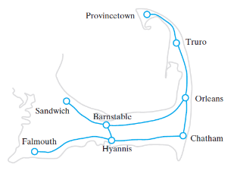
Graphs
A road map is a graph
Definition of a graph
  A collection of distinct vertices and distinct edges
In the map below
  The circles are vertices (or nodes)
  The lines are called edges
A subgraph is a portion of a graph that is itself a graph

Slide 3
Graphs
A graph is a pair (V, E), where
  V is a set of nodes, called vertices
  E is a collection of pairs of vertices, called edges
  Vertices and edges are positions and store elements
Example:
  A vertex represents an airport and stores the three-letter airport code
  An edge represents a flight route between two airports and stores the mileage of the route
849
PVD
1843
ORD
142
SFO
802
LGA
337
1743
1387
HNL
2555
1099
LAX
1233
DFW
1120
MIA
Graphs

Slide 4
Edge Types
Directed edge
  ordered pair of vertices (u,v)
  first vertex u is the origin
  second vertex v is the destination
  e.g., a flight
Undirected edge
  unordered pair of vertices (u,v)
  e.g., a flight route
Directed graph
  all the edges are directed
  e.g., route network
Undirected graph
  all the edges are undirected
  e.g., flight network
flight
AA 1206
ORD
PVD
849
miles
ORD
PVD
Graphs

Slide 5
Graph Types
There are two kinds of graphs:
  directed graphs (sometimes called digraphs)
  undirected graphs
start
60
Birmingham
Rugby
fill pan
with water
take egg
from fridge
150
190
100
140
Cambridge
London
190
120
add salt
to water
break egg
into pan
Bristol
110
Dover
boil
water
Southhampton
A directed graph
An undirected graph

Slide 6
Graph applications
Graphs can be used for:
  Finding a route from one city to another (eg. connecting flights)
  Determining least-cost highway connections
  Designing optimal connections on a computer chip
  Implementing automata, compilers, ...
  Doing garbage collection
  Representing family histories
  Doing similarity testing (e.g. for a dating service)
  Playing games
  And many more things...

Slide 7
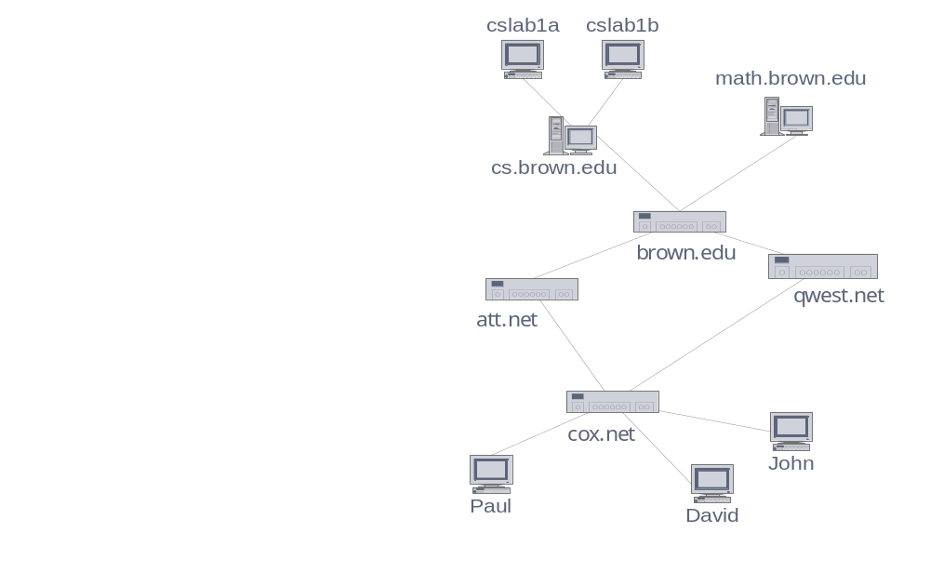
More Applications
Electronic circuits
  Printed circuit board
  Integrated circuit
Transportation networks
  Highway network
  Flight network
Computer networks
  Local area network
  Internet
  Web
Databases
  Entity-relationship diagram
Graphs

Slide 8
Terminology I
A graph is a collection of vertices (or nodes, singular is vertex) and edges (or arcs)
  Each node contains an element
  Each edge connects two nodes together (or possibly the same node to itself) and may contain an edge attribute
A directed graph is one in which the edges have a direction
An undirected graph is one in which the edges do not have a direction
  Note: Whether a graph is directed or undirected is a logical distinction—it describes how we think about the graph
  Depending on the implementation, we may or may not be able to follow a directed edge in the “backwards” direction

Slide 9
Terminology II
The size of a graph is the number of nodes in it
The empty graph has size zero (no nodes)
If two nodes are connected by an edge, they are neighbors (and the nodes are adjacent to each other)
The degree of a node is the number of edges it has

Slide 10
Terminology III
For directed graphs,
  If a directed edge goes from node S to node D,
    we call S the source/origin and D the destination of the edge
    The edge is an out-edge of S and an in-edge of D
    S is a predecessor of D, and D is a successor of S
  The in-degree of a node is the number of in-edges it has
  The out-degree of a node is the number of out-edges it has

Slide 11
Terminology IV
End vertices (or endpoints) of an edge
  U and V are the endpoints of a
Edges incident on a vertex
  a, d, and b are incident on V
Adjacent vertices
  U and V are adjacent
Degree of a vertex
  X has degree 5
Parallel edges
  h and i are parallel edges
Self-loop
  j is a self-loop
V
a
b
h
j
U
d
X
Z
c
e
i
W
g
f
Y
Graphs

Slide 12
Terminology V
Path
  sequence of alternating vertices and edges
  begins with a vertex
  ends with a vertex
  each edge is preceded and followed by its endpoints
Simple path
  path such that all its vertices and edges are distinct
Examples
  P₁=(V,b,X,h,Z) is a simple path
  P₂=(U,c,W,e,X,g,Y,f,W,d,V) is a path that is not simple
V
a
b
P₁
d
U
X
Z
P₂
h
c
e
W
g
f
Y
Graphs

Slide 13
Terminology VI
Cycle
  circular sequence of alternating vertices and edges
  each edge is preceded and followed by its endpoints
Simple cycle
  cycle such that all its vertices and edges are distinct
Examples
  C₁=(V,b,X,g,Y,f,W,c,U,a,↵) is a simple cycle
  C₂=(U,c,W,e,X,g,Y,f,W,d,V,a,↵) is a cycle that is not simple
V
a
b
d
U
X
Z
C₂
h
e
C₁
c
W
g
f
Y
Graphs

Slide 14
Terminology VII
An undirected graph is connected if there is a path from every node to every other node
A directed graph is strongly connected if there is a path from every node to every other node
A directed graph is weakly connected if the underlying undirected graph is connected
Node X is reachable from node Y if there is a path from Y to X
A subset of the nodes of the graph is a connected component (or just a component) if there is a path from every node in the subset to every other node in the subset

Slide 15
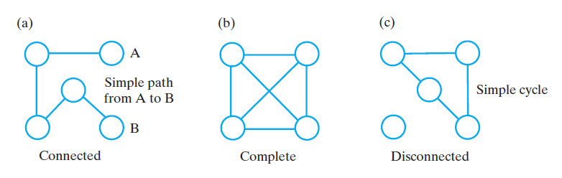
Connectivity in Undirected Graphs

Slide 16
Properties
Property 1
  Σ_{v} deg(v) = 2m
  Proof: each edge is counted twice
Property 2
  In an undirected graph with no self-loops and no multiple edges
  m ≤ n (n − 1)/2
  Proof: each vertex has degree at most (n − 1)
What is the bound for a directed graph?
Notation
  n number of vertices
  m number of edges
  deg(v) degree of vertex v
Example
  n = 4
  m = 6
  deg(v) = 3
Graphs

Slide 17
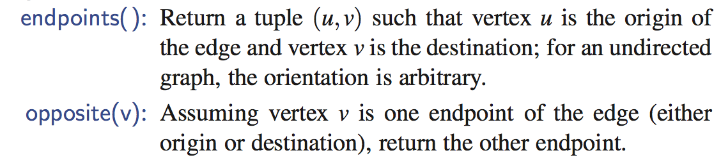
Vertices and Edges
A graph is a collection of vertices and edges.
We model the abstraction as a combination of three data types: Vertex, Edge, and Graph.
A Vertex is a lightweight object that stores an arbitrary element provided by the user (e.g., an airport code)
  We assume it supports a method, element(), to retrieve the stored element.
An Edge stores an associated object (e.g., a flight number, travel distance, cost), retrieved with the element( ) method.
In addition, we assume that an Edge supports the following methods:
Graphs

Slide 18
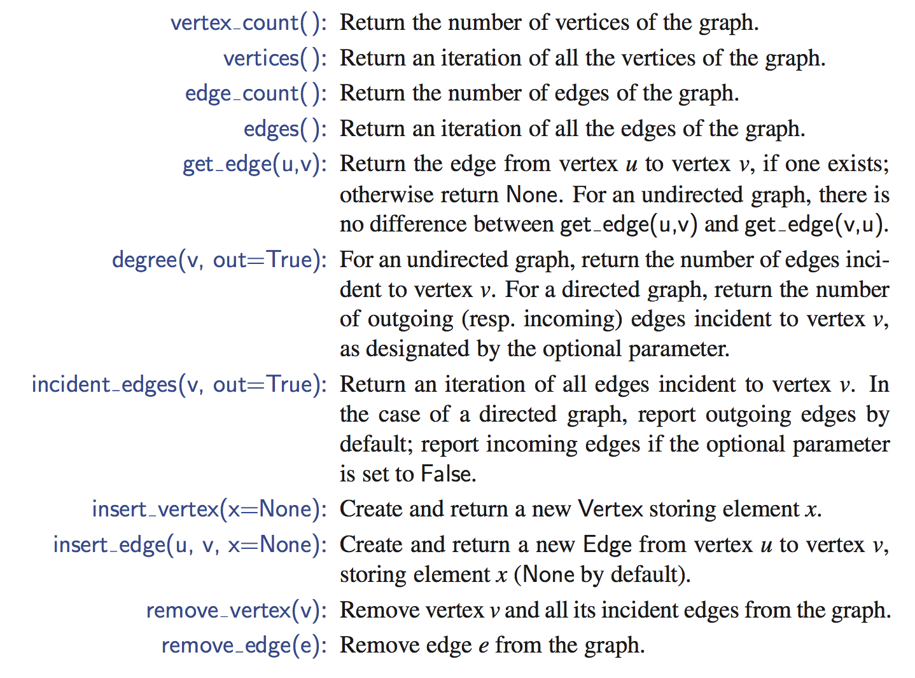
Graph ADT
Graphs

Slide 19
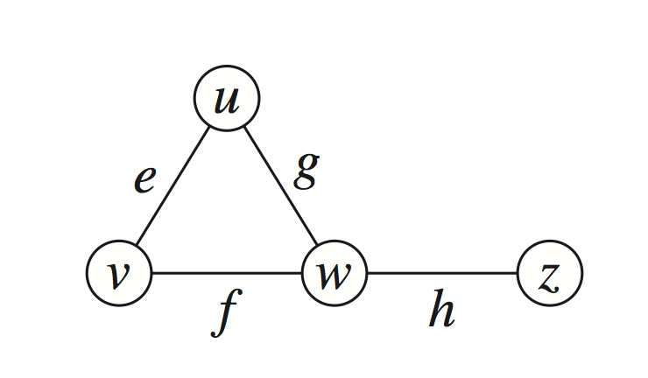
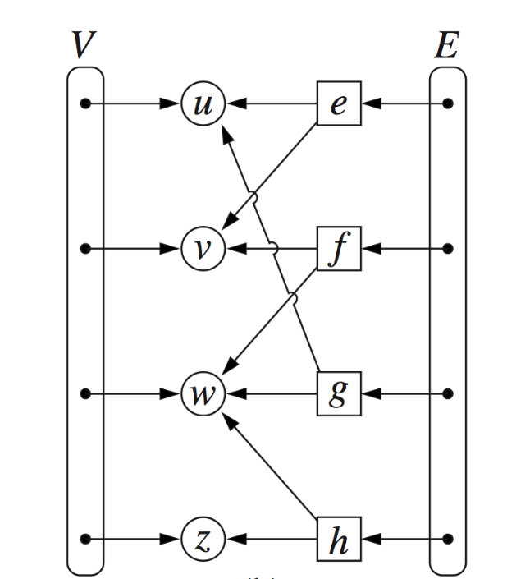
Edge List Structure
(Just for reference, you can skip)
Vertex object
  element
  reference to position in vertex sequence
Edge object
  element
  origin vertex object
  destination vertex object
  reference to position in edge sequence
Vertex sequence
  sequence of vertex objects
Edge sequence
  sequence of edge objects
Graphs

Slide 20
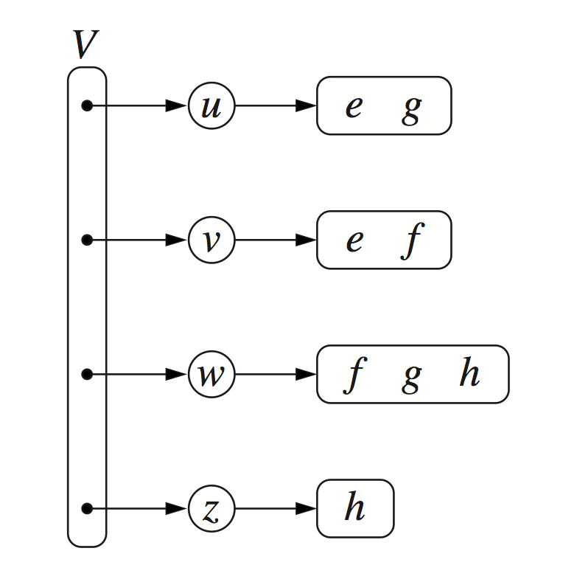
Adjacency List Structure
Incidence sequence for each vertex
  sequence of references to edge objects of incident edges
Augmented edge objects
  references to associated positions in incidence sequences of end vertices
Graphs

Slide 21
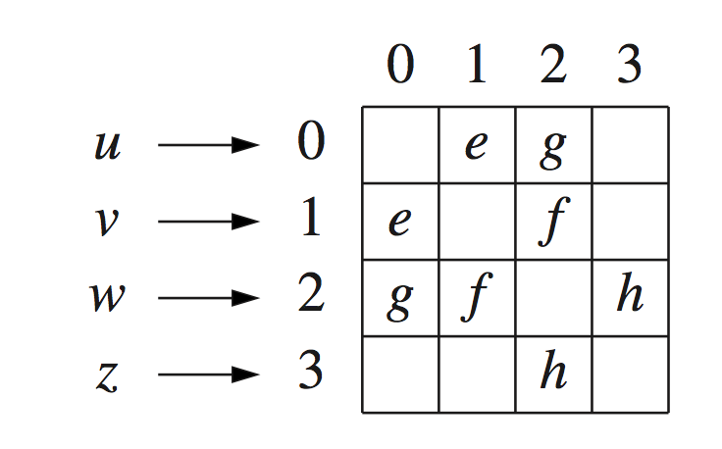
Adjacency Matrix Structure
(will be used for some coding problems)
Edge list structure
Augmented vertex objects
  Integer key (index) associated with vertex
2D-array adjacency array
  Reference to edge object for adjacent vertices
  Null for non nonadjacent vertices
The “old fashioned” version just has 0 for no edge and 1 for edge
Graphs

Slide 22
Performance
n vertices, m edges no parallel edges no self-loops | Edge List | Adjacency List | Adjacency Matrix
Space | n + m | n + m | n²
incidentEdges(v) | m | deg(v) | n
areAdjacent (v, w) | m | min(deg(v), deg(w)) | 1
insertVertex(o) | 1 | 1 | n²
insertEdge(v, w, o) | 1 | 1 | 1
removeVertex(v) | m | deg(v) | n²
removeEdge(e) | 1 | 1 | 1
Graphs

Slide 23
Python Graph Implementation
We use a variant of the adjacency map representation.
For each vertex v, we use a Python dictionary to represent the secondary incidence map I(v).
The list V is replaced by a top-level dictionary D that maps each vertex v to its incidence map I(v).
  Note that we can iterate through all vertices by generating the set of keys for dictionary D.
A vertex does not need to explicitly maintain a reference to its position in D, because it can be determined in O(1) expected time.
Running time bounds for the adjacency-list graph ADT operations, given above, become expected bounds.
Graphs

Slide 24
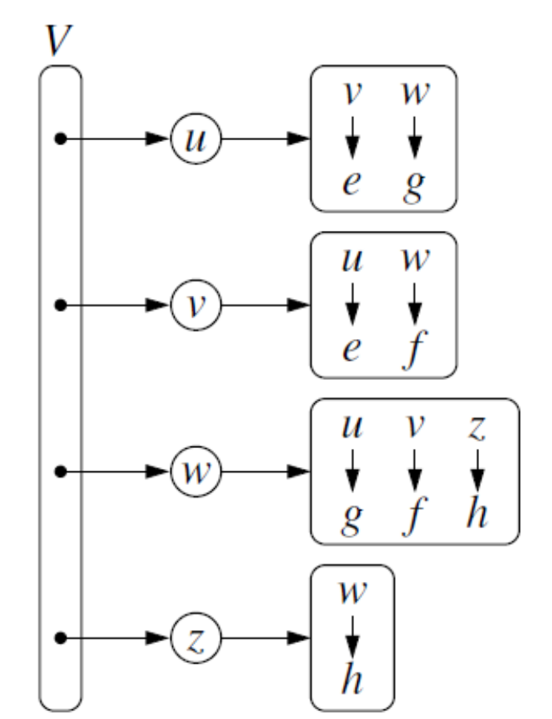
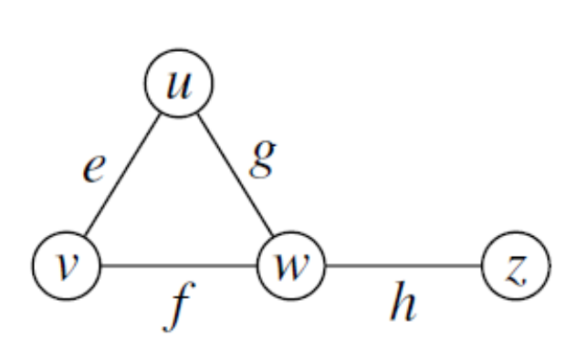
Adjacency Map Structure
(will be used for coding problems/examples)
Graphs

Slide 25
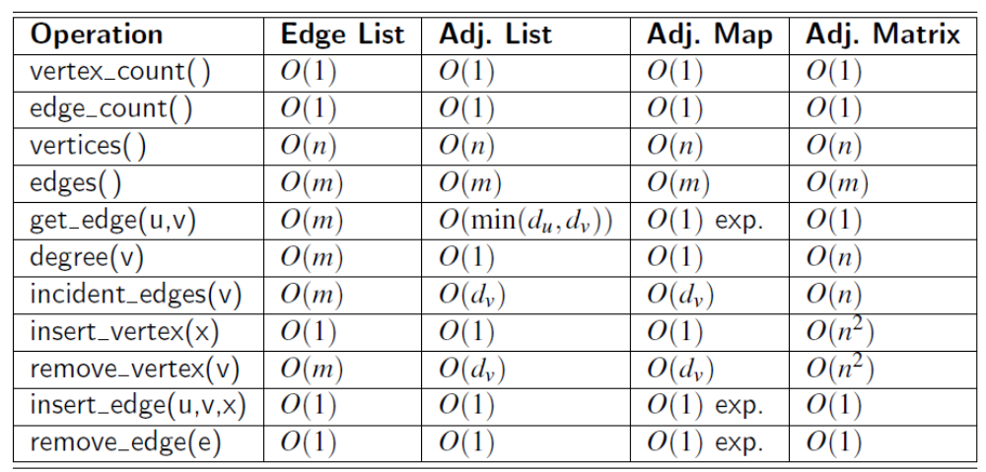
Summary of Running Times of Different Graph Representations
Graphs

Slide 26
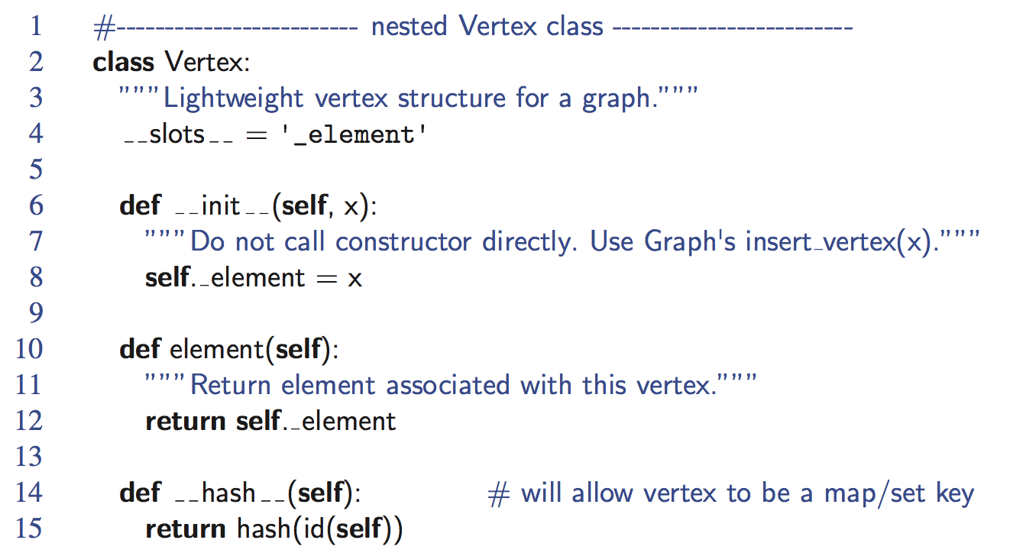
Vertex Class
Graphs

Slide 27
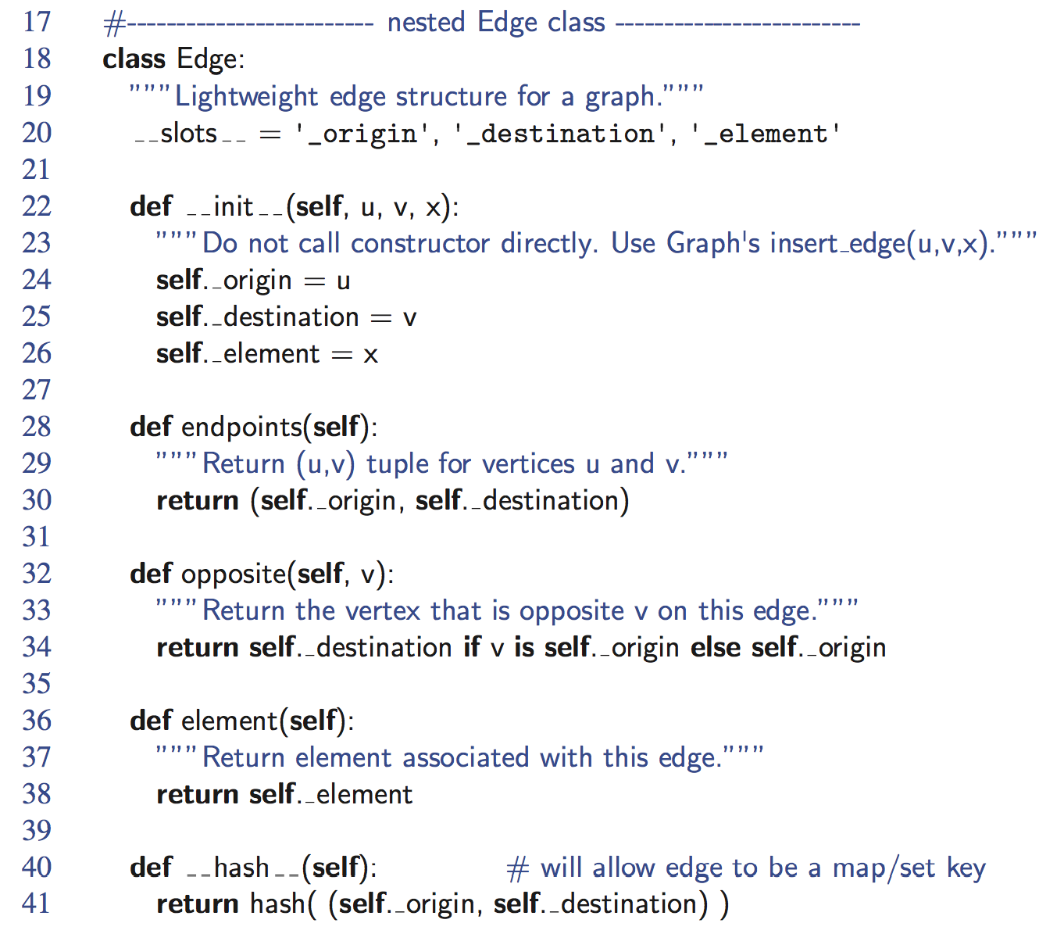
Edge Class
Graphs

Slide 28
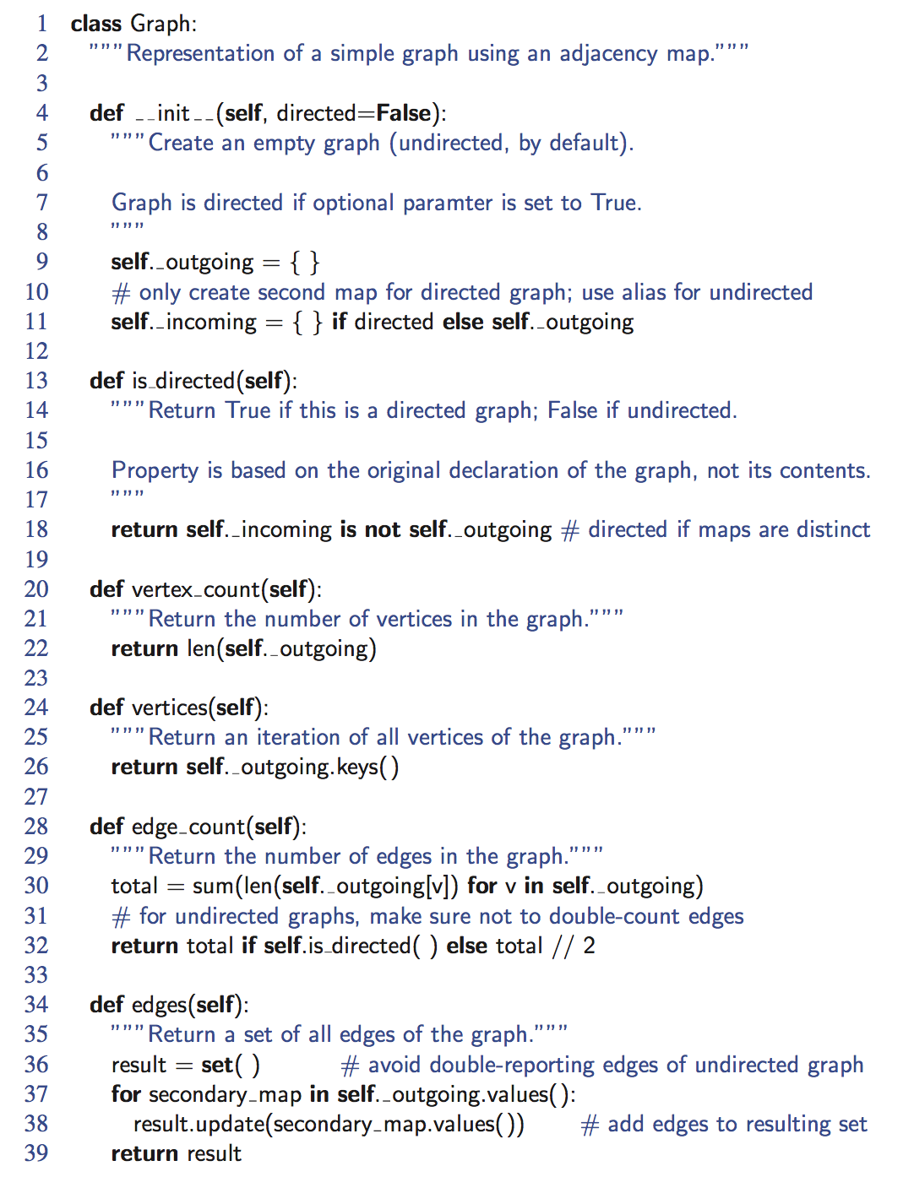
Graph,
Part 1
Graphs

Slide 29
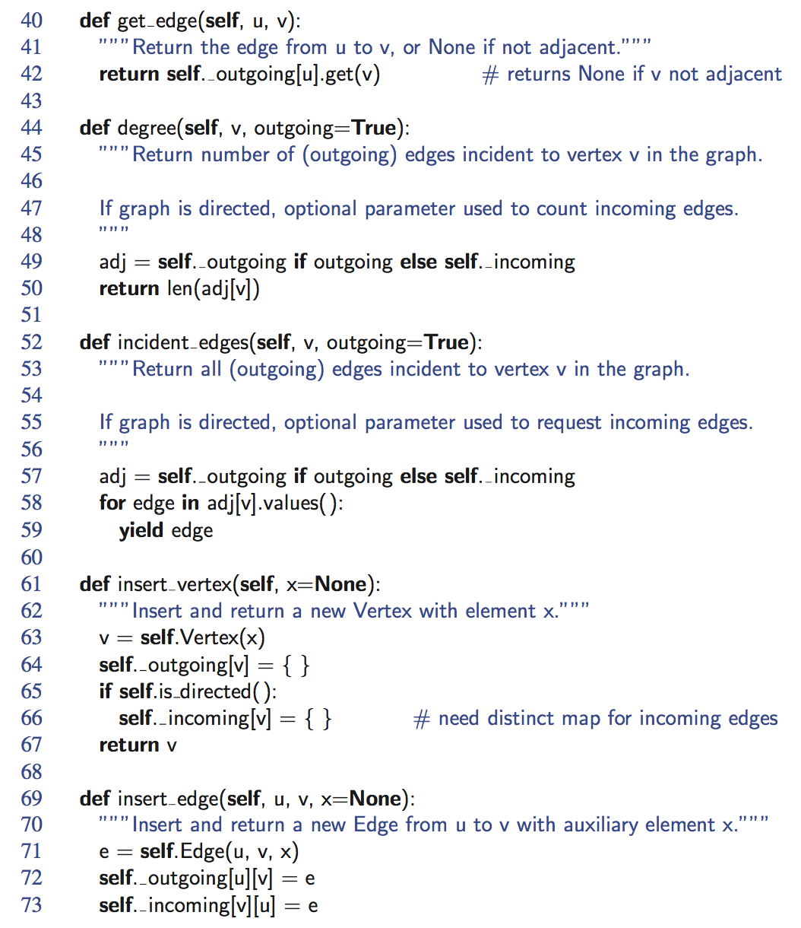
Graph, end
Graphs

