Slide 1

Maps and Dictionaries
© 2013 Goodrich, Tamassia, Goldwasser
Maps and Dictionaries
Notes:
Dictionaries

Slide 2

Maps
A map is a searchable collection of items that are key-value pairs
The main operations of a map are for searching, inserting, and deleting items
Multiple items with the same key are not allowed
Applications:
  address book
  student-record database
© 2013 Goodrich, Tamassia, Goldwasser
Maps and Dictionaries

Slide 3
Dictionaries
Python’s dict class is arguably the most significant data structure in the language.
  It represents an abstraction known as a dictionary in which unique keys are mapped to associated values.
Here, we use the term “dictionary” when specifically discussing Python’s dict class, and the term “map” when discussing the more general notion of the abstract data type.
© 2013 Goodrich, Tamassia, Goldwasser
Maps and Dictionaries

Slide 4
Definition of a Dictionary
A dictionary, in computer science, implies a container that stores key-element pairs called items, and allows for quick retrieval.
  Items must be stored in a way that allows them to be located with the key
  Not necessary to store the items in order
    Unordered dictionary
    Ordered dictionary
  Synonyms for Dictionary ADT
      Map, Table, Associative array

Slide 5
Applications
When you want to look up information
  The meaning of a word
  An address
  A phone number
  A contact on your phone

Slide 6
Dictionary Examples
Natural language dictionary
  word is key
  element contains word, definition, pronunciation, etc.
Web pages
  URL is key
  html or other file is element
Any typical database (e.g. student record)
  has one or more search keys
  each key may require own organizational dictionary

Slide 7
Dictionary ADT Specifications
An entry contains
  Search key
  Value
Data
  Collection of pairs (k, v) of objects k and v,
    k is the search key
    v is the corresponding value
  The number of pairs in the collection

Slide 8
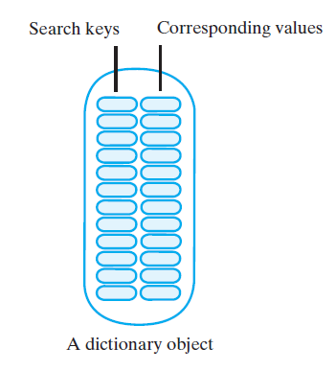
Anatomy of a Dictionary

Slide 9

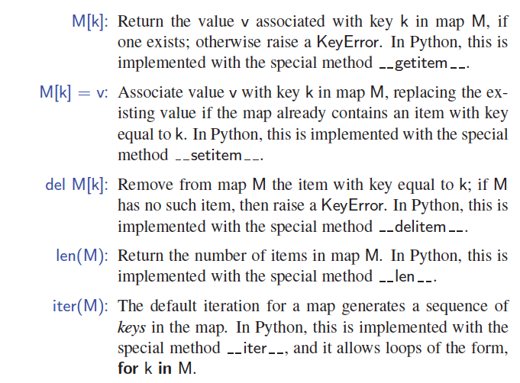
The Map ADT
(Using dict Syntax)
© 2013 Goodrich, Tamassia, Goldwasser
Maps and Dictionaries

Slide 10
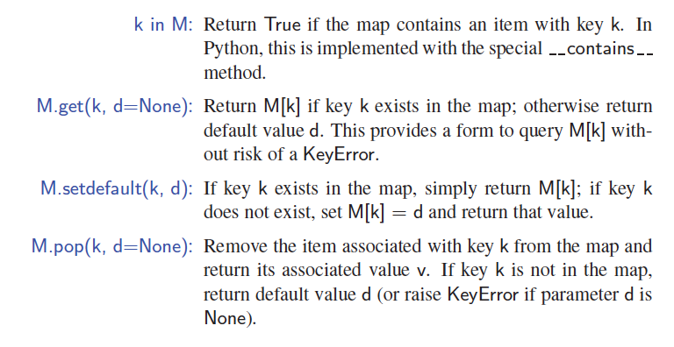
More Map Operations
© 2013 Goodrich, Tamassia, Goldwasser
Maps and Dictionaries

Slide 11
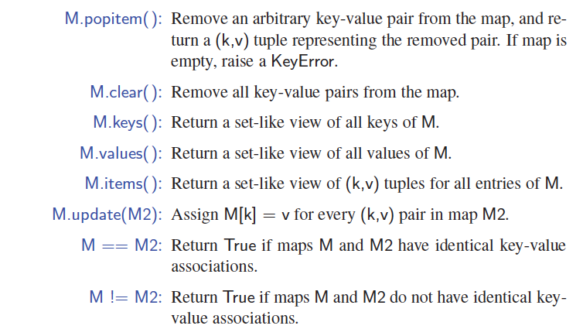
A Few More Map Operations
© 2013 Goodrich, Tamassia, Goldwasser
Maps and Dictionaries

Slide 12
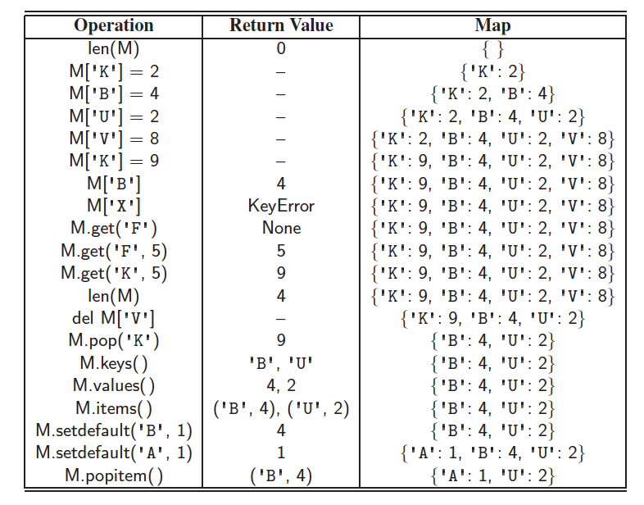
Example
© 2013 Goodrich, Tamassia, Goldwasser
Maps and Dictionaries

Slide 13
Coding: count word frequency
Consider the problem of counting the number of occurrences of words in a document.
Output the highest frequency word and number of times it appeared in the document.
Download word_frequency_students.py and inputtext2.txt file.
Write your code in word_frequency_students.py file.
© 2013 Goodrich, Tamassia, Goldwasser
Maps and Dictionaries
Notes:
Dictionaries

Slide 14
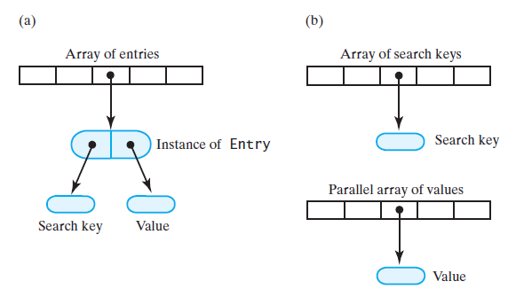
Array-Based Implementations

Slide 15
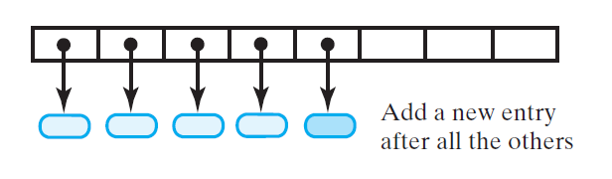
Array-Based – Entry Insertions

Slide 16
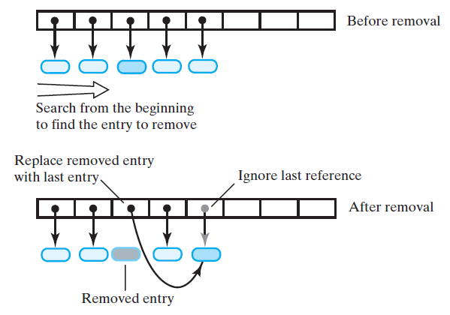
Array-Based – Entry Removals
Problem: empty index
Solution 1: Accept empty entries during traversal
Solution 2: Swap references

Slide 17
A Simple List-Based Map
We can efficiently implement a map using an unsorted list
  We store the items of the map in a list S (based on a doubly-linked list), in arbitrary order
header
nodes/positions
trailer
9
c
6
c
5
c
8
c
Items (key-value pairs)
© 2013 Goodrich, Tamassia, Goldwasser
Maps and Dictionaries

Slide 18
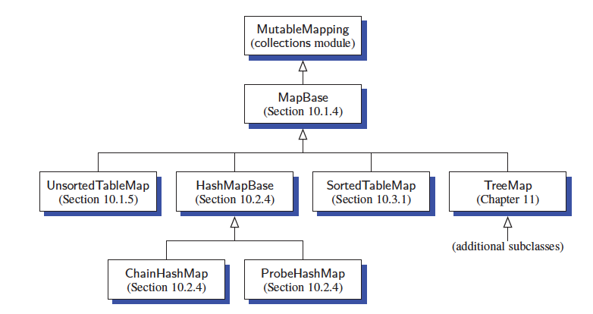
Our MapBase Class
© 2013 Goodrich, Tamassia, Goldwasser
Maps and Dictionaries

Slide 19
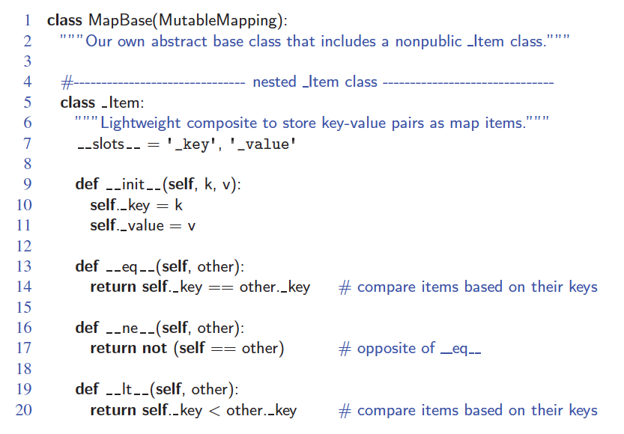
The MapBase Abstract Class
© 2013 Goodrich, Tamassia, Goldwasser
Maps and Dictionaries

Slide 20
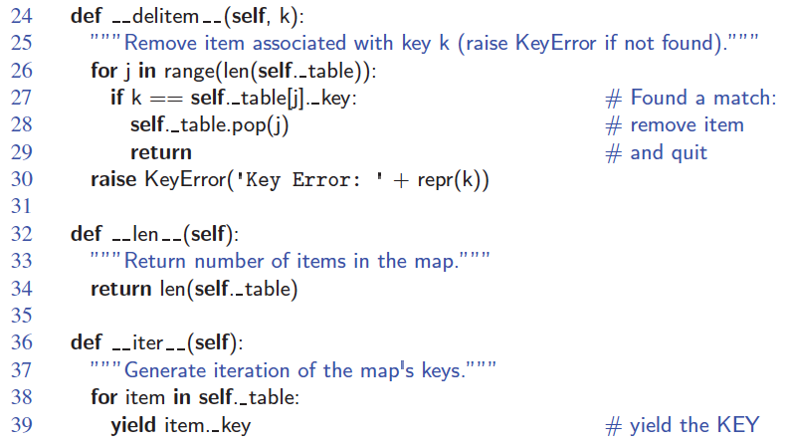
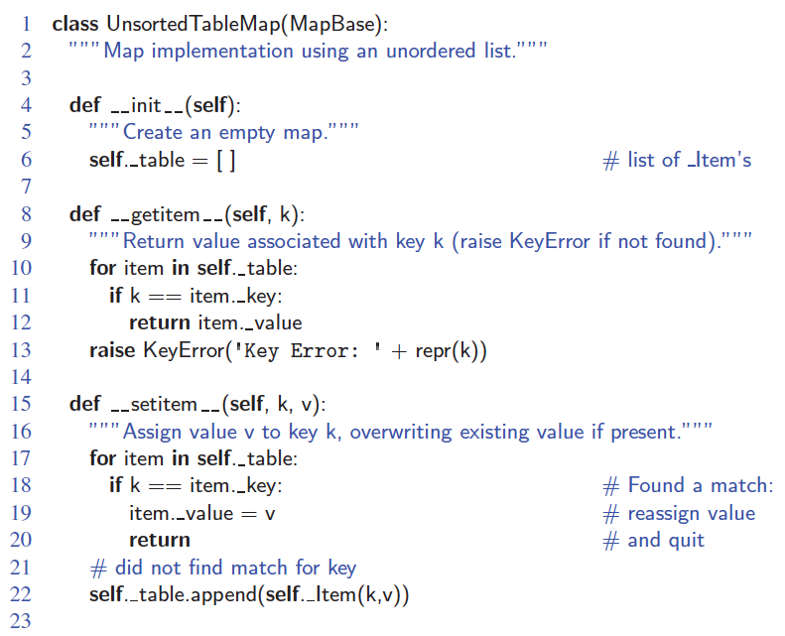
An Unsorted List Implementation
© 2013 Goodrich, Tamassia, Goldwasser
Maps and Dictionaries

Slide 21
Performance of a List-Based Map
Performance:
  Inserting an item takes O(1) time since we can insert the new item at the beginning or at the end of the unsorted list
  Searching for or removing an item takes O(n) time, since in the worst case (the item is not found) we traverse the entire listto look for an item with the given key
The unsorted list implementation is effective only for maps of small size or for maps in which insertions are the most common operations, while searches and removals are rarely performed (e.g., historical record of logins to a workstation)
© 2013 Goodrich, Tamassia, Goldwasser
Maps and Dictionaries

