Slide 1
AVL Trees
6
v
3
8
z
4
AVL Trees
Notes:
Red-Black Trees

Slide 2
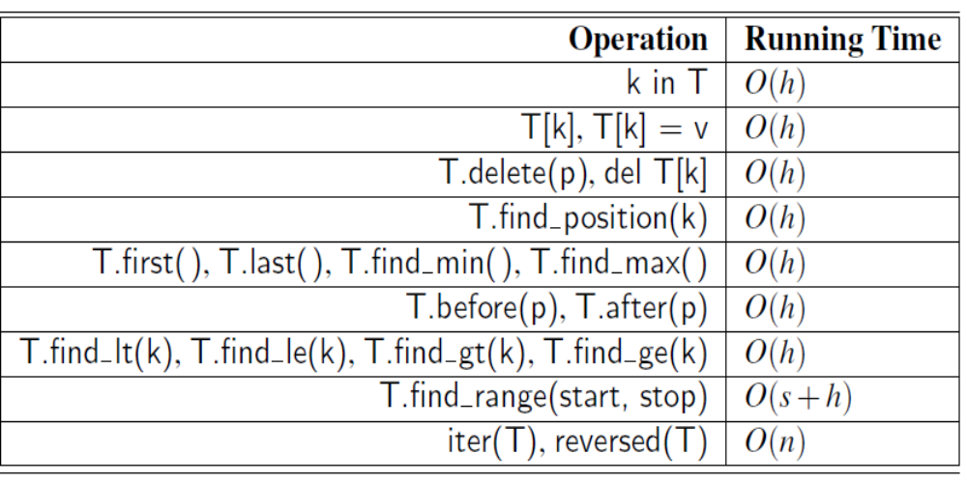
Performance of BST
Space usage is O(n), where n is the number of items
stored in the map.
AVL Trees
Notes:
A binary search tree T is therefore an efficient implementation of a map with n
entries only if its height is small. In the best case, T has height h=log(n+1)−1,
which yields logarithmic-time performance for all the map operations. In the worst
case, however, T has height n, in which case it would look and feel like an ordered
list implementation of a map. Such a worst-case configuration arises, for example,
if we insert items with keys in increasing or decreasing order.
We can nevertheless take comfort that, on average, a binary search tree with
n keys generated from a random series of insertions and removals of keys has expected
height O(logn); the justification of this statement is beyond the scope of the
book, requiring careful mathematical language to precisely define what we mean
by a random series of insertions and removals, and sophisticated probability theory
Red-Black Trees

Slide 3
Binary Search Tree - Best Time
All BST operations are O(h), where h is tree height.
In the best case, T has height
h = Ceil(log(n+1))−1
So, best case running time of BST operations is O(log n)
Notes:
A binary search tree T is therefore an efficient implementation of a map with n
entries only if its height is small.
Red-Black Trees

Slide 4
Binary Search Tree - Worst Time
Worst case running time is O(N)
Insertion of elements in monotonous order
Insert: 2, 4, 6, 8, 10, 12 into an empty BST
  Problem: Lack of balance
    compare depths of left and right subtree
  Unbalanced degenerate tree

Slide 5
Balanced vs Unbalanced BST
1
4
2
2
5
3
1
3
4
4
Is this “balanced”?
5
2
6
6
1
3
5
7
7

Slide 6
Approaches to balancing trees
Don't balance
  May end up with some nodes very deep
Strict balance
  The tree must always be balanced perfectly
Pretty good balance
  Only allow a little out of balance
Adjust on access
  Self-adjusting

Slide 7
Balancing Binary Search Trees
Many algorithms exist for keeping BSTs balanced
  Adelson-Velskii and Landis (AVL) trees
    (height-balanced trees)
  Splay trees and other self-adjusting trees
  Red-Black trees
  B-trees and other multiway search trees

Slide 8
Perfect Balance
Want a complete tree after every operation
  tree is full except possibly in the lower right
This is expensive
  For example, insert 2 in the tree on the left and then rebuild as a complete tree
6
5
Insert 2 &
complete tree
4
9
2
8
1
5
8
1
4
6
9

Slide 9
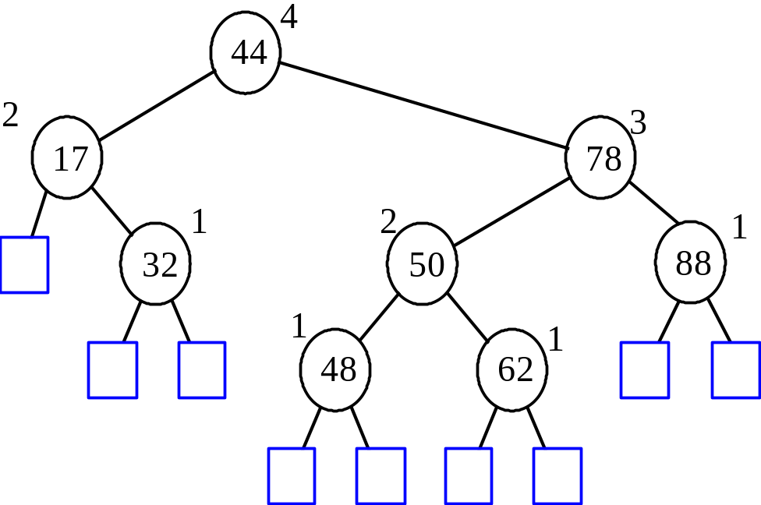
AVL Tree Definition
AVL trees are balanced
An AVL Tree is a binary search tree such that for every internal node v of T, the heights of the children of v can differ by at most 1
An example of an AVL tree where the heights are shown next to the nodes:
AVL Trees

Slide 10
Insertion
Insertion is as in a binary search tree
Always done by expanding an external node.
Example:
44
44
17
78
17
78
c=z
a=y
32
50
88
32
50
88
48
62
48
62
b=x
54
w
before insertion
after insertion
AVL Trees

Slide 11
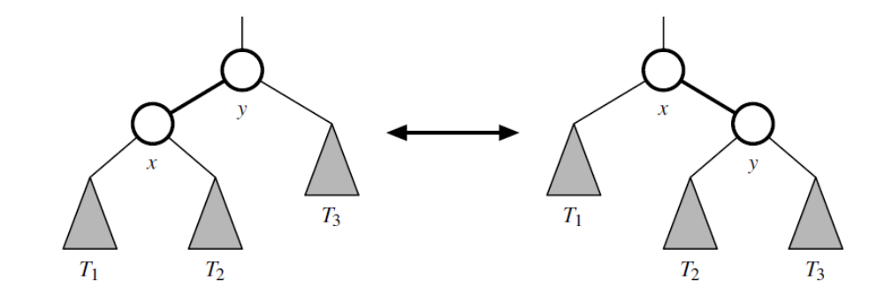
Rotation
AVL Trees
Notes:
A rotation operation in a binary search tree. A rotation can be performed
to transform the left formation into the right, or the right formation into the
left. Note that all keys in subtree T1 have keys less than that of position x, all keys
in subtree T2 have keys that are between those of positions x and y, and all keys in
subtree T3 have keys that are greater than that of position y.
Red-Black Trees

Slide 12
Trinode Restructuring
let (a,b,c) be an inorder listing of x, y, z
perform the rotations needed to make b the topmost node of the tree
(other two cases are symmetrical)
a=z
a=z
case 2: double rotation
(a right rotation about c, then a left rotation about a)
T₀
T₀
c=y
b=y
T₁
b=x
T₃
c=x
T₂
T₃
b=y
T₁
T₂
b=x
a=z
c=x
a=z
c=y
T₀
T₁
T₂
T₃
T₀
T₁
T₂
T₃
case 1: single rotation
(a left rotation about a)
AVL Trees

Slide 13
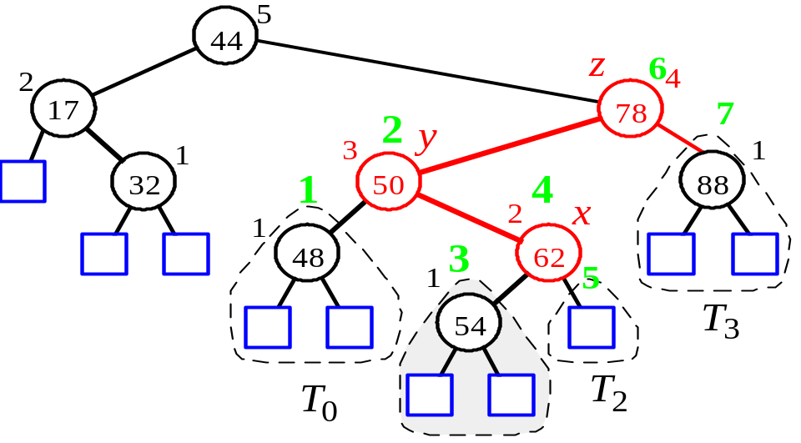
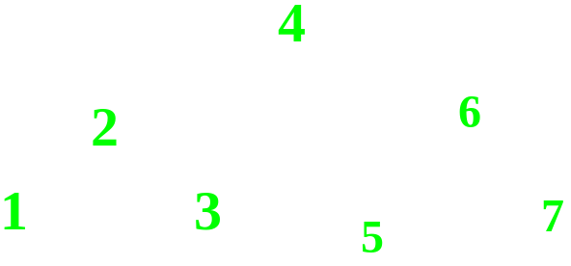

Insertion Example, continued
unbalanced...
T
4
1
44
2
3
x
17
y
62
z
1
2
2
32
50
78
1
1
1
...balanced
48
54
88
T
2
T
T
T
AVL Trees
0
1
3

Slide 14
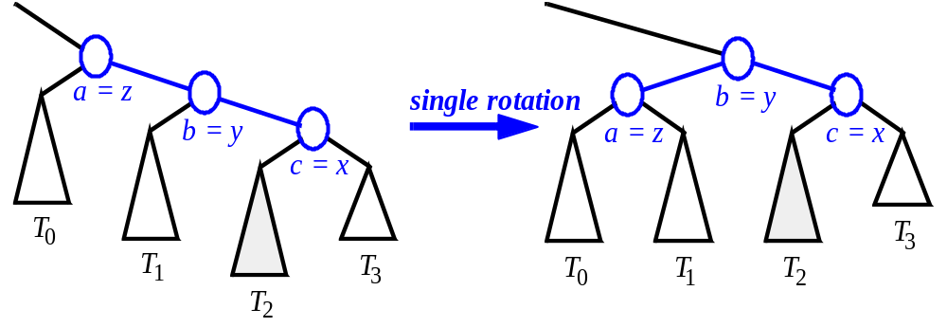
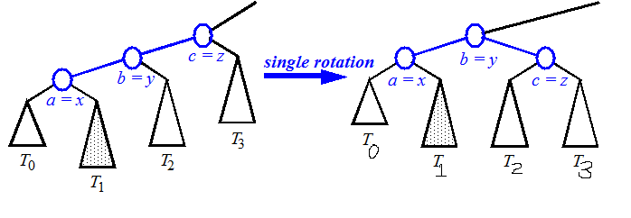
Restructuring (as Single Rotations)
Single Rotations:
AVL Trees

Slide 15
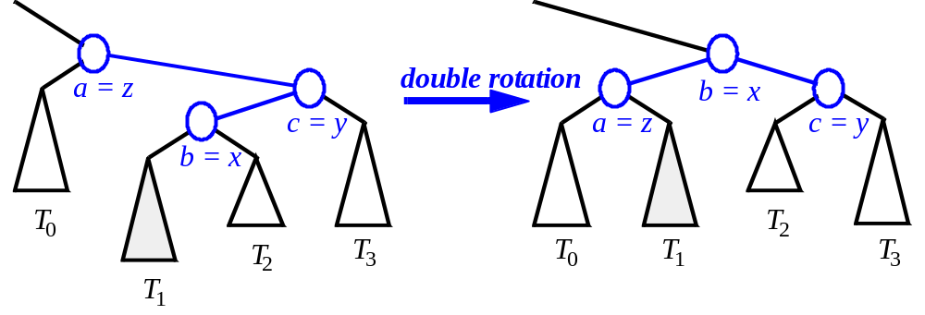
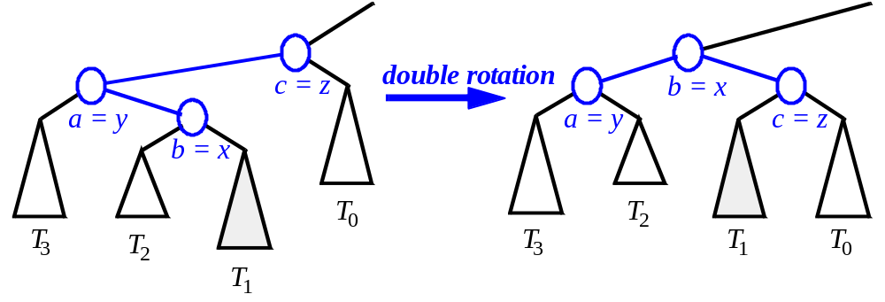
Restructuring (as Double Rotations)
double rotations:
AVL Trees
Notes:
First right, then left
First left, then right
Red-Black Trees

Slide 16
AVL Insertion: Outside Case
j
Consider a valid
AVL subtree
k
h
Z
h
h
X
Y

Slide 17
AVL Insertion: Outside Case
j
Inserting into X
destroys the AVL
property at node j
k
h
Z
h+1
h
Y
X

Slide 18
AVL Insertion: Outside Case
j
Do a “right rotation”
k
h
Z
h+1
h
Y
X

Slide 19
Single Right Rotation
j
Do a “right rotation”
k
h
Z
h+1
h
Y
X

Slide 20
Outside Case Completed
k
“Right rotation” done!
(“Left rotation” is mirror
symmetric)
j
h+1
h
h
X
Y
Z
AVL property has been restored!

Slide 21
AVL Insertion: Inside Case
j
Consider a valid
AVL subtree
k
h
Z
h
h
X
Y

Slide 22
AVL Insertion: Inside Case
Inserting into Y
destroys the
AVL property
at node j
j
Does “right rotation”
restore balance?
k
h
Z
h
h+1
X
Y

Slide 23
AVL Insertion: Inside Case
k
“Right rotation”
does not restore
balance… now k is
out of balance
j
h
X
h
h+1
Z
Y

Slide 24
AVL Insertion: Inside Case
Consider the structure
of subtree Y…
j
k
h
Z
h
h+1
X
Y

Slide 25
AVL Insertion: Inside Case
j
Y = node i and
subtrees V and W
k
h
Z
i
h
h+1
X
h or h-1
V
W

Slide 26
AVL Insertion: Inside Case
j
We will do a left-right
“double rotation” . . .
k
Z
i
X
V
W

Slide 27
Double Rotation: First Rotation
j
left rotation complete
i
Z
k
W
V
X

Slide 28
Double Rotation: Second Rotation
j
Now do a right rotation
i
Z
k
W
V

Slide 29
Double Rotation: Second Rotation
right rotation complete
Balance has been restored
i
k
j
h
h
h or h-1
V
X
W
Z

Slide 30
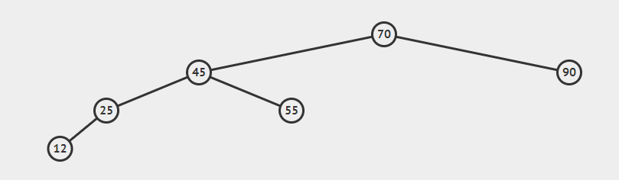
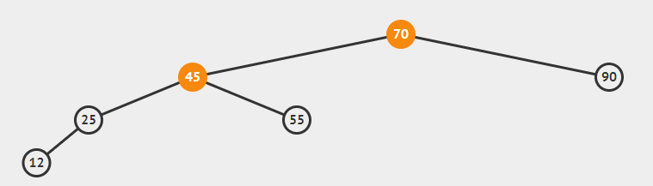
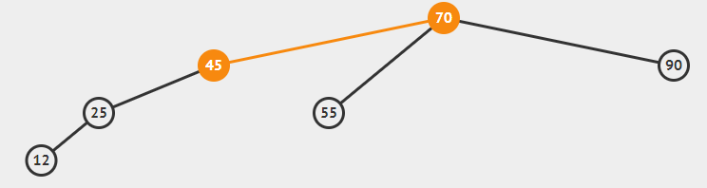
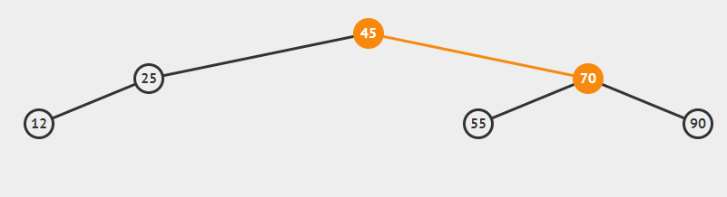
Insert 12
1
2
3
4
AVL Trees
Notes:
Red-Black Trees

Slide 31
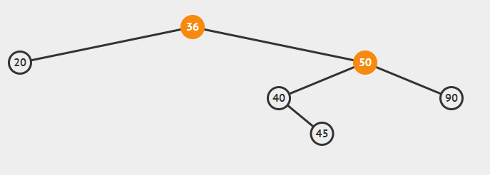
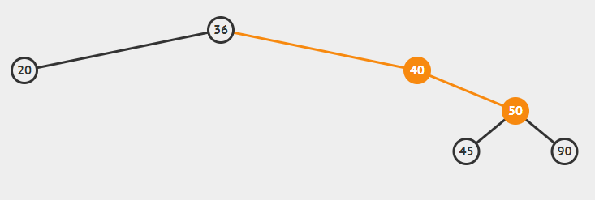
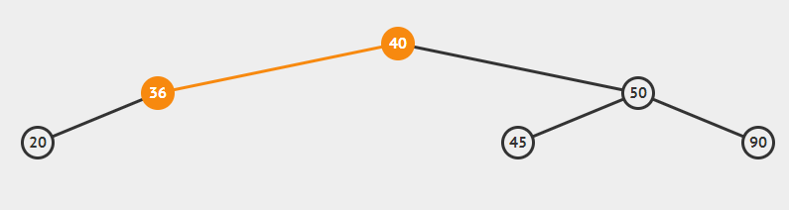
Insert 45 (Double Rotation)
Rotate right, then left
AVL Trees

Slide 32
Removal
Removal begins as in a binary search tree, which means the node removed will become an empty external node. Its parent, w, may cause an imbalance.
Example:
44
44
17
62
17
62
32
50
78
50
78
48
54
88
48
54
88
before deletion of 32
after deletion
AVL Trees

Slide 33
Rebalancing after a Removal
Let z be the first unbalanced node encountered while travelling up the tree from w. Also, let y be the child of z with the larger height, and let x be the child of y with the larger height
We perform restructure(x) to restore balance at z
As this restructuring may upset the balance of another node higher in the tree, we must continue checking for balance until the root of T is reached
62
a=z
44
w
b=y
44
78
17
62
c=x
17
50
88
50
78
48
54
48
54
88
AVL Trees

Slide 34

AVL Tree Performance
a single restructure takes O(1) time
  using a linked-structure binary tree
Searching takes O(log n) time
  height of tree is O(log n), no restructures needed
Insertion takes O(log n) time
  initial find is O(log n)
  Restructuring up the tree, maintaining heights is O(log n)
Removal takes O(log n) time
  initial find is O(log n)
  Restructuring up the tree, maintaining heights is O(log n)
AVL Trees

Slide 35
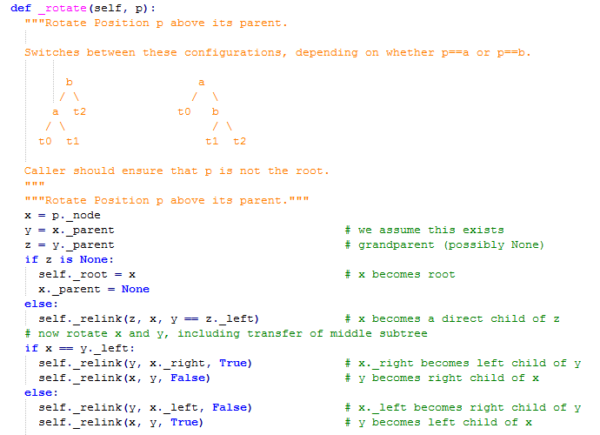
Implementing _Rotate function in Python
AVL Trees

Slide 36
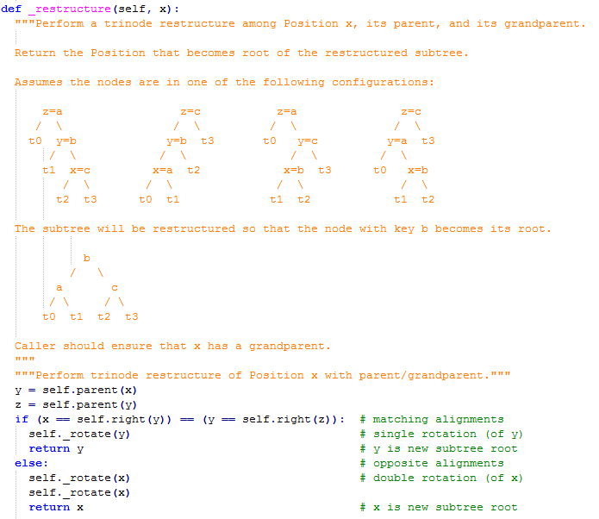
Implementing _restructure function in Python
AVL Trees

Slide 37
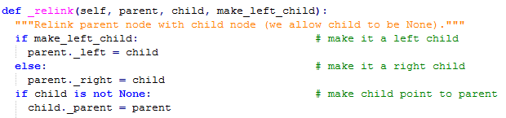
Implementing _relink function in Python
AVL Trees

Slide 38
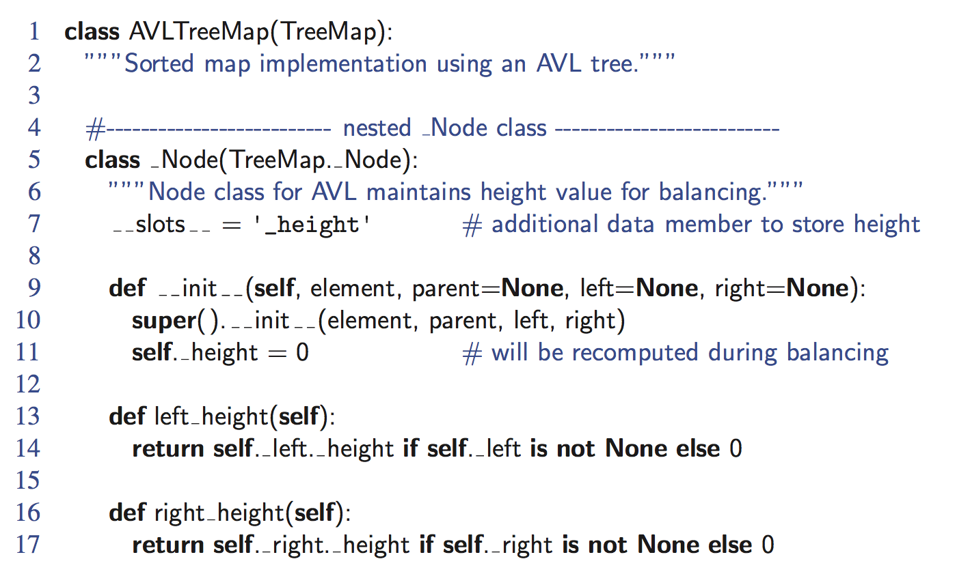
Python Implementation
AVL Trees

Slide 39
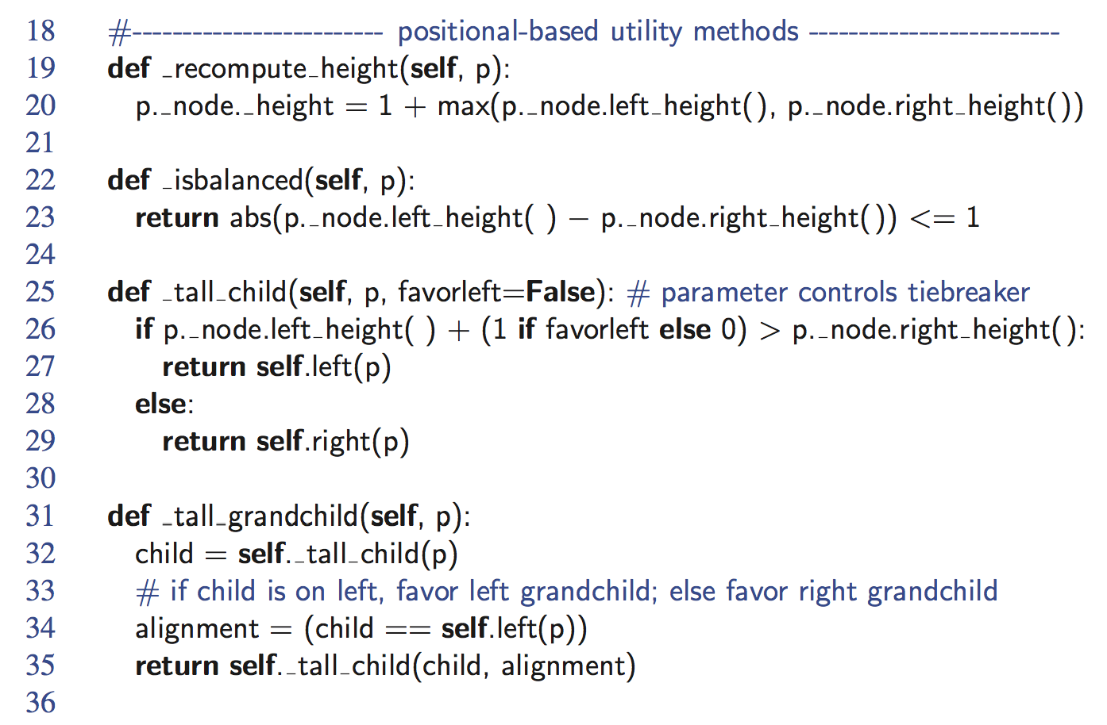
Python Implementation, Part 2
AVL Trees

Slide 40
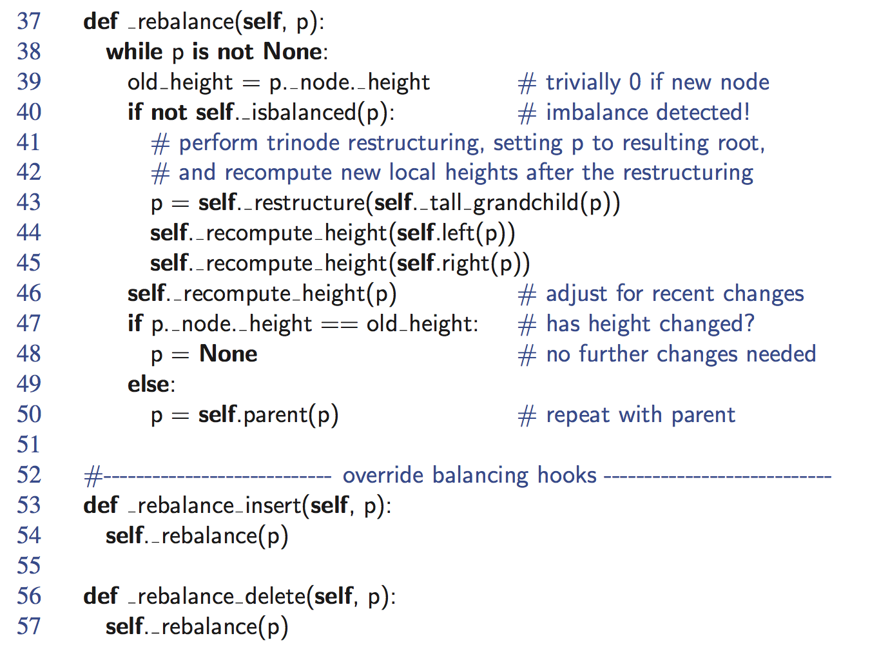
Python Implementation, end
AVL Trees

