Slide 1

Priority Queues
© 2013 Goodrich, Tamassia, Goldwasser
Priority Queues
Notes:
Priority Queues

Slide 2
Priority Queue ADT
A priority queue stores a collection of items
Each item is a pair
(key, value)
Main methods of the Priority Queue ADT
  add (k, x)
  inserts an item with key k and value x
  remove_min()
  removes and returns the item with smallest key
Additional methods
  min()
  returns, but does not remove, an item with smallest key
  len(P), is_empty()
Applications:
  Standby flyers
  Auctions
  Stock market
© 2013 Goodrich, Tamassia, Goldwasser
Priority Queues

Slide 3
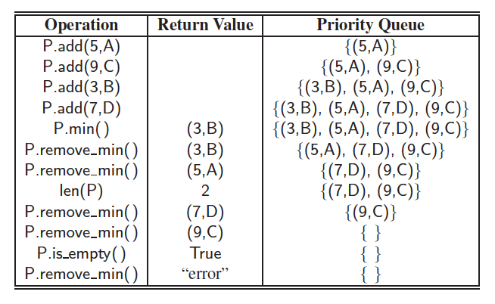
Priority Queue Example
© 2013 Goodrich, Tamassia, Goldwasser
Priority Queues

Slide 4
Total Order Relations
Keys in a priority queue can be arbitrary objects on which an order is defined
Two distinct entries in a priority queue can have the same key
Mathematical concept of total order relation ≤
  Reflexive property:
  x ≤ x
  Antisymmetric property:
  x ≤ y ∧ y ≤ x ⇒ x = y
  Transitive property:
  x ≤ y ∧ y ≤ z ⇒ x ≤ z
© 2013 Goodrich, Tamassia, Goldwasser
Priority Queues

Slide 5
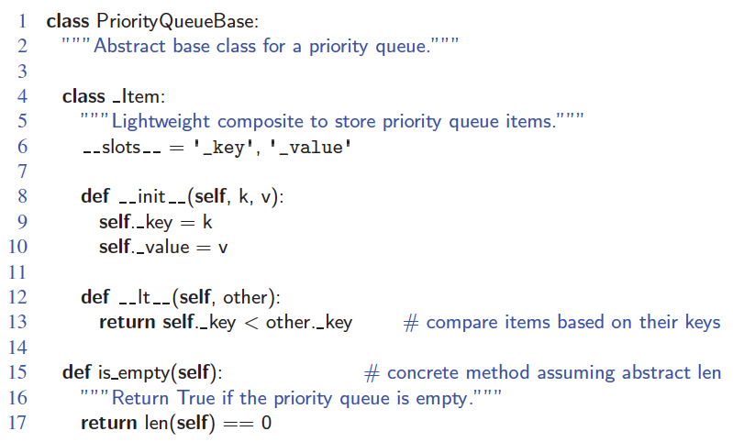
Composition Design Pattern
An item in a priority queue is simply a key-value pair
Priority queues store items to allow for efficient insertion and removal based on keys
© 2013 Goodrich, Tamassia, Goldwasser
Priority Queues

Slide 6
Sequence-based Priority Queue
Implementation with an unsorted list
Performance:
  add takes O(1) time since we can insert the item at the beginning or end of the sequence
  Remove_min and min take O(n) time since we have to traverse the entire sequence to find the smallest key
Implementation with a sorted list
Performance:
  add takes O(n) time since we have to find the place where to insert the item
  remove_min and min take O(1) time, since the smallest key is at the beginning
4
5
2
3
1
1
2
3
4
5
© 2013 Goodrich, Tamassia, Goldwasser
Priority Queues

Slide 7
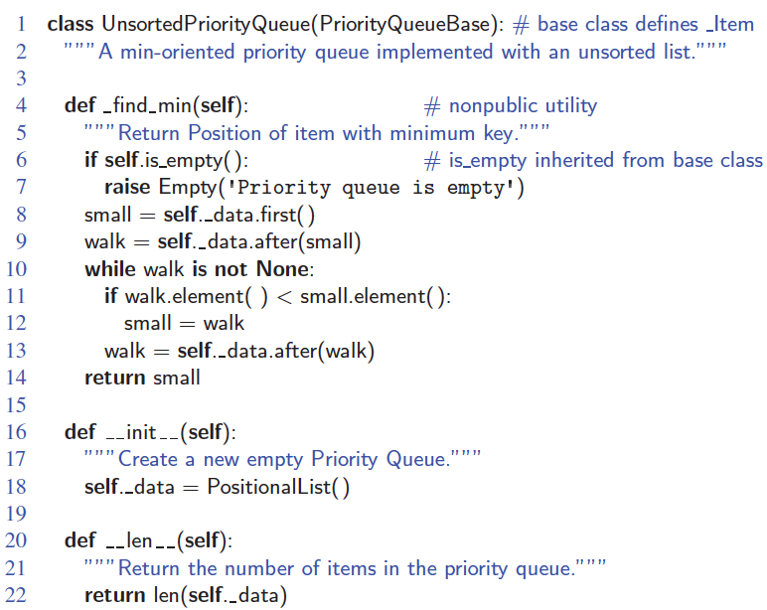
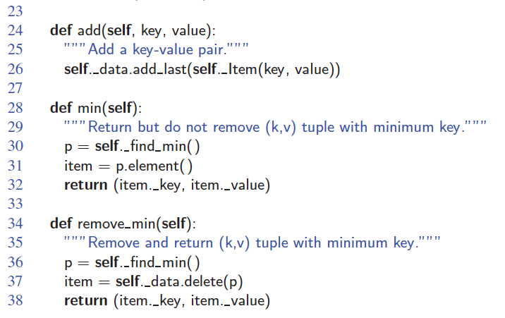
Unsorted List Implementation
© 2013 Goodrich, Tamassia, Goldwasser
Priority Queues

Slide 8
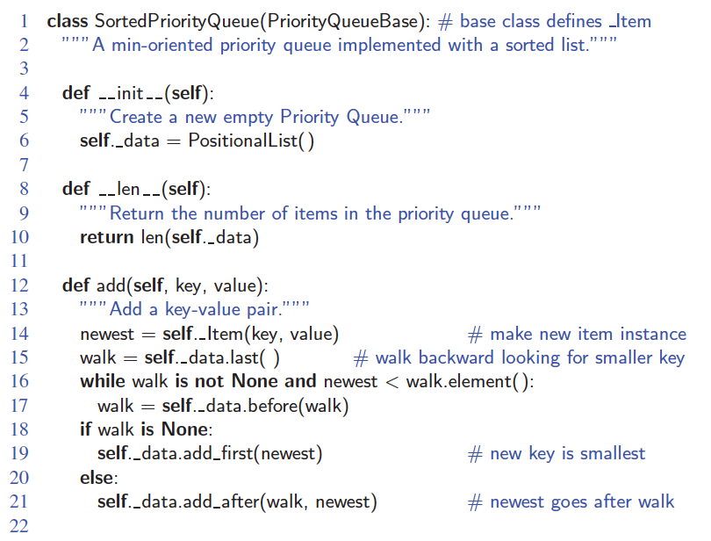
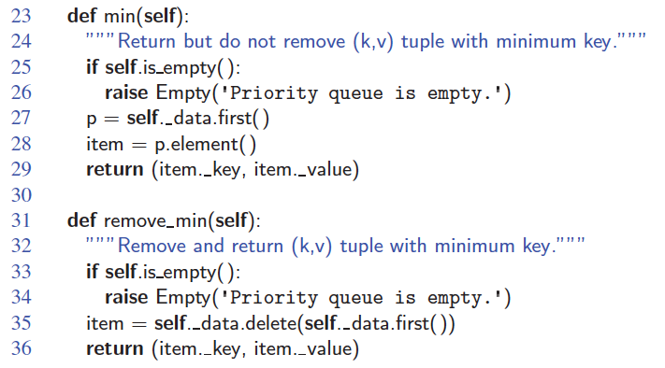
Sorted List Implementation
© 2013 Goodrich, Tamassia, Goldwasser
Priority Queues

Slide 9
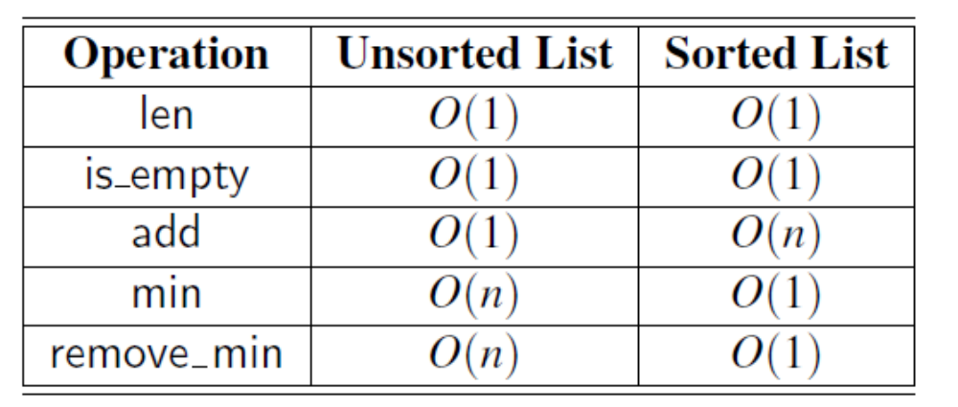
Runtime of implementing PQ using Sorted and Unsorted List
© 2013 Goodrich, Tamassia, Goldwasser
Priority Queues
Notes:
Worst-case running times of the methods of a priority queue of size n,
realized by means of an unsorted or sorted list, respectively. We assume that the
list is implemented by a doubly linked list. The space requirement is O(n).
Priority Queues

Slide 10
Priority Queue Sorting
We can use a priority queue to sort a set of comparable elements
  Insert the elements one by one with a series of add operations
  Remove the elements in sorted order with a series of remove_min operations
The running time of this sorting method depends on the priority queue implementation
Algorithm PQ-Sort(S, C)
  Input sequence S, comparator C for the elements of S
  Output sequence S sorted in increasing order according to C
  P ← priority queue with comparator C
  while ¬S.is_empty ()
  e ← S.remove_first ()
    P.add (e, ∅)
  while ¬P.is_empty()
  e ← P.removeMin().key()
    S.add_last(e)
© 2013 Goodrich, Tamassia, Goldwasser
Priority Queues

Slide 11
Selection-Sort
Selection-sort is the variation of PQ-sort where the priority queue is implemented with an unsorted sequence
Running time of Selection-sort:
  Inserting the elements into the priority queue with n insert operations takes O(n) time
  Removing the elements in sorted order from the priority queue with n removeMin operations takes time proportional to
  1 + 2 + …+ n
Selection-sort runs in O(n²) time
© 2013 Goodrich, Tamassia, Goldwasser
Priority Queues

Slide 12
Selection-Sort Example
Sequence S Priority Queue P
Input: (7,4,8,2,5,3,9) ()
Phase 1
(a) (4,8,2,5,3,9) (7)
(b) (8,2,5,3,9) (7,4)
.. .. ..
(g) () (7,4,8,2,5,3,9)
Phase 2
(a) (2) (7,4,8,5,3,9)
(b) (2,3) (7,4,8,5,9)
(c) (2,3,4) (7,8,5,9)
(d) (2,3,4,5) (7,8,9)
(e) (2,3,4,5,7) (8,9)
(f) (2,3,4,5,7,8) (9)
(g) (2,3,4,5,7,8,9) ()
© 2013 Goodrich, Tamassia, Goldwasser
Priority Queues

Slide 13
Insertion-Sort
Insertion-sort is the variation of PQ-sort where the priority queue is implemented with a sorted sequence
Running time of Insertion-sort:
  Inserting the elements into the priority queue with n insert operations takes time proportional to
  1 + 2 + …+ n
  Removing the elements in sorted order from the priority queue with a series of n removeMin operations takes O(n) time
Insertion-sort runs in O(n²) time
© 2013 Goodrich, Tamassia, Goldwasser
Priority Queues

Slide 14
Insertion-Sort Example
Sequence S Priority queue P
Input: (7,4,8,2,5,3,9) ()
Phase 1
(a) (4,8,2,5,3,9) (7)
(b) (8,2,5,3,9) (4,7)
(c) (2,5,3,9) (4,7,8)
(d) (5,3,9) (2,4,7,8)
(e) (3,9) (2,4,5,7,8)
(f) (9) (2,3,4,5,7,8)
(g) () (2,3,4,5,7,8,9)
Phase 2
(a) (2) (3,4,5,7,8,9)
(b) (2,3) (4,5,7,8,9)
.. .. ..
(g) (2,3,4,5,7,8,9) ()
© 2013 Goodrich, Tamassia, Goldwasser
Priority Queues

Slide 15
In-place Insertion-Sort
Instead of using an external data structure, we can implement selection-sort and insertion-sort in-place
A portion of the input sequence itself serves as the priority queue
For in-place insertion-sort
  We keep sorted the initial portion of the sequence
  We can use swaps instead of modifying the sequence
5
4
2
3
1
5
4
2
3
1
4
5
2
3
1
2
4
5
3
1
2
3
4
5
1
1
2
3
4
5
1
2
3
4
5
© 2013 Goodrich, Tamassia, Goldwasser
Priority Queues

