Slide 1
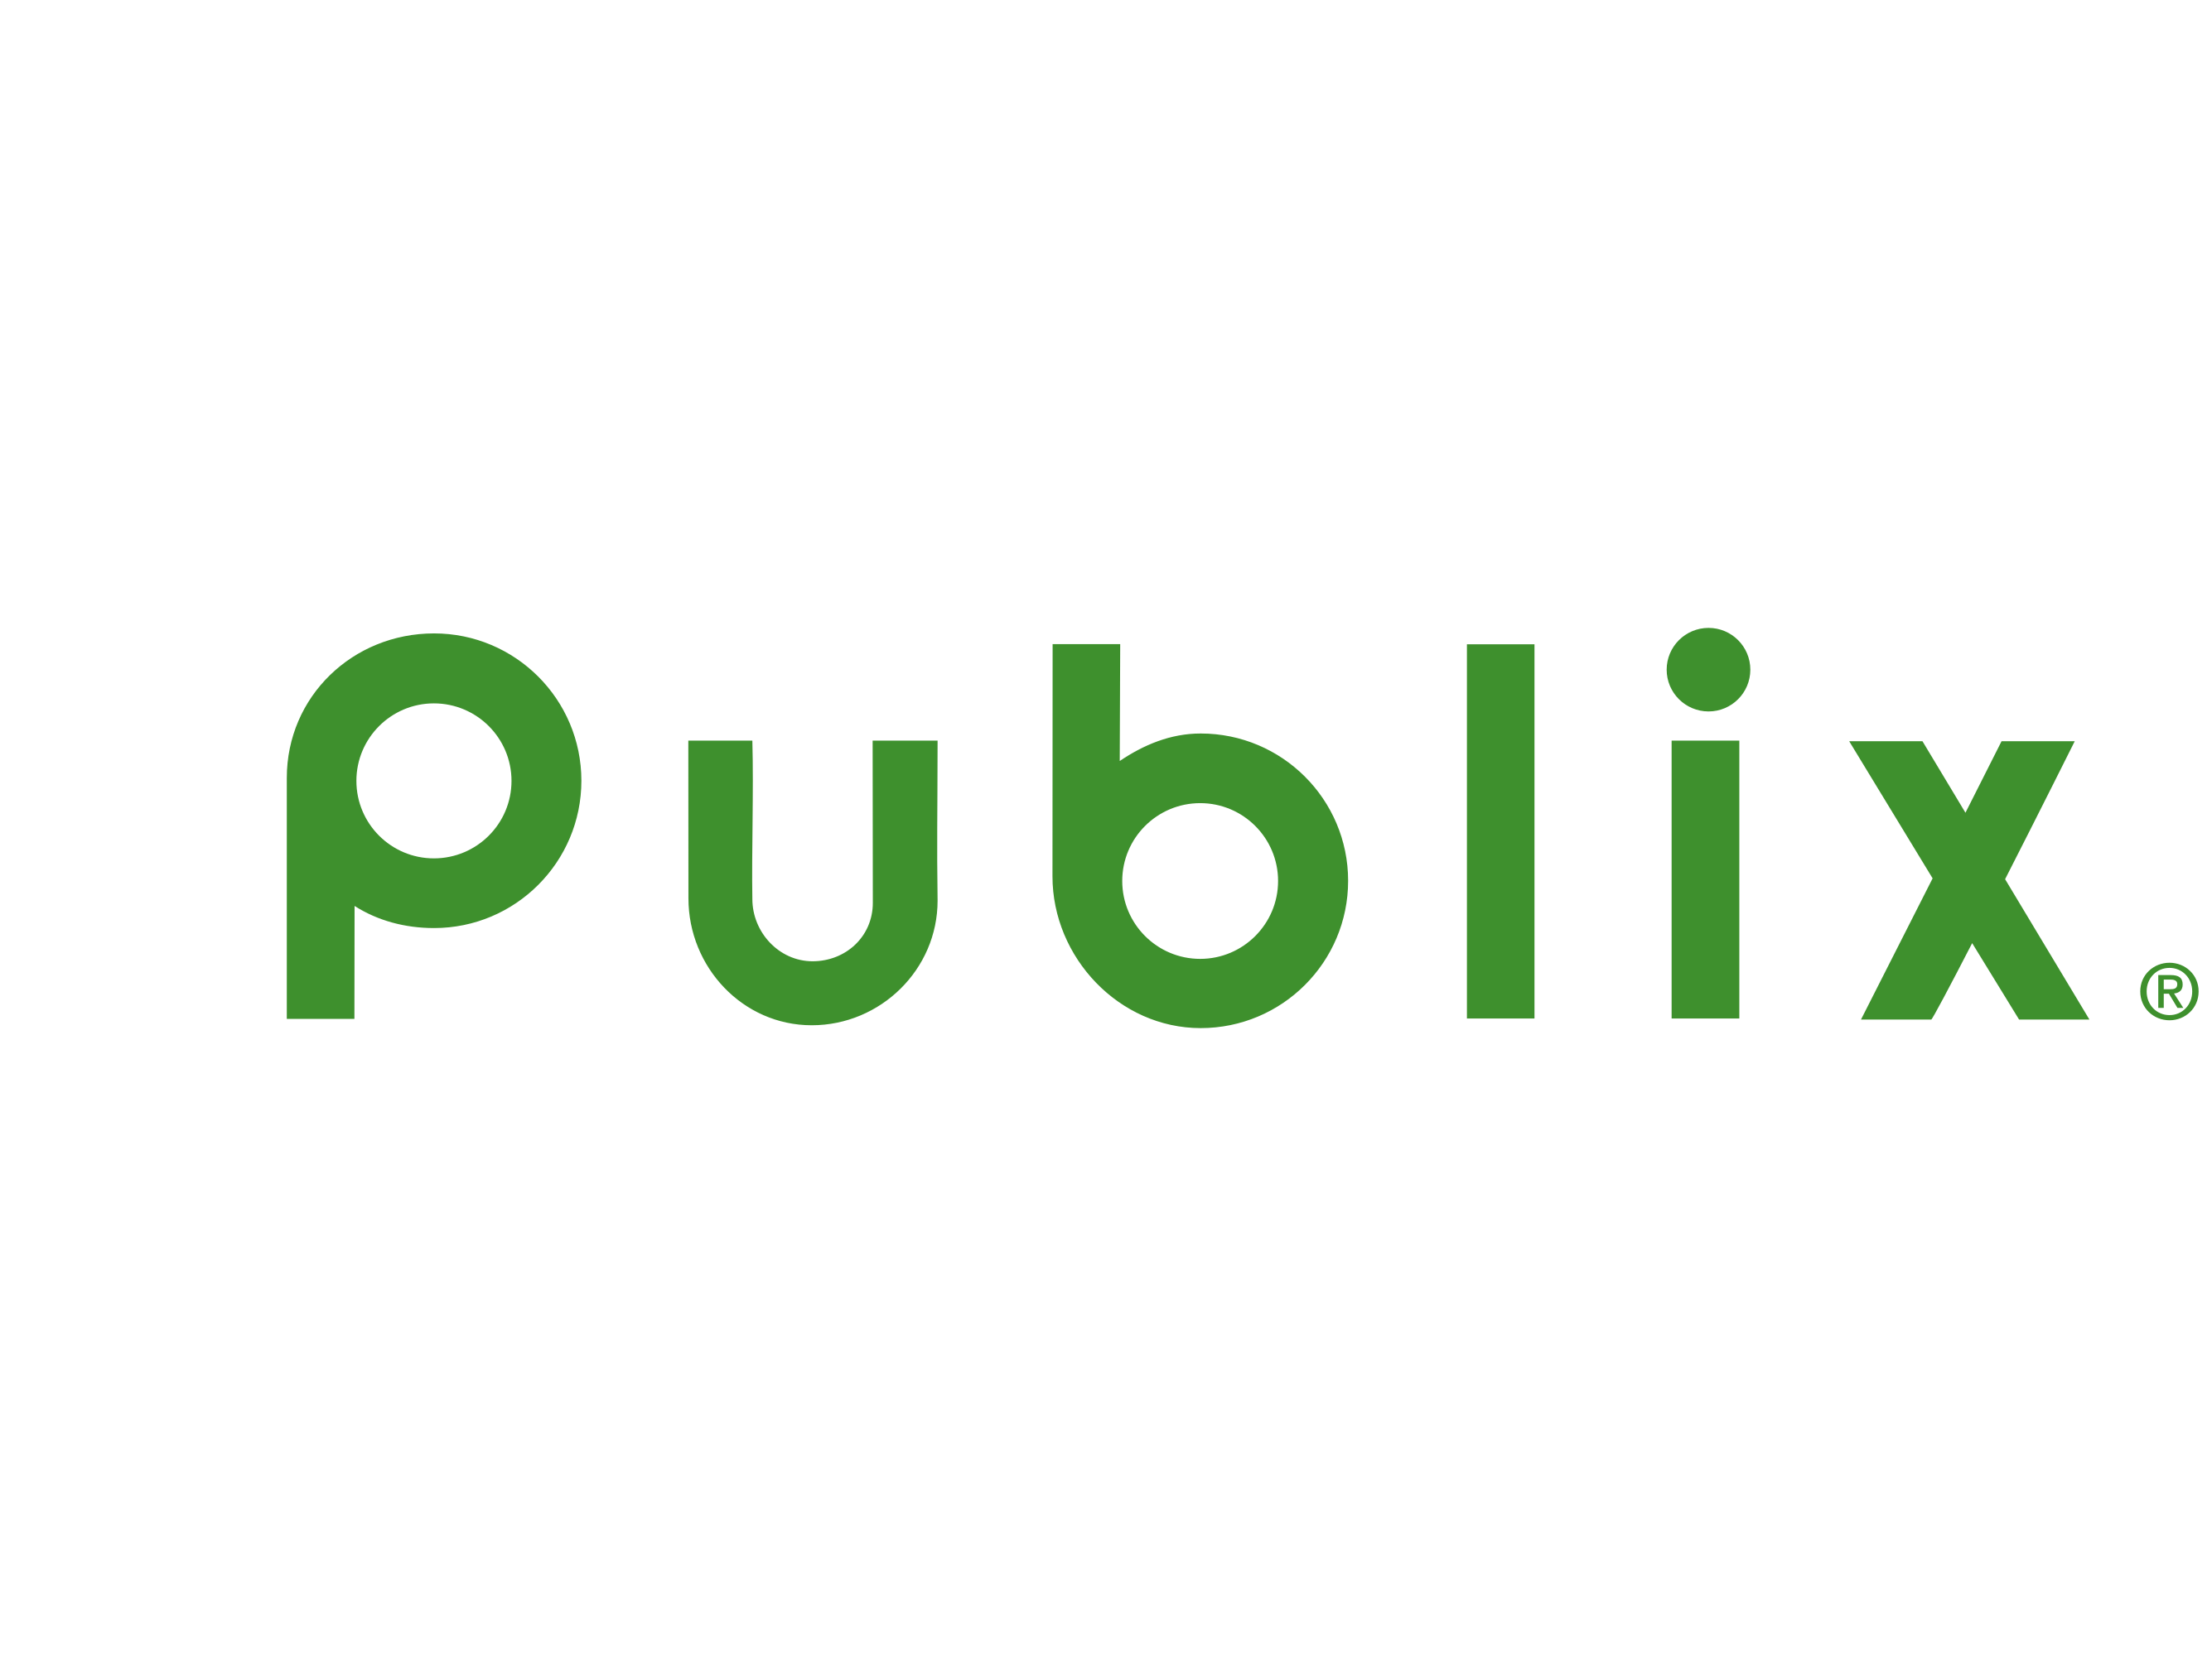
SA Solution Challenge Demo
Candidate: Jesse Saez

Slide 2

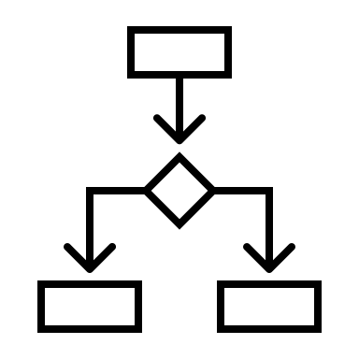







AGENDA
Review
Assumptions
Decision Matrix
Risks
High Level Overview
Components
Deployment
Security
Recommended Tech Stack

Slide 3
ASSUMPTIONS
AWS Stack: The architecture assumes utilization of AWS services.
Recall Frequency: Anticipate 10 recalls per hour.
Web Server Acceptance: Organization approves usage of web servers.
File Storage Model: All files (e.g., PDFs, PNGs, JPEGs) adhere to specified format. Non-standard files are not considered.
Server and Platform Selection: Decisions regarding server and platform are made.
Financial Operations (FinOps): Financial model not yet developed. Considerations for cost, Disaster Recovery (DR), and Business Continuity (BC) required.
Visualization Tool: Grafana used for visualization; interchangeable with PowerBI or similar tools.
Application Performance Monitoring: Assumption of standardized monitoring system and reference architecture across the organization.
DevOps and Test Automation: Organization follows standard practices for DevOps and test automation, facilitating maintenance windows setup.

Slide 4
DECISION MATRIX
Decision | Criteria | Primary Choice | Alternative
Cloud Vendor Selection | Cost benefits Potential data leakages | Stick to AWS due to cost and potential risks | Consider alternative vendors, considering risks
Data Governance | Privacy Consumer rights Legalities | Implement patterns with data governance in mind | Address anti-patterns with respect to governance
Message Infrastructure | Clarity of expected load | Use queues due to unclear load requirements | Consider streaming infrastructure if required
Deployment Model | Cost Technological choices | Containerization for cost and tech advantages | VMs for alternative considerations

Slide 5
DECISION MATRIX
Decision | Criteria | Primary Choice | Alternative
Technology Language | Long-term adaptability for business | Select modern event-based language | Considerations for adaptability and scalability
Source Code | Governance compliance | Preclude open source unless authorized | Consider open source with governance approval
Service Implementation | Adaptability & Framework support | Utilize standard REST API for adaptability | Assess other options based on requirements

Slide 6
RISKS
Non-standard Vendor Recall Notifications
Risk of notifications not adhering to standard format, affecting data consistency and processing reliability.
Failure to Notify Urgent Recalls
Potential for notifications to fail, leading to delayed alerts on critical recalls, posing liability concerns regarding ownership and accountability.

Slide 7
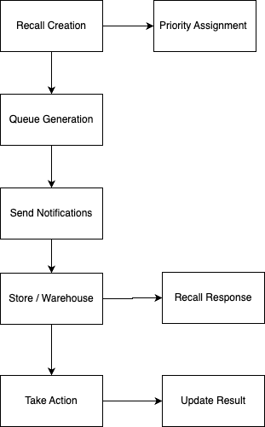
HIGH LEVEL OVERVIEW

Slide 8
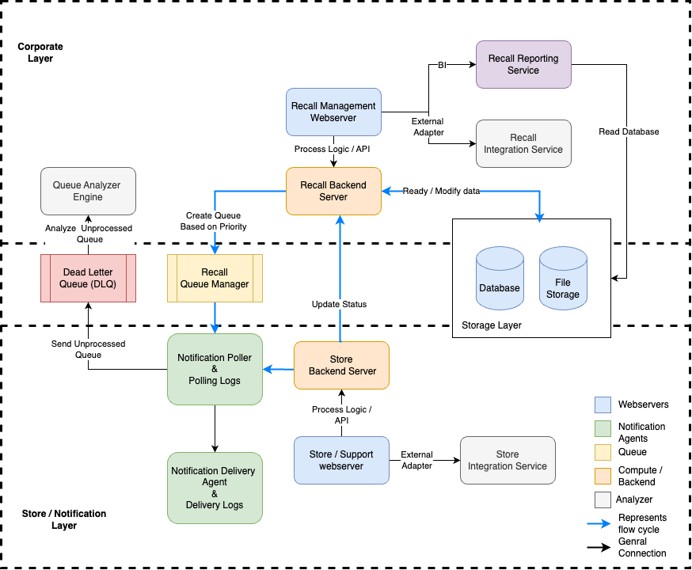
COMPONENT LAYOUT

Slide 9
DEPLOYMENT ARCHITECTURE
VPC and Subnet Configuration
Auto Scaling Groups
Application Load Balancers
Recall Web Server ALB
Recall Backend Server ALB
Store Webserver ALB
Store Backend Server ALB
AWS Route 53 Configuration
External Adapter and AWS Lambda
Amazon RDS
Notification System
Notification Poller and Priority Queue Processing
Integration with SES and SNS for Notification Delivery

Slide 10
SECURITY OVERVIEW
Identity and Access Management (IAM)
Amazon Virtual Private Cloud (VPC)
Subnetting and Network Segmentation
Encryption
AWS WAF and AWS Shield
Amazon Cognito
CloudTrail
CloudWatch
Route 53 DNSSEC
AWS Config
AWS GuardDuty
AWS Inspector
AWS Security Hub
VPC Flow Logs

Slide 11
Recommended Tech Stack
Backend
Language: Node.js
Framework: AWS Lambda with the Serverless Framework
Database: Amazon RDS for MySQL or Amazon DynamoDB for NoSQL requirements
Message Queuing: AWS SQS
Load Balancer: AWS Elastic Load Balancing (ELB)
Cache: Primary: Amazon ElastiCache with Redis

Slide 12
Recommended Tech Stack
Frontend
Framework: React.js
State Management: Context API with React or Vuex with Vue.js
CSS Framework: AWS Amplify UI
Middleware
API Gateway: AWS API Gateway
Authentication: Amazon Cognito
Monitoring: Amazon CloudWatch
Logging: AWS CloudWatch Logs

Slide 13
Recommended Tech Stack
DevOps
CI/CD: AWS CodePipeline and AWS CodeBuild , Jenkins
Containerization: AWS Fargate
Deployment: Amazon ECS
Infrastructure as Code: AWS CloudFormation
Code Versioning: Github
Communication
Service Communication: Amazon API Gateway for RESTful services, AWS Lambda
Notification Services: AWS SNS and Amazon SES

Slide 14
Recommended Tech Stack
Data Storage
Recall Data Storage: Amazon RDS
Log Storage: Amazon S3
Security
Authentication: AWS IAM with Amazon Cognito for user management
Encryption: AWS KMS
Access Control: AWS IAM for Role-based access control
Monitoring and Logging
Monitoring: Amazon CloudWatch
Logging: AWS CloudWatch Logs

