Slide 1
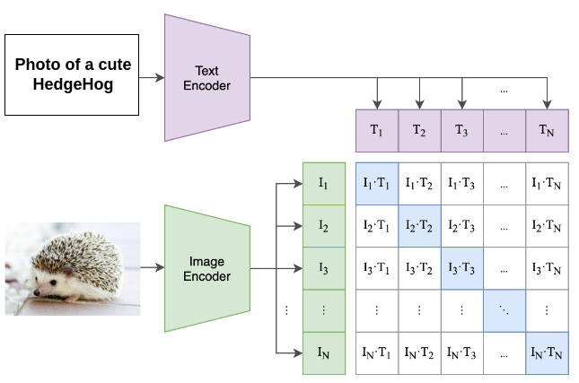
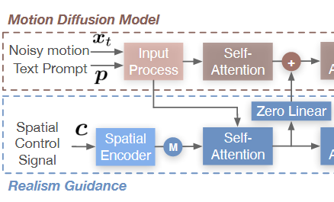
CLIP Text Encoder
Fine-Grained Text
"Bend your body forward and put your hands in front of your thighs. Look forward.",
"Raise your left leg up and bend your knee. Extend your left arm out behind you. Move your right arm forward.",
"Move your left hand to your left thigh. Move your right hand to your right thigh."

Slide 2
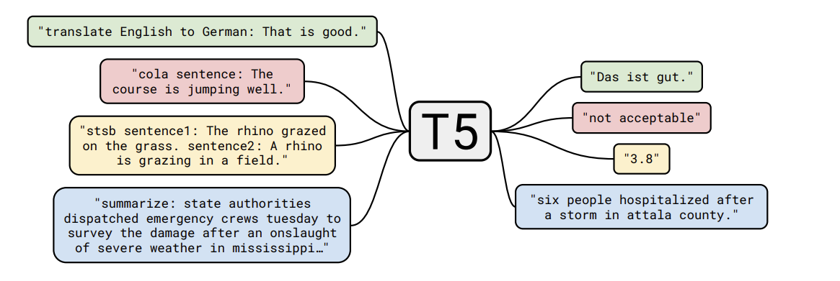
Positive Pair
Move your right arm forward
Extend your right arm in front.
Cross-entropy
Stretch your left arm backward.
Lean forward gently.
T5 Embedding
Negative Pair
backward
Fine-Grained Text
"Bend your body forward and put your hands in front of your thighs. Look forward.",
"Raise your left leg up and bend your knee. Extend your left arm out behind you. Move your right arm forward.",
"Move your left hand to your left thigh. Move your right hand to your right thigh."

