Slide 1
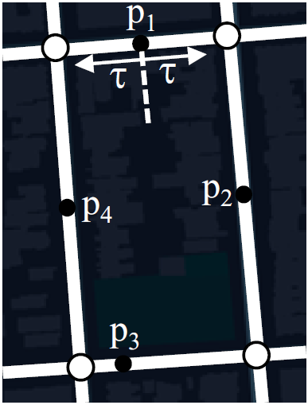
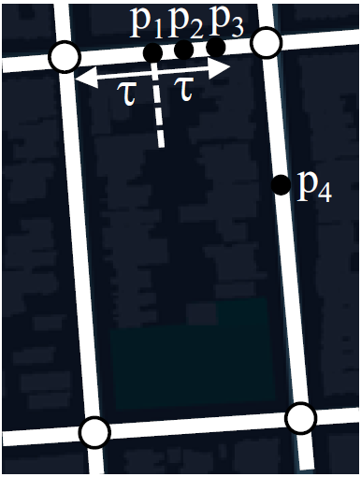
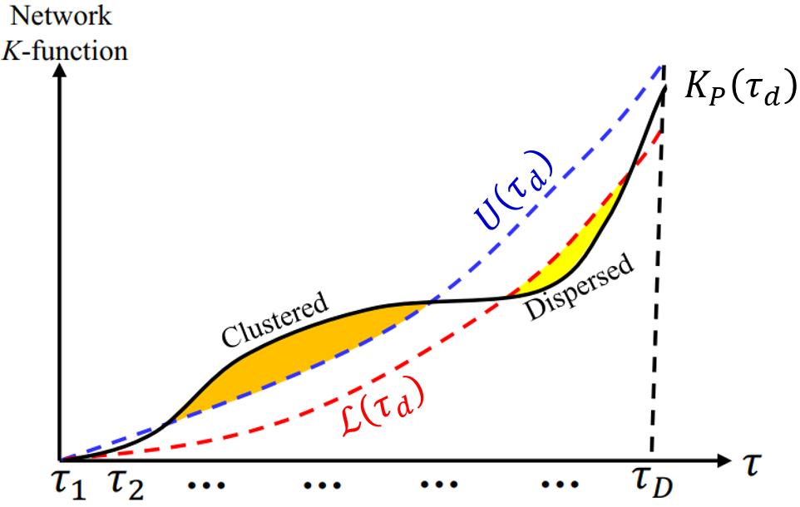
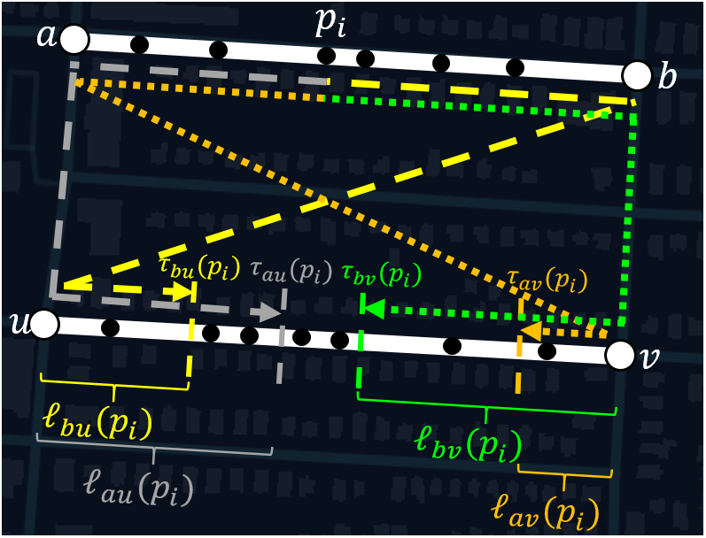
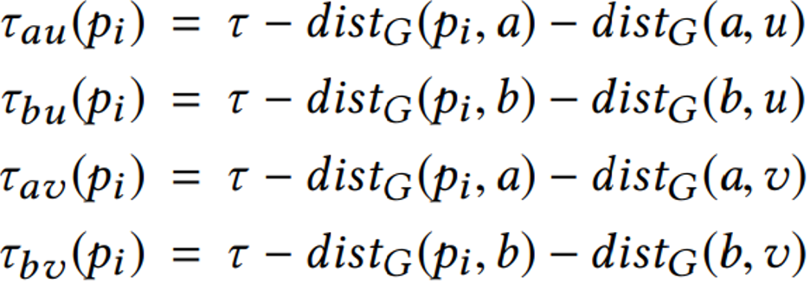
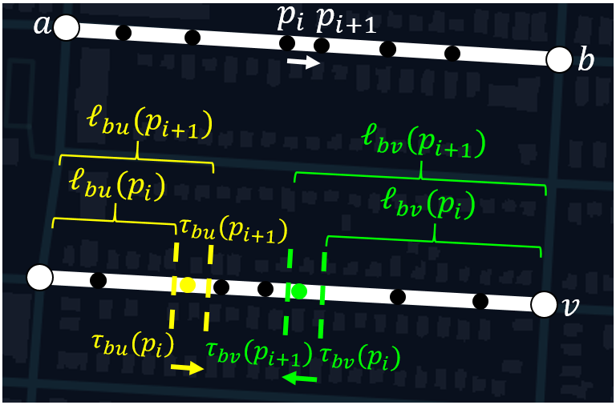
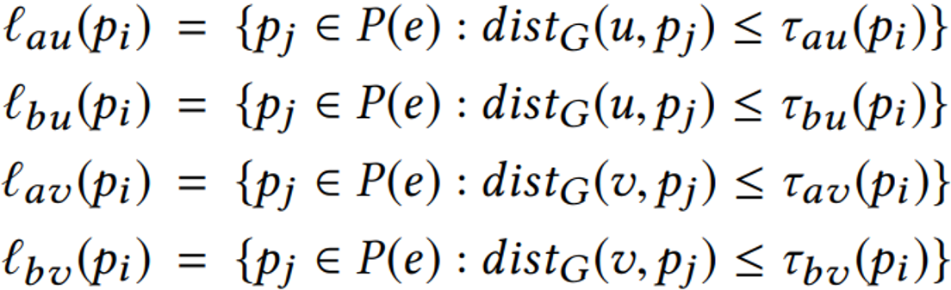
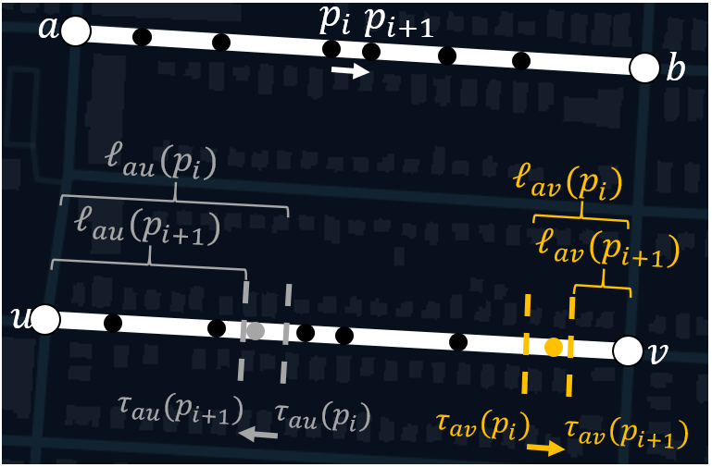
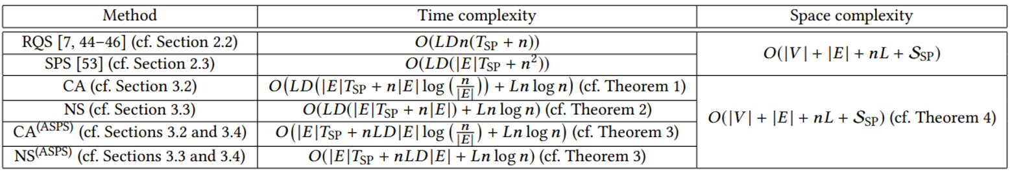
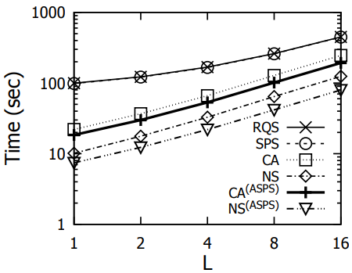
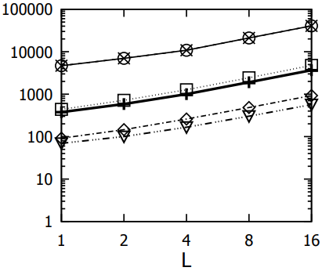
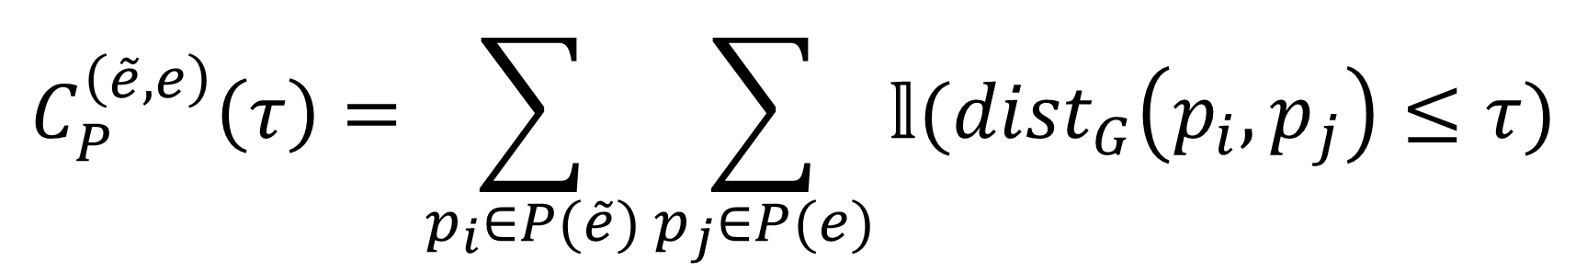

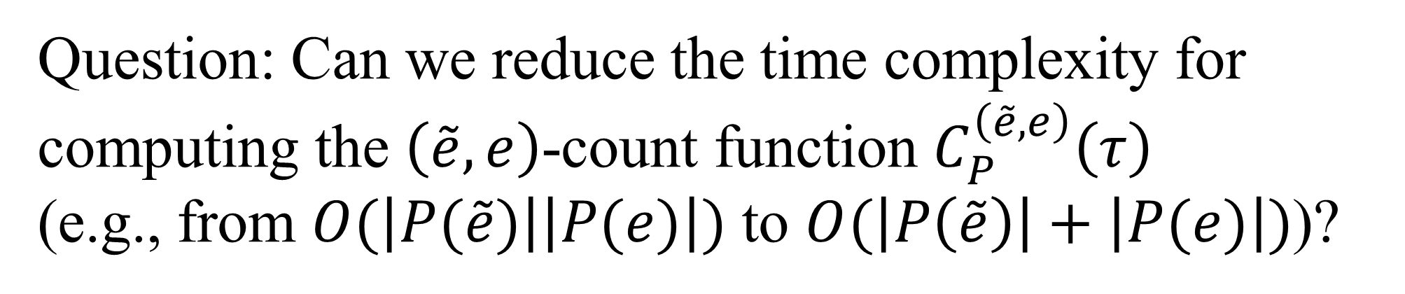
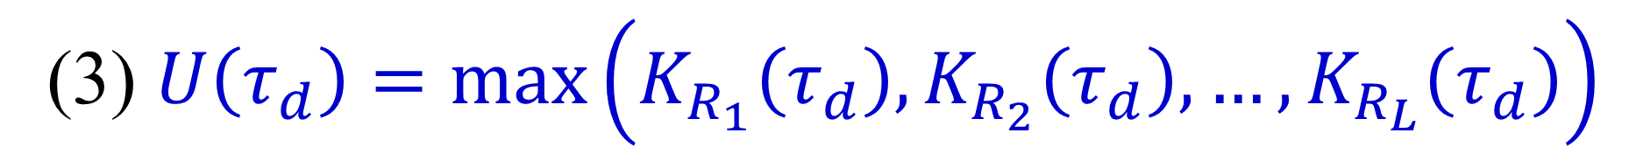
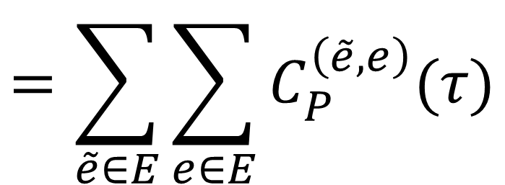
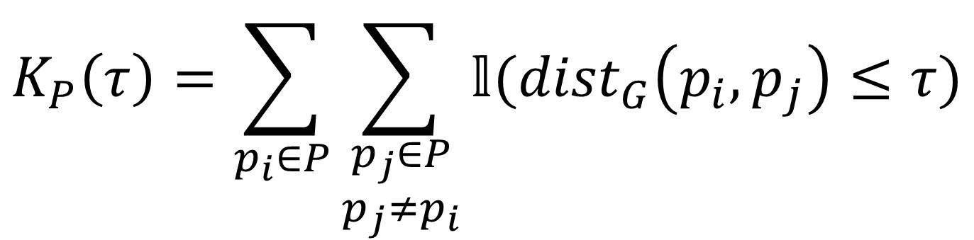
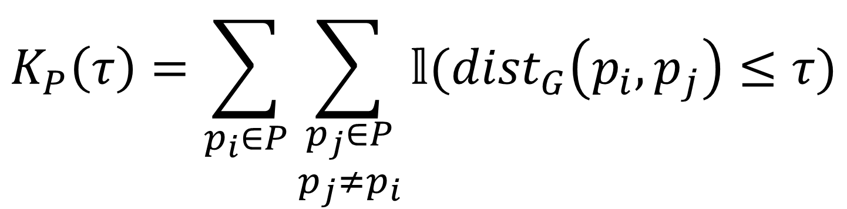
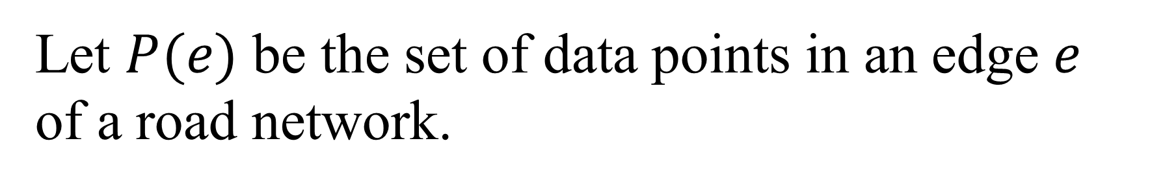
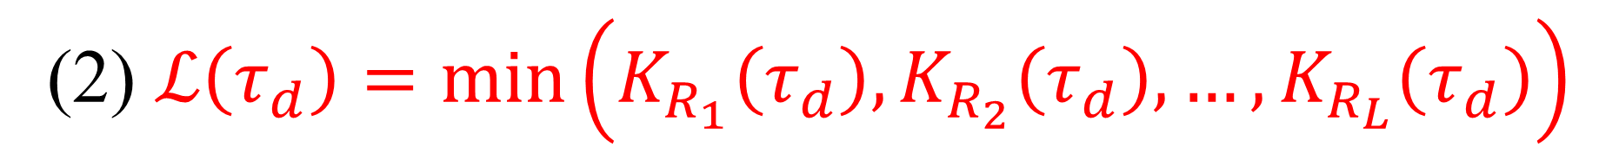
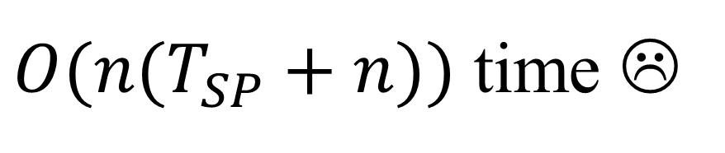
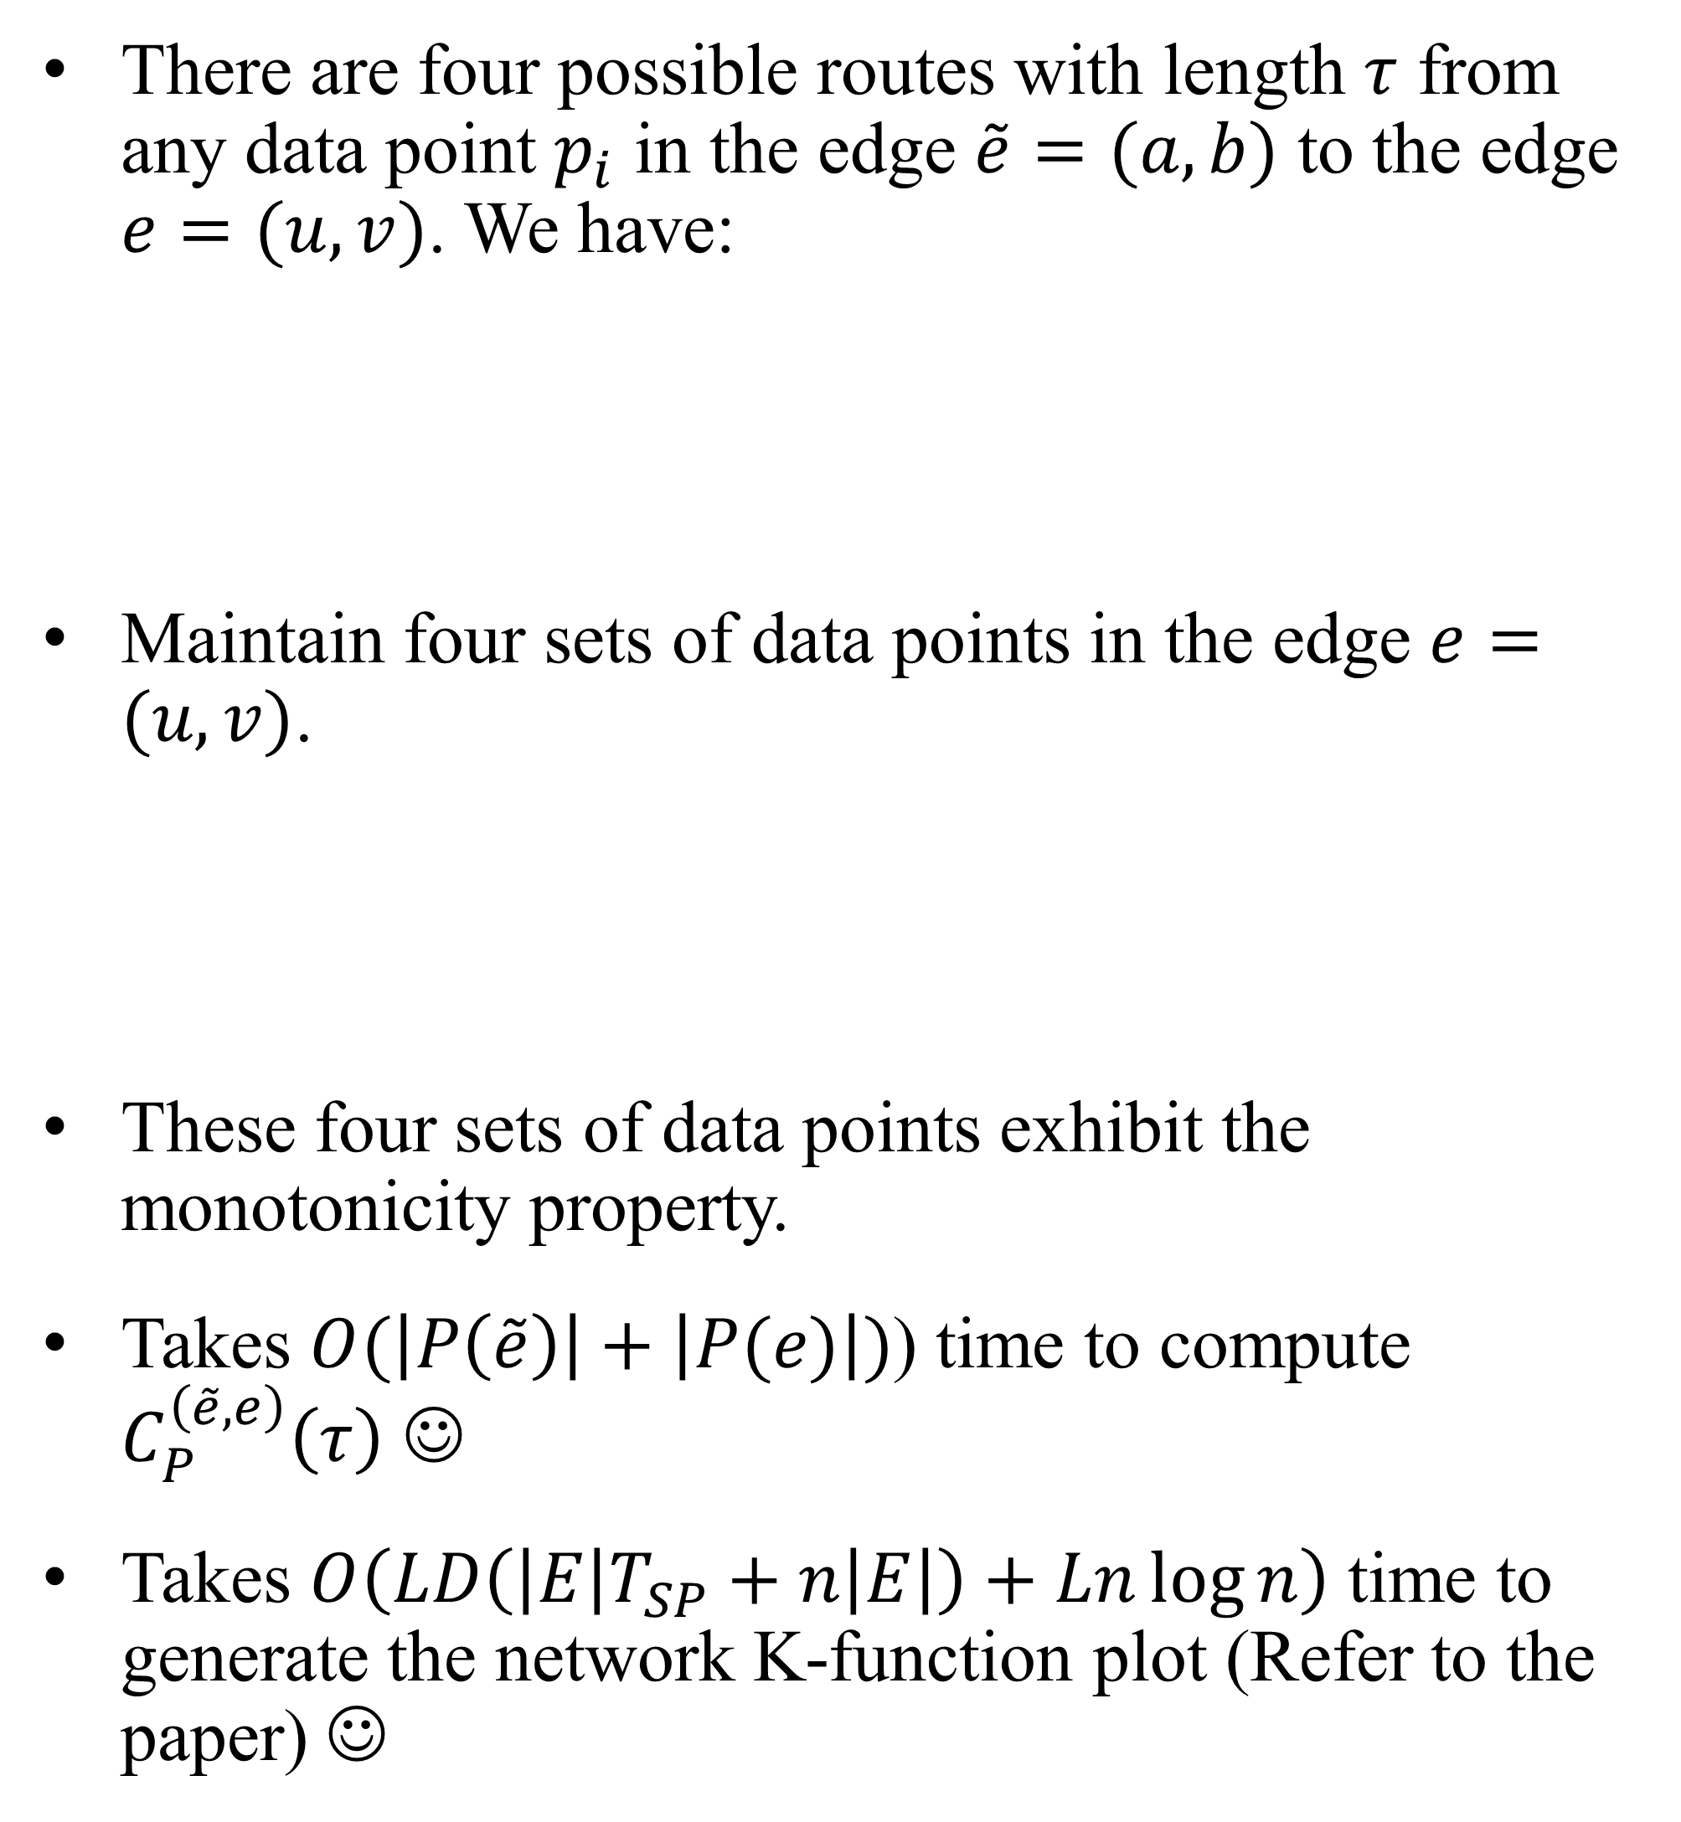
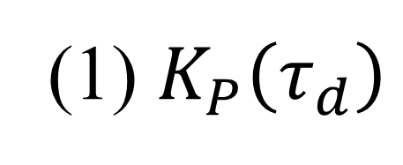
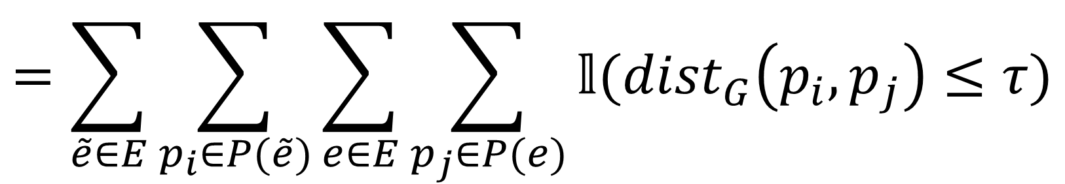
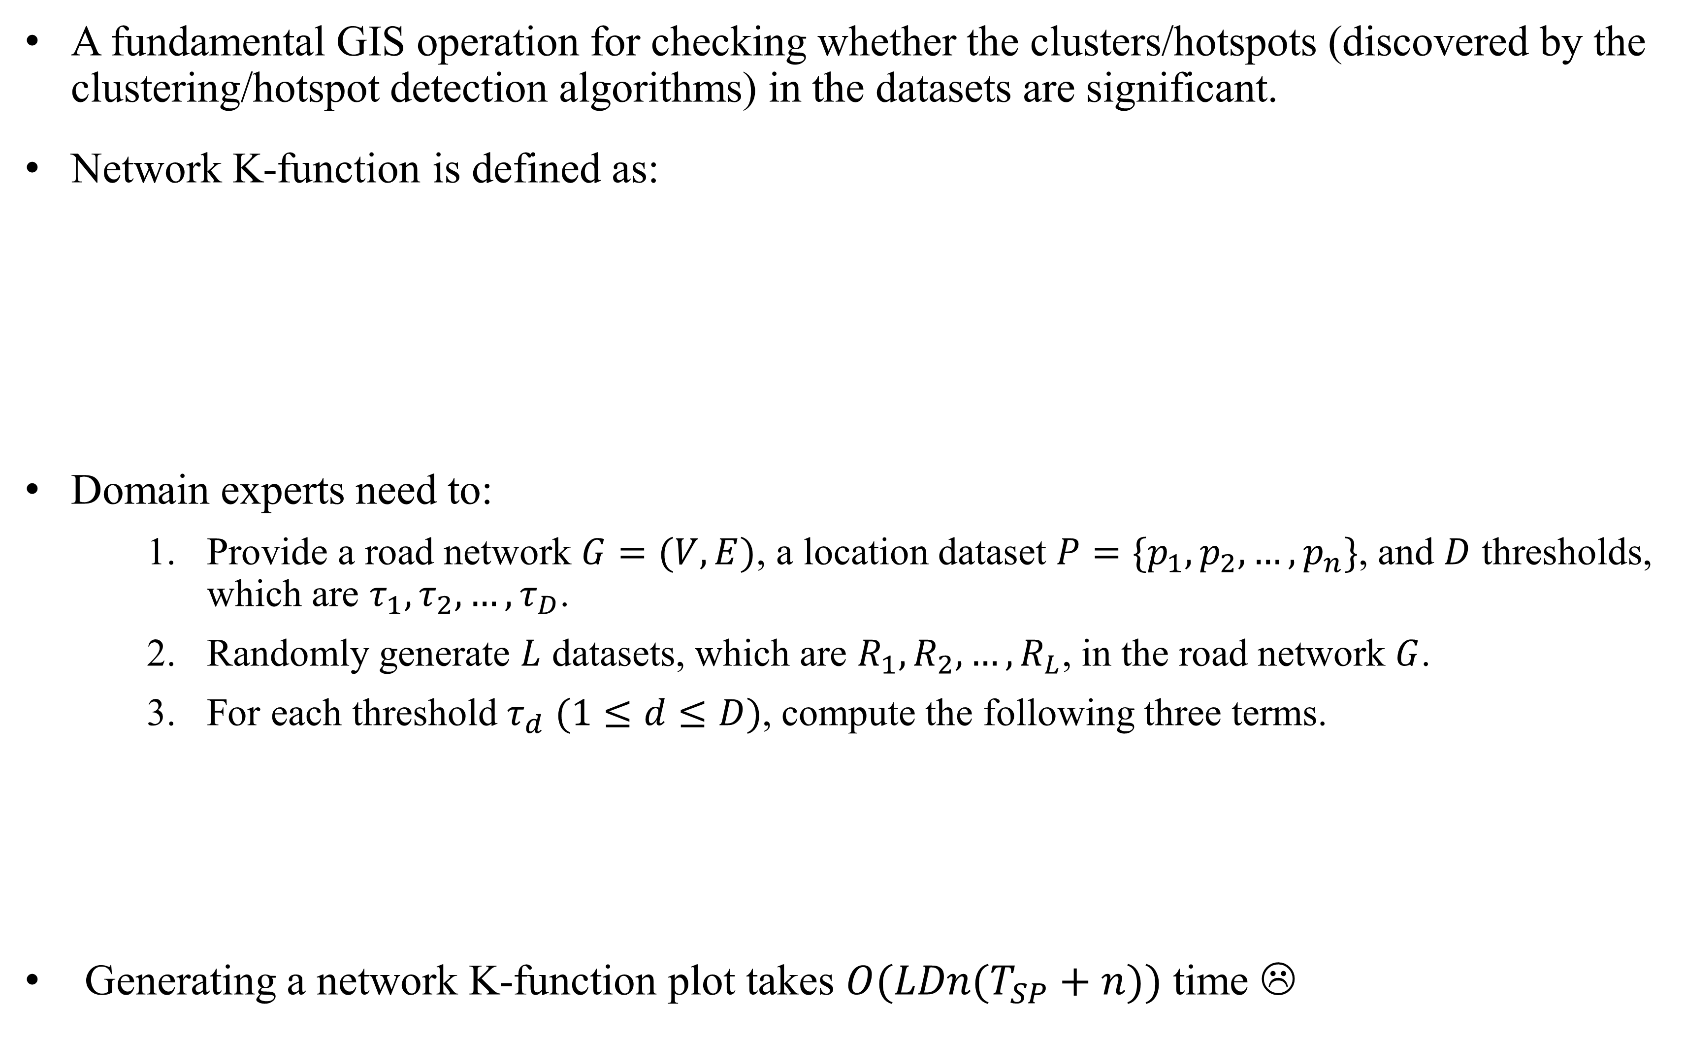
Fast Network K-function-based Spatial Analysis
Tsz Nam Chan
Hong Kong Baptist University
edisonchan@comp.hkbu.edu.hk
Leong Hou U
University of Macau
SKL of Internet of Things
for Smart City
paklonip@um.edu.mo
Yun Peng
Institute of Artificial Intelligence and
Blockchain, Guangzhou University
yunpeng@gzhu.edu.cn
Byron Choi
Hong Kong Baptist University
bchoi@comp.hkbu.edu.hk
Jianliang Xu
Hong Kong Baptist University
xujl@comp.hkbu.edu.hk
Overview of Network K-function
A fundamental GIS operation for checking whether the clusters/hotspots (discovered by the clustering/hotspot detection algorithms) in the datasets are significant.
Network K-function is defined as:
Domain experts need to:
Provide a road network $G=(V, E)$, a location dataset $P=\{p_{1},p_{2},…,p_{n}\}$, and $D$ thresholds, which are $τ_{1},τ_{2},…,τ_{D}$.
Randomly generate $L$ datasets, which are $R_{1}, R_{2}, …, R_{L}$, in the road network $G$.
For each threshold $τ_{d}$ $(1≤d≤D)$, compute the following three terms.
Generating a network K-function plot takes $O(LDn(T_{SP}+n))$ time ☹
Shortest path distance
$$K_{P}\left(τ\right)=\sum_{p_{i}∈P}{\sum_{\begin{aligned}p_{j}∈P \\ p_{j}≠p_{i}\end{aligned}}{𝕝({dist}_{G}\left(p_{i},p_{j}\right)≤τ)}}$$
$O(n(T_{SP}+n))$ time ☹
Dispersed
Clustered
Dataset
Road network
Threshold
where $𝕝$ denotes an indicator function.
(1) $K_{P}\left(τ_{d}\right)$
(2) $ℒ\left(τ_{d}\right)=min⁡\left(K_{R_{1}}\left(τ_{d}\right),K_{R_{2}}\left(τ_{d}\right),…,K_{R_{L}}\left(τ_{d}\right)\right)$
(3) $U\left(τ_{d}\right)=max⁡\left(K_{R_{1}}\left(τ_{d}\right),K_{R_{2}}\left(τ_{d}\right),…,K_{R_{L}}\left(τ_{d}\right)\right)$
A network K-function plot
Decompose the Network K-function
Neighbor-Sharing (NS) Method
Let $P(e)$ be the set of data points in an edge $e$ of a road network.
There are four possible routes with length $τ$ from any data point $p_{i}$ in the edge $\tilde{e}=(a,b)$ to the edge $e=(u,v)$. We have:
Maintain four sets of data points in the edge $e=(u,v)$.
These four sets of data points exhibit the monotonicity property.
Takes $O(\left|P\left(\tilde{e}\right)\right|+\left|P(e)\right|)$) time to compute $C_{P}^{\left(\tilde{e},e\right)}\left(τ\right)$ ☺
Takes $O\left(LD\left(\left|E\right|T_{SP}+n\left|E\right|\right)+Ln\log{n}\right)$ time to generate the network K-function plot (Refer to the paper) ☺
$$K_{P}\left(τ\right)=\sum_{p_{i}∈P}{\sum_{\begin{aligned}p_{j}∈P \\ p_{j}≠p_{i}\end{aligned}}{𝕝({dist}_{G}\left(p_{i},p_{j}\right)≤τ)}}$$
$$=\sum_{\tilde{e}∈E}{\sum_{p_{i}∈P(\tilde{e})}{\sum_{e∈E}{\sum_{p_{j}∈P(e)}{𝕝({dist}_{G}\left(p_{i},p_{j}\right)≤τ)}}}}$$
$$=\sum_{\tilde{e}∈E}{\sum_{e∈E}{C_{P}^{\left(\tilde{e},e\right)}(τ)}}$$
where
$$C_{P}^{\left(\tilde{e},e\right)}\left(τ\right)=\sum_{p_{i}∈P(\tilde{e})}{\sum_{p_{j}∈P(e)}{𝕝({dist}_{G}\left(p_{i},p_{j}\right)≤τ)}}$$
Question: Can we reduce the time complexity for computing the $\left(\tilde{e},e\right)$-count function $C_{P}^{\left(\tilde{e},e\right)}\left(τ\right)$ (e.g., from $O(\left|P(\tilde{e})\right|\left|P(e)\right|)$ to $O(\left|P\left(\tilde{e}\right)\right|+\left|P(e)\right|)$)?
Theoretical Results
Experimental Results
London
Chicago

