Slide 1


SAFE: A Share-and-Aggregate Bandwidth Exploration Framework for Kernel Density Visualization
(Edison) Tsz Nam Chan¹ Pak Lon Ip² Leong Hou U²
Byron Choi¹ Jianliang Xu¹
¹Hong Kong Baptist University ²University of Macau

Slide 2
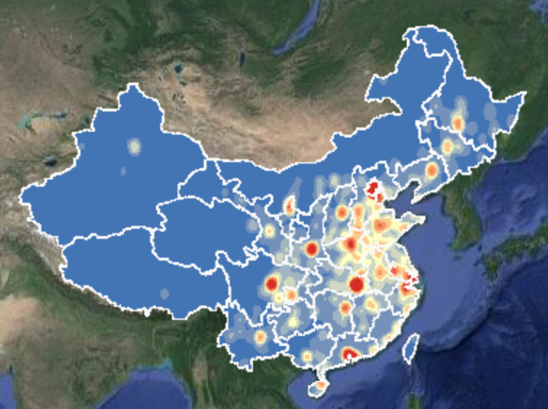
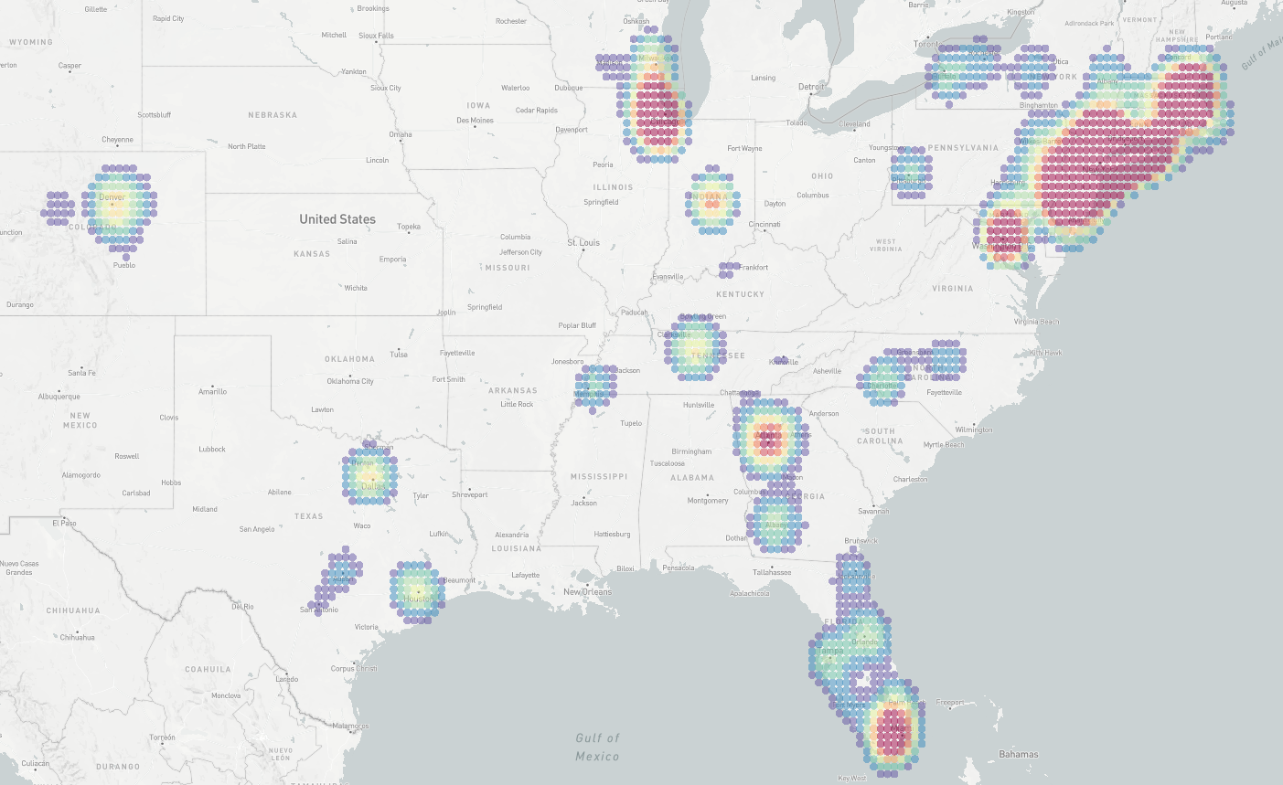
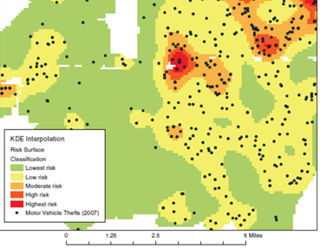
Why Kernel Density Visualization (KDV)?
(a) Density visualization of COVID-19 cases
(b) Density visualization of crime events
[1] http://drr.ikcest.org/knowledge_service/ncp.html
[2] T. N. Chan, P. L. Ip, L. H. U, W. H. Tong, S. Mittal, Y. Li, R. Cheng. "KDV-Explorer: A Near Real-Time Kernel Density Visualization System for Spatial Analysis" VLDB2021
[3] T. Hart and P. Zandbergen “Kernel density estimation and hotspot mapping Examining the influence of interpolation method, grid cell size, and bandwidth on crime forecasting”, International Journal of Police Strategies and Management 2014

Slide 3
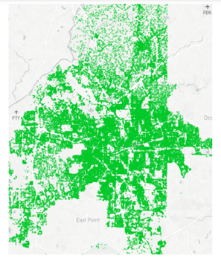
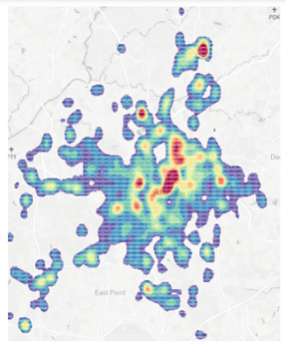

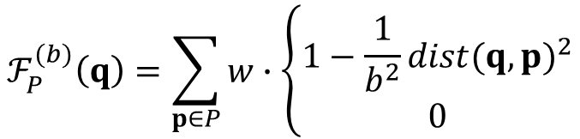

What is KDV?
Given a location dataset $P$, we need to color each pixel $q$ based on the kernel density function $ℱ_{P}^{(b)}(q)$.
High density: red color
Low density: blue color
2D pixel
weighting
Euclidean distance
$$ℱ_{P}^{(b)}\left(q\right)=\sum_{p∈P}{w}∙\left\{\begin{matrix}1−\frac{1}{b^{2}}{dist(q,p)}^{2} \\ 0\end{matrix}\right.$$
If $dist\left(q,p\right)≤b$
Crime location dataset
(in Atlanta)
Crime hotspot map
(based on KDV)
Otherwise
dataset
bandwidth

Slide 4
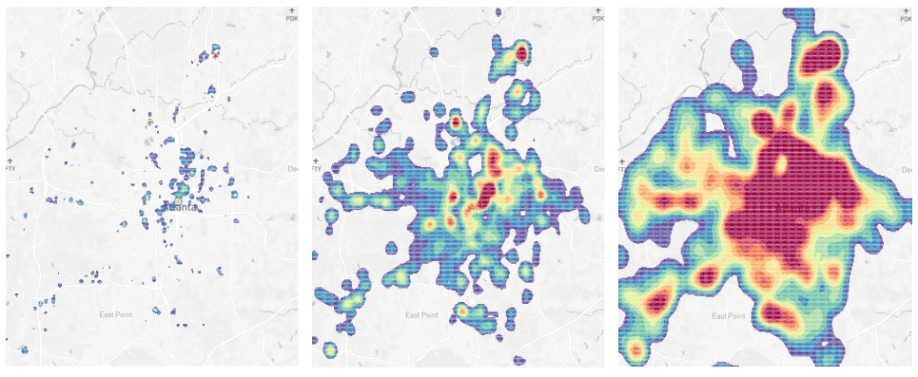



KDV is Sensitive to the Bandwidth Parameter!
$b$ is small
$b$ is moderate
$b$ is large
(undersmoothing)
(oversmoothing)
Research Question: Can we obtain the KDV with the best visual quality by generating multiple KDVs with different bandwidth values?

Slide 5
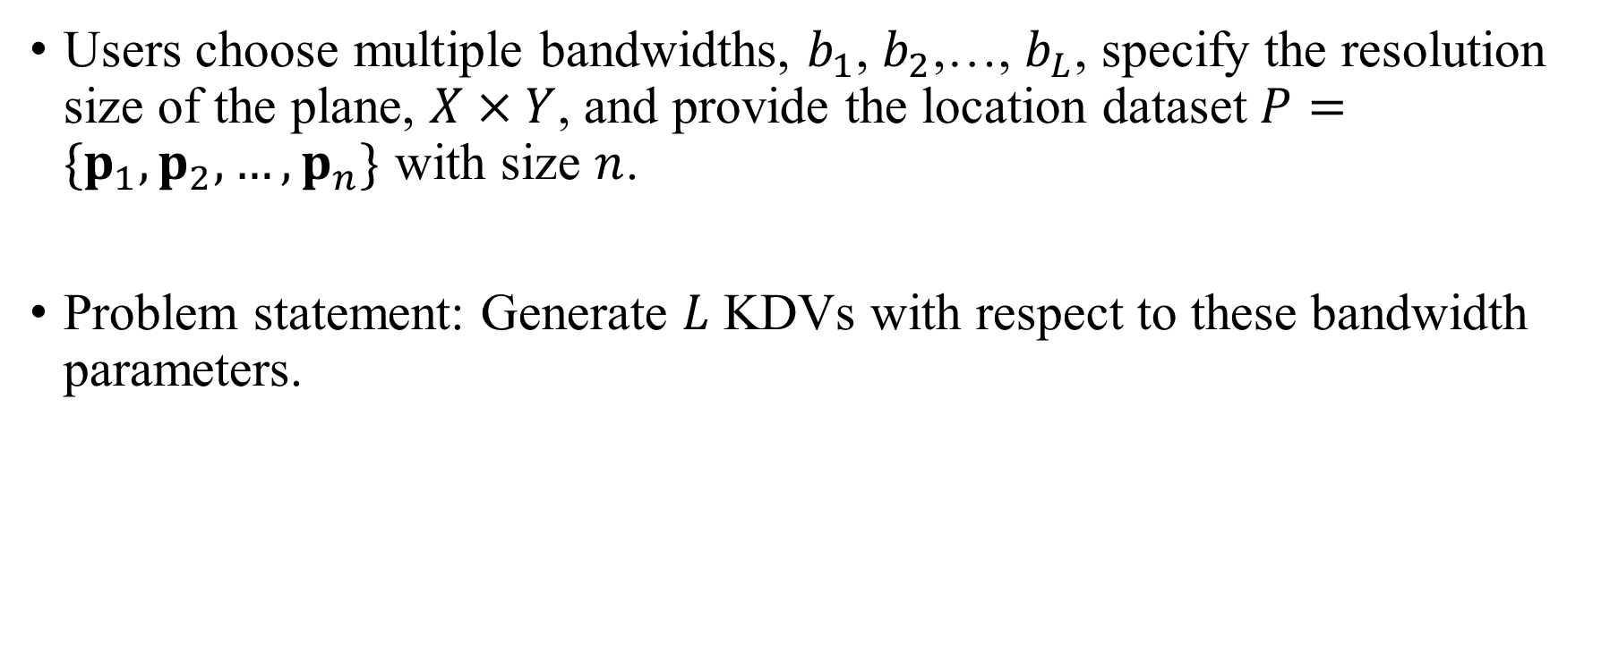
Bandwidth-tuning Operation (Problem)
Users choose multiple bandwidths, $b_{1}$, $b_{2}$,…, $b_{L}$, specify the resolution size of the plane, $X×Y$, and provide the location dataset $P=\{p_{1},p_{2},…,p_{n}\}$ with size $n$.
Problem statement: Generate $L$ KDVs with respect to these bandwidth parameters.

Slide 6
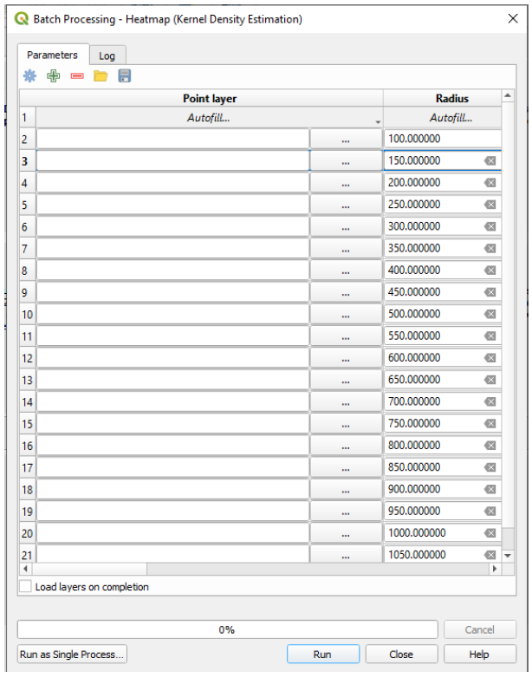
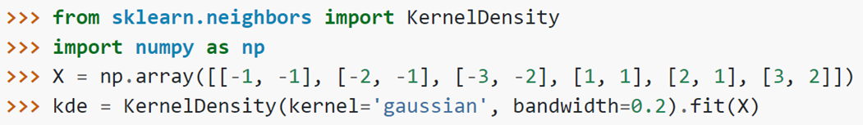
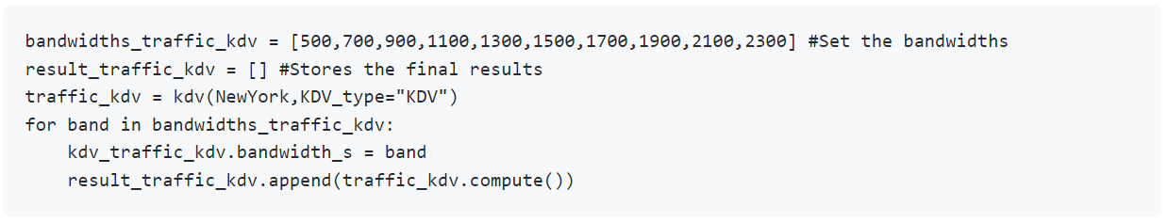
Many Software Packages Support the Bandwidth-tuning Operation
Scikit-learn
LIBKDV
Seaborn
QGIS

Slide 7
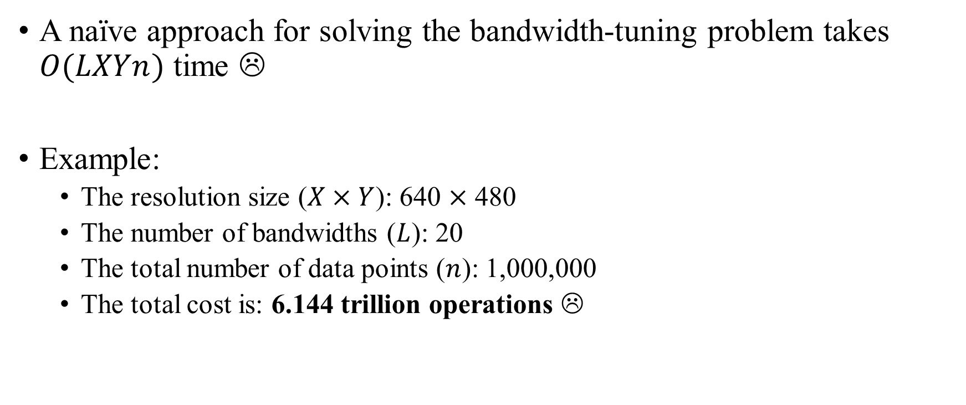
Bandwidth-tuning Operation is Slow!
A naïve approach for solving the bandwidth-tuning problem takes $O(LXYn)$ time ☹
Example:
The resolution size ($X×Y$): 640 $×$ 480
The number of bandwidths ($L$): 20
The total number of data points ($n$): 1,000,000
The total cost is: 6.144 trillion operations ☹

Slide 8
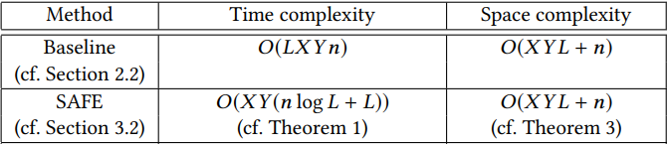
Our Main Contributions
Develop the first method, SAFE, that can reduce the time complexity for generating exact KDVs with multiple bandwidths, without increasing the space complexity.
Achieve at least one-order-of-magnitude speedup for generating multiple KDVs.

Slide 9


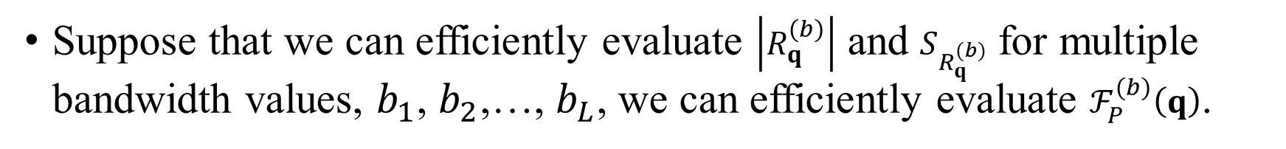
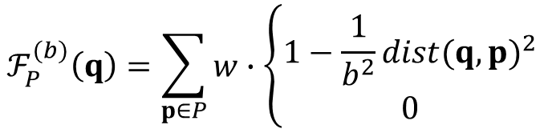
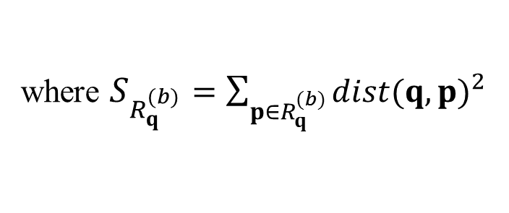

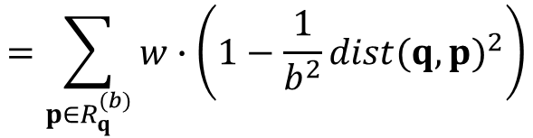
Core Idea 1: Decomposition of Kernel Density Function
$$ℱ_{P}^{(b)}\left(q\right)=\sum_{p∈P}{w}∙\left\{\begin{matrix}1−\frac{1}{b^{2}}{dist(q,p)}^{2} \\ 0\end{matrix}\right.$$
If $dist\left(q,p\right)≤b$
Otherwise
b
q
$$=\sum_{p∈R_{q}^{(b)}}{w}∙\left(1−\frac{1}{b^{2}}{dist(q,p)}^{2}\right)$$
$$=w\left|R_{q}^{(b)}\right|−\frac{w}{b^{2}}S_{R_{q}^{(b)}}$$
Range query set $R_{q}^{(b)}$
where $S_{R_{q}^{(b)}}=\sum_{p∈R_{q}^{(b)}}{{dist(q,p)}^{2}}$
Suppose that we can efficiently evaluate $\left|R_{q}^{(b)}\right|$ and $S_{R_{q}^{(b)}}$ for multiple bandwidth values, $b_{1}$, $b_{2}$,…, $b_{L}$, we can efficiently evaluate $ℱ_{P}^{(b)}\left(q\right)$.

Slide 10

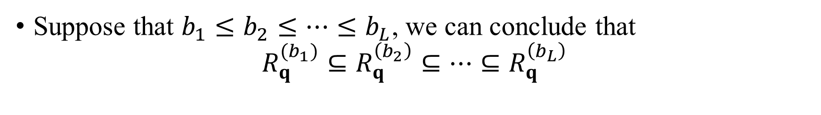


Core Idea 2: Exploit the Monotonicity Property of Range Query Set
…
…
$$b_{L}$$
$$b_{2}$$
$$b_{1}$$
q
…
…
Suppose that $b_{1}≤b_{2}≤…≤b_{L}$, we can conclude that $R_{q}^{(b_{1})}⊆R_{q}^{\left(b_{2}\right)}⊆…⊆R_{q}^{\left(b_{L}\right)}$

Slide 11
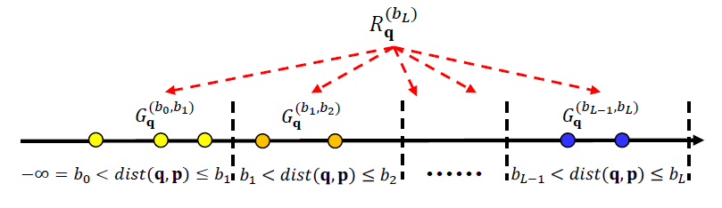
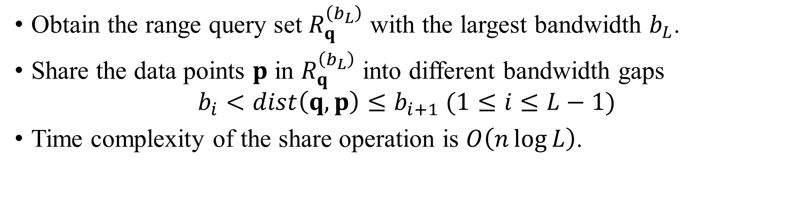
SAFE: Share Operation
Obtain the range query set $R_{q}^{\left(b_{L}\right)}$ with the largest bandwidth $b_{L}$.
Share the data points $p$ in $R_{q}^{\left(b_{L}\right)}$ into different bandwidth gaps $b_{i}<dist\left(q,p\right)≤b_{i+1} (1≤i≤L−1)$
Time complexity of the share operation is $O\left(n\log{L}\right)$.

Slide 12
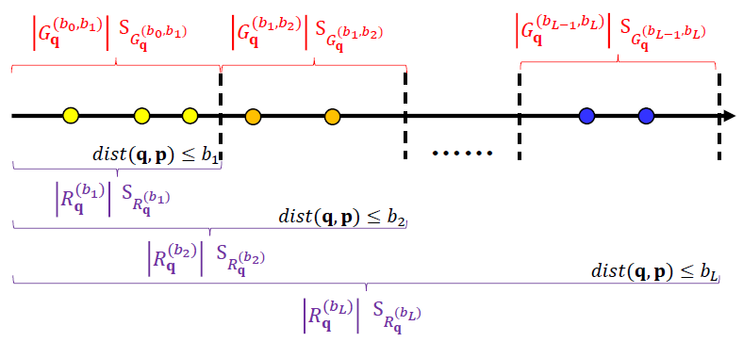
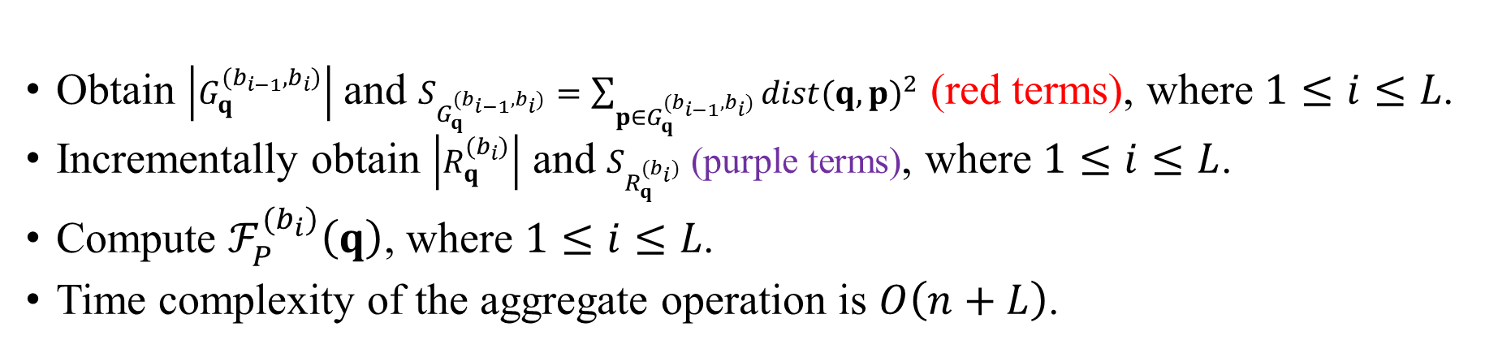
SAFE: Aggregate Operation
Obtain $\left|G_{q}^{(b_{i−1},b_{i})}\right|$ and $S_{G_{q}^{(b_{i−1},b_{i})}}=\sum_{p∈G_{q}^{(b_{i−1},b_{i})}}{{dist(q,p)}^{2}}$ (red terms), where $1≤i≤L$.
Incrementally obtain $\left|R_{q}^{(b_{i})}\right|$ and $S_{R_{q}^{(b_{i})}}$ (purple terms), where $1≤i≤L$.
Compute $ℱ_{P}^{(b_{i})}\left(q\right)$, where $1≤i≤L$.
Time complexity of the aggregate operation is $O\left(n+L\right)$.

Slide 13
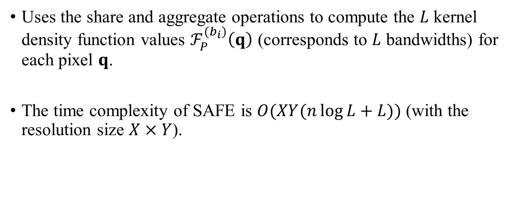
Summarization of SAFE
Uses the share and aggregate operations to compute the $L$ kernel density function values $ℱ_{P}^{(b_{i})}\left(q\right)$ (corresponds to $L$ bandwidths) for each pixel $q$.
The time complexity of SAFE is $O(XY(n\log{L}+L))$ (with the resolution size $X×Y$).

Slide 14
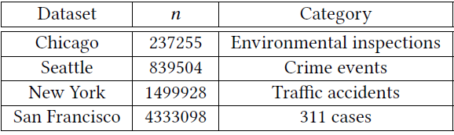
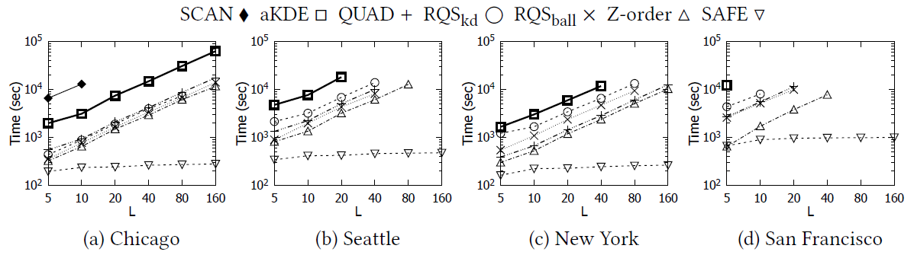

Experimental Evaluation
The resolution size is fixed to be 640 $×$ 480.

Slide 15
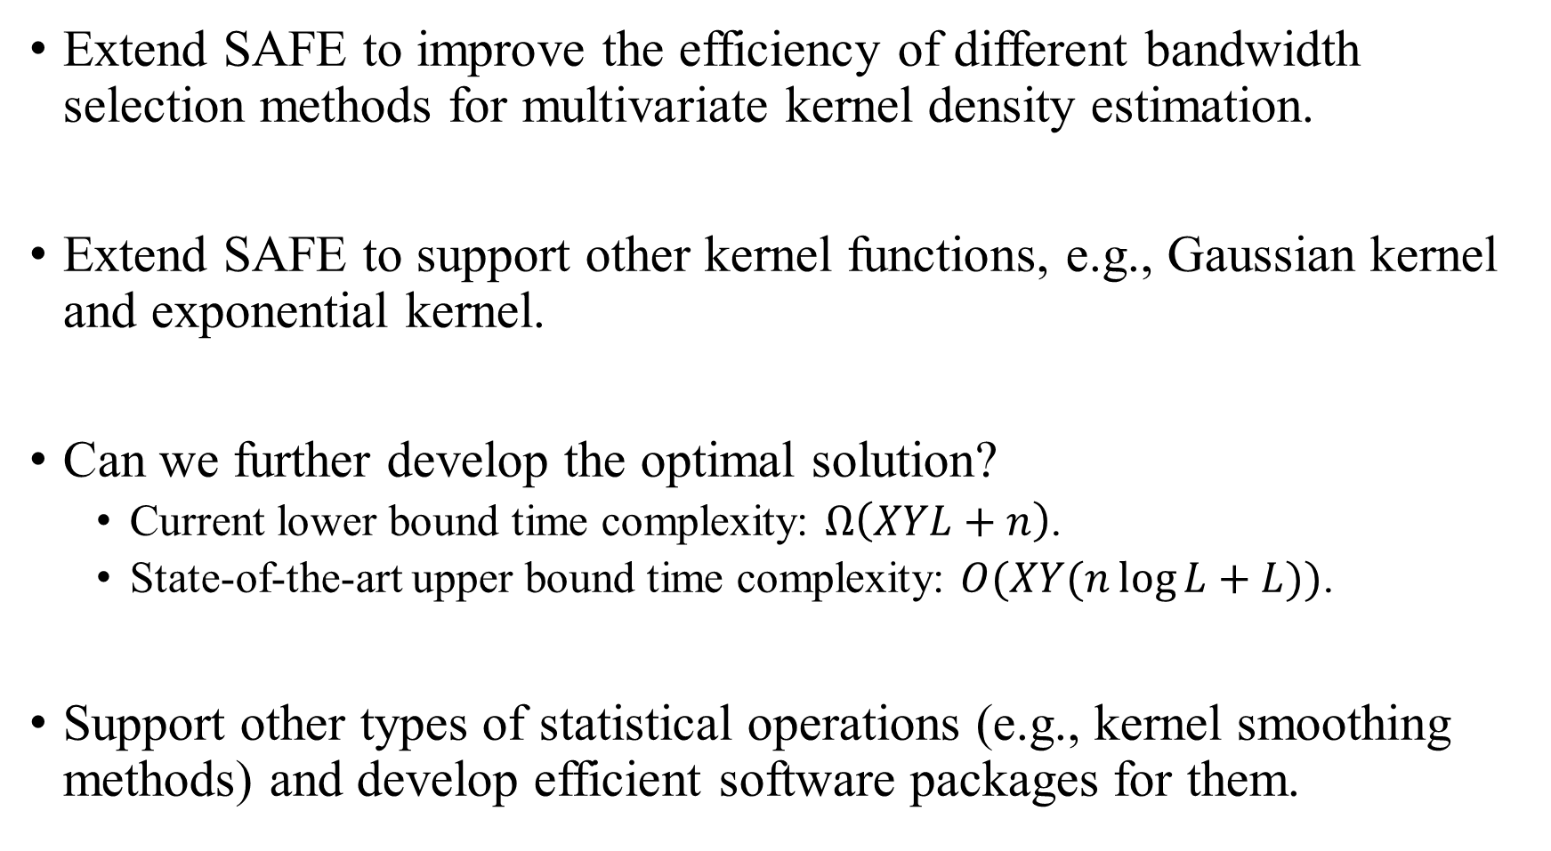
Ongoing Work and Future Opportunities
Extend SAFE to improve the efficiency of different bandwidth selection methods for multivariate kernel density estimation.
Extend SAFE to support other kernel functions, e.g., Gaussian kernel and exponential kernel.
Can we further develop the optimal solution?
Current lower bound time complexity: $Ω\left(XYL+n\right)$.
State-of-the-art upper bound time complexity: $O(XY(n\log{L}+L))$.
Support other types of statistical operations (e.g., kernel smoothing methods) and develop efficient software packages for them.

