Slide 1
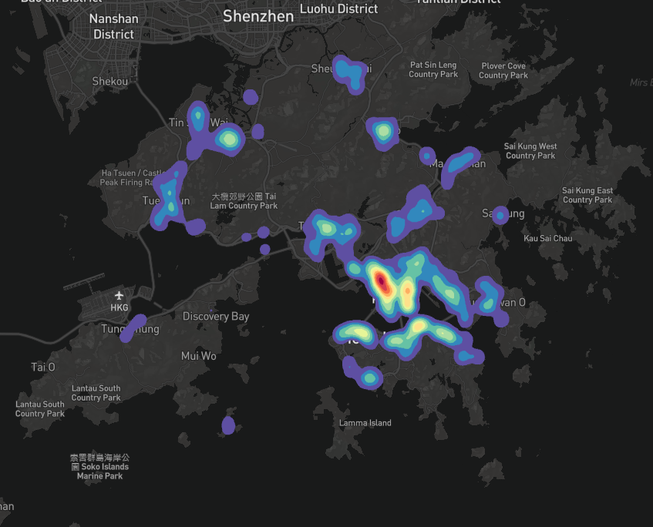
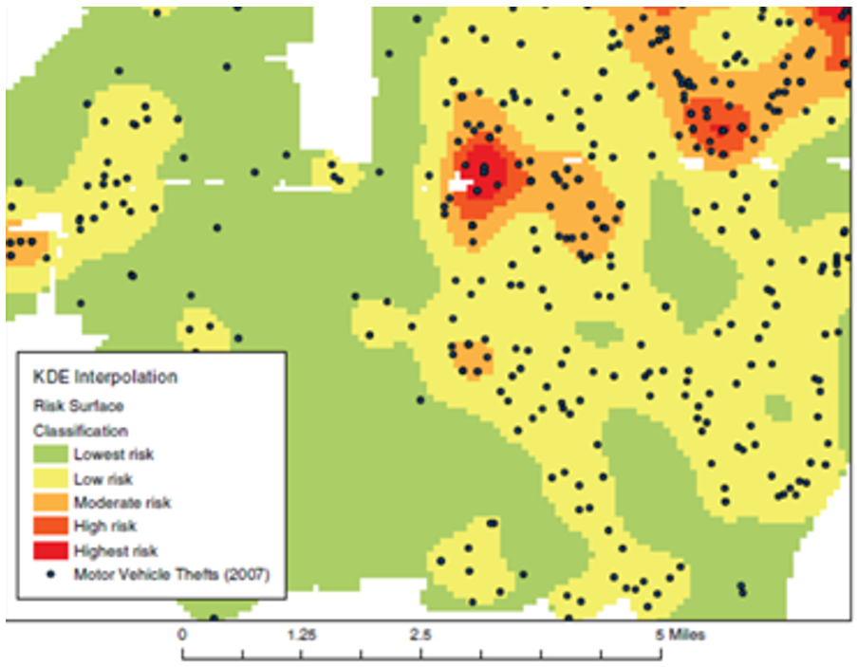
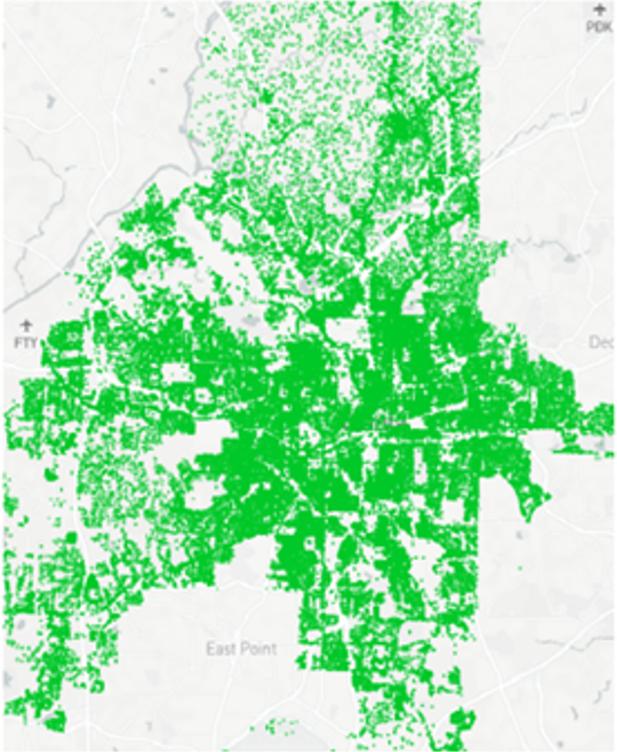
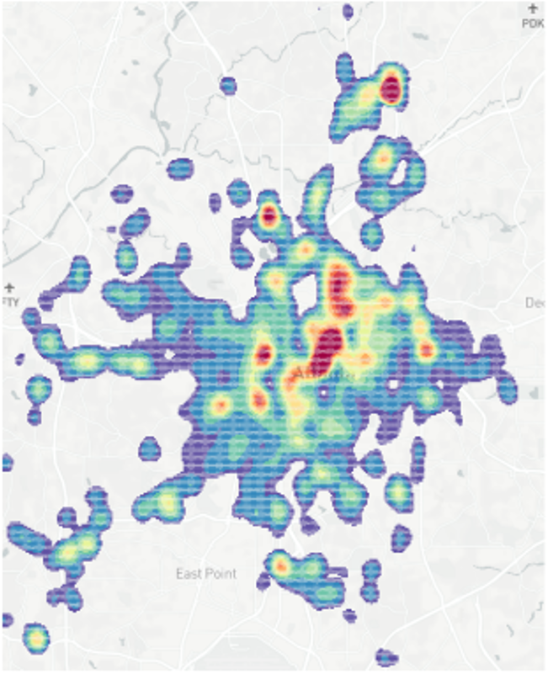
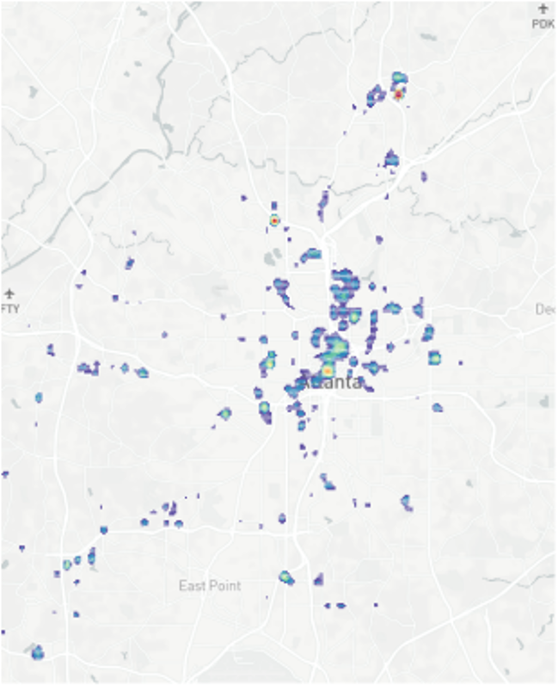
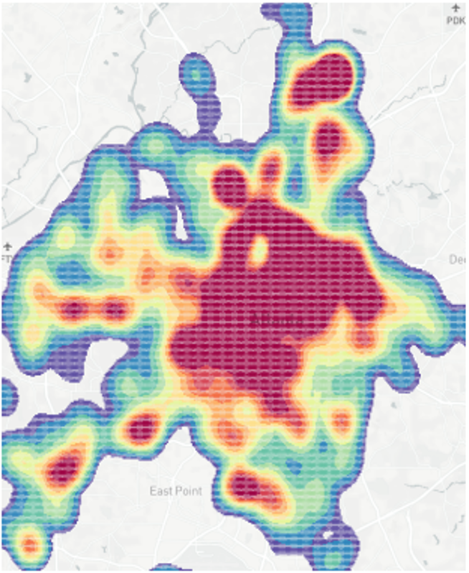
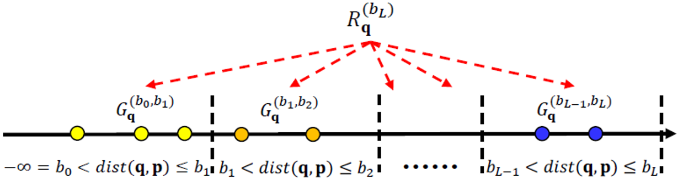
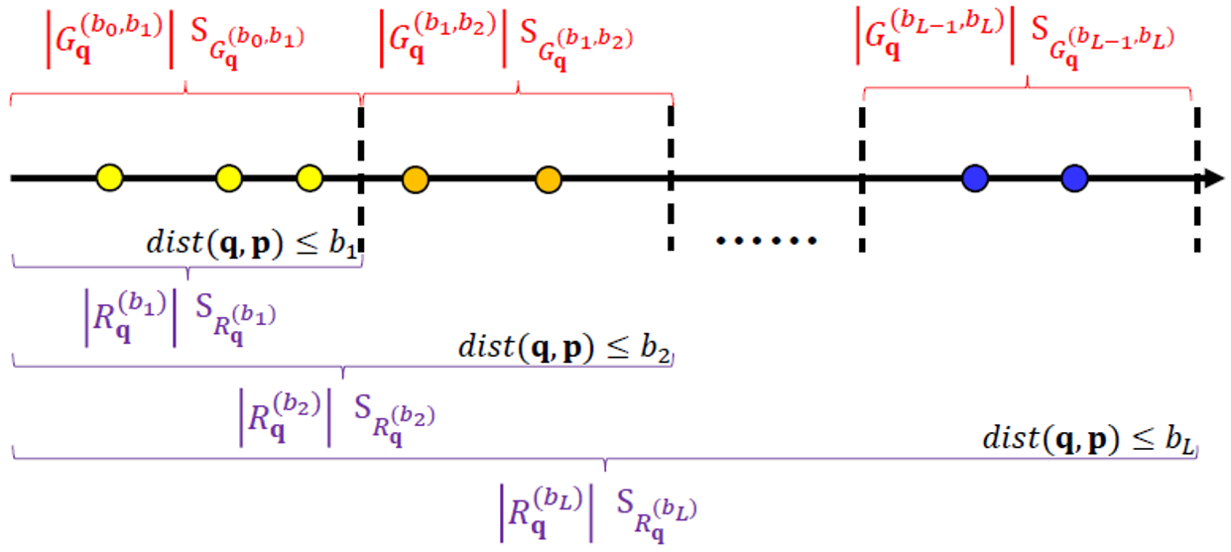
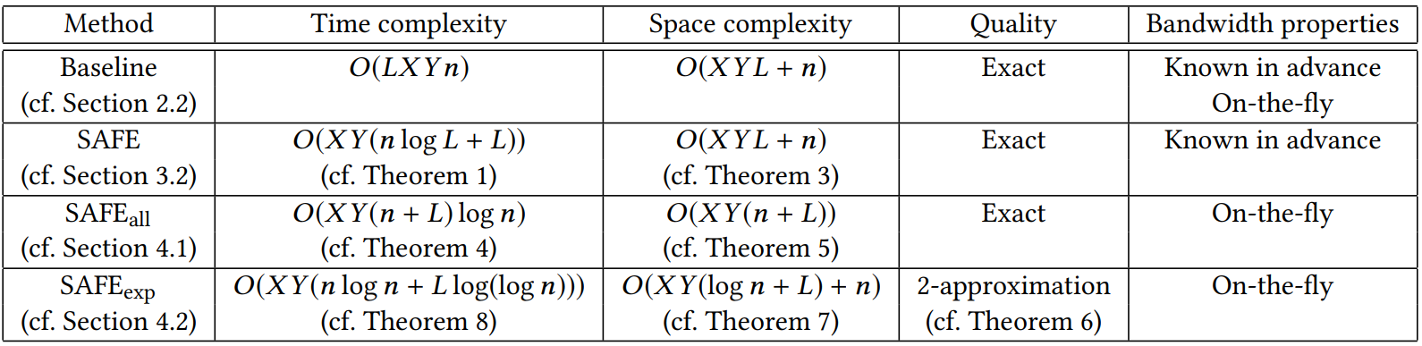
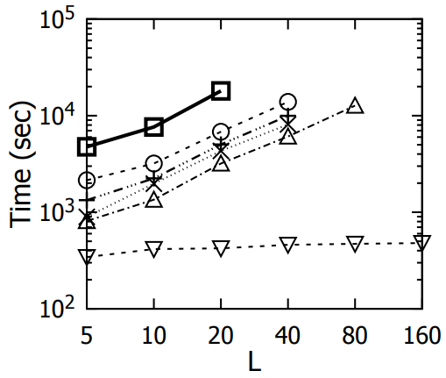
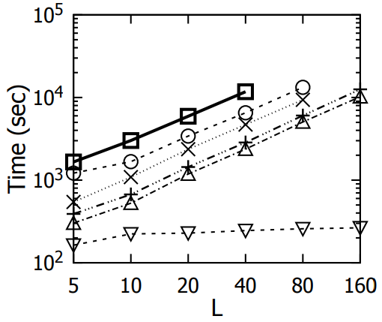
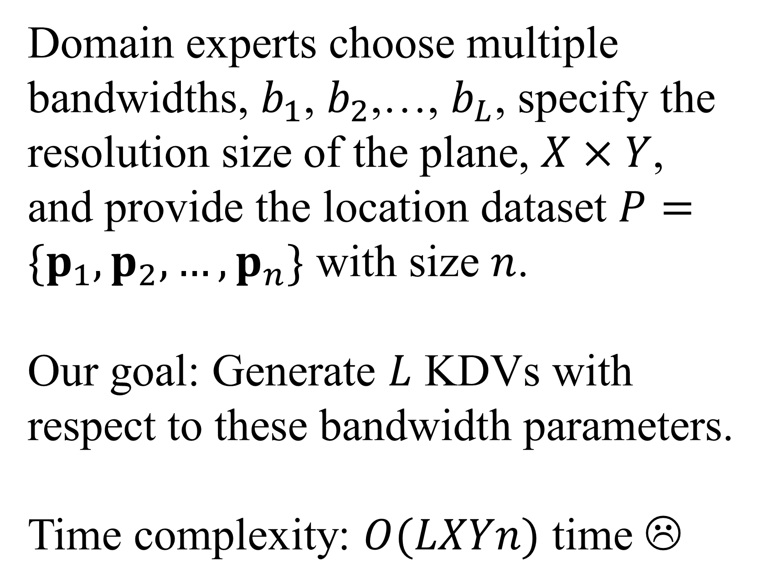
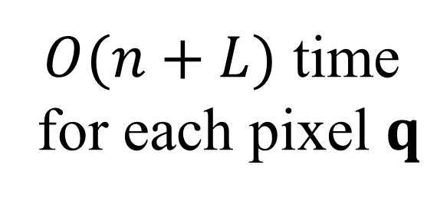
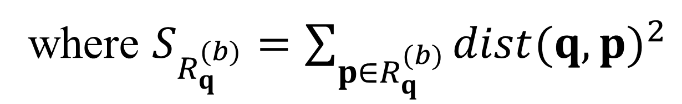
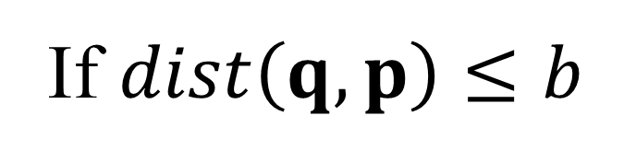
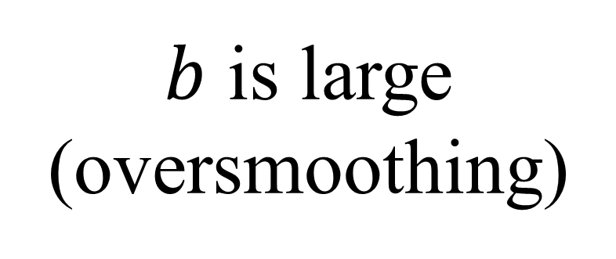
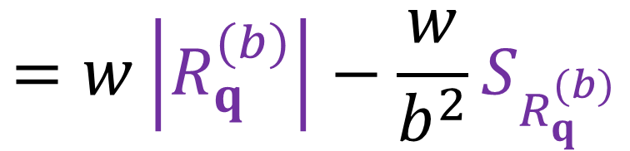
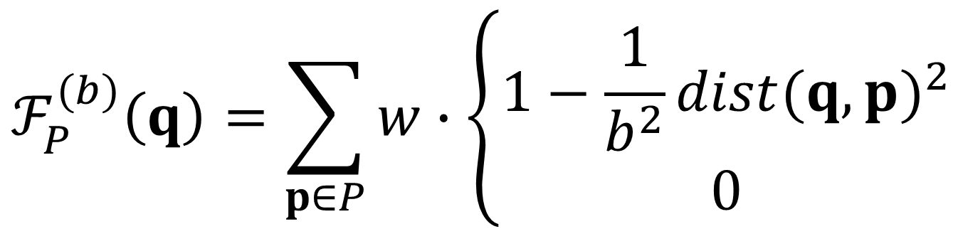
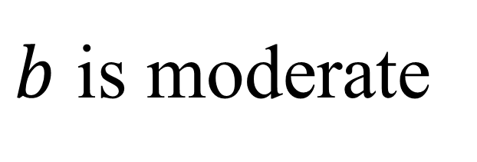
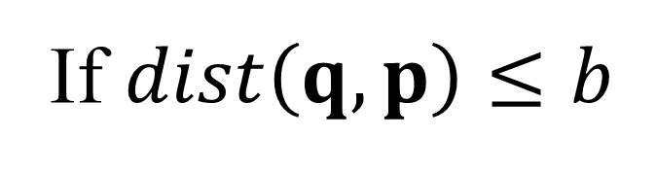
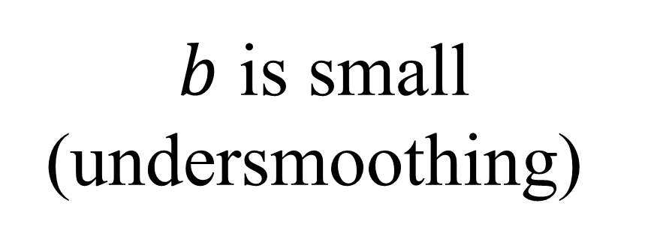
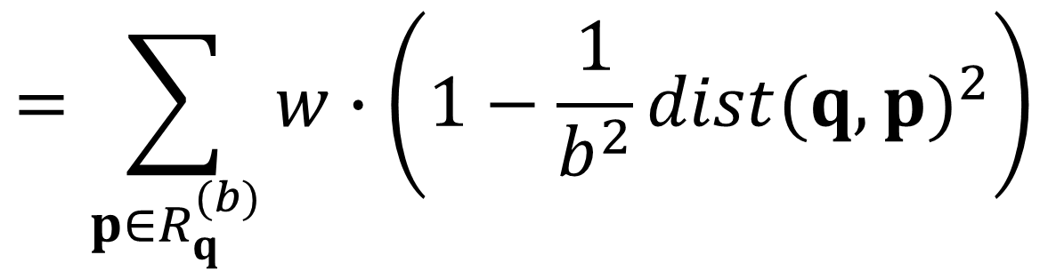
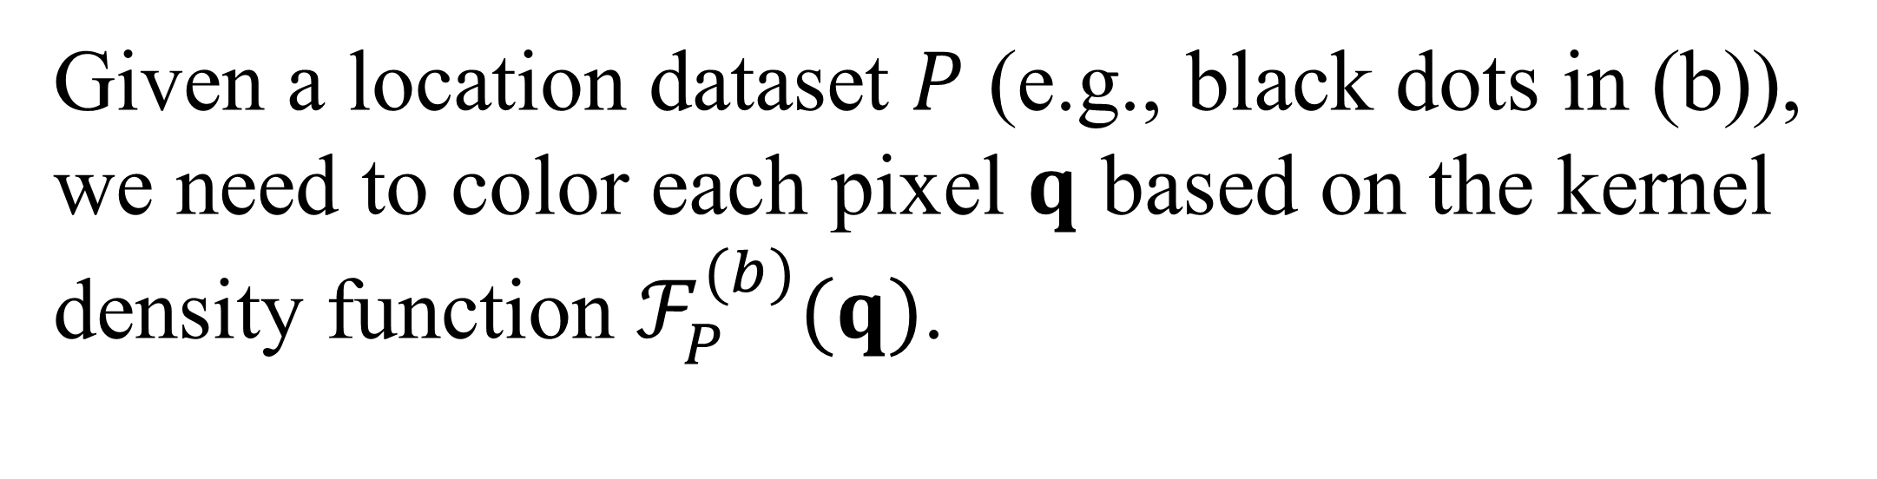
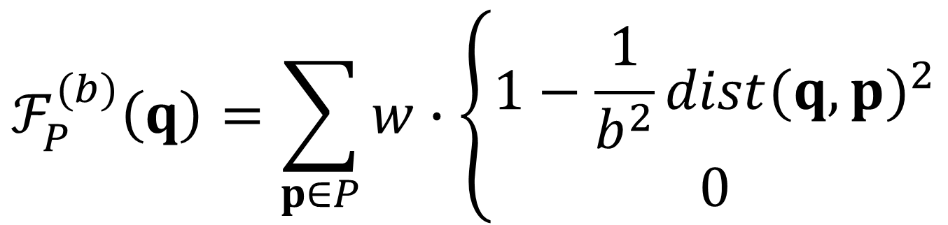
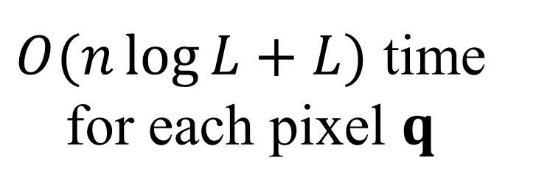
SAFE: A Share-and-Aggregate Bandwidth Exploration Framework for Kernel Density Visualization
Tsz Nam Chan
Hong Kong Baptist University
edisonchan@comp.hkbu.edu.hk
Pak Lon Ip
University of Macau
SKL of Internet of Things
for Smart City
paklonip@um.edu.mo
Leong Hou U
University of Macau
SKL of Internet of Things
for Smart City
ryanlhu@um.edu.mo
Byron Choi
Hong Kong Baptist University
bchoi@comp.hkbu.edu.hk
Jianliang Xu
Hong Kong Baptist University
xujl@comp.hkbu.edu.hk
Overview of Kernel Density Visualization (KDV)
Given a location dataset $P$ (e.g., black dots in (b)), we need to color each pixel $q$ based on the kernel density function $ℱ_{P}^{(b)}(q)$.
2D pixel
weighting
Euclidean distance
$$ℱ_{P}^{(b)}\left(q\right)=\sum_{p∈P}{w}∙\left\{\begin{matrix}1−\frac{1}{b^{2}}{dist(q,p)}^{2} \\ 0\end{matrix}\right.$$
If $dist\left(q,p\right)≤b$
COVID-19 hotspot map
(in Hong Kong)
(b) Crime hotspot map
(in Arlington, Taxes)
Otherwise
dataset
bandwidth
KDV is Sensitive to the Bandwidth Parameter $b$
Domain experts choose multiple bandwidths, $b_{1}$, $b_{2}$,…, $b_{L}$, specify the resolution size of the plane, $X×Y$, and provide the location dataset $P=\{p_{1},p_{2},…,p_{n}\}$ with size $n$.
Our goal: Generate $L$ KDVs with respect to these bandwidth parameters.
Time complexity: $O(LXYn)$ time ☹
Crime location data (in Atlanta)
$b$ is small (undersmoothing)
$b$ is moderate
$b$ is large (oversmoothing)
Share-and-Aggregate Framework (SAFE)
$$ℱ_{P}^{(b)}\left(q\right)=\sum_{p∈P}{w}∙\left\{\begin{matrix}1−\frac{1}{b^{2}}{dist(q,p)}^{2} \\ 0\end{matrix}\right.$$
If $dist\left(q,p\right)≤b$
Share
Otherwise
$O(n\log{L}+L)$ time for each pixel $q$
$$=\sum_{p∈R_{q}^{(b)}}{w}∙\left(1−\frac{1}{b^{2}}{dist(q,p)}^{2}\right)$$
Aggregate
$$=w\left|R_{q}^{(b)}\right|−\frac{w}{b^{2}}S_{R_{q}^{(b)}}$$
$O(n+L)$ time for each pixel $q$
where $S_{R_{q}^{(b)}}=\sum_{p∈R_{q}^{(b)}}{{dist(q,p)}^{2}}$
Theoretical Results
Experimental Results
Seattle
New York

