Slide 1


SWS: A Complexity-Optimized Solution for Spatial-Temporal Kernel Density Visualization
(Edison) Tsz Nam Chan¹ Pak Lon Ip² Leong Hou U²
Byron Choi¹ Jianliang Xu¹
¹Hong Kong Baptist University ²University of Macau

Slide 2
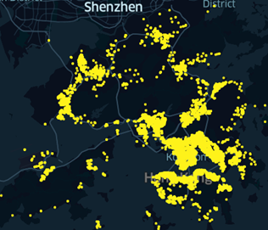
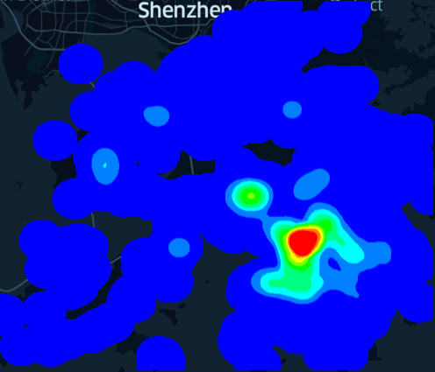
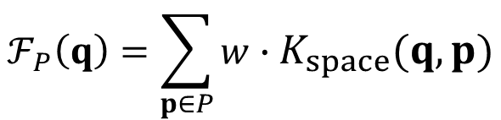
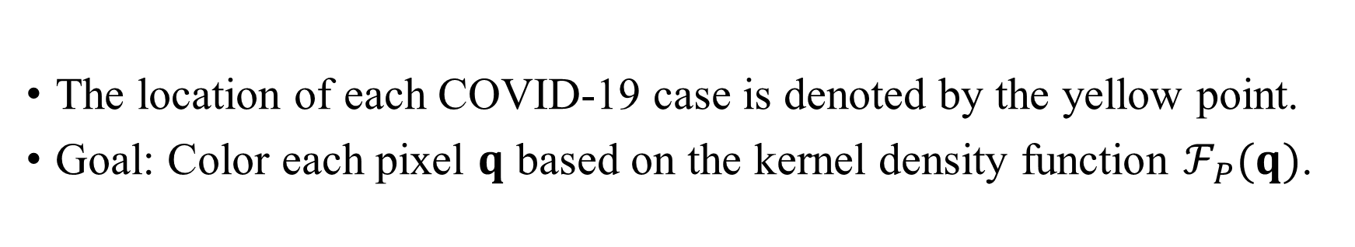
Overview of Kernel Density Visualization (KDV)
Hong Kong COVID-19 cases
Hotspot map (based on KDV)
The location of each COVID-19 case is denoted by the yellow point.
Goal: Color each pixel $q$ based on the kernel density function $ℱ_{P}(q)$.
$$ℱ_{P}\left(q\right)=\sum_{p∈P}{w}∙K_{space}(q,p)$$

Slide 3
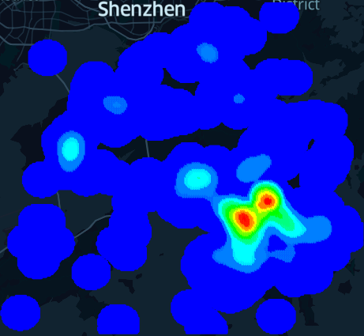
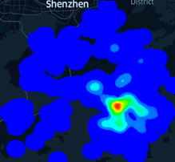
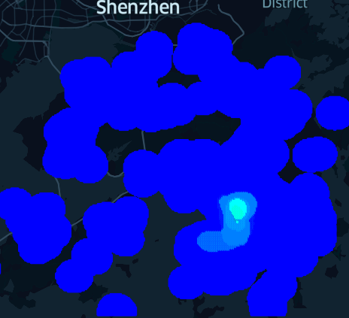
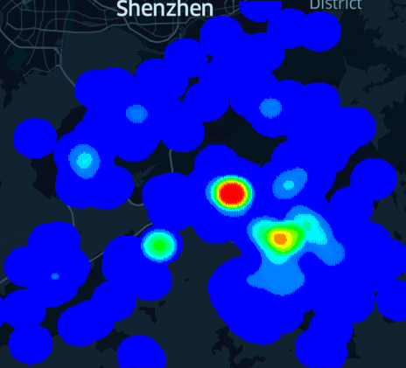
Weakness of KDV
Does not consider the occurrence time of each geographical event ☹
2nd August 2020
6th December 2020
Hong Kong COVID-19 cases
Hotspot map (based on KDV)
28th February 2021
28th January 2022

Slide 4
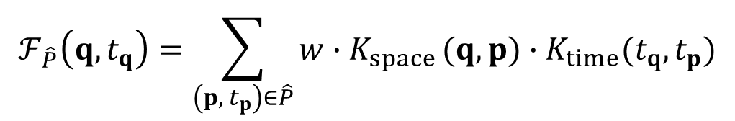
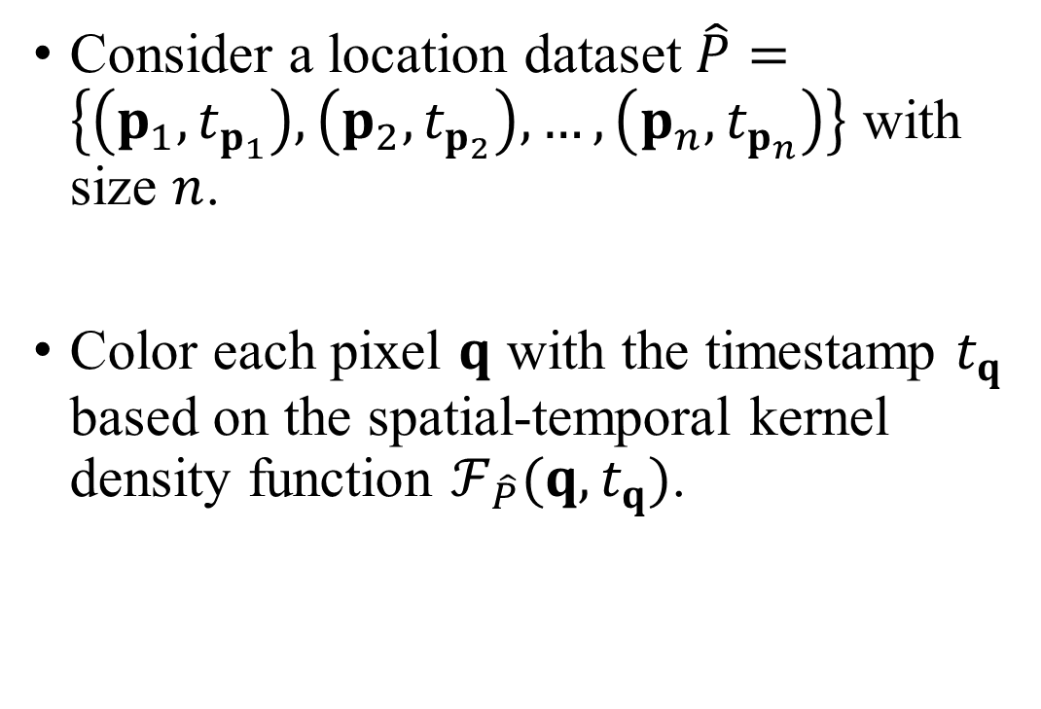
Spatial-Temporal Kernel Density Visualization (STKDV)
Consider a location dataset $\hat{P}=\left\{\left(p_{1}, t_{p_{1}}\right),\left(p_{2}, t_{p_{2}}\right),…,\left(p_{n}, t_{p_{n}}\right)\right\}$ with size $n$.
Color each pixel $q$ with the timestamp $t_{q}$ based on the spatial-temporal kernel density function $ℱ_{\hat{P}}(q,t_{q})$.
2nd August 2020
6th December 2020
$$ℱ_{\hat{P}}\left(q,t_{q}\right)=\sum_{\left(p, { t}_{p}\right)∈\hat{P}}{w∙K_{space}}(q,p)∙K_{time}(t_{q},t_{p})$$
28th February 2021
28th January 2022

Slide 5
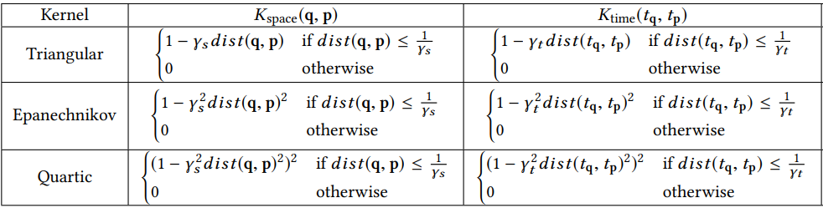
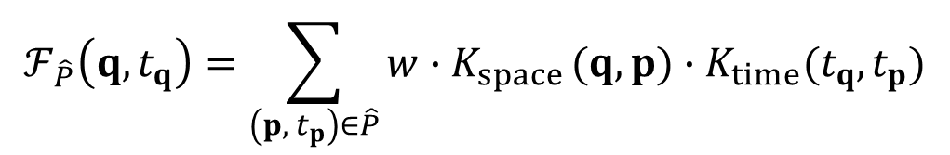

Spatial-Temporal Kernel Density Visualization (STKDV)
Some representative spatial and temporal kernel functions that are used in the spatial-temporal kernel density function $ℱ_{\hat{P}}(q,t_{q})$.
$$ℱ_{\hat{P}}\left(q,t_{q}\right)=\sum_{\left(p, { t}_{p}\right)∈\hat{P}}{w∙K_{space}}(q,p)∙K_{time}(t_{q},t_{p})$$

Slide 6
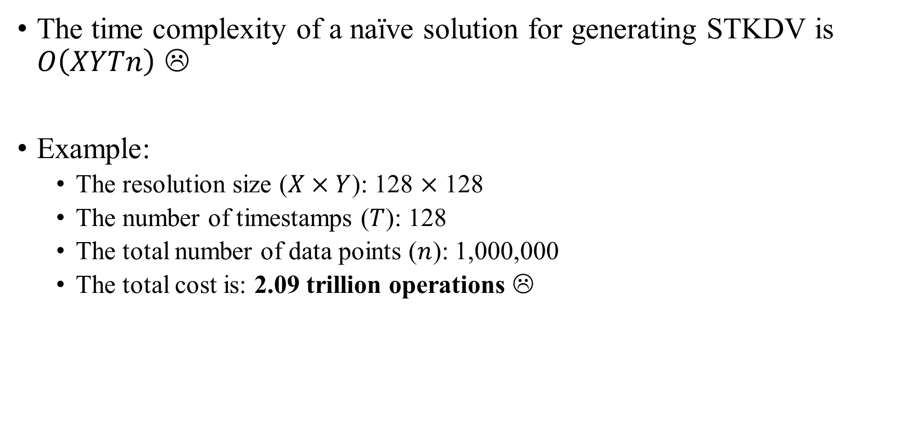
STKDV is Slow!
The time complexity of a naïve solution for generating STKDV is $O\left(XYTn\right)$ ☹
Example:
The resolution size ($X×Y$): 128 $×$ 128
The number of timestamps ($T$): 128
The total number of data points ($n$): 1,000,000
The total cost is: 2.09 trillion operations ☹

Slide 7
Many Complaints from Domain Experts
Delmelle et al. [1] “Expanding the KDE algorithm to integrate the temporal dimension is computationally demanding…”
Hohl et al. [2] “The temporal extension of the KDE is known as the space-time kernel density estimation (STKDE) and essentially maps a volume of disease intensity along the space-time domain (Nakaya and Yano 2010). However, the above methods are computationally intensive…”
[1] Eric Delmelle, Coline Dony, Irene Casas, Meijuan Jia, and Wenwu Tang. 2014. Visualizing the impact of space-time uncertainties on dengue fever patterns. International Journal of Geographical Information Science 28, 5 (2014), 1107–1127.
[2] Alexander Hohl, Eric Delmelle, Wenwu Tang, and Irene Casas. 2016. Accelerating the discovery of space-time patterns of infectious diseases using parallel computing. Spatial and Spatio-temporal Epidemiology 19 (2016), 10 – 20.

Slide 8
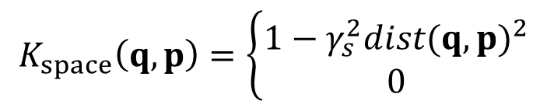
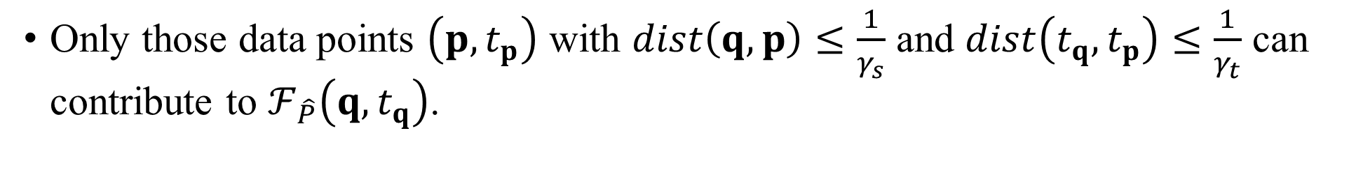
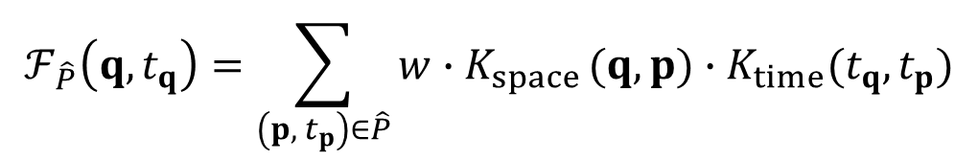
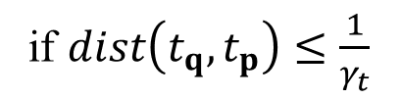
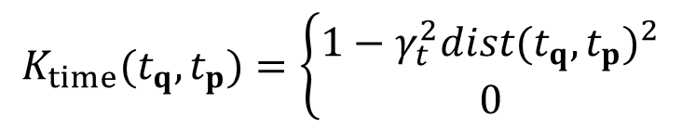
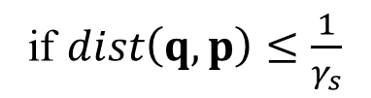
Range-Query-based Solution (RQS)
Recall that:
where (with the Epanechnikov kernel):
$$ℱ_{\hat{P}}\left(q,t_{q}\right)=\sum_{\left(p, { t}_{p}\right)∈\hat{P}}{w∙K_{space}}(q,p)∙K_{time}(t_{q},t_{p})$$
$$K_{space}\left(q,p\right)=\left\{\begin{matrix}1−γ_{s}^{2}{dist(q,p)}^{2} \\ 0\end{matrix}\right.$$
if $dist\left(q,p\right)≤\frac{1}{γ_{s}}$
otherwise
$$K_{time}(t_{q},t_{p})=\left\{\begin{matrix}1−γ_{t}^{2}{dist(t_{q},t_{p})}^{2} \\ 0\end{matrix}\right.$$
if $dist\left(t_{q},t_{p}\right)≤\frac{1}{γ_{t}}$
otherwise
Only those data points $\left(p, t_{p}\right)$ with $dist\left(q,p\right)≤\frac{1}{γ_{s}}$ and $dist\left(t_{q},t_{p}\right)≤\frac{1}{γ_{t}}$ can contribute to $ℱ_{\hat{P}}\left(q,t_{q}\right)$.

Slide 9
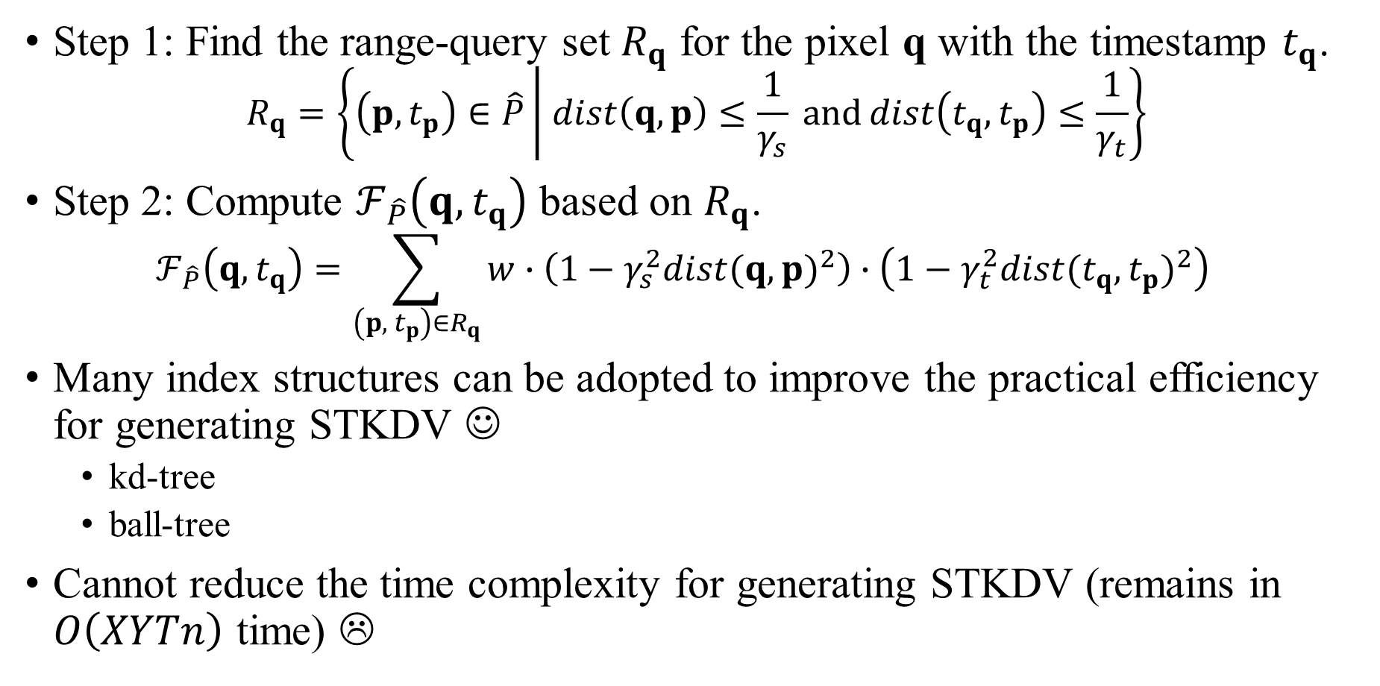
Range-Query-based Solution (RQS)
Step 1: Find the range-query set $R_{q}$ for the pixel q with the timestamp $t_{q}$. $R_{q}=\left\{\left(p, t_{p}\right)∈\hat{P}\left| dist\left(q,p\right)≤\frac{1}{γ_{s}} and\right.dist\left(t_{q},t_{p}\right)≤\frac{1}{γ_{t}}\right\}$
Step 2: Compute $ℱ_{\hat{P}}\left(q,t_{q}\right)$ based on $R_{q}$. $ℱ_{\hat{P}}\left(q,t_{q}\right)=\sum_{\left(p, { t}_{p}\right)∈R_{q}}{w∙\left(1−γ_{s}^{2}{dist(q,p)}^{2}\right)∙\left(1−γ_{t}^{2}{dist(t_{q},t_{p})}^{2}\right)}$
Many index structures can be adopted to improve the practical efficiency for generating STKDV ☺
kd-tree
ball-tree
Cannot reduce the time complexity for generating STKDV (remains in $O\left(XYTn\right)$ time) ☹

Slide 10
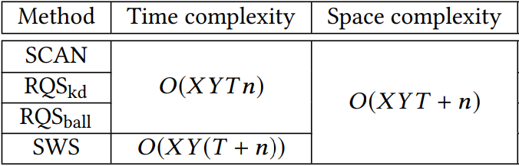
Our Contributions
Theory: Reduce the time complexity for generating exact STKDV, without increasing the space complexity ☺
Practice: Achieve 1.71x to 24x speedup compared with the state-of-the-art method (RQS) ☺

Slide 11
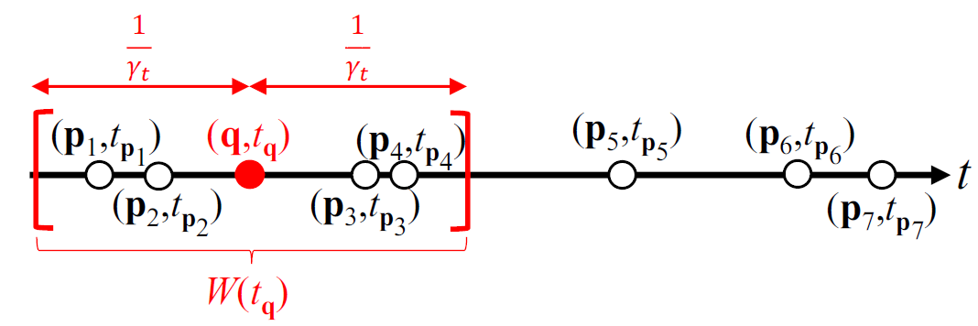

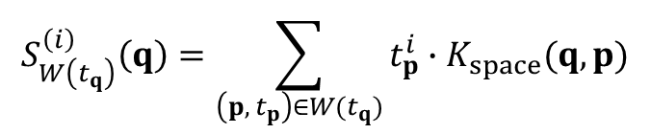
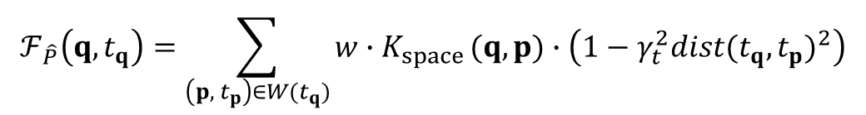
Core Idea 1 of SWS: Sliding Window
Establish the sliding window in the temporal dimension.
Only $\left(p_{1}, t_{p_{1}}\right)$, $\left(p_{2}, t_{p_{2}}\right)$, $\left(p_{3}, t_{p_{3}}\right)$, and $\left(p_{4}, t_{p_{4}}\right)$ can contribute to $ℱ_{\hat{P}}\left(q,t_{q}\right)$.
$$ℱ_{\hat{P}}\left(q,t_{q}\right)=\sum_{\left(p, { t}_{p}\right)∈W(t_{q})}{w∙K_{space}}(q,p)∙\left(1−γ_{t}^{2}{dist(t_{q},t_{p})}^{2}\right)$$
$$=w\left(1−γ_{t}^{2}t_{q}^{2}\right)∙S_{W\left(t_{q}\right)}^{\left(0\right)}\left(q\right)+2wγ_{t}^{2}t_{q}∙S_{W\left(t_{q}\right)}^{\left(1\right)}\left(q\right)−wγ_{t}^{2}∙S_{W\left(t_{q}\right)}^{\left(2\right)}\left(q\right)$$
$$S_{W\left(t_{q}\right)}^{\left(i\right)}\left(q\right)=\sum_{\left(p, { t}_{p}\right)∈W(t_{q})}{t_{p}^{i}∙K_{space}(q,p)}$$

Slide 12
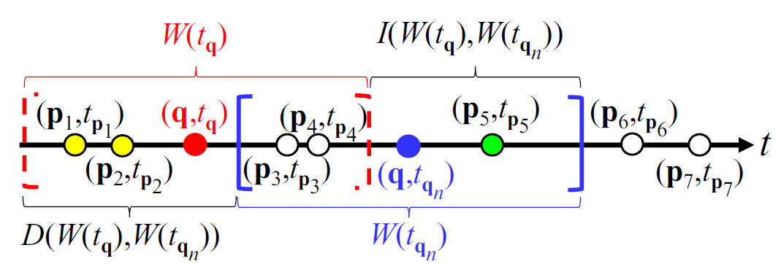
Core Idea 2 of SWS: Incremental Computation
$$S_{W\left(t_{q_{n}}\right)}^{\left(i\right)}\left(q\right)=S_{W\left(t_{q}\right)}^{\left(i\right)}\left(q\right)−\sum_{\left(p, { t}_{p}\right)∈D\left(W\left(t_{q}\right),W\left(t_{q_{n}}\right)\right)}{t_{p}^{i}∙K_{space}\left(q,p\right)}+\sum_{\left(p, { t}_{p}\right)∈I(W\left(t_{q}\right),W\left(t_{q_{n}}\right))}{t_{p}^{i}∙K_{space}(q,p)}$$
The time complexity is
$$O\left(\left|I\left(W\left(t_{q}\right),W\left(t_{q_{n}}\right)\right)\right|+\left|D\left(W\left(t_{q}\right),W\left(t_{q_{n}}\right)\right)\right|\right)$$

Slide 13
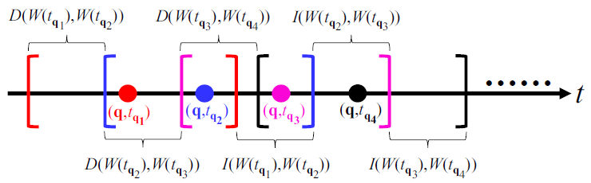
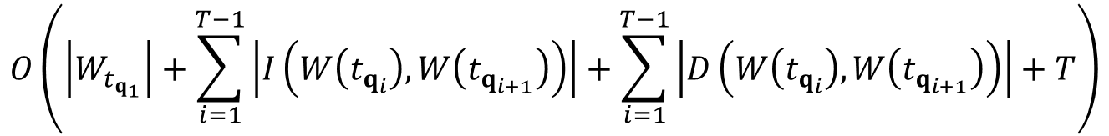

Core Idea 2 of SWS: Incremental Computation
$$O\left(\left|W_{t_{q_{1}}}\right|+\sum_{i=1}^{T−1}{\left|I\left(W\left(t_{q_{i}}\right),W\left(t_{q_{i+1}}\right)\right)\right|}+\sum_{i=1}^{T−1}{\left|D\left(W\left(t_{q_{i}}\right),W\left(t_{q_{i+1}}\right)\right)\right|+T}\right)$$
The time complexity is
$$=O\left(T+n\right)$$
There are $X×Y$ pixels $⇒$ Generating STKDV is $O\left(XY(T+n)\right)$ time ☺

Slide 14
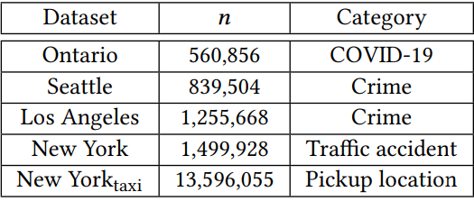
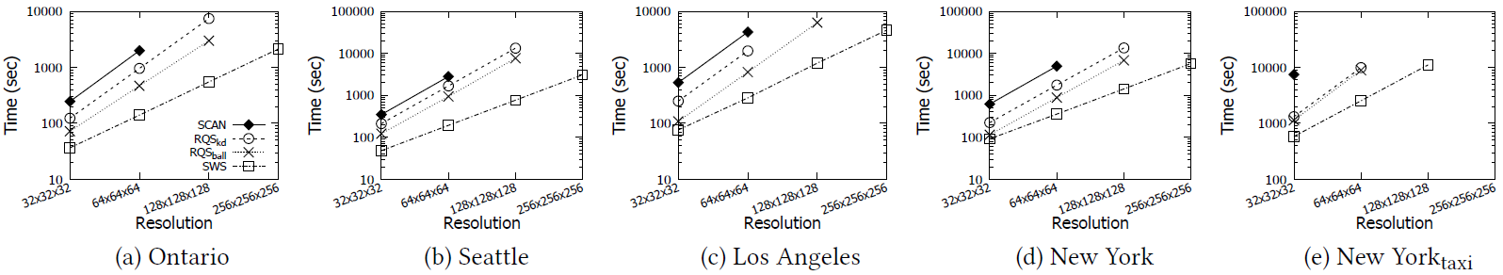
Experimental Evaluation

Slide 15
Use Case: Detect the COVID-19 hotspots in Hong Kong

Slide 16
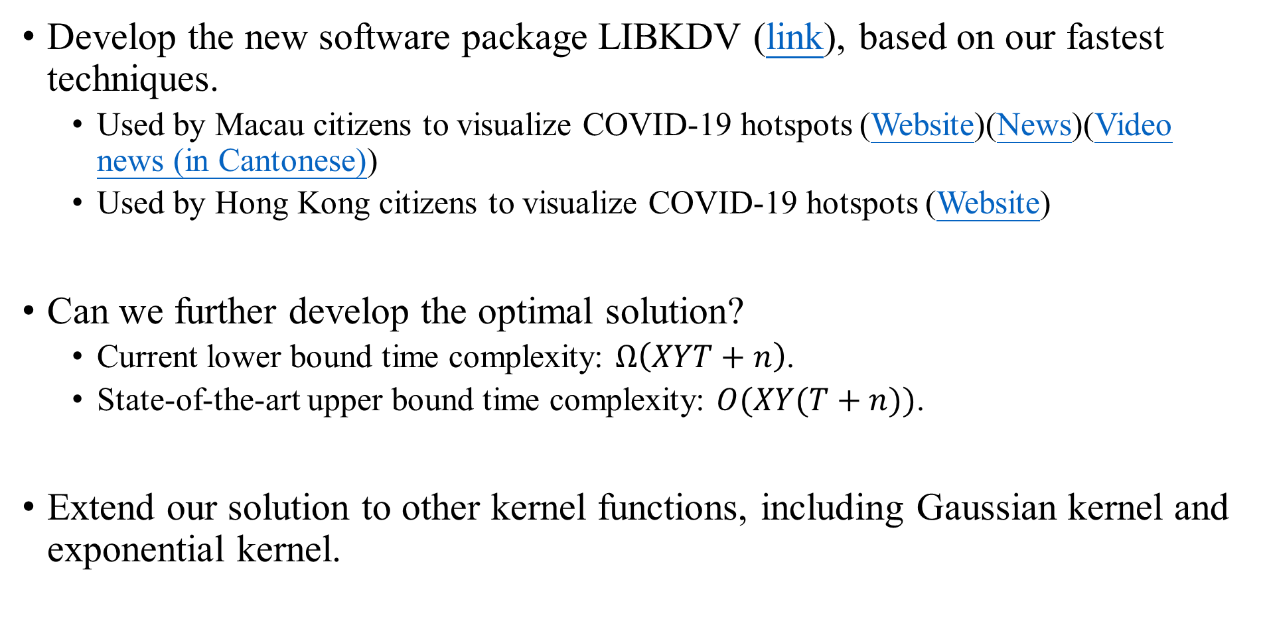
Ongoing Work and Future Opportunities
Develop the new software package LIBKDV (link), based on our fastest techniques.
Used by Macau citizens to visualize COVID-19 hotspots (Website)(News)(Video news (in Cantonese))
Used by Hong Kong citizens to visualize COVID-19 hotspots (Website)
Can we further develop the optimal solution?
Current lower bound time complexity: $Ω\left(XYT+n\right)$.
State-of-the-art upper bound time complexity: $O(XY(T+n))$.
Extend our solution to other kernel functions, including Gaussian kernel and exponential kernel.

Slide 17
Ongoing Work and Future Opportunities
Develop complexity-reduced algorithms for different GIS/statistical operations, including STNKDV, kriging, and K-function.
(Long-term goal) Develop a software package (like ArcGIS and Scikit-learn) that includes our complexity-reduced algorithms for different operations.

