Slide 1
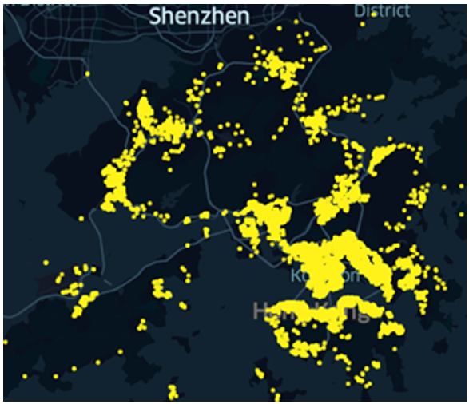
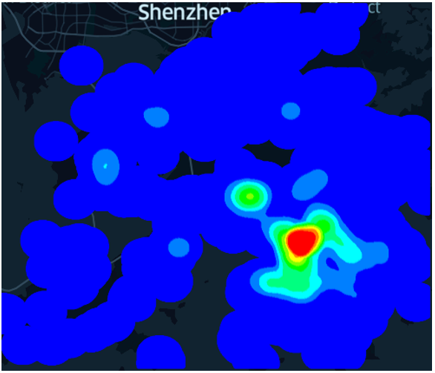
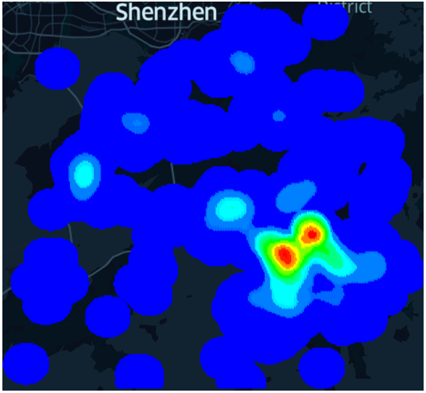
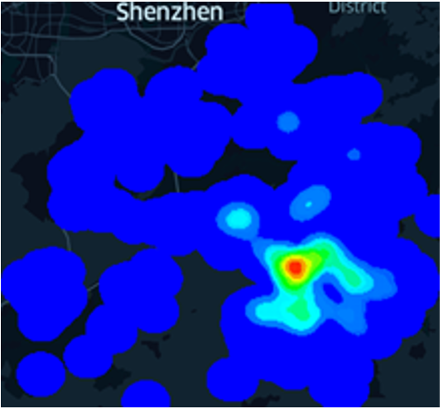
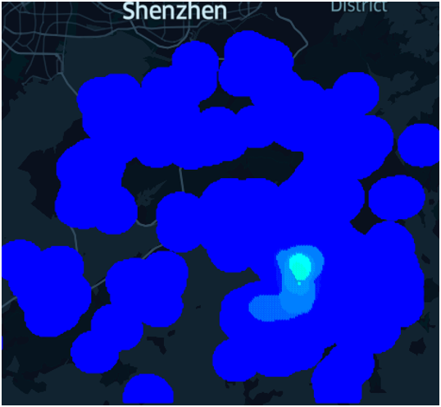
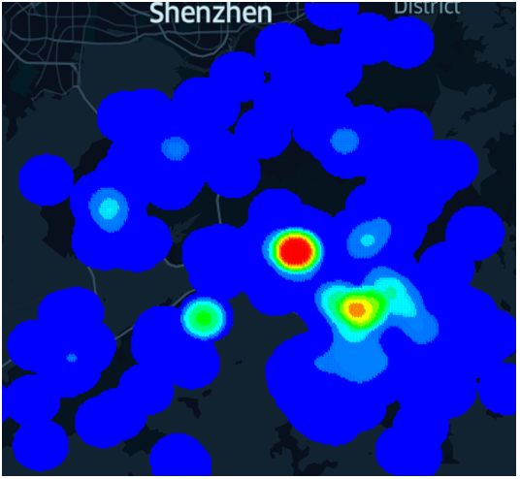
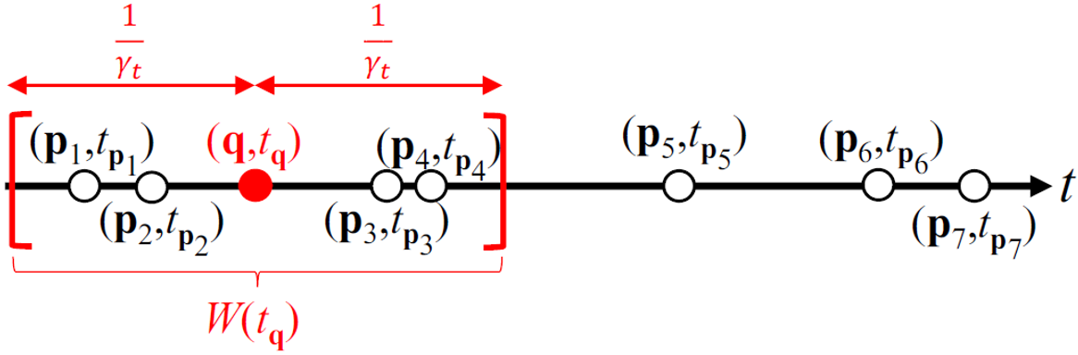
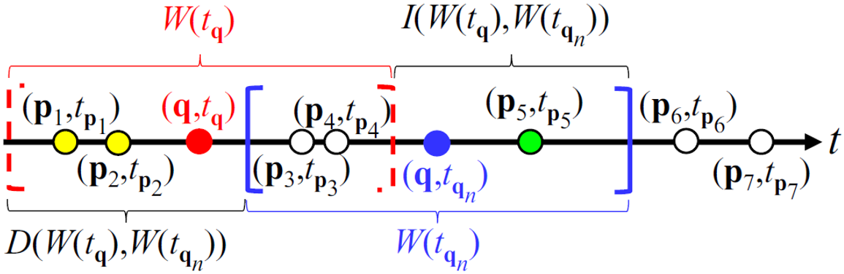
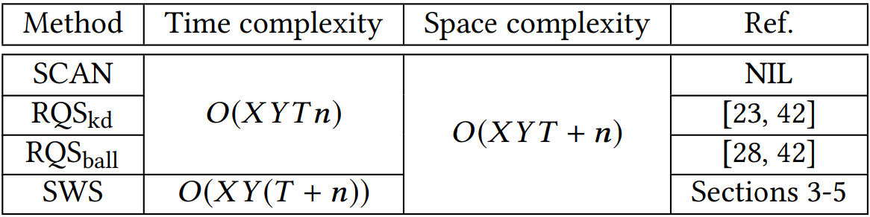
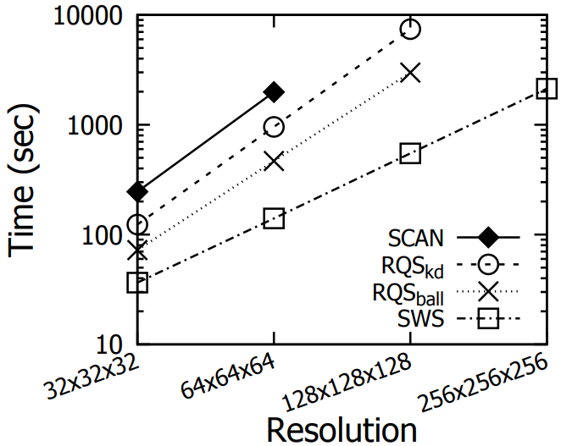
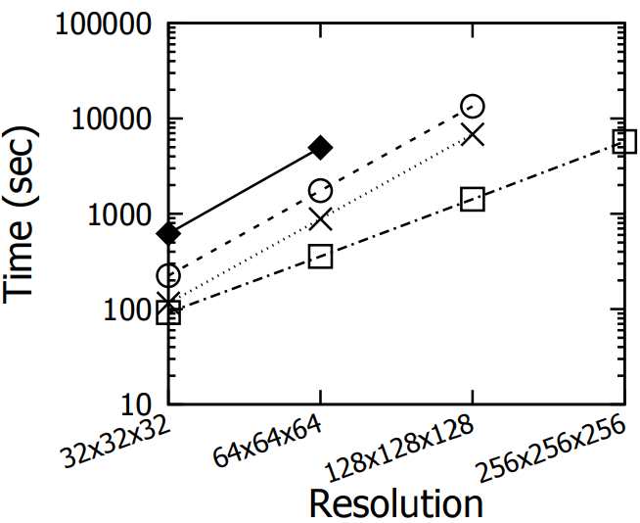
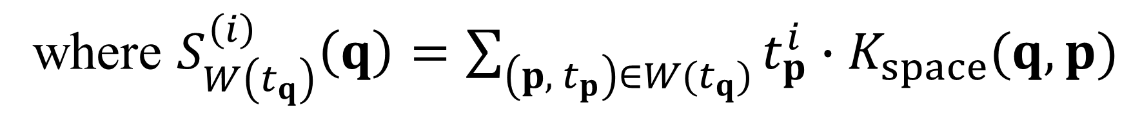
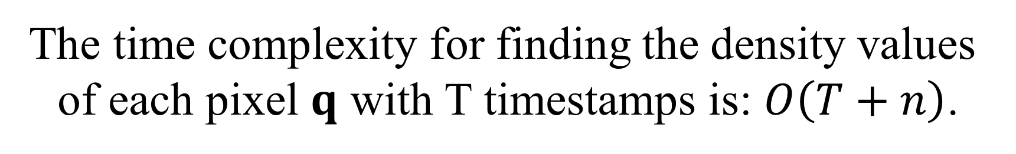
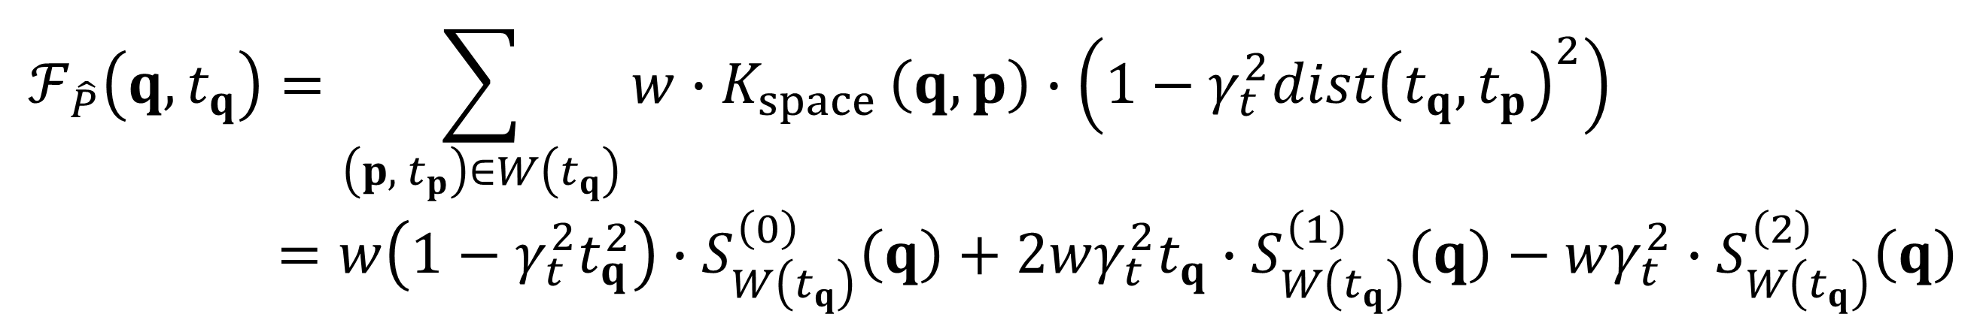
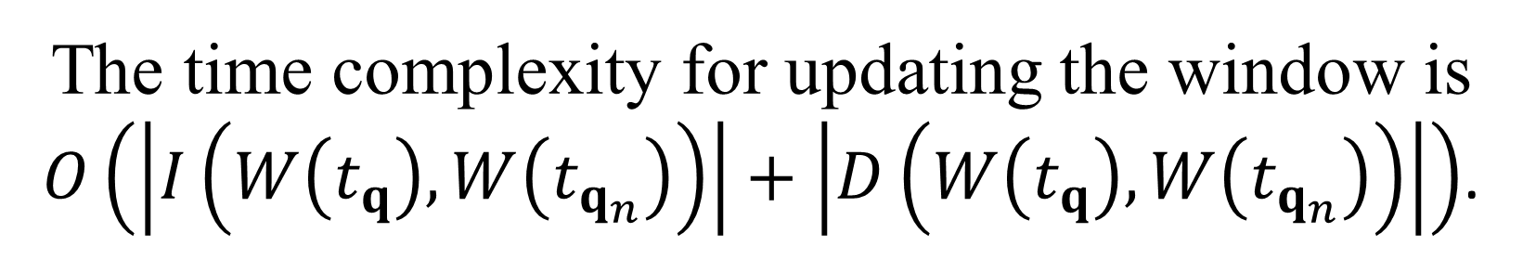
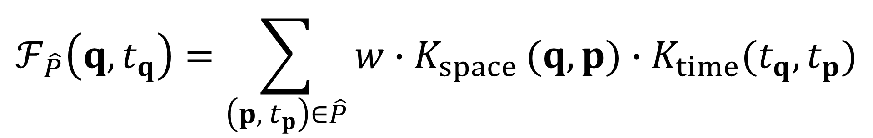
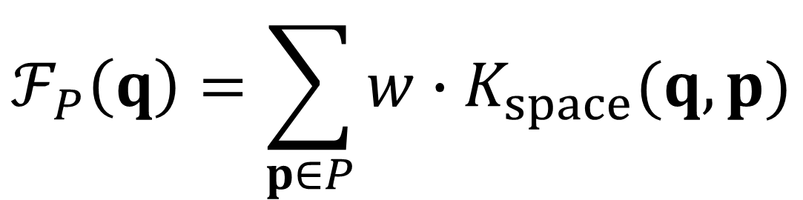
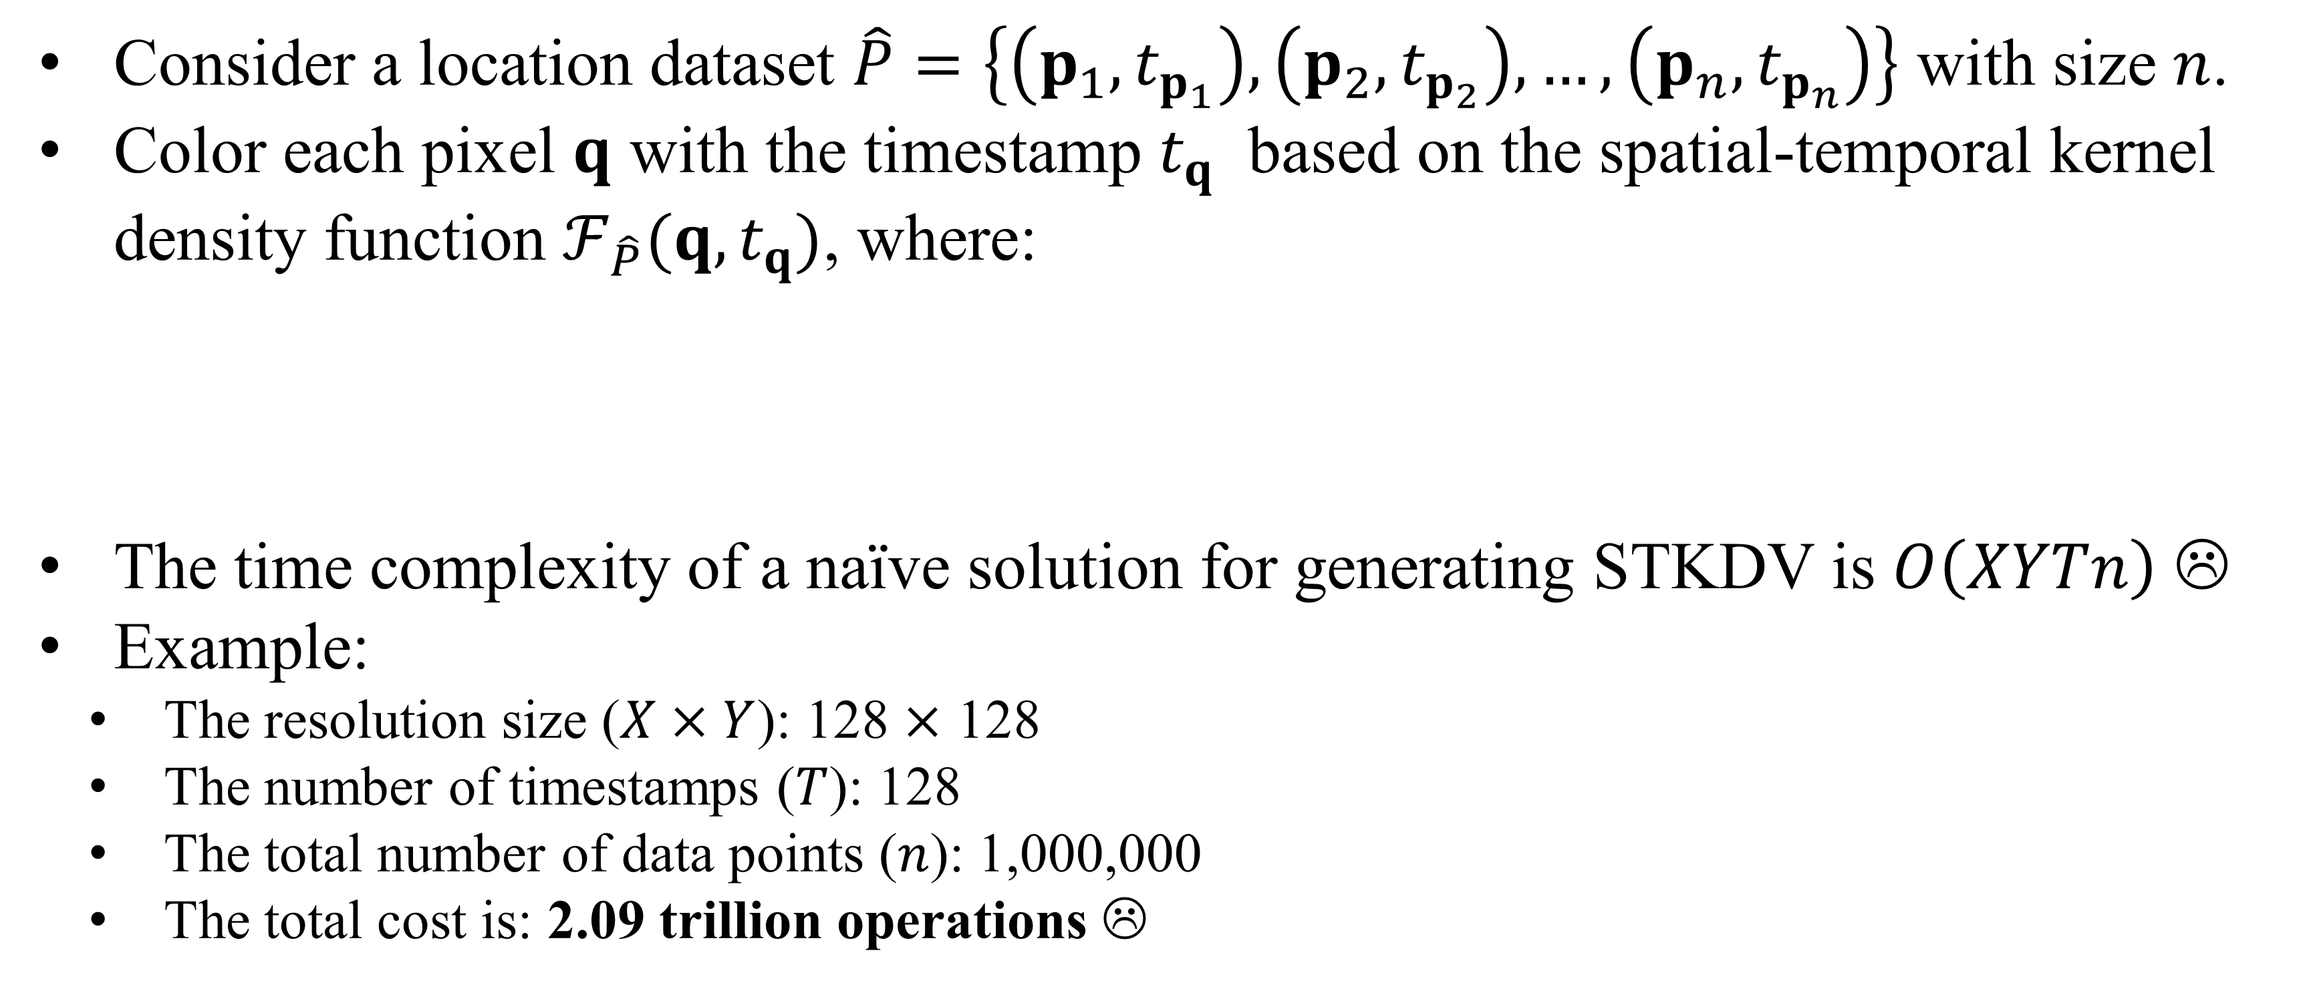
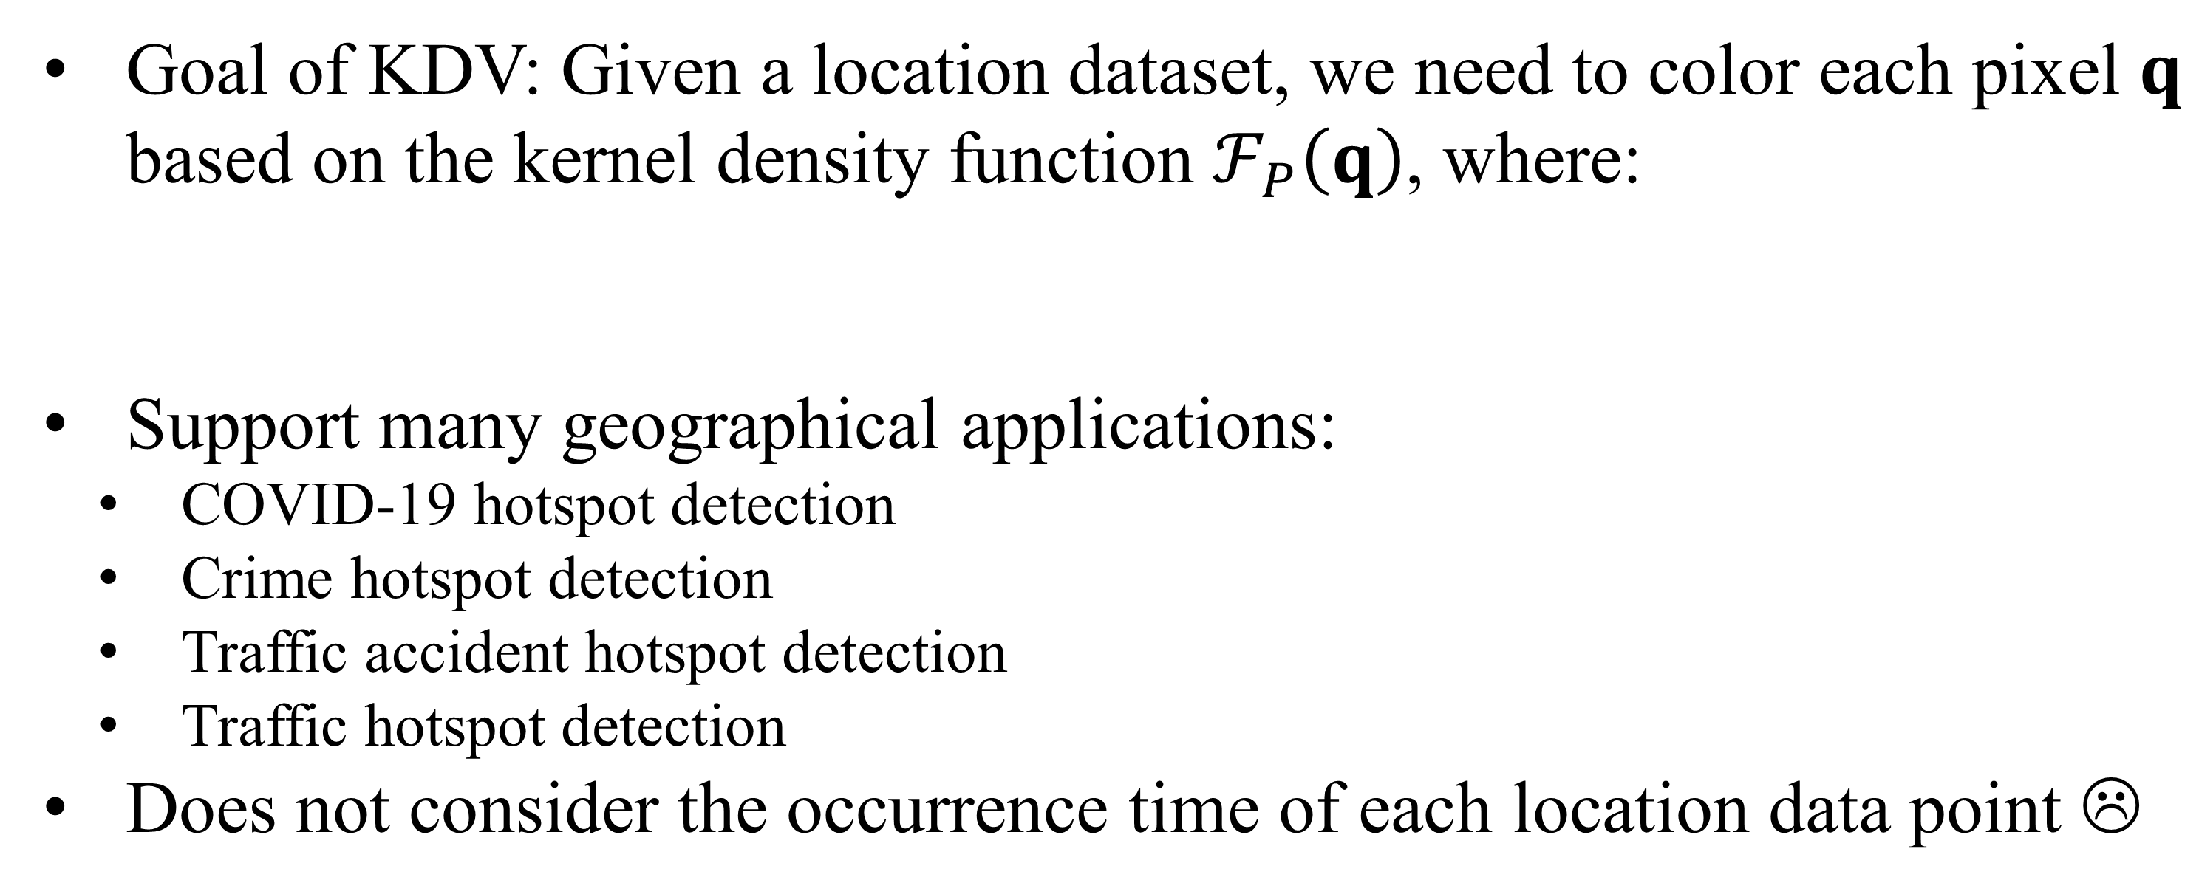
SWS: A Complexity-Optimized Solution for Spatial-Temporal Kernel Density Visualization
Tsz Nam Chan
Hong Kong Baptist University
edisonchan@comp.hkbu.edu.hk
Pak Lon Ip
University of Macau
SKL of Internet of Things
for Smart City
paklonip@um.edu.mo
Leong Hou U
University of Macau
SKL of Internet of Things
for Smart City
ryanlhu@um.edu.mo
Byron Choi
Hong Kong Baptist University
bchoi@comp.hkbu.edu.hk
Jianliang Xu
Hong Kong Baptist University
xujl@comp.hkbu.edu.hk
What is Kernel Density Visualization (KDV)?
Goal of KDV: Given a location dataset, we need to color each pixel $q$ based on the kernel density function $ℱ_{P}\left(q\right)$, where:
Support many geographical applications:
COVID-19 hotspot detection
Crime hotspot detection
Traffic accident hotspot detection
Traffic hotspot detection
Does not consider the occurrence time of each location data point ☹
$$ℱ_{P}\left(q\right)=\sum_{p∈P}{w}∙K_{space}(q,p)$$
Hong Kong COVID-19 cases
Hotspot map
(based on KDV)
Overview of Spatial-Temporal Kernel Density Visualization (STKDV)
Consider a location dataset $\hat{P}=\left\{\left(p_{1}, t_{p_{1}}\right),\left(p_{2}, t_{p_{2}}\right),…,\left(p_{n}, t_{p_{n}}\right)\right\}$ with size $n$.
Color each pixel $q$ with the timestamp $t_{q}$ based on the spatial-temporal kernel density function $ℱ_{\hat{P}}(q,t_{q})$, where:
The time complexity of a naïve solution for generating STKDV is $O\left(XYTn\right)$ ☹
Example:
The resolution size ($X×Y$): 128 $×$ 128
The number of timestamps ($T$): 128
The total number of data points ($n$): 1,000,000
The total cost is: 2.09 trillion operations ☹
$$ℱ_{\hat{P}}\left(q,t_{q}\right)=\sum_{\left(p, { t}_{p}\right)∈\hat{P}}{w∙K_{space}}(q,p)∙K_{time}(t_{q},t_{p})$$
2nd August 2020
6th December 2020
28th February 2021
28th January 2022
Sliding-Window-based Solution (SWS)
$$ℱ_{\hat{P}}\left(q,t_{q}\right)=\sum_{\left(p, { t}_{p}\right)∈W\left(t_{q}\right)}{w∙K_{space}}\left(q,p\right)∙\left(1−γ_{t}^{2}{dist\left(t_{q},t_{p}\right)}^{2}\right) \\ =w\left(1−γ_{t}^{2}t_{q}^{2}\right)∙S_{W\left(t_{q}\right)}^{\left(0\right)}\left(q\right)+2wγ_{t}^{2}t_{q}∙S_{W\left(t_{q}\right)}^{\left(1\right)}\left(q\right)−wγ_{t}^{2}∙S_{W\left(t_{q}\right)}^{\left(2\right)}\left(q\right)$$
$$S_{W\left(t_{q_{n}}\right)}^{\left(i\right)}\left(q\right)=S_{W\left(t_{q}\right)}^{\left(i\right)}\left(q\right)−S_{D\left(W\left(t_{q}\right),W\left(t_{q_{n}}\right)\right)}^{\left(i\right)}\left(q\right)+{ S}_{I\left(W\left(t_{q}\right),W\left(t_{q_{n}}\right)\right)}^{\left(i\right)}\left(q\right)$$
The time complexity for updating the window is
$O\left(\left|I\left(W\left(t_{q}\right),W\left(t_{q_{n}}\right)\right)\right|+\left|D\left(W\left(t_{q}\right),W\left(t_{q_{n}}\right)\right)\right|\right)$.
where $S_{W\left(t_{q}\right)}^{\left(i\right)}\left(q\right)=\sum_{\left(p, { t}_{p}\right)∈W(t_{q})}{t_{p}^{i}∙K_{space}(q,p)}$
The time complexity for finding the density values of each pixel $q$ with T timestamps is: $O\left(T+n\right)$.
Theoretical Results
Experimental Results
Ontario
New York

