Slide 1
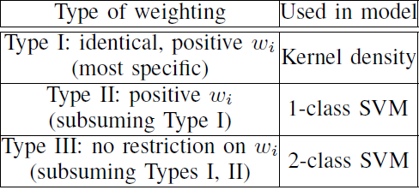
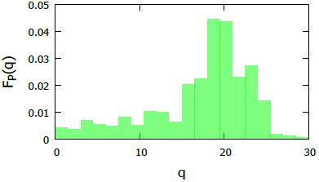
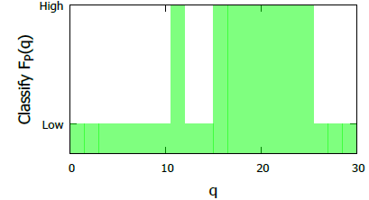
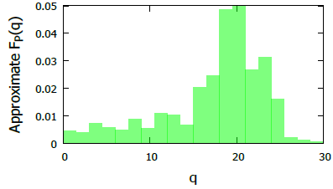
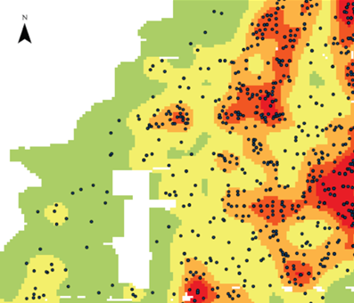
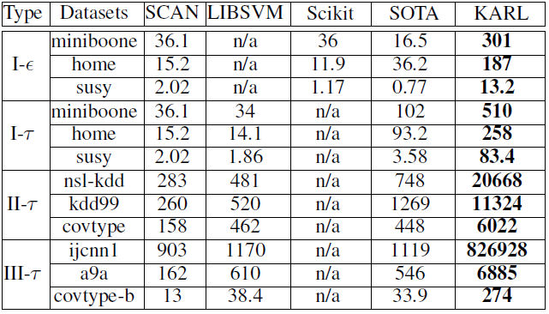
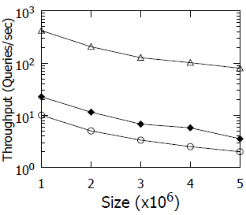
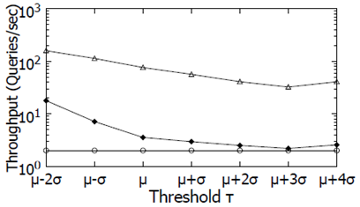

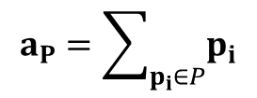

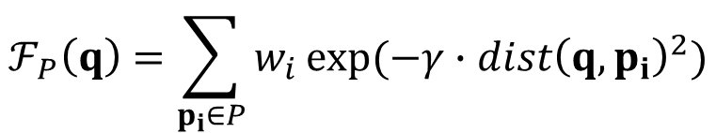
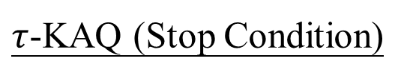
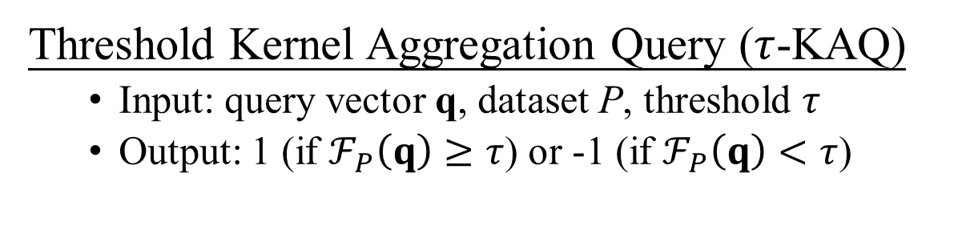
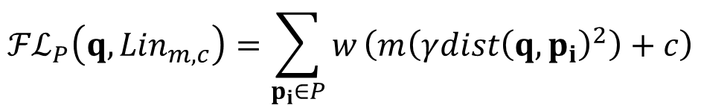
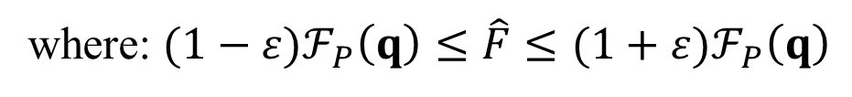
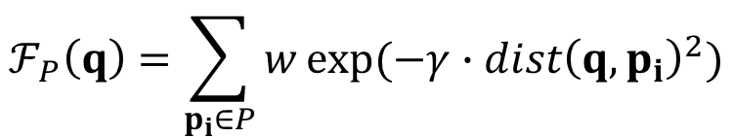
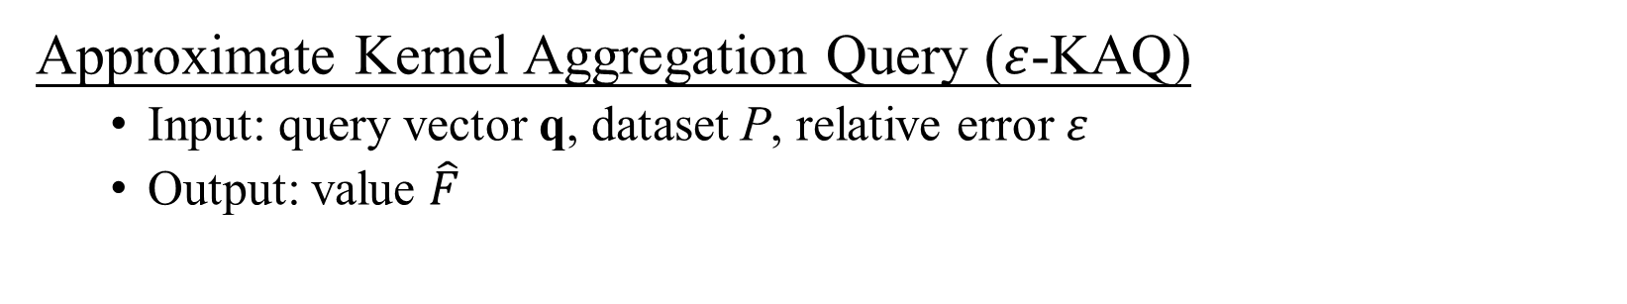

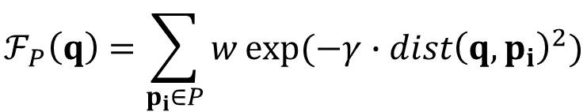
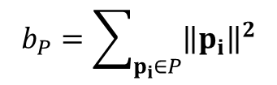
KARL: Fast Kernel Aggregation Queries
Tsz Nam Chan^{1,2}, Man Lung Yiu², and Leong Hou U³
¹The University of Hong Kong, ²Hong Kong Polytechnic University, ³University of Macau
¹tnchan2@hku.hk, ²{cstnchan,csmlyiu}@comp.polyu.edu.hk and ³ryanlhu@umac.mo
What is Kernel Aggregation Queries?
Kernel Aggregation Function
Approximate Kernel Aggregation Query ($ε$-KAQ)
Input: query vector q, dataset P, relative error$ε$
Output: value $\hat{F}$
Threshold Kernel Aggregation Query ($τ$-KAQ)
Input: query vector q, dataset P, threshold $τ$
Output: 1 (if $ℱ_{P}\left(q\right)≥τ$) or -1 (if $ℱ_{P}\left(q\right)<τ$)
$$ℱ_{P}\left(q\right)=\sum_{p_{i}∈P}{w_{i}}exp⁡(−γ∙{dist\left(q,p_{i}\right)}^{2})$$
where: $(1−ε)ℱ_{P}\left(q\right)≤\hat{F}≤(1+ε)ℱ_{P}\left(q\right)$
KAQ
τ-KAQ, τ=0.01
ε-KAQ, ε=0.2
Applications of Kernel Aggregation Queries
Kernel Density Estimation
Kernel Support Vector Machine Classification
Black dots (Crimes)
Aggravated assault
Robbery
Commercial burglary
Motor vehicle theft
Goal:
Crime rates prediction
User 4
User 5
Classify
Signal
$$ℱ_{P}\left(q\right)≤τ$$
Anomaly
Class
Server
$$ℱ_{P}\left(q\right)>τ$$
Normal
Class
User 1
User 2
User 3
How to speed up?
State-of-the-art Method and its Weakness
$τ$-KAQ (Stop Condition)
R
$$ℱ_{P}\left(q\right)=\sum_{p_{i}∈P}{w}exp⁡(−γ{∙dist\left(q,p_{i}\right)}^{2})$$
$$ℱ_{P}\left(q\right)=\sum_{p_{i}∈P}{w}exp⁡(−γ∙{dist\left(q,p_{i}\right)}^{2})$$
UB(q)
maxdist(q,R)
x_{min}
x_{i}
O(|P| × d) time
q is in class +1
mindist(q,R)
q
x₁
x₂
$$LB\left(q\right)≤ℱ_{P}\left(q\right)≤UB(q)$$
LB(q)
+1
τ
Too loose
x₃
x_{max}
function
exp(–x)
UB(q)
-1
$${LB}_{R}\left(q\right)=w∙R.count∙exp⁡(−γ{∙maxdist\left(q,R\right)}^{2})$$
existing bound:
exp(-x_{max})
LB(q)
q is in class -1
$${UB}_{R}\left(q\right)=w∙R.count∙exp⁡(−γ{∙mindist\left(q,R\right)}^{2})$$
Much smaller than
O(|P| × d) time
O(d) time
$${LB}_{R}\left(q\right)=w∙R.count∙exp⁡(−γ{∙maxdist\left(q,R\right)}^{2})$$
Our techniques
Experimental Results
x_{max}
x_{min}
the tangent line (at x_{max}):
E^{L}(x) = m_{l} x + c_{l}
x_{min}
x₁
x₁
x₂
x₂
x₃
x_{max}
function
exp(–x)
x₃
x_{max}
function
exp(–x)
existing bound:
exp(-x_{max})
optimized tangent line (at t):
E^{L}(x)=m_{l} x + c_{l}
$${ℱℒ}_{P}\left(q,{Lin}_{m,c}\right)=\sum_{p_{i}∈P}{w}\left(m\left(γ{dist\left(q,p_{i}\right)}^{2}\right)+c\right)$$
Tightness
Exact
$$=wmγ\left(\left|P\right|{\left\|q\right\|}^{2}−2q∙a_{P}+b_{P}\right)+wc|P|$$
Ours
$$a_{P}=\sum_{p_{i}∈P}{p_{i}}$$
O(d)
O(d)
Existing bounds
where
and
$$b_{P}=\sum_{p_{i}∈P}{{\left\|p_{i}\right\|}^{2}}$$
Time
O(d)
O(|P|d)

