Slide 1
ETF Forecasts
B y
Tim Clemens
Max Heatter
Gabriel Millan
Sam Zun

Slide 2
Idea💡
Summary
In this project we are using historical ETF data from Yahoo Finance to predict/forecast historical ETF prices. The ETF's we are using are the ARK Innovation Fund (Ticker: ARKK), the SPDR S&P 500 ETF Trust (Ticker: SPY) and the Bank of Montreal MicroSectors FANG Index (Ticker: FNGU). We are using two machine learning models, the Facebook/Meta Prophet model as well as a Google Tensorflow LSTM Recurrent Neural Network models to predict/forecast these ETF prices. And we compare and contrast these different models and their performance against the real historic prices.
We saw that the Prophet model was easier to develop when it came to processing the data, doing the train-test-split, creating and training the model, as well as scoring high well in terms of the metrics. Though we know that for tuning as well as the final visualized results, we can see that the Prophet model fell very short compared to the LSTM RNN. The LSTM RNN was much more involved and harder to develop. Everything from scaling the data, the train-test-split and reshaping of the data, to creating and training the models, as well as scoring poorly on the metrics. But when it came to tuning as well as the predictive power of the model, we can see that investing the time was well worth it. All in all, we would recommend using the LSTM RNN model for its highly performant deep learning predictive power, whereas we would recommend using the Prophet model when development time and ease of use is paramount.

Slide 3



ET Fs
Our ETFs
ETF Definition
“An ETF, or exchange-traded fund, is a type of investment fund that holds a collection of securities, such as stocks, bonds, or commodities, and trades on an exchange like a stock. ETFs are designed to track the performance of a specific index, such as the S&P 500, or a specific sector, such as technology. They offer investors the ability to diversify their portfolio and gain exposure to a wide range of assets with a single purchase.”
– ChatGPT
ARK Innovation ETF - Ticker: ARKK
“ARKK is an actively managed Exchange Traded Fund (ETF) that seeks long-term growth of capital by investing under normal circumstances primarily (at least 65% of its assets) in domestic and foreign equity securities of companies that are relevant to the Fund’s investment theme of disruptive innovation.”
– ARK Funds Website
SPDR S&P 500 ETF Trust - Ticker: SPY
The SPDR® S&P 500® ETF Trust seeks to provide investment results that, before expenses, correspond generally to the price and yield performance of the S&P 500® Index (the “Index”)
The S&P 500 Index is a diversified large cap U.S. index that holds companies across all eleven GICS sectors
Launched in January 1993, SPY was the very first exchange traded fund listed in the United States
– State Street Global Advisors Website
Microsectors 3x FANG+ ETF - Ticker: FNGU
“The NYSE® FANG+™ Index includes 10 highly liquid stocks that represent industry leaders across today’s tech and internet/media companies. The index’s underlying composition is equally weighted across all stocks, providing a unique performance benchmark that allows for a value-driven approach to investing. While the performance of indices weighted by market capitalization can be dominated by a few of the largest stocks, an equal-weighting allows for a more diversified portfolio.”
– Microsectors Website

Slide 4
Price Forecasting
LSTM RNN Model
Recurrent Neural Network
“A recurrent neural network is a class of artificial neural networks where connections between nodes can create a cycle, allowing output from some nodes to affect subsequent input to the same nodes. This allows it to exhibit temporal dynamic behavior.”
– Google
“Price forecasting in finance is the process of estimating the future price of a financial asset, such as a stock, commodity, or currency, using a variety of methods and techniques. These methods can include technical analysis, fundamental analysis, and statistical models, and can be used to make investment decisions or to inform risk management strategies.”
– ChatGPT
Long Short Term Memory Networks
“Long Short Term Memory networks – usually just called “LSTMs” – are a special kind of Recurrent Neural Network, capable of learning long-term dependencies. They were introduced by Hochreiter & Schmidhuber (1997), and were refined and popularized by many people in following work.1 They work tremendously well on a large variety of problems, and are now widely used.”
– Google

Slide 5


Tensorflow
Prophet Model
Prophet Definition
“Prophet is a forecasting procedure implemented in R and Python. It is fast and provides completely automated forecasts that can be tuned by hand by data scientists and analysts.”
“Prophet is a procedure for forecasting time series data based on an additive model where non-linear trends are fit with yearly, weekly, and daily seasonality, plus holiday effects. It works best with time series that have strong seasonal effects and several seasons of historical data. Prophet is robust to missing data and shifts in the trend, and typically handles outliers well.”
– Prophet Website
Tensorflow Definition
“TensorFlow is a free and open-source software library for machine learning and artificial intelligence. It can be used across a range of tasks but has a particular focus on training and inference of deep neural networks.”
– Google

Slide 6
Wh y?
LSTM RNN
Prophet
Facebook Prophet is a tool for time series forecasting that is specifically designed for business forecasting. One of the reasons it is good for forecasting prices is that it is built on an additive model framework, which allows for modeling both trend and seasonality in the data. This is particularly useful for tasks such as price forecasting, where understanding the underlying patterns in the data is crucial. Additionally, Prophet is designed to be easily interpretable, which makes it easier for analysts to understand the factors that are driving the predictions. It also provides options to tune models based on business constraints like holidays, changepoints, and caps on the forecasted values. This makes it a good choice for companies that want to incorporate domain knowledge into their forecasting models.
LSTM (Long Short-Term Memory) is a type of recurrent neural network (RNN) that is well-suited for forecasting time series data, such as stock prices, because it is able to effectively retain information about past events for a long period of time. This allows the model to make predictions based on patterns and trends in the data that span multiple time steps, which is important for tasks such as price forecasting where understanding long-term dependencies in the data is crucial. Additionally, LSTMs are able to handle input sequences of varying lengths, which is useful for dealing with irregular time series data.

Slide 7

The Data
Data Processing
The data used was pulled from Yahoo Finance. The focus of the data was on three ETFs: ARKK, SPY, and FNGU. The timeframe of the data is from January of 2018 to March of 2022. To get a clear review and analysis of the data we used the Adjusted Close Price.
First, we pulled data for the three ETFs from 01/26/2018 - 03/31-2022 (Release of FNGU - End of COVID19 Pandemic). We then removed all of the columns except for the Adjusted Closing Price. And finally we rounded each value in the Adjusted Closing Price column to two decimal places. Finally we saved the processed Pandas DataFrame as a CSV file in our ./Resources/Data directory to then be read in our machine learning notebooks.
Data Exploration Notebook

Slide 8
Trai ning
Tun ing
LSTM RNN Training:
We trained the models with the entire dataset, minus the last 60 days. This data was scaled using the skcikit-learn MinMaxScaler class and reshaped using Numpy. We also used a batch size of 1 (the entire dataset) and 35 epochs.
Prophet Training:
Here we also trained the models with the entire dataset minus the last 60 days, but the data was not scaled or reshaped by Numpy. Though, the results were shaped by a number of different parameters.
LSTM RNN Tuning:
The three hyperparameters that we changed during the tuning process that had the most impact were, the size of the training data (changed from 2 years to 4 years), the batch size (changed from large value to just 1) and the epochs (changed from a miniscule number to 35, which is where we saw the beginning of diminishing returns).
Prophet Tuning:
Tuning the Prophet model was extremely time intensive, but somewhat automated. Here we created a dictionary of different hyperparameters as keys and lists of their possible values as the values of the dictionary. We then trained the model on each combination of the different hyperparameters (which took lots of time and computing power) until we had the best performing hyperparameters selected.
LSTM RNN Notebook
Prophet Notebook

Slide 9
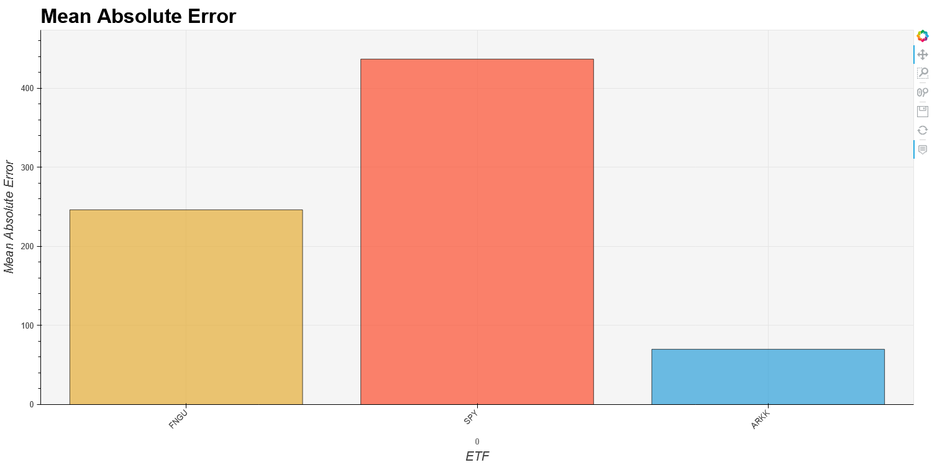
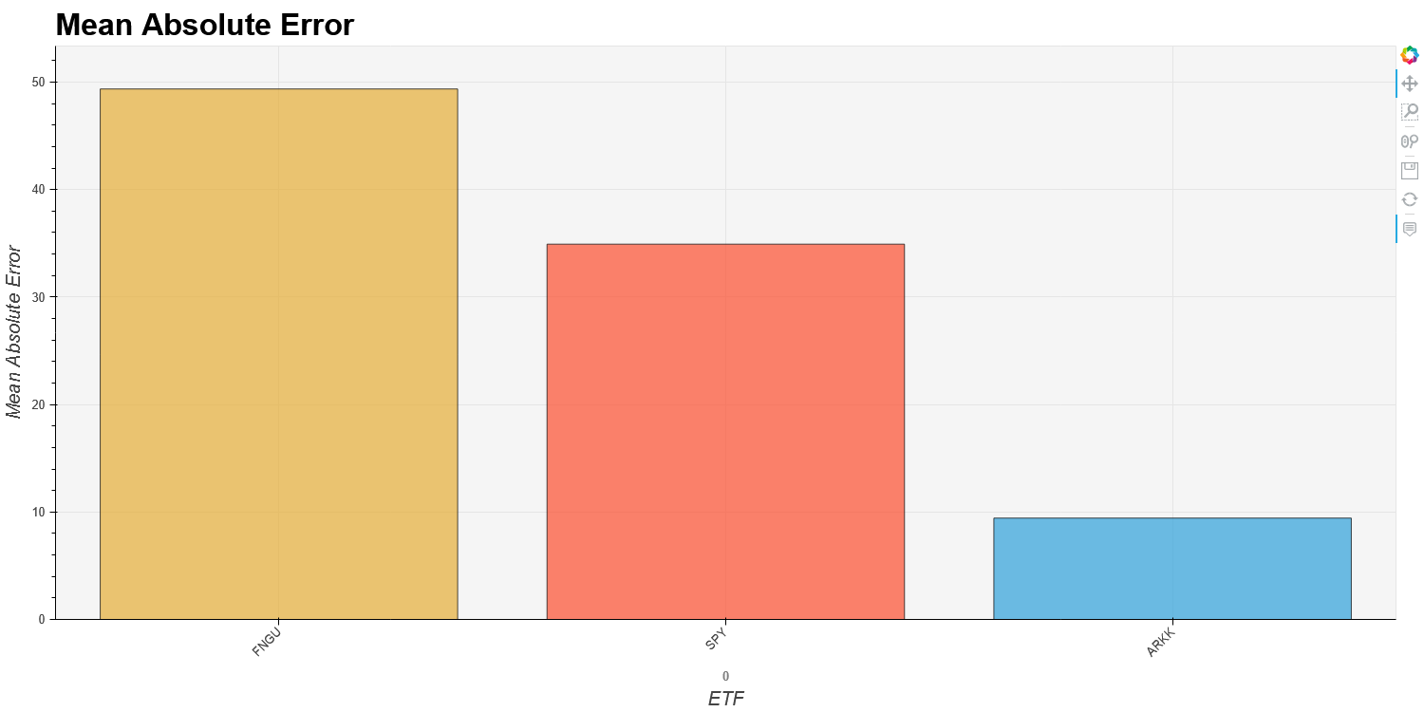
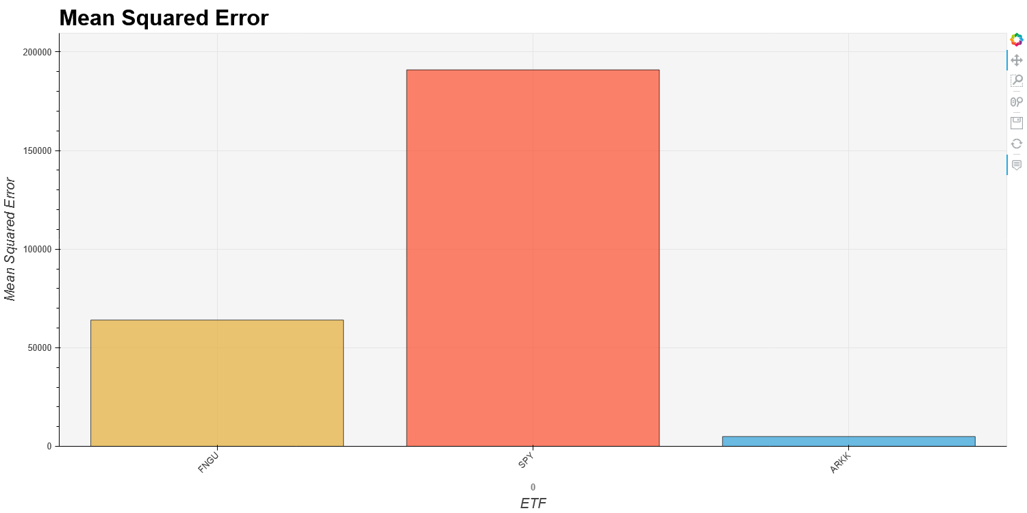
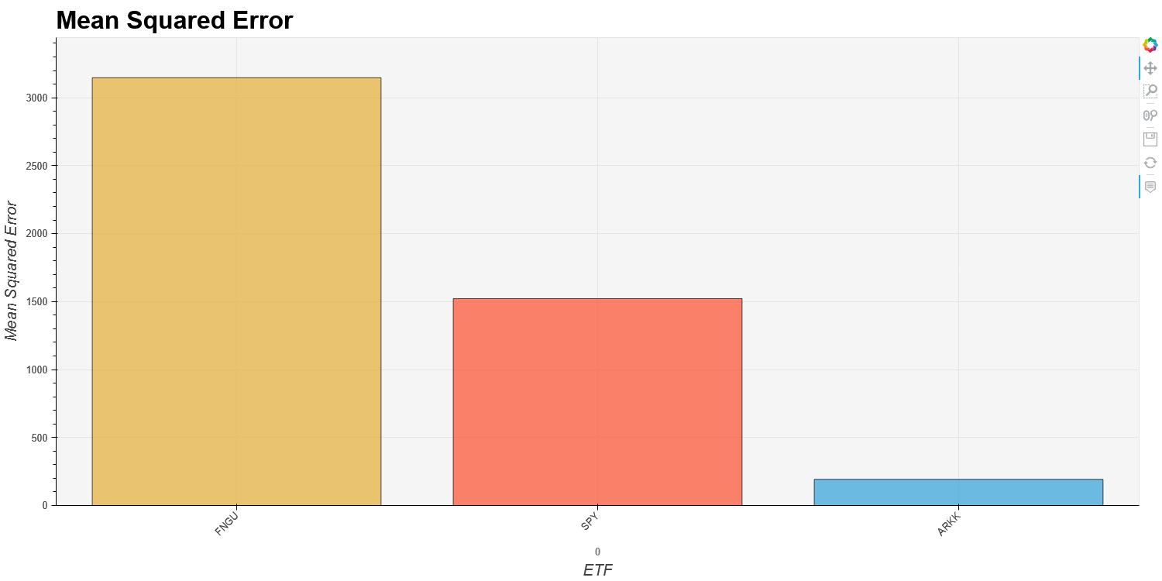
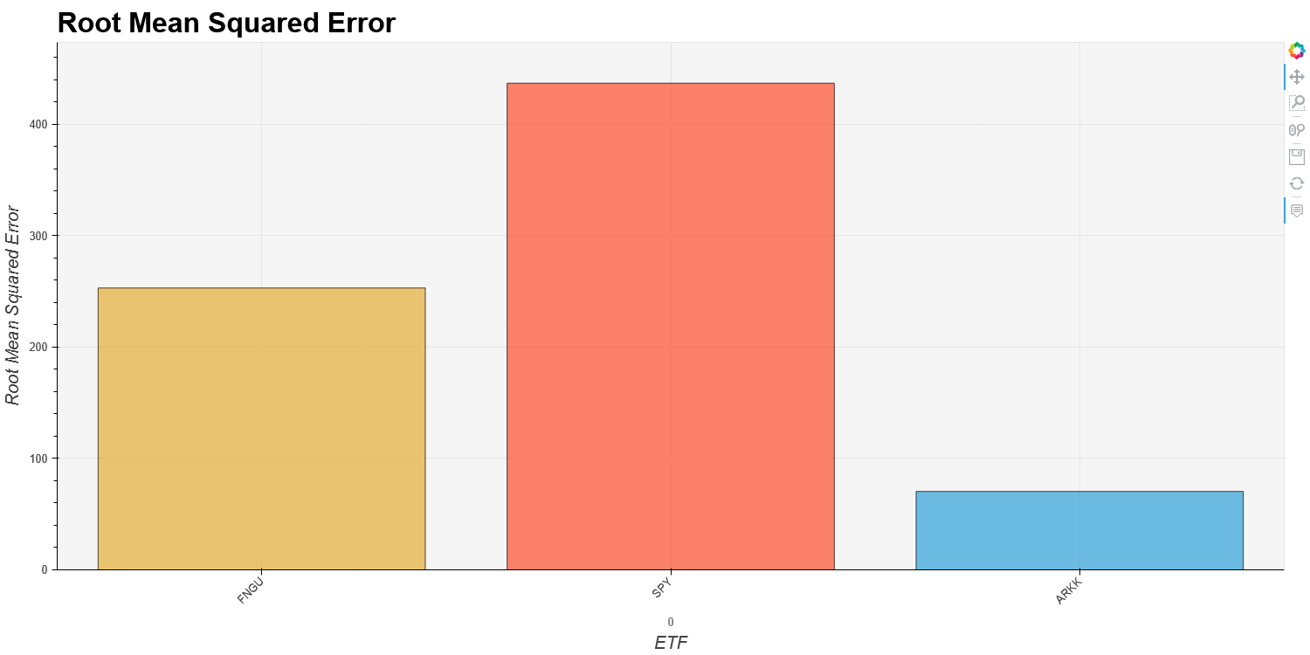
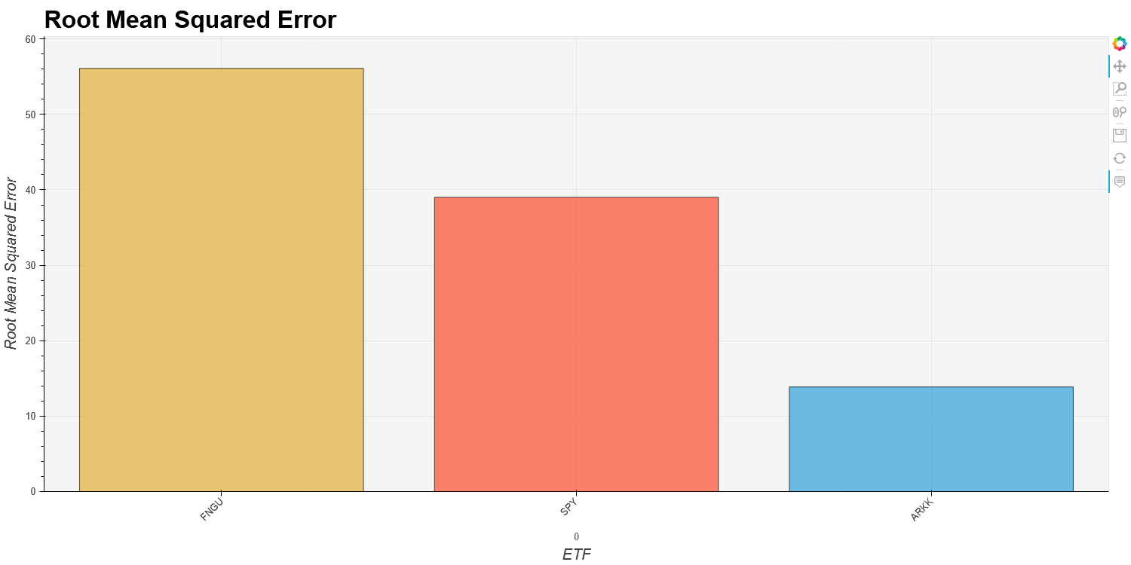
Eval uation
LSTM RNN
Prophet
Mean Abso lute Error
ARKK: 69.90
SPY: 436.71
FNGU: 246.19
ARKK: 9.43
SPY: 34.92
FNGU: 49.36
Mean Squa red Error
ARKK: 4956.81
SPY: 190925.27
FNGU: 64040.12
ARKK: 192.27
SPY: 1522.05
FNGU: 3147.08
Root Mean Squared Error
ARKK: 70.40
SPY: 436.95
FNGU: 253.67
ARKK: 13.87
SPY: 39.01
FNGU: 56.10

Slide 10
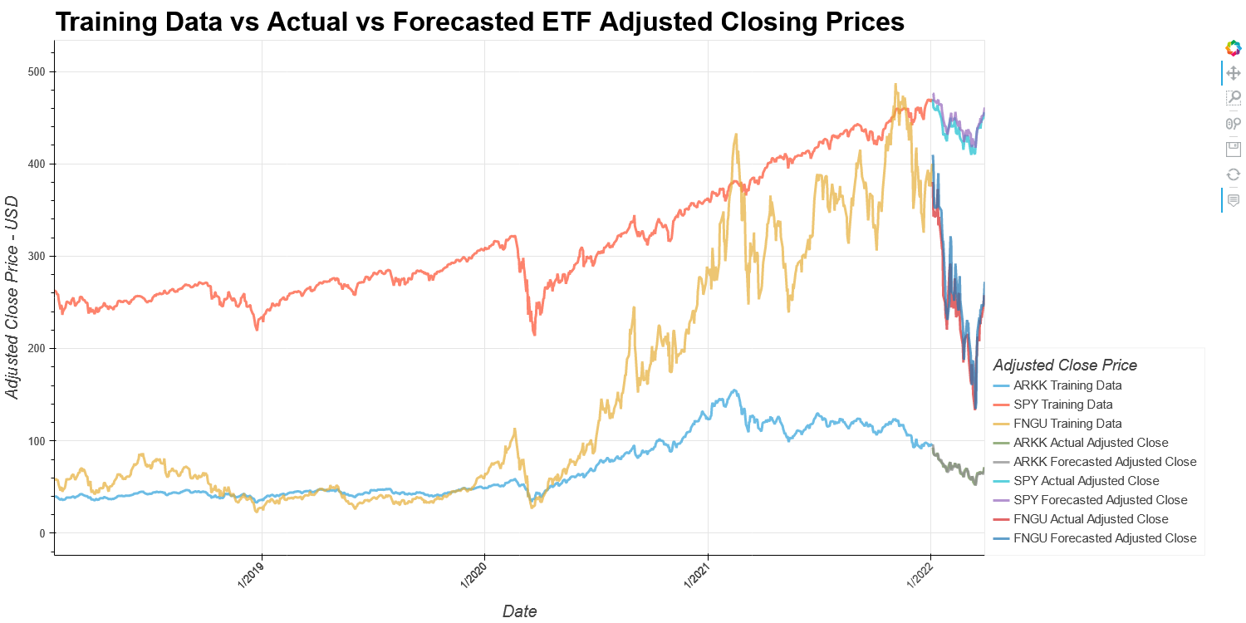
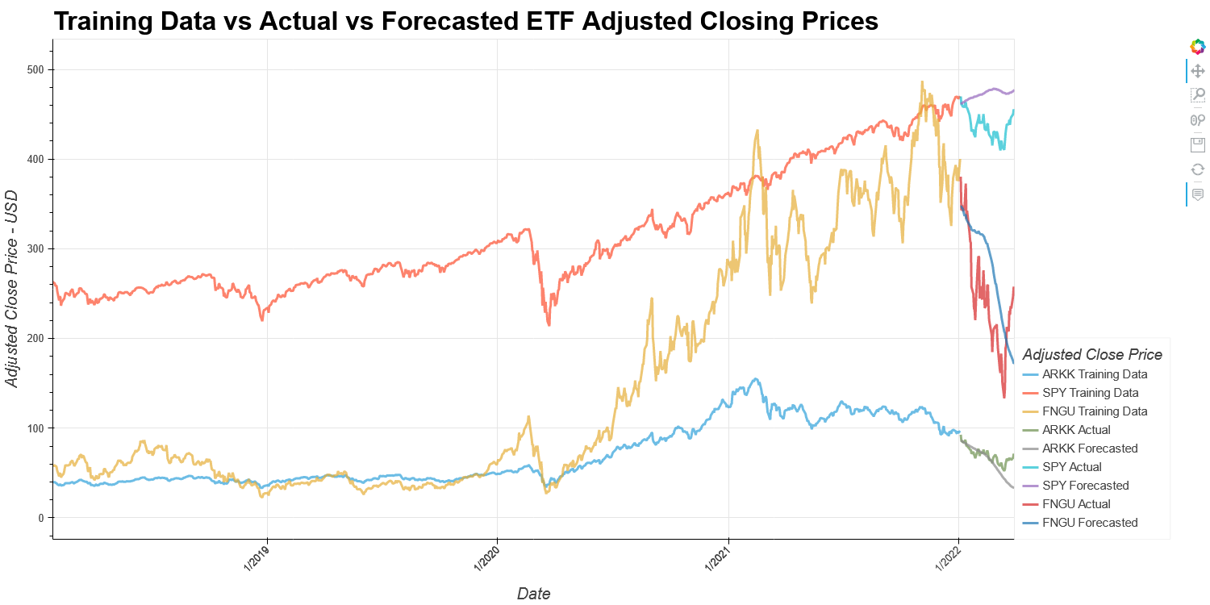
Results
LSTM RNN
Prophet

Slide 11
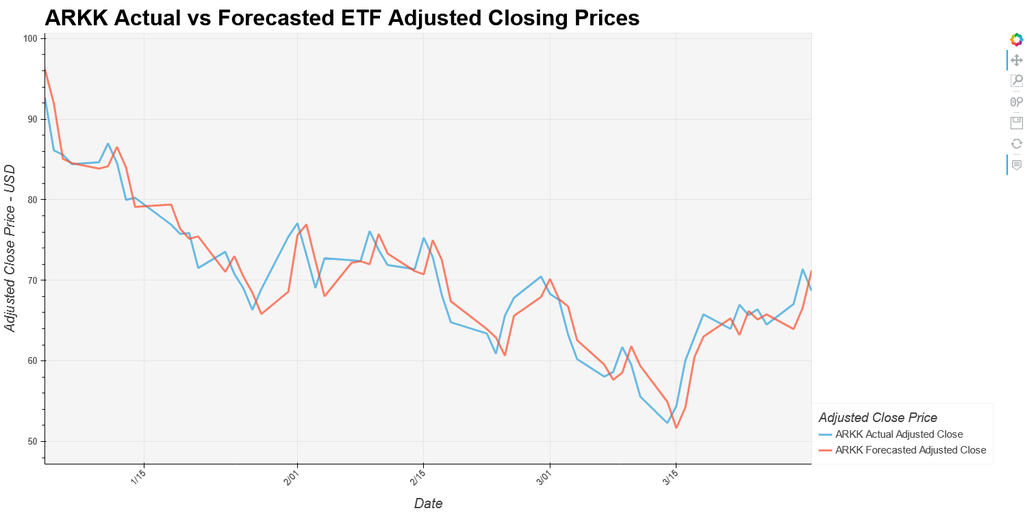
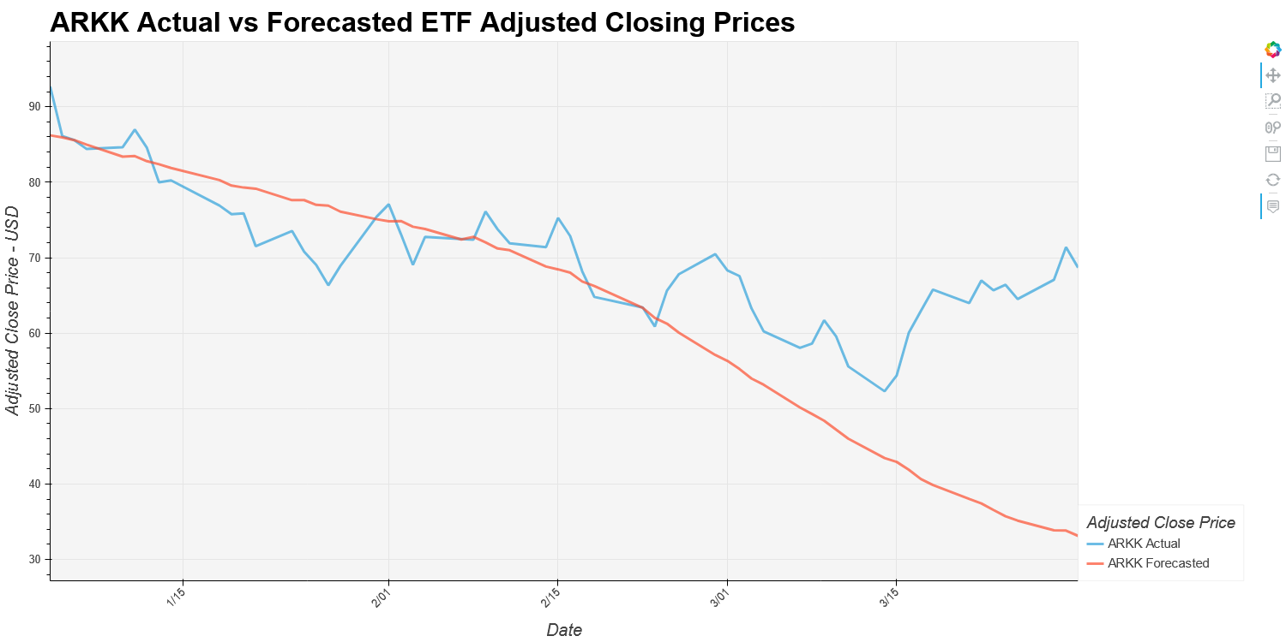
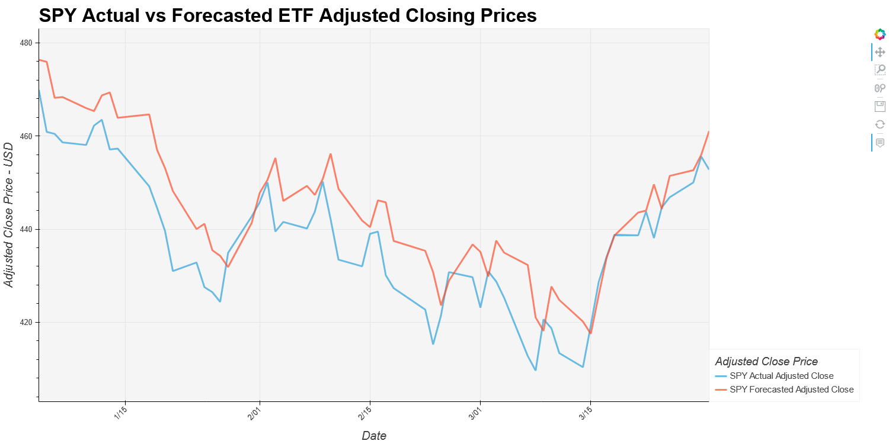
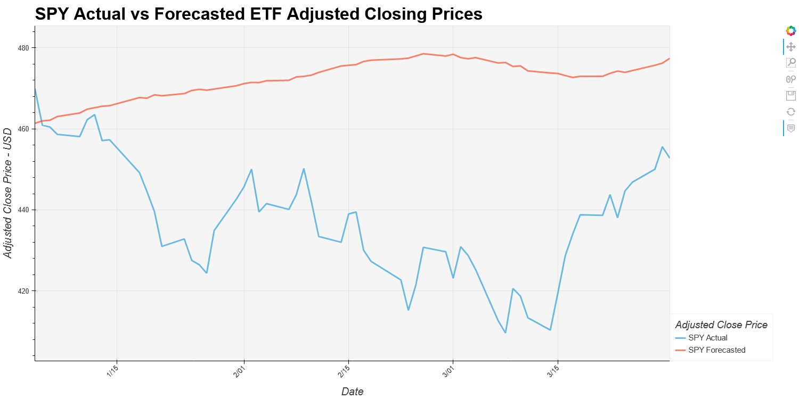
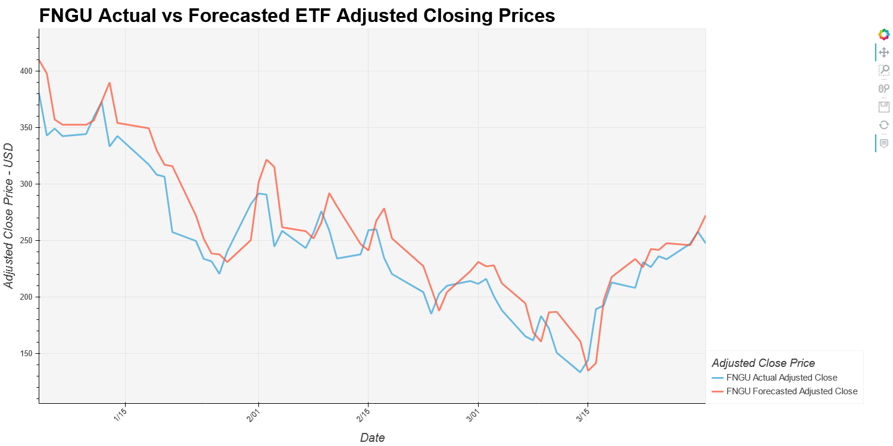
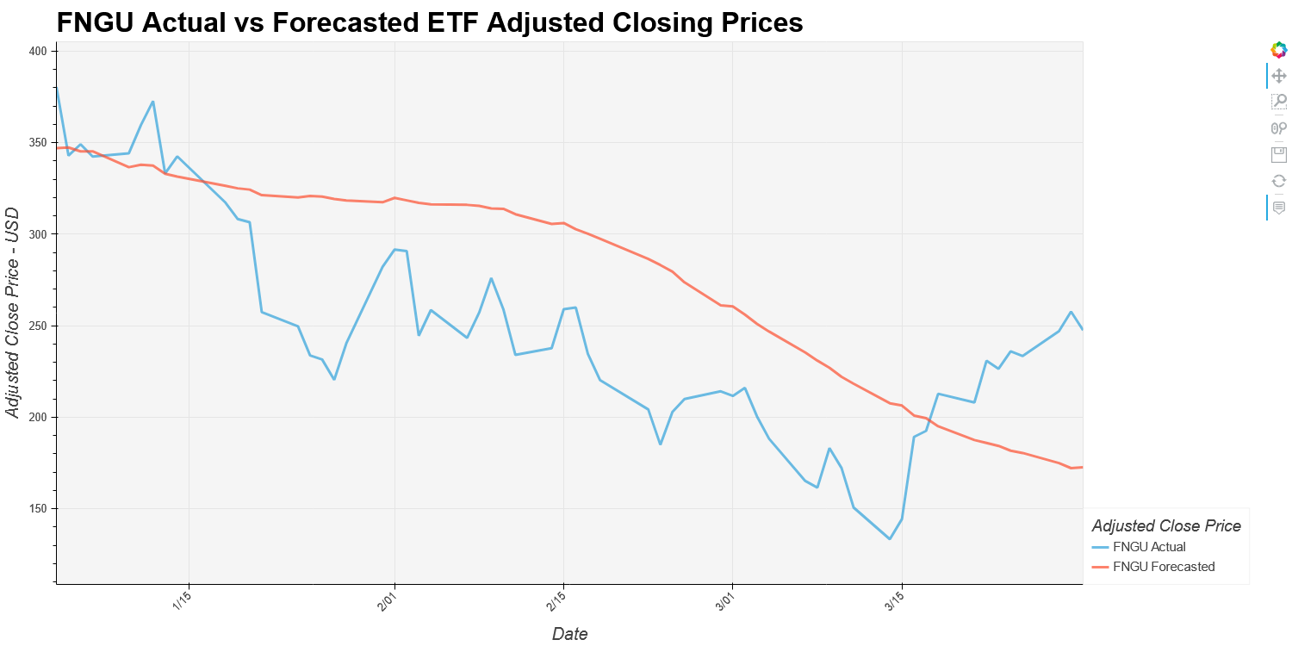
Results
LSTM RNN
Prophet

Slide 12
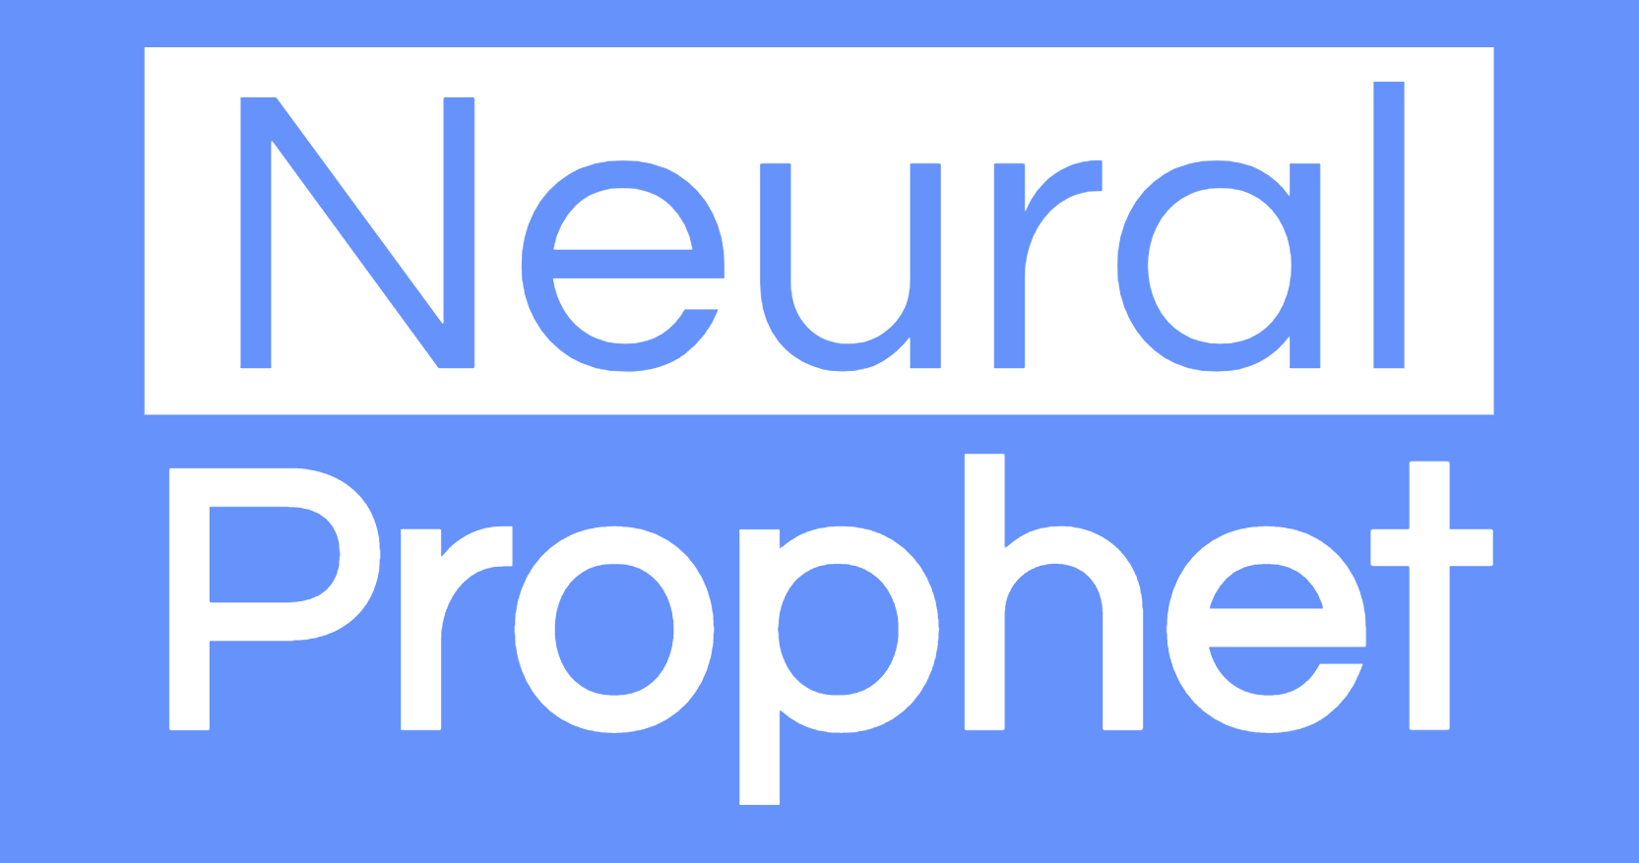
Post mortem
LSTM RNN
Prophet
What could have been done differently?
The biggest difficulty with the LSTM RNN model that we encountered was getting clear results for our metrics. If we had more time we would likely have decreased the learning rate through our “adam” optimization function to around .001. This would likely get rid of lots of the noise that occurred during both the training and prediction processes and allow for the generation of much clearer and accurate results.
What could have been done differently?
When it comes to Prophet side of things would have liked to spend much more time tuning the models. Two things that made the tuning process quite difficult were the fact that there were very little to no documentation or articles that had solid information on how to tune the model. The second was that the method we can across of automatically tuning the hyperparameters was extremely heavy on both time and computing process.
Where to go from here?
What seems like an interesting further application for these LSTM RNN models is to expand their forecasting power to different securities, commodities, cryptocurrencies and financial instruments, to see if the models would continue to perform with the accuracy that we have seen.
Where to go from here?
A great idea would likely be to use the successor to Facebook/Meta’s Prophet model, the Neural Prophet model. “NeuralProphet bridges the gap between traditional time-series models and deep learning methods. It's based on PyTorch and can be installed using pip.” – Neural Prophet Website. Reworking our models to harness the power of Deep Learning, just as the LSTM RNN does, as well as the design of PyTorch (Facebook/Meta’s Deep Learning Framework), would be an extremely interesting way to perform forecasting of these ETFs as well as many other securities, commodities, cryptocurrencies and financial instruments.

Slide 13
Questions ????????

