Slide 1

Network Design Project
Comprehensive Configurations and Topology

Slide 2

Project Overview
This project focuses on:
Designing a segmented network using VLANs for enhanced security and traffic management.
Establishing redundancy and improving bandwidth with EtherChannel.
Implementing high-availability features using HSRP.
Setting up dynamic routing with OSPF.
Configuring servers and network services for functionality.
Securing the network with advanced features like Port Security, DAI, and DHCP Snooping.

Slide 3
Objectives
The primary objectives of this project were:
- To design a segmented network using VLANs for enhanced security and traffic management.
- To establish redundancy and improve bandwidth with EtherChannel.
- To implement high-availability features using HSRP.
- To set up dynamic routing with OSPF.
- To configure servers and network services for functionality.
- To secure the network with advanced features like Port Security, DAI, and DHCP Snooping.

Slide 4
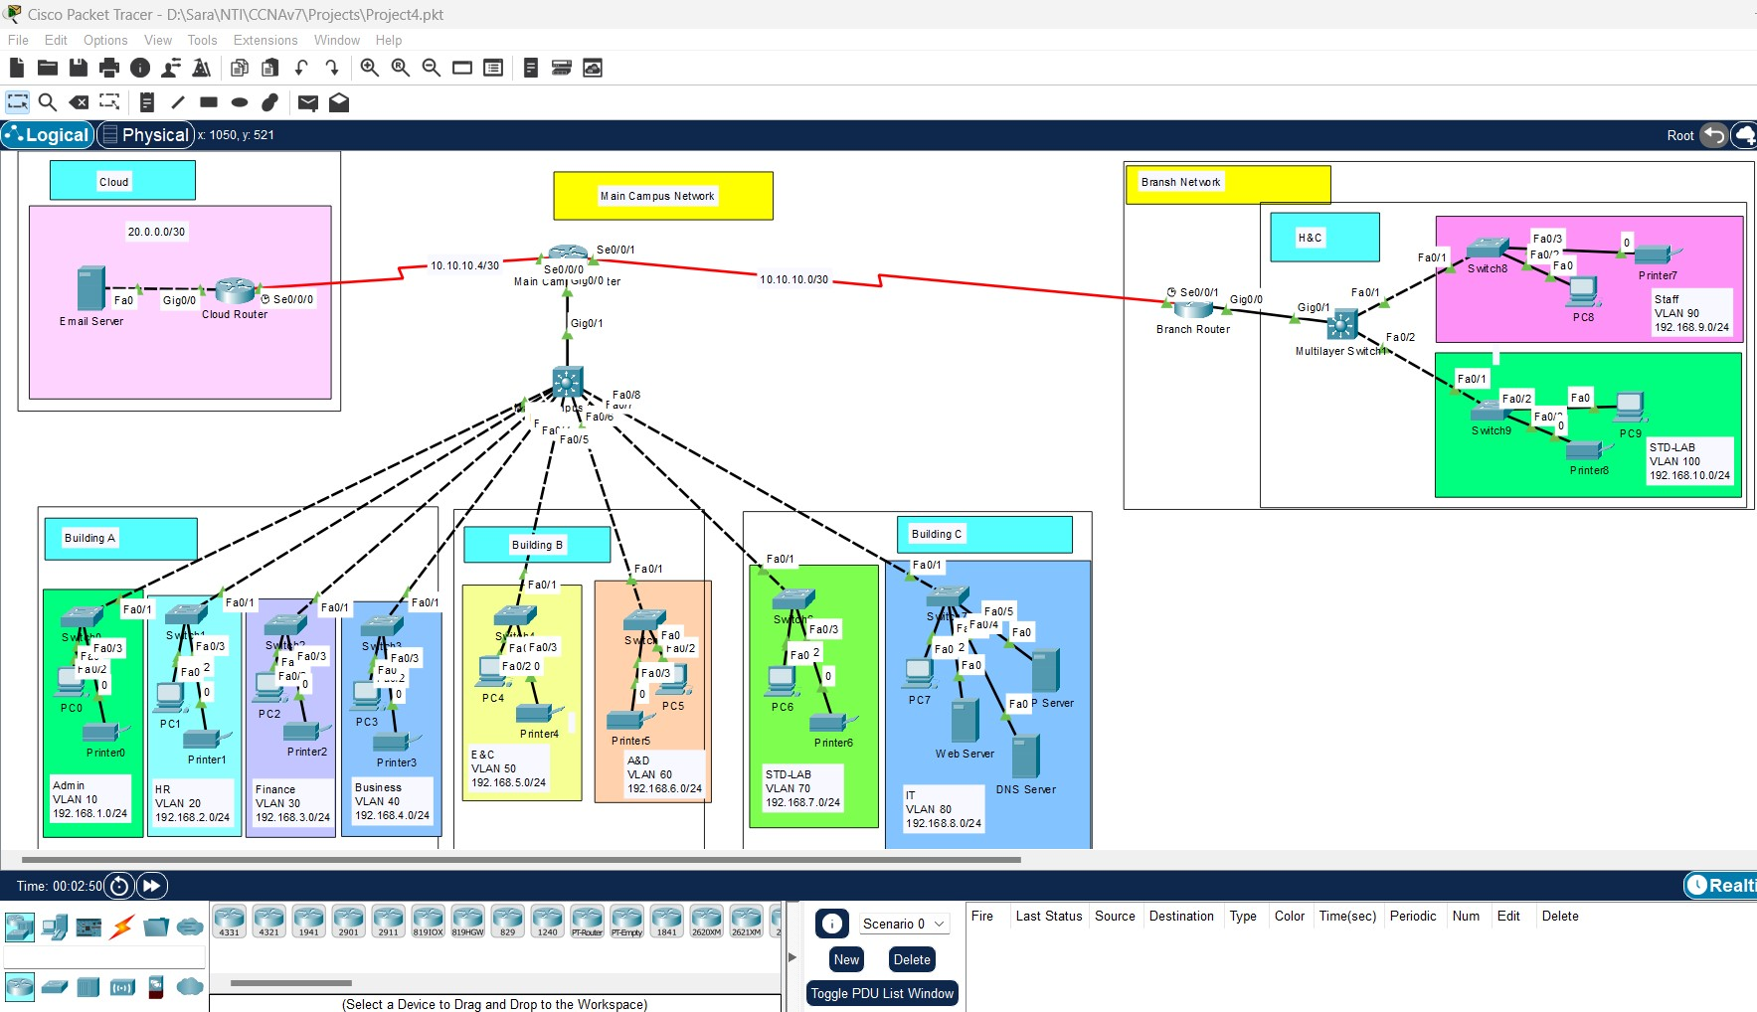
Network Topology

Slide 5
Configurations Overview
The project includes configurations for:
Basic Settings
VLAN Configurations
STP port fast and BBDU guard
Etherchannel
Subnetting and IP addressing
Static IP address to DMZ servers
HSRP, Inter-VLAN Routing (SVI), IP Helper Address.
OSPF dynamic routing.
Firewall static route, NAT
Firewall Inspection Policies.
Server Setup: Web, Email, FTP, DNS.
Network Security: Port Security, Dynamic ARP Inspection (DAI), DHCP Snooping.

Slide 6

Steps to Test and Verify
Ping Tests: Check connectivity between devices.
DHCP Tests: Verify IP address allocation.
OSPF Routing: Use 'show ip route' on devices to confirm routes.
Security Tests: Test scenarios to validate Port Security, DAI, and DHCP Snooping.

Slide 7

For the configuration files here is my GitHub repo that contains the project file and the configurations
https://github.com/Sa-Ra24/Advanced-Network-Campus-Project

