Slide 1

Prediction of Heart Diseases Using Data Science and Machine Learning
SRM INSTITUTE OF SCIENCE AND TECHNOLOGY
FACULTY OF ENGINEERING AND TECHNOLOGY
DEPARTMENT OF COMPUTER SCIENCE AND ENGINEERING
15CS496L MAJOR PROJECT
Candidate Name: Sanskriti Shivhare
Reg No: RA1711003010237
Batch Number: CSE00000237
Guide Name: Dr. S. S. Sridhar
Designation: Professor

Slide 2
Abstract
Nearly every day, terabytes of data are generated, as we are living in the "digital era." Day in day out, the healthcare sector produces a massive amount of data about patients and diseases. Researchers and practitioners, on the other hand, do not make good use of this data. Heart disease is widely regarded as one of the world's leading causes of death. If present trends are left unabated, heart disease will claim the lives of 23.6 million people by 2030. As a response, credible, viable, and accurate diagnosis of such diseases sufficient time for proper treatment is needed.
Today's healthcare sector is "data-rich" but "knowledge-poor." There is indeed a scarcity of efficient data analysis methods for uncovering concealed patterns and relationships. So, the main objectives of this research paper are predicting and also making an analytic conclusion regarding Heart Diseases with comparative results by using data analysis and machine learning.

Slide 3
Objective of the Project
Heart disease can be managed effectively with a combination of lifestyle changes, medicine and, in some cases, surgery. With the right treatment, the symptoms of heart disease can be reduced and the functioning of the heart improved. The predicted results can be used to prevent and thus reduce cost for surgical treatment and other expensive.
The overall objective of my work will be to predict accurately using different attributes, and come up with a solution that can help them to prevent any future loss. This prediction model will use data science life cycle along with machine learning models to come up an appropriate prediction and insights about the person’s well-being.

Slide 4
Literature Survey
S. No. | Title | Author | Year Published | Contribution | Inference
1. | Heart Disease Prediction Using Machine learning and Data Mining Technique | Jaymin Patel, Prof.TejalUpadhyay, Dr. Samir Patel | 2016 | This research compares different algorithms of Decision Tree classification seeking better performance in heart disease diagnosis using WEKA. The algorithms which are tested is J48 algorithm, Logistic model tree algorithm and Random Forest algorithm | It is concluded that J48 tree technique turned out to be best classifier for heart disease prediction because it contains more accuracy and least total time to build. But the success id very marginal and needs more complex models to increase the accuracy of predicting the early onset of heart disease

Slide 5
Literature Survey
S. No. | Title | Author | Year Published | Contribution | Inference
2. | Prediction of Heart Disease Using Machine Learning Algorithms | Sonam Nikhar et al | 2016 | This research intends to provide a detailed description of Naïve Bayes and decision tree classifier that are applied in their research particularly in the prediction of Heart Disease. Some experiment has been conducted to compare the execution of predictive data mining technique on the same dataset, and the consequence reveals that Decision Tree outperforms over Bayesian classification. | They have analyzed that the decision tree has better accuracy as compared to naïve Bayes classifier. To increase the performance of the classifier in future, they will be working on Selective naïve Bayes classifier; It is known that Naïve Bayesian classifier (NB) works very well on some domains, and poorly on some. Their purpose is to improve the performance of the Naïve Bayesian classifier by removing unnecessary and irrelevant attributes from the dataset and only picking those that are most informative for the classification task

Slide 6
Literature Survey
S. No. | Title | Author | Year Published | Contribution | Inference
3. | Heart Disease Diagnosis And Prediction Using Machine Learning And Data Mining Techniques: A Review | Animesh Hazra et al | 2017 | The aim of this paper was to summarize some of the current research on predicting heart diseases using data mining techniques, analyze the various combinations of mining algorithms used and conclude which technique(s) are effective and efficient. | The main focus has been on the application of classification techniques for heart disease prediction, rather than studying various data cleaning and pruning techniques that prepare and make a dataset suitable for mining. It has been observed that a properly cleaned and pruned dataset provides much better accuracy than an unclean one with missing values.

Slide 7
Literature Survey
S. No. | Title | Author | Year Published | Contribution | Inference
4. | Heart Disease Prediction System Using Naïve Bayes Data Mining Technique | Amruta Powar et al. | 2018 | In this paper they develop heart disease prediction system using naïve bayes data mining technique, which will help in predicting heart disease so that diagnosing it can take less medical tests and provide effective treatments. | In this proposed system they used 15 attributes. They used maximum no. of records for training and remaining no. of records for testing. The testing procedure evaluates the proposed system model in terms of sensitivity, specificity and accuracy. They took 50 records for testing. The system has 82% accurate. And when the dataset was increased then accuracy of the system is also get increased.

Slide 8
Literature Survey
S. No. | Title | Author | Year Published | Contribution | Inference
5. | Heart Disease Prediction using Machine Learning | Abhijeet Jagtap et al | 2019 | The goal was to extract the hidden patterns by applying data mining techniques on the dataset and predict the presence of heart disease in patients. The objective was to find out the suitable machine learning technique that is computationally efficient as well as accurate for the prediction of heart disease. Data mining combines Statistical analysis, machine learning and database technology to extract hidden patterns and relationships from large databases. | Heart diseases prediction is a web-based machine learning application, trained by a UCI dataset. The user inputs its specific medical details. The algorithm will calculate the probability of presence of heart disease. The system was implementing using 3 algorithms: Support Vector Machine (SVM), Logistic Regression, Naïve Bayes Algorithm. SVM was the most accurate out of the three with 64.4% efficiency

Slide 9
Literature Survey
S. No. | Title | Author | Year Published | Contribution | Inference
6. | A Review on Heart Disease Prediction Using Machine Learning Techniques | Adil Hussain Sehet al | 2019 | The main objective of this research paper is to summarize the recent research with comparative results that has been done on heart disease prediction and also make analytical conclusions. From the study, it is observed Naive Bayes with Genetic algorithm; Decision Trees and Artificial Neural Networks techniques improve the accuracy of the heart disease prediction system in different scenarios. | From the study they found that Neural Networks with 15 attributes provide 100% accuracy, another experiment gives 76.55% accuracy with 8 attributes. Naive Bayes has high accuracy above (90%) in most experiments with different number of attributes. Decision lists (J48) also performs very well in accuracy goes up to 99.62 % in a case. So, different techniques used indicate the different accuracies depend upon number of attributes taken and tool used for implementation.

Slide 10
Inference from the survey
The existing heart disease prediction systems (hdps) is developed using Naives bayes and decision tree algorithms for predicting the risk level of heart disease
These systems use 15 medical parameters such as age, sex, blood pressure, cholesterol, and obesity for prediction. The hdps predicts the likelihood of patients getting heart disease.
Most of the system proceed with their prediction without data preparation will leads to a lot of errors while predicting heart diseases

Slide 11
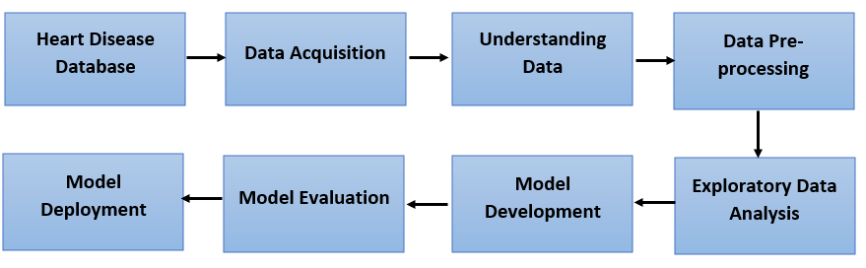
Architecture Diagram

Slide 12
Module Description
Data collection and Data preparation
ETL is a 3 steps process:
Extracting data from single or multiple data sources.
Transforming data as per business logic. Transformation is in itself a two steps process- data cleansing and data manipulation.
Loading the previously transformed data into the target data source or data warehouse.

Slide 13
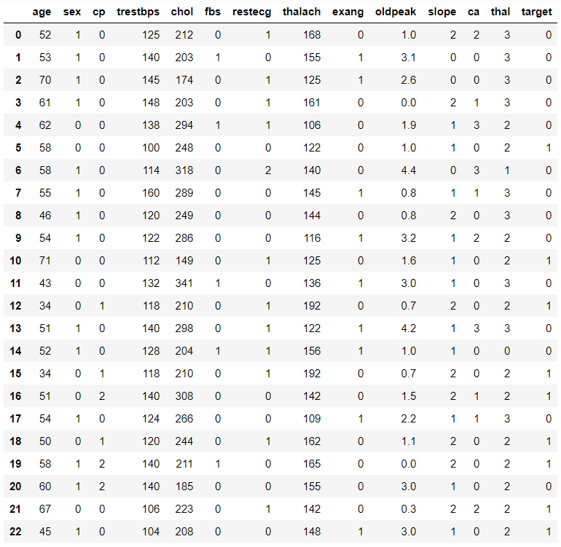
Data Set
age - in years
sex- (1 = male; 0 = female)
cp - chest pain type
trestbps - resting blood pressure (in mm Hg on admission to the hospital)
chol - serum cholestoral in mg/dl
fbs - (fasting blood sugar &gt; 120 mg/dl) (1 = true; 0 = false)
restecg - resting electrocardiographic results
thalach - maximum heart rate achieved
exang- exercise induced angina (1 = yes; 0 = no)
oldpeak - ST depression induced by exercise relative to rest
slope -the slope of the peak exercise ST segment
ca -number of major vessels (0-3) colored by flourosopy
thal - 3 = normal; 6 = fixed defect; 7 = reversable defect
target – 1(presence of heart disease) or 0(absence of heart disease)

Slide 14
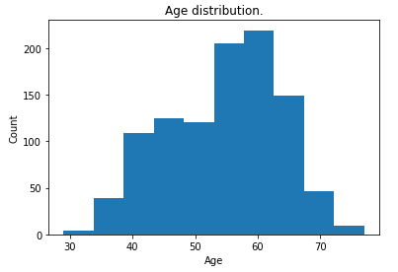
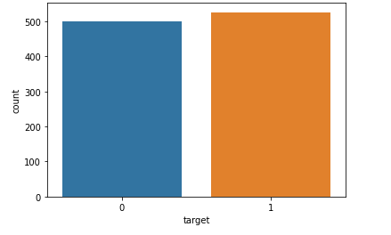
Module Description
Exploratory Data Analysis
Understand everything about the data, the patterns etc.
This is done by adopting statistics and data visualization.
Age Distribution Case Count

Slide 15
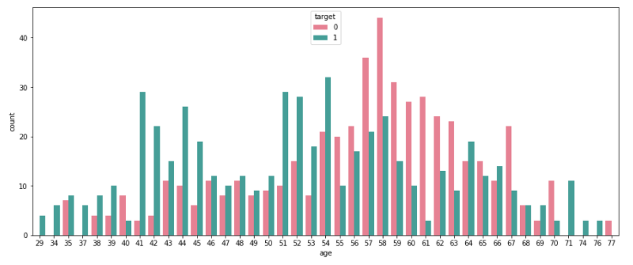
Module Description
Exploratory Data Analysis
Number of people who have disease vs age

Slide 16
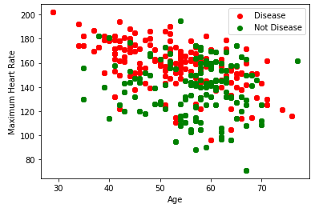
Module Description
Exploratory Data Analysis
Scatter plot for Heart Rate vs Age

Slide 17
Module Description
Modelling and Model Evaluation
Create a baseline model, once the features are chosen.
The model training is done with increasing the complexity of the model.
Increasing testing with various algorithms to see how this particular dataset respond to this algorithm

Slide 18
Module Description
MODELLING
Models used for the prediction:
Stochastic Gradient Descent
K-Nearest Neighbour
Decision Tree
Random Forest
Extreme Gradient Boost

Slide 19
Module Description
MODEL EVALUATION:
S. No | Model | Accuracy | Absence of heart disease | Presence of heart disease
1. | Stochastic Gradient Descent | 80.19 | 0.76 | 0.85
2. | K-Nearest Neighbour | 89.61 | 0.88 | 0.91
3. | Extreme Gradient Boost | 89.93 | 0.89 | 0.91
4. | Decision tree | 91.88 | 0.88 | 0.95
5. | Random Forest | 93.51 | 0.96 | 0.91

Slide 20
Module Description
Model Deployment
After evaluating various algorithm the one with best result is deployed.
Continuously monitor the model, in order to prevent extreme cases where model can be non-performant and just throw garbage value.

Slide 21
Result
Random Forest is chosen because it has the highest accuracy and precision in predicting heart diseases

Slide 22
References
Heart Disease Dataset https://www.kaggle.com/sulianova/cardiovascular-disease-dataset
Heart Disease Dataset https://www.kaggle.com/ronitf/heart-disease-uci
Heart Disease Dataset https://archive.ics.uci.edu/ml/datasets/heart+Disease
http://www.who.int/cardiovascular_diseases/en/
https://en.wikipedia.org/wiki/Cardiovascular_disease
https://analyticsindiamag.com/7-types-classification-algorithms/
https://www.mayoclinic.org/diseases-conditions/heart-disease/symptoms-causes/syc-20353118
Adil Hussain Seh, Dr. Pawan Kumar Chaurasia“A Review on Heart Disease Prediction Using Machine Learning Techniques”, International Journal of Mangement, IT & Engineering, Volume 9, Issue 4, April 2019
Abhijeet Jagtap , Priya Malewadkar , Omkar Baswat , Harshali Rambade, “Heart Disease Prediction using Machine Learning ”, International Journal of Research in Engineering, Science and Management Volume-2, Issue-2, February-2019, ISSN (Online): 2581-5792
Animesh Hazra, Subrata Kumar Mandal, Amit Gupta, Arkomita Mukherjee and Asmita Mukherjee,”Heart Disease Diagnosis and Prediction Using Machine Learning and Data Mining Techniques: A Review”, Research India Publications, Advances in Computational Sciences and Technology ISSN 0973-6107 Volume 10, Number 7 (2017) pp. 2137-2159

Slide 23
References
Jaymin Patel, Prof.TejalUpadhyay, Dr. Samir Patel, “Heart Disease Prediction Using Machine learning and Data Mining Technique”, IJCSC Volume 7, Number 1 Sept 2015 – March 2016, pp. 129-137
G. Parthiban, S.K.Srivatsa, “Applying Machine Learning Methods in Diagnosing Heart Disease for Diabetic Patients”, International Journal of Applied Information Systems (IJAIS) – ISSN : 2249-0868 Foundation of Computer Science FCS, New York, USA Volume 3– No.7, August 2012
Sonam Nikhar , A.M. Karandikar, “Prediction of Heart Disease Using Machine Learning Algorithms”, International Journal of Advanced Engineering, Management and Science (IJAEMS), [Vol-2, Issue-6, June- 2016], ISSN : 2454-1311
Amruta Powar and Prof. Dr. Vijay Ghorpade, “Heart Disease Prediction System Using Naïve Bayes Data Mining Technique”, wjert, 2018, Vol. 4, Issue 4, 313-318, ISSN 2454-695
M. Marimuthu, M. Abinaya, K. S. Hariesh, K. Madhankumar, K. Madhankumar, “A Review on Heart Disease Prediction using Machine Learning and Data Analytics Approach”, International Journal of Computer Applications (0975 – 8887) Volume 181 – No. 18, September 2018
Mr. Amol A. Wghmode, Mr. Darpan Sawant, Prof. Deven D. Ketkar, “Heart Disease Prediction Using Data Mining Techniques”, Heart Disease Prediction Using Data Mining Techniques, ISSN 2394 – 3386 Volume 4, Issue 10 October
Ajad Patel, Sonali Gandhi, Swetha Shetty,Prof. Bhanu Tekwan, “Heart Disease Prediction Using Data Mining”, International Research Journal of Engineering and Technology (IRJET), Volume: 04 Issue: 01 | Jan -2017, e-ISSN: 2395 -0056, p-ISSN: 2395-0072
Prof. Mamta Sharma , Farheen Khan , Vishnupriya Ravichandran, Comparing Data Mining Techniques Used For Heart Disease Prediction, International Research Journal of Engineering and Technology (IRJET) Volume: 04 Issue: 06 | June -2017, e-ISSN: 2395 -0056 , p-ISSN: 2395-0072
Devansh Shah1 · Samir Patel1 · Santosh Kumar Bharti, “Heart Disease Prediction using Machine Learning Techniques”, Springer Nature Singapore Pte Ltd 2020, 16 October 2020
Taye Oladele Aro , Besiru Jibrin Muhammed , Olufisayo Babatope Ayoade , Idowu Dauda Oladipo, “A Review On Data Mining Techniques For Heart Disease Prediction”, Anale. Seria Informatică. Vol. XV fasc. 1 – 2017
Smriti Mukesh Singh, Dr. Dinesh B. Hanchate, “Improving Disease Prediction by Machine Learning”, International Research Journal of Engineering and Technology (IRJET), Volume: 05 Issue: 06 | June-2018, e-ISSN: 2395-0056, p-ISSN: 2395-0072

Slide 24
Thank You

