Slide 1
Front End Engineering-I Project
Team Details:
Sahil (2210992211)
Sahil (2210992210)
Sahil Bhatti (2210992209)
Sahil Bansal (2210992208)
Faculty Coordinator: Dr Mudita
:
Chitkara University Institute of Engineering and Technology,
Chitkara University, Punjab

Slide 2

Test Management System

Slide 3
Table of Contents
Introduction
Problem Statement
Technical Statement
Benefit of using a test management system
Key Features
Project Highlight
How to use?
Conclusion

Slide 4

Introduction
Test management system is a software tool that helps in managing and organizing the testing process of a software project. It provides a centralized platform for test planning, execution, and reporting.
The main aim of a test management system is to improve the efficiency and effectiveness of the testing process by providing features like test case management, test execution tracking, and defect management.

Slide 5

Problem Statement
The Online Test Management System helps in conducting and maintaining the exams online in a proficient manner. It also provides:
Better Time Management
Online Access
No Unauthenticated Access
Facilities
Accuracy
Security
Efficiency1629

Slide 6
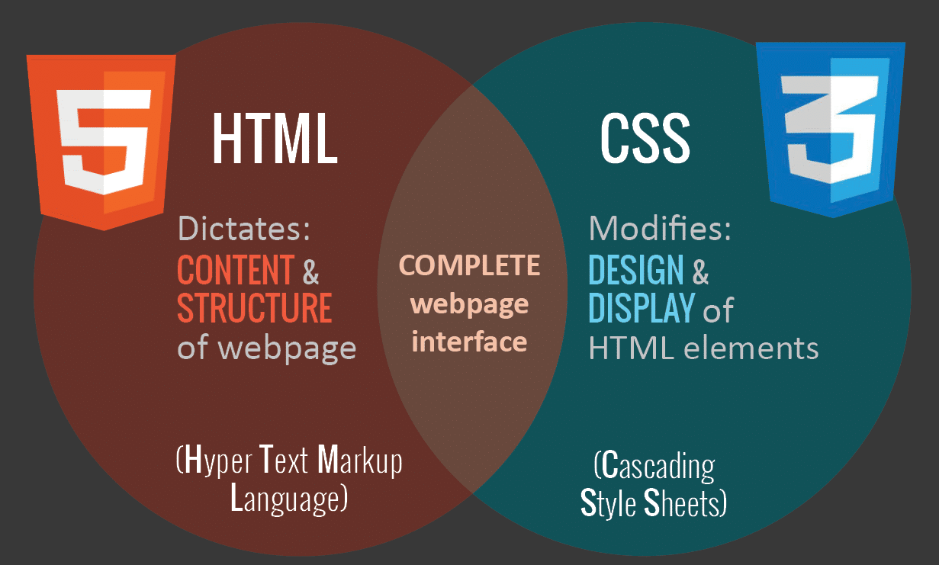
Technical Details
Using HTML and CSS, you would need to use a number of technologies and approaches to create a Test Management System, such as:
HTML: Every website, including Google, is built on top of Hypertext Markup Language. Using HTML tags, you would need to construct the page's structure.
CSS: Flowing Templates are utilized to style the HTML content. Your Test management system would get its colors, fonts, and layout from CSS.

Slide 7
Design that responds: Test management system is responsive, which means that it works with a variety of screen sizes. You would have to involve media questions in CSS to make a responsive plan that changes with various gadgets.
Flexbox: Flexbox is a CSS layout module that makes creating responsive and flexible layouts simpler. It would be used to align page elements like the search bar and buttons.
Fonts from Google: Google Textual styles is a library of free web text styles that you can use to style your text. To use the same fonts as Google, you can include Google Fonts in your HTML and CSS..

Slide 8
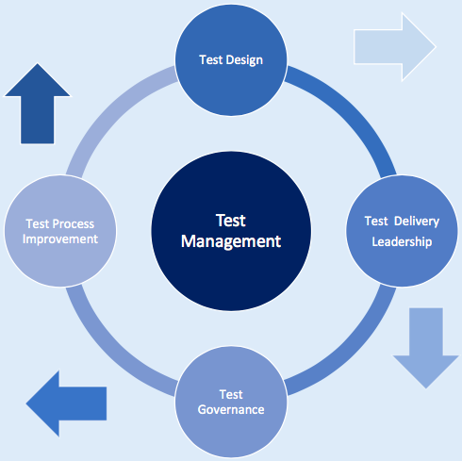
Key Features
A test management system comes with a wide range of features that help in streamlining the testing process. Some of the key features include test case management, test execution tracking, and defect management.
Other important features of a test management system include requirement management, traceability matrix, and integration with other tools like test automation and project management tools.

Slide 9

Project Highlight

Slide 10

How To Use?
To ensure the success of a test management system, it is important to follow best practices such as defining clear testing objectives, creating a comprehensive test plan, and regularly reviewing and updating the testing process.
It is also important to involve all stakeholders in the testing process and to use automation tools wherever possible to increase efficiency and accuracy.

Slide 11
Conclusion
In conclusion, a test management system is an essential tool for managing and organizing the testing process of a software project. It helps in improving the efficiency and effectiveness of the testing process by providing features like test case management, test execution tracking, and defect management.
By following the best practices and overcoming the challenges, organizations can successfully implement and use a test management system to improve the quality of their software and reduce the testing time and cost.

Slide 12


