Slide 1
LENDING CASE STUDY
Using Python and EDA
-Sagarika Bhadra (GML C7)

Slide 2
Introduction
In this case study, we are attempting to solve a real world business problem using Exploratory Data Science techniques. We will be understanding and solving a risk analytics problem in Banking and Financial Domain.We will be checking how data can be used effectively to solve business problems like defaulters prediction in Loan Lending club

Slide 3
Business Problem Statement:
We are working for a consumer finance company which specialises in lending various types of loans to urban customers. When the company receives a loan application, the company has to make a decision for loan approval based on the applicant’s profile. Two types of risks are associated with the bank’s decision:
If the applicant is likely to repay the loan, then not approving the loan results in a loss of business to the company
If the applicant is not likely to repay the loan, i.e. he/she is likely to default, then approving the loan may lead to a financial loss for the company
The data given to us contains the information about past loan applicants and whether they ‘defaulted’ or not. The aim is to identify patterns which indicate if a person is likely to default, which may be used for taking actions such as denying the loan, reducing the amount of loan, lending (to risky applicants) at a higher interest rate, etc.

Slide 4
Business and Data Understanding
We need to make a strategic decision whether to accept the loan application or not based on the detailsof the customers given in the dataset
We have been provided with a loan.csv dataset file which contains all the details for all the loan applicants and DataDictionary file which contains the details and meaning of all the columns of loan.csv file.
Business Objectives:
When a person applies for a loan, there are two types of decisions that could be taken by the company:
Loan accepted: If the company approves the loan, there are 3 possible scenarios described below:
Fully paid: Applicant has fully paid the loan (the principal and the interest rate)
Current: Applicant is in the process of paying the instalments, i.e. the tenure of the loan is not yet completed. These candidates are not labelled as 'defaulted'.
Charged-off: Applicant has not paid the instalments in due time for a long period of time, i.e. he/she has defaulted on the loan
Loan rejected: The company had rejected the loan (because the candidate does not meet their requirements etc.). Since the loan was rejected, there is no transactional history of those applicants with the company and so this data is not available with the company (and thus in this dataset)

Slide 5
Process for solving the Case Study
Importing the required libraries.
import pandas as pd
import numpy as np # linear algebra
import matplotlib.pyplot as plt
import seaborn as sns
sns.set_style('whitegrid')
%matplotlib inline
import warnings,scipy
warnings.filterwarnings("ignore")
import scipy.stats as stats
from scipy.special import boxcox1p, boxcox
import scipy.stats as stats
import statsmodels.api as sm
Loading the Data
Extracting the basic info about the Dataset
Exploratory Data Analysis

Slide 6
Data Cleaning & Data Manipulation Methods
Data Cleaning
Checking for Duplicate rows in dataset
Finding the rows and columns which have missing values
Finding out columns which have all NULL values
Dropping the columns which have NULL values and which are not applicable for the analysis.
Data Manipulation – Replacing with ‘’ where ‘%’ is used.
Extracting digits from Employee length of years.
Converting Amount columns to Numeric characters.
Deleting rows containing either 50% or more than 50% NaN Values
Dropping Constant Features.
Data Cleaning with missing value treatment

Slide 7
Exploratory Data Analysis (EDA)
Finding out percentages of various loan_status out of total loans issued
Finding out percentages of various purpose of loans out of total loans issued
Usefull insights obtained from here are :-
Top4 purposes for taking loans are Debt_consolidation, Credit Card payment, home improvements and other personal reasons.
Below 4 purposes for taking loans are vacation, house, education and renewable energy.
Outlier Identification and Removal - Box Plot helps in removing Outliers

Slide 8
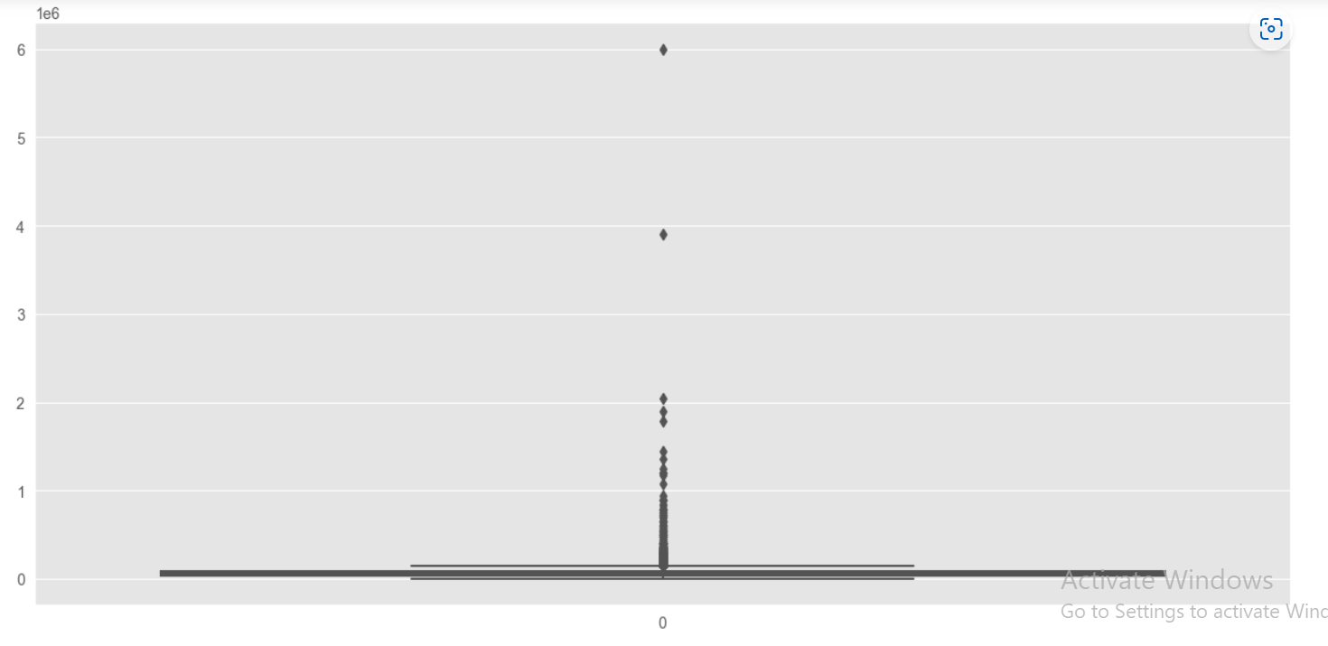
Box Plot for Annual Income
# Observations -
# There are outliers, so we need to remove it
# So, we are taking a threshold of 95 percentile

Slide 9
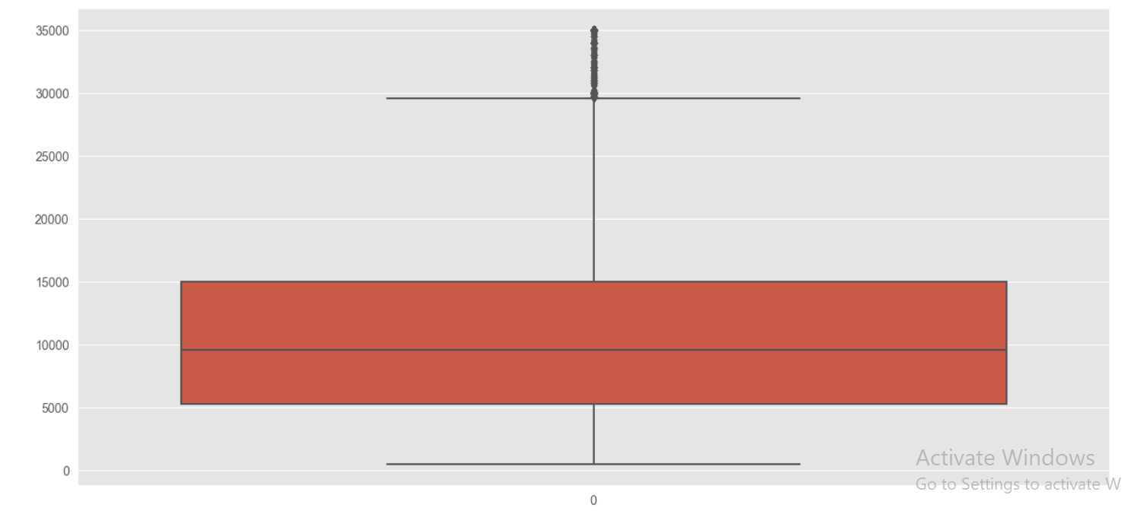
Box Plot for loan amount
# Observations -
# There are outliers, so we need to remove it
# So, we are taking a threshold of 95 percentile

Slide 10
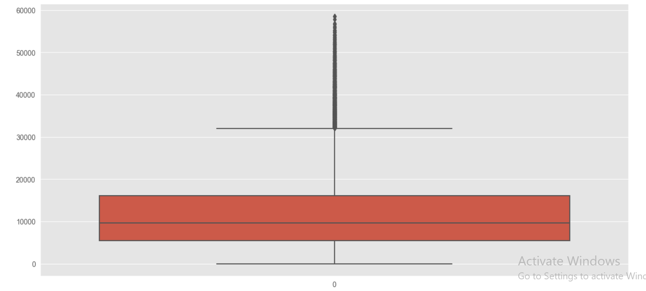
Box Plot for Total Payment
# Observations -
# Mostly the values are concentrated from ~7000 to ~18000.
# There are some values far from the distribution, but as the distribution is mostly continuous.
# So, there is no need to remove outliers / extreme values for these above columns.

Slide 11
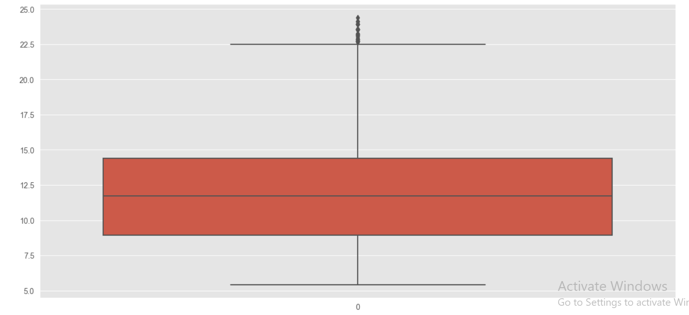
Box Plot for Interest Rate
# Observations -
There are some values far from the distribution, but as the distribution is mostly continuous.
# Mostly the values are concentrated between ~9 tp ~14
# So, there is no need to remove outliers / extreme values for these above columns.

Slide 12
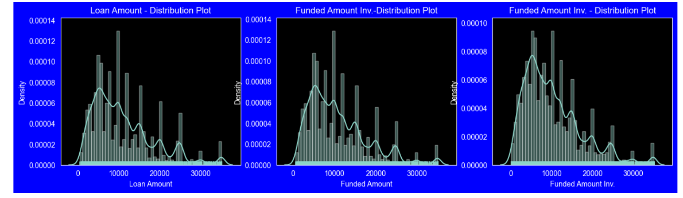
Distribution ofLoan Amounts using distribution plots
Observation - Distribution of amounts for all three looks very much similar.

Slide 13
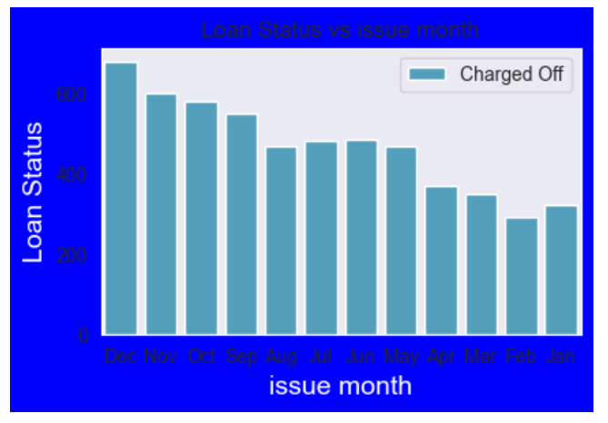
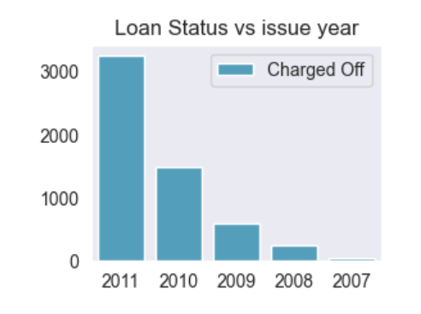
Univariate Analysis for Loan Amount Variable
# Observations:-
# Maximum Loans were charged off during the months from Sept to Dec with maximum in Dec.
# Least number of loans were charged off during the months of Feb-Apr.
# In the year 2011 maximum loans were Charged off.
# Minimum loans were charged off in the year 2007.

Slide 14
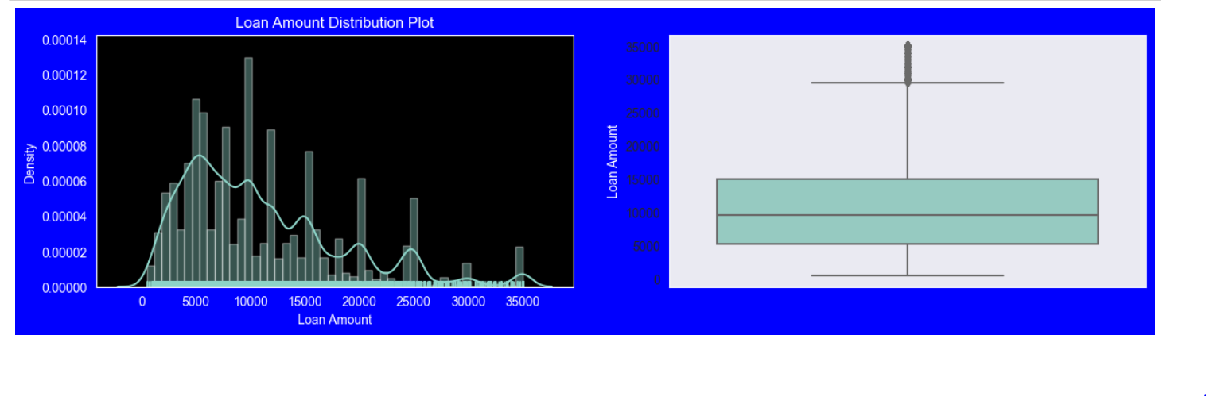
Univariate Analysis for Loan Amount Variable
# Observations -
# Most of the loan amounts are in the range 5000-15000
# High density of loan amounts are taken for rounded amounts like 5000, 10000, 15000, 20000, 25000, 30000, 35000. Major spikes
# are seen at these values.

Slide 15
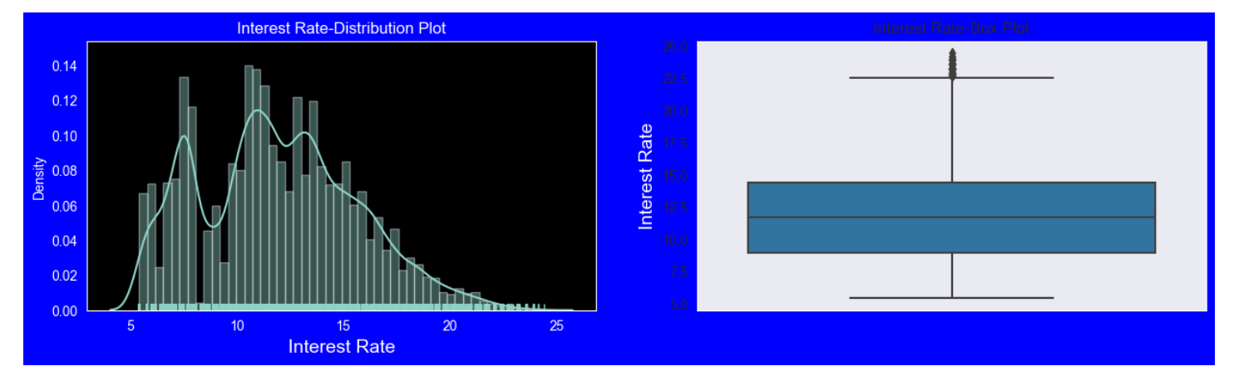
Univariate Analysis for Interest Rate Variable
# Observations:-
# The interest rates for most of the density is from 10% to 15%.
# Most of the people are having a income in such a way that the interest rates are calculated from 10-15 range.
# Very less people are having high income so the intrest rates are not high for 20-25 range.
# Also the loan amount seems to be same for a high number of people such that the interest rates are seen from 10-15.
# Very less people are asking for high loan amount.

Slide 16
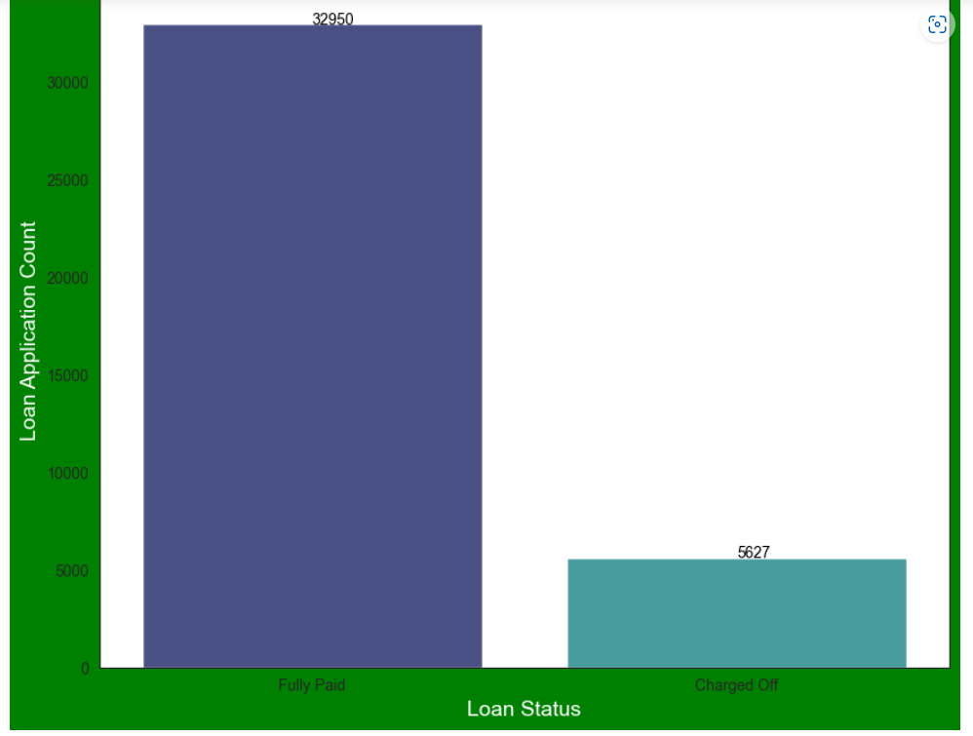
Univariate Analysis - Unordered Categorical Variables - Loan Status
# Observations -
# 32950 Loans are fully paid off and 5627 loans are charged off loans.
# The following plot shows that around 14% loans were charged off out of the total loans issued

Slide 17
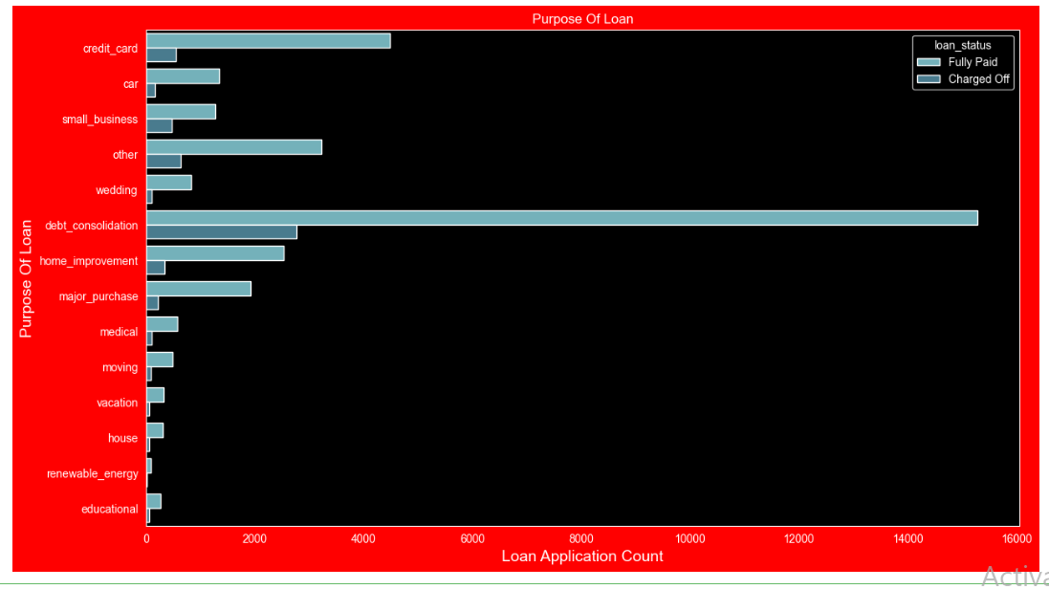
# Univariate Analysis - Unordered Categorical Variables - Purpose of Loan
# Observations -
# The Count Plot shows that most of the loans were taken for the purpose of debt consolidation & paying credit card bill.
# Number of charged off count also high too for these loans.

Slide 18
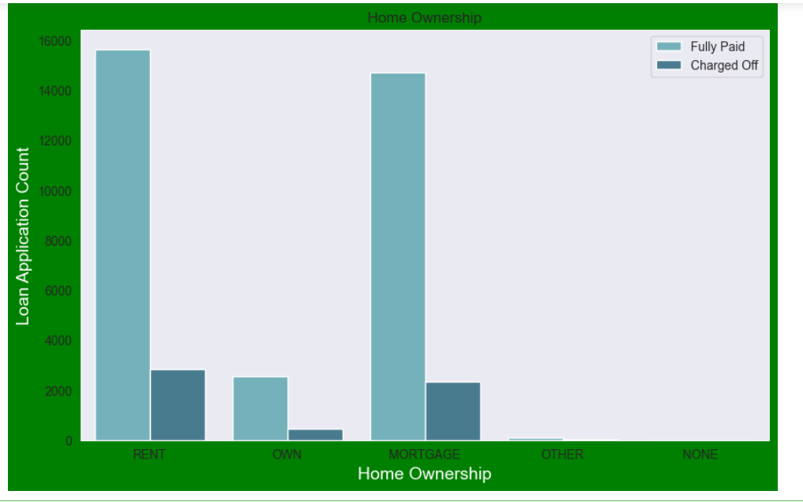
Univariate Analysis - Unordered Categorical Variable - Home Ownership
# Observations:-
# Most of the loan applicants are staying in Rented homes followed by Mortgage homes.
# Very less Loan applicants own a home.

Slide 19
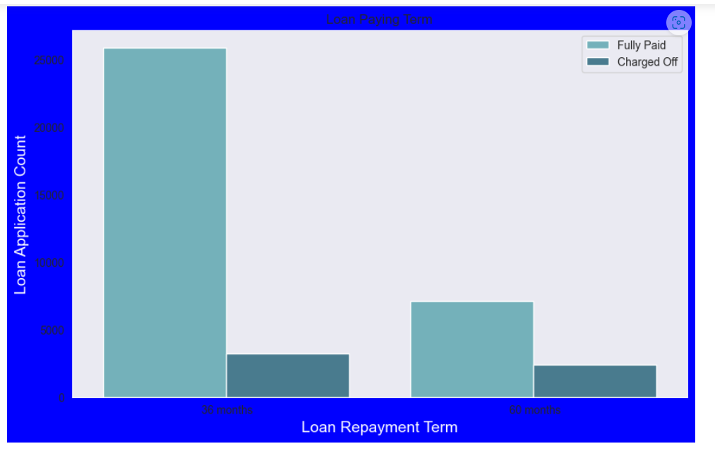
Univariate analysis- Loan Paying Term
# Observations:-
#Below plot shows that those who had taken loan to repay in 60 months had more % of number of applicants getting
#charged off as compared to applicants who had taken loan for 36 months.

Slide 20
Bivariate Analysis - Correlation
# Observations -
# Annual Income to Debt To Income Ratio i.e. dti are negatively correlated
# Loan Amount,Investor Amount and Funding Amount are strongly correlated
# Positive correlation between Annual Income and employment years
# Positive correlation between annual income and funded amount that means people with high income gets high funded amount
# Positive correlation between annual income and total payment
# Heat Map for the Correlation shown in the next slide.

Slide 21
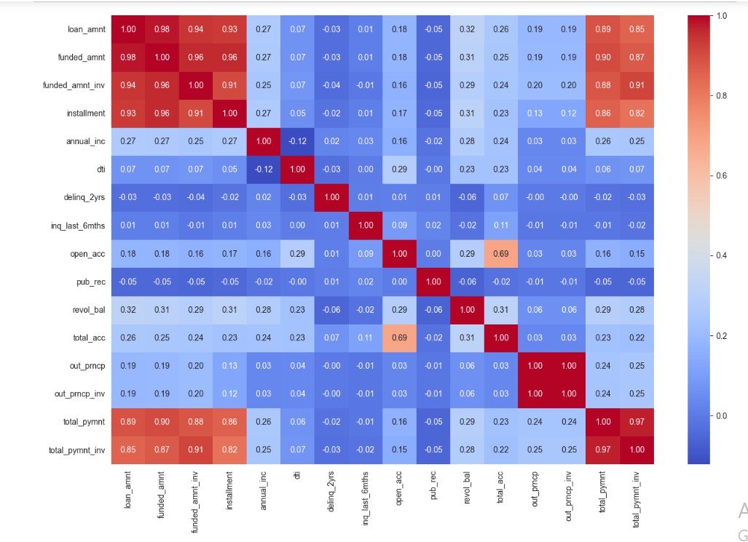

Slide 22
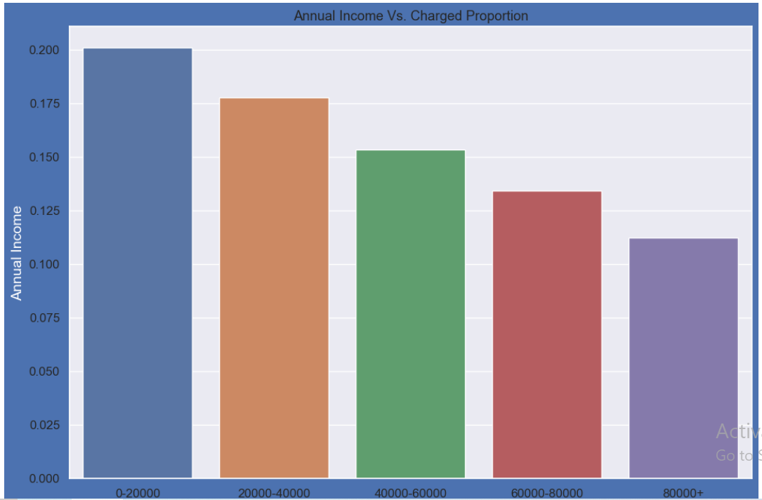
# Bivariate Analysis – In this section we will analyze the loan status against some important columns which might have an impact on charged off loans. Bivariate Analysis on annual income on Charged Off Loans
# Observations
#Income range 80000+ has less chances of charged off.
#Income range 0-20000 has high chances of charged off.
#Notice that with increase in annual income charged off proportion got decreased. So, they are inversely proportional.

Slide 23
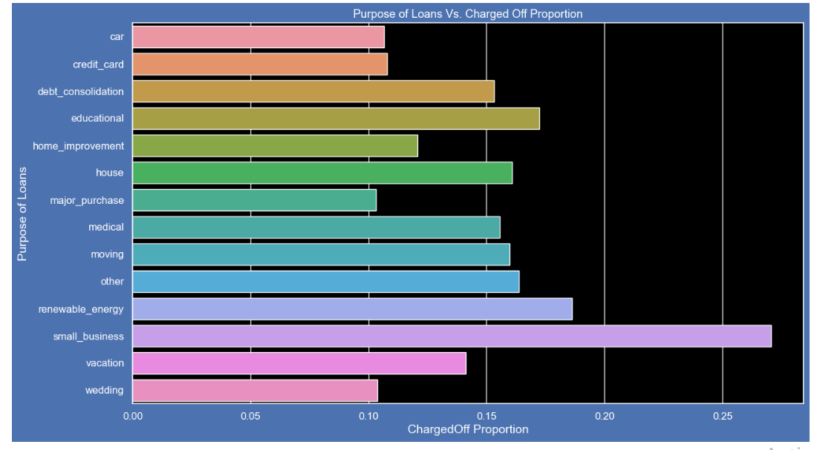
Bivariate Analysis for purpose of Loan Vs Charged Off Proportion
# Observations:-
# Top 4 purposes where the loan is charged off is Small business, education, renewable energy and house and debt consolidation.
# Car, credit card payment and wedding are some of the purposes where the loan is charged off.

Slide 24
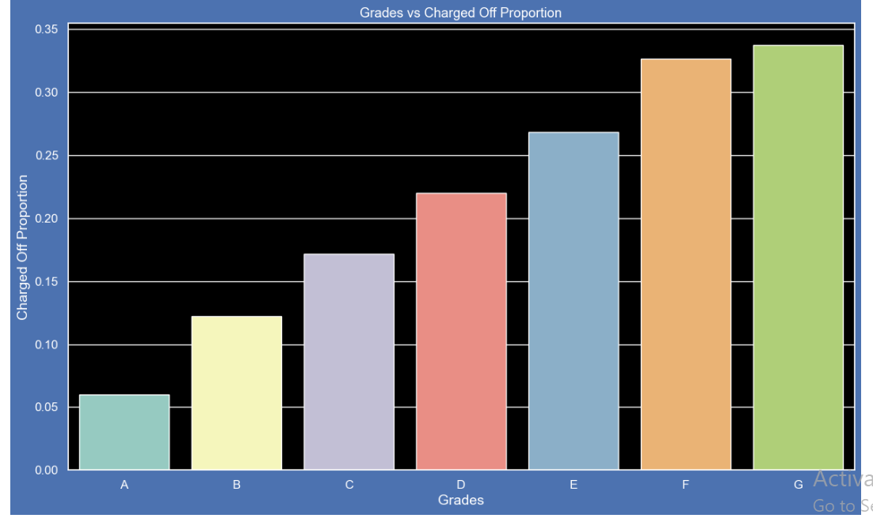
Bivariate analysis of grade against Charged Off Proportion
# Observations:-
# Grade E and F are having high proportion of charged off loans.
# Grade A is having less proportion of charged off loans.
# Chances of getting charged off is increasing with grades moving from A to G

Slide 25
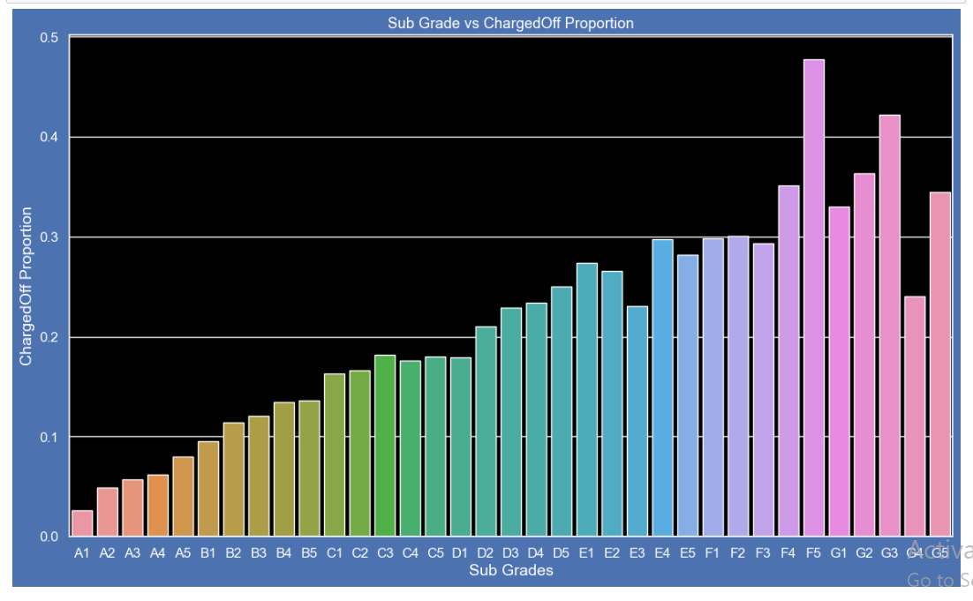
Bivariate Analysis on sub grade against Charged Off Proportion
# Observations -
# Sub Grade A1 has least chances of getting charged off
# Sub Grade F and Sub Grade G have high chances of getting charged off
# Chances of getting charged off is increasing with Subgrades moving from A to G

Slide 26
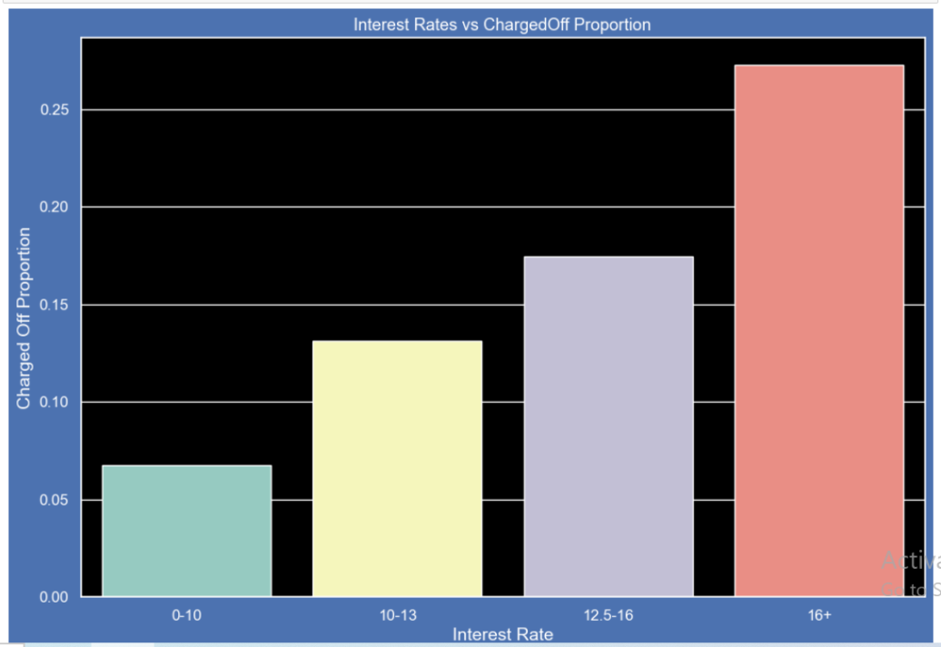
Bivariate analysis on interest rate against Charged Off
# Observations:
#1.Interest Rates which are less than 10% have very less chances of charged off.
#2.Interest Rates greater than 16 are having high chances of charged off. Less the interest rates, lesser is the chances of
# loan being charged off.
#3.Charged Off Proportion increases with higher interest rates

Slide 27
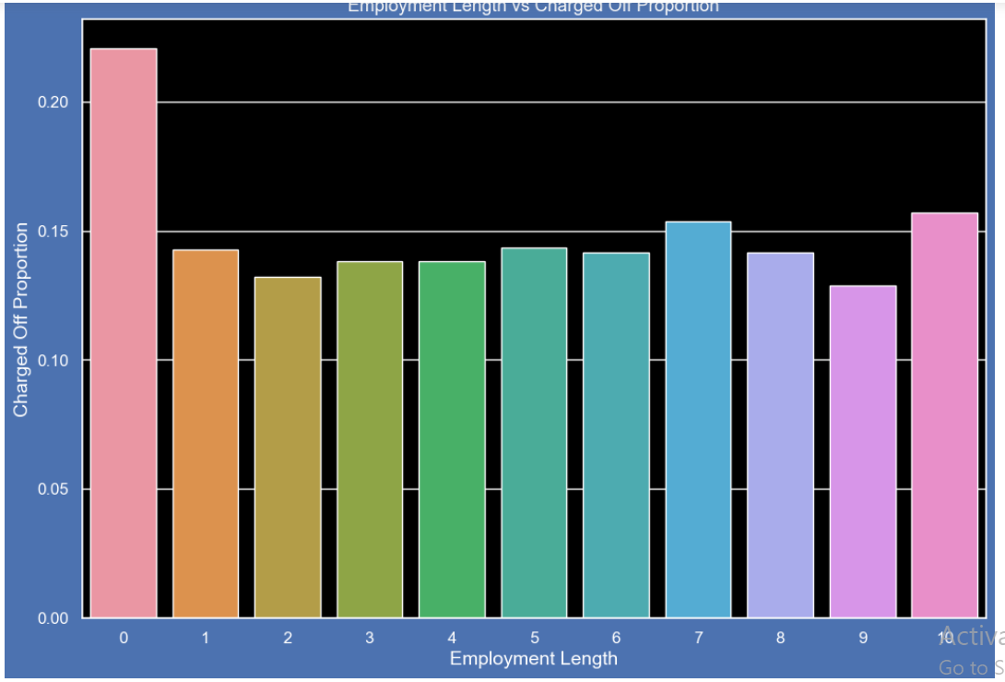
Bivariate analysis on employment length vs Charged Off Proportion
# Observations -
#Those who are not working or have less than 1 year of work experience have high chances of getting charged off.
#It makes sense as with less or no experience they don't have source of income to repay loan.
#Rest of the applicants have more or less same chances of getting charged off.

Slide 28
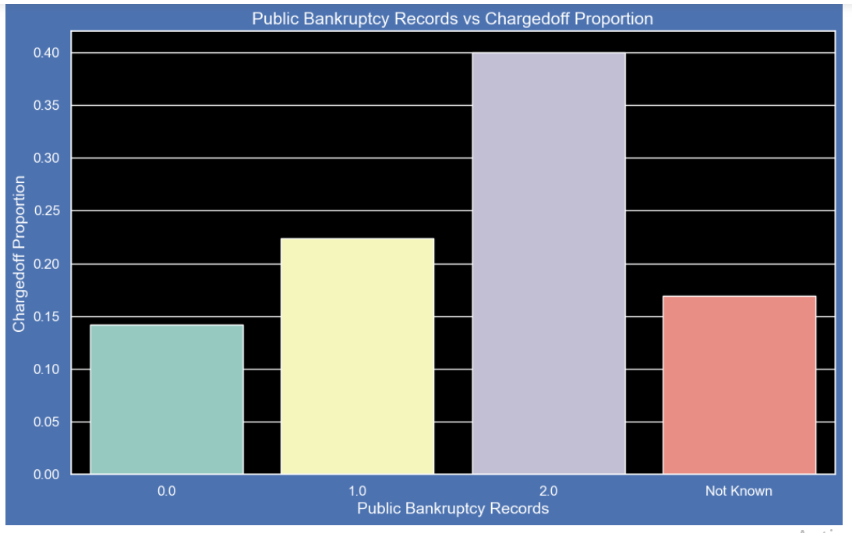
Bivariate analysis on pub_rec_bankruptcies against ChargedOff Proportion
#Those who already have pub_rec_bankruptcies value 1, have charged off proportion higher than who have no pub_rec_bankruptcies.
#pub_rec_bankruptcies count 2 has even higher charged off proportion but those numbers are not significant to decide.
#Not known is the column for which we don't have any information abount borrower.
#This also makes sense that who has defaulted before has more chances of dafaulting in future as well.

Slide 29
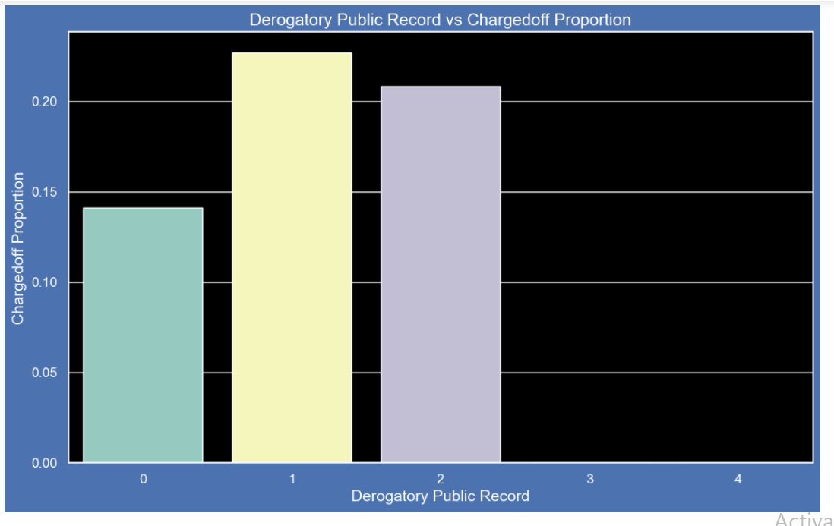
Bivariate analysis of Derogatory Public Records vs. Charged Off Proportion
# Observations -
#A derogatory item is an entry that may be considered negative by lenders because it indicates risk.Public records and collections are derogatory items
#because they reflect financial obligations that were not paid as agreed.
#Those who already have pub_rec value 1 or 2 have charged off chances higher than who have no Derogatory Public Record.
#pub_rec count 3-4 has less numbers so cannot reach on any conclusions.

Slide 30
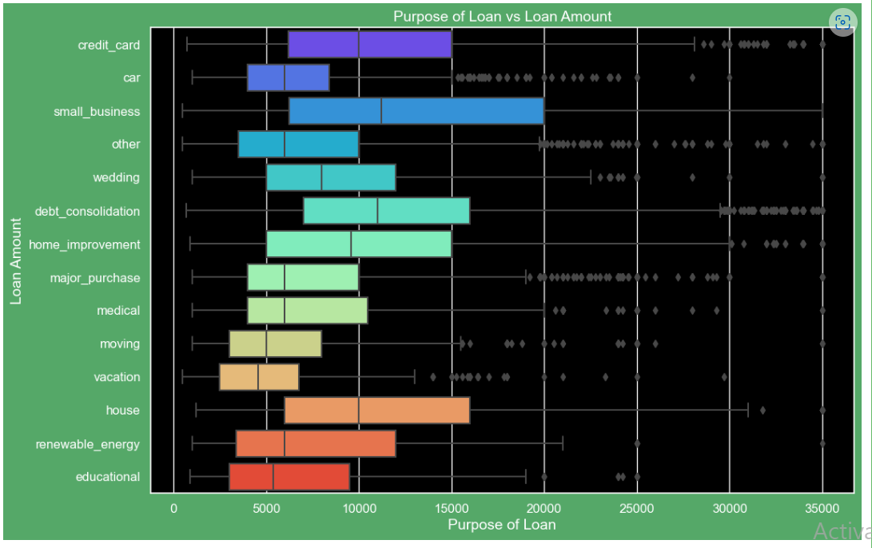
Bivariate Analysis Purpose of Loan Vs Loan amount
# Observations -
# Median,95th percentile,75th percentile of loan amount is highest for loan taken for small business purpose among all purposes.
# Debt consolidation is second and Credit card comes 3rd.

Slide 31
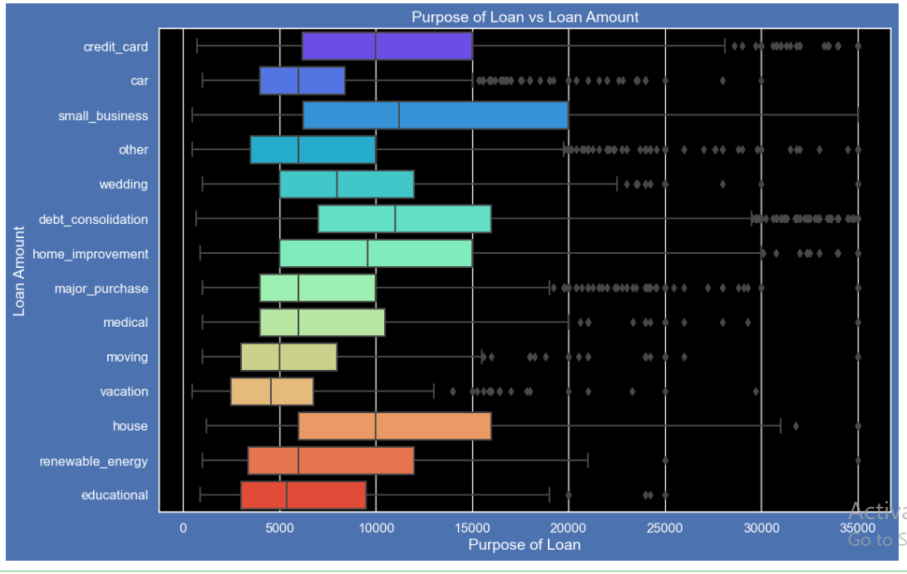
Bivariate Analysis -Purpose of Loan Vs. Loan amount
# Observations-
# Loan taken for small business purpose, Debt consolidation and Credit card are somewhat evenly distributed as compare to loan taken for other purposes.

Slide 32
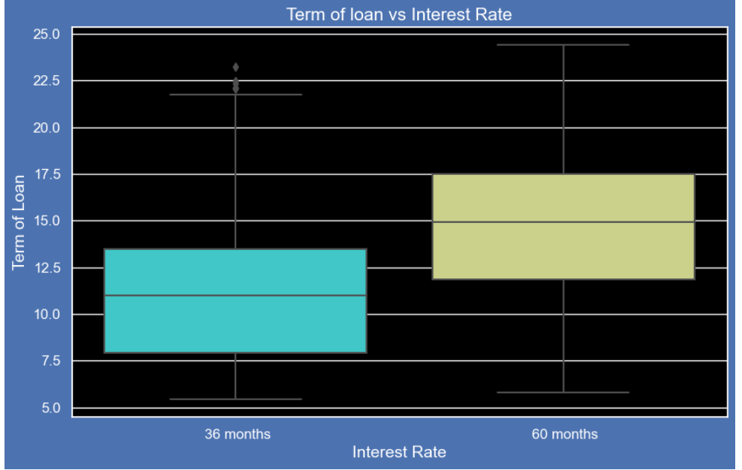
Bivariate Analysis-Term of Loan vs. Interest Rate Box Plot
# Observations -
# It is clear that average interest rate is higher for 60 months loan term.
# Most of the loans issued for longer term had higher interest rates for repayment.

Slide 33
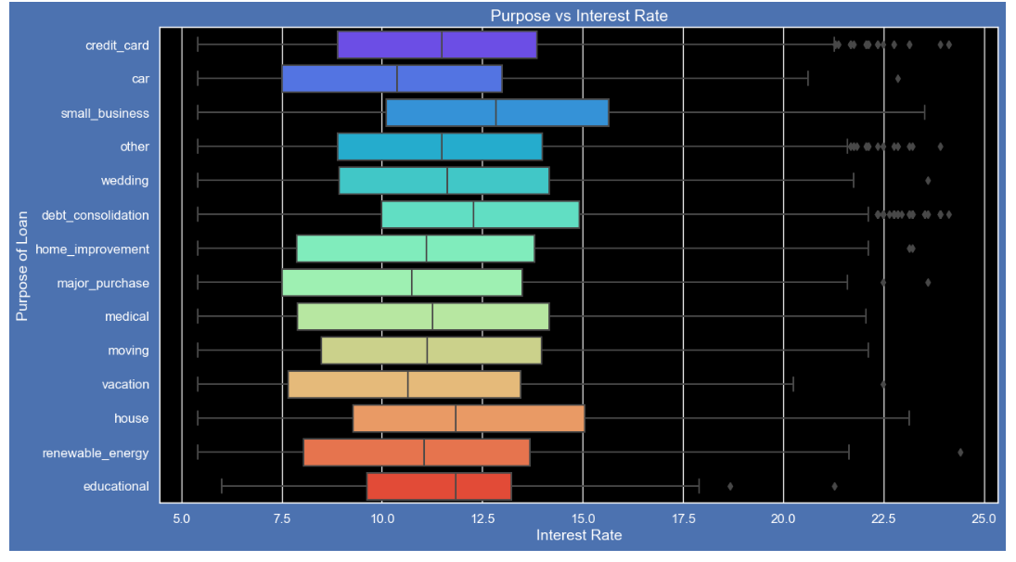
Bivariate Analysis - Purpose vs Interest Rate
# Observations -
# It is clear that avearge intrest rate is highest for small business purpose.
#Loans taken for small business purposes had to repay the loan with more intrest rate as compared to other.

Slide 34
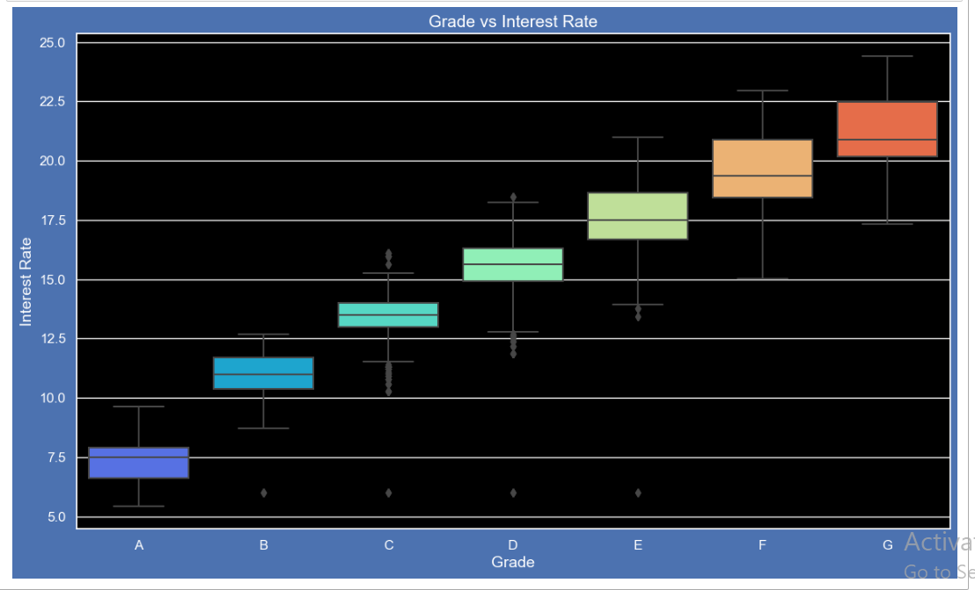
Bivariate Analysis - Grade vs Interest Rate
# Observations -
#A-grade is a top letter grade for a lender to assign to a borrower.
# The higher the borrower's credit grade,the lower the interest rate offered to that borrower on a loan.
#It is clear that intrest rate is increasing with grades moving from A to F.

Slide 35
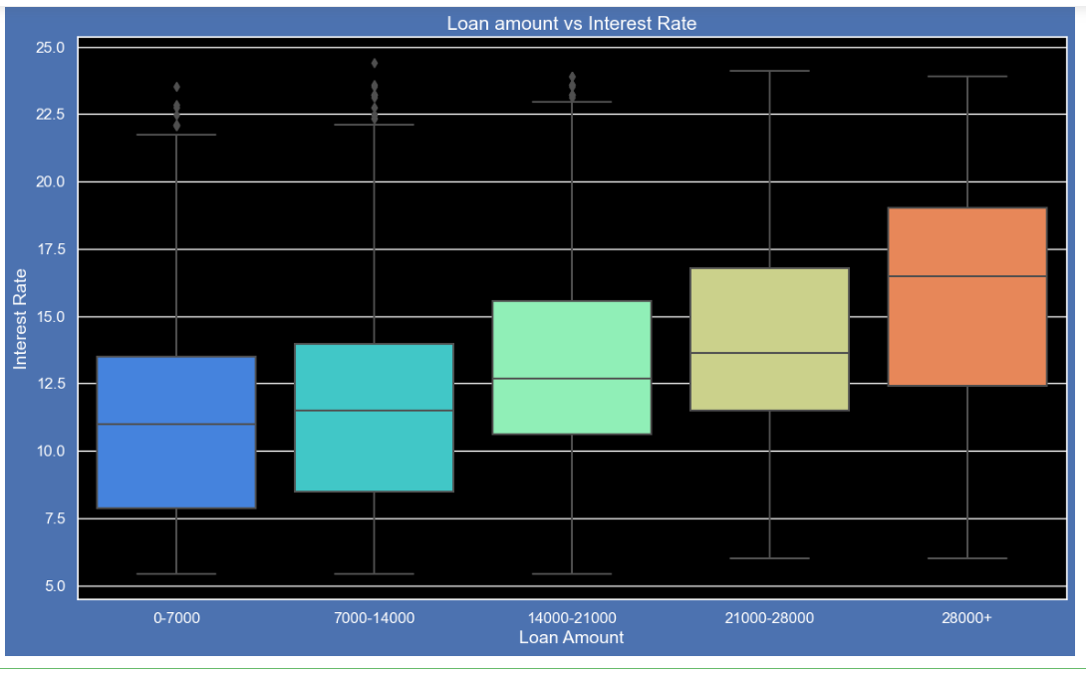
Bivariate Analysis - Loan Amount vs Interest Rate
# Observations -
# It is clear that intrest rate is increasing with loan amount increase.
# probably when loan amount is more it is taken for longer loan term, we saw earlier that longer the loan term more the interest rate.

Slide 36
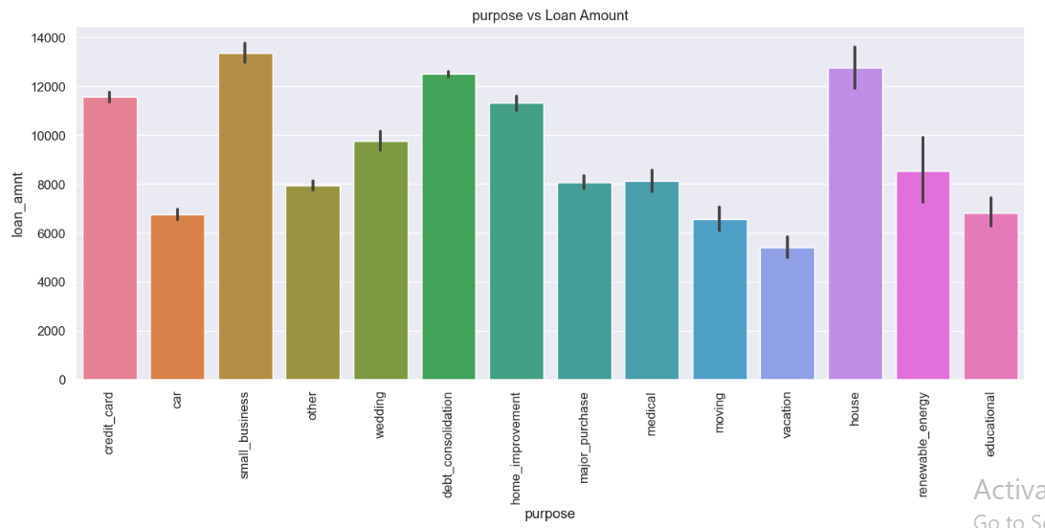
Segmented Analysis The purpose of loan also plays a major driving factor, that will be analyzed below filtering the fully paid & charged-off converting it to integer type
# Observations -
# It is clear that intrest rate is increasing with loan amount increase.
# probably when loan amount is more it is taken for longer loan term, we saw earlier that longer the loan term more the interest rate.

Slide 37
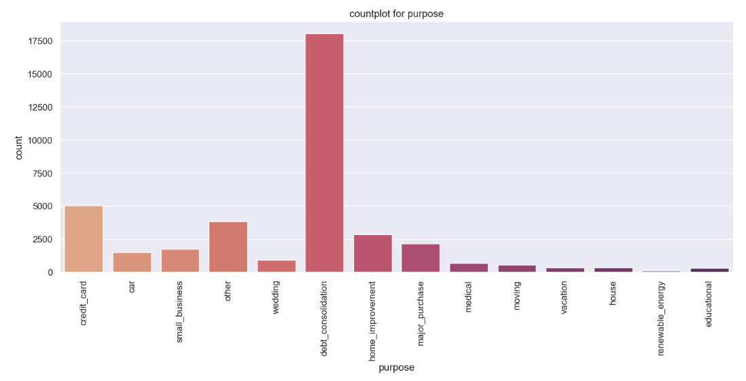
# Observations -
#small business has the most loans defualts, followed by renewable energy and education but the count plot
#depicts that there is more samples of debt_consolidation.
#The small business has more sample compared to eductation followed by renewable energy

Slide 38
Inferences & Insights
Annual Income, Loan Amount, Interest Rate, Purpose of Loan, Grade, Charged Off Proportion play an important factor in deciding whether the applicant can pay the installment or will default out.
Public Bank Discrepancies and Derogatory records also play an important factor to decide whether the applicant will default out.
Higher Loan Amount is directly proportional to high Annual income and It leads to higher interest rates and higher installment values.
It is seen that Loans are taken mainly for Debt consolidation payment, Credit Card payment and small business setup. Education, Car etc holds very less value for loan.
Higher Interest rates and higher installment values can be a factor for loan default.
People with higher grades and higher employment years are less considered to default out.

