Slide 1

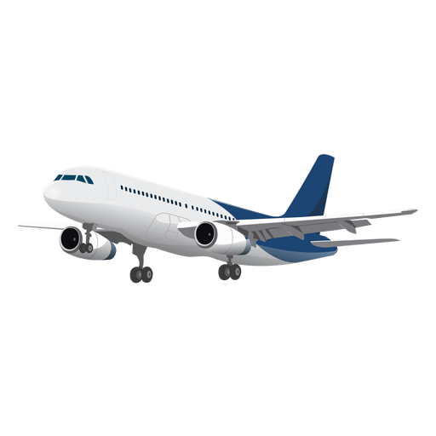
Airport Terminal Project
Ben
Adedunni Adebusuyi
Benjamin Ranson
Isobel Fitt-Conway
Saverio Cutrupi
Notes:
DRY

Slide 2

What We'll Cover
Isobel
Test Driven Development
User Stories
Code Demo
Summary
Retrospective
Overview
Object Oriented Programming
Data Persistence
Git Flow
Agile
Scrum

Slide 3




Project Overview
Ben
Writing a simulated airport terminal
Making an interface for interacting with the code and the database
Making data persistent
Tools: Python, SQL, Git & Git-hub, Flask, DRY
Methodologies: Agile, Scrum, TDD, OOP, MVC
Notes:
Ben
Add diagram to "Tools"
Add "agile" to "methodologies"

Slide 4
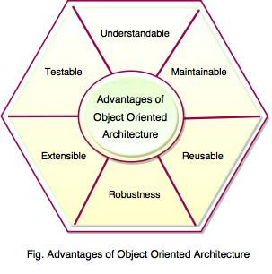
Object Oriented Programming
Dunni
Our code:
Modular
Hierarchy of inheritance
from base to special case
Encapsulation of private methods
Don't Repeat Yourself (DRY)
Notes:
Dunni

Slide 5
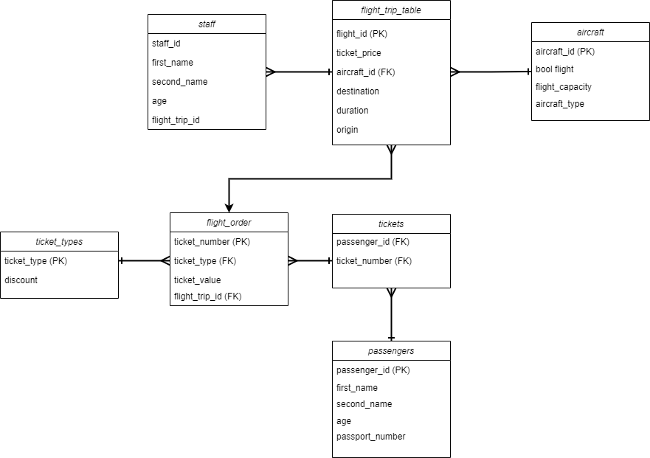
Persistent Data
Savi
All data is saved to the database (SQLSERVER)
Tables are uploaded to classes
Objects in turn save to database
Entity Relationship Diagram
Notes:
Savi
Improve readability
Mention it's an Entity Relationship Diagram

Slide 6

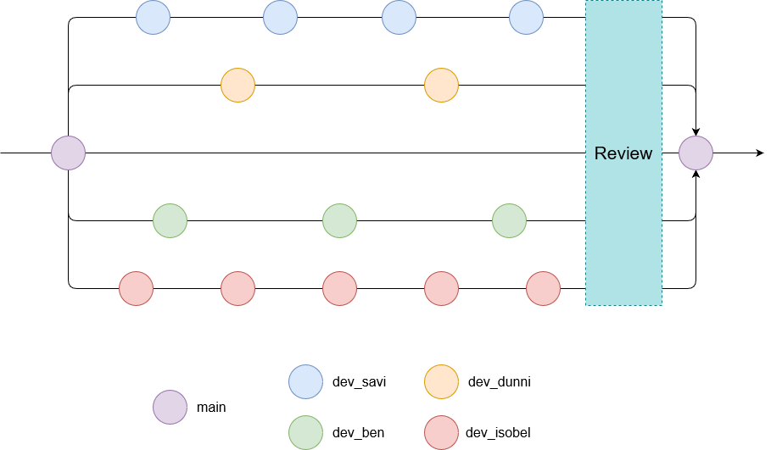
Git Flow
Isobel
Used a shared Git-hub repository
Version Control
Each person had their own branch
Review
Merged into main

Slide 7
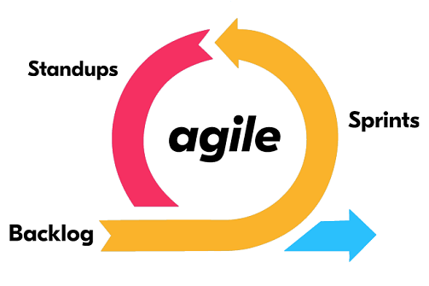
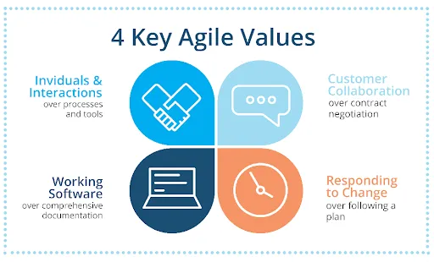
Agile
Dunni
Relied on an agile approach
Leaned on the 4 Values
Implemented using Scrum
Notes:
Explain the 4 values diagram

Slide 8
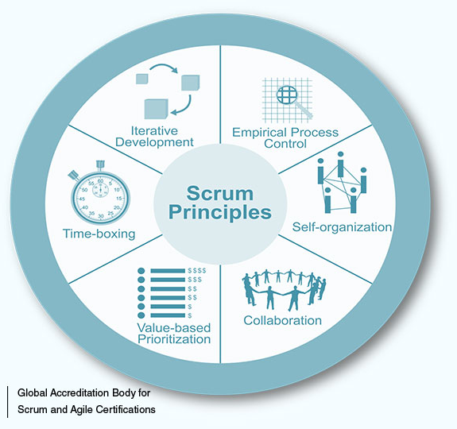
Scrum
Savi
We used Trello.
We selected a scrum master every day.
Scrum events

Slide 9
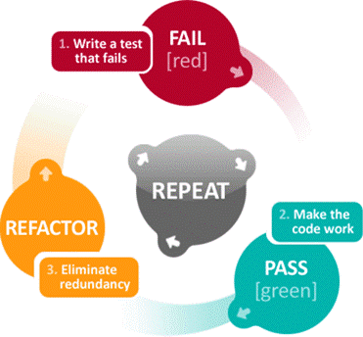
Test Driven Development
Ben
TDD involves continuous testing
Used methods to perform tests
A test file let us test functions individually
Some functions were hard to predict an outcome for.
Unittest – Pytest
Notes:
Ben

Slide 10
User Story 1
Dunni
"As an airport Assistant, I want to be able to create flight trip with a specific destination"
Ask
Ask for a destination, origin, etc...
Save
Save as an object in a dictionary along with its aircraft and passengers
Notes:
We ask the user to provide information
We save that information into that database for later use
Each flight trip is unique

Slide 11
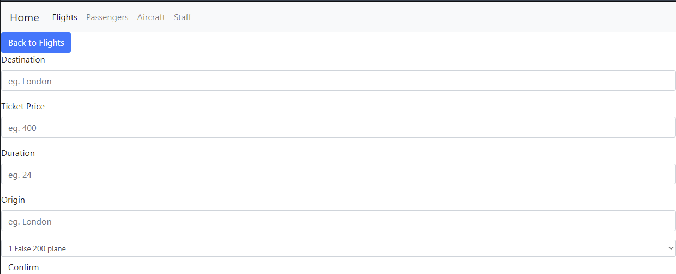
Dunni
Notes:
Explain navbar explain values to input
Done

Slide 12
User Story 2
Dunni
"As an airport Assistant, I want to be able to create a passenger with a name and Passport number, so that I can add them to a flight"
Ask
Ask for user to input details
Create
Create an object from the given details
Save
Save the information from the object to the database
Notes:
Again we ask the user to provide information
Create a passenger object from the info
Save to DB for data persistence
Passengers are used later for ticket selling

Slide 13
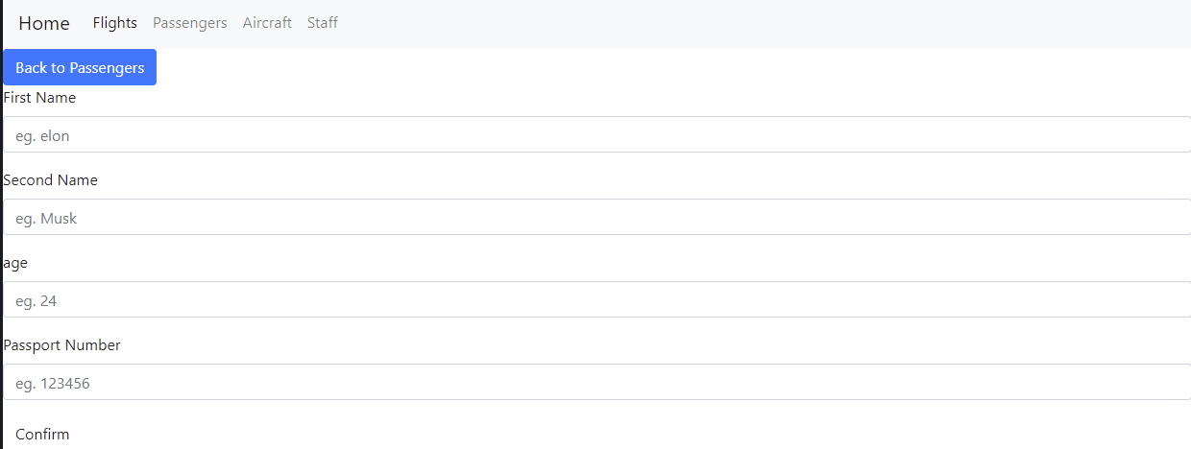
Dunni
Notes:
Talk about the fields
Age influences ticket type

Slide 14
User Story 3
Isobel
"As an airport Assistant, I want to be able to add passengers to the flight trip so that I can sell tickets to them"
Ask
Ask for passenger ID and flight ID
Check
Check that there are empty seats available on the flight
Check
Check ticket type
Create
Create a ticket and insert into the database
Notes:
Ticket type – adult, child, infant
Isobel

Slide 15
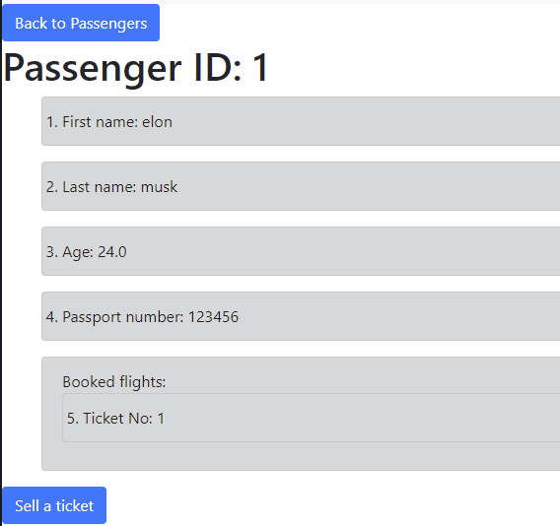
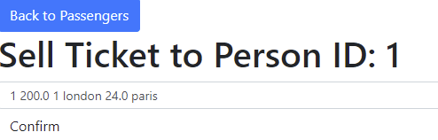
Isobel

Slide 16
User Story 4
Ben
"As an airport Assistant, I want to be able to generate a flight attendees list report that lists passengers name and passports so that I can check their identity documents"
Create
Create a dictionary with information about each flight
Dictionary
Dictionary contained a list of passenger objects
Ask
Ask the user to input a flight number
Find
Find the associated list of passenger objects and printed names and passport numbers
Notes:
List of passengers in dict from junction tables
Ben

Slide 17
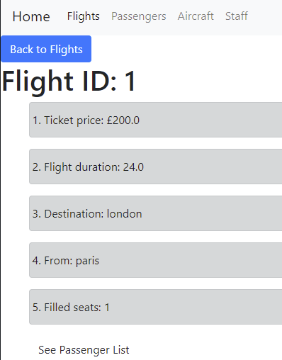
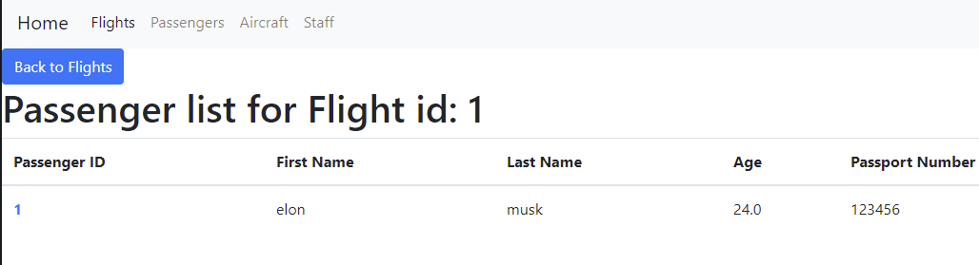
Ben

Slide 18
User Story 5
Savi
"As an airport Assistant, I want to be able to assign and/or change a plane to my flight trip, and input my password, so I can handle the problem"
Login
Login: need to enter username and password correctly
Password Storage
Password is securely stored by using hashing with salt
Ask
Aircraft creation: ask if plane or helicopter, ask capacity
Add
Add into aircraft dictionary
Assign
Give the option to assign the aircraft to a flight
Notes:
Dunni
Talk true hash

Slide 19
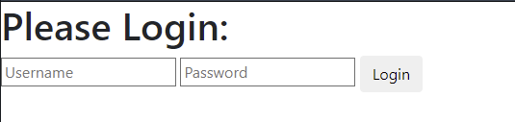
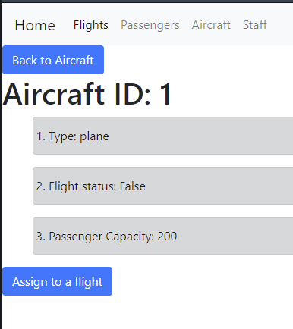
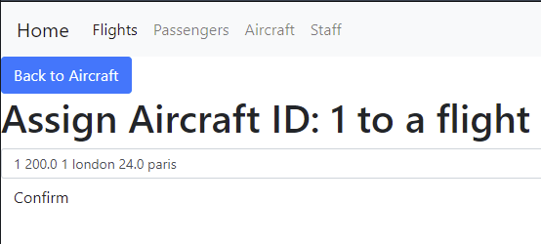
Savi
Notes:
Mention security

Slide 20

Code Demo
Ben

Slide 21

Summary
Savi
We checked all the acceptance criteria for the project
We used all the tools available to us
We worked in a group, coordinating the whole way

Slide 22
Retrospective
Dunni
Time management: very important!
Always keep in mind the Acceptance Criteria
Research and development help release a better product
Notes:
What we learnt
Making presentation helped teach us time management
Researching tools and sparta global learning helped us

Slide 23
Any questions?
Dunni

