Slide 1
DevWhoops
Developing an application is not the end

Slide 2
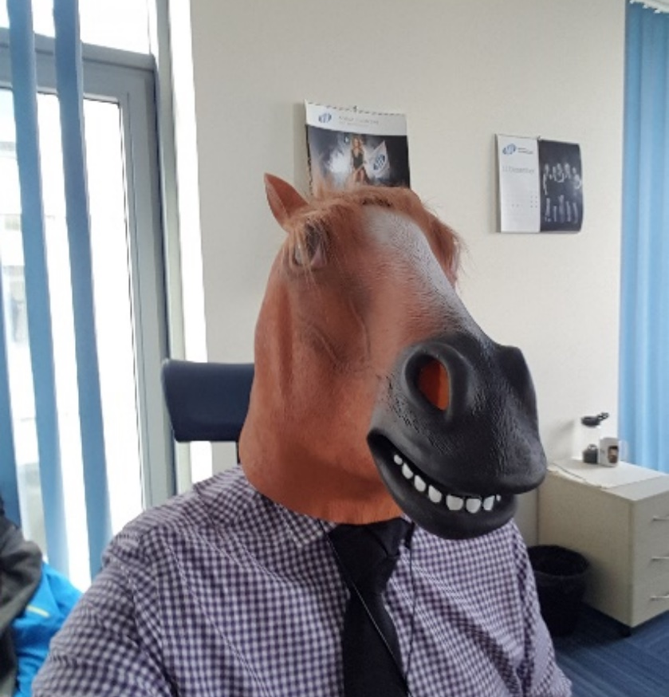
About Me
Not all heroes wear capes ;)
Maciej Sadowski
maciej@sadowski.org.pl
Developing bugs for 7+ years
Father of soon to be 2 boys
Amateur volleyball player

Slide 3

What is Love?
Docker
SII CRACOW TEAM

Slide 4


What are containers?
https://www.docker.com/resources/what-container
„Containers are an abstraction at the app layer that packages code and dependencies together. Multiple containers can run on the same machine and share the OS kernel with other containers, each running as isolated processes in user space. Containers take up less space than VMs (container images are typically tens of MBs in size), can handle more applications and require fewer VMs and Operating systems.”

Slide 5
You must choose
Virtual Machines
Containers
Virtual machines
Containers
‚New’ kid on the block
Fail quickly, get back up quicker
Less maintainance overhead*
Standard way of managing resources
Stable for the most part
Large maintainance overhead

Slide 6
DEMO 1
SHOW
ME
THE CODE

Slide 7

Pros
Quick to deploy
Easy to share between projects
Easy to share between workstations
Docker run and forget!
KUBA, SERVICE DELIVERY MANAGER

Slide 8

CONs
Network management
Storage management
Scaling
KUBA, SERVICE DELIVERY MANAGER

Slide 9
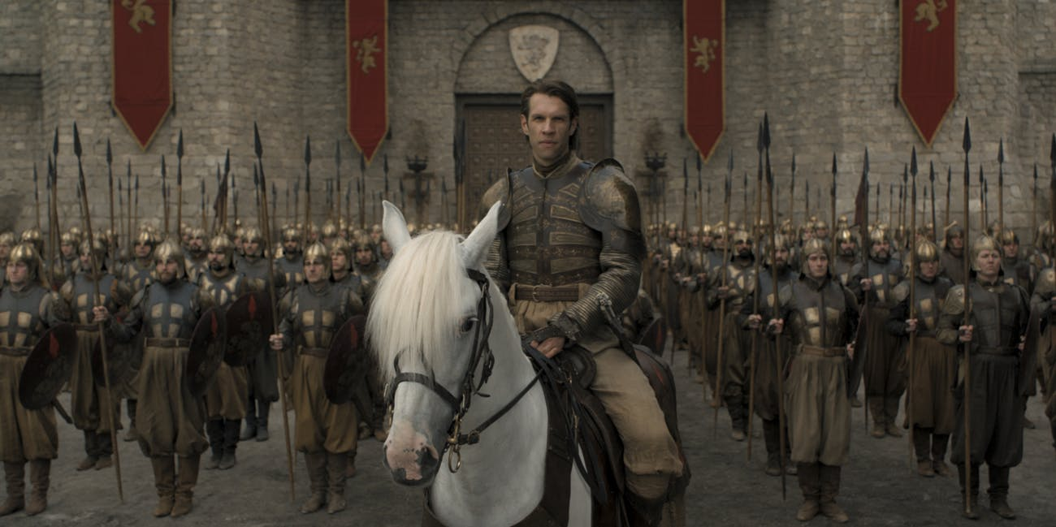
Kubernetes
THAT GUY LEADING THE SO INVICIBLE GOLDEN COMPANY
Credits HBO ;)

Slide 10
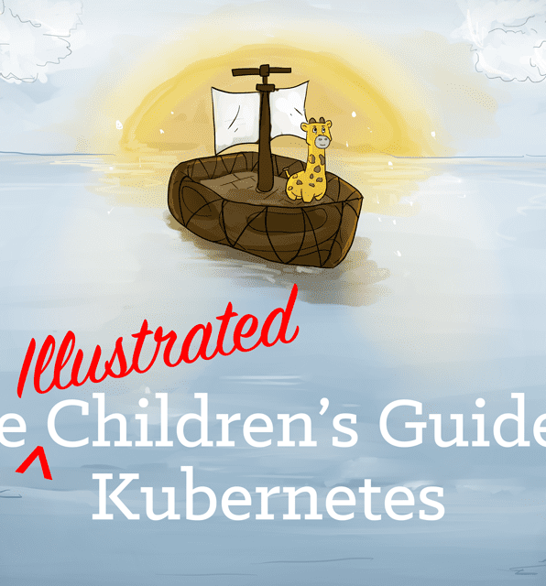
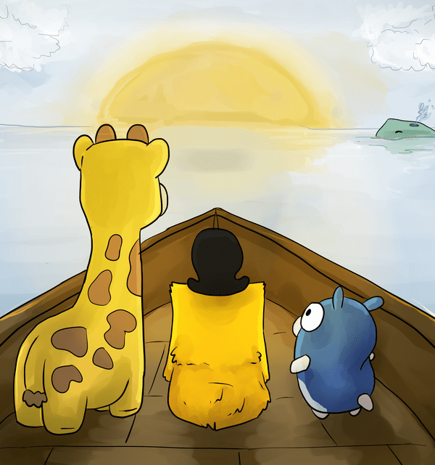
Where to start
https://www.youtube.com/watch?v=4ht22ReBjno
„Kubernetes is an open-source orchestration system for docker containers. It handles scheduling onto nodes in a compute-cluster and actively manages workloads to ensure that their state matches the users declared intentions. Using the concept of labels and pods it groups the containers that make up the application into logical units for easy management and discovery”
Written and performed by Matt Butcher
Illustrated by Bailey Beougher

Slide 11
DEMO 2
SHOW
ME
THE CODE

Slide 12

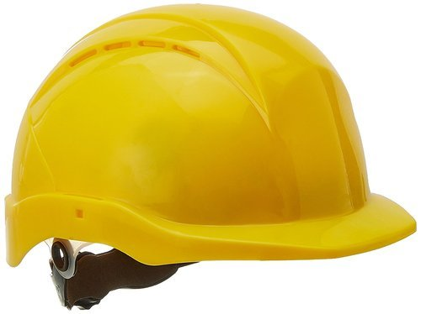
HELM
JOANNA, SOFTWARE ENGINEER

Slide 13

Why helm?
This bar was in the template...... ☺
Easy building of complex templates
Easy rollback/cleanup
Easy deployment
One generic chart to rule them all
And a values.yaml to distinguish them ☺

Slide 14
DEMO 2
SHOW
ME
THE CODE

Slide 15

Thank you =)
Maciej Sadowski
maciej@sadowski.org.pl

