Slide 1



RUET Campus Network
Puja P 200351
Puja Saha (2003151)
Rezanur Akndo (2003152)
Anika Hossain (2003153)
Sajidur Rahman (2003154)
Md Abdur Rahaman (2003155)
Rajshahi University of Engineering & Technology

Slide 2
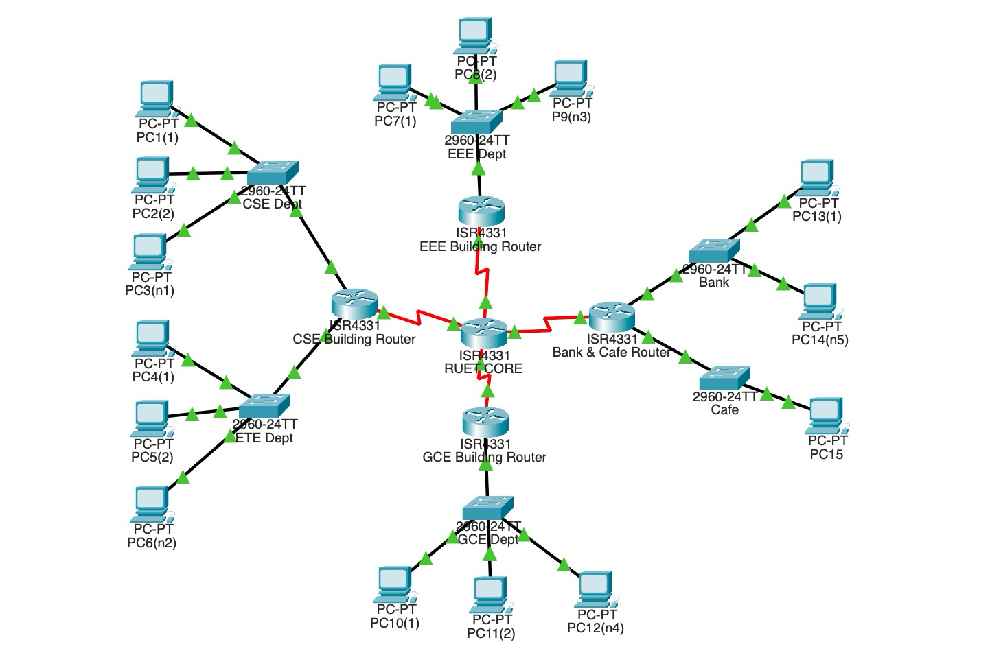





Campus Network Overview
A campus network connects all buildings and departments in a university so everyone can share the internet and digital resources.
RUET‑CORE connects CSE, EEE, GCE, Cafe & Bank
Each department has its own router & switch connecting local PCs
Static routing within departments provides predictable communication
Dynamic RIP links buildings with automatic updates & link recovery
Hybrid design ensures seamless internet, data sharing & admin access

Slide 3
Routing Basics
Routing selects the best path for data packets so information reaches its destination accurately and efficiently.
Static Routing
Dynamic Routing
Remote networks are manually configured
Only directly connected networks are manually configured
Ideal for small, predictable networks (e.g. departments)
Uses the Bellman–Ford algorithm for Distance-Vector and Dijkstra algorithm for Link-State routing protocol
Highly stable and Secure
Low CPU & Bandwith usage
Broadcast updates every 30 seconds (RIPv1)
Ideal for large networks, but higher CPU & bandwidth usage

Slide 4


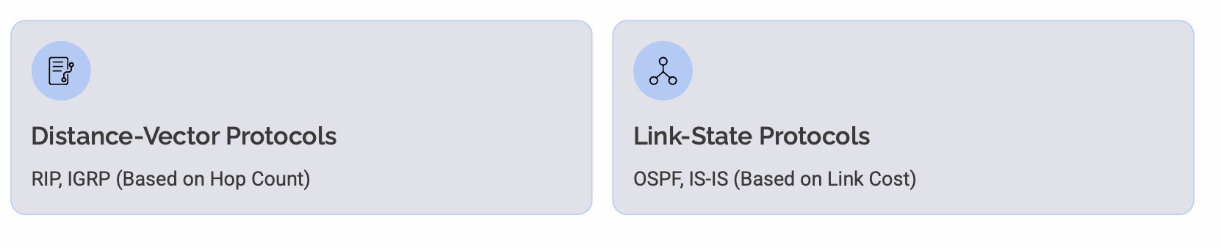
Static Routing: Types
Standard Static Routing
Default Static Routing
Defines a path to a specific network; used for known destinations and direct links.
Catch‑all path for unknown destinations; forwards all unmatched traffic to a default gateway (0.0.0.0/0).
Summary Static Routing
Floating Static Routing
Combines multiple contiguous routes into one to reduce routing table size, saving memory and CPU.
Backup route with a higher administrative distance; activates when the primary route fails, ensuring failover.
Dynamic Routing: Types

Slide 5


Ethical & Operational Considerations
Fair Access
Risks if Misconfigured
Equal bandwidth & reliability for students, faculty & staff
Downtime from incorrect routes disconnects departments
Avoid throttling or prioritising select users
Misrouted packets may expose sensitive data
Ensuring consistent network performance
Unchecked admin rights can be abused

Slide 6
Societal Impact
Student Experience
Faculty & Admin
Fast, reliable access to learning resources, lectures & online exams depends on efficient routing.
Departments rely on shared services (academic portals, file servers); routing misconfigurations can disrupt productivity.
Campus Services
Cafe, bank & other services require stable connectivity for transactions & supplies.

Slide 7
Real-World Effects and Risks
Exam System Downtime
Administrative Delays
If RIP updates fail or a static route is broken, students cannot access online exam portals — disrupting assessments and delaying grading.
The administration and finance departments (connected through the core router and bank) face interruptions in payroll processing or fee transactions.
Academic Resource Inaccessibility
Campus-Wide Productivity Loss
Faculty lose access to shared research data or departmental drives, halting collaborative projects and lab operations.
Misrouted traffic increases helpdesk tickets, wastes teaching hours, and reduces trust in the university’s digital infrastructure.

Slide 8

Environmental Considerations
Protocol / Area | CPU Load | Energy Use | Example
Static (CSE, EEE, GCE) | Low | Low | Fixed routes → no periodic updates
Dynamic RIP (Ruet Core ↔ Cafe/Bank) | Moderate – High | Higher | Core router sends updates every 30 s
Energy‑Efficient Practices
• Optimize routing tables to reduce CPU overhead
• Disable unused switch ports in labs after hours
• Extend RIP update intervals where possible
• Deploy modern, low‑power routers for inter‑building links
Green energy for a sustainable campus network

Slide 9
Best Practices & Solutions
Monitor & Audit
Regularly check routing tables and logs to detect misconfigurations or unauthorized changes.
Redundancy
Implement backup links and redundant routers to prevent outages during failures.
Optimize Updates
Tune RIP timers and disable unused ports to balance convergence speed with energy efficiency.
Educate Admins
Train network staff on ethical routing principles and security best practices.

Slide 10
Comparison of Routing Approaches
Aspects | Static | Floating | RIP
Reliability | High if configured | Medium | High (Converges)
Ease of Setup | Manual | Semi-automatic | Automatic
Energy Use | Low | Medium | Higher
Scalability | Poor | Moderate | Good
Winner for RUET: Hybrid mix!

Slide 11


Conclusion & Recommendations
Ethical Commitment
Hybrid Performance
Societal Responsibility
Ensure transparent & fair network access for all users.
Static + RIP design balances simplicity with scalability & resilience.
Keep the academic system running smoothly.
Final Recommendations for RUET Networking
• Redundancy: Implement physical & logical redundant links for vital connections.
• Auditing: Routinely review all configurations and security logs.
• Model Maintenance: Continue to maintain the hybrid routing model—simple, reliable, fair & sustainable for RUET’s evolving needs.

Slide 12
THANK YOU ANY QUESTION ??

