Slide 1
Non-parametric methods
Kernel density estimate, KNN classifier
Machine Learning
Sadegh Khosravi
Feb,2022

Slide 2
Histogram Density Estimation
Imagine we mapped data in axis x

Slide 3


Histogram Density Estimation
Partition the feature space into the distinct bins with
widths Δ and count the number of
observations, $n_{i}$, in each bin
$$∆$$

Slide 4

Histogram Density Estimation
how many data has in every bin?
$$\hat{p}\left(x\right)=\frac{n_{i}}{∆_{i}}$$
$$∆$$

Slide 5
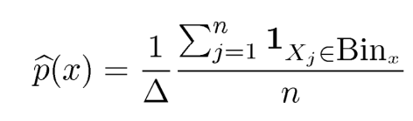
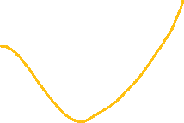
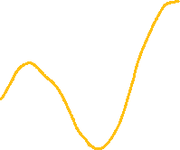
Histogram Density Estimation
how many data has in every bin?
density in every bin:
$$∆$$

Slide 6
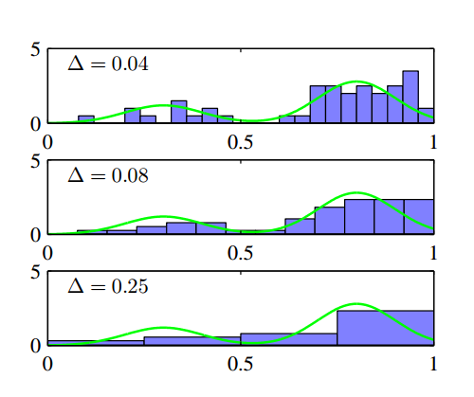
Histogram Density Estimation
This is a non-parametric estimate of this density shown in green and this density is based on the data.

Slide 7
Histogram Density Estimation
What is the condition of being non-parametric?

Slide 8
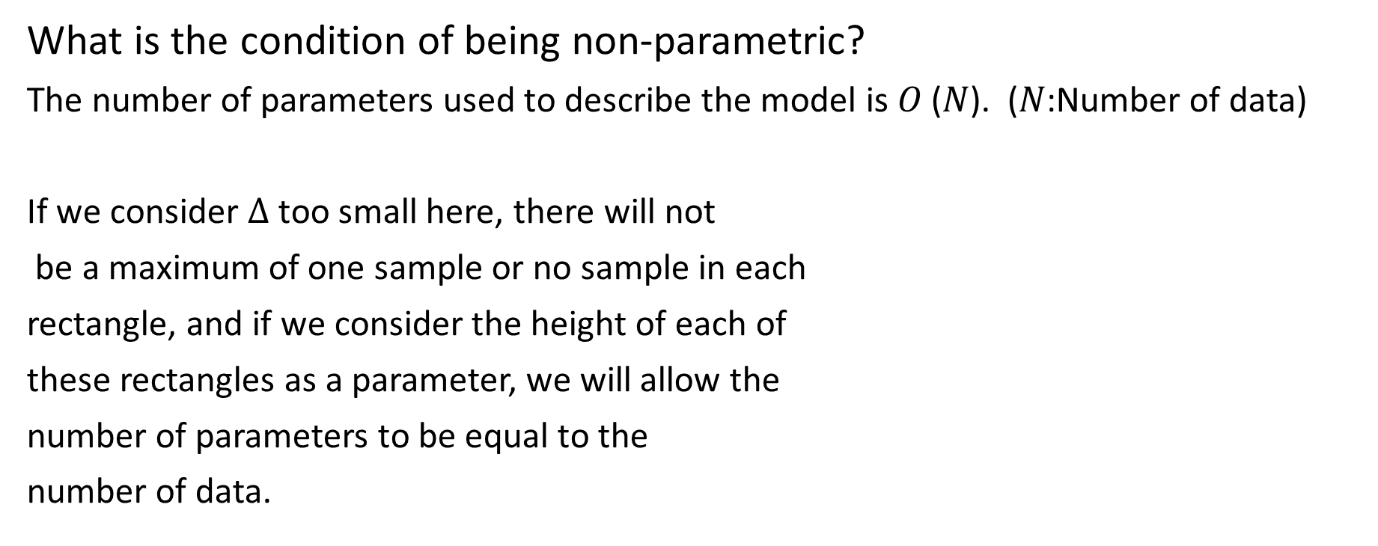
Histogram Density Estimation
What is the condition of being non-parametric?
The number of parameters used to describe the model is 𝑂 (𝑁). (𝑁:Number of data)
If we consider $∆$ too small here, there will not
be a maximum of one sample or no sample in each
rectangle, and if we consider the height of each of
these rectangles as a parameter, we will allow the
number of parameters to be equal to the
number of data.

Slide 9
Histogram Density Estimation
In this way we can learn any form of distribution.

Slide 10
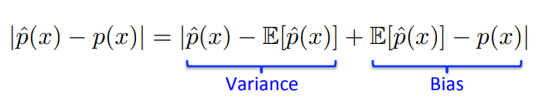
Bias-Variance trade off
We know our error is as follows:

Slide 11




Bias-Variance trade off
We know our error is as follows:
If $∆$ width is too small:
Bias Variance
If $∆$ width is too large:
Bias Variance

Slide 12
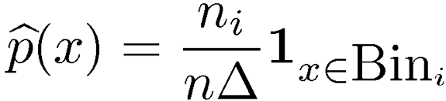
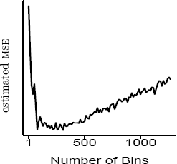
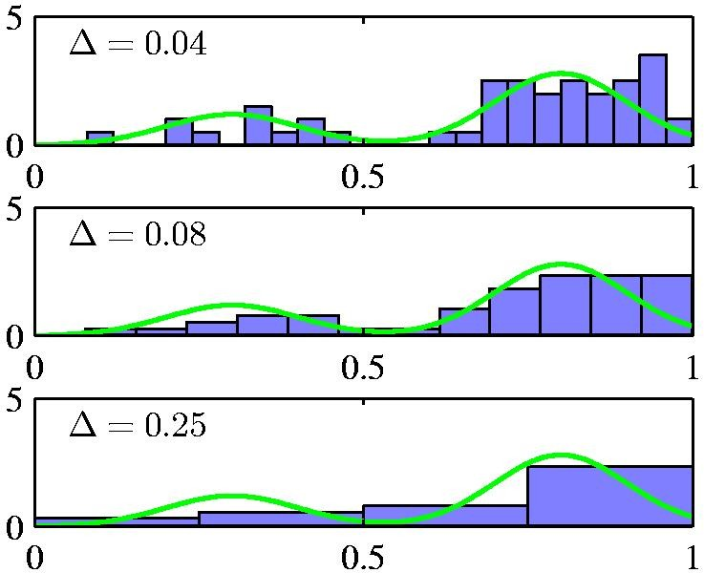
Choice of #bins

Slide 13

Histogram Density Estimation
We place a window in the center of each data$∆$

Slide 14


Histogram Density Estimation
Now, instead of using bins, use a series
of windows the length of $∆$
$$∆$$

Slide 15

Histogram Density Estimation
For each x(data) , we want to get a density height,
around of that x we place a window
along the length of $∆$.

Slide 16

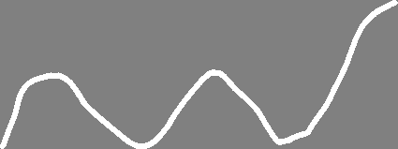
Histogram Density Estimation
Now let all the data that are as far away from x as delta, let participate in estimating the density of x.

Slide 17
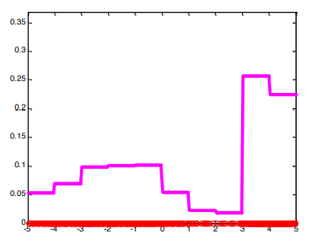
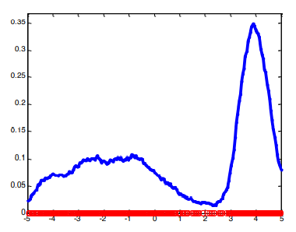
Histogram vs Kernel density
In histogram density:
In kernel density:

Slide 18
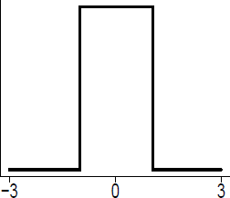



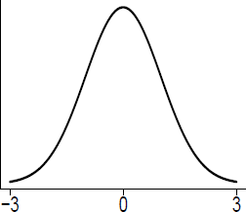

Kernel density estimate"Parzen/Window"
Type of kernel:

Slide 19
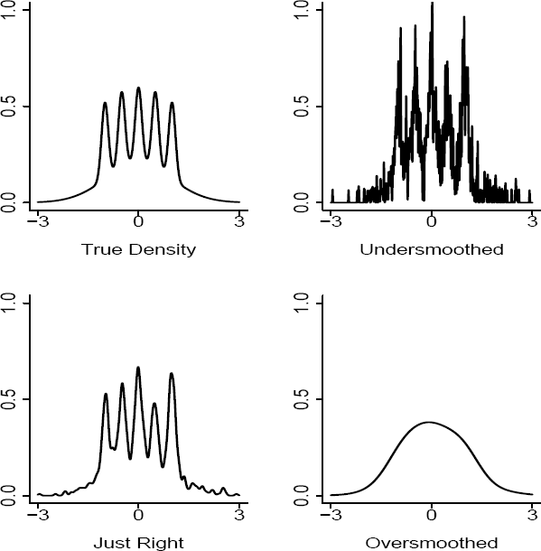
Choice of kernel bandwidth
Too small
Bias-Variance tradeoff
Just right
Too large

Slide 20


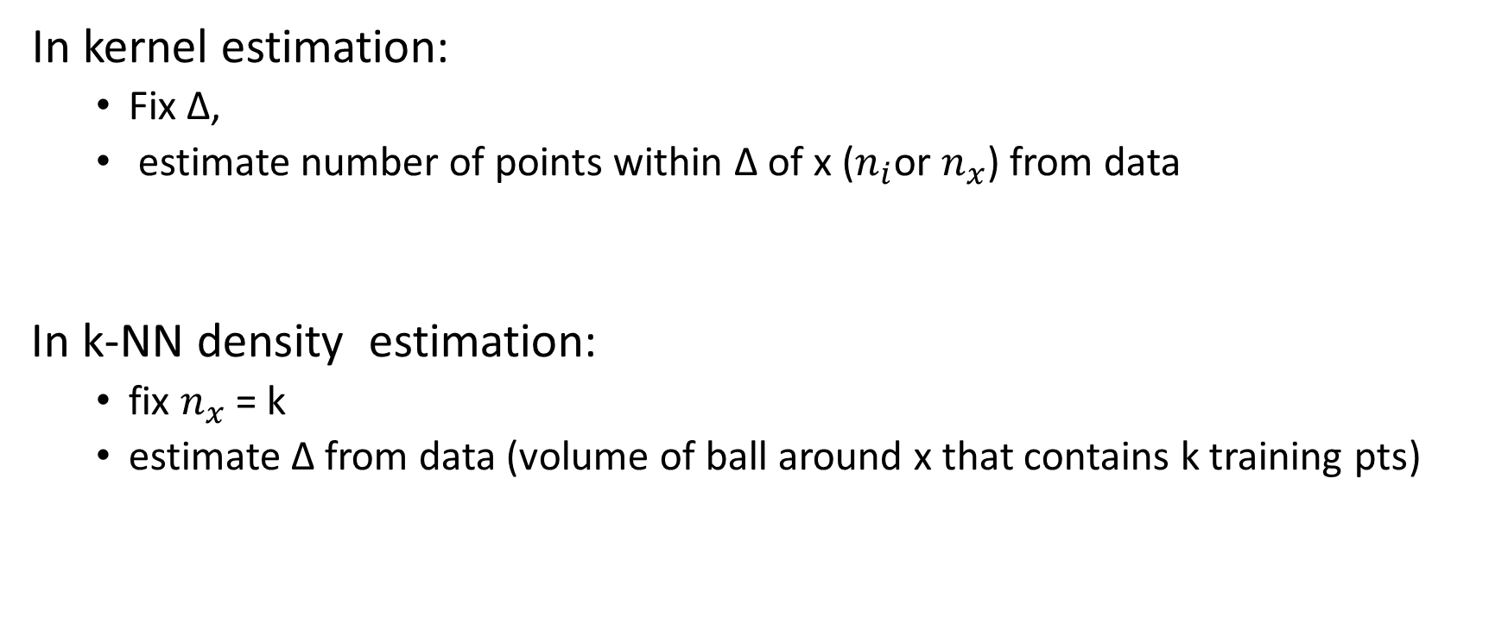
k-NN density estimation
In kernel estimation:
Fix Δ,
estimate number of points within Δ of x ($n_{i}$or $n_{x}$) from data
In k-NN density estimation:
fix $n_{x}$= k
estimate Δ from data (volume of ball around x that contains k training pts)

Slide 21
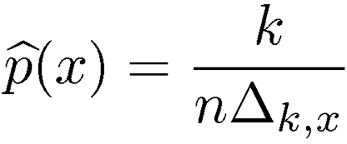
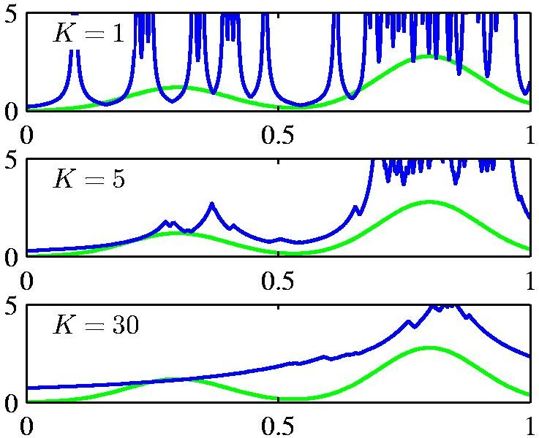
k-NN density estimation
Not very popular for density estimation
But a related version for classification
on quite popular

Slide 22

Inductive bias in k-NN

Slide 23
Nearest Neighbor
Classify using k-nn

Slide 24


Nearest Neighbor
Step1 :calculate distance with all data point
Distance: $\left[\sqrt{5} 1 \sqrt{2} 1 1 √3 \right]$
Label: [ ]
Step2 :sort distance
Distance: $\left[1 1 1 \sqrt{2} \sqrt{3} \sqrt{5} \right]$
Label: [ ]
Step3:select k- min distance
Distance: $\left[1 1 1 \right]$
Label: [ ]
Step4:select label
Label :
$$√2$$

Slide 25


Nearest Neighbor
Step1 :calculate distance with all data point
Distance: $\left[\sqrt{5} 1 \sqrt{2} 1 1 √3 \right]$
Label: [ ]
Step2 :sort distance
Distance: $\left[1 1 1 \sqrt{2} \sqrt{3} \sqrt{5} \right]$
Label: [ ]
Step3:select k- min distance
Distance: $\left[1 1 1 \right]$
Label: [ ]
Step4:select label
Label :
$$√2$$

Slide 26

Nearest Neighbor
Step1 :calculate distance with all data point
Distance: $\left[\sqrt{5} 1 \sqrt{2} 1 1 √3 \right]$
Label: [ ]
Step2 :sort distance
Distance: $\left[1 1 1 \sqrt{2} \sqrt{3} \sqrt{5} \right]$
Label: [ ]
Step3:select k- min distance
Distance: $\left[1 1 1 \right]$
Label: [ ]
Step4:select label
Label :
$$√2$$

Slide 27

Nearest Neighbor
Step1 :calculate distance with all data point
Distance: $\left[\sqrt{5} 1 \sqrt{2} 1 1 √3 \right]$
Label: [ ]
Step2 :sort distance
Distance: $\left[1 1 1 \sqrt{2} \sqrt{3} \sqrt{5} \right]$
Label: [ ]
Step3:select k- min distance
Distance: $\left[1 1 1 \right]$
Label: [ ]
Step4:select label
Label :
$$√2$$

Slide 28
Nearest Neighbor
If we look only at one-nearest neighbor:
Noisy decision

Slide 29
Nearest Neighbor
If we look at k-nearest neighbor
Robust decision
K=3

Slide 30
Iris-data decision boundary
Iris-data decision boundary

Slide 31
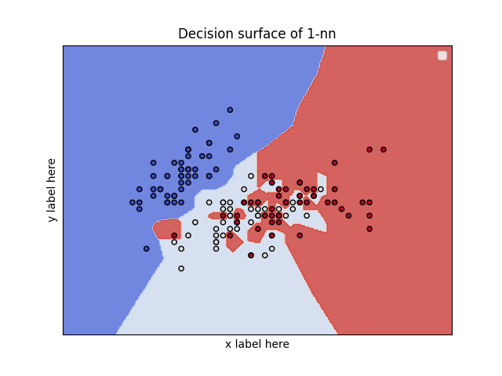
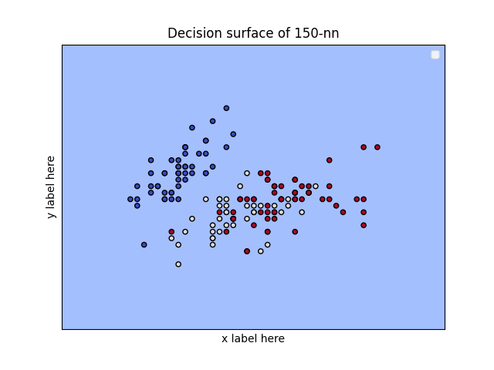
Iris-data decision boundary
K=1 k=150
High variance Low variance
Low bias High bias

Slide 32
What is the best K?
Bias-Variance tradeoff:
Large k -> high bias
Low k -> high variance

Slide 33
K-Nearest Neighbor
Lazy Learner (Instance based learning).
Non-parametric
Pattern recognition ,data mining
easy to implement
Unknown distribution

Slide 34
K-Nearest Neighbor
Does not work well with high dimensions
Need feature scaling
Sensitive to noisy data, missing values and outliers

Slide 35
distance
Euclidean Distance
Manhattan Distance
Minkowski Distance
Cosine Distance
Jaccard Distance
Hamming Distance

Slide 36
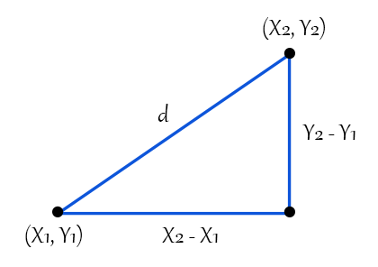
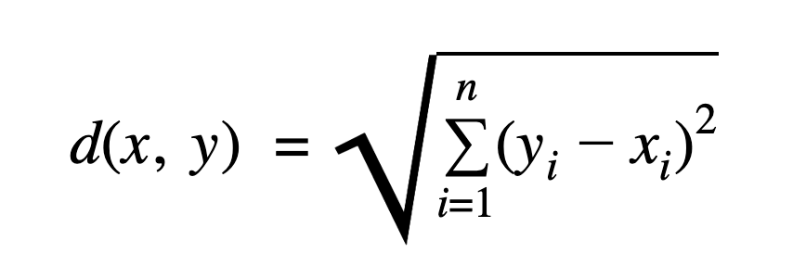
Euclidean Distance

Slide 37
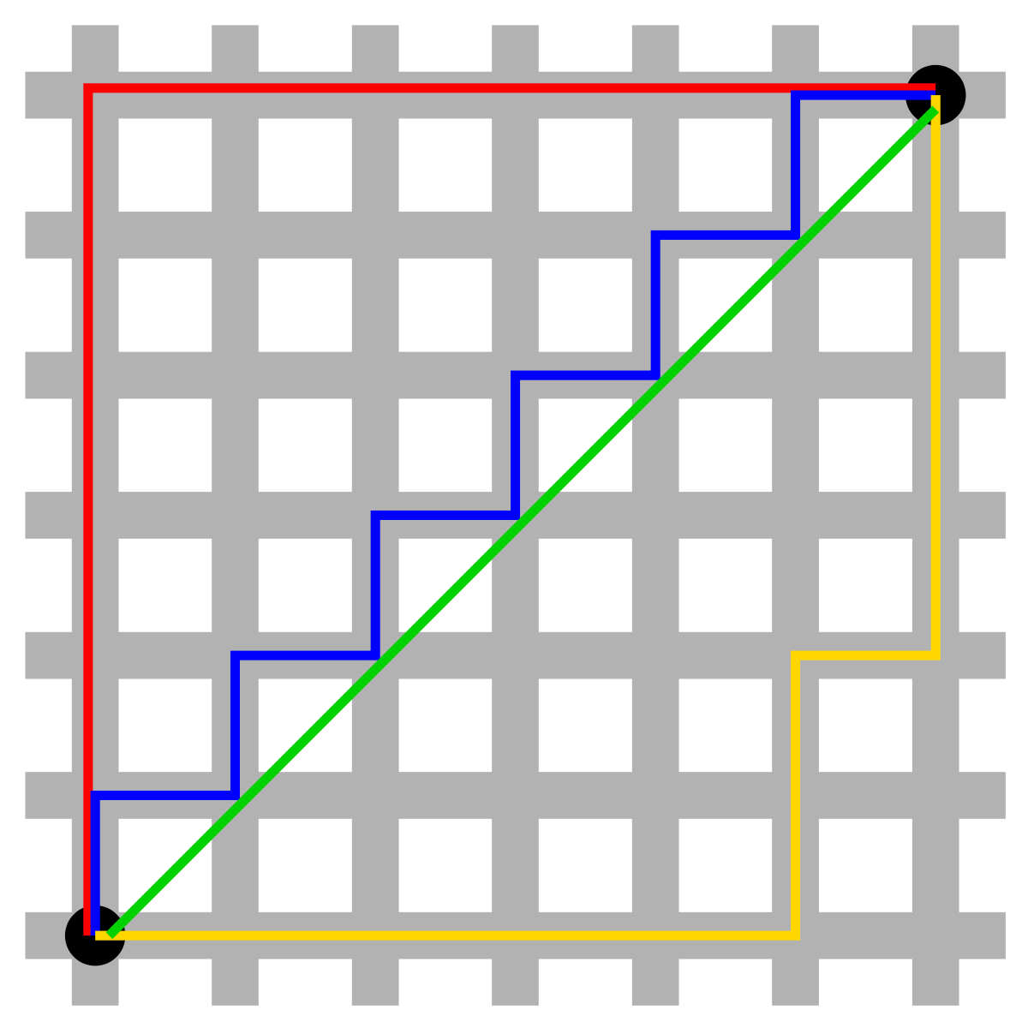
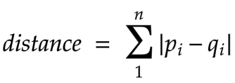
Manhattan Distance

Slide 38
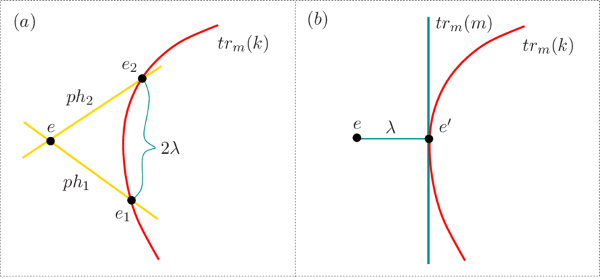
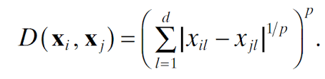
Minkowski Distance

Slide 39
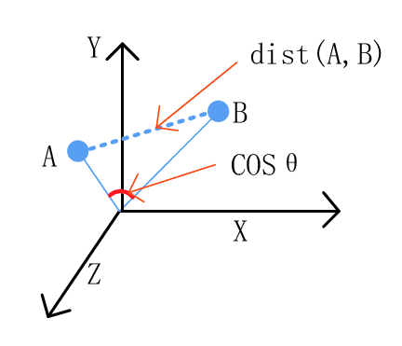
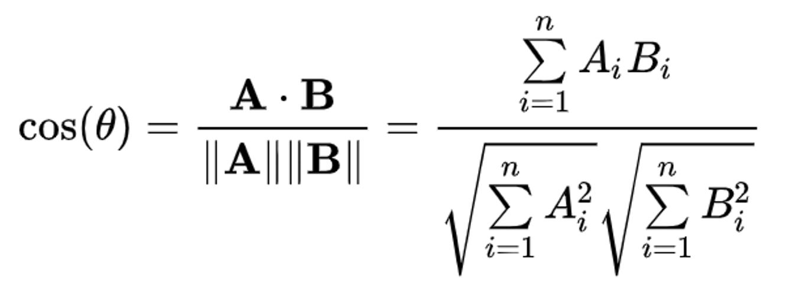
Cosine Distance

Slide 40
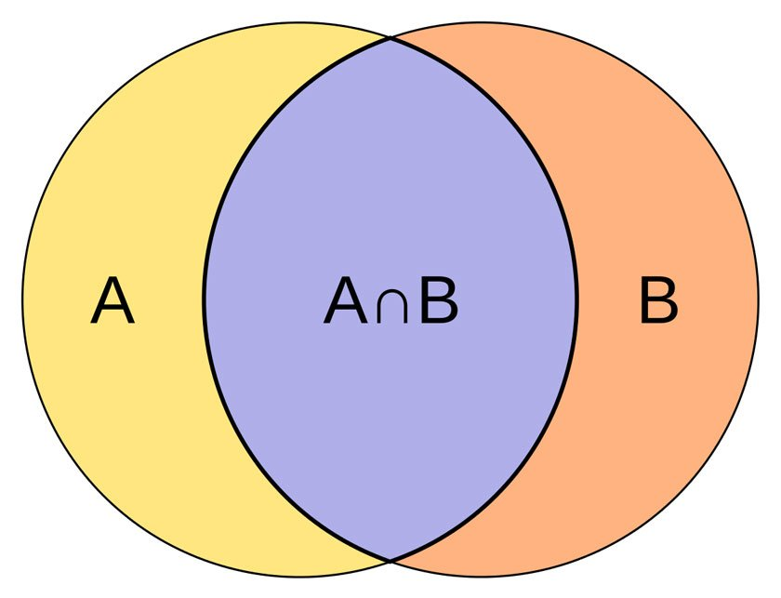
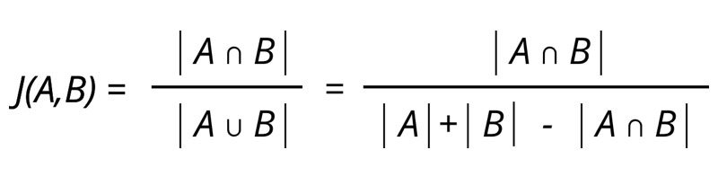
Jaccard Distance

Slide 41
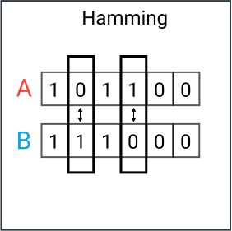
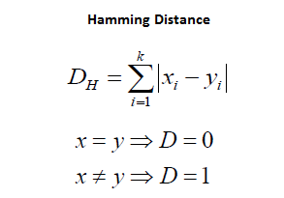
Hamming Distance

Slide 42







Slide 43
resources
https://www.aparat.com/v/kZU7v?playlist=954603
http://www.cs.cmu.edu/~aarti/Class/10701_Spring14/lecs.html

