Slide 1
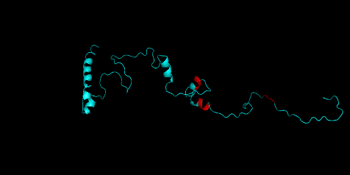
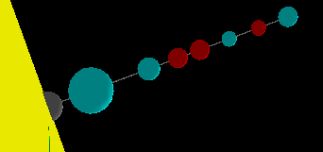
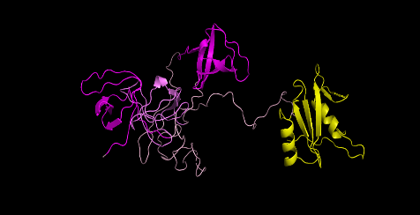
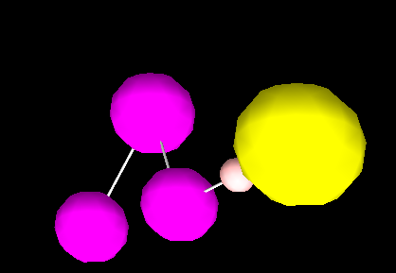
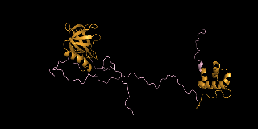
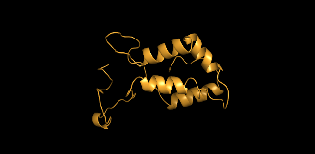
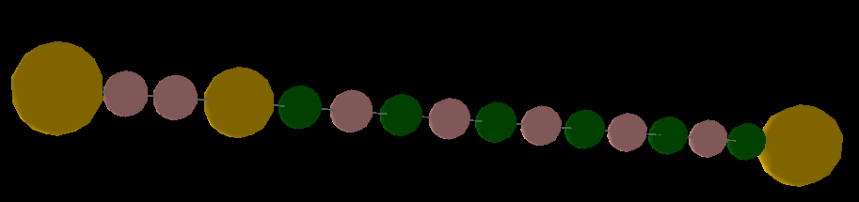
A.1
A.2
B.1
B.2
C.1
C.2
Figure 1: Construction of model components by coarse-graining the protein structures. (A) 165 aa long intracellular part of the transmembrane protein nephrin is modelled with 8 sites, three of them (red) represent pY-containing binding sites which bind to SH2 domains; this molecule is tethered with membrane (yellow surface) with the anchoring site (grey). (B) 376 aa long cytoplasmic protein nck1 is modelled with three SH3 sites (magenta), one SH2 site (yellow) and one linker site (light pink). (C) 505 aa containing cytoplasmic protein nwasp has a lot of intrinsically disordered region (specially the proline rich motifs in 277-392) in its sequence. No secondary structure is predicted for the proline-rich sequence by most of the prediction servers (shown in black dotted line). So this stretch is assumed to adopt polyproline-II (PP-II) type helical structure which is modelled with six binding sites (green) for SH3 domains and five structural sites (pink). The N-terminal (1-276) and C-terminal sequences (393-505) are modelled with four and one structural sites respectively, according to the predicted secondary structures.

Slide 2
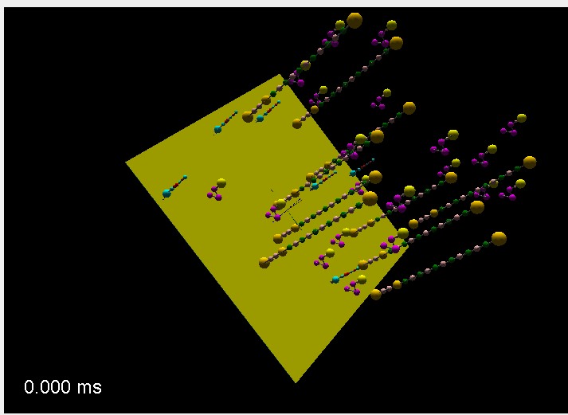
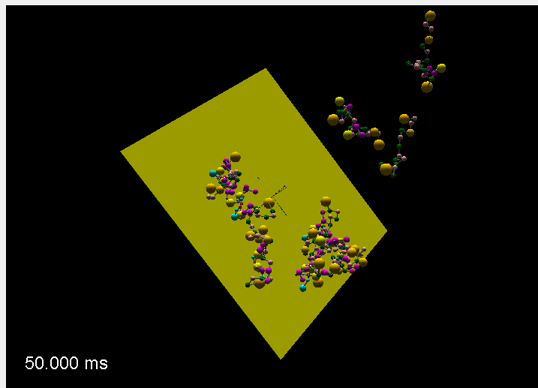
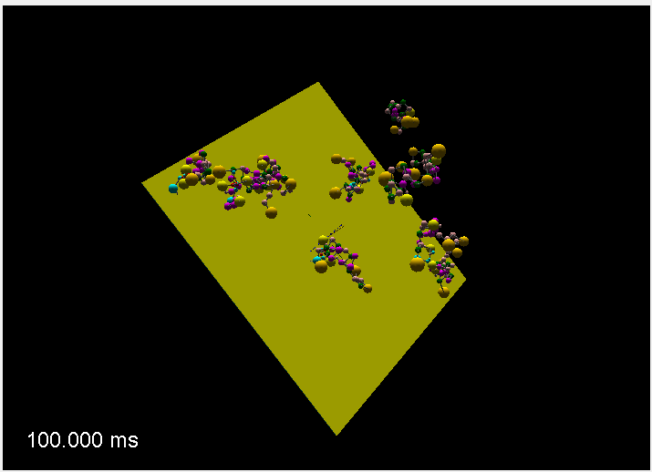
X
Y
Z
A
B
C
Figure 2: Clustering dynamics of the control system. (A) The system contains a total of 36 molecules (6 Nephrin, 20 Nck, 10 Nwasp) in a cubic reaction volume (X = Y = Z = 100 nm); XY surface represents the membrane where Nephrin is anchored. At the beginning of simulation (t = 0), 36 molecules are distributed randomly (Nephrin onto the membrane, Nck and Nwasp in the cytosol) in the reaction volume. (B, C) Molecular clustering happens due to diffusion driven (multivalent) bimolecular interactions. At steady state (t ~ 100 ms), most clusters reside in the vicinity of membrane.

Slide 3
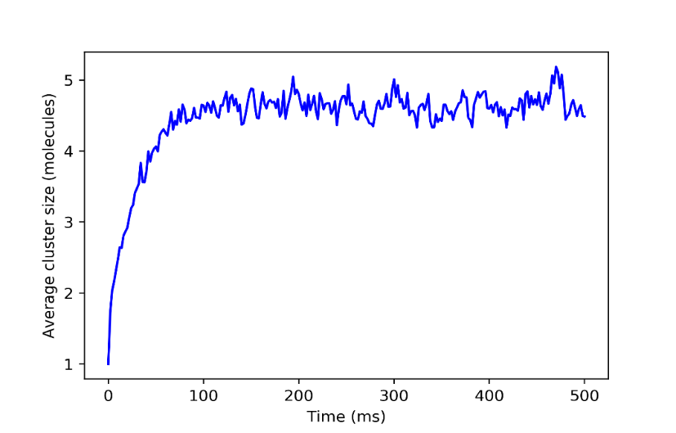
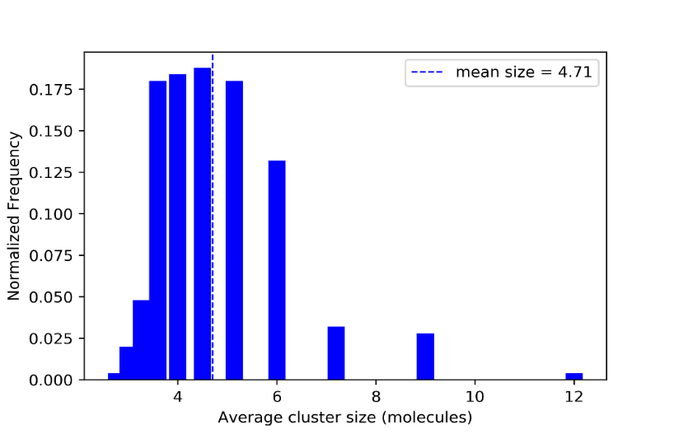
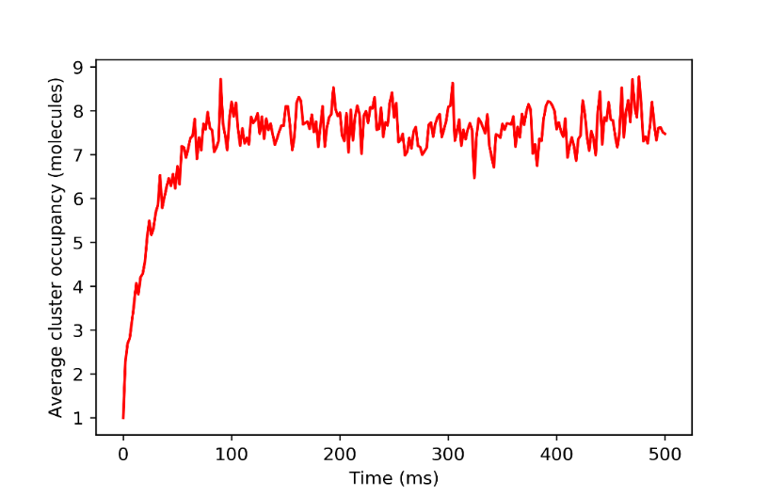
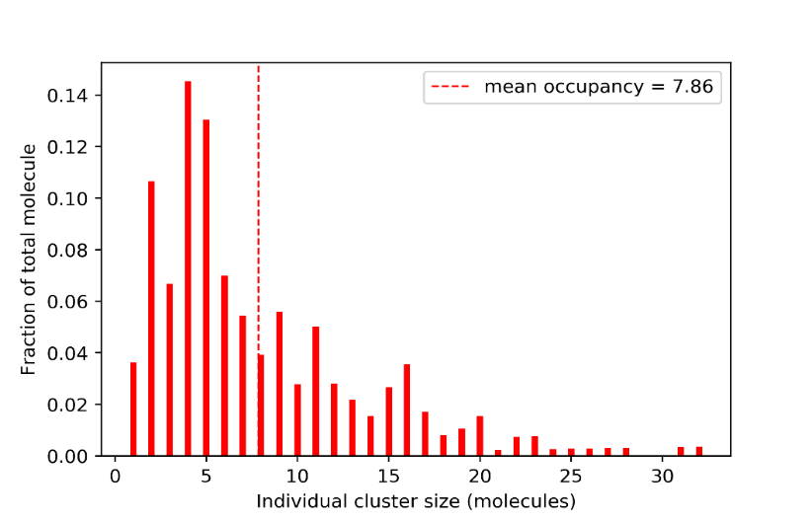
A
C
B
D
Figure 3: Quantification of molecular clustering. Each time course (A, B) is averaged over 50 trajectories. The steady state distributions (C, D) are sampled over five time points (100 - 500 ms) with the interval of 100 ms.

