Slide 1
RULES FOR PRESENTATIONS
Cannot exceed six slides. Yes, that’s its own kind of challenge
5 minute presentations per team.
You have to submit presentation to DevPost by the deadline (6 pm).
The required slides can be presented in any order that makes sense. All slides except this one are required.

Slide 2
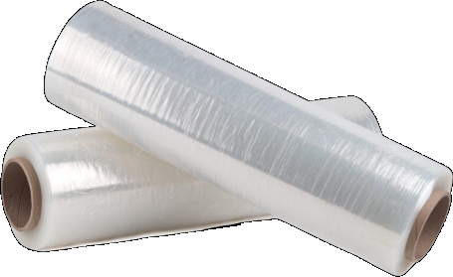
ShrinkWrap
Automating Principle of Least Privilege
Team 6
Andrew, Burc, David, Dheeraj, Patrick

Slide 3
SOLUTION
ShrinkWrap is for simplifying and automating assigning user correct permissions
Restricts access policies for users based on how often they last access the service
Provides an interface to easily manage a user’s permissions on specific AWS services.
Set it and forget it
No automated process exists for access management

Slide 4
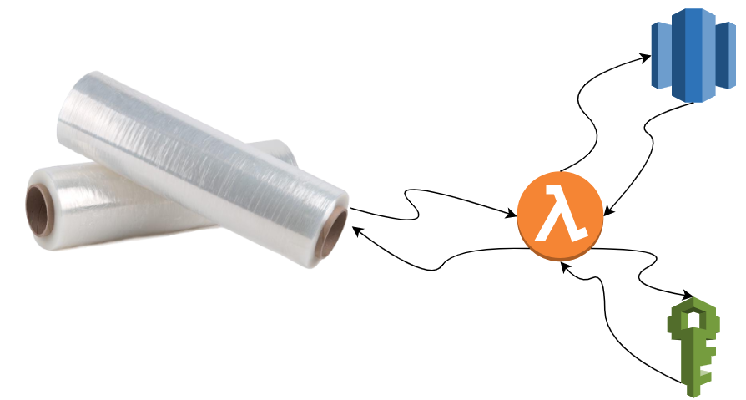
HOW DID YOU CREATE IT?

Slide 5
THE PATH FORWARD
• Organizations can onboard new-hires faster with proper permissions set. • ShrinkWrap will now remove access to users based on when they last used the service. • This can easily be extended to include as many services as you need permissions for.
What’s Next? • Packaging the front end from our POC to an installable executable • Target companies that are interested in migrating to the cloud. • Increase the granularity of access management
• Offering: Free for < 10 Users, costs based on # of users

Slide 6
DEMONSTRATE
LIVE DEMO

