Slide 1
Software System Architectures (NSWI130) C4 model
Martin Nečaský, Ph.D.
Department of Software Engineering
Faculty of Mathematics and Physics
Charles University in Prague

Slide 2
C4 model introduction
Structurizr environment
Project in C4 model
Quality attributes and C4 model

Slide 3
What is C4 model?
A lightweight model for describing software architectures
The primary interest is the static structure (module viewpoint from Bass, Clements, Kazman (BCK) )
https://c4model.com/

Slide 4
C4 model terminology
A software system is made up of one or more containers (web, mobile and desktop applications, databases, file systems, …).
A container contains one or more components, which in turn are implemented by one or more code elements (e.g., classes, interfaces, objects, functions, …).
And people use the software systems that we build.

Slide 5
Abstraction levels in C4 model
Level 1 : Software System
Level 2 : Container
Level 3 : Component
Level 4 : Code
Software System
Container
Component
Component
Component
Code
Code
Code

Slide 6
Level 1 : Software System
highest level of abstraction
delivers value to its users (human or not)
presented with system context diagrams

Slide 7
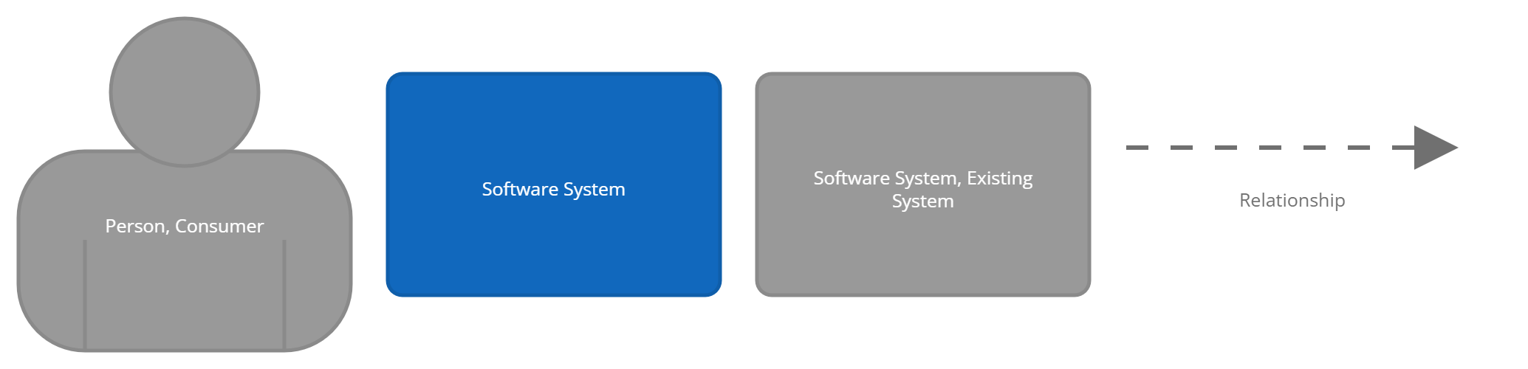
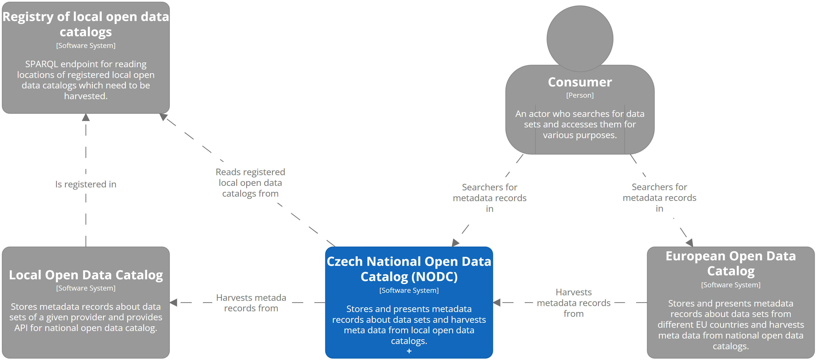

Slide 8
Level 2 : Container
represents a context inside which some code is executed (application, service, script, …)
or some data is stored (database, file system, …)

Slide 9
Level 2 : Container
needs to run but we consider it from the static point of view
we are not interested in its runtime behavior
separately deployable
presented with container diagrams

Slide 10
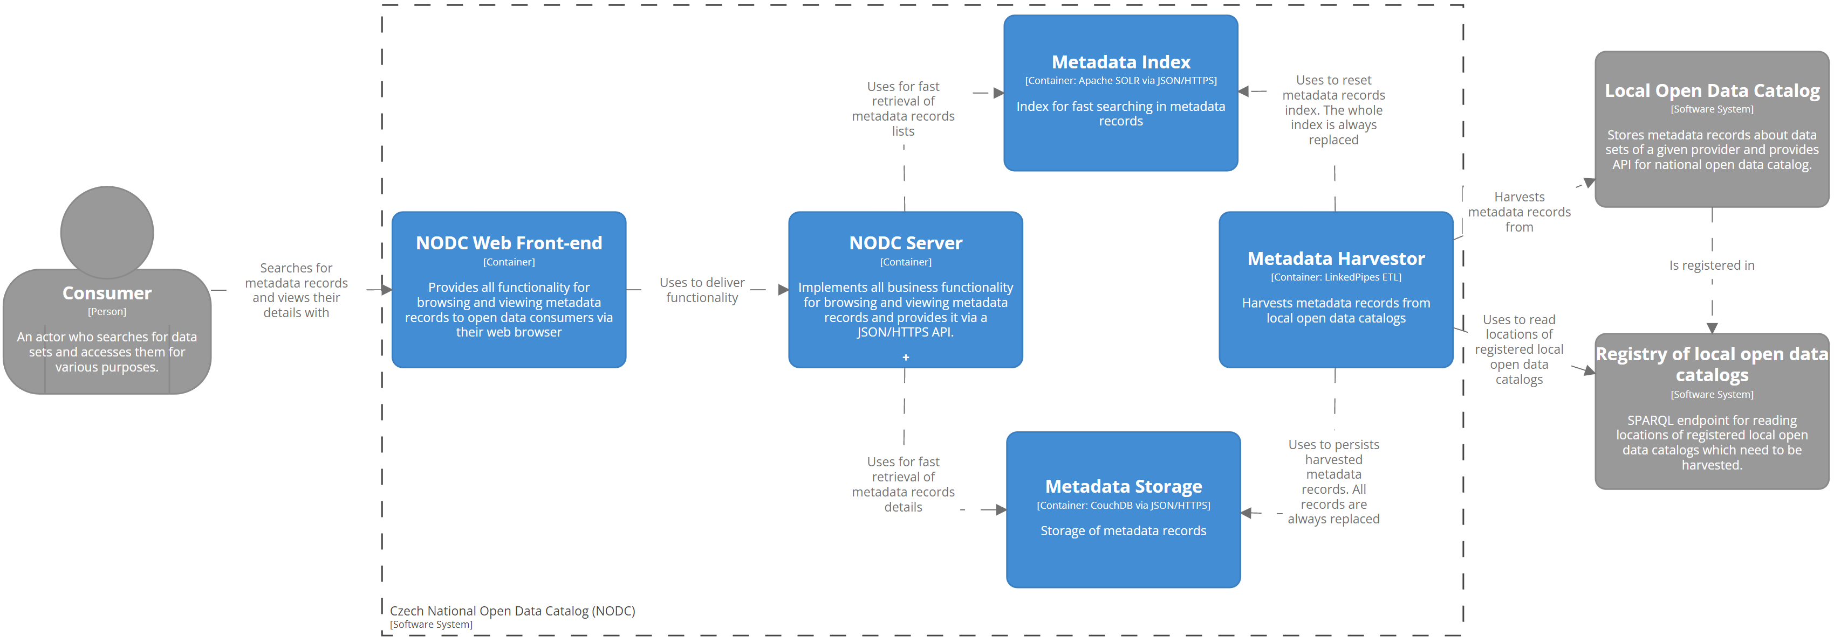
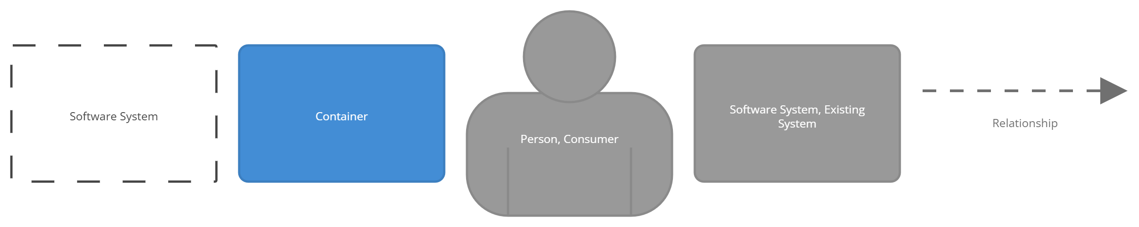

Slide 11
Level 3 : Component
represents a grouping of related functionality encapsulated behind a well-defined interface
corresponds to module from BCK model but it is not further decomposed to submodules
presented with component diagrams

Slide 12
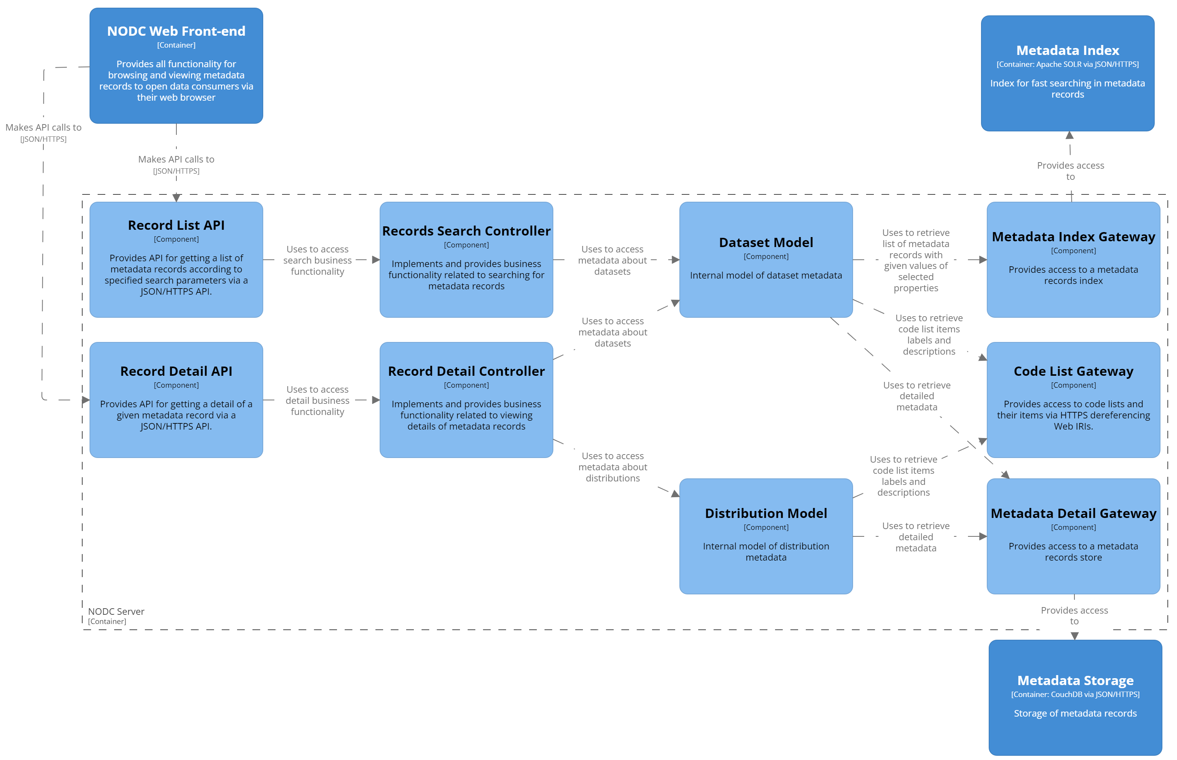
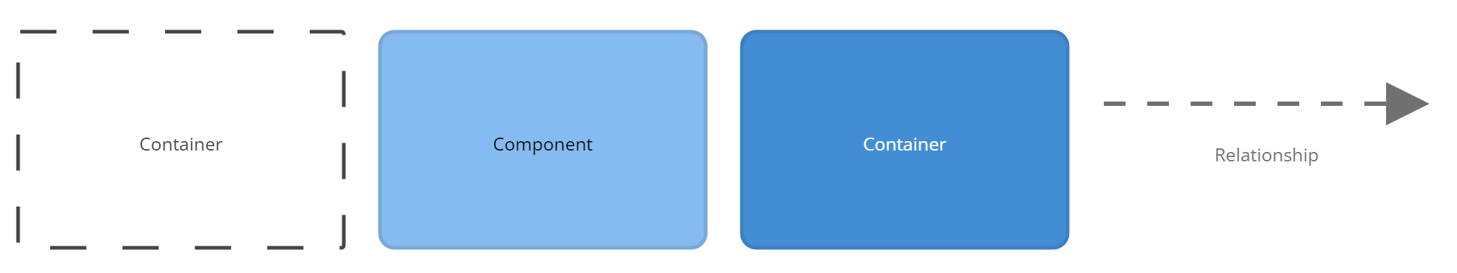

Slide 13
Level 4 : Code
code elements forming components
basic building blocks of programming languages, e.g., classes, interfaces, functions, …
presented with UML class diagrams

Slide 14
Structurizr
Web-based rendering tool for software development teams to design and document software architecture with C4 model
Structurizr DSL for creating architectural diagrams as code from a single model (C4 model system context, container and component diagrams)
Markdown/AsciiDoc for documentation

Slide 15
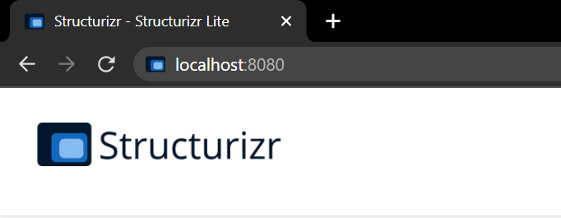
Structurizr Lite
Packaged as a Docker container
Displays diagrams in a workspace stored in workspace.dsl or workspace.json in a directory on WORKSPACE_PATH (replace WORKSPACE_PATH with your local directory path)
docker pull structurizr/lite
docker run -it --rm -p 8080:8080 -v WORKSPACE_PATH:/usr/local/structurizr structurizr/lite

Slide 16
workspace.dsl
Main file of your Structurizr project
Sample project from the lecture

