Slide 1
Software System Architectures (NSWI130) What is software architecture
Martin Nečaský, Ph.D.
Department of Software Engineering
Faculty of Mathematics and Physics
Charles University in Prague

Slide 2
Running example
https://data.gov.cz

Slide 3
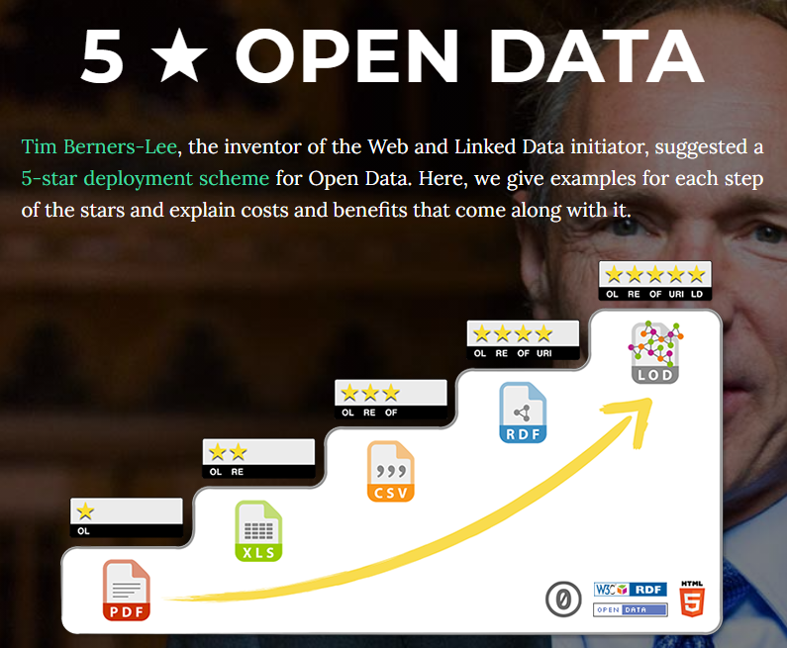
Open Data

Slide 4
Dataset
University | Headquarters | Rector
... | ... | ...
... | ... | ...
Teacher | Personal Number | Email
... | ... | ...
... | ... | ...

Slide 5
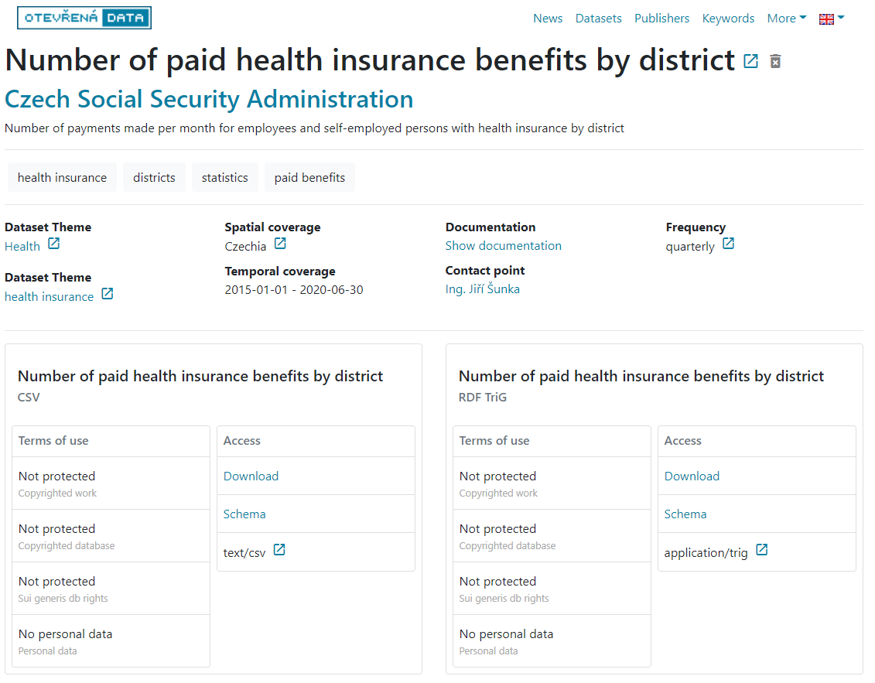

Slide 6
Dataset
Name | Headquarters | Rector
... | ... | ...
... | ... | ...
name,headquarters,rector
…,…,…
…,…,…
{
"name": "…",
"headquarters": "…",
"rector": "…"
}
<universities>
<university>
<name>…</name>
<headquarters>…</headquarters>
<rector>…</rector>
</university>
…
</universities>

Slide 8
National Open Data Catalog
Search dataset
Register dataset
Unregister dataset
Report quality

Slide 9
National Open Data Catalog
Search dataset
Register dataset
Unregister dataset
Report quality

Slide 10
National Open Data Catalog
???
???
???
???
???

Slide 11
National Open Data Catalog
Source code
Data structures

Slide 12
National Open Data Catalog
defines executable instructions that provide desired behavior
Source code
Data structures

Slide 13
National Open Data Catalog
defines executable instructions that provide desired behavior
enable instructions to manipulate information processed by the behavior
Source code
Data structures

Slide 14
National Open Data Catalog

Slide 15
National Open Data Catalog
Presentation

Slide 16
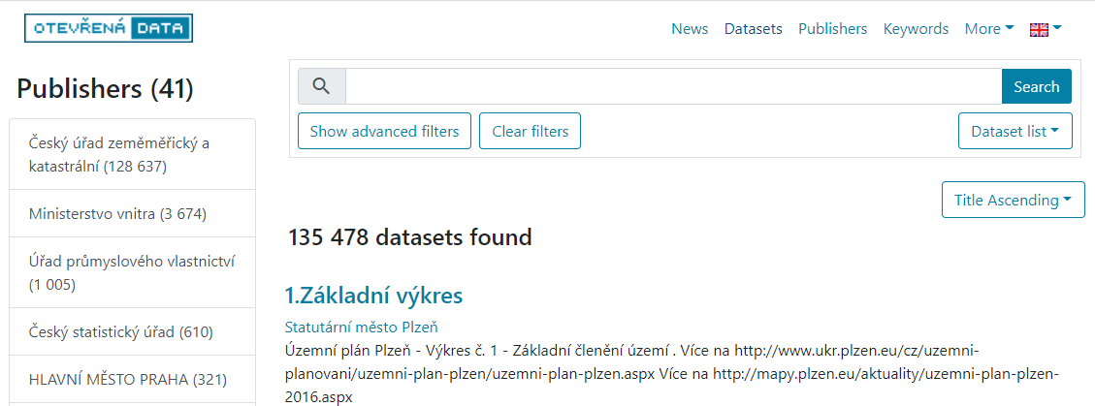
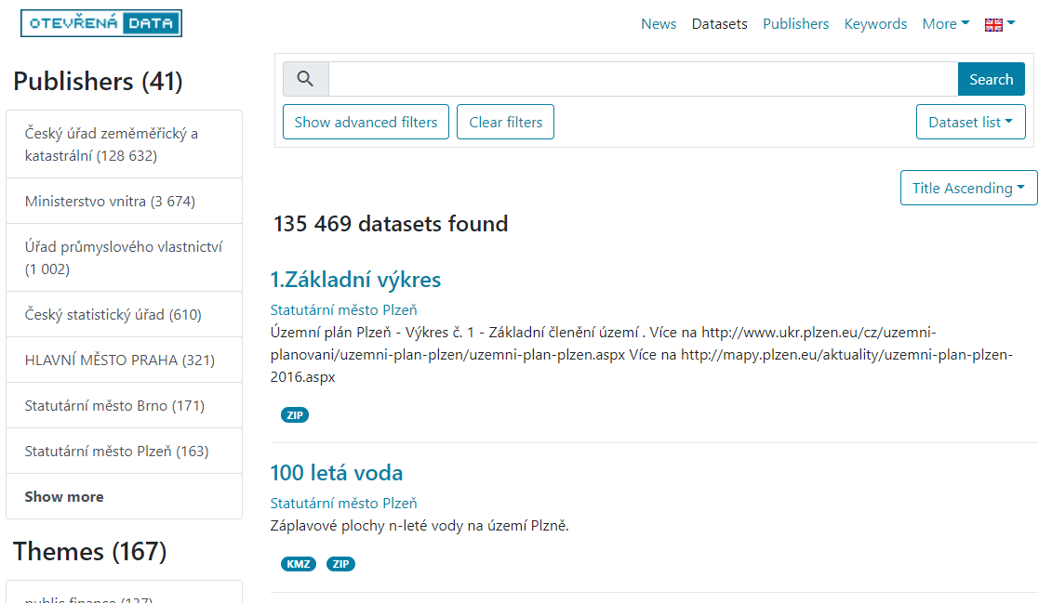
Presentation
Action
Application
data

Slide 17
Presentation
Datasets
Dataset Detail

Slide 18
National Open Data Catalog
Presentation
Data Source

Slide 19
Data Source
Query
Dataset Detail
CouchDB
Data

Slide 20
Data Source
Query
Dataset Detail
CouchDB
Data
Query
Filtered Dataset List
Apache
Solr
Data

Slide 21
Data Source
Query
Dataset Detail
CouchDB
Data
Query
Filtered Dataset List
Apache
Solr
Data
Query
Code list Item Detail
WWW
Data

Slide 23
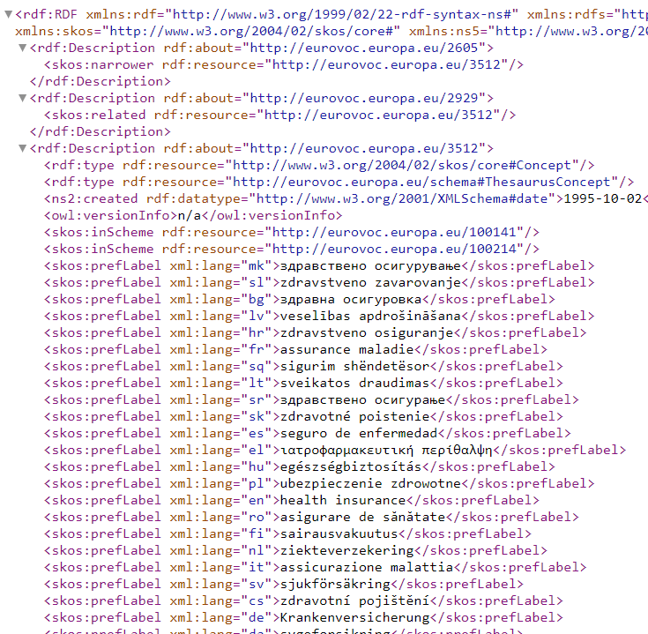
http://publications.europa.eu/resource/authority/eurovoc/3512

Slide 24
Data Source
Query
Dataset Detail
CouchDB
Data
Query
Filtered Dataset List
Apache
Solr
Data
Query
Code list Item Detail
WWW
Data

Slide 25
Data Source
Query
Call for data
Dataset Detail
CouchDB
Data
Query
Filtered Dataset List
Apache
Solr
Data
Query
Code list Item Detail
WWW
Application
data
Data

Slide 26
National Open Data Catalog
Presentation
Domain
Data Source

Slide 27
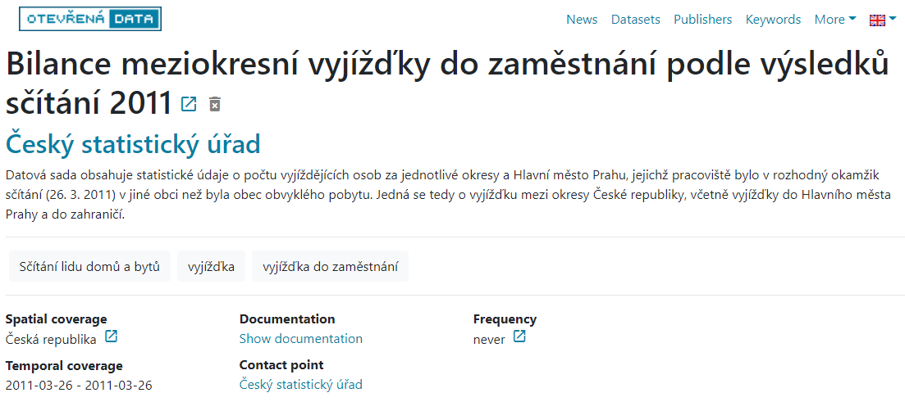
❗

Slide 28
Domain
Dataset Detail
Dataset Search

Slide 29
National Open Data Catalog
uses
Web client app
(presentation)
National Open Data Catalog Server
Catalog Server
(domain)
Data Providers
(data source)
Apache
Solr
Datasets
Dataset Search
Filtered Dataset List
Code list Item Detail
WWW
Dataset Detail
Dataset
Detail
Dataset Detail
CouchDB

Slide 30
What is Software Architecture?
“The software architecture of a system is a set of structures needed to reason about the system, which comprise software elements, relations among them, and properties of both.”
-- Bass, Clemens, Kazman, “Software Architecture in Practice, 3rd Edition”

Slide 31
What is Software Architecture
according to the previous definition, architecture is
set of (architectural) software structures
abstraction

Slide 32
Architecture = Set of Software Structures
structure = set of elements held together by relations
we distinguish three kinds of architectural structures

Slide 33
Kinds of Architectural Structures
Modules = structures which partition system into implementation units
assigned specific computational responsibilities
the basis of work assignments for programming teams
static structures
programming code
Notes:
Let students discuss examples of modules and team assignments
Complex systems may have their modules divided to sub-modules, e.g. primary data from different data sources (N database modules) and several data marts for different applications (M database modules)
Example :
Web application(
Client(
UI(
M(ValueObjects,REST-client),
V(particular views,REACT),
C(particular controllers)
),
Server(Database, DataAccessObjects, Cache, BusinessRules,REST-server)
)
What does the term static mean?
Focus on the way the system's functionality is divided up and assigned to implementation teams.

Slide 34
National Open Data Catalog
uses
Web client app
(presentation)
National Open Data Catalog Server
Catalog Server
(domain)
Data Providers
(data source)
Apache
Solr
Datasets
Dataset Search
Filtered Dataset List
Code list Item Detail
WWW
Dataset Detail
Dataset
Detail
Dataset Detail
CouchDB

Slide 35
Kinds of Architectural Structures
Components = structures which focus on the way the software elements interact with each other at runtime
always run-time entities
are made up of (compiled form of) programs from various implementation units (= modules)

Slide 36
Kinds of Architectural Structures
Allocation = structures which describe mapping from software structures (modules/components) to the system's environments
organizational
developmental
installation
execution
Notes:
Modules are assigned to
teams to develop
places in a file structure for implementation, integration, and testing
Components are deployed to hardware to execute (testing or production)

Slide 37
Which Structures are Architectural
A structure is architectural if it supports reasoning about the systems and the system's properties.
Notes:
System properties =
= QUALITY ATTRIBUTES

Slide 38
Architecture = Abstraction
architectural structures describe particular kinds of software elements and relations between them
architecture omits information about elements that is not useful for reasoning
we simply cannot deal with all of the complexity of the system at once
Notes:
Abstraction of something means that we omit certain information in our specification of something (software system in our case).

Slide 39
System – Architecture
What is the relationship between software system and software architecture?
Can a system exist without an architecture?
Can an architecture exist without a system?
Who creates the system? Who creates the architecture
What are we missing?

Slide 40
Architecture includes Behavior
behavior of each element is part of the architecture when the knowledge of that behavior is important to reason about the system
this behavior must be documented as part of the documentation of the architecture

Slide 41
Why software architecture?
The architecture is a bridge between the business goals and the final resulting system.

Slide 42
Why software architecture?
An architecture inhibits or enables system’s qualities and enables their early predictions.
An architecture allows to reason about and manage changes.
An architecture enhances communication among stakeholders.
An architecture defines constraints on an implementation.
An architecture influences organizational structure.
An architecture enables evolutionary prototyping.
An architecture helps to improve cost and schedule estimates.
An architecture can be created as a transferable, reusable model that forms the heart of a product line.
An architecture can be the foundation for training a new team member.

Slide 43
The End Check out https://www.ksi.mff.cuni.cz/ for amazing student project topics and bachelor’s, master’s and doctoral theses.

