Slide 1
Software System Architectures (NSWI130) Domain-Driven Architectural Pattern
Martin Nečaský
Faculty of Mathematics and Physics
Charles University in Prague

Slide 2
Design Pattern
Recommended coding practice which is a well-known solution to well-known problems caused by a recurring common situation.

Slide 3
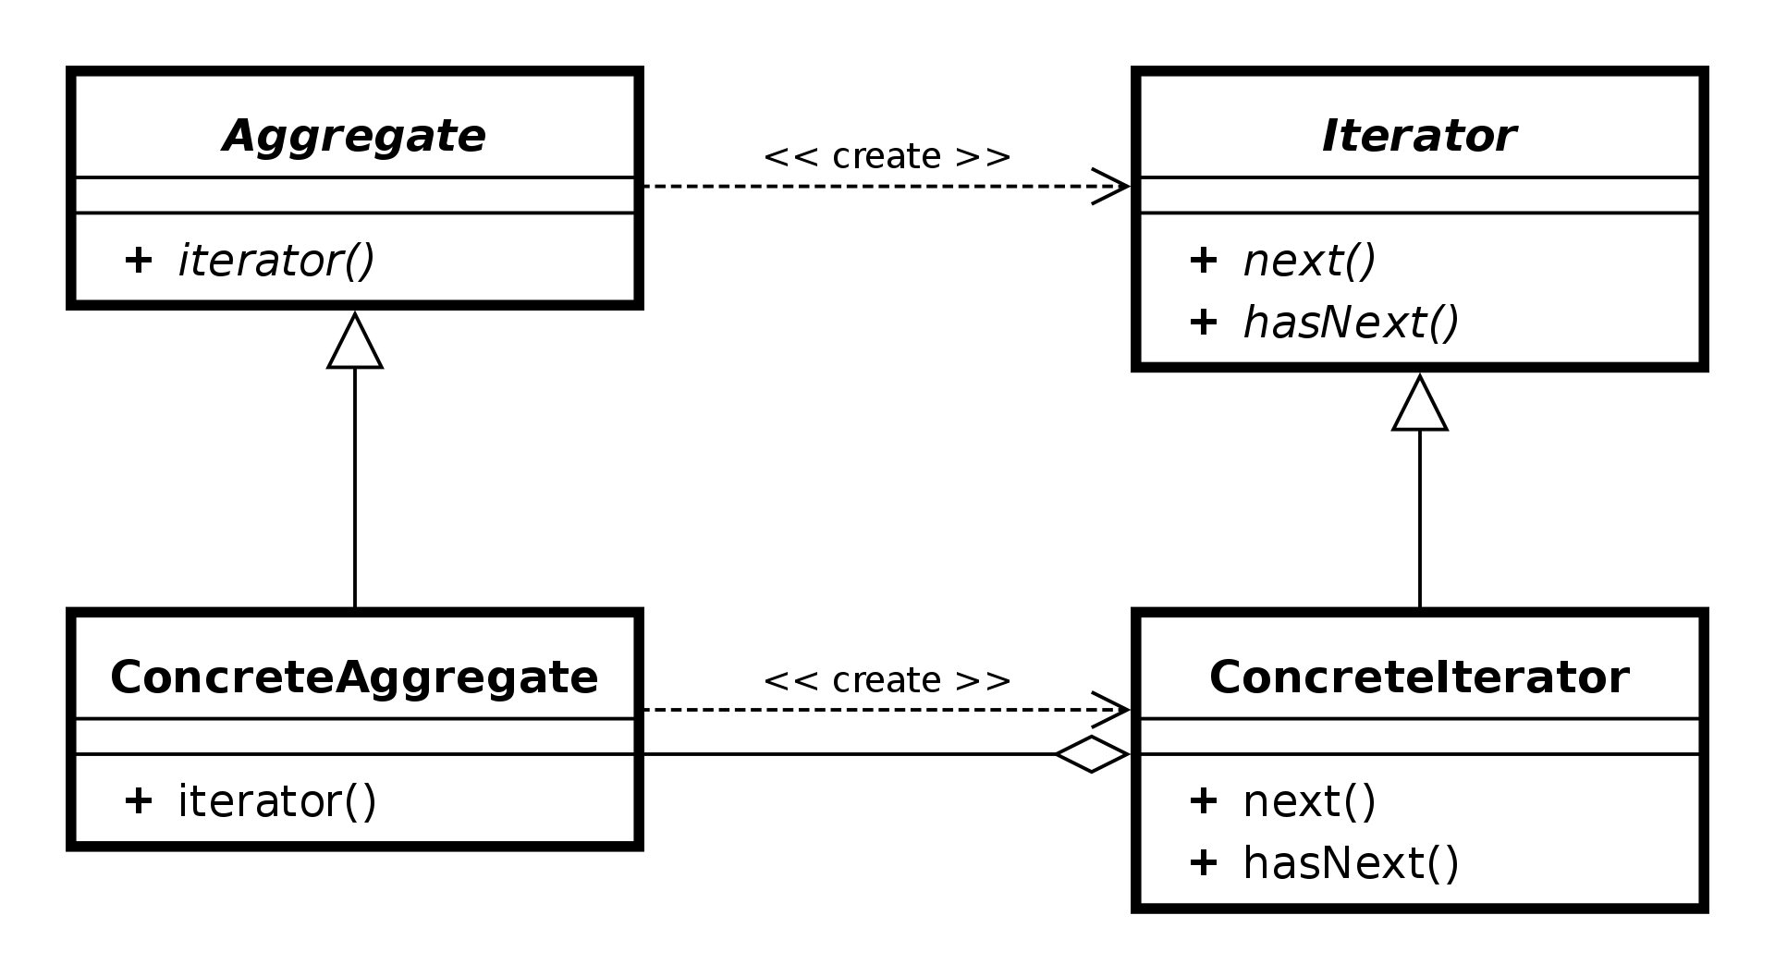
Design Pattern
Source: https://en.wikipedia.org/wiki/Iterator_pattern#/media/File:Iterator_UML_class_diagram.svg

Slide 4
Architectural Pattern
Recommended architectural practice which is a well-known solution to well-known architectural problems caused by a recurring common situation.

Slide 5
Design pattern | Architectural pattern
Fine grained | Coarse grained
Focused on programming problem | Focused on quality attributes
Introduces particular source code structure inside one or more architectural modules | Introduces modules or components/connectors to architectural design

Slide 6
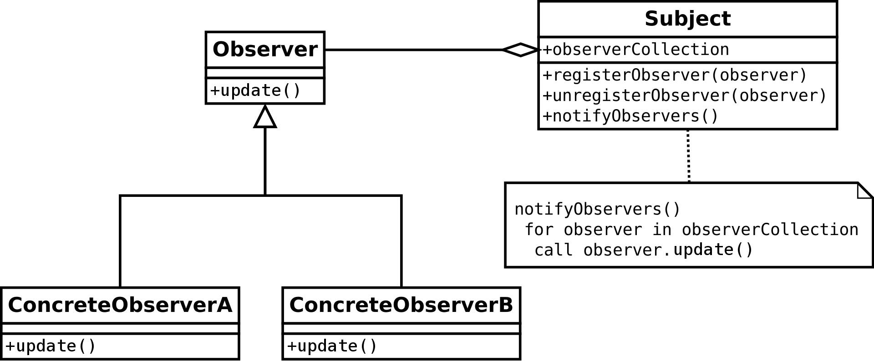
Design vs Architectural Patterns
Source: https://en.wikipedia.org/wiki/Observer_pattern#/media/File:Observer_w_update.svg

Slide 7
Examples of Patterns
load balancer
router
broker
application programming interface (API)

Slide 8
Layer Pattern
situation - complex system where we need to develop and evolve its portions independently
problem - dependencies between parts
solution - layers

Slide 9
Layer Pattern
Presentation
API
Application Services
Domain Model
Infrastructure
Data Sources

Slide 10
Layer Pattern
Monolithic Component
Monolith
Layered Modules
Distributed Network Components

Slide 11
Domain-driven architecture
based on separation of technical complexities from the complexities of the problem domain
helps to change portion of the system without undesired effects
assumption – presentation, persistence and domain logic usually change independently

Slide 12
Domain Layer

Slide 13
Domain Layer
Application Service Layer

Slide 14
Domain Layer
Application Service Layer
Infrastructural Layers

Slide 15
uses
Presentation API
Public API
Domain Layer
Persistence
Application Service Layer
Logging
Infrastructural Layers

Slide 16
Web front-end
Presentation API
Public API
Domain Layer
Persistence
Application Service Layer
Logging
Infrastructural Layers

Slide 17
Web front-end
Presentation API
Public API
Domain Layer
Persistence
Application Service Layer
Logging
Infrastructural Layers

Slide 18
Web front-end
Presentation API
Public API
Domain Layer
Persistence
Application Service Layer
Logging
Infrastructural Layers

Slide 19
Web front-end
Presentation API
Public API
Domain Layer
Persistence
Application Service Layer
Logging
Infrastructural Layers

Slide 20
Web front-end
Presentation API
Public API
Domain Layer
Persistence
Application Service Layer
Logging
Infrastructural Layers

Slide 21
Web front-end
Presentation API
Public API
Domain Layer
Persistence
Application Service Layer
Logging
Infrastructural Layers

Slide 22
Web front-end
Presentation API
Public API
Domain Layer
Persistence
Application Service Layer
Logging
Infrastructural Layers

Slide 23
Web front-end
Presentation API
Public API
Domain Layer
Persistence
Application Service Layer
Logging
Infrastructural Layers

Slide 24
Presentation API
Public API
Domain Layer
Persistence
Application Service Layer
Logging
Infrastructural Layers

Slide 25
Presentation API
Public API
Domain Layer
Persistence
Application Service Layer
Logging
Infrastructural Layers

Slide 26
Domain-driven pattern can be applied in any software system.
But it cannot be recommended for all cases.

Slide 27
Three-tier Pattern

Slide 28
Three-tier Pattern
Presentation tier

Slide 29
Three-tier Pattern
Presentation tier
Application tier

Slide 30
Three-tier Pattern
Presentation tier
Application tier
Data tier

Slide 31
Three-tier Pattern
Benefits - simplicity
separation of teams, platforms, servers
faster development
improved scalability, availability, security, modifiability and integrability
Drawbacks
concentration on technical aspects of software lifecycle

Slide 32
Problem Domain Overview
Open Data Catalog

Slide 33
Subdomains
Registration
Search
Notification
Semantic
Annotations
Quality
Preview
Reporting

Slide 34
Core Domains
Registration
Search (C)
Notification
Semantic
Annotations
(C)
Quality (C)
Preview (C)
Reporting

Slide 35
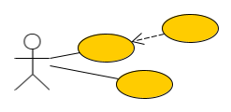
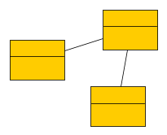
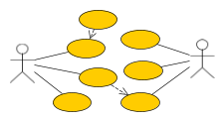
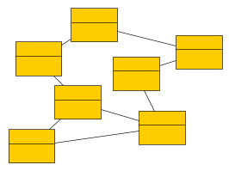
Modeling Problem Domain

Slide 36
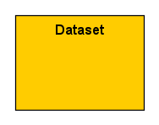
Modeling Problem Domain

Slide 37
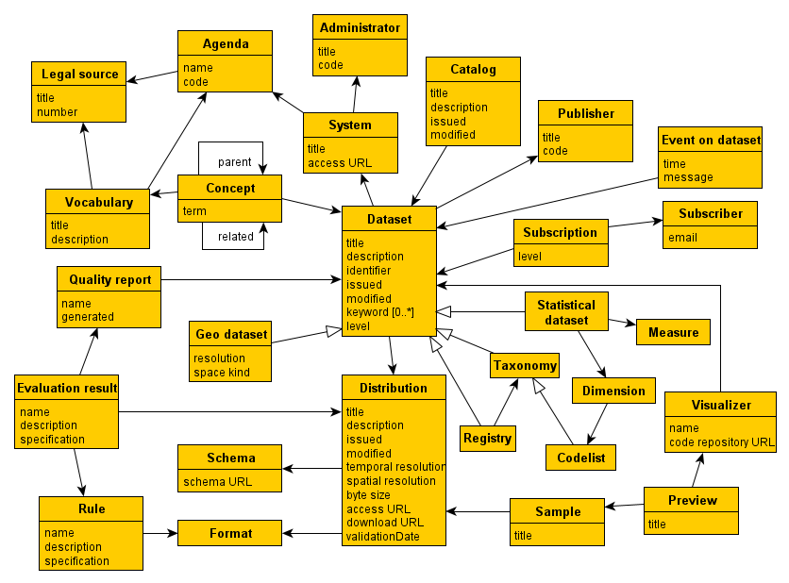
Modeling Problem Domain

Slide 38
Presentation tier
Data tier

Slide 40
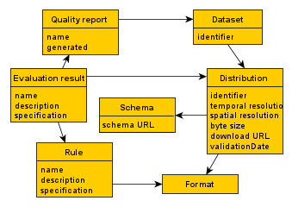
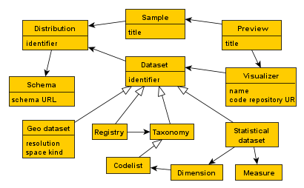
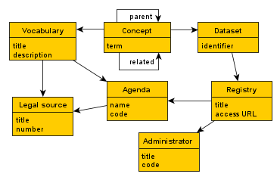
Quality Subdomain (C)
Preview Subdomain (C)
Semantic Annotations Subdomain (C)

Slide 42
???

Slide 43
Database

Slide 44
Database
Database
Database

Slide 45
Database

Slide 46
Database
Database
Database

Slide 47
Database
Database
Database

Slide 48
Database integration
⏬
Integration through defined contracts
⏬
Incorporating anticorruption layers and open host services
⏬
Event-driven pattern

Slide 49
Layer Pattern
Monolithic Component
Monolith
Layered Modules
Distributed Network Components

Slide 50
Monolith - application server
Monolith - database server
Database
Database
Database

Slide 51
Monolith - application server
Database
Database
Database

Slide 52
Quality Service
Semantic annotations Service
HTTP REST
Preview Service
Database
Database
Database

Slide 53
Service-oriented architecture (SOA)
“Service-oriented architecture (SOA) is an architectural pattern for building software systems by reusing and composing functional components called services. A service is independent of its surrounding environment (formed by other services and service clients) and provides a certain functionality which is required by the business.”

Slide 54
8 key SOA principles
standardization
loose-coupling
abstraction
reusability
autonomy
statelessness
discoverability
composability

Slide 55
Quality Service
Semantic annotations Service
HTTP REST
Preview Service
Database
Database
Database

Slide 56
Microservices pattern
domain-driven architecture
strictly autonomous runtime services
small
sagas for data consistency

