Slide 1
SAP
Simple as possible compiter

Slide 2
Introduction to SAP1:
SAP1 is a basic computer architecture designed for educational purposes, offering a simple yet effective platform for learning computer organization and architecture. It features essential components like CPU, memory, and I/O interfaces, providing hands-on experience with digital logic and instruction execution. Despite its simplicity, SAP1 serves as a foundation for understanding more advanced computer systems and architectures.

Slide 3
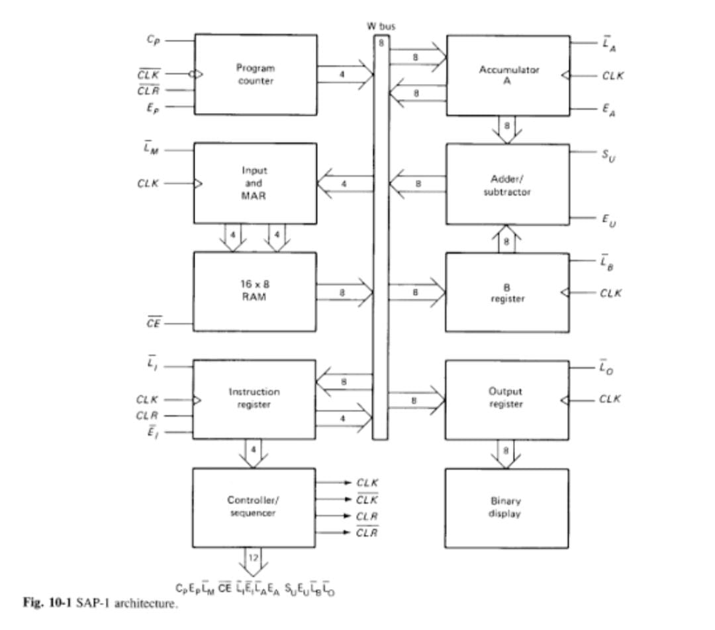
SAP-1 Computer Architecture
The SAP-1 computer is a bus-organized computer and makes use of Von-Neumann architecture. It makes use of an 8-bit central bus and has ten main components. A pictorial representation of its architecture is shown below. Each of the individual components that make up this computer are described right after.

Slide 4
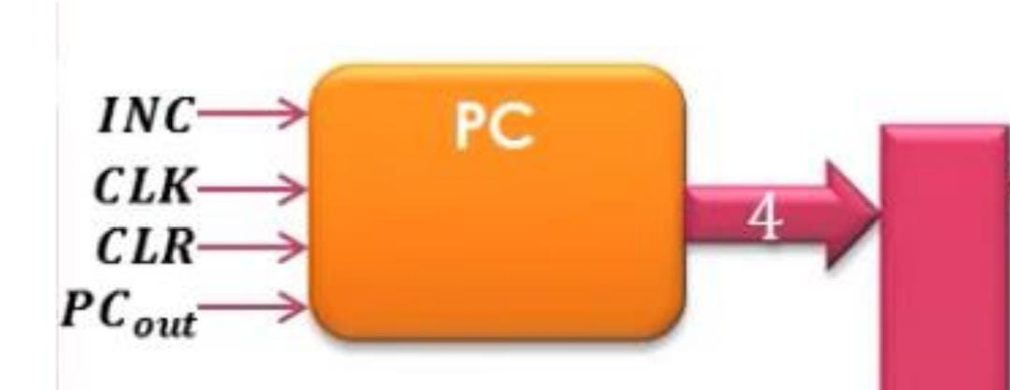
PC ‘program counter’
The program counter, which is part of the control unit, counts from 0000 to 1111 as the program is stored at the beginning of the memory with the first instruction at binary address 0000, the second instruction at address 0001, the third at address 0010

Slide 5
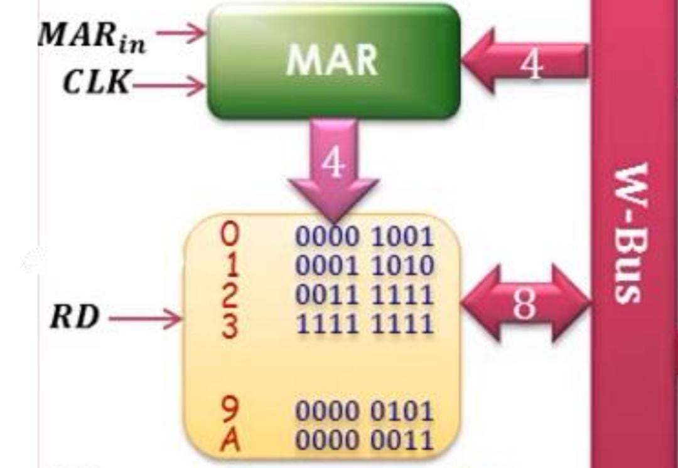
MAR ‘Memory address Register’ The MAR stores the 4-bit address of data or instruction which are placed in memory. When the SAP-1 is running, the 4-bit address is gotten from the Program Counter through the W-bus and then stored. This stored address is sent to the RAM where data or instructions are read from

Slide 6
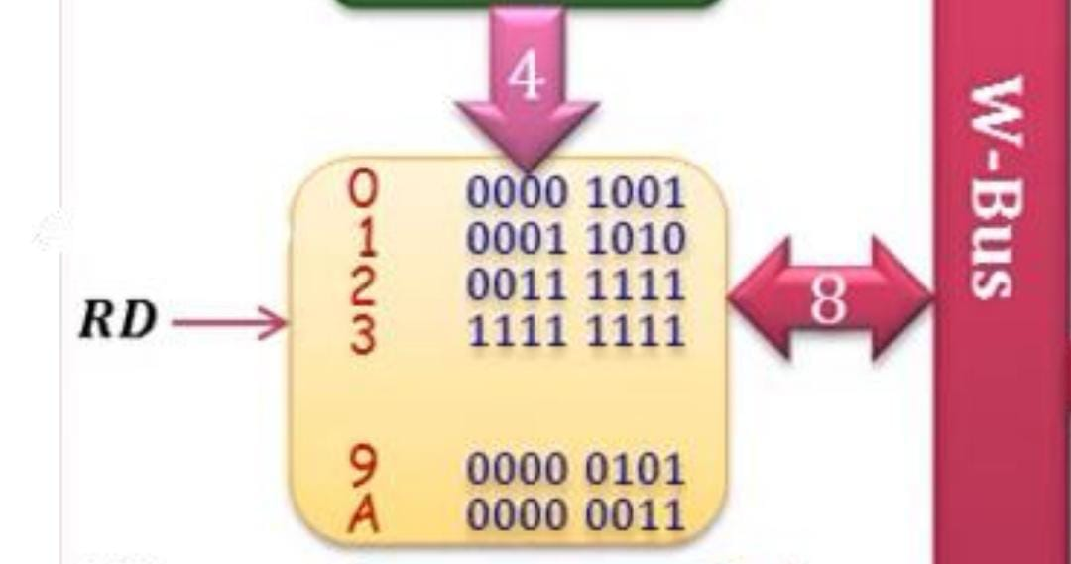
RAM
Random-Access Memory (RAM): The SAP-1 makes use of a 16 x 8 RAM (16 memory locations each storing 8 bits of data). The RAM can be programmed by means of the address and data switches allowing you to write to the memory before a computer run. During a computer run, the RAM receives its 4-bit address from the MAR and read operation is performed. In this way the instruction or data word stored in the RAM is placed on the W bus for use in some other part of the computer.

Slide 7
SAP-1 instruction set consists of following
instructions
Mnemonic | operation | opcode
LDA | Load addressed memory contents onto accumulator | 0000
ADD | Add addressed memory contents to accumulator | 0001
SUB | Subtract addressed memory contents from accumulator | 0010
AND | And addressed memory contents with accumulator | 0011
OR | Or addressed memory contents with accumulator | 0110
OUT | Load accumulator data into output register | 1110
HALT | Stop processing | 1111

Slide 8
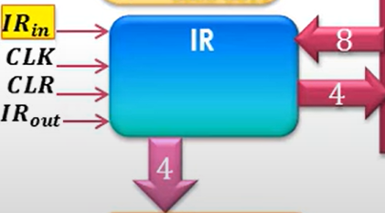
Operation Codes
Each operation in the SAP-1’s instruction set have been mapped to 4 bits. These 4 bits make up the first 4 of the total 8 bits that are stored in each RAM location. The last 4 bits specify the operand which the operation will act on. Example – 000 0001 will load (0000) the operand 1 (0001) to the accumulator.
LOAD – 0000
ADD – 0001
SUBTRACT – 0010
AND – 0111
OR – 0111
OUTPUT -1110
HALT - 1111

Slide 9
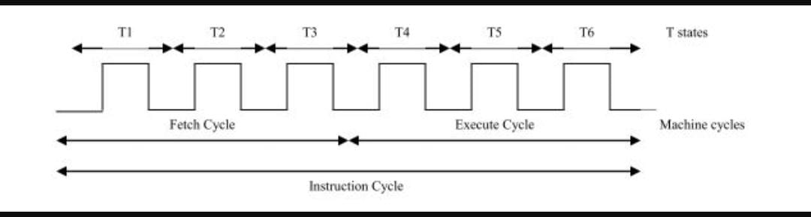
Machine cycle and Instruction cycle
SAP1 has six T-states (three fetch and three execute cycles) reserved for each instruction. Not all instructions require all the six T-states for execution. The unused T- state is marked as No Operation (NOP) cycle. Each T-state is called a machine cycle for SAP1. A ring counter is used to generate a T-state at every falling edge of clock pulse. The ring counter output is reset after the 6th T-state.
FETCH CYCLE – T1, T2, T3 machine cycle
EXECUTE CYCLE - T4, T5, T6 machine cycle
Complete code includes opcode and operand One instruction is executed in one instruction cycle Instruction cycle may consist of many machine cycles For SAP-1, Instruction cycle = Machine cycle Instruction cycle = Fetch cycle + Execution cycle Fetch cycle is generally same for all instructions Complete code includes opcode and operand Like LDA 04H 0000 0100One instruction is executed in one instruction cycle

Slide 10
Fetch and Execution Cycle of SAP-1 instructionsSAP-1 instruction cycle: 3 clock cycles to fetch and decode phase, 3 clock
cycles to execute The first three states are:
1. address 2. increment 3. memory
Controller has a 6-bit ring counter which continuously cycles from 000001 up to 100000 then resets (must be set to 000001 when we initialize the computer)Ring counter is clocked on clock high-to-low transition, most of the other circuits in the computer on clock low-to-high transition Fetch Cycle
Address state: enable PC to bus three-state output, MAR load line Increment state: enable PC increment (and perhaps wait for memory access time)
Memory state: enable memory CE,
IR load line IR is loaded on the low-to-high clock transition, so stabilizes before state 4 is entered
t1: MAR ← PC t2: PC ← PC +1 t3: IR ← RAR
Execution Cycle – LDA
state 4: enable IR to bus three-state output, MAR load line
state 5: enable memory CE, accumulator load line
state 6: enable nothing
t4: MAR ← (IR (Address of operand)) t5: Accumulator ← RAM t6: nothing
Execution Cycle – ADD
state 4: enable IR to bus three-state output, MAR load line
state 5: enable memory CE, register B load line
state 6: enable add, ALU to bus three-state output, accumulator load line
t4: MAR ← (IR (Address of B)) t5: B ← RAM t6: Accumulator ← Accumulator +B

Slide 11
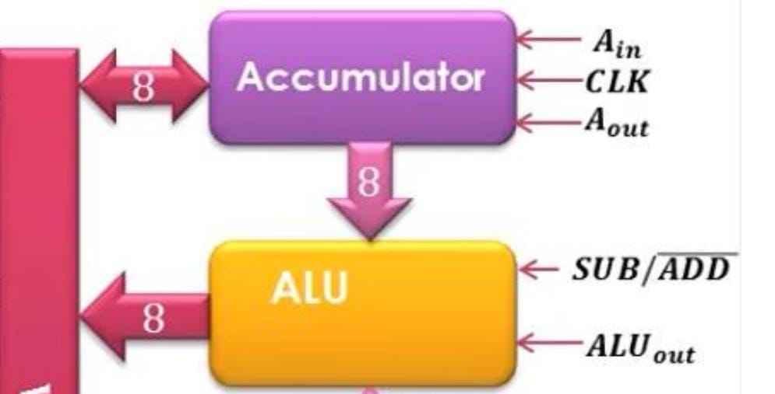
Accumulator:
The accumulator is an 8-bit buffer register that stores intermediate answers during a computer run. The accumulator has two outputs. The two-state output goes directly to the adder-subtractor and the three-state output goes to the bus. This implies that the 8-bit accumulator word continuously drives the adder- subtractor but only appears on the W bus when Ea is high.

Slide 12
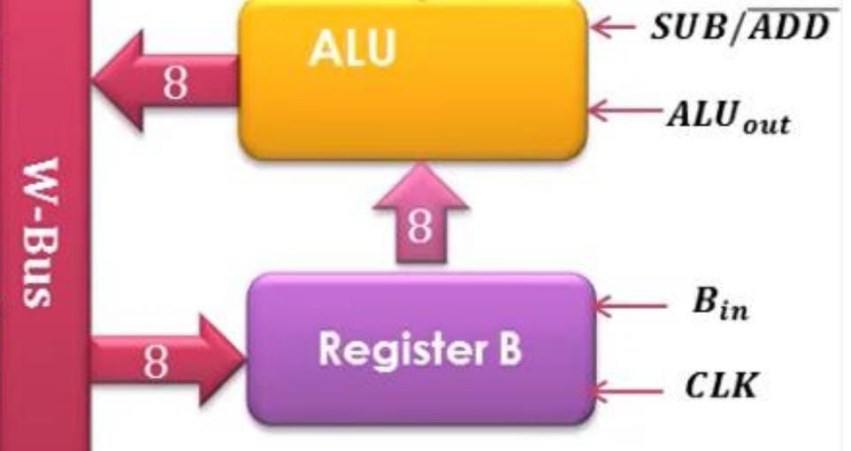
The B-Register
The B-register is a buffer register used in performing arithmetic operations. It supplies the number to be added or subtracted from the contents of the accumulator to the adder/subtractor. When data is available at the bus and Lb is low, at the positive clock edge, B register gets and stores the data.

Slide 13
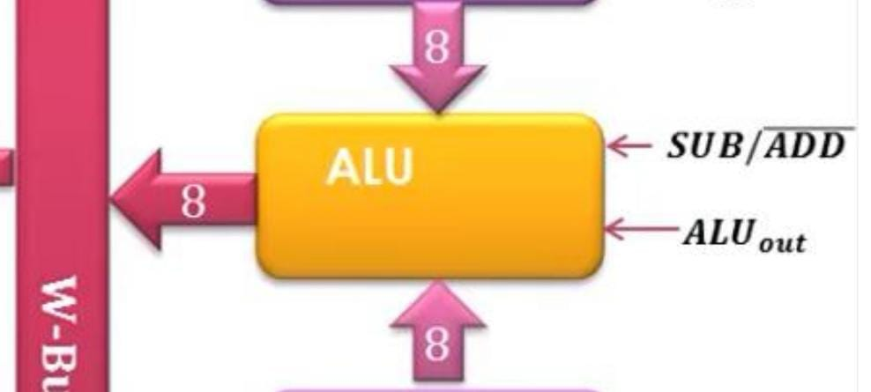
ALU
Arithmetic Logic Unit (ALU)
The ALU enables the Processor to perform simple arithmetic operations. In fact, it only can perform the addition or substraction of the values in the two data registers RA and RB:
ALUOUT=RA+RB
Or
ALUOUT=RA−RB
Or
ALUOUT=RA^RB
Or
ALUOUT=RA*RB
Mode of Operation
Addition
The ALU uses 2 74LS283 4-bit binary adders with carry. The carry output (ALU:C4) of ALU:IC1 is connected to the carry input (ALU:C0) of ALU:IC2, thus a carry after bit 4 is propagated to the second nibble of the result. The inputs A and B of the ICs are connected directly to the outputs of the 74LS173 registers of RA and (through XOR gates) RB instead of the DB. For addition, the substract line SU line is low,and OR_AND line is low also thus the XOR gates output the same value as the input from RB. To only drive the DB lines when the result of the computation is needed, another 74LS245 is used as tristate buffer, enabling the display of the result on ALU:LED1−8 without driving the DB.
Substraction
For substraction of RA and RB, the ADD_SUB line signal is active,and OR_AND line is low, thus the output of the XOR gates is always the logical inverse of the input from RB. Thus the second byte into the 8-bit adder is the 1s complement of RB. To calculate a 2s complement result however, the SU signal also drives the ALU:C0 input of ALU:IC1, effectivley adding 1 to the result.
OR
For OR operation of RA and RB, the ADD_SUB line signal is low,and OR_AND line is active, thus the output of the XOR gates is always the logical inverse of the input from RB. Thus the second byte into the 8-bit adder is the 1s complement of RB, the SU signal also drives the ALU:C0 input of ALU:IC1, effectivley adding 1 to the result.
AND
For AND operation of RA and RB, the ADD_SUB line signal is active,and OR_AND line is active, thus the output of the XOR gates is always the logical inverse of the input from RB. Thus the second byte into the 8-bit adder is the 1s complement of RB, the SU signal also drives the ALU:C0 input of ALU:IC1, effectivley adding 1 to the result.

Slide 14
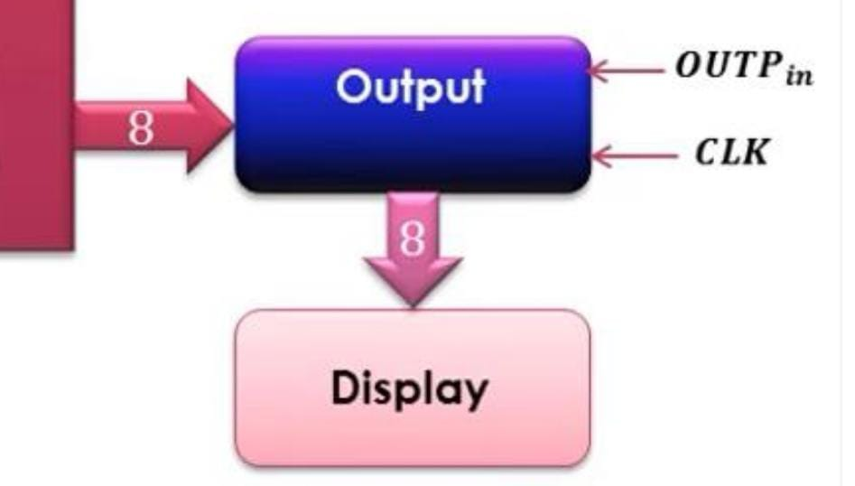
OUTPUT Register
The output register gets and stores the value stored in the accumulator usually after the performance of an arithmetic operation. The answer that is stored in the accumulator is loaded into the output register through the W bus. This is done in the next positive clock edge when Ea is high and Lo is low. The processed data can now be displayed to the outside world

Slide 15
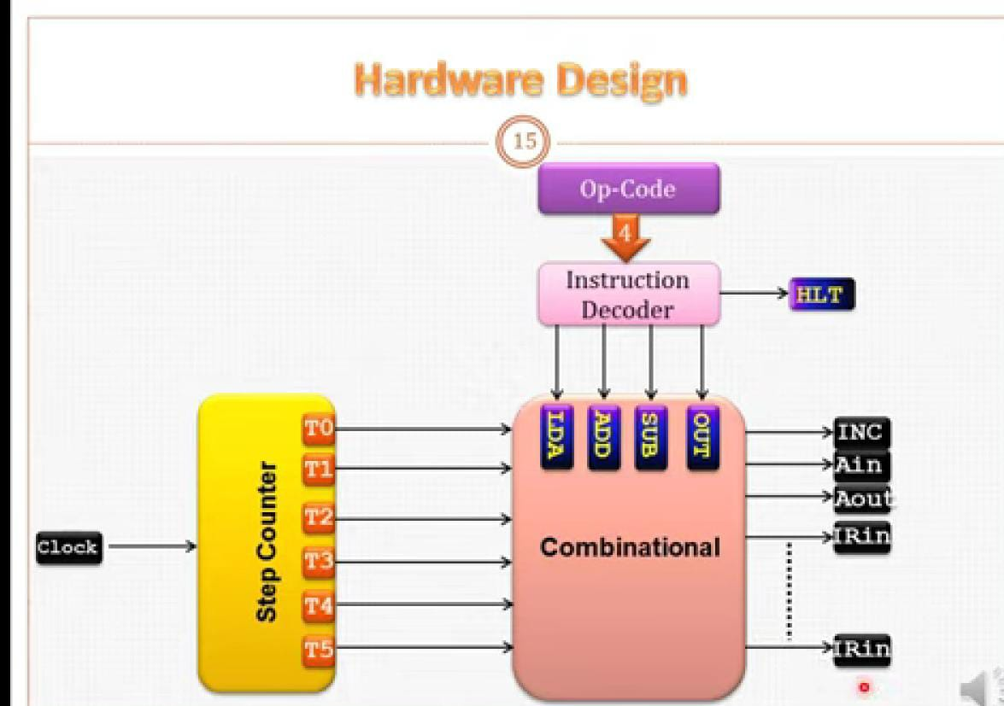
CONTROLLER

Slide 16
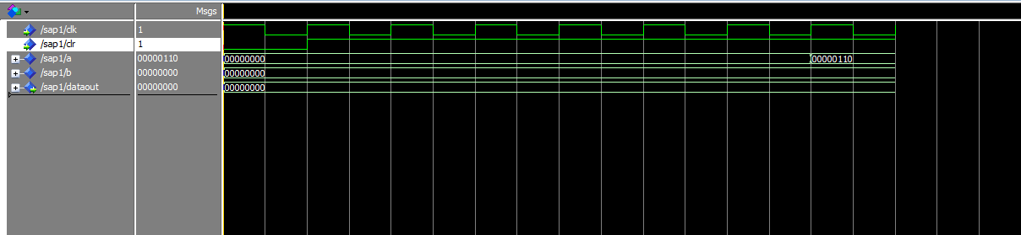
Simulation output 1-LDA load 6 in accumulator

Slide 17
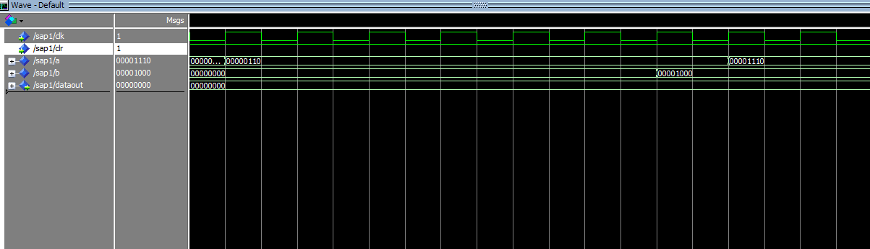
Simulation output 2-ADD add value of a to b and store result in a

Slide 18
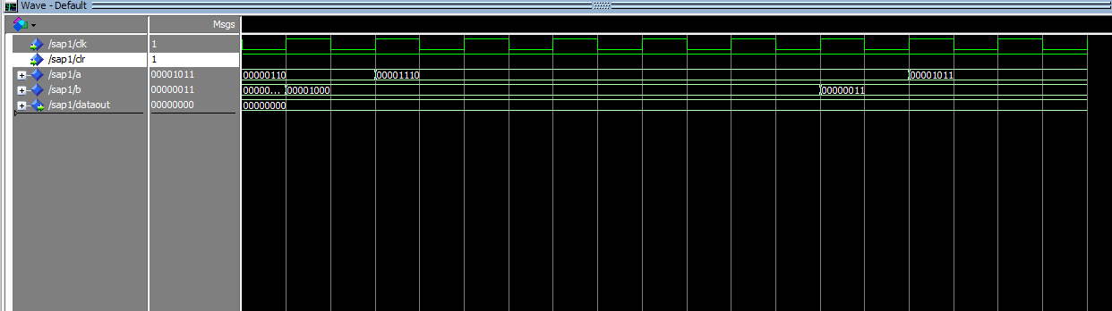
Simulation output 3-SUB subtract b from a and store result in a

Slide 19
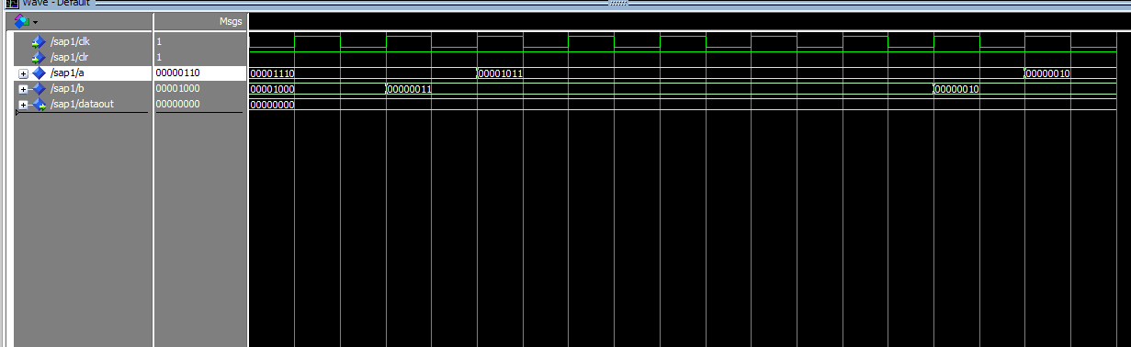
Simulation output 4-AND make and operation to a with b and store result in a

Slide 20
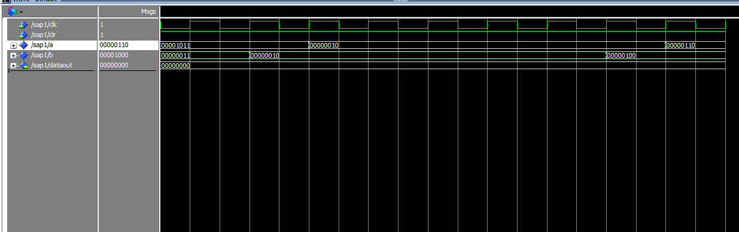
Simulation output 5-OR make or operation to a with b and store result in a

Slide 21
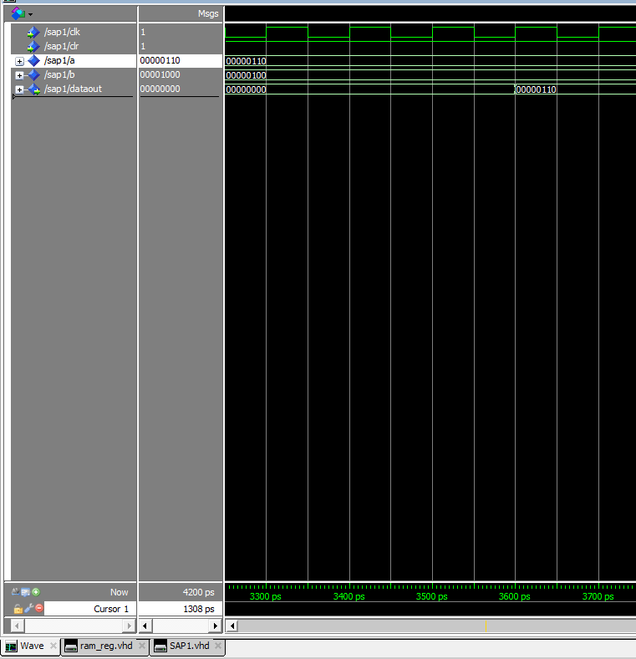
Simulation output 6-OUTPUT show the result on output reg

Slide 22
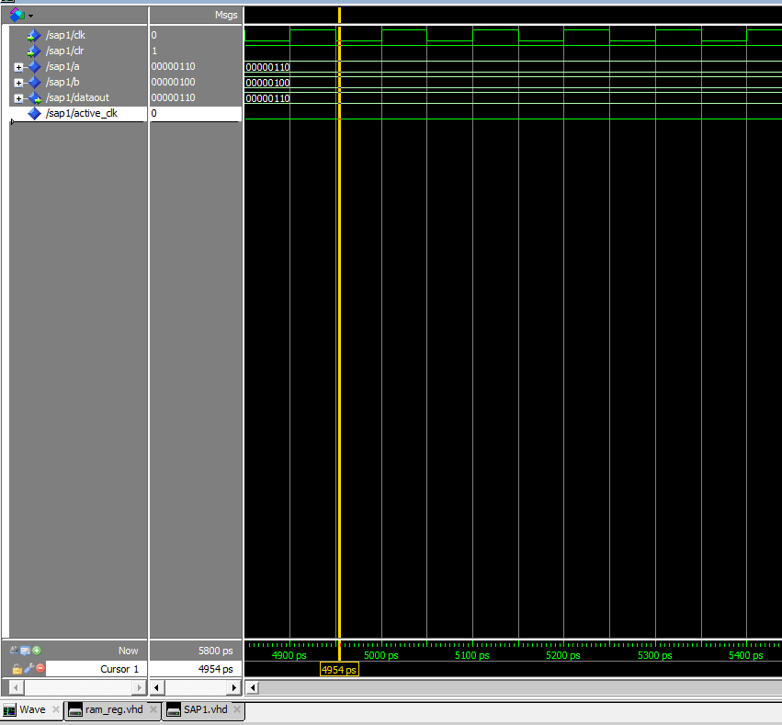
Simulation output 7-HALT make the active clock equal 0

