Slide 1
CSCI 434 · COLL 400 Capstone
Network Traffic
Classification
Using Machine Learning to Identify Websites
from Encrypted Network Packets
Sam, Levi, Lauren, Alex, Timmy, Joe · William & Mary

Slide 2
BACKGROUND
Objective
Can we identify which website someone is visiting without ever seeing the URL or reading encrypted data?
Network Security
Network Management
Policy Enforcement
Detect unusual or malicious traffic patterns without decrypting private data
Identify traffic sources to balance load and optimize performance
ISPs and admins can classify traffic types to enforce access policies
2 / 9

Slide 3
PROPOSED METHOD
Data Collection
Dataset Summary
1
Website | Sessions
Amazon | 20
Bose | 20
GitHub | 20
Handshake | 20
Indeed | 20
LinkedIn | 20
NYT | 20
Tetris | 20
Tribecareers | 20
Wash. Post | 20
YouTube | 20
Total | 220
1
Visit Website
3
3
Export File
About a minute of browsing per session (depending on site)
Save as .pcapng — one file = one record
2
Capture Packets
4
Label & Repeat
2
4
Wireshark records all traffic during the session
11 websites, 220 sessions total
3 / 9

Slide 4
PROPOSED METHOD
Features
Raw pcap files can't be used directly, we extracted 9 numeric features from each browsing session.
Wireshark .pcapng
Feature Extraction
(Python)
Dataset CSV
(220 rows, each with 9 features and 1 label)
Packet Count
Total Length
Avg Packet Interval
Max Packet Interval
Min Packet Interval
Avg Packet Length
Max Packet Length
Min Packet Length
Most Common Packet Length
4 / 9

Slide 5
PROPOSED METHOD
Models
Proposed Model - Random Forest
Baseline Model
Definition:
Logistic Regression
An ensemble learning method that builds many decision trees during training and combines their votes for the final prediction.
Maps features to class probabilities using a logistic function. Simple, interpretable, and widely used as a benchmark for classification tasks.
How it works:
Bootstrapping: each tree trains on a random sample of the data
Feature randomness: random subset of features at each split
Majority voting: the most common class prediction wins
Why we chose it:
Handles complex feature interactions, resistant to overfitting, and works well on small datasets.
5 / 9
Data split: 60% train · 20% validation · 20% test

Slide 6
EVALUATION
Results
0.64
0.62
0.32
0.29
Random Forest Accuracy
Random Forest Macro F1
Logistic Reg. Accuracy
Logistic Reg. Macro F1
Model Comparison
Key Finding
Model | Accuracy | Macro F1
Logistic Regression (baseline) | 0.32 | 0.29
Random Forest (proposed) | 0.64 | 0.62
Random Forest outperformed the baseline in both accuracy (+32%) and Macro F1 (+33%), showing it better captures the complex patterns that distinguish website traffic.
6 / 9

Slide 7
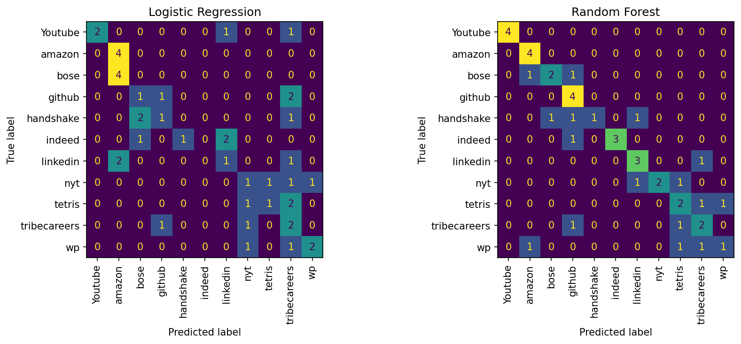
EVALUATION
7 / 9
Confusion Matrices

Slide 8
DISCUSSION & LIMITATIONS
8 / 9
Key Findings
Random Forest (0.64 accuracy) clearly outperformed Logistic Regression (0.32 accuracy)
9 simple packet-level features are enough to loosely distinguish website traffic fingerprints, but not enough to distinguish them accurately
ML-based classification is feasible without URL access or payload decryption, but some more work needs to be done to make it more accurate
Limitations
Small dataset (220 sessions); more captures per site would improve generalization
Static sessions only; real-world traffic is dynamic and continuous

Slide 9
FUTURE WORK & CONCLUSION
9 / 9
Future Work
Expand dataset: more websites, longer sessions, diverse network conditions
Explore deep learning: CNNs trained directly on raw packet sequences
Conclusion
This project demonstrates that machine learning, specifically Random Forest, can classify website traffic from simple packet-level features, without ever accessing URLs or encrypted content. While improvements could to be made to increase the accuracy, we think this a good demonstration of the possibilities of website classification using packet features. The approach has direct applications in network security, management, and performance optimization.

