Slide 1







HF’26
ADVANCED TRACK · TEAM VISIONX

Slide 2

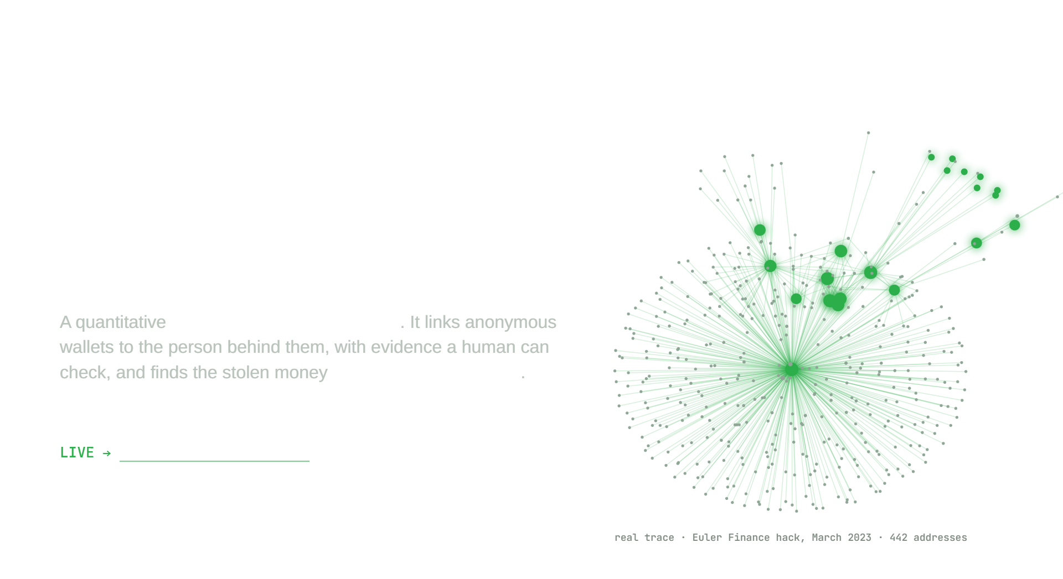

PROBLEM STATEMENT: GHOST ATTACKS
TEAM NAME: VISIONX
IDEA TITLE: UNMASK

Slide 3
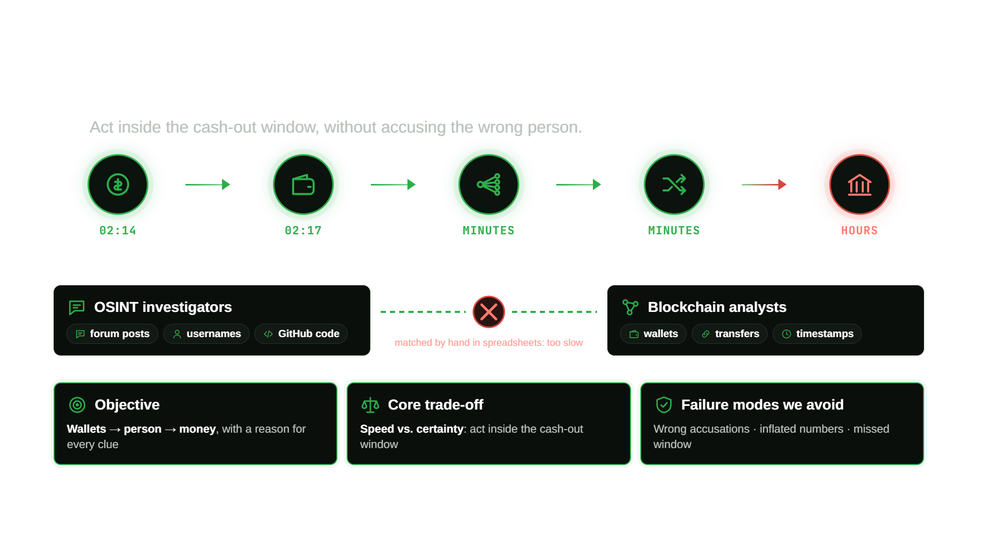
PROBLEM FRAMING

Slide 4
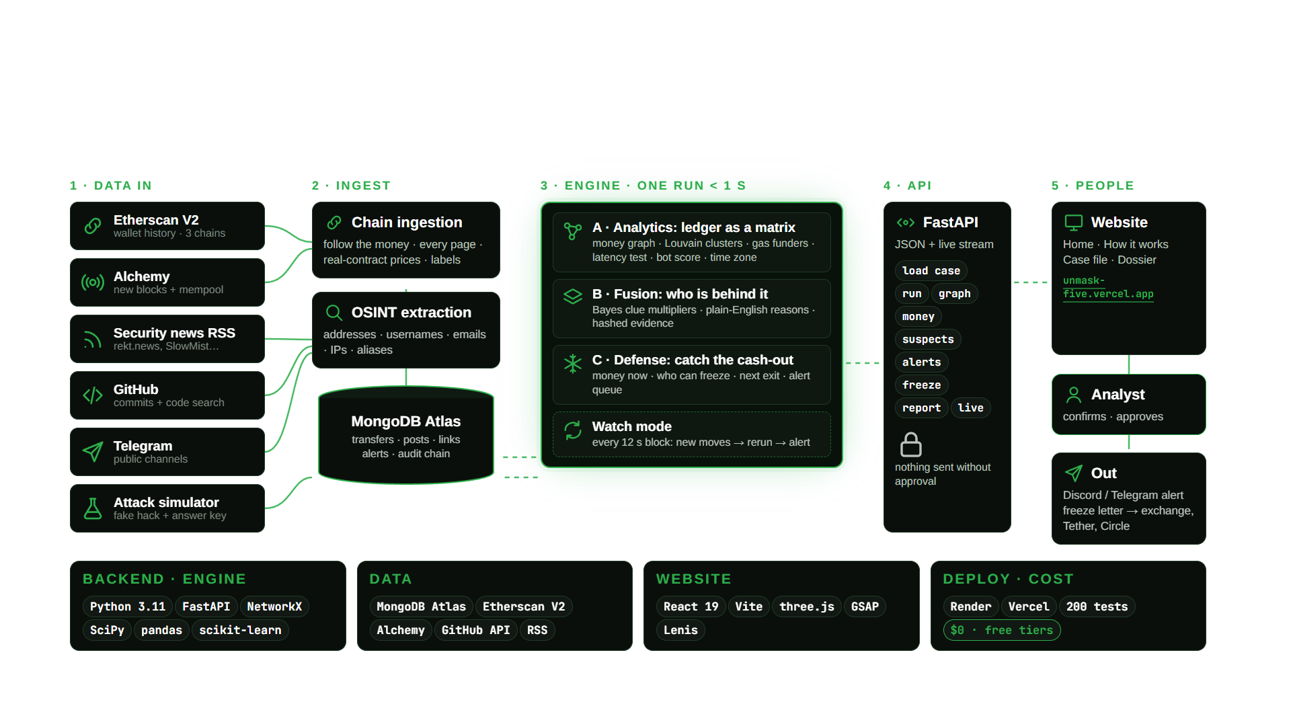
ARCHITECTURE & TECH STACK

Slide 5
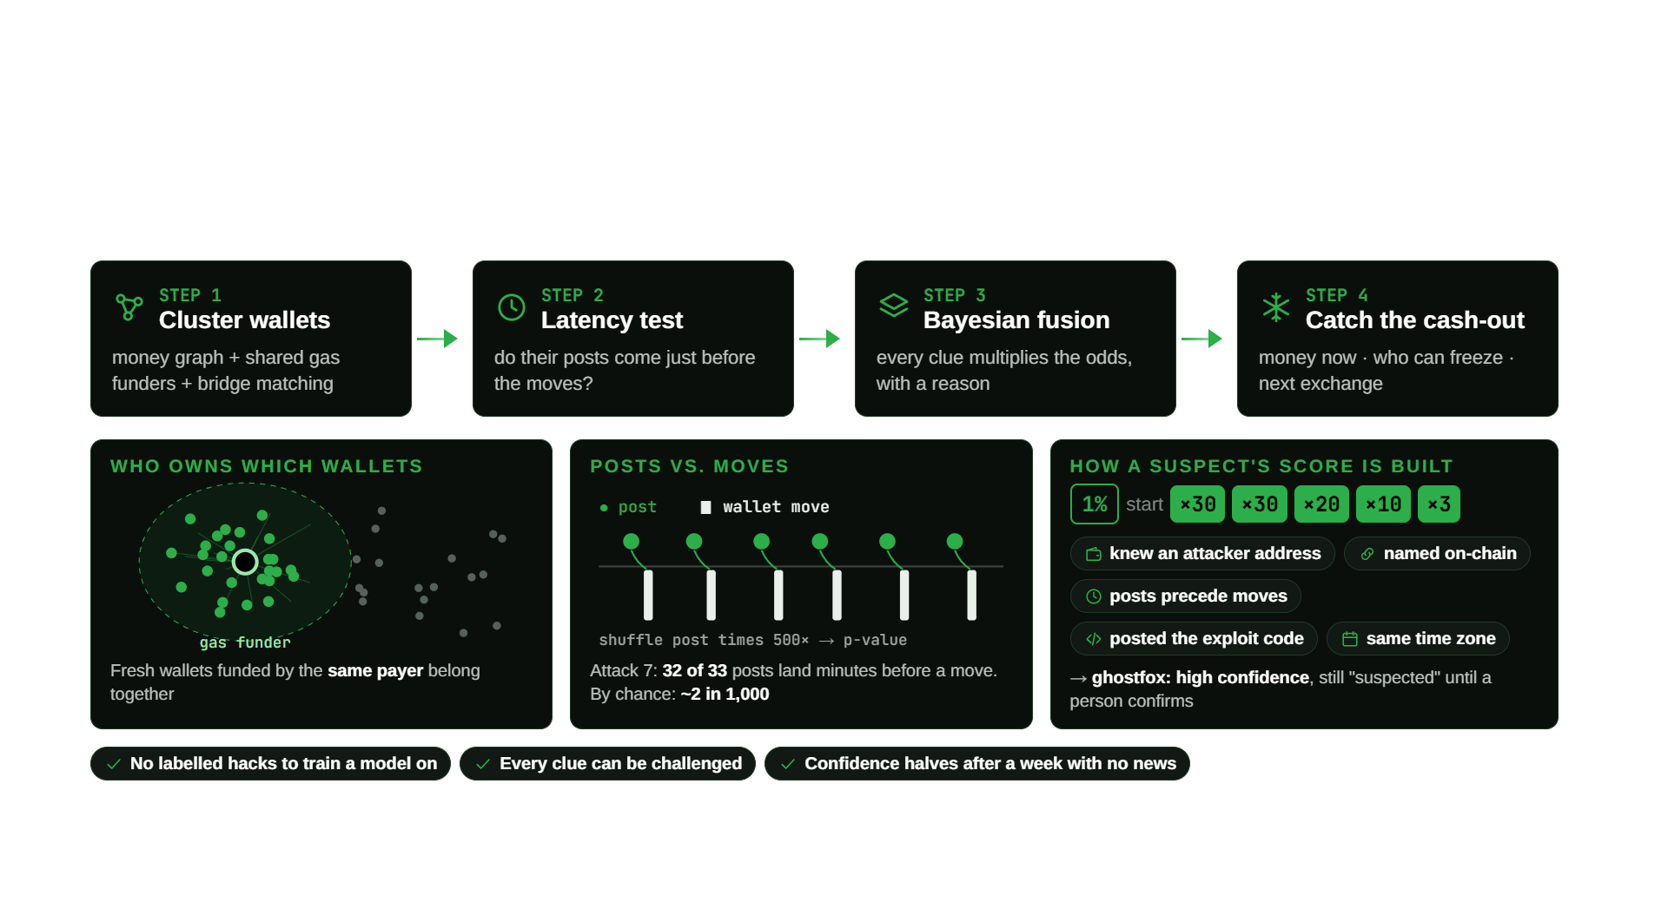
MODEL AND ALGORITHM

Slide 6
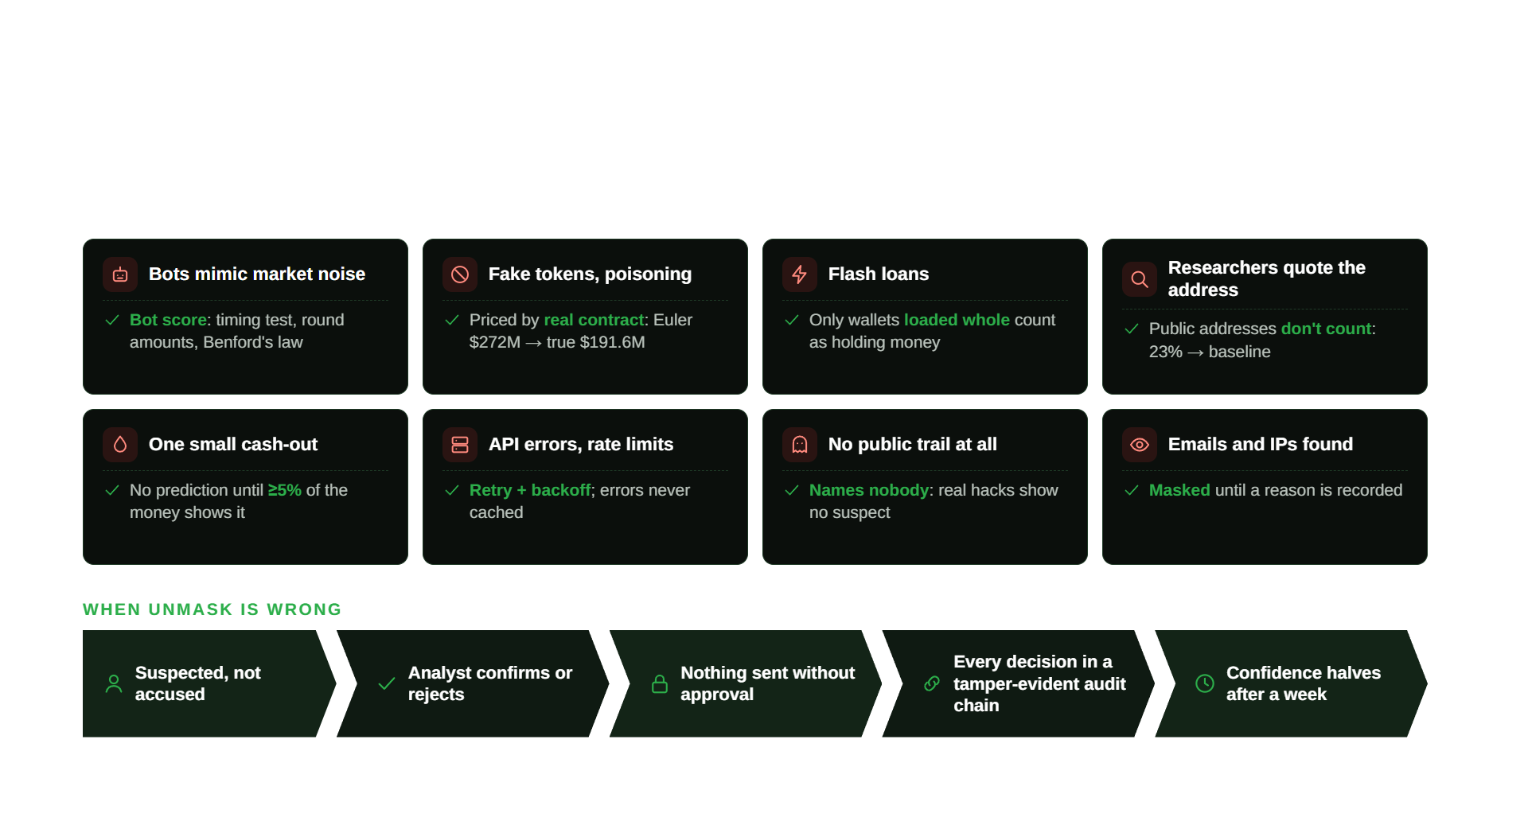
HANDLING UNCERTAINTY AND EDGE CASES

Slide 7
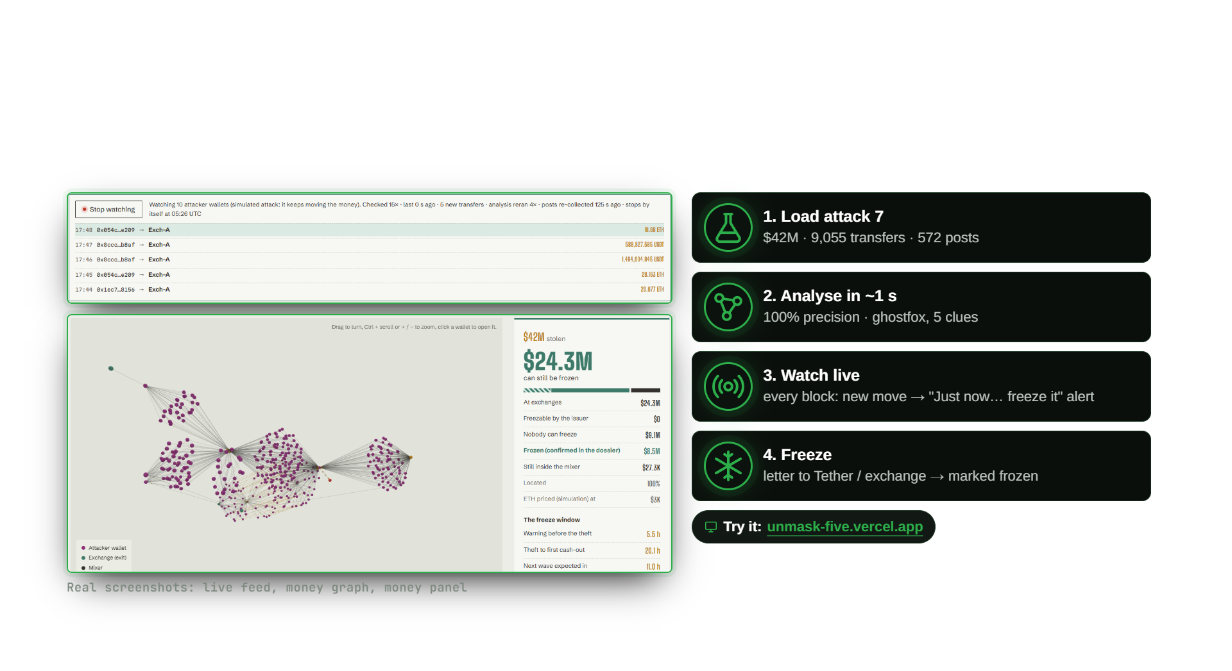
LIVE DEMO / SIMULATION RUN

Slide 8
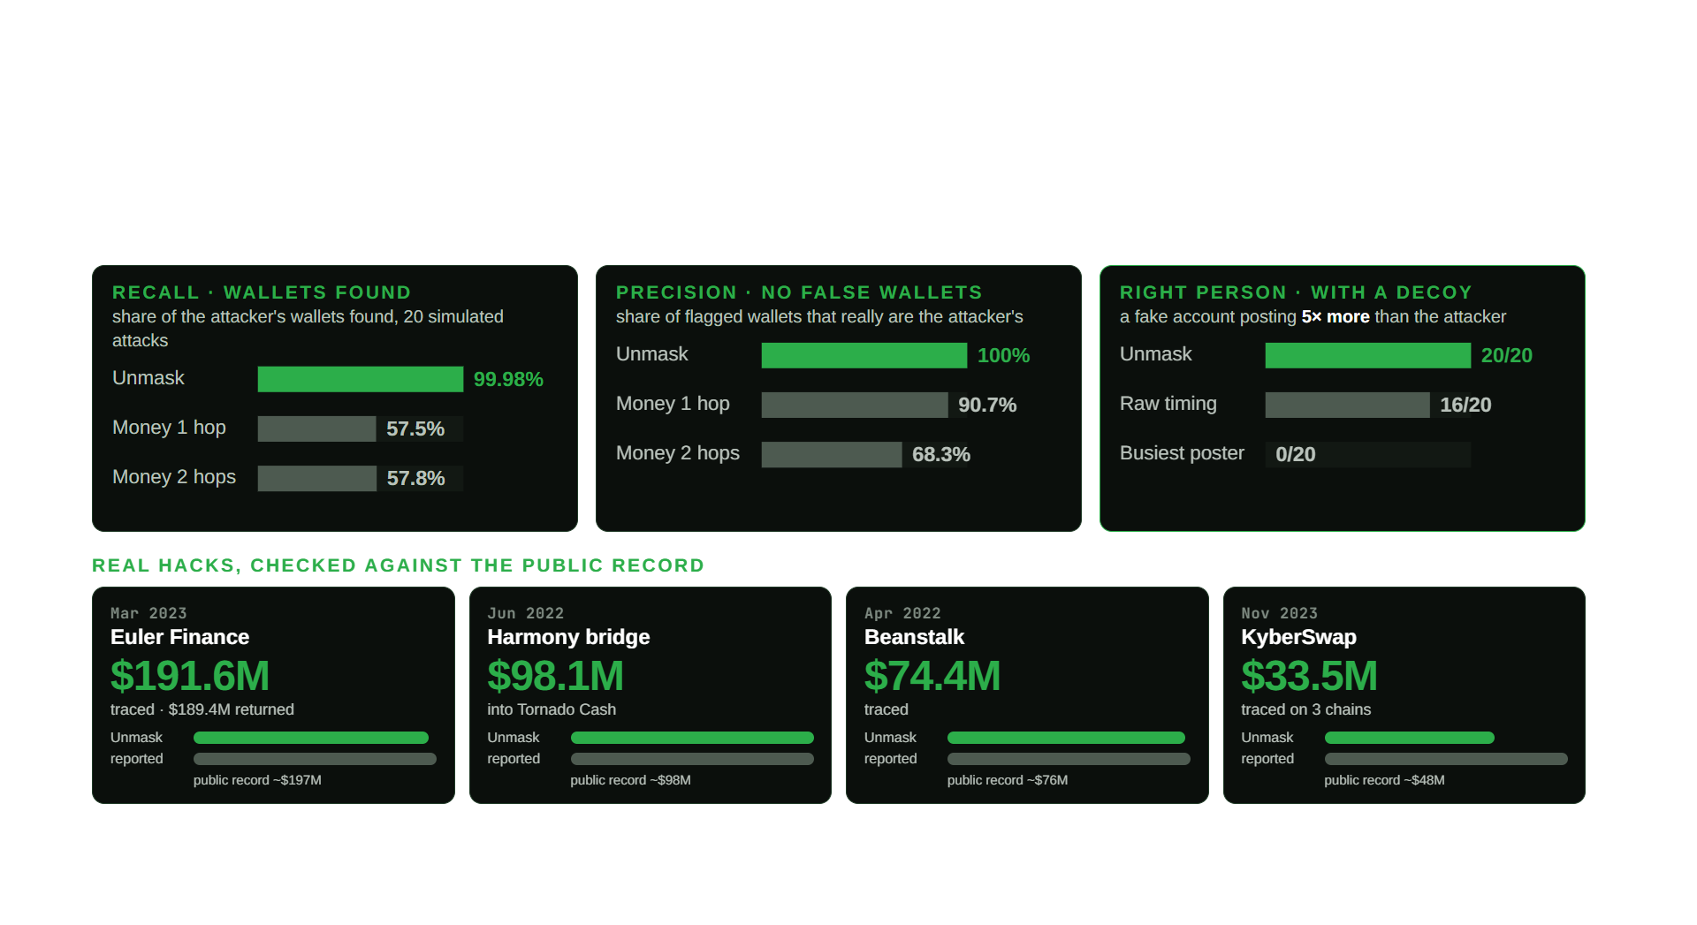
RESULTS

Slide 9
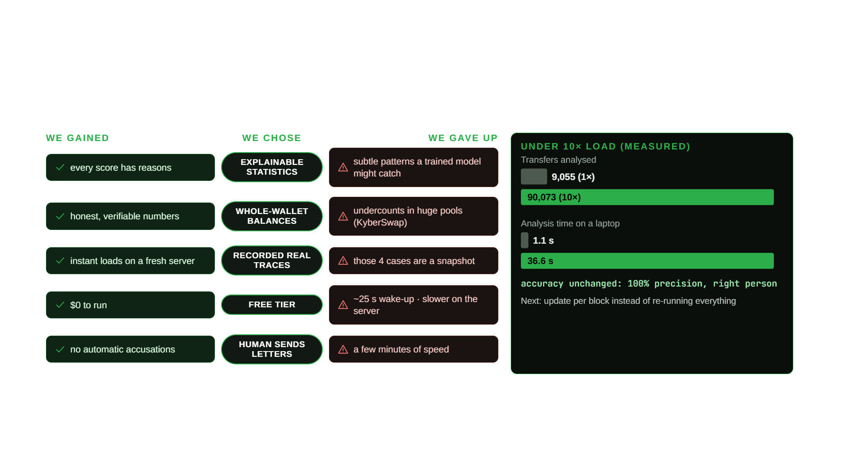
TRADE-OFFS

Slide 10
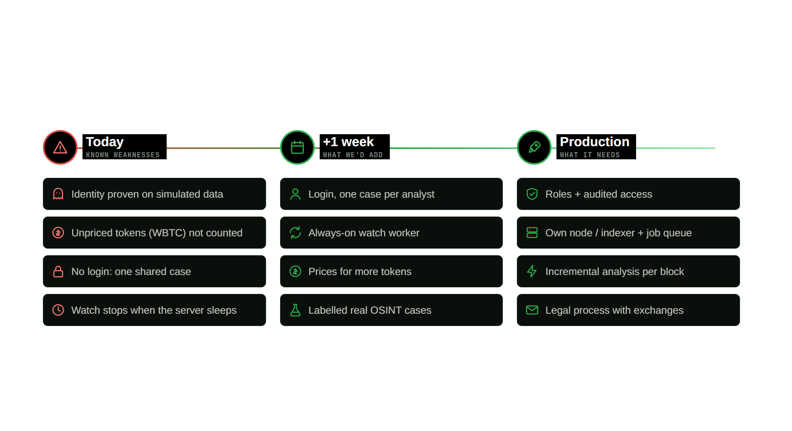
LIMITS AND NEXT STEPS

