Slide 1
Update: Data analyses Tracking-Task A and B
25.08.2022

Slide 2
Wavelet analysis & cluster-based permutation test
Morlet wavelet: 5 cycles, length of wavelet kernel = 3 (same for all frequencies)
Frequencies: 1 to 35 Hz
Cluster based permutation test:
Monte-Carlo, 1000 iterations, alpha = 0.001, cluster alpha = 0.001
Until now only for theta and alpha band

Slide 3
Task A: trajectory segments
3 trajectory segments: random1, constant, random2 (each 3 seconds long)
Next slides: power calculated by wavelet analyses for each trajectory segment
+ difference between power in constant and both random trajectory segments (i.e. subtracted constant – random)

Slide 4
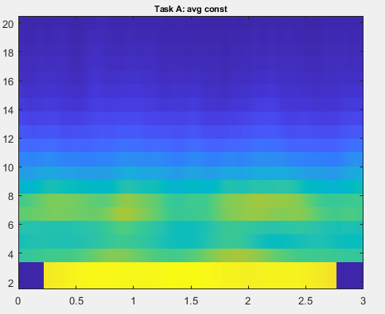
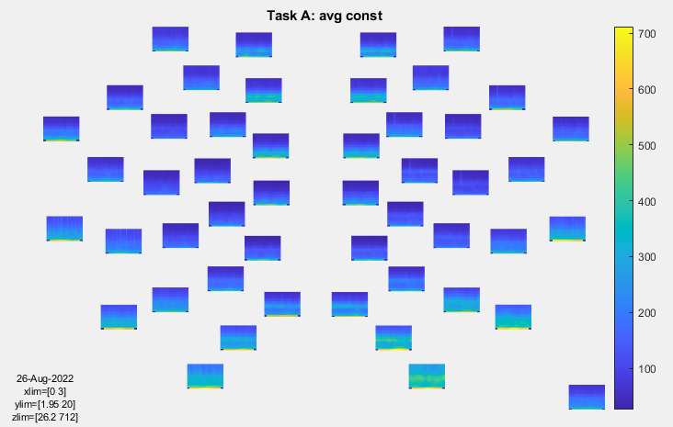
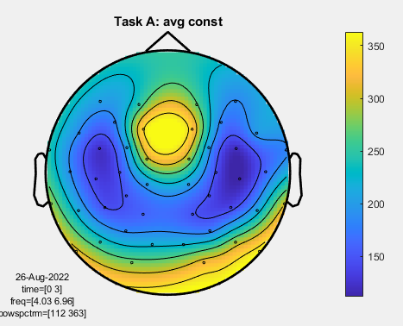
Constant trajectory
Only frontal electrodes, 1-20 Hz
All electrodes across constant traj, 1-20 Hz
Topography: theta

Slide 5
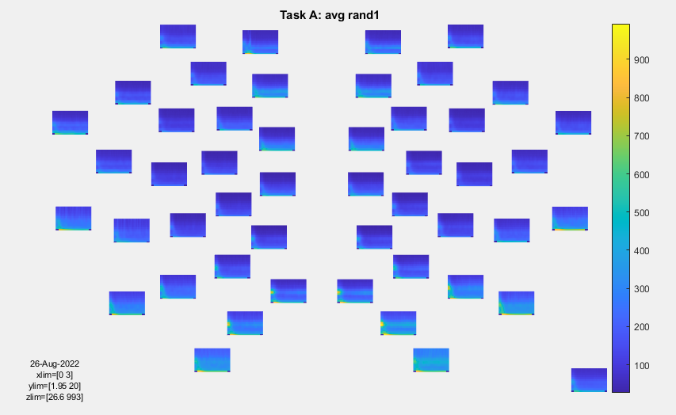
Random trajectory 1 (trial start)
All electrodes across rand1 traj, 1-20 Hz

Slide 6
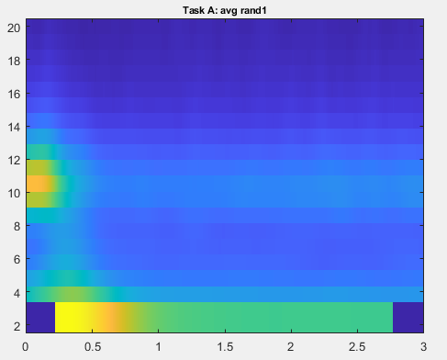
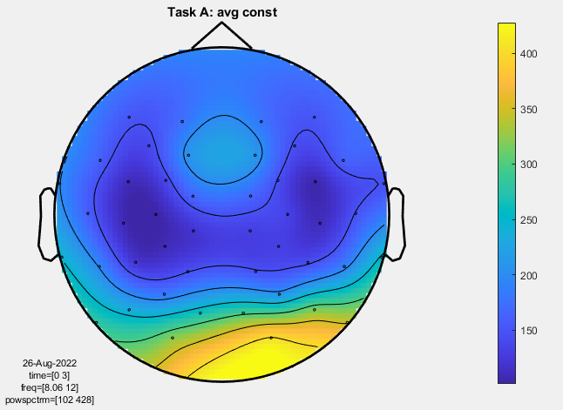
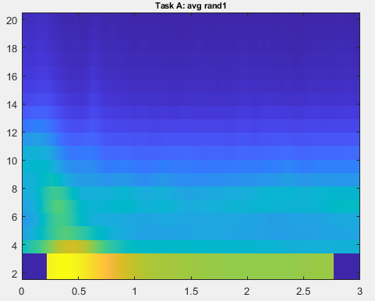
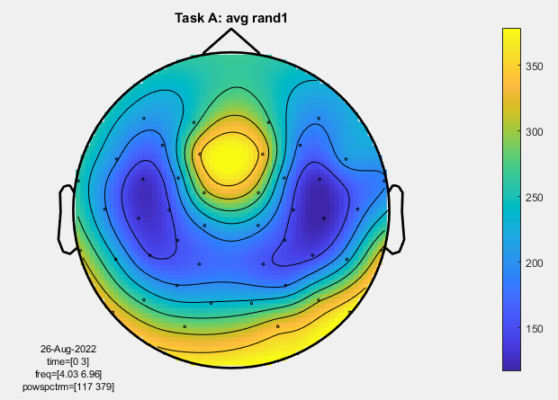
Topography: alpha
Topography: theta

Slide 7
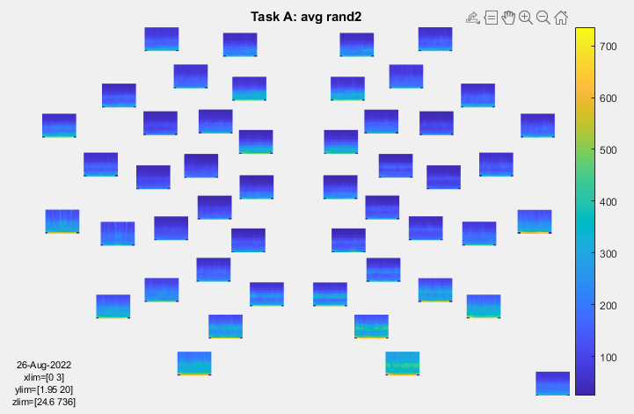
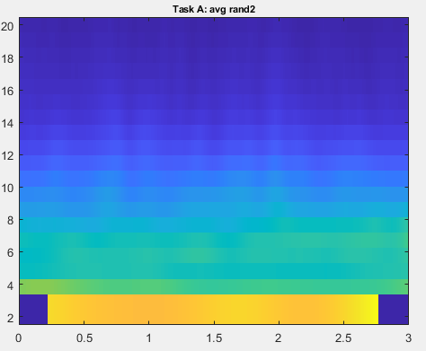
Random trajectory 2 (trial end)

Slide 8
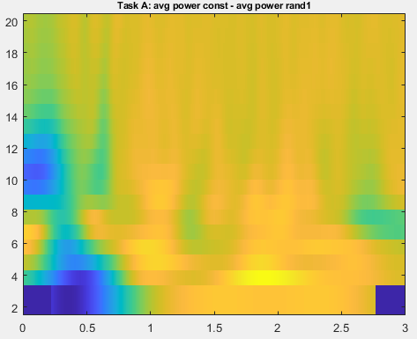
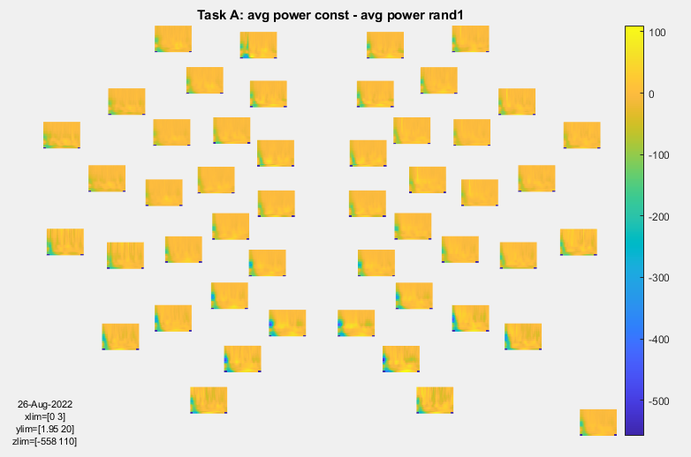
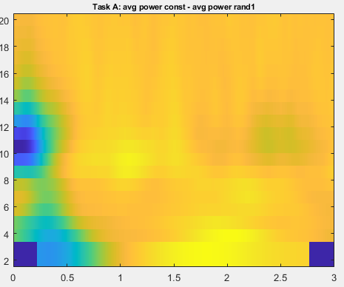
Difference: constant – rand1

Slide 9
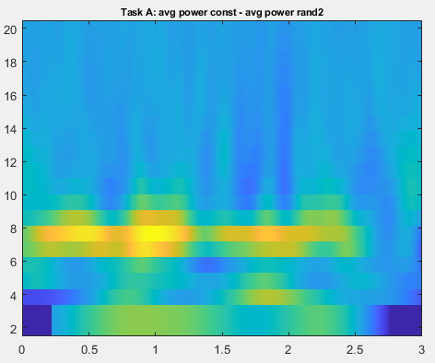
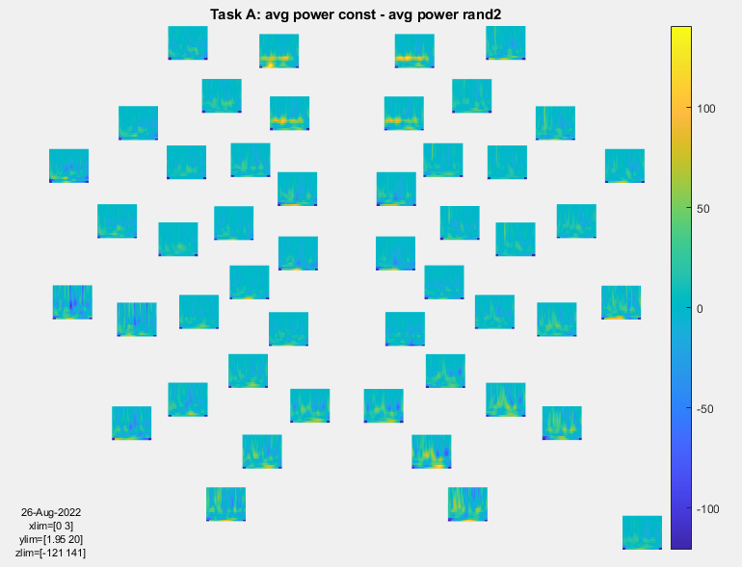
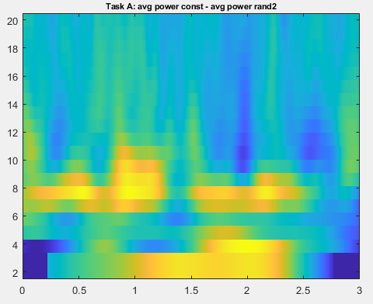
Difference: constant – rand2

Slide 10
Cluster-based permutation test: Task A
Cluster alpha = 0.001
Alpha = 0.001
Constant vs. random 1:
Significant difference in theta band: 5 negative clusters (sig)
Significant difference in alpha band: 9 negative clusters (sig)
Constant vs. random 2:
Significant difference in theta band: 1 pos cluster (sig)
Significant difference in alpha band: 1 pos cluster (sig),
Random 1 vs. random 2:
No significant difference in theta band
No significant difference in alpha band

Slide 11
Task B: occlusion and non-occlusion
Several occlusion-segments per trial, each 2 seconds long + non-occluded, i.e. visible, segments (also 2 seconds)
Next slides: power calculated by wavelet analyses for each segment on average
+ difference between power in occluded and visible trajectory segments (i.e. subtracted occluded – visible)

Slide 12
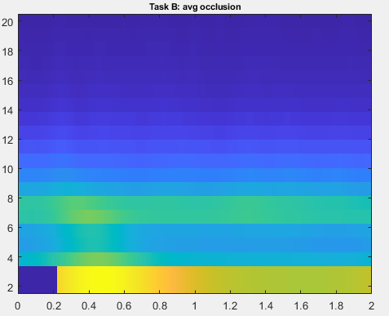
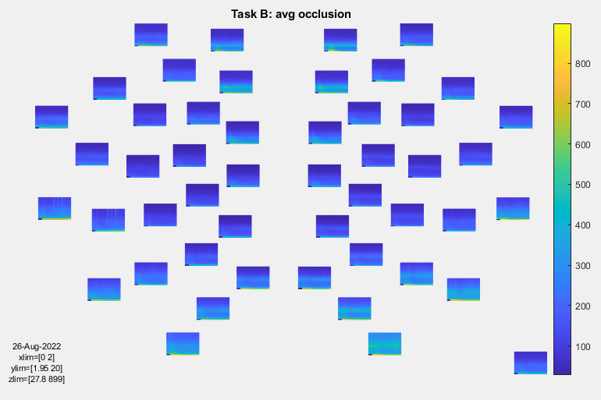
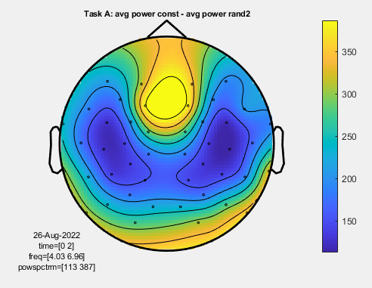
Occluded target
Topography: theta

Slide 13
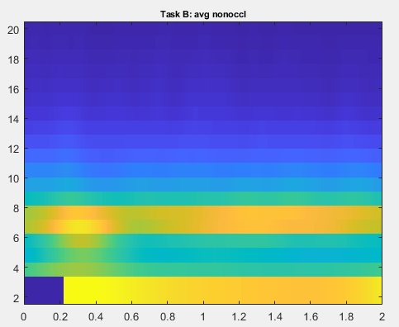

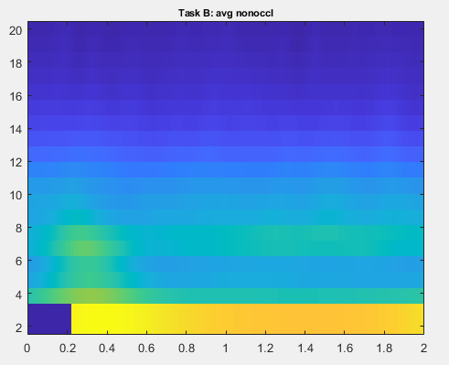
Visible target

Slide 14
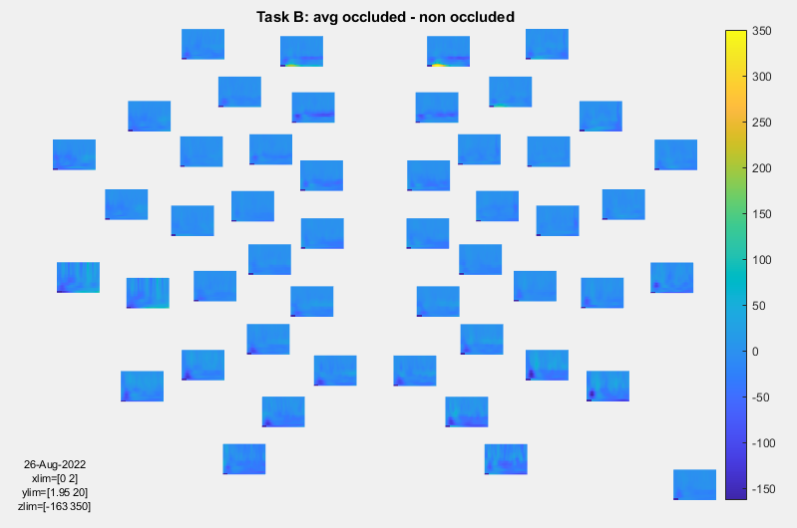
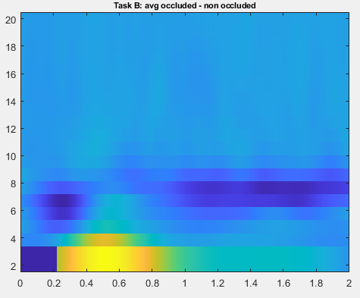
Difference occluded - visible

Slide 15
Cluster-based permutation test: Task B
Cluster alpha = 0.001
Alpha = 0.001
Occlusion vs. non-occlusion:
Significant difference in theta band: 2 negative clusters (sig)
No significant difference in alpha band

