Slide 1
Update: Data analyses Tracking-Task A and B
31.08.2022

Slide 2
Preprocessing
FPz as reference electrode
Downsampling to 250 Hz
Highpass filter for 1 Hz
Remove line noise at 50 Hz
Remove bad channels (flat, minimum channel correlation)
Lowpass filter 40 Hz
Interpolate bad channels
Rereference to average
Merge data for task A & B: for ICA, epoch data, detrending, artifact rejection
run ICA (extended infomax algorithm)
Iclabel: keep only those Ics that are labelled as neural component with at least 0.5 probability
Visual checks of remaining components
Parallelize behavioral and EEG data → add triggers etc.
Epoch data: 1) for whole trial (-1 13) → baseline correction for fixcross interval (-750 0)
2) -1 4 for task A and B, later reduced to relevant time interval
Artifact rejection for segments

Slide 3
Wavelet analysis & cluster-based permutation test
Morlet wavelet: 5 cycles, length of wavelet kernel = 3 (same for all frequencies)
Frequencies: 1 to 35 Hz
Cluster based permutation test:
Monte-Carlo, 1000 iterations, alpha = 0.001, cluster alpha = 0.001
For alpha, beta and theta band
Averaged in frequency dimension, not in time dimension

Slide 4
Task A: trajectory segments
3 trajectory segments: random1, constant, random2 (each 3 seconds long)
Next slides: power calculated by wavelet analyses for each trajectory segment
+ difference between power in constant and both random trajectory segments (i.e. subtracted constant – random)

Slide 5
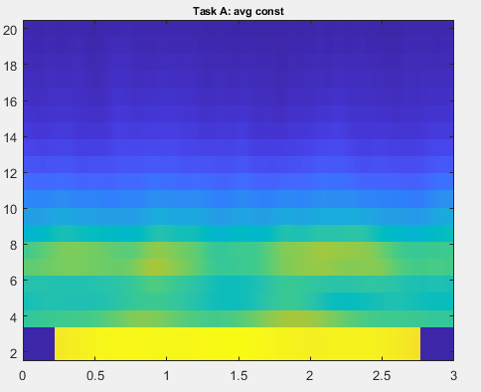
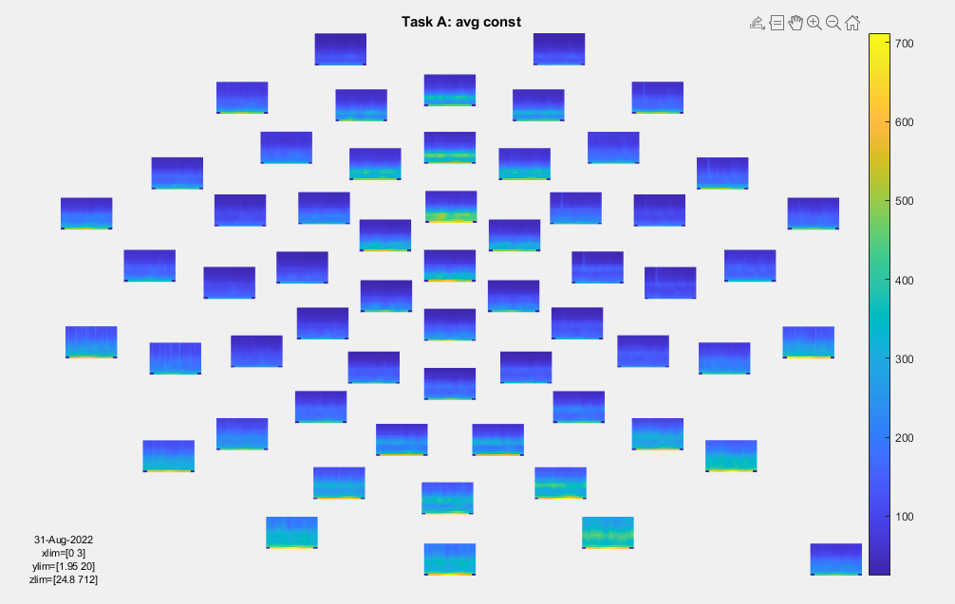
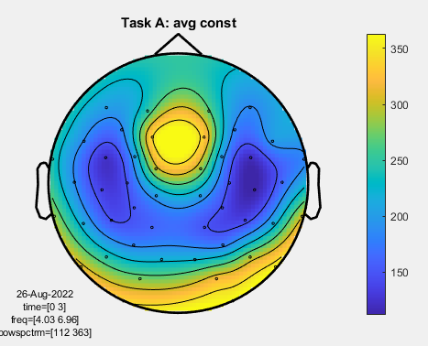
Constant trajectory
All electrodes across constant traj, 2-20 Hz
Topography: theta

Slide 6
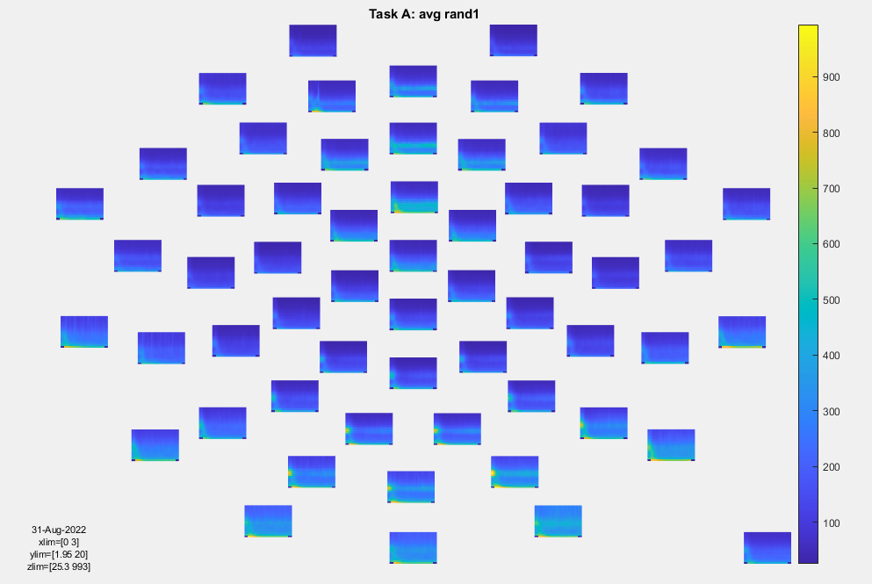
Random trajectory 1 (trial start)
All electrodes across rand1 traj, 2-20 Hz

Slide 7
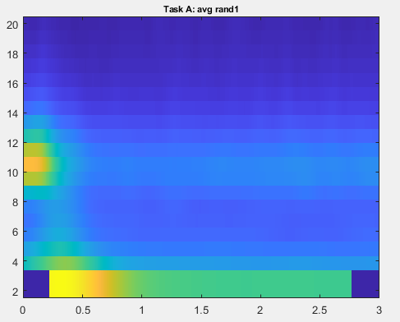
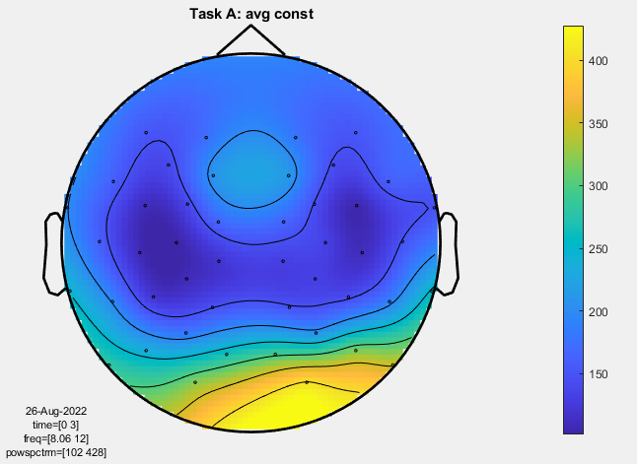
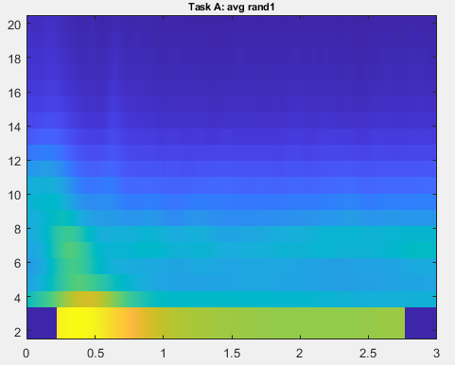
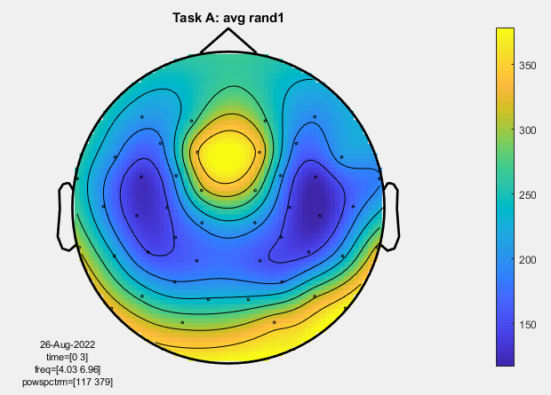
Topography: alpha
Topography: theta

Slide 8
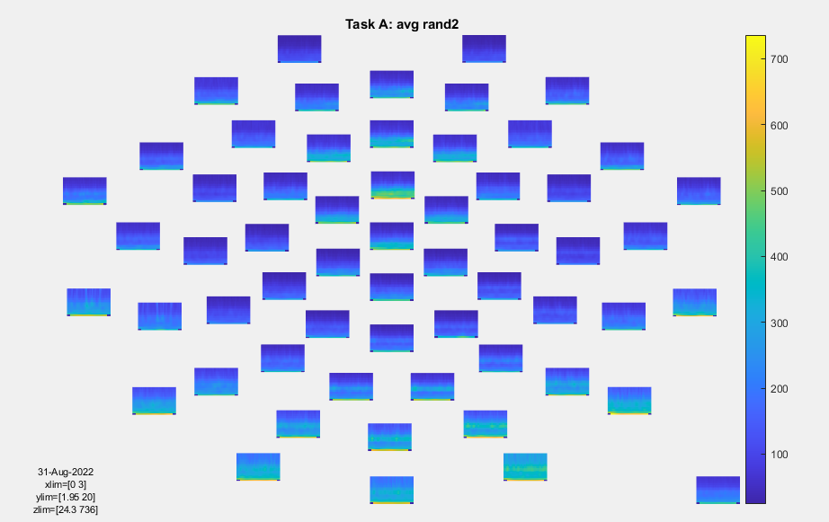
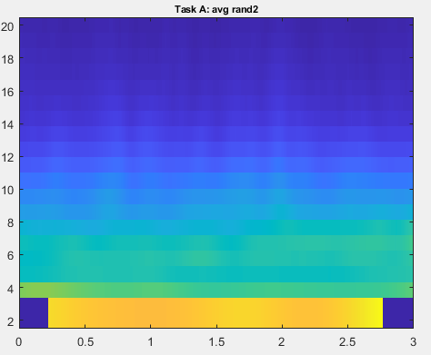
Random trajectory 2 (trial end)

Slide 9
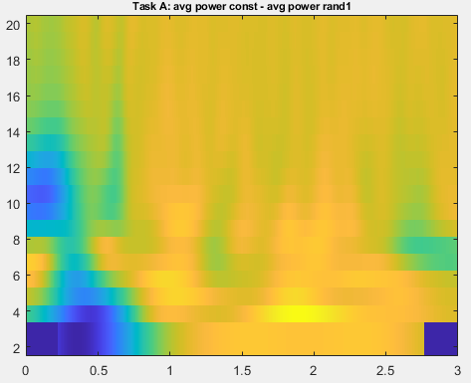
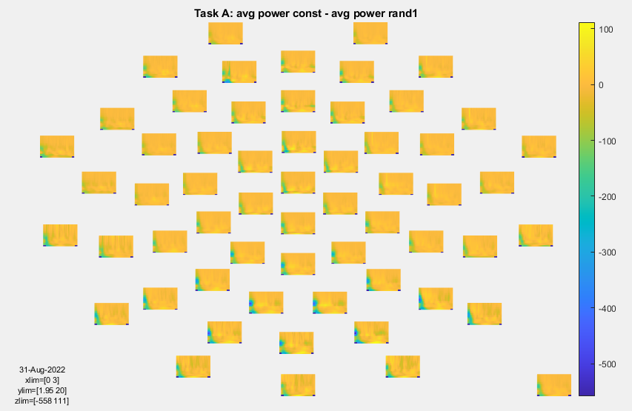
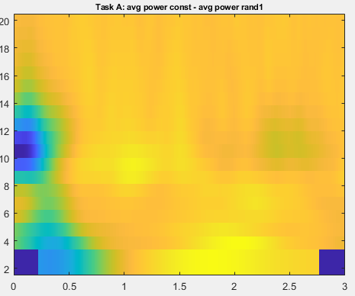
Difference: constant – rand1

Slide 10
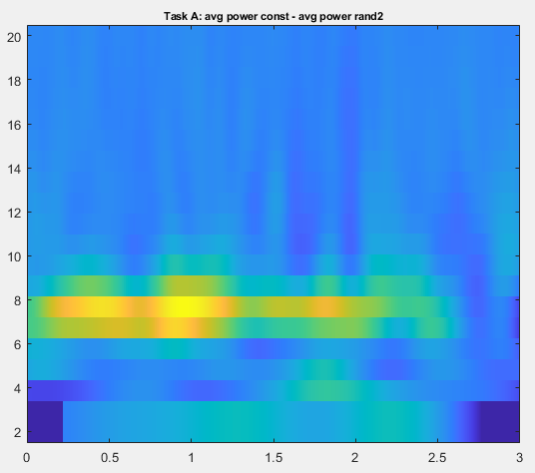
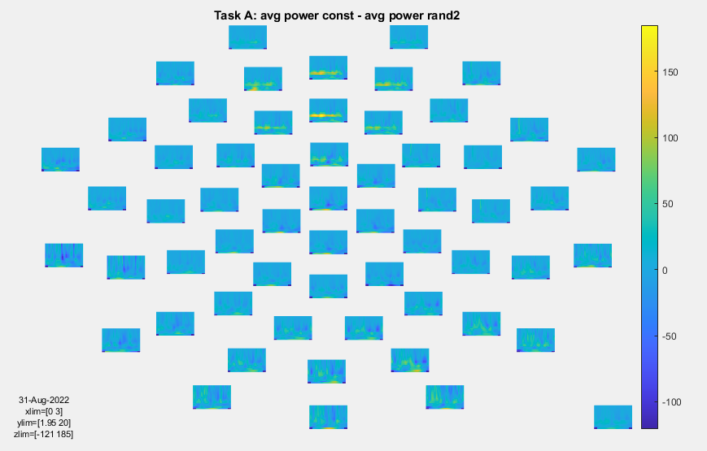
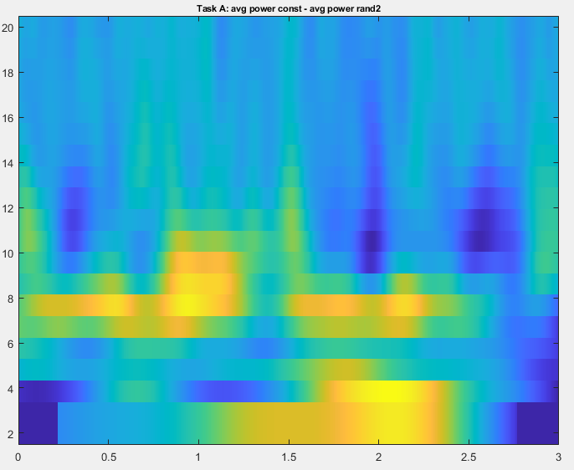
Difference: constant – rand2

Slide 11
Cluster-based permutation test: Task A, averaged across frequencies
Cluster alpha = 0.001
Alpha = 0.001
Constant vs. random 1:
Significant difference in theta band: 1 sig. negative clusters
Significant difference in alpha band: 7 sig. negative clusters
Significant difference in beta band: 1 sig. negative cluster
Constant vs. random 2:
Significant difference in theta band: 1 sig. positive cluster
Significant difference in alpha band: 2 sig. positive cluster
Significant difference in beta band: 1 sig. positive cluster
Random 1 vs. random 2:
No significant difference in theta band
No significant difference in alpha band
No significant diference in beta band

Slide 12
Task B: occlusion and non-occlusion
Several occlusion-segments per trial, each 2 seconds long + non-occluded, i.e. visible, segments (also 2 seconds)
Next slides: power calculated by wavelet analyses for each segment on average
+ difference between power in occluded and visible trajectory segments (i.e. subtracted occluded – visible)

Slide 13
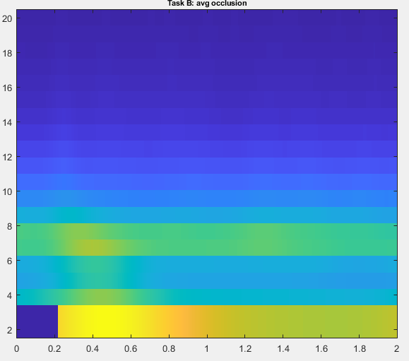
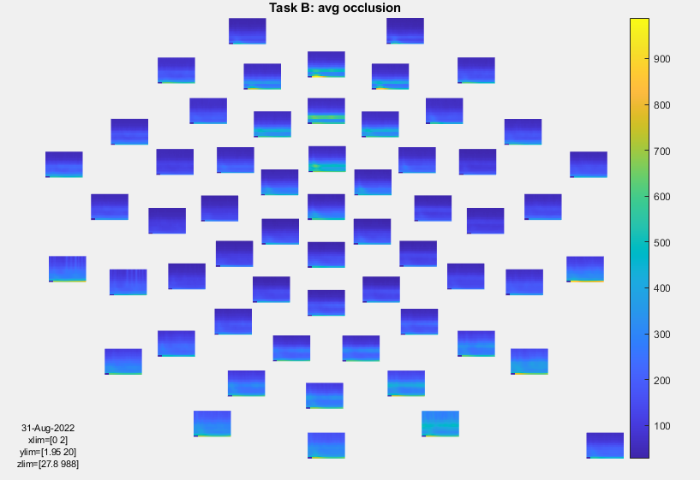
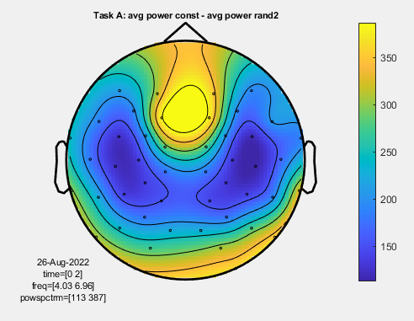
Occluded target
Topography: theta

Slide 14
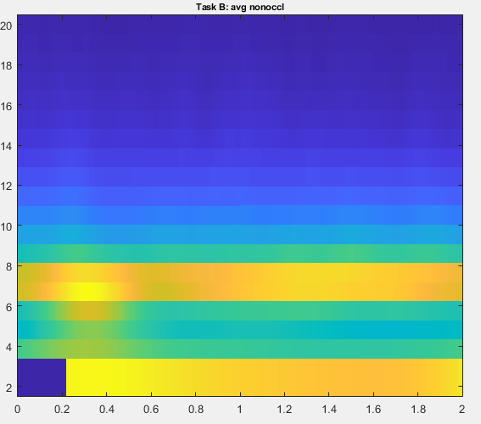
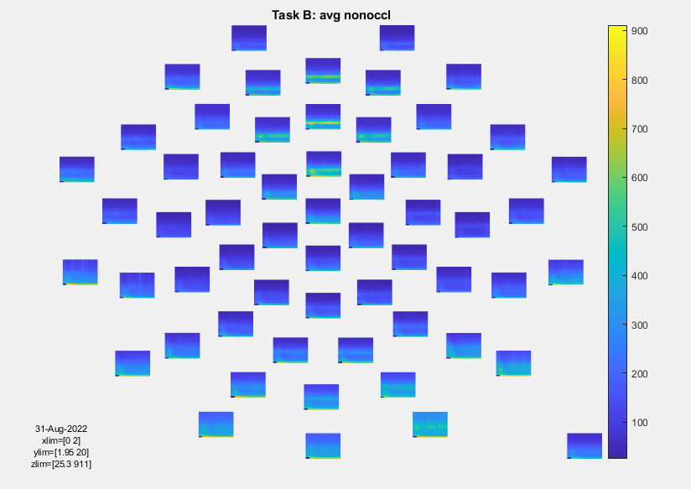
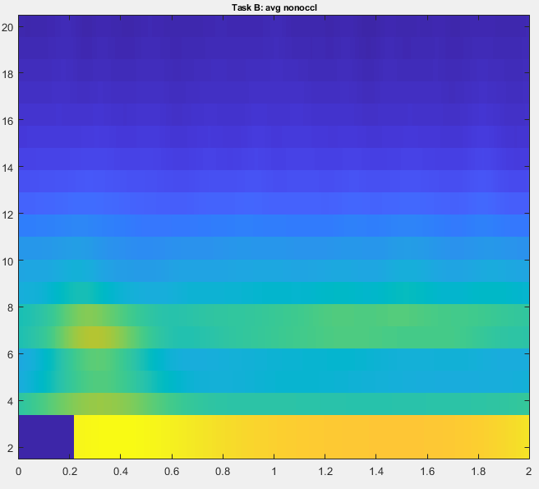
Visible target

Slide 15
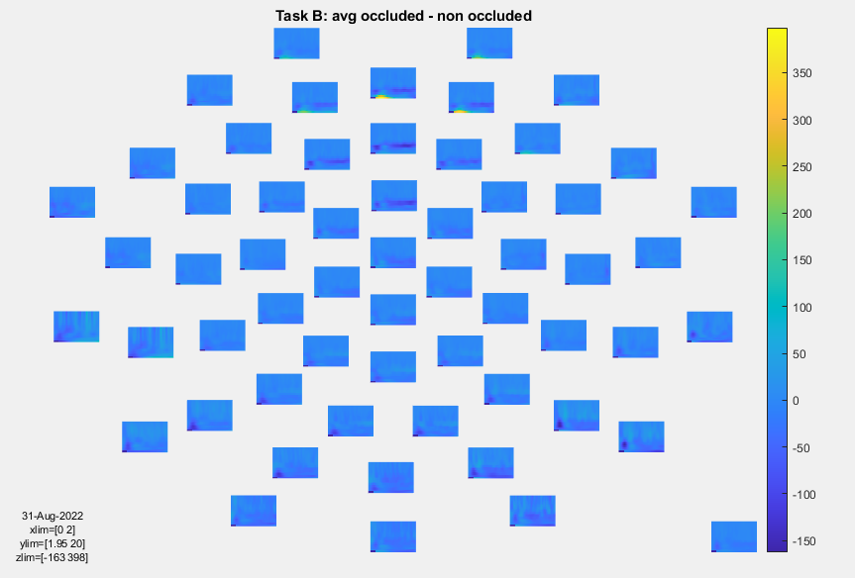
Difference occluded - visible

Slide 16
Cluster-based permutation test: Task B
Cluster alpha = 0.001
Alpha = 0.001
Occlusion vs. non-occlusion:
Significant difference in theta band: 1 sig. negative cluster
No significant difference in alpha band
No significant difference in beta band

Slide 17
Next steps
Delta band activity → potentially just a filter artifact? (high-pass filtered for 1 Hz)
Change high-pass filter?
Dynamic parameters (depending on frequency) for wavelet analysis?
Determine significant time windows in CBPT to analyse with DICS beamformer

