Slide 1
Project work – 1
game development

Slide 2




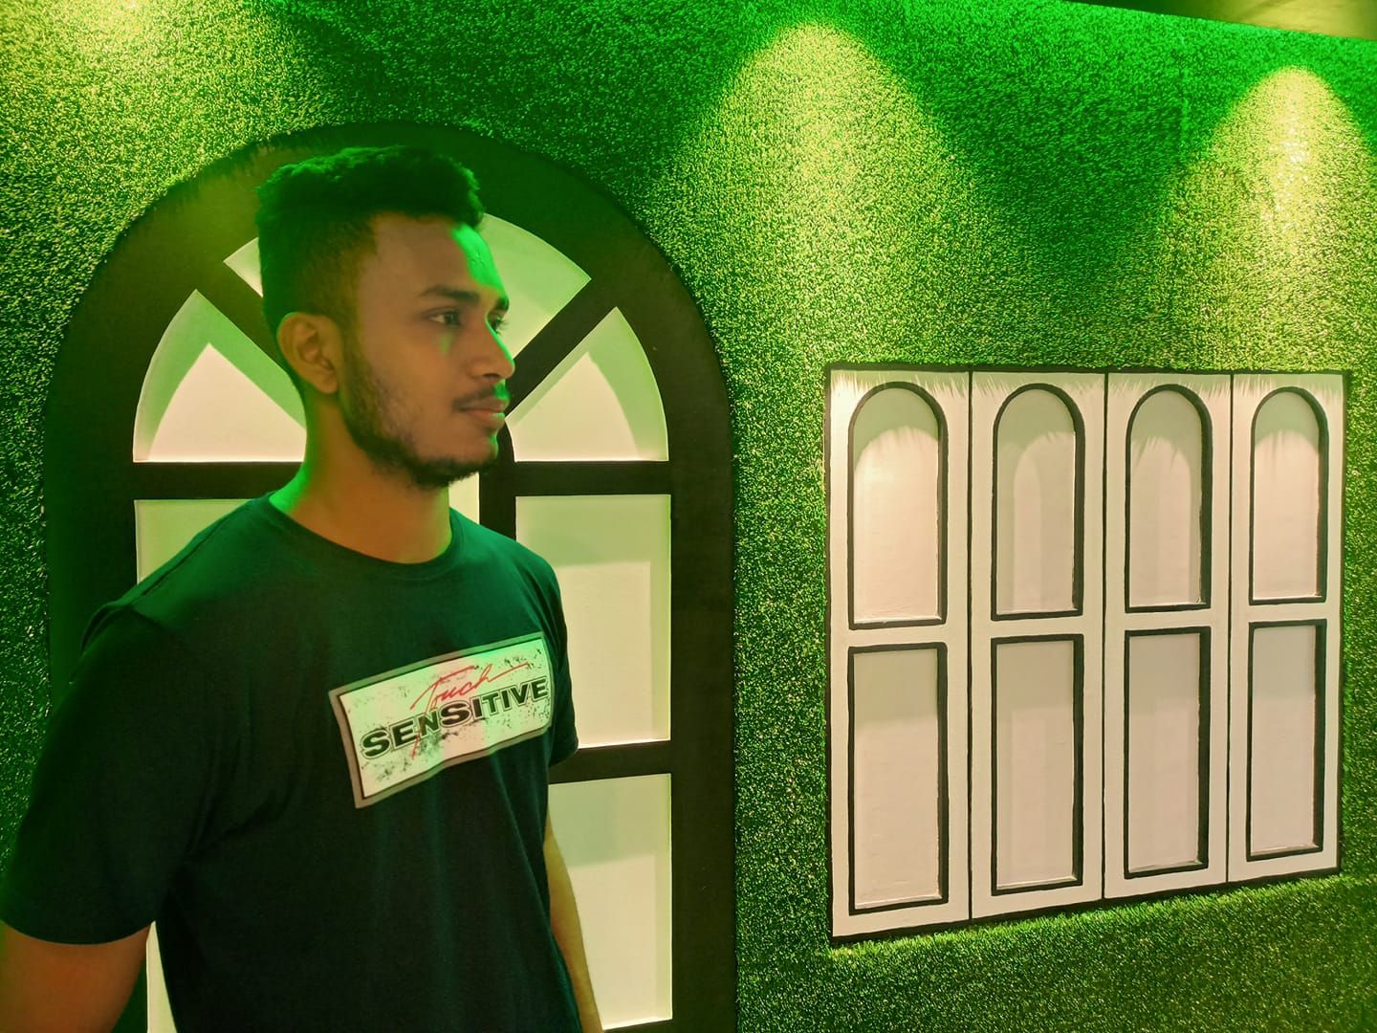

SUBMITTED TO:
DR. AHSAN HABIB
ASSISTANT PROFESSOR | IICT | SUST
TEAM ASPHALT
SUBMITTED BY:
BIJON SAHA
SHAIKH IFAZ AIMAN
HAMIM RAHMAN
MD TUSHER IMRAN MASHRAFI
ASHRAFUR RAHMAN CHY
2019831007
2019831031
2019831034
2019831069
2019831070

Slide 3
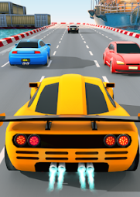
Dodge and drive

Slide 4
INTRODUCTION TO OUR GAME
We’ve come up with a game named “Dodge and Drive” using SFML (Simple and Fast Multimedia Library).
This is a simple car game where many obstacles will appear in front of the racer car and we have to dodge the obstacle. If the obstacle can cover the height of the window then the scoring variable will be incremented by 1. After crossing certain score-boundaries, the game speed increases making it harder. I hope you’ll like our game.

Slide 5

What is sfml ?
Sfml stands for Simple and Fast Multimedia Library. It is a cross-platform software development library which is an object oriented SDL. SFML is implemented in C++.
SFML is divided into 5 modules:
System provided by sfml-system
Window provided by sfml-window
Graphics provided by sfml-graphics
Audio provided by sfml-audio
Network provided by sfml-network

Slide 6
Objects we used
We have used a background image of racing track. We also used an image for our racer car and different colored obstacle cars. We have used a game-over screen as well. When the racer car gets hit by any obstacle, a troll photo pops up along with the game-over screen. Different sounds have also been attached to different scenarios corresponding to the incidents.

Slide 7
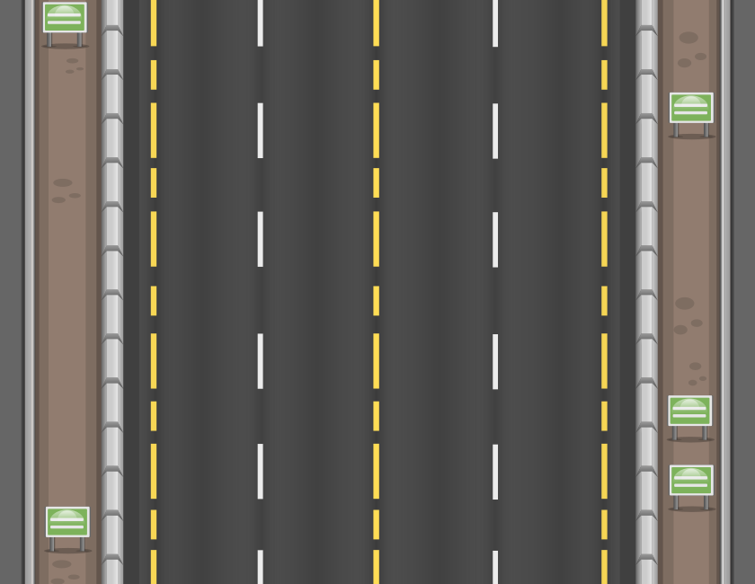
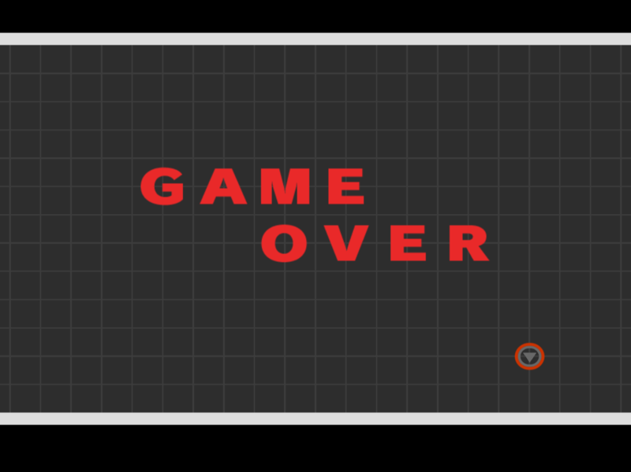






images of objects we used
OBSTACLES
TRACK
GAME OVER
RACER
TROLL

Slide 8
Objectives
At the beginning of the game ,we take control over the movement of the racer car. While moving forward many obstacles will come up and we have to DODGE them and DRIVE away to get as much score as possible. Every after certain points, the speed of the racer car will increase making it harder to dodge the obstacles.

Slide 9
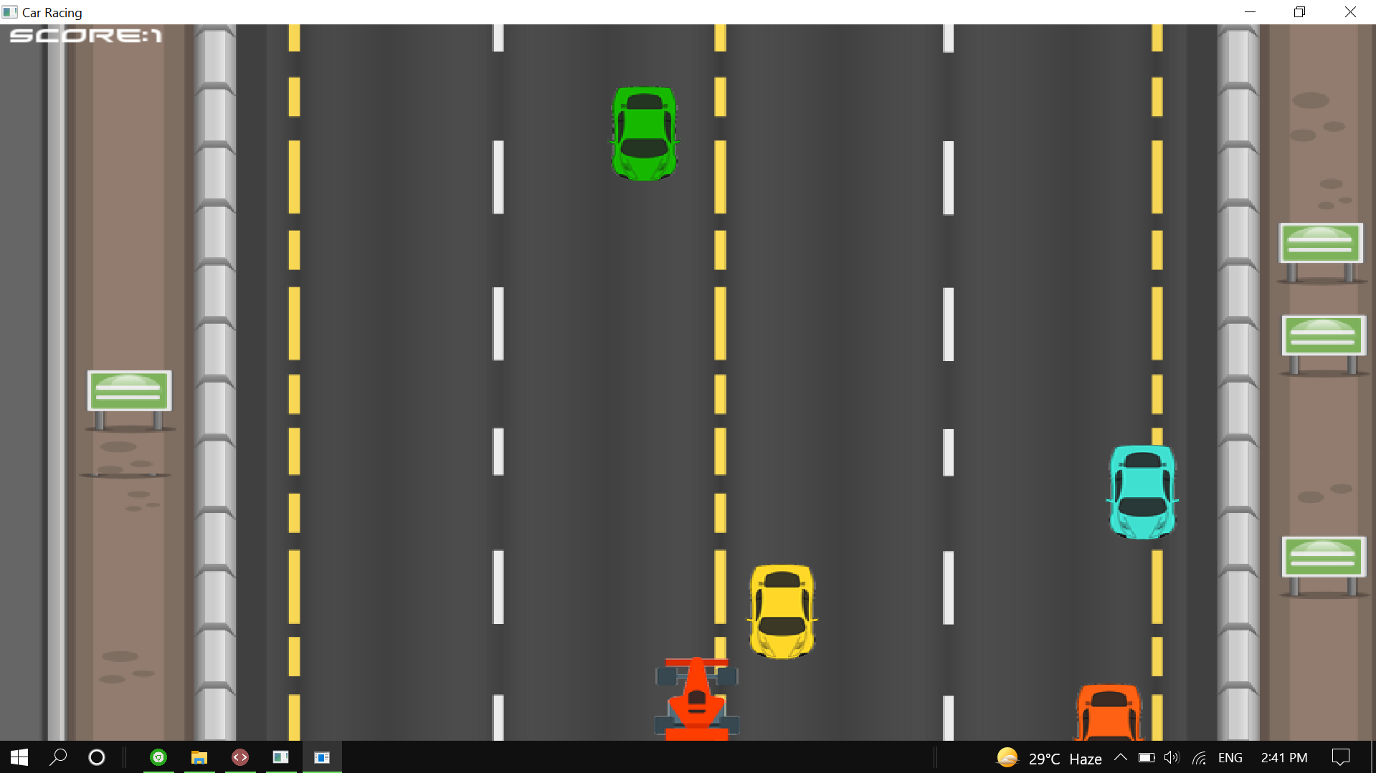
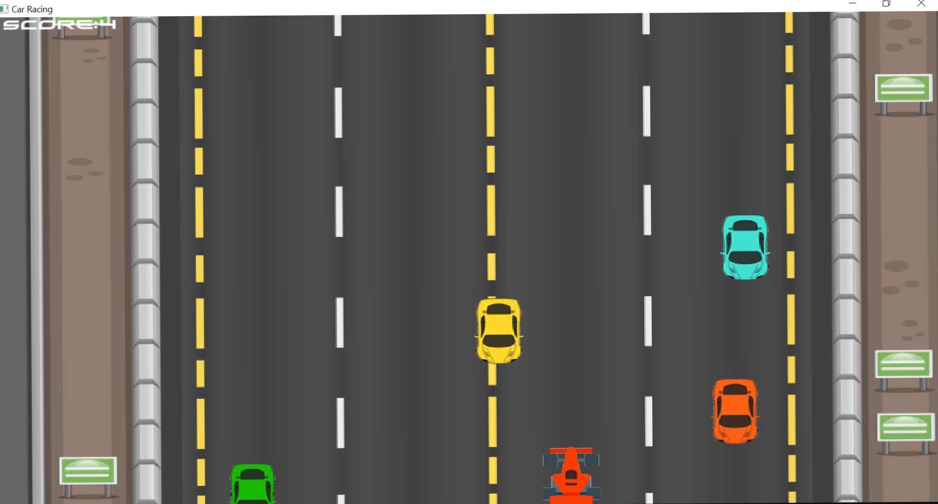
Different phases of the game

Slide 10
Limitations of the game AND ENDING
During the game, although we can dodge left to right, front to back and vice versa, we cannot maneuver the car in any direction we want . No matter how many obstacles may appear, the player has to keep dodging them as a single clash will put an end to the game. Thus a Game-over screen will pop up with a Troll image at the side and The player’s score will be recorded.

Slide 11
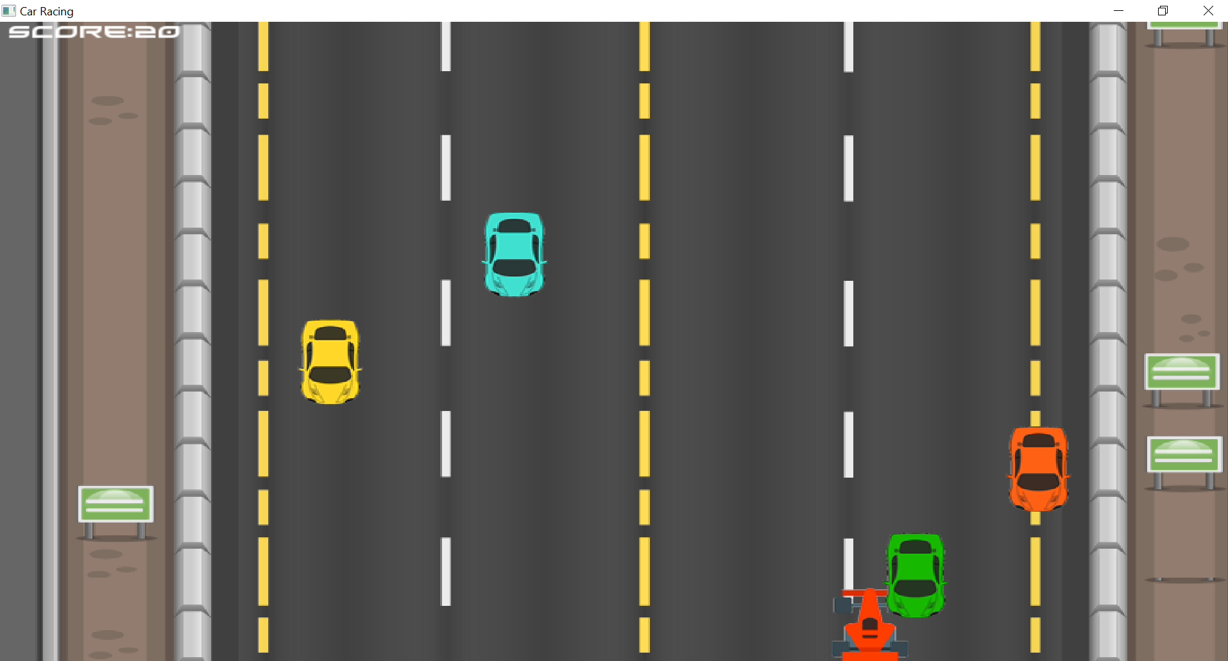
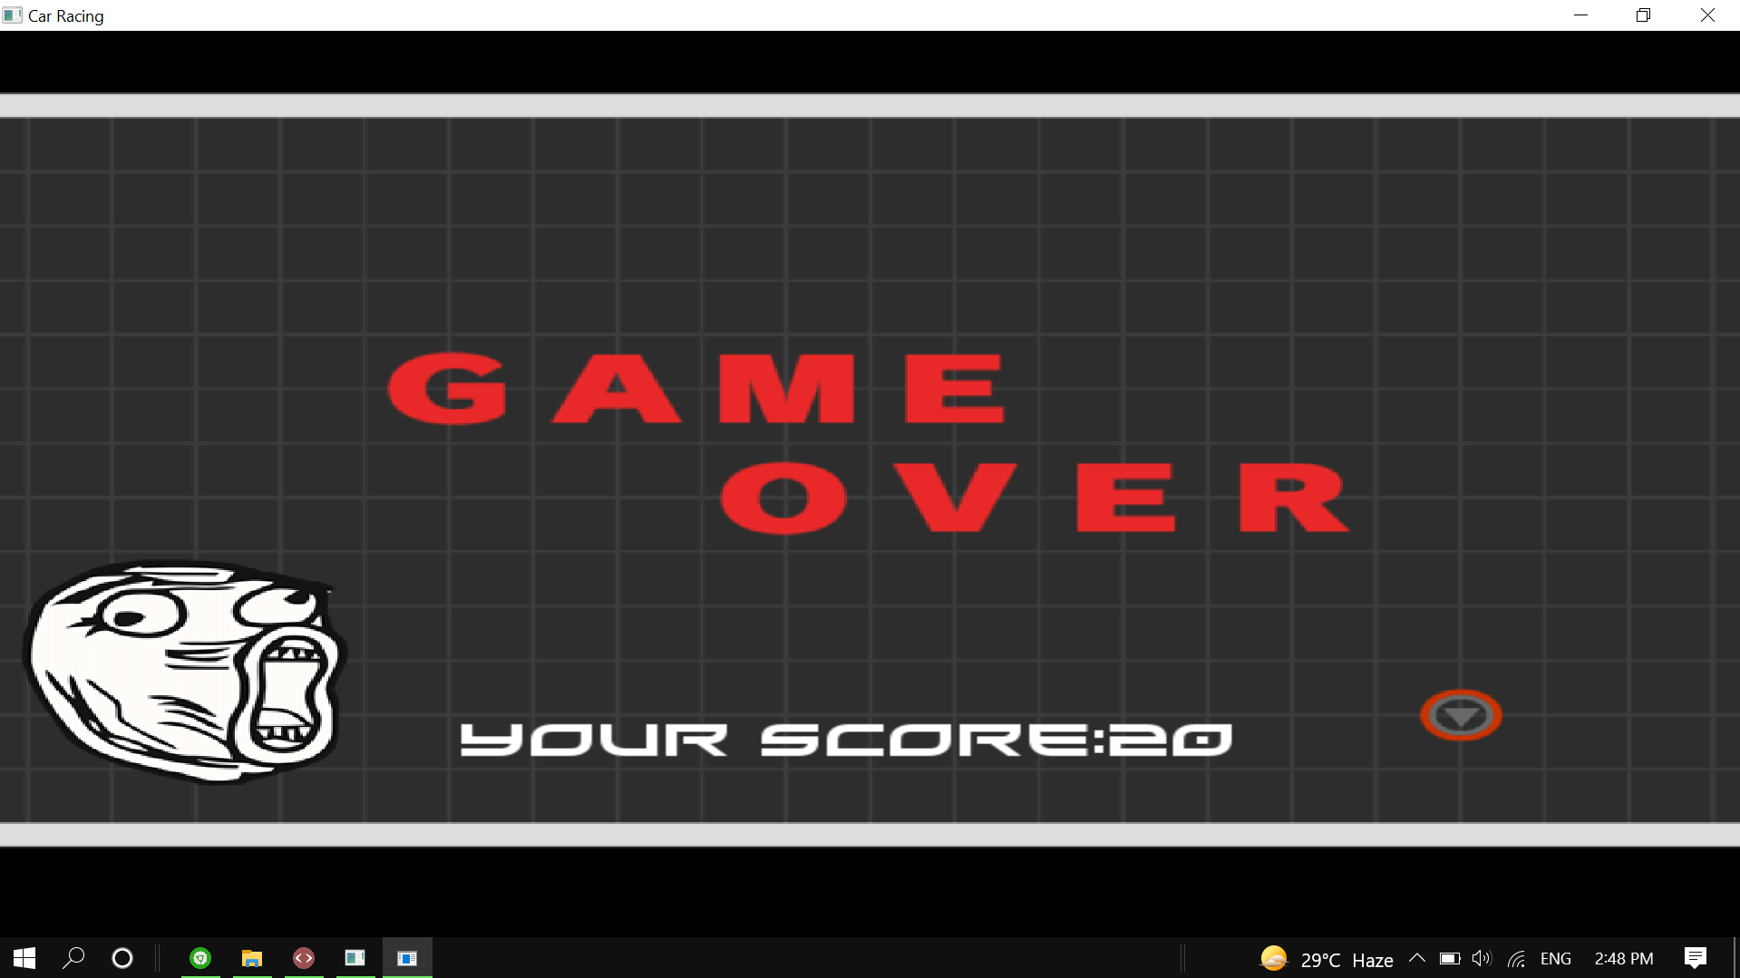
Visual representation of the limitations
IF RACER CAR TOUCHES ANY OBSTACLE
GAME OVER SCREEN

Slide 12
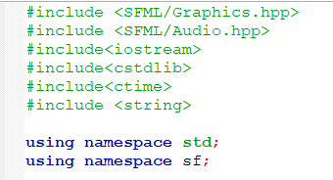
HEADER FILES

Slide 13
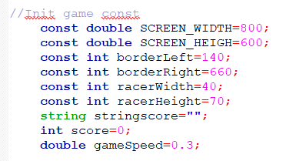
INITIALIZATION OF GAME CONST

Slide 14
RENDERING THE WINDOW

Slide 15
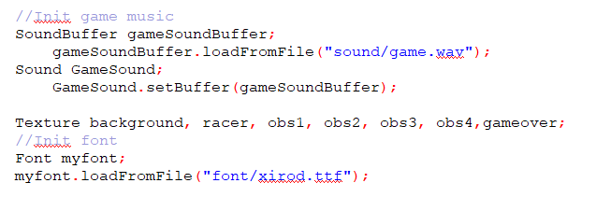
INITIALIZATION OF GAME MUSIC AND FONT

Slide 16
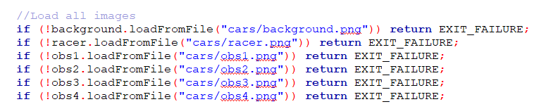
LOAD ALL IMAGES

Slide 17
CREATE SPRITE

Slide 18
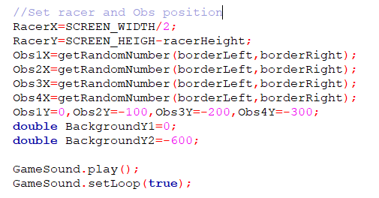
SET RACER AND OBSTACLES POSITION

Slide 19
SET RACER AND OBSTACLES POSITION

Slide 20
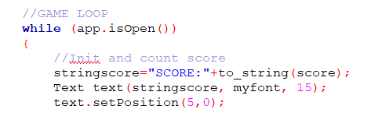
GAME LOOP: INITIALIZATION AND COUNT SCORE

Slide 21
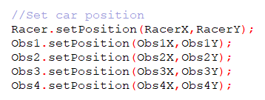
SET CAR POSITION

Slide 22
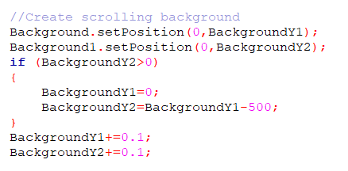
CREATE SCROLLING BACKGROUND

Slide 23
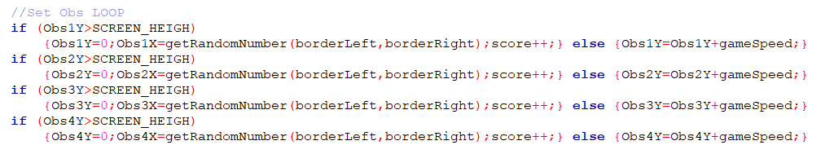
SET OBSCTACLES LOOP

Slide 24
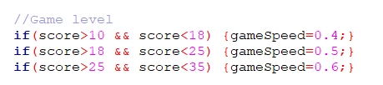
GAME LEVEL

Slide 25
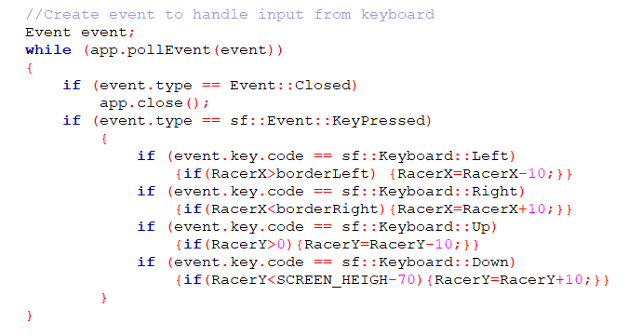
EVENT LOOP

Slide 26
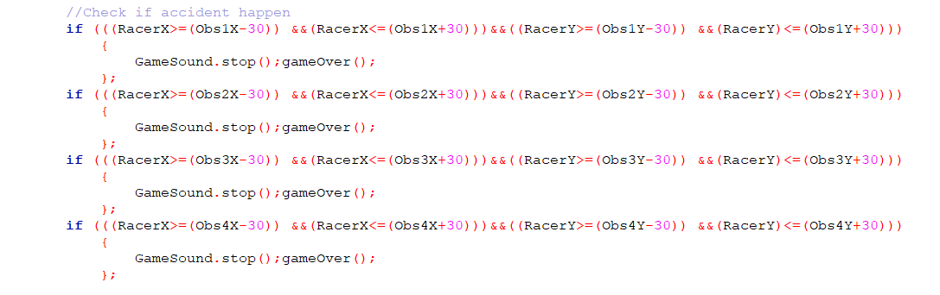
ACCIDENT

Slide 27
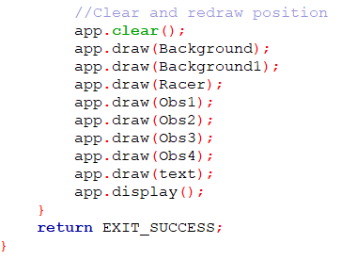
CLEAR AND REDRAW POSITION

Slide 28
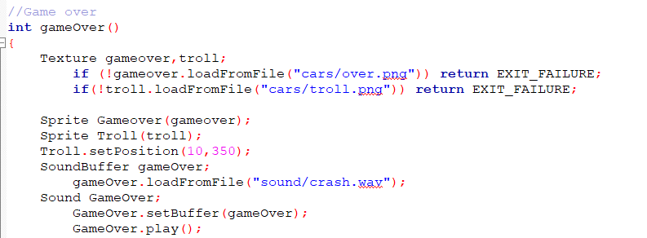
GAME OVER FUNCTION

Slide 29
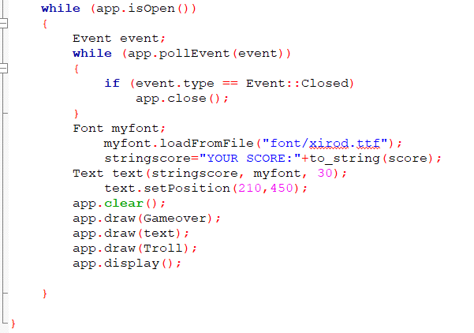
OUTPUTING THE SCORE WHEN GAME IS OVER

Slide 30
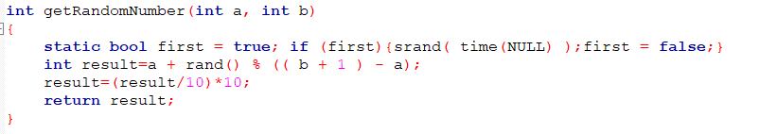
RANDOM NUMBER GENERATOR

Slide 31
CONCLUSION
Why we chose this game ?
Because this game is quite easy to implement for a beginner using C++. Besides, before the arrival of smartphones and modern developed games, we used to play these type of games.
Why we chose to use SFML ?
SFML provides a simple interface to the various components of your PC, to ease the development of games and multimedia applications. There isn't a "better" one. SFML can do more stuff without outside libraries.

Slide 32
THANKS
KEEP APPRECIATING!

