Slide 1

Blood Bank Management System
Sagar Bohara
2417791

Slide 2


Project Overview
Web application for donor registration, blood requests, and admin management
Helps manage blood bank efficiently and saves lives

Slide 3
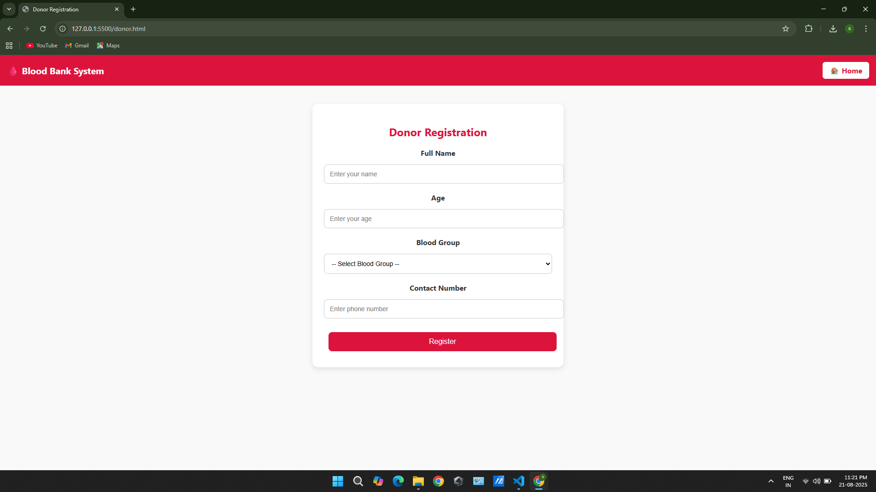
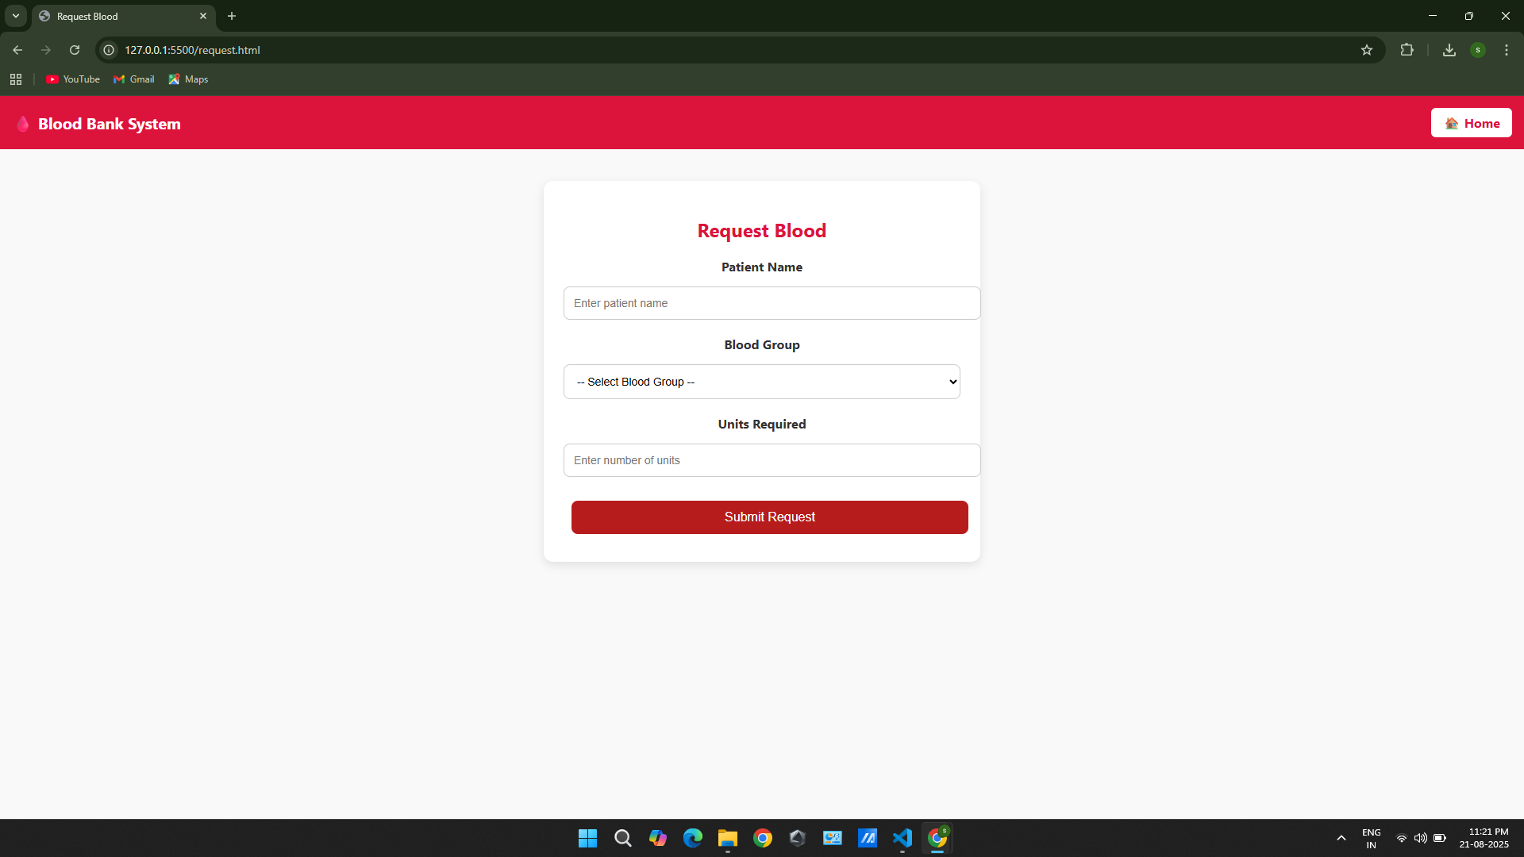
Features
Donor registration
Blood request form
Admin dashboard with real-time updates
Responsive design and home navigation

Slide 4
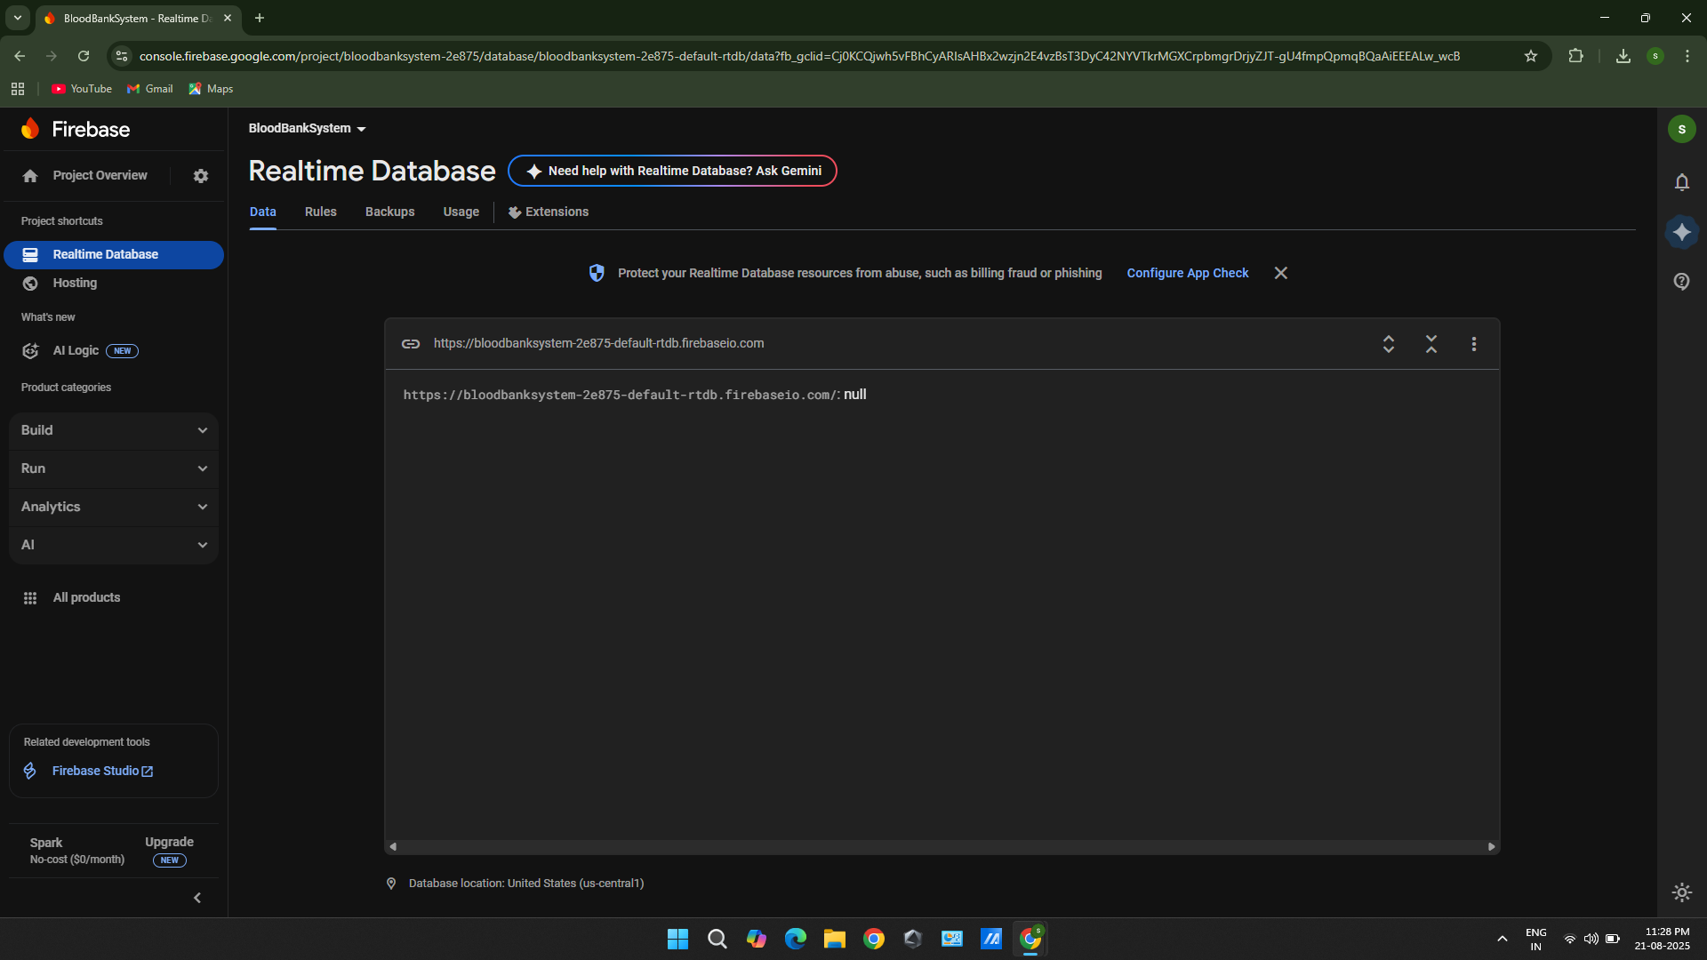
Technologies
HTML, CSS, JavaScript for frontend
Firebase Realtime Database for backend
Real-time updates without server-side code

Slide 5
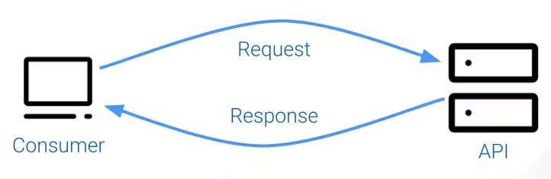
Data Flow
User fills donor/request form
Data pushed to Firebase
Admin dashboard fetches and displays data in real-time

Slide 6
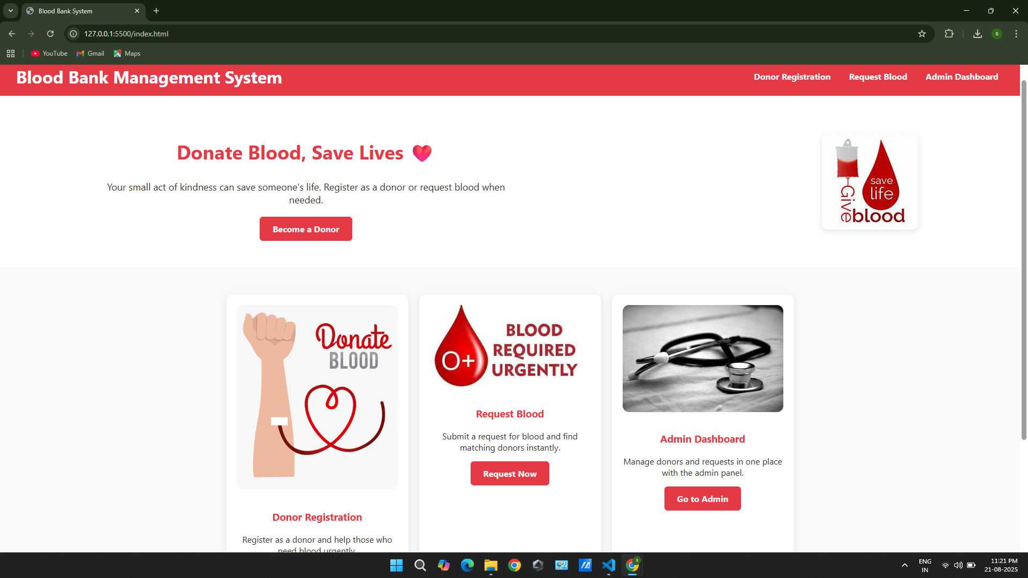
UI / UX
Modern CSS: cards, containers, buttons
Flexbox and media queries for mobile responsiveness

Slide 7

Admin Dashboard & Functionality
Shows all donors and requests
Data fetched in real-time using Firebase onValue
Contact, blood group, units, patient name displayed

Slide 8
Coding / Integration
Import Firebase modules in JS
Initialize Firebase using firebaseConfig
Use push for saving data, onValue for fetching data
Forms differentiated by IDs: donorForm, requestForm

Slide 9
Testing & Demo
Tested multiple donor registrations and blood requests
Verified real-time updates on admin dashboard
Firebase handles multiple users simultaneously

Slide 10

Future Enhancements
Admin authentication & login
Notifications for donors
Search Nearest & filter donors

Slide 11
Thankyou!

