Slide 1

TKR college of Engineering & Technology
Autonomous
Final project review on
AN EFFICIENT TRAFFIC MONITORING
AND IDENTIFICATION BASED ON
CATEGORISATION IN INTERNET ACCESS
BATCH NO-D11
GUIDED BY-Dr.S.A. KALAISELVAN
TEAM-
SEELAM GOYAL
SAACHI JAISWAL
VADYAVATH RAMU
YELLANKI SAI KIRAN KUMAR REDDY

Slide 2
ABSTRACT
With the growth in the amount of devices associated with the internet; the data that is getting circulated over the internet is also increasing.
It is an undeniable fact that this data has significant presence for individuals as well as for organisations.
A network needs to handle this massive amount of data traffic which contains malicious data as well.
Therefore, it is very essential to distinguish between normal and abnormal traffic by analysing the network traffic.
Network Traffic Classification plays a very vital role in network security and management, such as Intrusion Detection
Through this technique, network operators can take some actions such as to block some flows and manage resources. They can also find the growth of network applications.

Slide 3
Introduction
Internet traffic has been constantly increasing with the revolutionarydevelopments in communication networks and applications. Global IP traffic is predicted to increase threefold over the next 5 years in Cisco’s report on global IP traffic forecast for 2011–2016.
A network should handle this massive amount of data traffic and needs to identify malicious data in the data traffic.
In order to perform this, there is a need of monitoring the network flow and detect any network intrusion.
An Intrusion Detection System (IDS) is one such system which is used to generate an alert by trying to discriminate between malicious or normal traffic by observing network traffic over the internet linked devices, and it can also identify an attack which may be enduring attack and intrusion that has previously happened.
The IDSs are generally classified into two categories: Signature-based detection and anomaly- based detection.
Recently, many investigators have proposed various approaches to classify network traffic like port based technique, payload based technique, machine learning based technique.

Slide 4
Problem statement
Title: INTERNET TRAFFIC ANALYSER
Description:Institution of Large scale have difficulty in monitoring the internet traffic that is going to and from routers round the clock.
An mechanism where all the traffic can intercepted and categorised into the categorise such as news, education, sexually explicit content, movies and so on

Slide 5
Objective
All the network traffic should be categorised into categories like news, education, sexually explicit content, movies and so on.
LITERATURE SURVEY
1)Evaluating visualisation approaches to detect abnormal activities in network traffic data
AUTHORS:Dong Hyun Jeong,Soo-Yeon Ji,Bong-Keun Jeong
In this paper, we examined various visualisation approaches used to identify abnormal network activities.Based on the literature review, we identified four common visualisation techniques: data filtration and transformation, pixel-based visualisation, graph representation, and coordinated multi- views.Data filtration is a simple technique that focuses on extracting portions of data or attributes with user- specified criteria.Data transformation utilises various approaches such as statistical analysis, machine learning, and data min- ing to extract transformed data.Pixel-based representation is a popular technique that supports the representation of data elements as coloured pixels.Graph representations is used to support the analysis of network traffic patterns and determine anomalous behaviours. Coordinated multi views enable users to analyse data from different perspectives by creating tightly integrated multiple views.

Slide 6
CONTD
2)NETWORK TRAFFIC CLASSIFICATION TECHNIQUES-A REVIEW
AUTHORS:Yoga Durgadevi Goli, Dr. Ambika R
In this paper we discuss few techniques for network traffic classification. Three types of methods are available for network traffic classification: port- based, payload-based and machine learning-based.In port based techniques network traffic identification can be done based on the port numbers.In these techniques, many applications use the port number assigned by (IANA) Internet Assigned Numbers Authority.Unfortunately, these techniques suffers from the following disadvantages.As the applications are growing, they may use unpredictable port numbers.These techniques may not be suitable when some applications didn’t registered their port numbers with IANA.In payload based technique, which is also known as Deep Packet Inspection (DPI), the contents of the packets are observed by referring characteristic signatures of network applications in the traffic.Although these techniques provide accurate results, it has some disadvantages.Some of the limitations of port-based and payload- based techniques can be avoided by using Machine learning- based methods.Using machine learning techniques for traffic classification leads to reduce computational costs and identify encrypted traffic easily.Applying Machine Learning Techniques for Traffic classification involves a number of steps that need to be followed: First, the features need to be identified. These features are required to identify and differentiate unknown traffic.The next step is to train the Machine Language classifier by associating the set of features with known traffic classes.Then, a machine learning algorithm can be used to classify unknown traffic using previous training.

Slide 7
CONTD
3)On Internet Traffic Classification: A Two-Phased Machine Learning Approach
AUTHORS:Taimur Bakhshi and Bogdan Ghita
Traffic classification serves as a fundamental requirement for network operators to differentiate and prioritise traffic for a number of purposes, from guaranteeing quality of service to anomaly detection and even profiling user resource requirements. To increase the flow classification accuracy, cascaded classification methodologies employing a combination of algorithms as well as semisupervised ML approaches have also been previously explored.ML tool used in traffic classification studies is Weka [37], incorporating a library (Java based) of supervised and unsupervised classifiers which can be readily implemented on test data set to evaluate the accuracy of the results from each methodology.Weka machine learning software suite (version 3.6.13) was employed to evaluate the eight most commonly utilised supervised machine learning algorithms in comparison with the proposed two- phased approach. The comparison evaluated (i) the classification accuracy of each algorithm and (ii) the computational overhead including the training and testing times to validate the results from each classification technique as well as (iii) provide perspectives on the scalability of our two-phased machine learning classifier.ML algorithms, unsupervised and supervised, were combined and the scheme used a probabilistic assignment during unsupervised cluster analysis to associated clusters with traffic labels.A high level overview of the traffic classification scheme is shown
(i) Preprocessing. Internet traffic is collected from end- user machines and marked with application labels accordingly.
(ii) Cluster Analysis. Using unsupervised 𝑘-means, flows belonging to individual applications are separately
cluster analysed to extract unique subclasses per application, offering a finer granularity of the classification e.g., YouTube and Netflix flows would be classed as streaming and browsing.
(iii) Classifier Training. Flows marked with their 𝑘-means clusters, indicating the subclass they belong to, are
afterwards fed to a C5.0 classifier for supervised training, leading to a decision tree. (iv) Evaluation. A separate data set is used for testing the accuracy of the algorithm.

Slide 8
CONTD
4)A Review of Current Machine Learning Approaches for Anomaly Detection in Network Traffic
AUTHORS: Wasim A. Ali,Malika Bendechache,Mohammed Fadhel Aljunid
A computer network is a combination of many individual entities assembled together to provide complete and various communication services.Anomalies in these networks are also called abnormalities, outliers, or exceptions.Anomaly detection system is an automated security system used for monitoring, analysing, and detecting abnormal activities within a network or host.In this paper, we will investigate different types of attacks handled by using supervised, unsupervised and semi-supervised algorithms.Applying supervised techniques on the network data sets allows us to build a model, and the data instances can be labelled using a set of attributes. Many supervised algorithms are used to detect anomalies and intrusions in the network traffic and have proven effectiveness and efficiency, such as Support Vector Machine(SVM), Artificial Neural Network(ANN), Nearest Neighbour algorithm, Decision Trees, K- nearest neighbour, Ensembles classifiers, and Naïve Bayes classifier.Unsupervised Network Detection Systems (NDS)are used to overcome the limitation of the supervised anomaly techniques system.There are many unsupervised algorithms used to cluster given data and detect anomalous/ abnormal activities in network traffic successfully like the K-means algorithm, Hidden Markov Model(HMM), Gaussian Mixture, Hierarchical clustering, and Neural Networks (NNs).Semi-supervised machine learning could be a combination of supervised and unsupervised machine learning approaches.

Slide 9
Existing system
In this section, we discuss few techniques for network traffic classification.
Two types of methods are available for network traffic classification: port- based and pay load based.(2)
Port-based techniques: In Port-based techniques network traffic identification can be done based on the port numbers.
In these techniques, many applications use the port number assigned by (IANA) Internet Assigned Numbers Authority on a local host in the network, which will be used as a meeting point and the other hosts may initiate communication using that local host.(2)
Payload based techniques:In payload-based techniques, which is also known as Deep Packet Inspection (DPI), the contents of the packets are observed by referring characteristic signatures of network applications in the traffic.(2)
Most of the payload based techniques inspects the contents of the packet and tries to match them with a set of signatures stored in the database.

Slide 10
Drawbacks of the existing system
1)Port based technique failed due to increase of Peer to Peer applications (P2P) in [5], which use dynamic port numbers. Dynamic port number means unregistered number with Internet Assign Number Authority (lANA).
2)Pay load based technique also failed due to use of encrypted flow of applications.

Slide 11
Proposed system
We propose a solution that is based on network packet inspection. We propose a lightweight model that works with any load and across different protocols.
We can sort the traffic into different classifications Movies,Education,Games,explicit content.
With TCP and UDP protocols, packets entering the organisation should precisely match a current meeting: the entering packets should have a similar source or objective locations and source or objective port numbers as the leaving bundle (however switched). Any other way, the entering packets will be hindered at the point of interaction. Like- wise, all TCP data with a succession number beyond the window are dropped.
By using packet based technique we can sort data especially fast speed of 1.5kb with ipv6 64bits thusly this approach less expense and quick accessible.

Slide 12
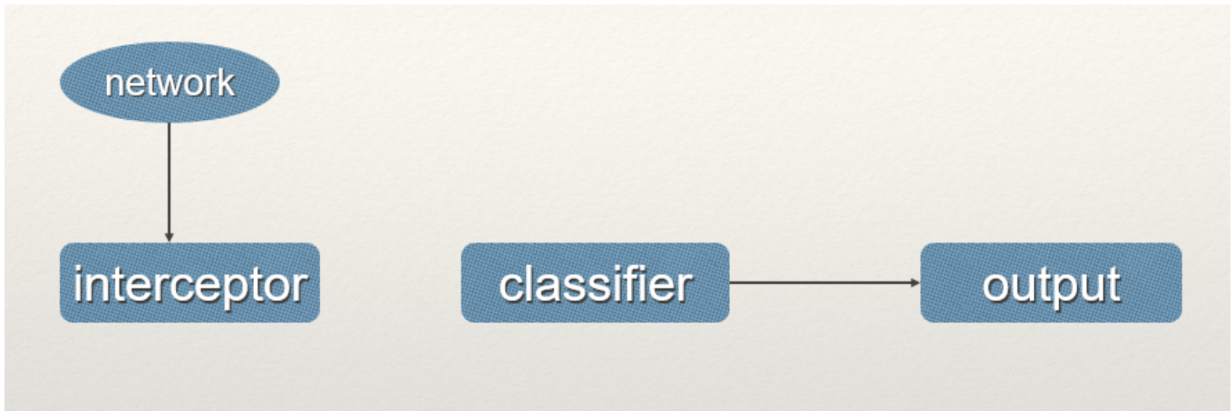
System architecture

Slide 13
Software requirement specification
Functional Requirements
1. Pandas
2. Matplotlib
3. SciPy
4. Base64
5. os
Non-Functional Requirements
i. Security
a. We are providing security to our application means that there should be no hacking of information.
ii. Usability
a. We should get response within seconds.
b. The application must have a simple, user friendly interface to save time and confusion.
iii. Reliability
The application is reliable because of the qualities that are inherited by the reliable Web application standards.
iv. Performance
The application is high performing as the user’s interaction with the online pharmacy management system is responded within seconds which describe the performance of the application.
Software Requirements
Operating System : Windows 8/10
Coding Language : Python.

Slide 14
Hardware Requirements
Processor : Intel i3
Clock Speed : 1.7 GHz
Hard Disk : 250 GB
RAM : 4 GB

Slide 15
Packages required
a. SciPy
SciPy (pronounced “Sigh Pie”) is open-source software for mathematics, science, and engineering. The SciPy library depends on NumPy, which provides convenient and fast N-dimensional array manipulation.
b. OS
This module provides a portable way of using operating system dependent functionality. If you just want to read or write a file see open(), if you want to manipulate paths, see the os.path module, and if you want to read all the lines in all the files on the command line see the file input module.
c. Pandas
pandas is a Python package that provides fast, flexible, and expressive data structures designed to make working with "relational" or "labeled" data both easy and intuitive. It aims to be the fundamental high-level building block for doing practical, real world data analysis in Python.
d. base64
This module provides functions for encoding binary data to printable ASCII characters and decoding such encodings back to binary data.
e. Matplotlib
Matplotlib is a plotting library for the Python programming language and its numerical mathematics extension NumPy. It provides an object-oriented API for embedding plots into applications using general-purpose GUI toolkits like Tkinter, wxPython, Qt, or GTK.

Slide 16
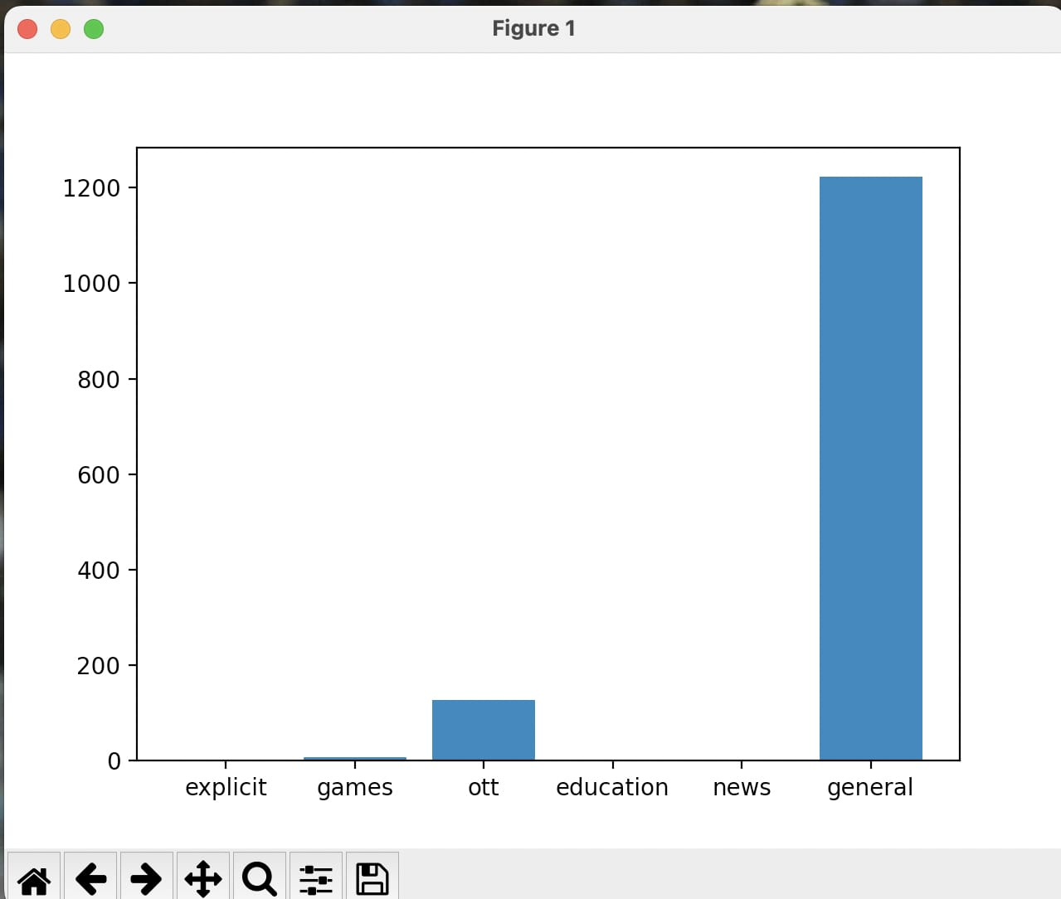
Results

Slide 17
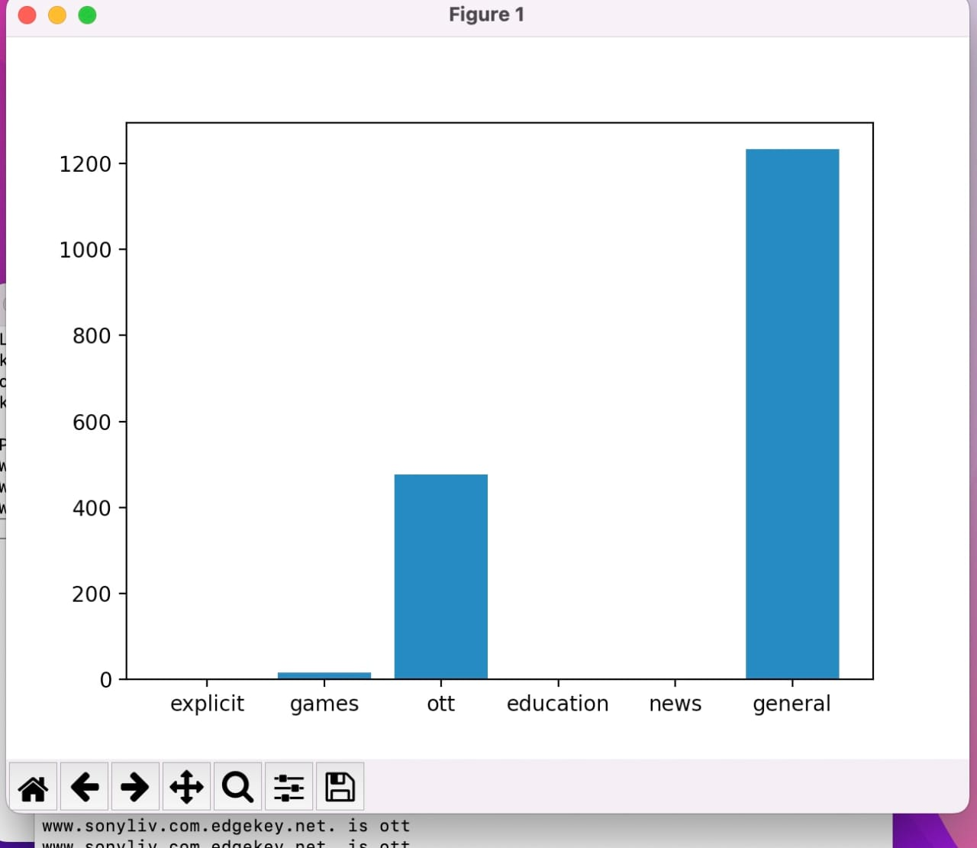
Contd

Slide 18
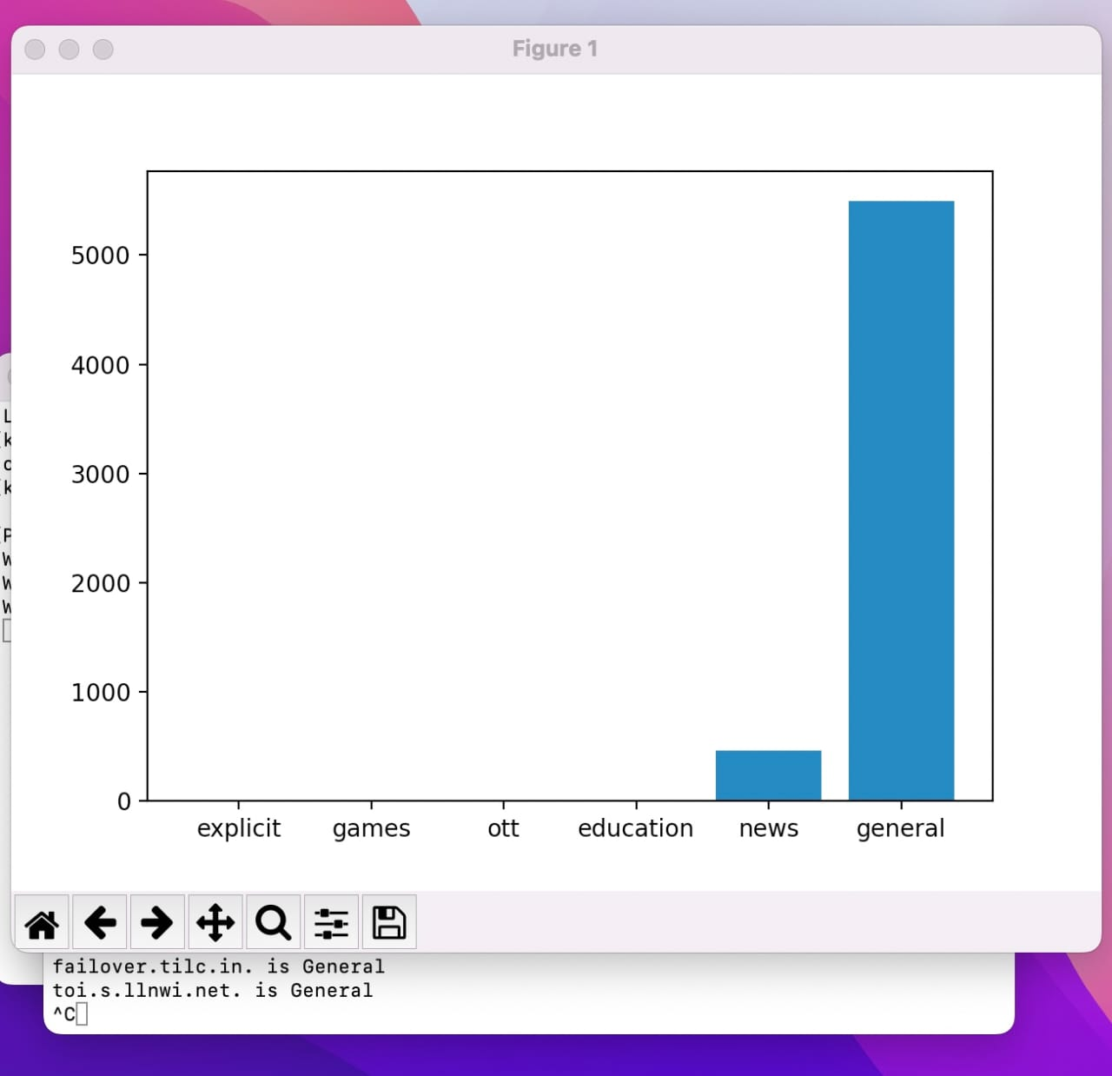
Contd

Slide 19
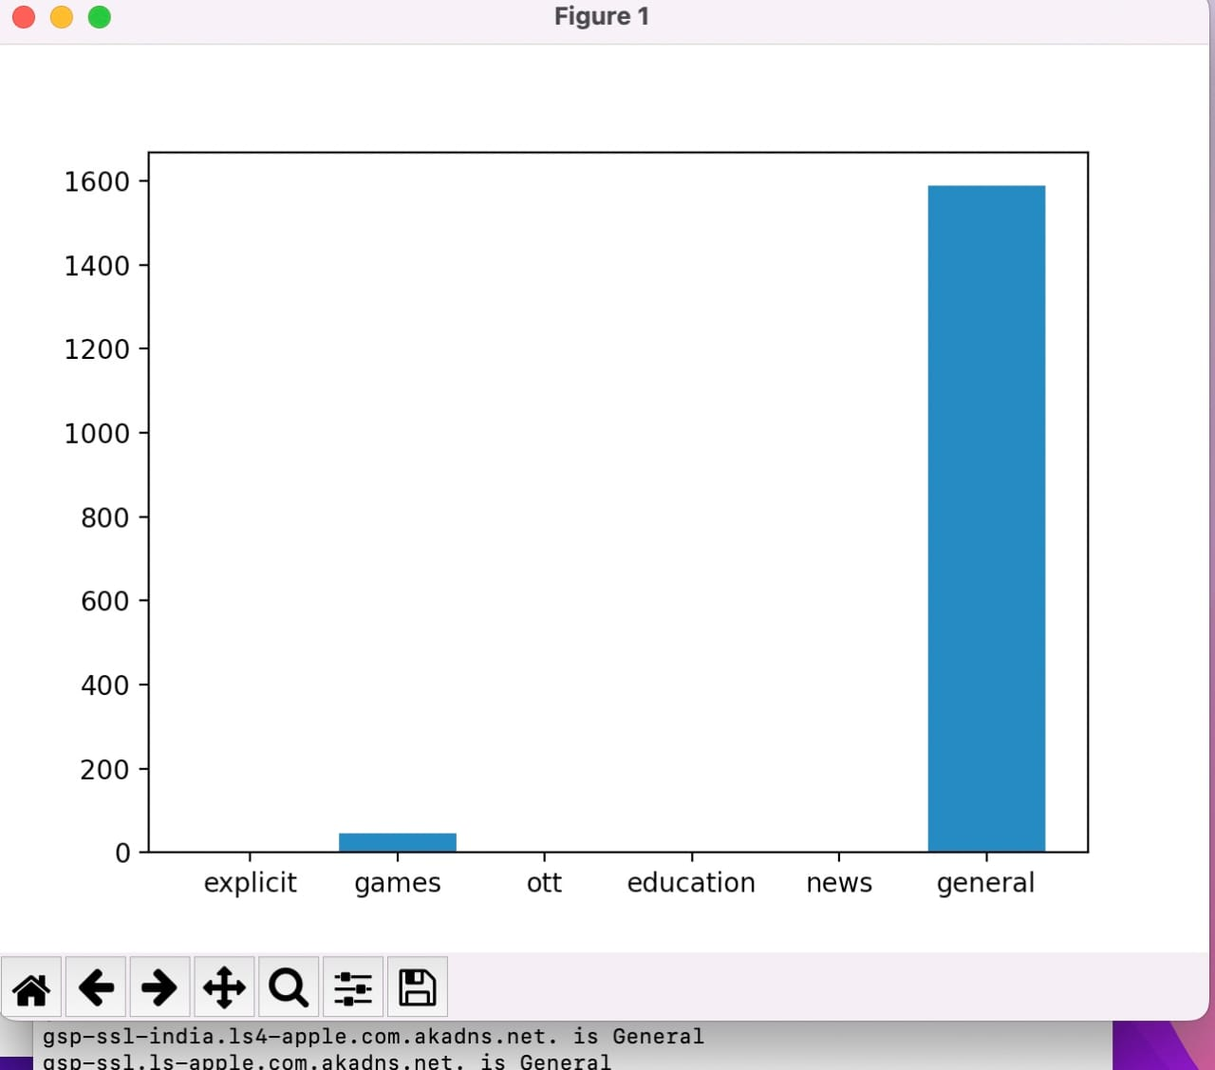
Contd

Slide 20
Conclusion
Network traffic categorisation has been effectively researched/analysed by utilising net- work packet inspection. In the end we developed a free and effort less web packet classification application using python and it’s libraries.
As per the tests the application seems to work perfectly with any load.
We can sort the traffic into different classifications Movies,Education,Games,explicit content.
Future enhancements
Updates are best to continue the legacy of any applications. For this we propose to integrate micro businesses into the research and try to make the accuracy maximum

Slide 21
References
[1] Evaluating visualisation approaches to detect abnormal activities in network traffic data. International Journal of Computer Applications, 10(2):1–5, 2010.
[2] Taimur Bakhshi and Bogdan Ghita. On internet traffic classification: A two-phased ma- chine learning approach. Canadian Journal of Electrical and Computer Engineering, 39(2):141–149, 2022.
[3] Alisha Cecil. A summary of network traffic monitoring and analysis techniques. Journal of Scientific and Industrial Research, 76(3):149–153, 2020.
[4] Conference papers. Network traffic classification techniques and comparative analysis using machine learning. Journal of Scientific and Industrial Research, 76(3):149–153, 2020.
[5] Conference1 papers. Internet traffic classification using machine learning. Journal of Scientific and Industrial Research, 76(3):149–153, 2020.
[6] HENRY FRIDAY NWEKE2 SYLVESTER I. ELE1 3 UZOMA RITA ALO1, *. Ma- chine learning-based framework for automatic malware detection using android traffic data. Journal of Scientific and Industrial Research, 76(3):149–153, 2020.
[7] Dr. Ambika R Yoga Durgadevi Goli. Network traffic classification techniques-a review. Computers and Electrical Engineering, 71:309–320, 2022.

