Slide 1

Assignment 1c
AuE8230 Spring 2023
Group 3:
Jairo Leal
Rohit Ravikumar
Saachi Walia
Vasanth Seethapathi
https://github.com/jleal7/AuE8230_Group3/tree/main/catkin_ws/src/assignment1c_turtlebot3/videos

Slide 2
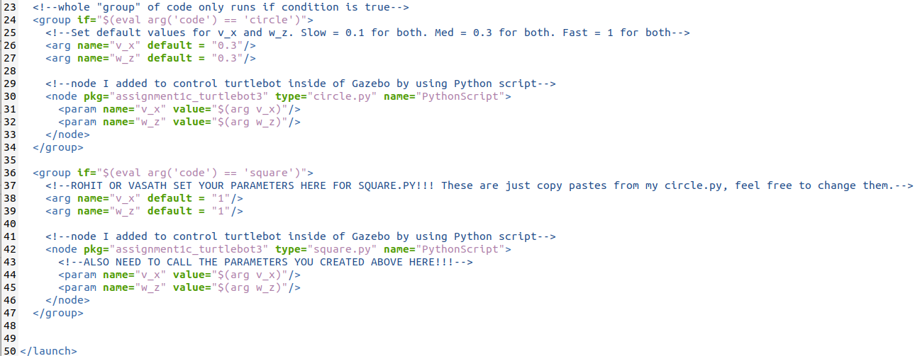
Launch File: Launch circle.py or square.py based on roslaunch argument
Copy-paste top from turtlebot3_empty_world.launch
roslaunch assignment1c_turtlebot3 move.launch code:= ‘circle’ or ‘square’

Slide 3
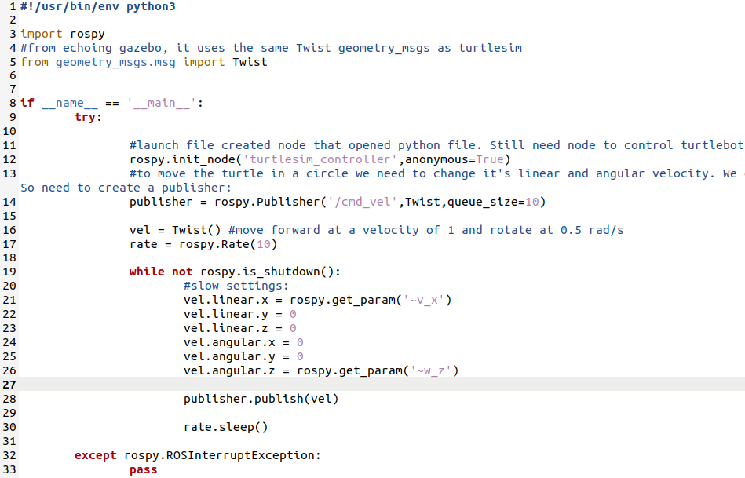
Circle.py
Unlike turtlesim now we need to publish to /cmd_vel instead of /turtle1/cmd_vel
Gazebo uses same Twist message as turtlesim
Use rospy.get_param(‘~’) to retrieve args from launch file

Slide 4

Slow and Medium Speed
Wheels have not saturated. Circle ends where it starts.
Slow Speed
(v_x = w_z = 0.1)
Medium Speed
(v_x = w_z = 0.3)

Slide 5
Fast Speed
Wheels have reached limit of grip. Inertia of car takes over and loose circle.
Fast Speed
(v_x = w_z = 1)

Slide 6
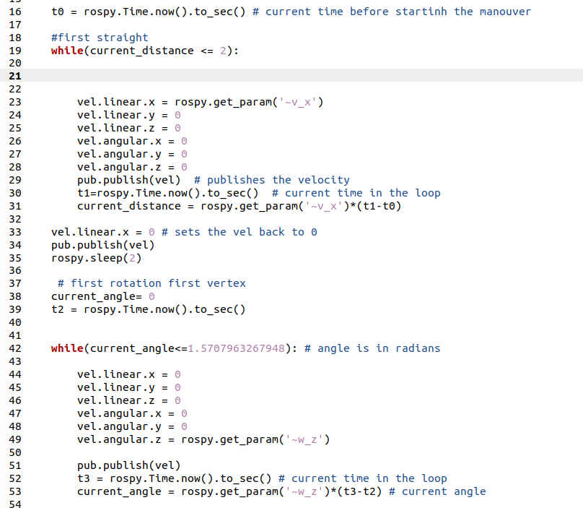
Square.py - CODE
Initially rospy.sleep() was not used which led to the reaction time between the turn and the straight to be too less and it caused the bot to swerve to one side.
Each segment of the square represents one while loop and it is run sequentially.

Slide 7
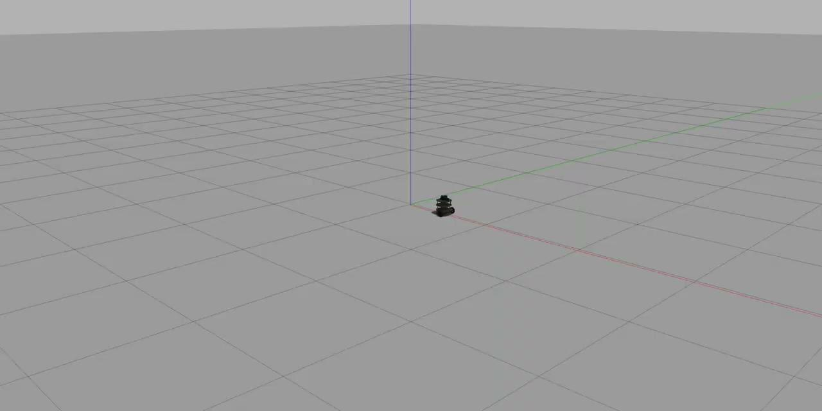
Slow and Medium Speed
The speed with 0.1 gives the best results as at this speed there is minimum slipping of the wheels.
At speeds of 0.3, we can notice that there is additional slip when the bot starts. The additional
SLOW SPEED (BEST RESULT)
(v_x = w_z = 0.1)
MEDIUM SPEED
(v_x = w_z = 0.3)

Slide 8
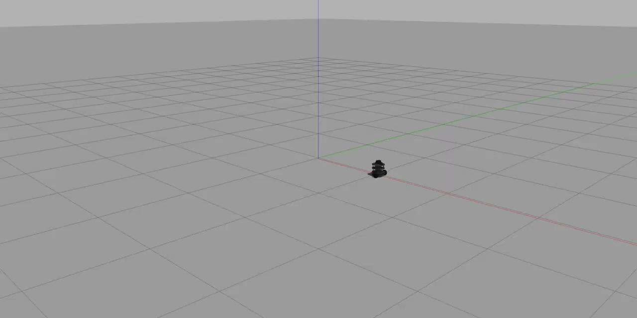
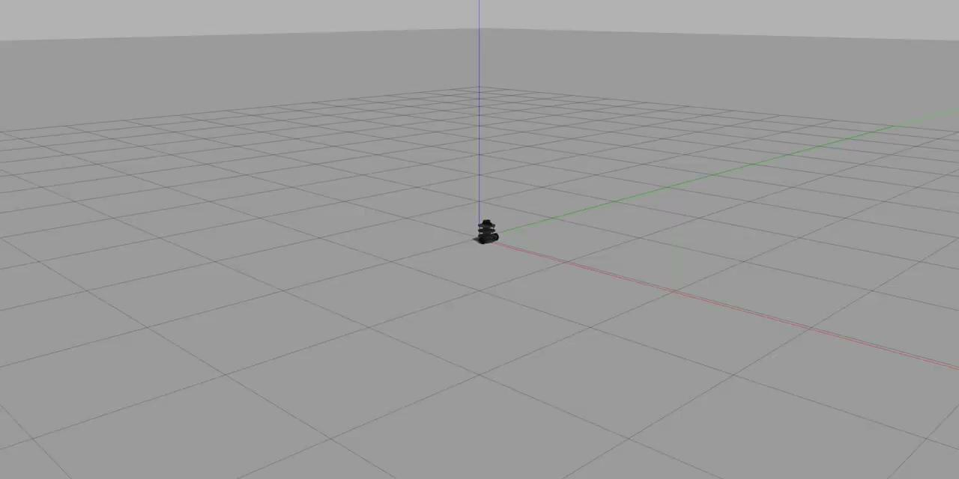
Fast Speed
Very Slow Speed
At higher speeds, the vehicle completely lost traction and often steered to one side. This is caused the initial burst of acceleration as the car reached high velocities immediately, which caused the wheels to slip longitudinally
Another interesting phenomena that was noticed was that at very low velocities, the car instead of performing ideally experienced a yaw and started drifting. This was because the cross wind was on and the car faced a yaw motion or lateral slip, as seen in the video below.
Fast Speed
(v_x = 0.5 w_z = 0.1)
Very Slow Speed
(v_x = 0.05 w_z = 0.1)

Slide 9
Observations
The same code which worked fine in Turtlebot simulator, didn’t follow the desired trajectory in Gazebo environment.The reasons could be -
Turtlebot simulator runs in a 2D physics engine but Gazebo uses a 3D engine.
Turtlebot is a differential drive agent - where two wheels are mounted on an axle - where each wheel has its own velocity which is controlled independently.
The simulation is performed based on the default simulator parameters. These settings might be need to be tuned for an optimal performance.

Slide 10
Conclusions
All the simulations were run on the default physics setting on gazebo, and hence the tire to ground contact friction coefficient was not touched. Hence this led to the bot following some absurd trajectories even at low speeds, due to low coefficients of friction between the two surfaces, which led the turtle to slip even while turning and align itself some degrees off from the intended path. This led to a skewed square.
As the speed increased, the turtlebot kept breaking the traction limit instantly after starting off and veered of into a new path.

