Slide 1
DMI Finance: JSON and XML Parser
Project: MetaParser
Team: jahnavi_Puppala
Saachi Kaup
Shobharani
JAHNAVi puppala

Slide 2
Contents
Problem Statement
Meta data definition
Design Architecture/ Considerations
Entity-Relationship Diagram
References

Slide 3
Problem Statement: Generic Parser for XML and JSON
to develop a generic XML/JSON parser using which any incoming JSON can be deserialized, converted into lists/arrays etc and stored in relevant databases.

Slide 4
Meta data definition
Metadata with one-to-one and one-to-many relationships has been parsed.
{
"ONE_TO_MANY":
{ "employer": "" },
"ONE_TO_ONE":
{ "result": "" },
"MANDATORY": [ ]
}

Slide 5
Design Architecture/ Considerations
Parse JSON: An API has been developed and deployed to ASGI server that can parse JSON file.
Parse Metadata: The system parses the meta data and structure of meta data.
Implementation: Implemented a robust flow that fosters seamless interaction between consumer and service,
Error handling: implemented error handling for MANDATORY KEY situation where a KEY is absent.
Code Design: Code design to be extensible and modular using standard design patterns, facilitating future enhancements and integrations with other software.
Callbacks: Service can be called from anywhere with the JSON and below output solution can be considered –
Direct insertion into the databases based on meta data. System should be able to generate the DDL script based on the meta data.
Recursion: A recursive solution has been implemented in the internal parsing solution.
Future Plans:
1. Scalability: Ability to handle scale. Target would be to handle 50K calls per hour

Slide 6
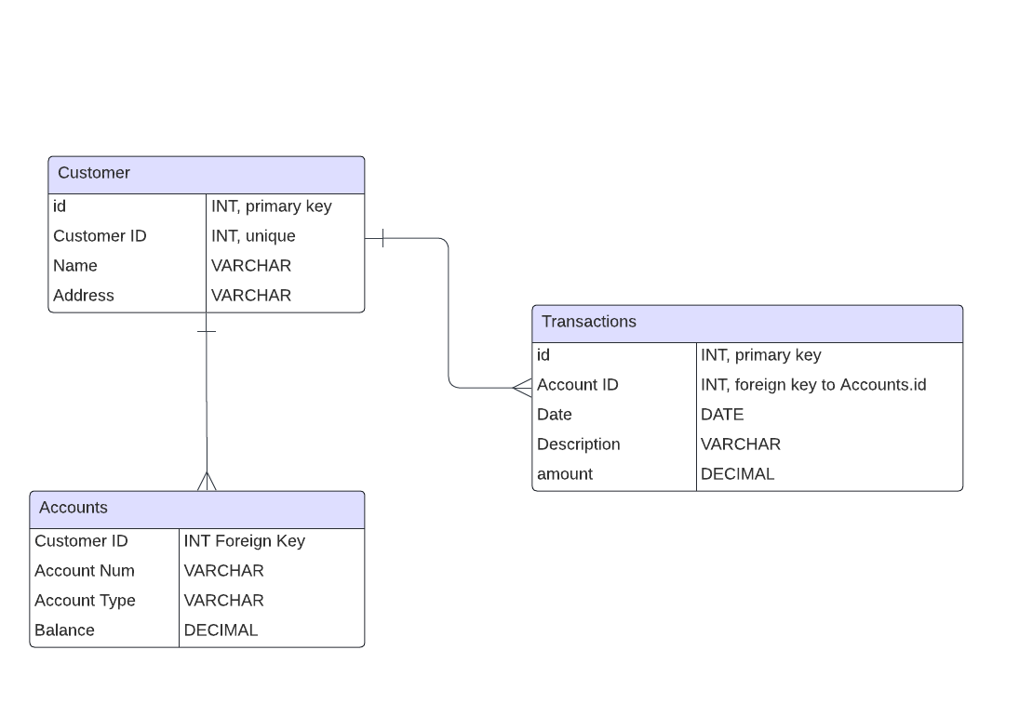
DB Diagram
Entity-Relationship Diagram for Banking System for instance:

Slide 7
Future work
Atlas search integration
Performance consideration with bulk insert
Separate Database urls

Slide 8
References
Github repository: https://github.com/SaachiKaup/JSON_XML_Parser

