Slide 1














Aavishkar
Inter-Collegiate / Institute / Department Research Convention
Category : Engineering and Technology Level : UG
Student Attendance System
Slot No. : 449

Slide 2

Origin of the creative idea
Problems lead to creative solutions. The traditional method of marking attendance with paper and pen is prone to manipulation. This led to the development of a digital student attendance system that marks attendance without the possibility of alteration.
In this system, both teachers and students can access only their specific functions after receiving approval from the Head of Department (HOD). This ensures that unnecessary access is removed and makes the attendance process smoother.

Slide 3
01.
To develop a user-friendly digital platform for marking attendance that eliminates errors and manipulation.
Project vision and mission
02.
To save time by eliminating the need for paper and pen, allowing for quick and efficient digital attendance marking.
Our vision is to create a reliable, efficient, and secure digital attendance system that ensures accurate tracking of student attendance while preventing manipulation, providing a seamless experience for both teachers and students..
03.
To enhance accountability and efficiency in the educational environment through digital innovation.

Slide 4
Ideation process
01
02
03
04
Identifying the Problem
The ideation process starts by recognizing the issues with the traditional paper-and-pen attendance system, such as manipulation, inefficiency, and time consumption. These problems highlight the need for a secure, digital solution.
Generating Ideas
During brainstorming, various digital solutions, like mobile apps, web platforms, and biometric systems, are explored to improve the attendance process, ensuring ease of use and reducing errors.
Evaluating and Refining Ideas
After brainstorming, ideas are assessed for feasibility, security, and user experience. The best solutions are selected and refined to meet the project’s goals of simplicity, security, and efficiency.
Prototyping and Testing
A prototype of the chosen solution is developed and tested with teachers and students. Feedback from the testing phase helps refine the system to ensure it works smoothly for all users.

Slide 5

Creation process
The creation process of the digital attendance system began with careful planning and structuring of the project. I started by designing the database using MySQL to store the attendance data securely. Once the database was set up, I focused on creating the basic structure of the website using HTML. This allowed me to establish the foundation of the system, defining the layout and content. Afterward, I added functionality with PHP, which enabled features like marking attendance and user authentication. PHP was key to linking the front-end with the database, allowing real-time data updates and interaction. Used JavaScript for Logic Implementation.
After building the core functionality, I turned my attention to the design. Using CSS and Bootstrap, I gave the website a professional and user-friendly interface. Bootstrap’s responsive features ensured the site would be accessible across all devices. The final step involved fine-tuning the design with CSS to enhance the visual appeal and ensure the site was both functional and easy to navigate. This combination of tools helped me create a seamless, secure, and efficient digital attendance system tailored to the needs of both teachers and students..

Slide 6
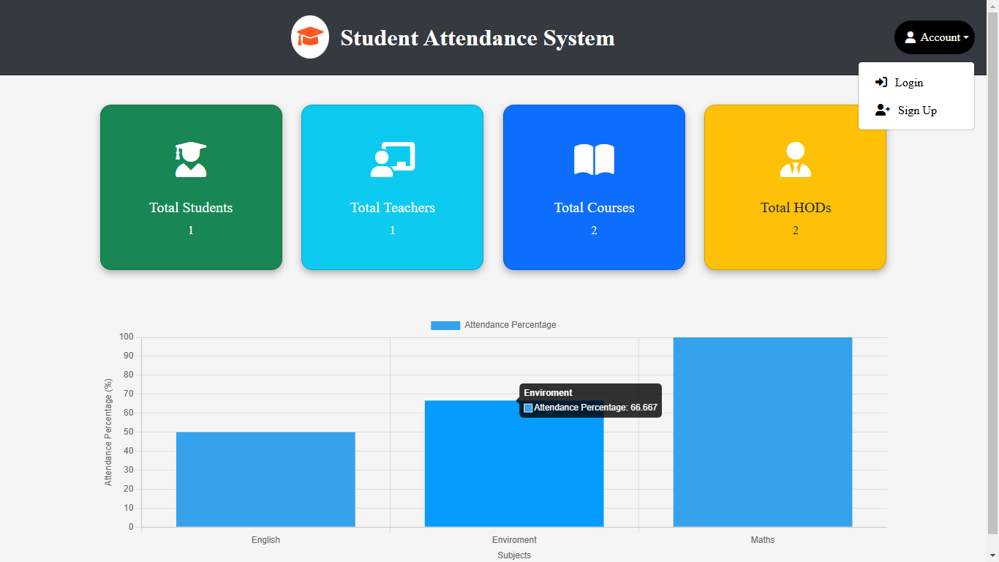
Main Page
The main page of the project provides a clear and concise dashboard showcasing key metrics for the institution. It features four dynamic cards that display real-time counts of total students, teachers, courses, and HODs, ensuring the data is always up-to-date. Alongside these, a graphical representation highlights the attendance percentage for each subject individually, offering a visual overview of participation trends. This combination of dynamic cards and an attendance graph ensures quick access to critical data, making the dashboard both informative and user-friendly.

Slide 7
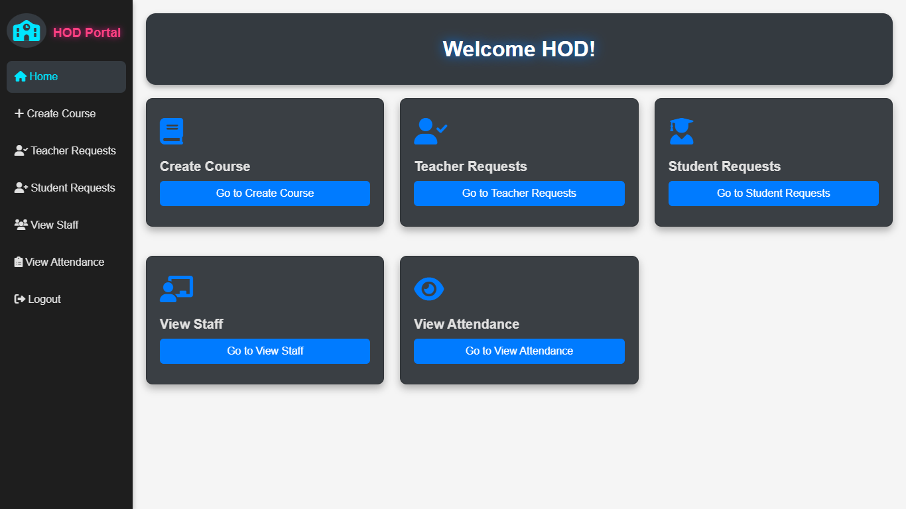
Hod
Dashboard
The HOD (Head of Department) dashboard is designed to streamline departmental management with key functionalities. It includes options to create a course, allowing HODs to define and manage new courses within the system. The teacher request and student request sections enable the review and approval of requests submitted by teachers and students, ensuring smooth communication and process handling. Additionally, the view staff feature provides an overview of all staff members in the department, while the view attendance functionality offers detailed insights into attendance records for better monitoring and analysis.The Dashboard also includes a logout button for easy and secure sign-out.

Slide 8
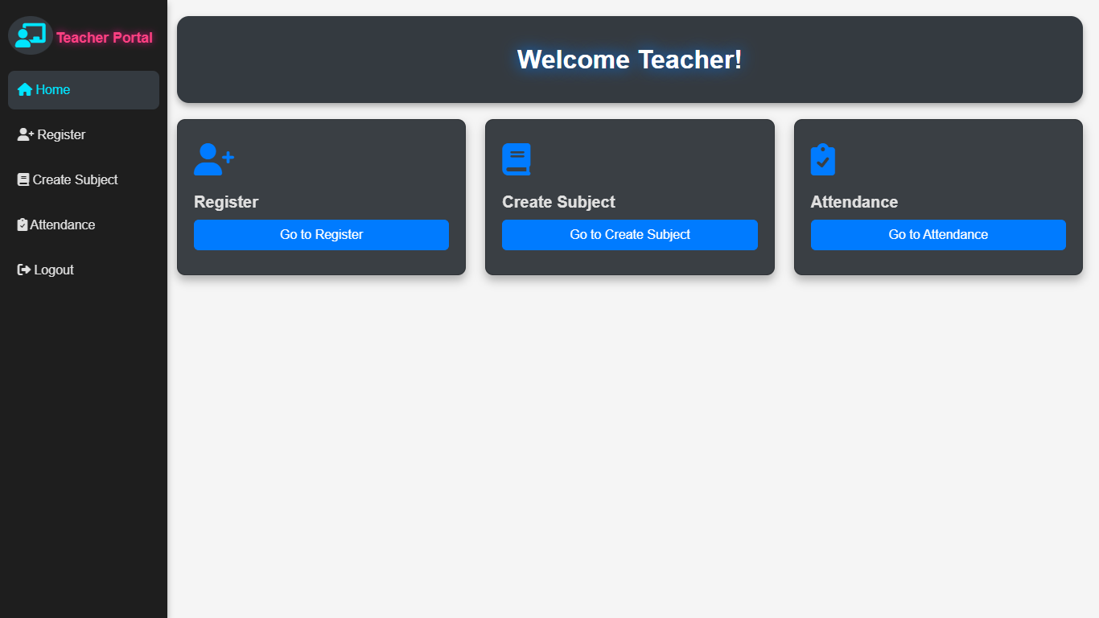
Teacher
Dashboard
The Teacher dashboard is structured to provide essential functionalities for managing academic activities, with access granted after HOD approval. Initially, teachers register through the dashboard, and upon approval, they gain access to additional features. Teachers can create subjects for their classes, forming the basis for managing attendance. The attendance section offers comprehensive tools, including mark attendance, manage attendance, delete attendance, and view attendance, enabling efficient tracking and updates of student participation. A logout button is also included to ensure secure session termination.

Slide 9
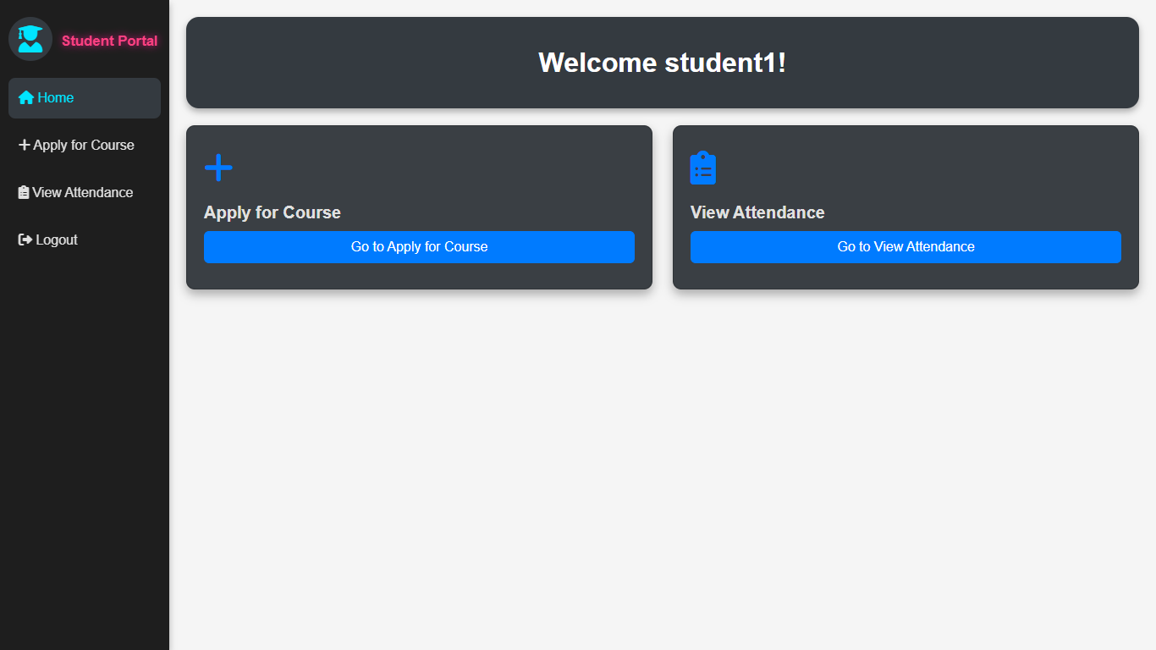
Student Dashboard
The Student portal is designed to provide a streamlined interface for students to manage their academic interactions. Initially, students can register through the portal, and access to further functionalities is granted only after the HOD approves their registration. Once approved, students can utilize the view attendance feature to monitor their attendance records for each subject, ensuring transparency and helping them stay informed about their academic progress. The portal also includes a logout button to securely end their session.

Slide 10

Weaknesses
Threats
The system's reliance on internet connectivity can be a weakness, as network issues may disrupt attendance marking. Doesn’t support on Mozilla Firefox.
Cybersecurity threats, such as hacking attempts or data breaches, pose a risk to the system's integrity. Additionally, competition from other attendance systems and the challenge of maintaining user engagement could affect the system's success.
Strengths
Opportunities
The digital attendance system is efficient, secure, and accurate. It eliminates the risk of manipulation and human error, saving time for both teachers and students. With technologies like PHP and MySQL, it ensures reliable data storage and quick access to attendance records.
The system has opportunities for growth, such as integrating with other school management tools or incorporating advanced features like biometric tracking. With the rise of digital education, there is potential for wider adoption across institutions.

Slide 11

Final reflections and future steps
Creating the digital attendance system has been a great learning experience. I was able to solve the problem of paper-based attendance by developing a simple, secure, and efficient solution using HTML, CSS, PHP, Javascript, and MySQL. This project taught me how important it is to create a system that is both functional and easy to use. I’m happy with the results and how it improves the attendance process for both teachers and students.
Biometric Integration
AI-based Attendance Tracking
Automated Notifications and Alerts
Mobile App Integration

Slide 12
Thank you very much!

