Slide 1

FRAUD DETECTION PROJECT
Machine learning using PySpark

Slide 2
TABLE OF CONTENTS
01
Introduction
02
Preprocessing
03
EDA
04
ML Models
Dataset Specification.
Problem Statement.
Rename.
Drop.
Add Columns.
Explore data.
Dashboard.
Baseline Model.
Classification Model.

Slide 3
01
INTRODUCTION

Slide 4
Dataset Specification
Simulated credit card transaction dataset containing legitimate and fraud transactions from the duration 1st Jan 2019 - 31st Dec 2020.
It covers credit cards of 1000 customers doing transactions with a pool of 800 merchants.

Slide 5
23 Columns
500K Records
150 MBs

Slide 6
Goal
Problem
There are transactions frauds that we want to detect.
To predict fraud transactions using a classification machine learning model.

Slide 7
COLUMNS SPECIFICATION
01
02
03
index
Trans_date_trans_time
cc_num
Unique Identifier for each row
Transaction DateTime
Credit Card Number of Customer
04
05
06
merchant
category
amt
Merchant Name
Category of Merchant
Amount of Transaction

Slide 8
COLUMNS SPECIFICATION
07
08
09
first
last
gender
First Name of Credit Card Holder
Last Name of Credit Card Holder
Gender of Credit Card Holder
10
11
12
street
city
state
Street Address of Credit Card Holder
City of Credit Card Holder
State of Credit Card Holder

Slide 9
COLUMNS SPECIFICATION
13
14
15
zip
lat
long
Zip of Credit Card Holder
Latitude Location of Credit Card Holder
Longitude Location of Credit Card Holder
16
17
18
city_pop
job
dob
Credit Card Holder's City Population
Job of Credit Card Holder
Date of Birth of Credit Card Holder

Slide 10
COLUMNS SPECIFICATION
19
20
21
trans_num
unix_time
merch_lat
Transaction Number
UNIX Time of transaction
Latitude Location of Merchant
22
23
merch_long
is_fraud
Longitude Location of Merchant
Fraud Flag
Target

Slide 11
02
PREPROCESSING

Slide 12
RENAME
amt
Amount
lat
long
latitude
longitude
merch_lat
merch_long
merch_latitude
merch_longitude

Slide 13
DROP
trans_num
first
last
Useless in our work

Slide 14
ADD COLUMNS
Source
Calculation
Result
trans_date
2019-01-02 01:06:37
Year | Month | Day | Hour | Time
2019 | January | Wednesday | 1 | 01:06:37
trans_date
Separate
Year
Month
Day
Hour
Time

Slide 15
ADD COLUMNS
Source
Calculation
Result
Dob | trans_date
1960-10-28 | 2019-01-02 03:05:23
Age
59
dob
trans_date
Calculate the difference between dob and trans_date
Age

Slide 16
ADD COLUMNS
Source
Calculation
Result
latitude | longitude | merch_latitude | merch_longitude
35.9946 | -81.7266 | 36.430124 | -81.179483
Distance(km)
68.96272
latitude
longitude
merch_latitude
merch_longitude
Calculate the distance between two locations
Distance(km)

Slide 17
ADD COLUMNS
Source
Calculation
Result
cc_num
4613314721966
340187018810220
card_type
VISA
American Express
cc_num
Extract the credit card type by the number of the credit card
card_type
Notes:
Drop transdatetrans_time

Slide 18
DROP
Trans_date_trans_time
Useless in our work

Slide 19
03
EDA

Slide 20
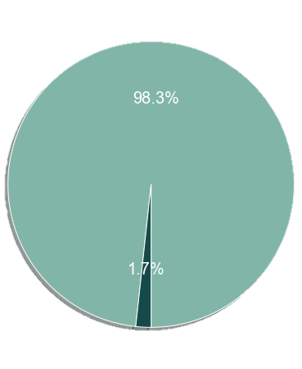
FRAUD RATIO
563,165
We can see that
9651
1.7%
The number of frauds is 1.7%, which means that only 9651 from 563165
Total transactions
Fraud transactions
Fraud Percentage

Slide 21
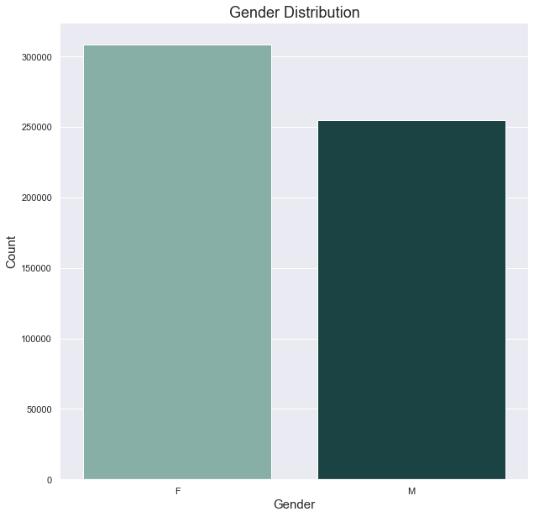
GENDER DISTRIBUTION
This plot shows that the majority of the clients are females

Slide 22
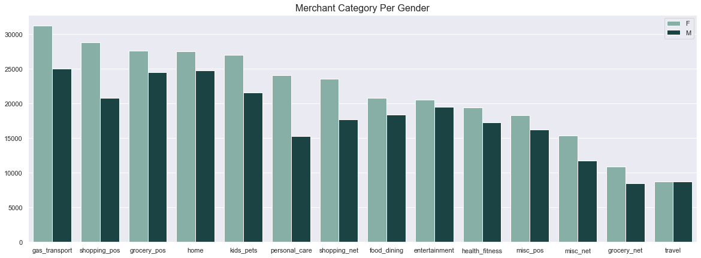
MERCHANT CATEGORY PER GENDER
gas_transport
The highest category in the dataset.
travel
The lowest category in the dataset.
10.2%
of the merchant deal happen in gas_transport

Slide 23
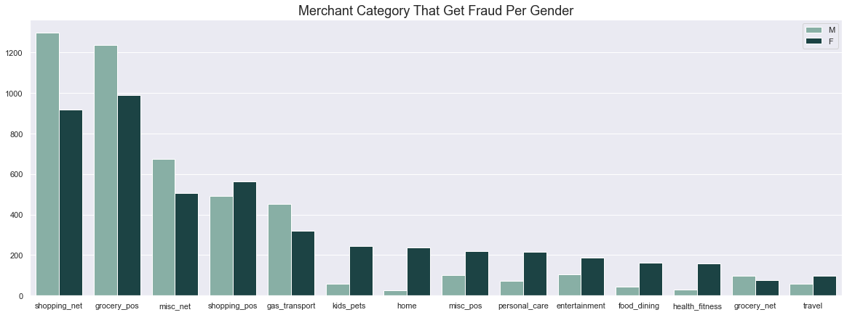
MERCHANT CATEGORY THAT GETS FRAUD PER GENDER
Shopping Net
The highest category in which fraud occurs.

Slide 24
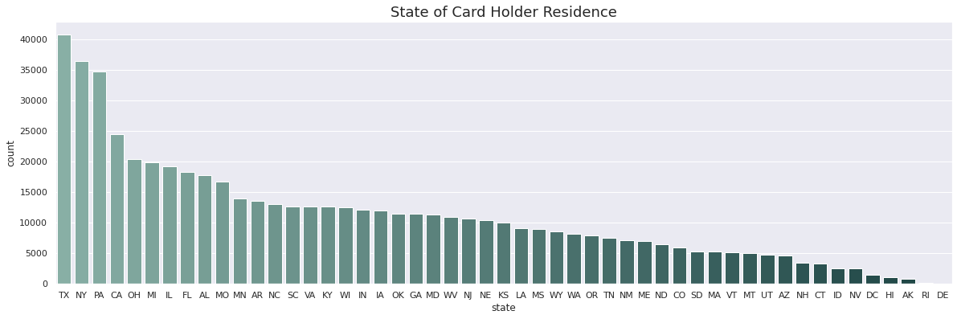
STATE OF CARD HOLDER RESIDENCE
Texas
Delaware
The highest state in the dataset
The lowest state in the dataset

Slide 25
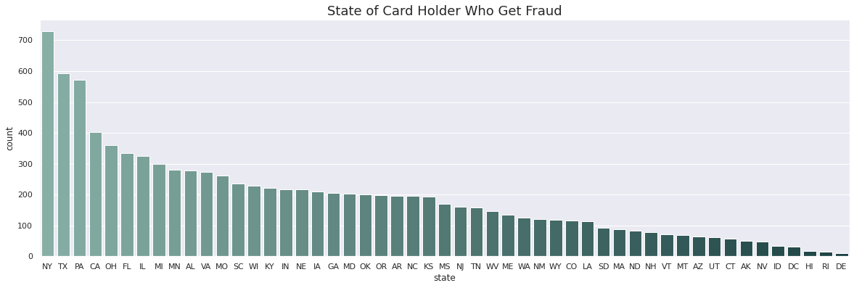
STATE OF CARD HOLDER WHO GETS FRAUD
New York
Delaware
The highest state that gets fraud
The lowest state that gets fraud

Slide 26
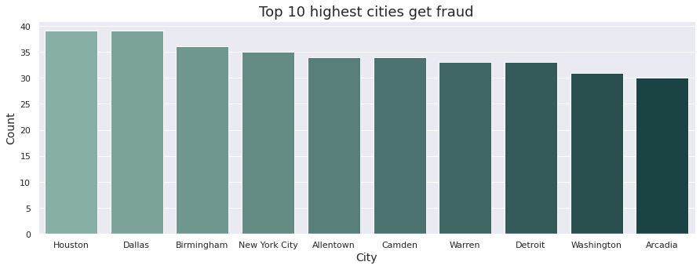
THE TOP 10 HIGHEST CITIES GET FRAUD
Houston & Dallas
The highest cities that get fraud

Slide 27
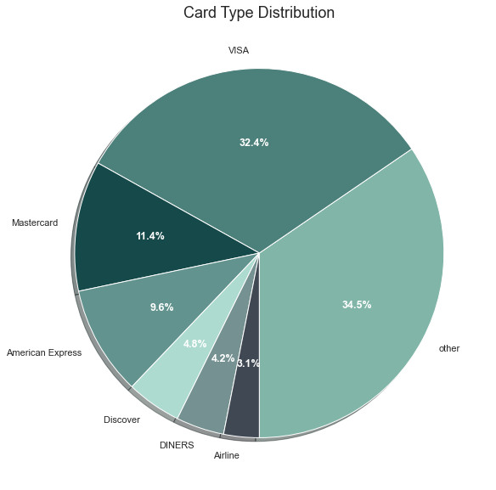
CARD TYPE DITRIBUTION
32.4%
3.1%
Visa
Airline
The highest card type used
The lowest card type used

Slide 28
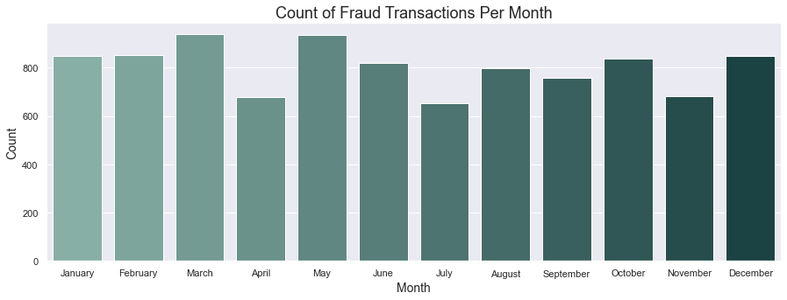
COUNT OF FRAUD TRANSACTIONS PER MONTH
March & May
August
The highest months that fraud transactions happen
The lowest month that fraud transactions happen

Slide 29
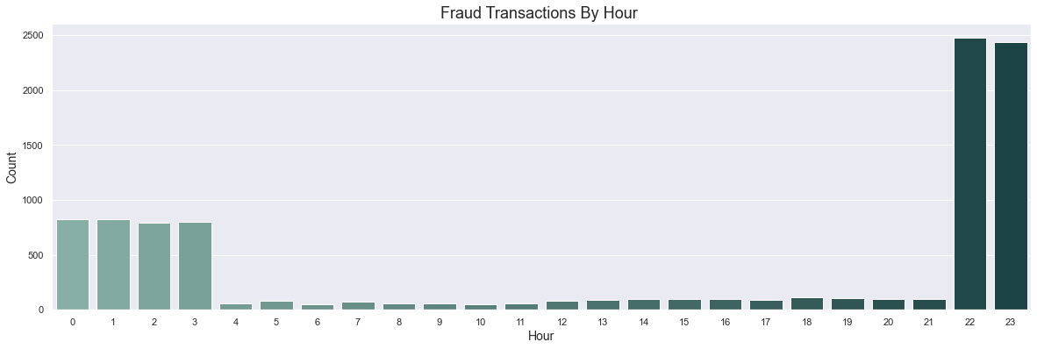
COUNT OF FRAUD TRANSACTIONS BY HOUR
10 pm – 3 am
The period in which most fraud transactions occur

Slide 30
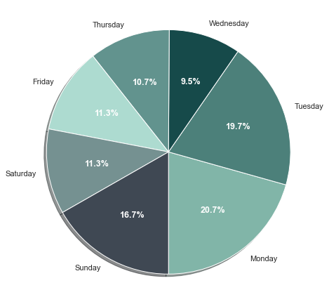
THE DAYS THAT FRAUD HAPPEN
32.3%
11.5%
Weekend
Wednesday
One-third of fraud transactions happen on the weekend
The lowest day that fraud transactions happen

Slide 31
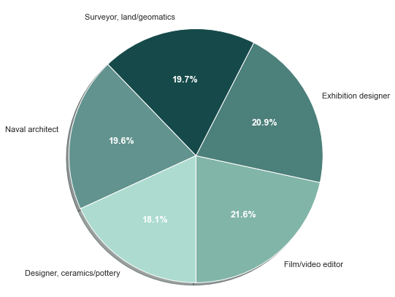
TOP 5 MAJORS OF ALL CARDHOLDERS
21.6%
Film/video editor
The highest major of all cardholders who get fraud

Slide 32
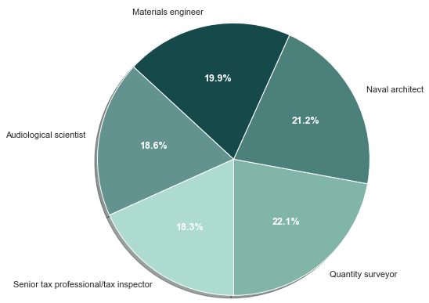
TOP 5 MAJORS OF CARDHOLDERS WHO GET FRAUD
22.1%
Quantity Surveyor
The highest major of all cardholders who get fraud

Slide 33
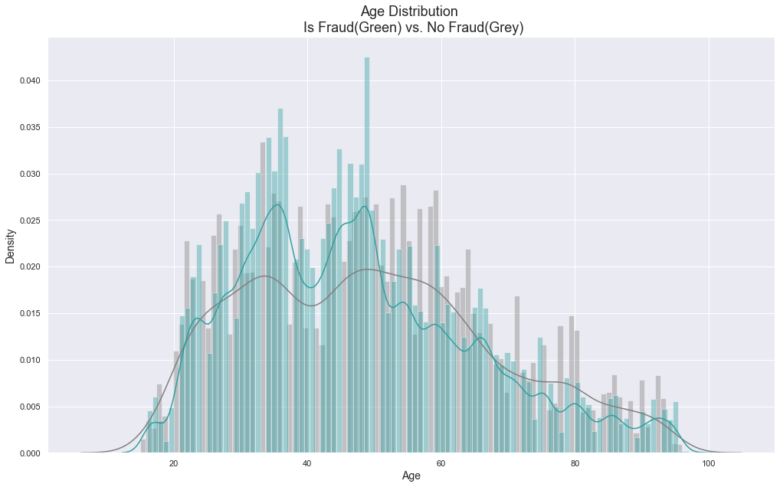
TARGET
> 50 years old
15-89 years old
Most of the ages that are exposed to fraud
The range of age

Slide 34
DASHBOARD

Slide 35
04
ML MODELS

Slide 36
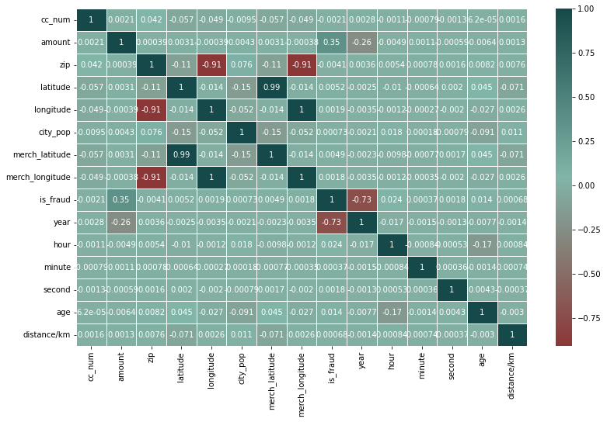
Correlation Plot

Slide 37
COLUMNS
01
02
03
cc_num
amount
zip
04
05
06
latitude
longitude
city_pop

Slide 38
COLUMNS
07
08
09
unix_time
merch_latitude
merch_longitude
10
11
12
Year
hour
age

Slide 39
COLUMNS
13
14
15
distance(km)
merchant_idx
category_idx
16
17
18
gender_idx
street_idx
city_idx

Slide 40
COLUMNS
19
20
state_idx
job_idx
Target
is_fraud

Slide 41
Baseline
 | Count | Percentage
1 | 9651 | 1.713 %
0 | 0.992910 | 98.29%
Baseline accuracy = 98.29

Slide 42
CLASSIFICATION
 | Logistic Regression | Random Forest Classifier | Gradient Boost Tree Classifier | Logistic Regression_diff | Random Forest Classifier_diff | Gradient Boost Tree Classifier_diff
Accuracy | 0.993458 | 0.996217 | 0.997303 | -0.018952 | 0.032941 | 0.122194
F1 score | 0.992910 | 0.995990 | 0.997281 | -0.027385 | 0.036661 | 0.121980
Weighted Precision | 0.993181 | 0.996232 | 0.997268 | -0.017673 | 0.032525 | 0.124492
Weighted Recall | 0.993458 | 0.996217 | 0.997303 | -0.018952 | 0.032941 | 0.122194
Best accuracy = 99.73

Slide 43
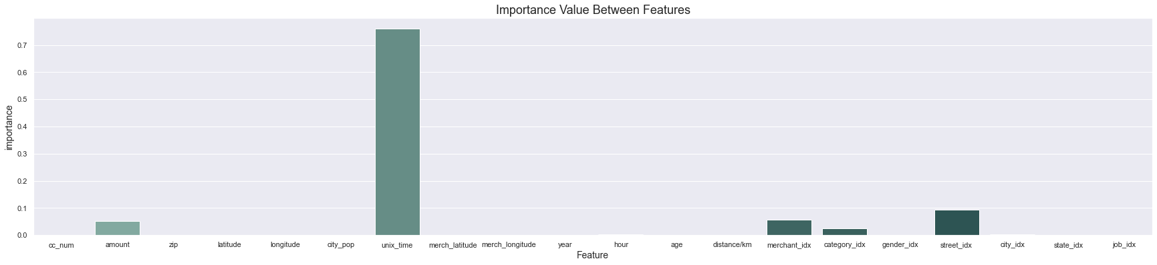
Importance Plot

Slide 44
THANKS!
Does anyone have any questions?
Please keep this slide for attribution

