Slide 1
MERN Stack
MEAN/MERN STACK

Slide 2
WEB-1: Learn HTML

Slide 3
Opening (5 mins)

Slide 4
Learning Objectives:
Introduction to HTML
Basic Structure of an HTML page
Text formatting tags in HTML
Lists in HTML
HTML Links and navigation
Adding images to web pages
Using images as links
Image map
Adding video to web pages
Adding audio to web pages
Tables in HTML
HTML FORMS
HTML5 enhancements in form
Write accessible HTML using Semantic HTML tags.

Slide 5
Read the following passage and answer the question in the next slide:
“Every day, you come across all kinds of printed documents for example newspapers, brochures, menus, etc. The Web is like a sea of documents all linked together; these documents bear a strong similarity to the documents that you meet in everyday life. So, let’s think for a moment about the structure of some of the documents we see around us, and how they compare to web pages. Every morning I used to read a newspaper. A newspaper is made up of several stories or articles (and probably a fair smattering of advertisements, too). Each story has a headline and then some paragraphs, perhaps a subheading, and then some more paragraphs; it may also include a picture or two. I don’t buy a daily paper anymore, as I tend to look at news online, but the structure of articles on news websites is very similar to the structure of articles in newspapers. Each article is made up of headings, paragraphs of text, and the odd picture. The parallel is quite clear; the only real difference is that each story gets its own page on a web site, and that page is accessed by clicking on a headline or a brief summary either on the site’s main home page or one of the home pages for a subsection of the site (such as the politics, sports, or entertainment sections).”

Slide 6
Answer the following questions:
Q1. What have you noticed about the format of Facebook?

Slide 7
Introduction to HTML (2 hrs)

Slide 8
What is HTML?
ML was first created by Tim Berners-Lee, Robert Cailliau, and others starting in 1989. It stands for Hyper Text Markup Language.
Originally, the Internet was designed as a means for distributing information across a robust, non centralized network of computers in a time of national emergency. However, as more organizations and people adopted the Internet, the need grew for easier access to resources and for a richer display of information. Publishing HTML-formatted documents on the Internet via the World Wide Web proved to be the answer to these needs.
Hypertext means that the document contains links that allow the reader to jump to other places in the document or to another document altogether. The latest version is known as HTML5.
A Markup Language is a way that computers speak to each other to control how text is processed and presented. Markup languages are completely different from programming languages and scripting languages. Markup languages prepare a structure for the data or prepare the look or design of a page. These are presentational languages, and it doesn’t include any kind of logic or algorithm. To do this HTML uses two things: tags and attributes.
HTML is the Language of Web Pages on the World Wide Web. It defines the structure of webpages and determines how data is displayed online.
HTML is needed to explain the structure of any web pages. It is used to indicate what text should be considered a heading, where paragraphs start and end, and what images should appear in the document, and to specify links between different pages. It is a set of special instructions that can be added in the text to add formatting and linking information. It Is directly interpreted by the browser.
It is not asking any kind of question to the computer or it’s not comparing things and it’s not asking any logical question. It’s just used to represent a view inside.

Slide 9
What is the purpose of HTML?
HTML is the language in which most websites are written. HTML is used to create pages and make them functional. Web developers use HTML keywords or tags to instruct the Web browser application how to format and display the content of Web pages. The code used to make them visually appealing is known as CSS and we shall focus on this in a later lesson. For now, we will focus on teaching you how to build rather than design. a web browser. So basically, it involves formatting data or it controls the presentation of data.
HTML files have .html extension. HTML is not case-sensitive, multiple spaces will appear as a single space blank and new lines are ignored. While getting started with HTML, you will likely encounter new and often strange terms. Over time you will become more and more familiar with all of them, but the three common HTML terms you should begin with are tags, elements, and attributes.

Slide 10
How HTML works
Tags:
The use of less-than and greater-than angle brackets surrounding an element creates what is known as a tag. Tags most commonly occur in pairs of opening and closing tags.
An opening tag marks the beginning of an element. It consists of a less-than sign followed by an element’s name, and then ends with a greater-than sign; for example, <div>.
A closing tag marks the end of an element. It consists of a less-than sign followed by a forward slash and the element’s name, and then ends with a greater-than sign; for example, </div>.
The content that falls between the opening and closing tags is the content of that element. An anchor link, for example, will have an opening tag of <a> and a closing tag of </a>. What falls between these two tags will be the content of the anchor link.
<a>…Content…</a>

Slide 11
How HTML works
Elements:
An HTML element is defined by a start tag, some content, and an end tag. Elements are designators that define the structure and content of objects within a page. Some of the more frequently used elements include multiple levels of headings (identified as <h1> through <h6> elements) and paragraphs (identified as the <p> element); the list goes on to include the <a>, <div>, <span>, <strong>, and <em> elements, and many more.
Elements are identified using less-than and greater-than angle brackets, < >, surrounding the element name. Thus, an element will look like the following:
<p>

Slide 12
How HTML works
Attributes:
Attributes are properties used to provide additional information about an element. The most common attributes include the id attribute, which identifies an element; the class attribute, which classifies an element; the src attribute, which specifies a source for embeddable content; and the href attribute, which provides a hyperlink reference to a linked resource. All the mentioned common attributes will be explained later in the program.
Attributes are defined within the opening tag, after an element’s name. Generally, attributes include a name and a value. The format for these attributes consists of the attribute name followed by an equals sign and then a quoted attribute value. For example, an <a> element including an href attribute would look like the following:
<a href="http://somewebsite.com/">Website</a>
Or
<img src="mydog.jpg" alt="A photo of my dog.">
In this instance, the image source (src) and the alt text (alt) are attributes of the <img> tag.

Slide 13
Basic Construction of an HTML Page:
<!DOCTYPE html> — This tag specifies the language you will write on the page. informs web browsers which version of HTML is being used and is placed at the very beginning of the HTML document. In this case, we’ll be using the latest version of HTML i.e. HTML 5, our document type declaration is simply <!DOCTYPE html>.
<html> — This tag signals that from here on we are going to write in HTML code and signifies the beginning of the document.
<head> — Inside the <html> element, the <head> element identifies the top of the document, including any metadata (accompanying information about the page) goes — stuff mostly meant for search engines and other computer programs. The content inside the <head> element is not displayed on the web page itself. Instead, it may include the document title (which is displayed on the title bar in the browser window), links to any external files, or any other beneficial metadata.
<body> — This is where the visible content of the page goes.
Further Tags:
Inside the <head> tag, there is one tag that is always included: <title>, but there are others that are just as important:
<title> - This is where we insert the page name as it will appear at the top of the browser window or tab.
<meta> - This is where information about the document is stored: character encoding, name (page context), description.
The charset attribute specifies the character encoding for the HTML document. The HTML5 specification encourages web developers to use the UTF-8 character set, which covers almost all of the characters and symbols in the world!

Slide 14
Basic Construction of an HTML Page:
Further Tags:
Inside the <head> tag, there is one tag that is always included: <title>, but there are others that are just as important:
<title> - This is where we insert the page name as it will appear at the top of the browser window or tab.
<meta> - This is where information about the document is stored: character encoding, name (page context), description.
The charset attribute specifies the character encoding for the HTML document. The HTML5 specification encourages web developers to use the UTF-8 character set, which covers almost all of the characters and symbols in the world!
Adding Content:
Next, we will make <body> tag.
The HTML <body> is where we add the content which is designed for viewing by human eyes.
This includes text, images, tables, forms and everything else that we see on the internet each day.

Slide 15
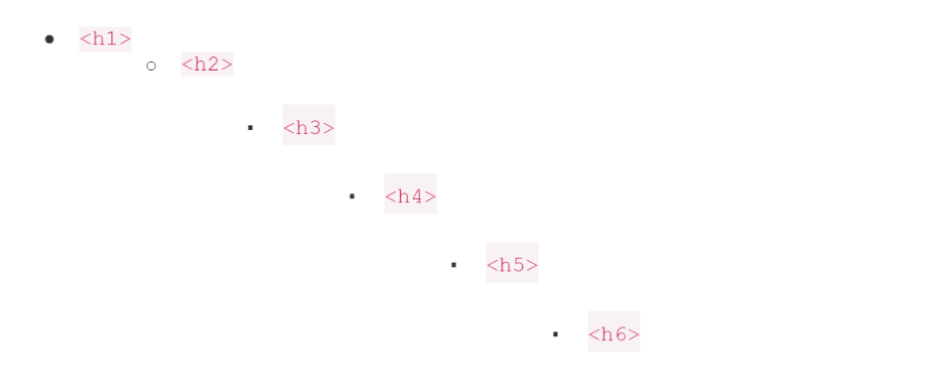
Basic Construction of an HTML Page:
How to Add HTML Headings To Your Web Page:
In HTML, headings are written in the following elements:
As you might have guessed <h1> and <h2> should be used for the most important titles, while the remaining tags should be used for sub-headings and less important text.
Search engine bots use this order when deciphering which information is most important on a page.
We will save this file as “index.html” in a new folder called “my webpage.”

Slide 16
Basic Construction of an HTML Page:
How To Add Text In HTML:
Adding text to our HTML page is simple using an element opened with the tag <p> which creates a new paragraph. We place all of our regular text inside the element <p>.
When we write text in HTML, we also have a number of other elements we can use to control the text or make it appear in a certain way.
Note:
Because both the heading and paragraph are nested within the <body> element, they are visible on the web page.
When an element is placed inside of another element, also known as nested, it is a good idea to indent that element to keep the document structure well organized and legible. In the previous code, both the <head> and <body> elements were nested and indented inside the <html> element. The pattern of indenting for elements continues as new elements are added inside the <head> and <body> elements.

Slide 17
Other key elements
Element | Meaning | Purpose
<b> | Bold | Highlight important information
<strong> | Strong | Similarly to bold, to highlight key text
<i> | Italic | To denote text
<em> | Emphasised Text | Usually used as image captions
<mark> | Marked Text | Highlight the background of the text
<small> | Small Text | To shrink the text
<strike> | Striked Out Text | To place a horizontal line across the text
<u> | Underlined Text | Used for links or text highlights
<ins> | Inserted Text | Displayed with an underline to show an inserted text
<sub> | Subscript Text | Typographical stylistic choice
<sup> | Superscript Text | Another typographical presentation style
These tags must be opened and closed around the text in question.

Slide 18
Basic Construction of an HTML Page:
Special Characters:
We can add special characters or symbol entities using Html as many mathematical, technical, and currency symbols, are not present on a normal keyboard.
For example:

Slide 19
Basic Construction of an HTML Page:
Similarly, following table shows some more examples of special characters and symbols.
Char |  | Entity | Description
 | &nbsp; |  | Non-breaking space
∀ | &forall; |  | FOR ALL
∂ | &part; |  | PARTIAL DIFFERENTIAL
∃ | &exist; |  | THERE EXISTS
∅ | &empty; |  | EMPTY SETS
Α | &Alpha; |  | GREEK CAPITAL LETTER ALPHA
Β | &Beta; |  | GREEK CAPITAL LETTER BETA
Γ | &Gamma; |  | GREEK CAPITAL LETTER GAMMA
Δ | &Delta; |  | GREEK CAPITAL LETTER DELTA
© | &copy; |  | COPYRIGHT SIGN
® | &reg; |  | REGISTERED SIGN
€ | &euro; |  | EURO SIGN
™ | &trade; |  | TRADEMARK
> | &gt; |  | Greater-than sign

Slide 20
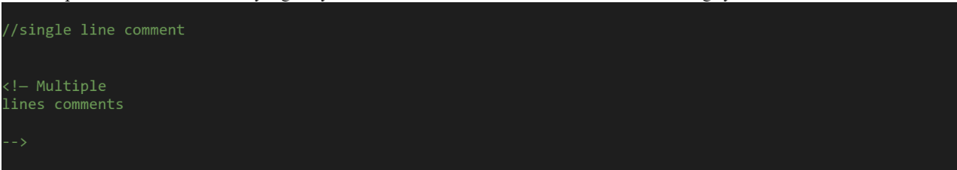
Basic Construction of an HTML Page:
Comments:
You can put comments between any tags in your HTML documents. Comments use the following syntax:
Anything after will not be displayed. It can still be seen in the source code for the document, but it is not shown on screen.
Note:
It is good practice to comment your code, especially in complex documents
Comments help you and others understand your code.

Slide 21
Basic Construction of an HTML Page:
Lists in HTML:
Html has tags and attributes to create un-ordered and ordered lists.
Un-ordered Lists:
Starting Tag <ul>, Ending Tag </ul>
List Items <li>
Type (FILLROUND, SQUARE)

Slide 22
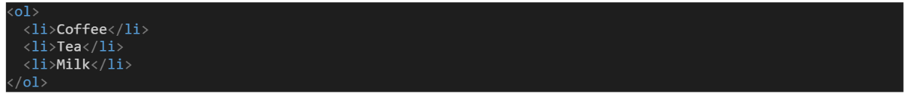
Basic Construction of an HTML Page:
Ordered Lists:
Starting Tag <ol>, Ending Tag </ol>
List Items <li>
Type (“1”, “A”, “a”, ”I”, ”i”)
Start (Alerts the numbering Sequence)
Value (Changes the number sequence in the middle of an ordered list)

Slide 23
Basic Construction of an HTML Page:
HTML Links and navigation
Internal Links: When you link to another page in your own website, the link is known as an internal link. Links pointing to other pages of the same website will have a relative path, which does not include the domain (.com, .org, .edu, etc.) in the href attribute value. Because the link is pointing to another page on the same website, the href attribute value needs to include only the filename of the page being linked to: pagename.html
External links:When you link to a different site, it is known as an external link. Linking to other websites outside of the current one requires an absolute path, where the href attribute value must include the full domain. A link to Google would need the href attribute value of http://google.com, starting with http and including the domain, .com in this case.
How to link pages?
Anything between the opening <a> tag and the closing </a> tag becomes part of the link that users can click in a browser. To link another page, href attribute of opening tag of <a> is used the value of the href attribute is the name of the file you are linking to
For example:

Slide 24
Basic Construction of an HTML Page:
HTML Links and navigation
Internal Links: When you link to another page in your own website, the link is known as an internal link. Links pointing to other pages of the same website will have a relative path, which does not include the domain (.com, .org, .edu, etc.) in the href attribute value. Because the link is pointing to another page on the same website, the href attribute value needs to include only the filename of the page being linked to: pagename.html
External links:When you link to a different site, it is known as an external link. Linking to other websites outside of the current one requires an absolute path, where the href attribute value must include the full domain. A link to Google would need the href attribute value of http://google.com, starting with http and including the domain, .com in this case.
How to link pages?
Anything between the opening <a> tag and the closing </a> tag becomes part of the link that users can click in a browser. To link another page, href attribute of opening tag of <a> is used the value of the href attribute is the name of the file you are linking to
For example:

Slide 25
Basic Construction of an HTML Page:
Adding images to web pages
Images are usually added to a site using the <img> element. It must carry the src attribute indicating the source of the image and an alt attribute whose value is an alternate description (alt) for the image in case it does not load or the user has a visual impairment.
The <img> tag is empty, it contains attributes only, and does not have a closing tag.
The <img> tag has two required attributes:
src - Specifies the path to the image
alt - Specifies an alternate text for the image
SRC attribute of the <img> tag is used to indicate the source of the image
We can add an image by

Slide 26
Basic Construction of an HTML Page:
Adding images to web pages
Using images as links:
We can put images between <a> and </a > tags instead of text to link other documents or portions of the page
Image map:
Image maps allow you to add multiple links to the same image
Each link can point to a different page
Each of these clickable areas is known as a hotspot
Steps required in defining a map:
Define a map:

Slide 27
Basic Construction of an HTML Page:
B. using the map:

Slide 28
Basic Construction of an HTML Page:
Adding video to web pages
The <video> tag is used to add a video to a web page
This tag is provided in HTML5
The src attribute of the <video> tag is used to indicate the source of the video
We can add a video to our page as
Attributes of <video> tag:
Auto-play
Controls
Height
Loop

Slide 29
Basic Construction of an HTML Page:
Adding audio to web pages:
The <audio> tab is used to add an audio to a web page
This tag is provided in HTML5
The src attribute of the <audio> tag is used to indicate the source of the audio
We can add a video to our page as
Attributes of <audio> tag:
Auto-play
Controls
Loop

Slide 30
Basic Construction of an HTML Page:
Tables in HTML
How to create tables
Table attributes
Page lay-out using tables
Creating Html tables:
Tables display information in rows and columns. Tables are commonly used to display all manner of data that fits in a grid such as train schedules, television listings, financial reports etc.
<table> tag is used to start a table while </table> tag indicates the end of the table. i.e:
Table Structure
</table>
<tr> tag starts a row of the table and </tr> ends the row
<td> is used to create a cell inside the row while </td> ends the cell.
The contents of the cell are written between <td> and </td> tags
<th> tag is used to declare the cell of the heading row of the table

Slide 31
Basic Construction of an HTML Page:
Table attributes:
Table level attributes
Row level attributes
Cell level attributes
Table level attributes:
Row level attributes:
The Border Attribute: Indicates the presence of the border around the table: <table border=“1”>
The align Attribute: <table align= “center, right or left”>
The bgcolor Attribute: sets the background color
of the table: <table bgcolor=“gray”>
The background Attribute: sets the specified image at the background of the table: <table background=“image-title”>
The height and width Attributes:
The cellpadding Attribute: The cellpadding attribute is used to create a gap between the edges of a cell and its contents: <table cellpadding=“50”>
The cellspacing Attribute: The cellspacing attribute is used to create a space between the borders of each cell
The align Attribute:
<tr align=“center,right or left”>
The bgcolor Attribute:
<tr bgcolor=“gray”>
The background Attribute:
<tr background=“image-name”>
The height and width Attributes:
<tr height=“20” widht=“20”>
The valign Attributes:
<tr valign=“top, middle or bottom”>

Slide 32
Basic Construction of an HTML Page:
Cell level attributes:
The align Attribute:
<tr align=“center,right or left”>
The bgcolor Attribute: The height and width Attributes:
The valign Attributes: a)The rowspan Attributes: used when a cell should span across more than one rows. b)The colspan Attribute: used when a cell should span across more than one column
Adding caption to the table:
<caption> tag is used to add a caption of the table
We usually add caption before the first row of the table

Slide 33
Basic Construction of an HTML Page:
HTML FORMS
Forms provide a means of submitting information from the client to the server
HTML supports tags for creating forms, however, it does not process the information
Use server-side script to process form information
Server-side script runs on the Web server and receives data from a form and uses it to perform a set of tasks
HTML FORMS elements
form> tag is used to start a form
</form> tag is used to end a form
Between <form> and </form>, form elements are placed
We can declare a form as: <form attributes>
form elements and layout tags: </form>
A single page can include several different forms, but you cannot nest one form inside another
Common Form Attributes:
action - gives the URL of the application that is to receive and process the forms data
method - sets the HTTP method that the browser uses to send the form's data to the server for processing; Either POST or GET
name – name of the form

Slide 34
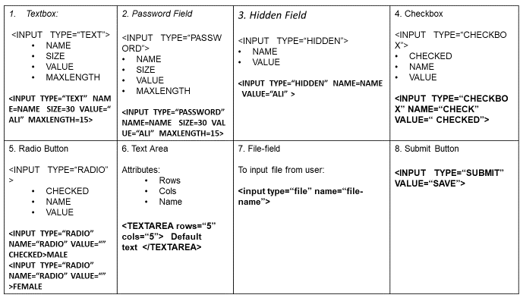
Basic Construction of an HTML Page:
HTML Forms and their elements

Slide 35
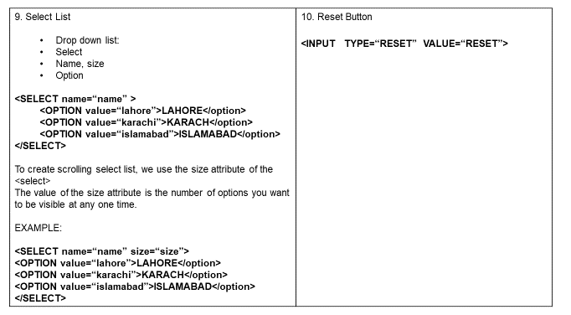
Basic Construction of an HTML Page:
HTML Forms and their elements

Slide 36
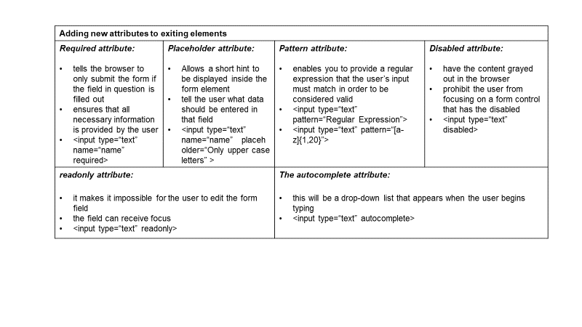
Basic Construction of an HTML Page:
Enhancements in forms
HTML5 enhances the forms in two ways

Slide 37
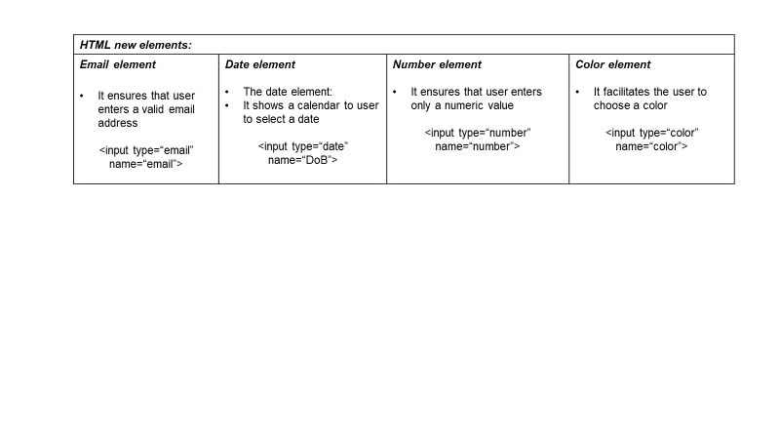
Basic Construction of an HTML Page:

Slide 38
Write accessible HTML using Semantic HTML tags
Semantic within HTML is the practice of giving content on the page meaning and structure by using the proper element. Semantic
code describes the value of content on a page, regardless of the style or appearance of that content. There are several benefits to using semantic elements, including enabling computers, screen readers, search engines, and other devices to adequately read and understand the content on a web page. Additionally, semantic HTML is easier to manage and work with, as it shows clearly what each piece of content is about.
Before going into semantic elements, let’s look at two elements <div>s and <span>s that don’t hold any semantic value. They exist for styling purposes only.
Divisions, or <div>s, and <span>s are HTML elements that act as containers solely for styling purposes.
To understand the difference between <div> and span<>, we must know the difference between inline and block elements
Block-level element: Block-level elements begin on a new line, stacking one on top of the other, and occupy any available width. Block-level elements may be nested inside one another and may wrap inline-level elements. We’ll most commonly see block-level elements used for larger pieces of content, such as paragraphs.
Inline-level elements: Inline-level elements do not begin on a new line. They fall into the normal flow of a document, lining up one after the other, and only maintain the width of their content. Inline-level elements may be nested inside one another; however, they cannot wrap block-level elements. We’ll usually see inline-level elements with smaller pieces of content, such as a few words.

Slide 39
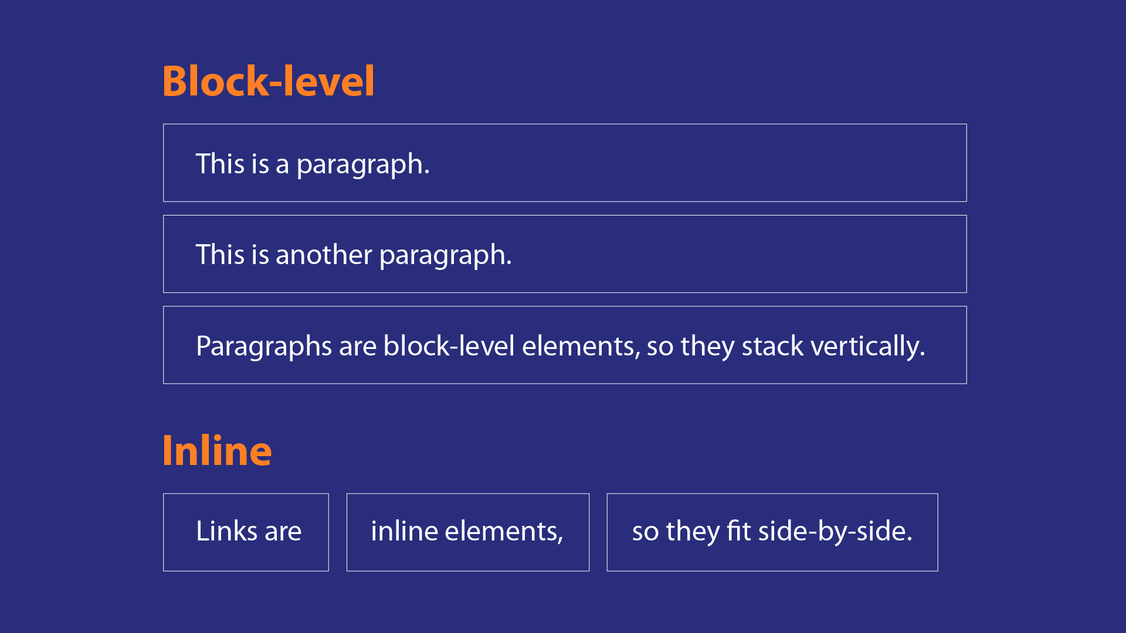
Write accessible HTML using Semantic HTML tags

Slide 40
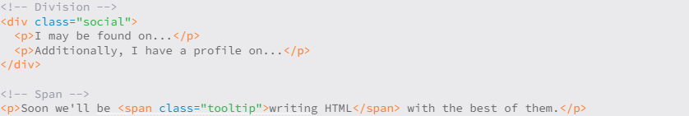
Basic Construction of an HTML Page:
<div>:
A <div> is a block-level element that is commonly used to identify large groupings of content, and which helps to build a web page’s layout and design.
<span>:
It is an inline-level element commonly used to identify smaller groupings of text within a block-level element.
We’ll commonly see <div>s and <span>s with class or id attributes for styling purposes. Choosing a class or id attribute value, or name, requires a bit of care. We want to choose a value that refers to the content of an element, not necessarily the appearance of an element.
For example, if we have a <div> with an orange background that contains social media links, our first thought might be to give the <div> a class value of orange. What happens if that orange background is later changed to blue? Having a class value of orange no longer makes sense. A more sensible choice for a class value would be social, as it pertains to the contents of the <div>, not the style.

Slide 41
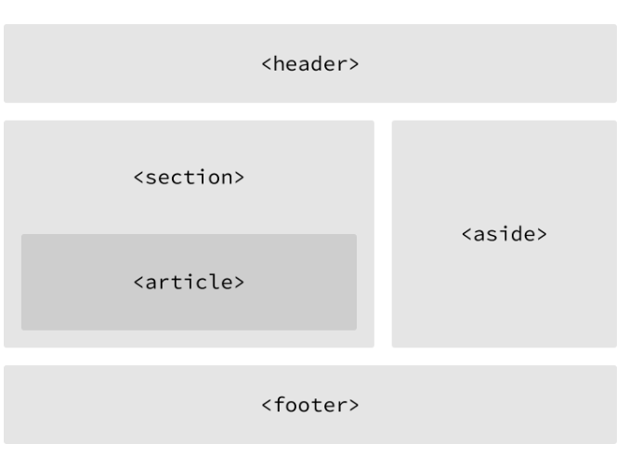
Write accessible HTML using Semantic HTML tags
Building Structure:
For the longest time the structure of a web page was built using divisions. The problem was that divisions provide no semantic value, and it was fairly difficult to determine the intention of these divisions. Fortunately HTML5 introduced new structurally based elements, including the <header>, <nav>, <article>, <section>, <aside>, and <footer> elements. All of these new elements are intended to give meaning to the organization of our pages and improve our structural semantics. They are all block-level elements and do not have any implied position or style. Additionally, all of these elements may be used multiple times per page, so long as each use reflects the proper semantic meaning.

Slide 42
Write accessible HTML using Semantic HTML tags
Building Structure:
Main: The main tag defines the primary section in the document related to the central content of a document with a <main> tag.
Section: It is used to define specific sections in a document such as a chapter, header, footer, or any other section, and is specified with the <section> tag.
Header: The header tag defines the title or heading of a document or its section. It is specified with the <header> tag.
Footer: The footer tag defines the section of a document that contains information such as copyright or author’s information. It is designated with the <footer> tag.
Article: The article tag represents an independent or self-contained part of the content of a document with the tag <article>.

Slide 43
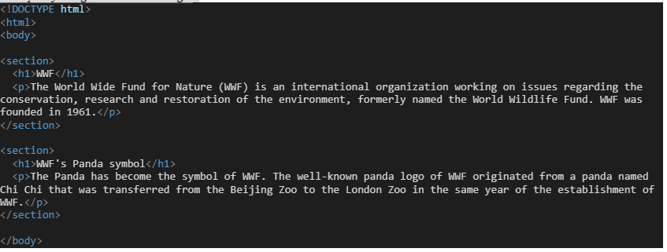
Example of using some semantic tags:
Making an html page using Semantics tags:
Open the notepad++ or VScode editor, and use some other semantic html tags on the above mentioned coding example: i.e. add <header>, <footer>, <aside> etc.

Slide 44
Closing (15 mins)

