Slide 1
Front End Web Development Fundamentals
2_ Learn CSS- SYNC (01 hours 30 minutes)
MEAN/MERN STACK

Slide 2
Opening (5 mins)

Slide 3
Learning Objectives:
Explain what CSS is?
How to use it to style pages?
Purpose of using CSS
Writing Style Sheets:
Style Sheet Strategies:
Using Id’s
Using Classes
font properties
text properties
styling links
styling background
styling tables
What is the box model?

Slide 4
What is CSS?
CSS stands for cascading style sheets:
Created by Hakon Lie of MIT in 1994
Has become the W3C standard for controlling visual presentation of web pages
Cascading style-sheets are powerful mechanism to add style to web document
Enforce standards and uniformity
Create dynamic effects
Works by allowing you to specify rules

Slide 5
Purpose of using CSS
Saves time
Easy to change
Pages load faster
Keep consistency
Give you more control over layout
Use styles with JavaScript
Multiple Device Compatibility

Slide 6
CSS in detail (1hr 15 mins)

Slide 7
Writing Style Sheets in CSS:
Let us understand the differences among inline, internal, and external style sheets.
In-line styles:
Add styles to each tag within the HTML file.
Use it when you need to format just a single section in a web page
Style attribute is used to add style.
Example:
<h1 style=“color:red; font-family: sans-sarif” > IU </h1>
Embedded/internal styles
A style is applied to the entire HTML file.
Use it when you need to modify all instances of particular element (e.g., h1) in a web page.
Example:
<style>
h1 {color:red; font-family:sans-serif}
</style>
External style sheet
An external style sheet is a text file containing the style definition (declaration)
Use it when you need to control the style for an entire website
Open a new blank document in Notepad
Type style declarations
h1 {color:red; font-family:calibri;}
Do not include <style> tags
Save the document as filename.css
Open a HTML file
Between <head> and </head> add
<link href=URL rel=“relation_type” type=“link_type”>
URL is the file.css
Relation_type=“stylesheet”
Link_type=“text/css”
Save this file and the .css file in the same web server directory.

Slide 8
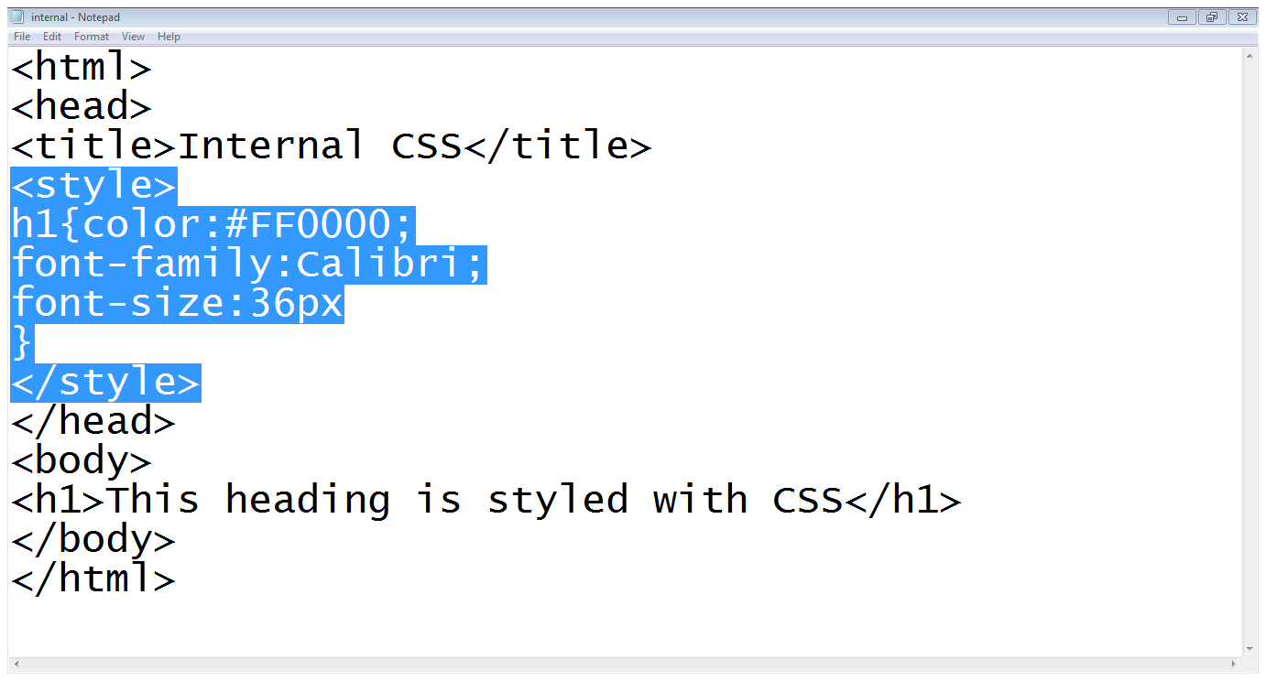
Writing Style Sheets in CSS:
Embedded/internal styles

Slide 9
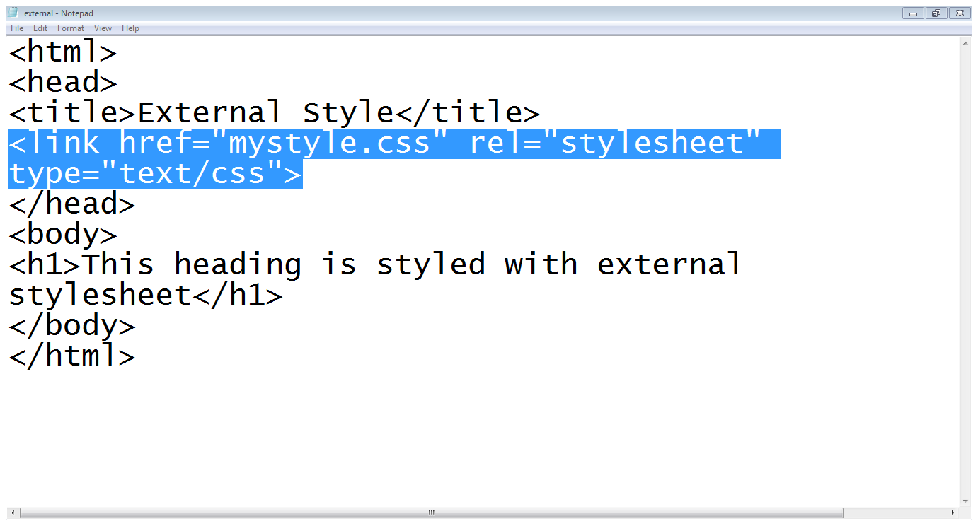
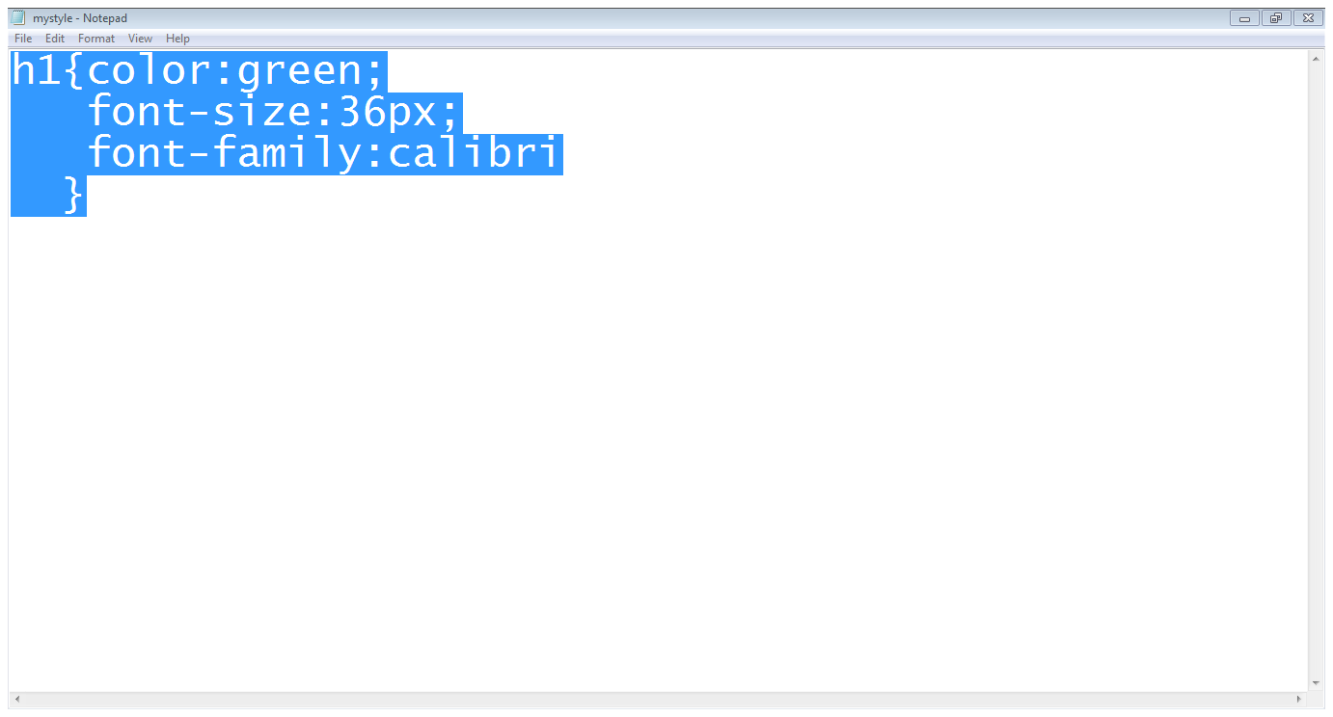
Writing Style Sheets in CSS:
External style sheet

Slide 10
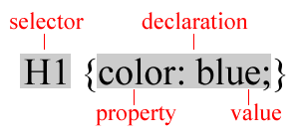
Understand how to declare a style:
A rule consists of
A selector: element or elements the declaration applies to
Declaration: how the elements referred to in the selector should be styled
property: which is the property of the selected element
value: which is a specification for this property
Using Id’s:
Use an id to distinguish something, like a paragraph, from the others in a document
The id selector is used to specify a style for a single, unique element
Create a style Id:
#id_name {style attributes and values}
Use a style Id:
<tag ID=id_name>

Slide 11
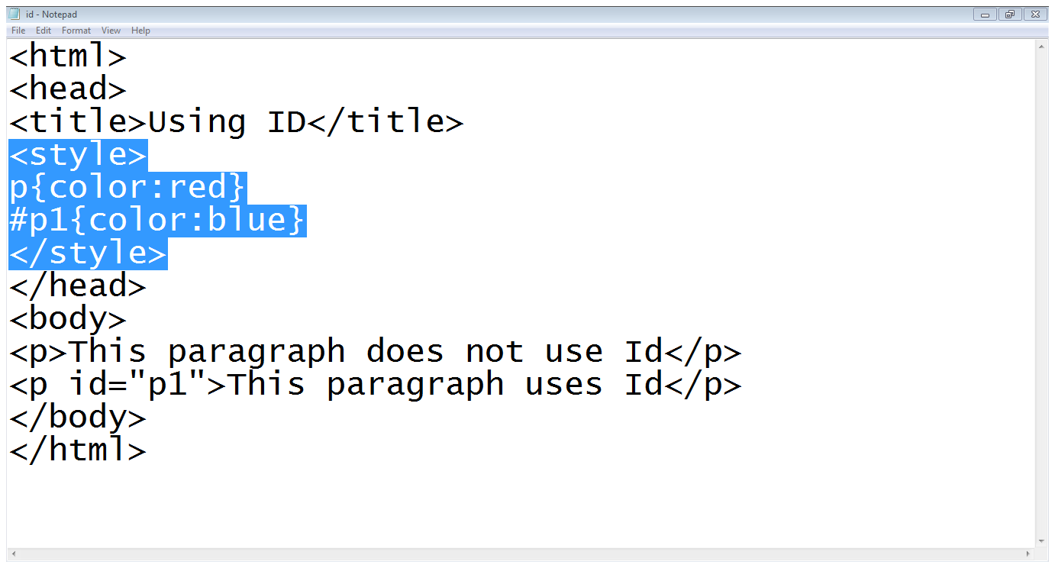
Understand how to declare a style:
Note: HTML requires each id be unique– therefore an id value can only be used once in a document.

Slide 12
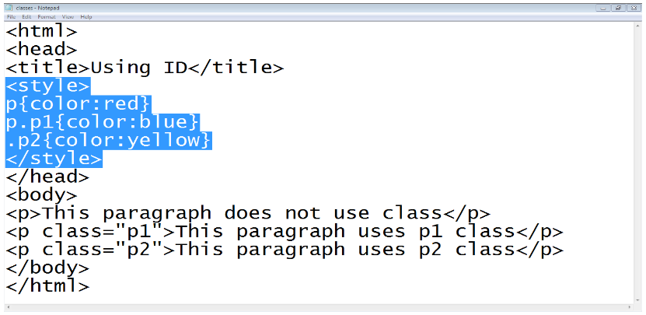
Using Classes:
To create a class
tag.class_name {style attributes} or
.class_name {style attributes}
To apply a style
<tag CLASS=class_name>
<h1 CLASS=FirstHeader>IU</h1>

Slide 13
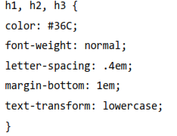
Difference between classes and Id’s:
You can’t have more than one tag with the same ID value
You can apply the same Class value to multiple document tags
Classes or Id?
use ID's for any elements that are simply used once on a page
OR
only use classes to style websites, but, when you have to use an element in JavaScript, use an identifier
You can apply a style to many selectors if you like

Slide 14
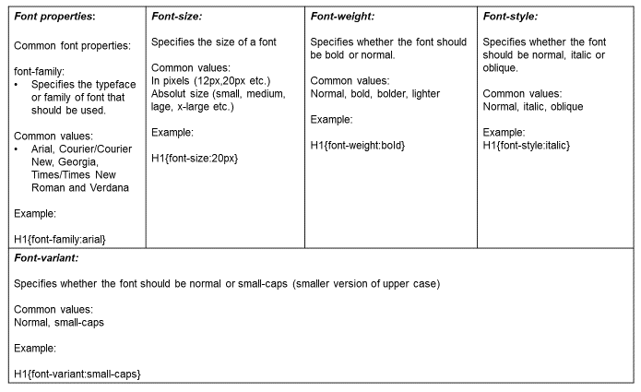
CSS properties:
Font properties:

Slide 15
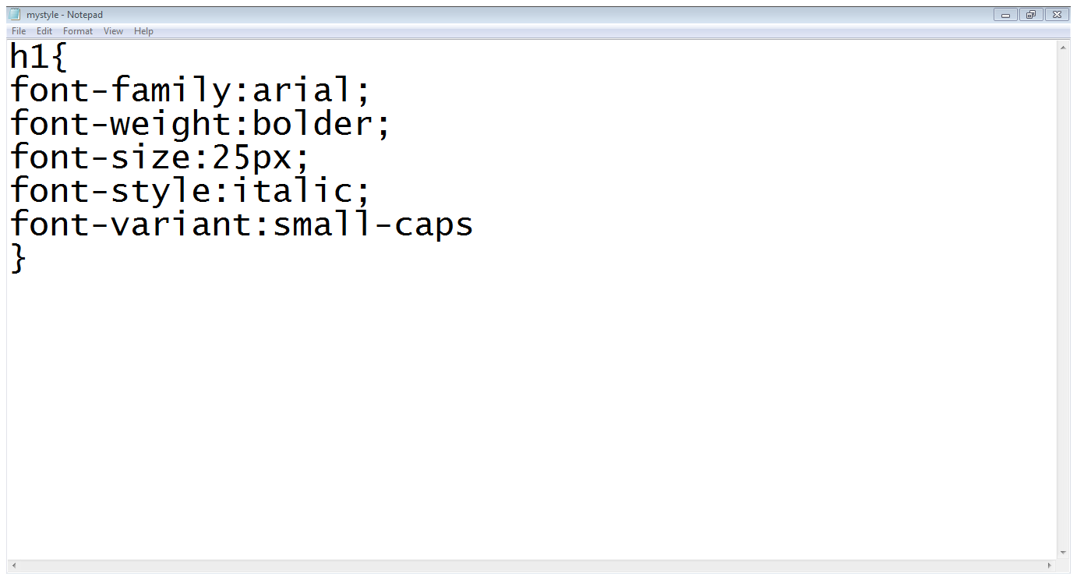
CSS properties:
Font properties:

Slide 16
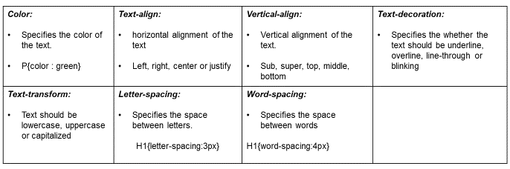
CSS properties:
TEXT properties:

Slide 17
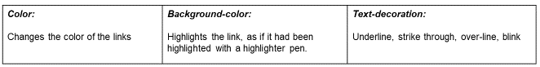
CSS properties:
Styling links:

Slide 18
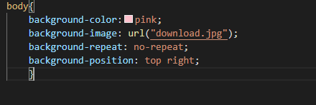
CSS properties:
Styling Background:
background-color:
Specifies the background color
background-image:
Specifies the background image
background-repeat:
Specifies whether the image should repeat or not
background-position:
Where an image should be positioned.

Slide 19
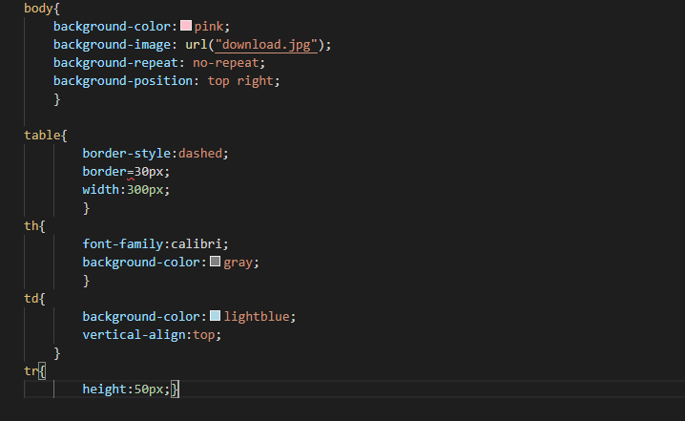
CSS properties:
Styling tables:
text and font
vertical – align
width
height
background - color
background – image
border:
border-style (solid, dashed, doted, double etc.)
border-color
border-bottom (solid, dashed, doted, double etc.)
padding
Padding-left
Padding-right
Padding-top
padding-bottom

Slide 20
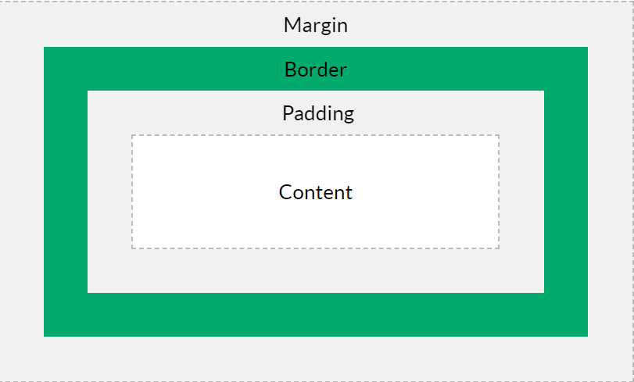
CSS properties:
What is the box model?
Every element on a page is a rectangular box and may have width, height, padding, borders, and margins.
The box model allows us to add a border around elements, and to define space between elements.
Content - The content of the box, where text and images appear
Padding - Clears an area around the content. The padding is transparent
Border - A border that goes around the padding and content
Margin - Clears an area outside the border. The margin is transparent

Slide 21
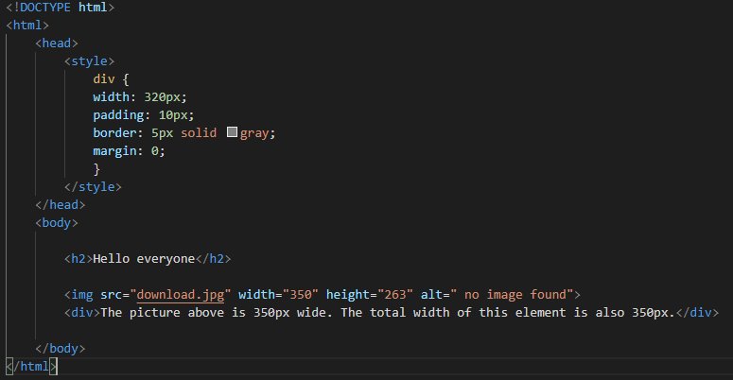
CSS properties:
What is the box model?
Every element on a page is a rectangular box and may have width, height, padding, borders, and margins.
The box model allows us to add a border around elements, and to define space between elements.
Content - The content of the box, where text and images appear
Padding - Clears an area around the content. The padding is transparent
Border - A border that goes around the padding and content
Margin - Clears an area outside the border. The margin is transparent

Slide 22
Closing (10 mins)

Slide 23
Sometimes you need to introduce a key point or definition.

Slide 24
Two Columns
This is good for introducing parallel concepts or facts.
You can also add tables, diagrams, or other visual aids here.

Slide 25
Three Columns
Slides like this can get
Very dense with content
So use them judiciously.

Slide 26
Named Comparison
ITEM ONE
ITEM TWO

Slide 27
Triple Named Comparison
ITEM 1
ITEM 2
ITEM 3

Slide 28
Answer the following question:
What have you noticed about the format of Facebook?

Slide 29
If you need a table
TABLE HEADING
Row 1
Row 2
Total Row

Slide 31
You can present
Content with a caption.

Slide 32


You can show a horizontal image with
Some explanatory text.

Slide 33

You can also show
A square image with text.

Slide 34
An end slide is important.
REMEMBER TO LEAVE KEY INFORMATION HERE, SUCH AS HOW TO GET IN TOUCH WITH THE INSTRUCTOR REGARDING QUESTIONS.

