Slide 1
1_WEB-3: Learn Bootstrap - SYNC (01 hours 30 minutes)
MEAN/MERN STACK

Slide 2
Opening (10 mins)

Slide 3
Learning Objectives:
Explain the core concept of Bootstrap.
What is Bootstrap?
What is Responsive Web Design?
Get Bootstrap 5
Layout and style your website using Bootstrap
Bootstrap Components

Slide 4
What is Bootstrap?
Bootstrap is a free front-end framework for faster and easier web development
Bootstrap includes HTML and CSS based design templates for typography, forms, buttons, tables, navigation, modals, image carousels and many other, as well as optional JavaScript plugins
Bootstrap also gives you the ability to easily create responsive designs
What is Responsive Web Design?
Responsive web design is about creating web sites which automatically adjust themselves to look good on all devices, from small phones to large desktops.

Slide 5
Content (1hr 15 mins)

Slide 6
What is Bootstrap?
Get Bootstrap 5:
There are two methods to use Bootstrap:
Download Bootstrap 5 from getbootstrap.com.
Include Bootstrap 5 from a CDN (Content Delivery Network): Adding these two line is you <head> will give you access to Bootstrap v5.
<!-- Latest compiled and minified CSS -->
<link href="https://cdn.jsdelivr.net/npm/bootstrap@5.1.3/dist/css/bootstrap.min.css" rel="stylesheet">
<!-- Latest compiled JavaScript -->
<script src="https://cdn.jsdelivr.net/npm/bootstrap@5.1.3/dist/js/bootstrap.bundle.min.js"></script>

Slide 7
What is Bootstrap?
Get Bootstrap 5:
There are two methods to use Bootstrap:
Download Bootstrap 5 from getbootstrap.com.
Include Bootstrap 5 from a CDN (Content Delivery Network): Adding these two line is you <head> will give you access to Bootstrap v5.
<!-- Latest compiled and minified CSS -->
<link href="https://cdn.jsdelivr.net/npm/bootstrap@5.1.3/dist/css/bootstrap.min.css" rel="stylesheet">
<!-- Latest compiled JavaScript -->
<script src="https://cdn.jsdelivr.net/npm/bootstrap@5.1.3/dist/js/bootstrap.bundle.min.js"></script>

Slide 8
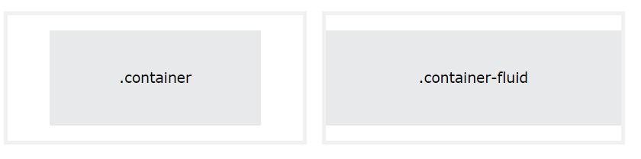
Layout and style your website using Bootstrap
Containers:
.container class: The .container class provides a responsive fixed width container
.container-fluid class: The .container-fluid class provides a full width container, spanning the entire width of the viewport
Below image is for your reference to understand the difference between .container and .container-fluid class.

Slide 9
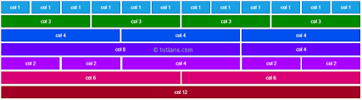
Layout and style your website using Bootstrap
2. Grid:
Bootstrap's grid system is built with flexbox and allows up to 12 columns across the page.
The grid system is responsive, and the columns will re-arrange automatically depending on the screen size.
Make sure that the sum adds up to 12 or fewer (it is not required that you use all 12 available columns).

Slide 10
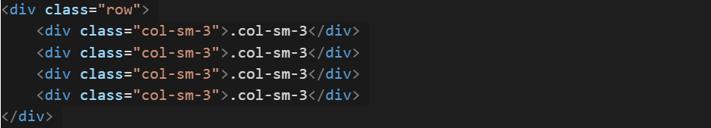
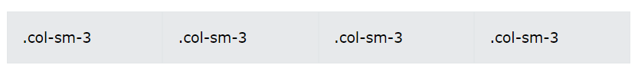
Layout and style your website using Bootstrap
2. Grid:
The Bootstrap 5 grid system has six classes:
.col- (extra small devices - screen width less than 576px)
.col-sm- (small devices - screen width equal to or greater than 576px)
.col-md- (medium devices - screen width equal to or greater than 768px)
.col-lg- (large devices - screen width equal to or greater than 992px)
.col-xl- (xlarge devices - screen width equal to or greater than 1200px)
.col-xxl- (xxlarge devices - screen width equal to or greater than 1400px
Output:

Slide 11
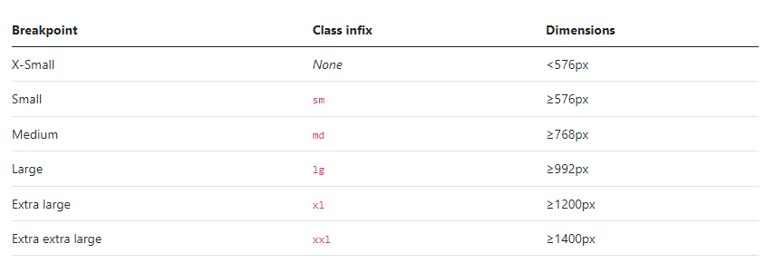
Layout and style your website using Bootstrap
3. Breakpoints:
Breakpoints are the building blocks of responsive design. Use them to control when your layout can be adapted at a particular viewport or device size.
Mobile first, responsive design is the goal. Bootstrap’s CSS aims to apply the bare minimum of styles to make a layout work at the smallest breakpoint, and then layers on styles to adjust that design for larger devices. This optimizes your CSS, improves rendering time, and provides a great experience for your visitors.
The following tables shows the break points.

Slide 12
Layout and style your website using Bootstrap
3. Breakpoints:
Breakpoints are the building blocks of responsive design. Use them to control when your layout can be adapted at a particular viewport or device size.
Mobile first, responsive design is the goal. Bootstrap’s CSS aims to apply the bare minimum of styles to make a layout work at the smallest breakpoint, and then layers on styles to adjust that design for larger devices. This optimizes your CSS, improves rendering time, and provides a great experience for your visitors.
The following tables shows the break points.

Slide 13
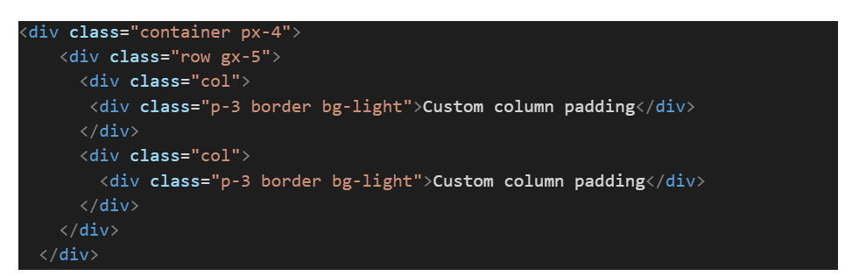
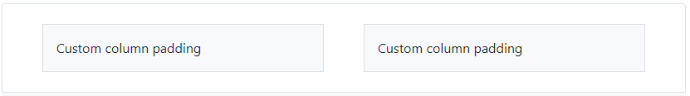
Layout and style your website using Bootstrap
3. Gutters
Gutters are the padding between your columns, used to responsively space and align content in the Bootstrap grid system.
Gutters are the gaps between column content, created by horizontal padding. We set padding-right and padding-left on each column, and use negative margin to offset that at the start and end of each row to align content.
Gutters start at 1.5rem (24px) wide. This allows us to match our grid to the padding and margin spacers scale.
Gutters can be responsively adjusted. Use breakpoint-specific gutter classes to modify horizontal gutters, vertical gutters, and all gutters.
Horizontal gutters
.gx-* classes can be used to control the horizontal gutter widths. The .container or .container-fluid parent may need to be adjusted if larger gutters are used too to avoid unwanted overflow, using a matching padding utility. For example, in the following example we’ve increased the padding with .px-4:

Slide 14
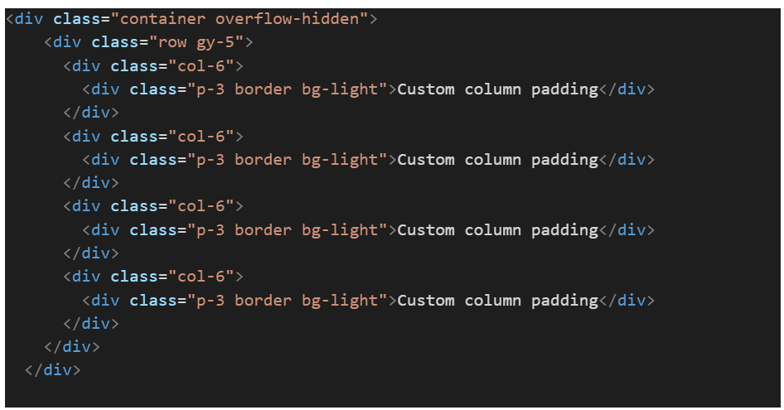
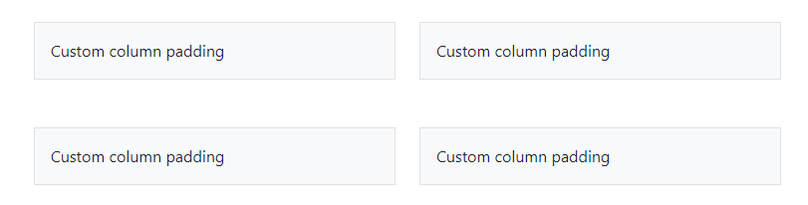
Layout and style your website using Bootstrap
3. Gutters
Vertical Gutter:
gy-* classes can be used to control the vertical gutter widths. Like the horizontal gutters, the vertical gutters can cause some overflow below the .row at the end of a page. If this occurs, you add a wrapper around .row with the .overflow-hidden class:

Slide 15
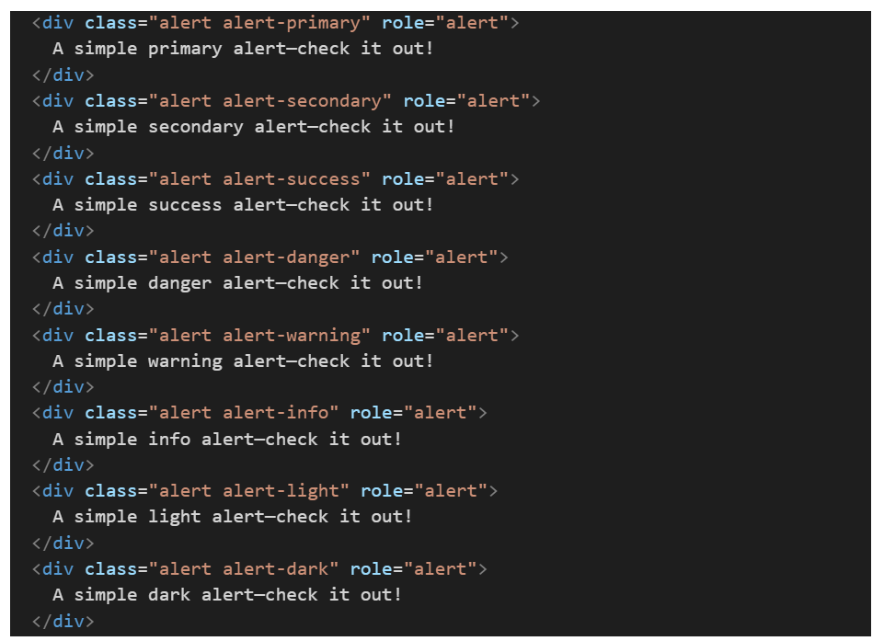
Components:
Alerts:
Provide contextual feedback messages for typical user actions with the handful of available and flexible alert messages.
Examples: Alerts are available for any length of text, as well as an optional close button. For proper styling, use one of the eight required contextual classes (e.g., .alert-success).

Slide 16
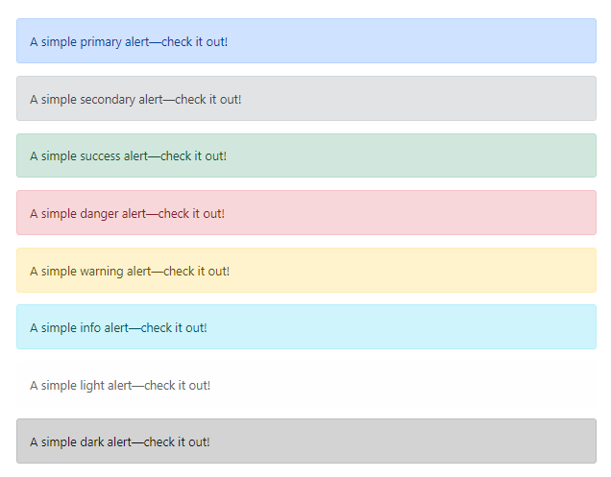
Components:
Alerts:
Provide contextual feedback messages for typical user actions with the handful of available and flexible alert messages.
Examples: Alerts are available for any length of text, as well as an optional close button. For proper styling, use one of the eight required contextual classes (e.g., .alert-success).

Slide 17
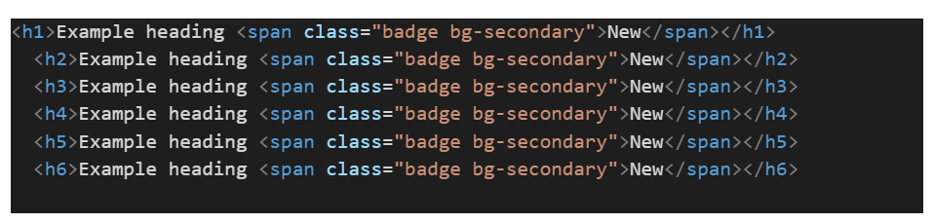
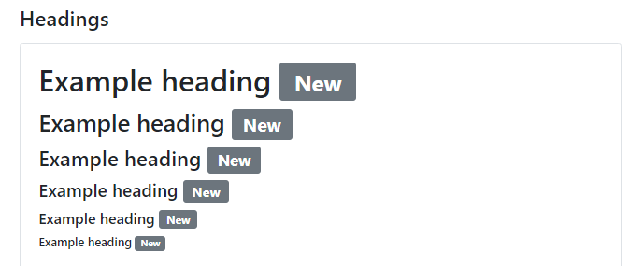
Components:
2. Badge
Badges is for small count and labeling component.
Badges scale to match the size of the immediate parent element by using relative font sizing and em units.
Example:

Slide 18

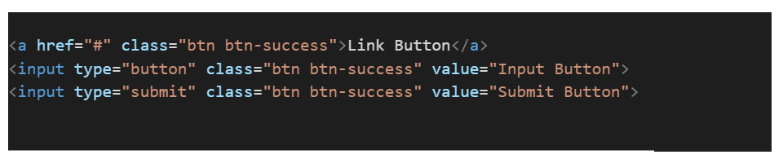
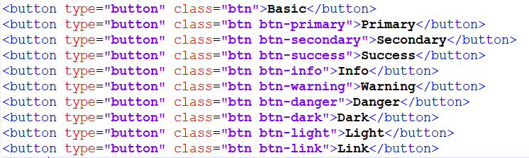

Components:
3.Buttons:
Use Bootstrap’s custom button styles for actions in forms, dialogs, and more with support for multiple sizes, states, and more. Button class can also be used on <a> and <input> elements.

Slide 19

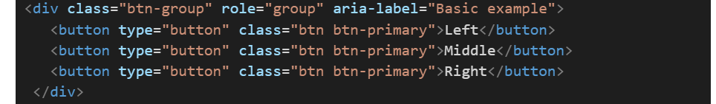
Components:
4. Button group: Group a series of buttons together on a single line or stack them in a vertical column.

Slide 20
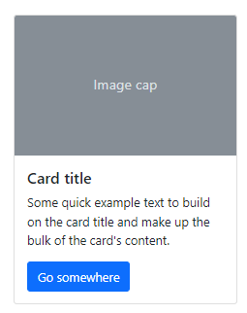
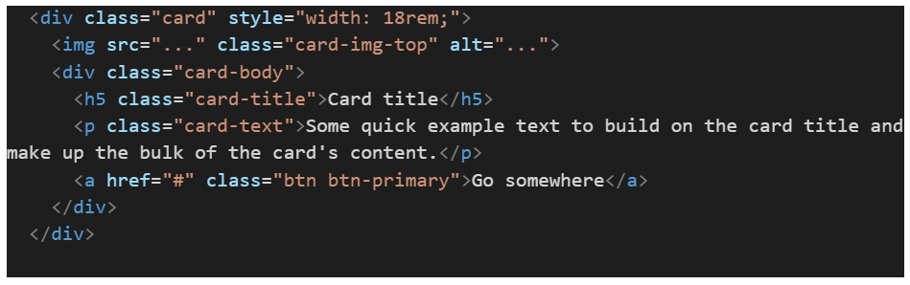
Components:
5. Card
Bootstrap’s cards provide a flexible and extensible content container with multiple variants and options.
Example:
Below is an example of a basic card with mixed content and a fixed width. Cards have no fixed width to start, so they’ll naturally fill the full width of its parent element. This is easily customized with our various sizing options.

Slide 21
Components:
6. Carousel: A slideshow component for cycling through elements—images or slides of text—like a carousel.
7. Close button: A generic close button for dismissing content like alerts.
8. Collapse:
The collapse is used to show and hide content.
Buttons or anchors are used as triggers that are mapped to specific elements you toggle.
Collapsing an element will animate the height from its current value to 0.
Given how CSS handles animations, you cannot use padding on a .collapse element. Instead, use the class as an independent wrapping element.
For examples refer the documentation.
9. Dropdowns
Dropdowns are toggleable, contextual overlays for displaying lists of links and more.
They’re made interactive with the included Bootstrap dropdown JavaScript plugin.
They’re toggled by clicking, not by hovering; this is an intentional design decision.
For examples refer the documentation.

Slide 22
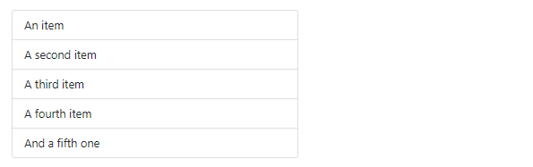
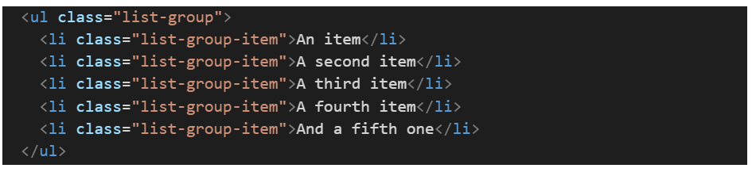
Components:
10. List group: List groups are a flexible and powerful component for displaying a series of content. Modify and extend them to support just about any content within.

Slide 23
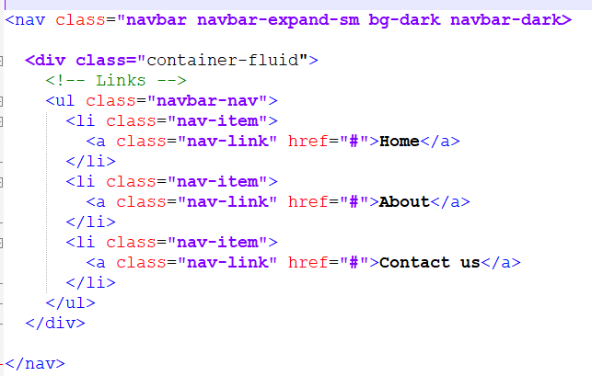
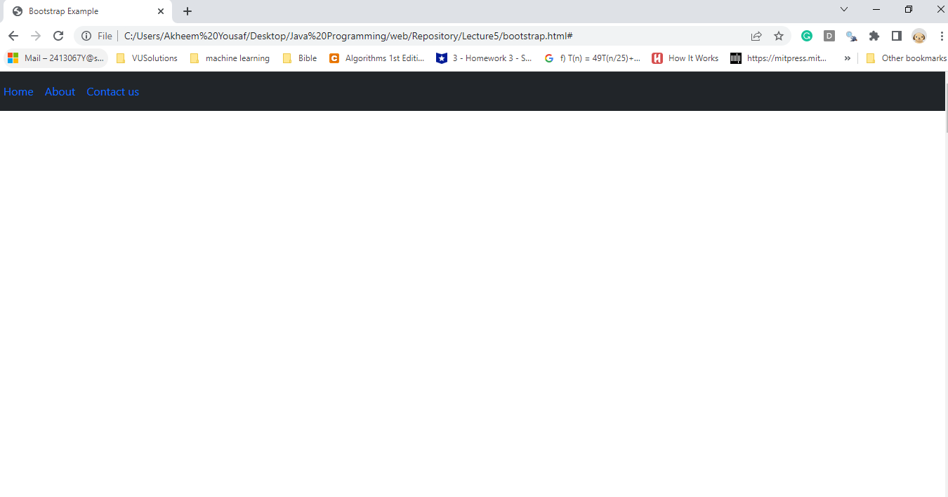
Components:
11. Navbar:
A navigation bar (also called a Navbar) is a user interface element within a webpage that contains links to other sections of the website.

Slide 24

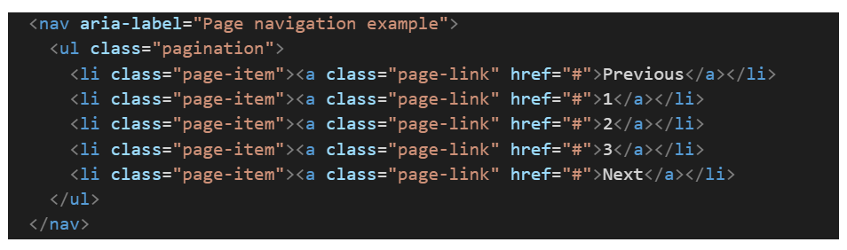
Components:
12. Pagination
Pagination is to indicate a series of related content exists across multiple pages.
We use a large block of connected links for our pagination, making links hard to miss and easily scalable, all while providing large hit areas.
Pagination is built with list HTML elements so screen readers can announce the number of available links.
Use a wrapping <nav> element to identify it as a navigation section to screen readers and other assistive technologies.
Example:

Slide 25
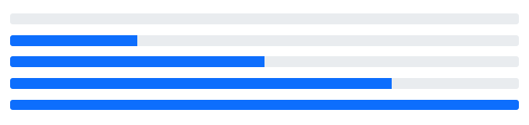
Components:
13. Progress
Progress components are built with two HTML elements, some CSS to set the width, and a few attributes.
We use the .progress as a wrapper to indicate the max value of the progress bar.
We use the inner .progress-bar to indicate the progress so far.
The .progress-bar requires an inline style, utility class, or custom CSS to set their width.
The .progress-bar also requires some role and aria attributes to make it accessible.
Put that all together, and you have the following examples.

Slide 26
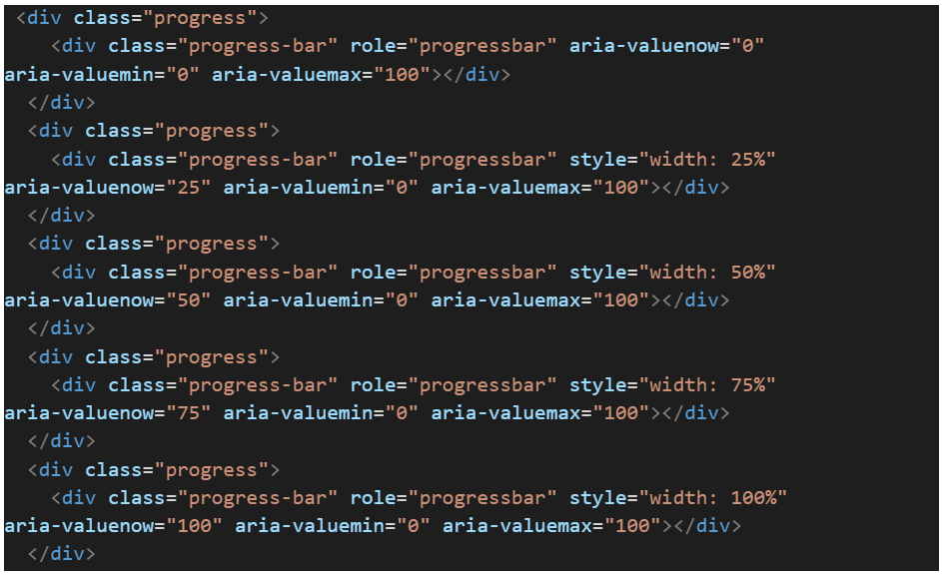
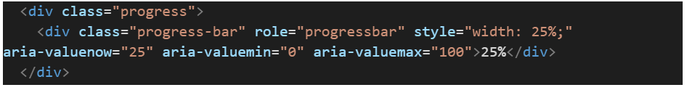
Components:
13. Progress
Put that all together, and you have the following examples.
Adding labels:
Add labels to your progress bars by placing text within the .progress-bar.

Slide 27
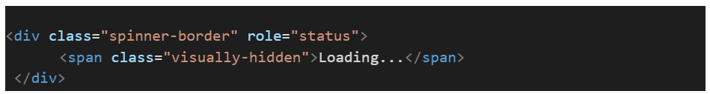
Components:
14. Spinners
Indicate the loading state of a component or page with Bootstrap spinners.
Their appearance, alignment, and sizing can be easily customized with our amazing utility classes.
For accessibility purposes, each loader includes role="status" and a nested <span class="visually-hidden">Loading...</span>.

Slide 28
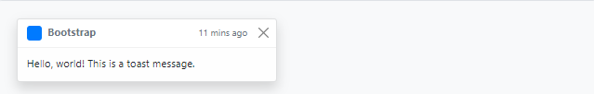
Components:
15. Toasts
Push notifications to your visitors with a toast, a lightweight and easily customizable alert message.
Toasts are lightweight notifications designed to mimic the push notifications that have been popularized by mobile and desktop operating systems.
Toasts are opt-in for performance reasons, so you must initialize them yourself.
Toasts will automatically hide if you do not specify autohide: false.
To encourage extensible and predictable toasts, we recommend a header and body. Toast headers use display: flex, allowing easy alignment of content thanks to our margin and flexbox utilities.
Toasts are as flexible as you need and have very little required markup. At a minimum, we require a single element to contain your “toasted” content and strongly encourage a dismiss button.

Slide 29
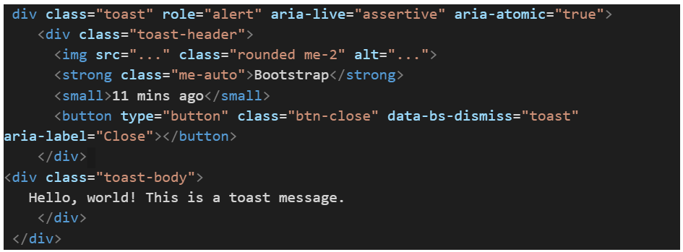
Components:
15. Toasts

Slide 30
Closing (5 mins)

