Slide 1
1_Git 2 - GitHub Fundamentals - SYNC (45 Minutes)
MEAN/MERN STACK

Slide 2
Opening (2 mins)

Slide 3
Learning Objectives:
Push Local to Remote
Repository Visibility (Public-Private Clarification)
.gitignore
GitHub fork and clone functionality
Reviewing the changes
Staging and Unstaging
Branches
Git Push, Fetch, Pull
Pull request

Slide 4
Content (40 mins)

Slide 5
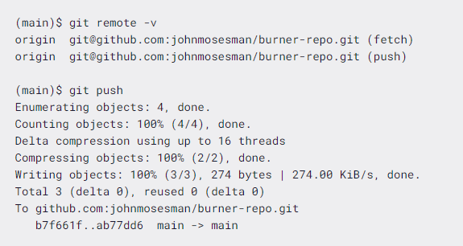
Trying to push local to remote:
In Git, branches are commonly used in order to develop features independently from the main workflow. Git is a decentralized versioning system: as a consequence, you have local and remote branches on your repository. When you are working locally, you are committing to your local branch, but what if you wanted to share your changes with your colleagues? In order to share changes, you will need to push your Git branch to the remote repository. The basic command for pushing a local branch to a remote repository is git push. This command has a variety of options and parameters you can pass to it, and we will discuss the ones that you will use the most often. If you run the simple command git push, Git will by default choose two more parameters for you: the remote repository to push to and the branch to push. The general form of the command is this: $ git push <remote> <branch> By default, Git chooses origin for the remote and your current branch as the branch to push. If your current branch is main, the command git push will supply the two default parameters—effectively running git push origin main. In the example below, the origin remote is a GitHub repository, and the current branch is main

Slide 6

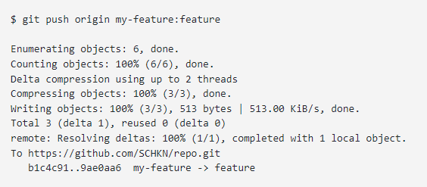
Trying to push local to remote:
From the output you can see that the local main branch was pushed to the remote main branch:
You will usually push your local branch to a remote branch of the same name—but not always. To push to a branch of a different name, you just need to specify the branch you want to push and the name of the branch you want to push to separated by a colon :.
$ git push <remote> <local_branch>:<remote_name>
As an example, let’s say that you have created a local branch named “my-feature”. However, you want to push your changes to the remote branch named “feature” on your repository. In order to push your branch to the “feature” branch, you would execute the following command

Slide 7
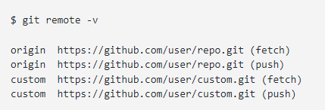
Trying to push local to remote:
In order to push your branch to another branch, you may need to merge the remote branch to your current local branch and in order to be merged; the tip of the remote branch cannot be behind the branch you are trying to push. Before pushing, make sure to pull the changes from the remote branch and integrate them with your current local branch. To push a branch to another repository, you need to execute the “git push” command, and specify the correct remote name as well as the branch to be pushed. $ git push <remote> <branch> In order to see the remotes defined in your repository, you have to execute the git remote command with the -v option for “verbose”.
In the previous examples, we pushed our branch to the origin remote but we can choose to publish it to the custom remote if we want.
$ git push custom feature
The git push command is one you'll be using often, and there are tons of options that can be used with it. For more helpful options and shortcuts, read the documentation.

Slide 8
Repository Visibility (Public-Private Clarification):
When you create a repository, you can choose to make the repository public or private. You can restrict who has access to a repository by choosing a repository's visibility: public or private. Making a repository public When you set visibility of your repository public, your code will be visible to anyone on the internet. Though you choose who can make a commit. GitHub will detach private forks and turn them into a standalone private repository. The repository will automatically gain access to GitHub Advanced Security features. Public repositories now have a public label next to their names like private repositories do. Previously, repositories had a label next to their name that indicated if they were private, but there was no label if they were public. This led to people not recognizing that a repository was public and accidentally committing private code to it. Making a repository private When you set visibility of your repository private, you can choose who can see your code and commit to your repository GitHub will detach public forks of the public repository and put them into a new network. Public forks are not made private. If you're using GitHub Free for personal accounts or organizations, some features won't be available in the repository after you change the visibility to private. Any published GitHub Pages site will be automatically unpublished. If you added a custom domain to the GitHub Pages site, you should remove or update your DNS records before making the repository private, to avoid the risk of a domain takeover. GitHub will no longer include the repository in the GitHub Archive Program. GitHub Advanced Security features, such as code scanning, will stop working.

Slide 9

.gitignore file:
Git sees every file in your working copy as one of three things: tracked - a file which has been previously staged or committed untracked - a file which has not been staged or committed; ignored - a file which Git has been explicitly told to ignore. Ignored files are usually build artifacts and machine generated files that can be derived from your repository source or should otherwise not be committed. Some common examples are: dependency caches, such as the contents of /node_modules or /packages compiled code, such as .o, .pyc, and .class files build output directories, such as /bin, /out, or /target files generated at runtime, such as .log, .lock, or .tmp hidden system files, such as .DS_Store or Thumbs.db personal IDE config files, such as .idea/workspace.xml Ignored files are tracked in a special file named .gitignore that is checked in at the root of your repository. There is no explicit git ignore command: instead the .gitignore file must be edited and committed by hand when you have new files that you wish to ignore. .gitignore files contain patterns that are matched against file names in your repository to determine whether or not they should be ignored. Git ignore patterns .gitignore uses globbing patterns to match against file names. You can construct your patterns using various symbols. Further reading available here In addition to these characters, you can use # to include comments in your .gitignore file:

Slide 10


.gitignore file:
You can use \ to escape .gitignore pattern characters if you have files or directories containing them:
Shared .gitignore files in your repository Git ignore rules are usually defined in a .gitignore file at the root of your repository. However, you can choose to define multiple .gitignore files in different directories in your repository. Each pattern in a particular .gitignore file is tested relative to the directory containing that file. However the convention, and simplest approach, is to define a single .gitignore file in the root. As your .gitignore file is checked in, it is versioned like any other file in your repository and shared with your teammates when you push. Typically you should only include patterns in .gitignore that will benefit other users of the repository.
Personal Git ignore rules You can also define personal ignore patterns for a particular repository in a special file at .git/info/exclude. These are not versioned, and not distributed with your repository, so it's an appropriate place to include patterns that will likely only benefit you. For example if you have a custom logging setup, or special development tools that produce files in your repository's working directory, you could consider adding them to .git/info/exclude to prevent them from being accidentally committed to your repository.
Global Git ignore rules In addition, you can define global Git ignore patterns for all repositories on your local system by setting the Git core.excludesFile property. You'll have to create this file yourself. If you're unsure where to put your global .gitignore file, your home directory isn't a bad choice (and makes it easy to find later). Once you've created the file, you'll need to configure its location with git config:

Slide 11
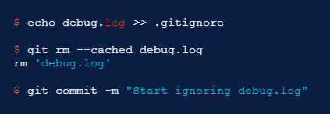
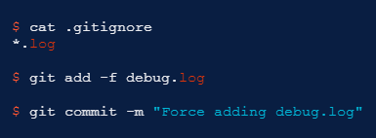
.gitignore file:
You should be careful what patterns you choose to globally ignore, as different file types are relevant for different projects. Special operating system files (e.g. .DS_Store and thumbs.db) or temporary files created by some developer tools are typical candidates for ignoring globally. Ignoring a previously committed file If you want to ignore a file that you've committed in the past, you'll need to delete the file from your repository and then add a .gitignore rule for it. Using the --cached option with git rm means that the file will be deleted from your repository, but will remain in your working directory as an ignored file.
You can omit the --cached option if you want to delete the file from both the repository and your local file system.
Committing an ignored file It is possible to force an ignored file to be committed to the repository using the -f (or --force) option with git add:

Slide 12
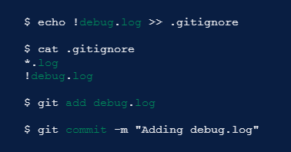

.gitignore file:
You might consider doing this if you have a general pattern (like *.log) defined, but you want to commit a specific file. However a better solution is to define an exception to the general rule:
This approach is more obvious, and less confusing, for your teammates.
Debugging .gitignore files If you have complicated .gitignore patterns, or patterns spread over multiple .gitignore files, it can be difficult to track down why a particular file is being ignored. You can use the git check-ignore command with the -v (or --verbose) option to determine which pattern is causing a particular file to be ignored:
The output shows:
<file containing the pattern> : <line number of the pattern> : <pattern> <file name>

Slide 13
GitHub fork and clone functionality:
Fork Fork is an operation been perform over the projects as real big projects contain chunks of pieces of code consisting of 1000 lines. Here if we try to do changes and if something goes wrong then it becomes very tedious for a programmer or community to correct it. So using this Fork operation we are creating a copy of the repository in which changes are supposed to be made and reflected without affecting the original project. Clone When we create a new repository on GitHub or Any repository on Github, it exists as a remote location where our / any other repository is stored. Cloning a repository creates a local copy on our computer so that we can sync between both the local and remote locations of the repository. How to fork and how to clone repository? Visit the reference for details on how to fork and clone.

Slide 14
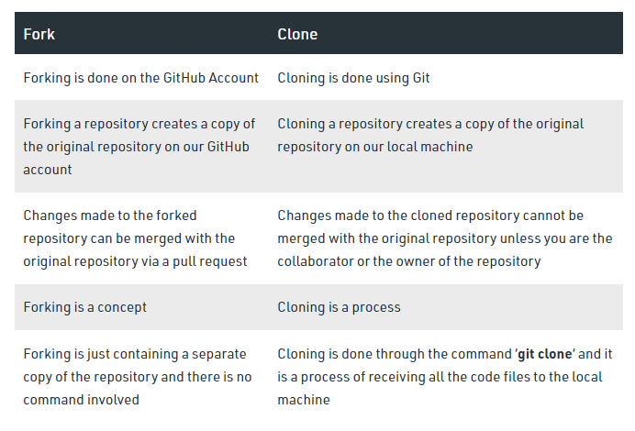
GitHub fork and clone functionality:
Difference between fork and clone:

Slide 15
GitHub fork and clone functionality:
Reviewing the changes
In a pull request, you can review and discuss commits, changed files, and the differences between the files in the base and compare branches.
You can review changes in a pull request one file at a time.
While reviewing the files in a pull request, you can leave individual comments on specific changes. After you finish reviewing each file, you can mark the file as viewed. This collapses the file, helping you identify the files you still need to review.
Details on reviewing a file, marking a file as viewed and how to review files. Follow the reference.
Staging and Unstaging
Unstaged changes exist in your working directory, but Git has not recorded them into its version history yet. You will usually want to stage them (mark them to become part of your next commit) or discard them by restoring the last committed version of the file.
Staged changes are a lot like unstaged changes, except that they’ve been marked to be committed the next time you run git commit. Upon your next commit, your staged changes become part of your Git history. git status will no longer list them as changes since they’re part of your last commit now.
https://howtogit.archive.pieterdedecker.be/concepts/types-of-changes.html

Slide 16
GitHub fork and clone functionality:
Branching:
Branches allow you to develop features, fix bugs, or safely experiment with new ideas in a contained area of your repository.
Use a branch to isolate development work without affecting other branches in the repository. Each repository has one default branch, and can have multiple other branches. You can merge a branch into another branch using a pull request.
You always create a branch from an existing branch. Typically, you might create a new branch from the default branch of your repository. You can then work on this new branch in isolation from changes that other people are making to the repository. A branch you create to build a feature is commonly referred to as a feature branch or topic branch. For more information, see "Creating and deleting branches within your repository."You can also use a branch to publish a GitHub Pages site. For more information, see "About GitHub Pages."You must have write access to a repository to create a branch, open a pull request, or delete and restore branches in a pull request. For more information, see "Access permissions on GitHub."
Default Branch:
When you create a repository with content on GitHub.com, GitHub creates the repository with a single branch. This first branch in the repository is the default branch. The default branch is the branch that GitHub displays when anyone visits your repository. The default branch is also the initial branch that Git checks out locally when someone clones the repository. Unless you specify a different branch, the default branch in a repository is the base branch for new pull requests and code commits.
By default, GitHub names the default branch main in any new repository.
You can change the default branch for an existing repository. For more information, see "Changing the default branch." You can set the name of the default branch for new repositories. For more information, see "Managing the default branch for your repositories," "Managing the default branch name for repositories in your organization," and "Enforcing repository management policies in your enterprise."

Slide 17
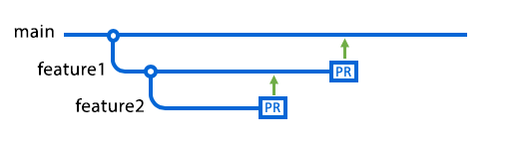
GitHub fork and clone functionality:
BWorking with branches:
Once you're satisfied with your work, you can open a pull request to merge the changes in the current branch (the head branch) into another branch (the base branch). For more information, see "About pull requests."
After a pull request has been merged, or closed, you can delete the head branch as this is no longer needed. You must have write access in the repository to delete branches. You can't delete branches that are directly associated with open pull requests. For more information, see "Deleting and restoring branches in a pull request"
If you delete a head branch after its pull request has been merged, GitHub checks for any open pull requests in the same repository that specify the deleted branch as their base branch. GitHub automatically updates any such pull requests, changing their base branch to the merged pull request's base branch. The following diagrams illustrate this.
Here someone has created a branch called feature1 from the main branch, and you've then created a branch called feature2 from feature1. There are open pull requests for both branches. The arrows indicate the current base branch for each pull request. At this point, feature1 is the base branch for feature2. If the pull request for feature2 is merged now, the feature2 branch will be merged into feature1.

Slide 18
GitHub fork and clone functionality:
Working with branches:
Once you're satisfied with your work, you can open a pull request to merge the changes in the current branch (the head branch) into another branch (the base branch). For more information, see "About pull requests."
After a pull request has been merged, or closed, you can delete the head branch as this is no longer needed. You must have write access in the repository to delete branches. You can't delete branches that are directly associated with open pull requests. For more information, see "Deleting and restoring branches in a pull request"
If you delete a head branch after its pull request has been merged, GitHub checks for any open pull requests in the same repository that specify the deleted branch as their base branch. GitHub automatically updates any such pull requests, changing their base branch to the merged pull request's base branch. The following diagrams illustrate this.
Here someone has created a branch called feature1 from the main branch, and you've then created a branch called feature2 from feature1. There are open pull requests for both branches. The arrows indicate the current base branch for each pull request. At this point, feature1 is the base branch for feature2. If the pull request for feature2 is merged now, the feature2 branch will be merged into feature1.

Slide 19
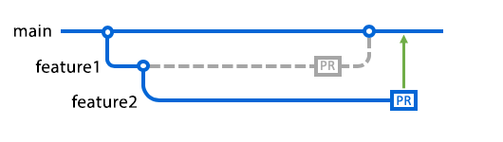
GitHub fork and clone functionality:
In the next diagram, someone has merged the pull request for feature1 into the main branch, and they have deleted the feature1 branch. As a result, GitHub has automatically retargeted the pull request for feature2 so that its base branch is now main.
Now when you merge the feature2 pull request, it'll be merged into the main branch.
Working with protected branches:
Repository administrators can enable protections on a branch. If you're working on a branch that's protected, you won't be able to delete or force push to the branch. Repository administrators can additionally enable several other protected branch settings to enforce various workflows before a branch can be merged.
To see if your pull request can be merged, look in the merge box at the bottom of the pull request's Conversation tab. For more information, "About protected branches."
When a branch is protected:
You won't be able to delete or force push to the branch.
If required status checks are enabled on the branch, you won't be able to merge changes into the branch until all of the required CI tests pass. For more information, see About status checks."

Slide 20
GitHub fork and clone functionality:
If required pull request reviews are enabled on the branch, you won't be able to merge changes into the branch until all requirements in the pull request review policy have been met. For more information, see "Merging a pull request."
If required review from a code owner is enabled on a branch, and a pull request modifies code that has an owner, a code owner must approve the pull request before it can be merged. For more information, see "About code owners."
If required commit signing is enabled on a branch, you won't be able to push any commits to the branch that are not signed and verified. For more information, see "About commit signature verification" and "About protected branches."
If you use GitHub's conflict editor to fix conflicts for a pull request that you created from a protected branch, GitHub helps you to create an alternative branch for the pull request, so that your resolution of the conflicts can be merged. For more information, see "Resolving a merge conflict on GitHub."

Slide 21
Git Push, Fetch, Pull:
Git Push:
The git push command is used to upload local repository content to a remote repository. Pushing is how you transfer commits from your local repository to a remote repo. It's the counterpart to git fetch, but whereas fetching imports commits to local branches, pushing exports commits to remote branches. Remote branches are configured using the git remote command. Pushing has the potential to overwrite changes, caution should be taken when pushing. These issues are discussed below.
Git push usage:
git push <remote> <branch>
Push the specified branch to , along with all of the necessary commits and internal objects. This creates a local branch in the destination repository. To prevent you from overwriting commits, Git won’t let you push when it results in a non-fast-forward merge in the destination repository.
git push <remote> --force
Same as the above command, but force the push even if it results in a non-fast-forward merge. Do not use the --force flag unless you’re absolutely sure you know what you’re doing.
git push <remote> --all
Push all of your local branches to the specified remote.
git push <remote> --tags
Tags are not automatically pushed when you push a branch or use the --all option. The --tags flag sends all of your local tags to the remote repository.
Git push discussion:
git push is most commonly used to publish an upload local changes to a central repository. After a local repository has been modified a push is executed to share the modifications with remote team members.

Slide 22
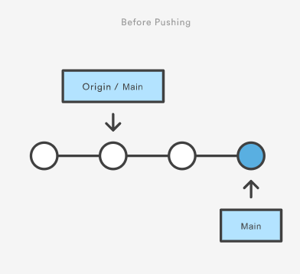
Git Push, Fetch, Pull:
The above diagram shows what happens when your local main has progressed past the central repository’s main and you publish changes by running git push origin main.
Notice how git push is essentially the same as running git merge main from inside the remote repository.

Slide 23
Git Push, Fetch, Pull:
Git Fetch:
The git fetch command downloads commits, files, and refs from a remote repository into your local repo. Fetching is what you do when you want to see what everybody else has been working on. It’s similar to svn update in that it lets you see how the central history has progressed, but it doesn’t force you to actually merge the changes into your repository. Git isolates fetched content from existing local content; it has absolutely no effect on your local development work. Fetched content has to be explicitly checked out using the git checkout command. This makes fetching a safe way to review commits before integrating them with your local repository.
When downloading content from a remote repo, git pull and git fetch commands are available to accomplish the task. You can consider git fetch the 'safe' version of the two commands. It will download the remote content but not update your local repo's working state, leaving your current work intact. git pull is the more aggressive alternative; it will download the remote content for the active local branch and immediately execute git merge to create a merge commit for the new remote content. If you have pending changes in progress this will cause conflicts and kick-off the merge conflict resolution flow.
Git FETCH Commands:
git fetch <remote>
Fetch all of the branches from the repository. This also downloads all of the required commits and files from the other repository.
git fetch <remote> <branch>
Same as the above command, but only fetch the specified branch.
git fetch --all
A power move which fetches all registered remotes and their branches:
git fetch --dry-run
The --dry-run option will perform a demo run of the command. It will output examples of actions it will take during the fetch but not apply them.

Slide 24
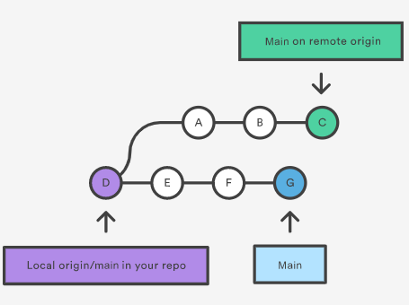
Git Push, Fetch, Pull:
Git PULL:
The git pull command is used to fetch and download content from a remote repository and immediately update the local repository to match that content. Merging remote upstream changes into your local repository is a common task in Git-based collaboration work flows. The git pull command is actually a combination of two other commands, git fetch followed by git merge. In the first stage of operation git pull will execute a git fetch scoped to the local branch that HEAD is pointed at. Once the content is downloaded, git pull will enter a merge workflow. A new merge commit will be-created and HEAD updated to point at the new commit.
The git pull command first runs git fetch which downloads content from the specified remote repository. Then a git merge is executed to merge the remote content refs and heads into a new local merge commit. To better demonstrate the pull and merging process let us consider the following example. Assume we have a repository with a main branch and a remote origin.
In this scenario, git pull will download all the changes from the point where the local and main diverged. In this example, that point is E. git pull will fetch the diverged remote commits which are A-B-C.
The pull process will then create a new local merge commit containing the content of the new diverged remote commits.

Slide 25
Git Push, Fetch, Pull:
In this scenario, git pull will download all the changes from the point where the local and main diverged. In this example, that point is E. git pull will fetch the diverged remote commits which are A-B-C.
The pull process will then create a new local merge commit containing the content of the new diverged remote commits.

Slide 26
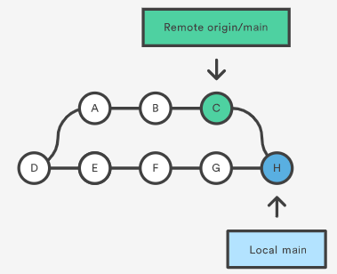
Git Push, Fetch, Pull:
In the above diagram, we can see the new commit H. This commit is a new merge commit that contains the contents of remote A-B-C commits and has a combined log message. This example is one of a few git pull merging strategies.
A --rebase option can be passed to git pull to use a rebase merging strategy instead of a merge commit. The next example will demonstrate how a rebase pull works. Assume that we are at a starting point of our first diagram, and we have executed git pull --rebase.

Slide 27
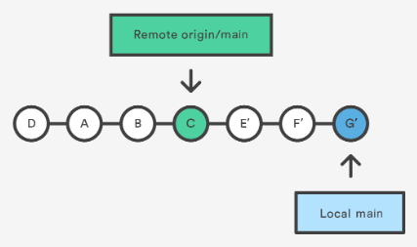
Git Push, Fetch, Pull:
In this diagram, we can now see that a rebase pull does not create the new H commit. Instead, the rebase has copied the remote commits A--B--C and rewritten the local commits E--F--G to appear after them in the local origin/main commit history.

Slide 28
PULL Common Options:
git pull <remote>
Fetch the specified remote’s copy of the current branch and immediately merge it into the local copy. This is the same as git fetch ＜remote＞ followed by git merge origin/＜current-branch＞.
git pull --no-commit <remote>
Similar to the default invocation, fetches the remote content but does not create a new merge commit.
git pull --rebase <remote>
Same as the previous pull Instead of using git merge to integrate the remote branch with the local one, use git rebase.
git pull --verbose
Gives verbose output during a pull which displays the content being downloaded and the merge details.

Slide 29
Closing (3 mins)

