Slide 1
1_Git-3: GitHub Management -SYNC (45 Minutes)
MEAN/MERN STACK

Slide 2
Opening (5 mins)

Slide 3
Learning Objectives:
Merging
Conflict resolution
Rebasing
Reverting changes
Maintaining Codebase Practices

Slide 4
Content (40 mins)

Slide 5
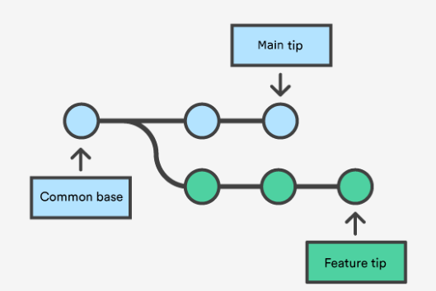
GitHub Management
Git Merge: Merging is Git's way of putting a forked history back together again. The git merge command lets you take the independent lines of development created by git branch and integrate them into a single branch. Note that all of the commands presented below merge into the current branch. The current branch will be updated to reflect the merge, but the target branch will be completely unaffected. Again, this means that git merge is often used in conjunction with git checkout for selecting the current branch and git branch -d for deleting the obsolete target branch. Working: Git merge will combine multiple sequences of commits into one unified history. In the most frequent use cases, git merge is used to combine two branches. The following examples in this document will focus on this branch merging pattern. In these scenarios, git merge takes two commit pointers, usually the branch tips, and will find a common base commit between them. Once Git finds a common base commit it will create a new "merge commit" that combines the changes of each queued merge commit sequence. Say we have a new branch feature that is based off the main branch. We now want to merge this feature branch into main.

Slide 6
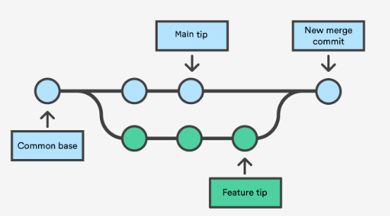
GitHub Management
Invoking this command will merge the specified branch feature into the current branch, we'll assume main. Git will determine the merge algorithm automatically (discussed below).
Merge commits are unique against other commits in the fact that they have two parent commits. When creating a merge commit Git will attempt to auto magically merge the separate histories for you. If Git encounters a piece of data that is changed in both histories it will be unable to automatically combine them. This scenario is a version control conflict and Git will need user intervention to continue.

Slide 7
GitHub Management
Preparing to merge: Before performing a merge there are a couple of preparation steps to take to ensure the merge goes smoothly. Confirm the receiving branch: Execute git status to ensure that HEAD is pointing to the correct merge-receiving branch. If needed, execute git checkout to switch to the receiving branch. In our case we will execute git checkout main. Fetch latest remote commits: Make sure the receiving branch and the merging branch are up-to-date with the latest remote changes. Execute git fetch to pull the latest remote commits. Once the fetch is completed ensure the main branch has the latest updates by executing git pull. Merging: Once the previously discussed "preparing to merge" steps have been taken a merge can be initiated by executing git merge whereas the name of the branch that will be merged into the receiving branch. Fast Forward Merge: A fast-forward merge can occur when there is a linear path from the current branch tip to the target branch. Instead of “actually” merging the branches, all Git has to do to integrate the histories is move (i.e., “fast forward”) the current branch tip up to the target branch tip. This effectively combines the histories, since all of the commits reachable from the target branch are now available through the current one. For example, a fast forward merge of some-feature into main would look something like the following:

Slide 8
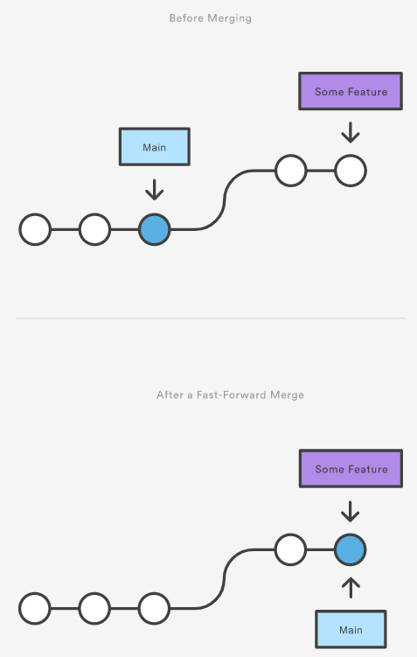
GitHub Management

Slide 9
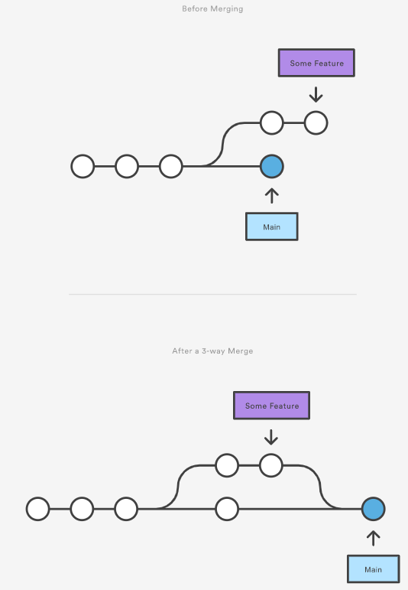
GitHub Management
However, a fast-forward merge is not possible if the branches have diverged. When there is not a linear path to the target branch, Git has no choice but to combine them via a 3-way merge. 3-way merges use a dedicated commit to tie together the two histories. The nomenclature comes from the fact that Git uses three commits to generate the merge commit: the two branch tips and their common ancestor.

Slide 10
GitHub Management
However, a fast-forward merge is not possible if the branches have diverged. When there is not a linear path to the target branch, Git has no choice but to combine them via a 3-way merge. 3-way merges use a dedicated commit to tie together the two histories. The nomenclature comes from the fact that Git uses three commits to generate the merge commit: the two branch tips and their common ancestor.
While you can use either of these merge strategies, many developers like to use fast-forward merges (facilitated through rebasing) for small features or bug fixes, while reserving 3-way merges for the integration of longer-running features. In the latter case, the resulting merge commit serves as a symbolic joining of the two branches.

Slide 11
GitHub Management
Our first example demonstrates a fast-forward merge. The code below creates a new branch, adds two commits to it, then integrates it into the main line with a fast-forward merge.
# Start a new feature
git checkout -b new-feature main
# Edit some files
git add <file>
git commit -m "Start a feature"
# Edit some files
git add <file>
git commit -m "Finish a feature"
# Merge in the new-feature branch
git checkout main
git merge new-feature
git branch -d new-feature
This is a common workflow for short-lived topic branches that are used more as an isolated development than an organizational tool for longer-running features.
Also note that Git should not complain about the git branch -d, since new-feature is now accessible from the main branch.
In the event that you require a merge commit during a fast forward merge for record keeping purposes you can execute git merge with the --no-ffoption.
git merge --no-ff <branch>
This command merges the specified branch into the current branch, but always generates a merge commit (even if it was a fast-forward merge). This is useful for documenting all merges that occur in your repository.

Slide 12
GitHub Management
Conflict Resolution:
If the two branches you're trying to merge both changed the same part of the same file, Git won't be able to figure out which version to use. When such a situation occurs, it stops right before the merge commit so that you can resolve the conflicts manually.
The great part of Git's merging process is that it uses the familiar edit/stage/commit workflow to resolve merge conflicts. When you encounter a merge conflict, running the git status command shows you which files need to be resolved. For example, if both branches modified the same section of hello.py, you would see something like the following:
On branch main
Unmerged paths:
(use "git add/rm ..." as appropriate to mark resolution)
both modified: hello.py
How conflicts are presented:
When Git encounters a conflict during a merge, It will edit the content of the affected files with visual indicators that mark both sides of the conflicted content. These visual markers are: <<<<<<<, =======, and >>>>>>>. Its helpful to search a project for these indicators during a merge to find where conflicts need to be resolved.
here is some content not affected by the conflict
<<<<<<< main
this is conflicted text from main
=======
this is conflicted text from feature branch
>>>>>>> feature branch;
Generally the content before the ======= marker is the receiving branch and the part after is the merging branch.
Once you've identified conflicting sections, you can go in and fix up the merge to your liking. When you're ready to finish the merge, all you have to do is run git add on the conflicted file(s) to tell Git they're resolved. Then, you run a normal git commit to generate the merge commit. It’s the exact same process as committing an ordinary snapshot, which means it’s easy for normal developers to manage their own merges.
Note that merge conflicts will only occur in the event of a 3-way merge. It’s not possible to have conflicting changes in a fast-forward merge.

Slide 13
GitHub Management
How conflicts are presented:
Generally the content before the ======= marker is the receiving branch and the part after is the merging branch.
Once you've identified conflicting sections, you can go in and fix up the merge to your liking. When you're ready to finish the merge, all you have to do is run git add on the conflicted file(s) to tell Git they're resolved. Then, you run a normal git commit to generate the merge commit. It’s the exact same process as committing an ordinary snapshot, which means it’s easy for normal developers to manage their own merges.
Note that merge conflicts will only occur in the event of a 3-way merge. It’s not possible to have conflicting changes in a fast-forward merge.
Git Rebase:
The git rebase command allows you to easily change a series of commits, modifying the history of your repository. You can reorder, edit, or squash commits together.
Typically, you would use git rebase to:
Edit previous commit messages
Combine multiple commits into one
Delete or revert commits that are no longer necessary
Rebasing commits against a branch:
To rebase all the commits between another branch and the current branch state, you can enter the following command in your shell (either the command prompt for Windows, or the terminal for Mac and Linux):
$ git rebase --interactive other_branch_name

Slide 14
GitHub Management
Rebasing commits against a point in time:
To rebase the last few commits in your current branch, you can enter the following command in your shell:
$ git rebase --interactive HEAD~7
Commands available while rebasing:
There are six commands available while rebasing:
Pick:
pick simply means that the commit is included. Rearranging the order of the pick commands changes the order of the commits when the rebase is underway. If you choose not to include a commit, you should delete the entire line.
Reword:
The reword command is similar to pick, but after you use it, the rebase process will pause and give you a chance to alter the commit message. Any changes made by the commit are not affected.
Edit:
If you choose to edit a commit, you'll be given the chance to amend the commit, meaning that you can add or change the commit entirely. You can also make more commits before you continue the rebase. This allows you to split a large commit into smaller ones, or, remove erroneous changes made in a commit.
Squash:
This command lets you combine two or more commits into a single commit. A commit is squashed into the commit above it. Git gives you the chance to write a new commit message describing both changes.
Fixup:
This is similar to squash, but the commit to be merged has its message discarded. The commit is simply merged into the commit above it, and the earlier commit's message is used to describe both changes.
Exec:
This lets you run arbitrary shell commands against a commit.

Slide 15
GitHub Management
Fixup:
This is similar to squash, but the commit to be merged has its message discarded. The commit is simply merged into the commit above it, and the earlier commit's message is used to describe both changes.
Exec:
This lets you run arbitrary shell commands against a commit.
Reverting Changes:
In this section, we will discuss the available 'undo' Git strategies and commands. It is first important to note that Git does not have a traditional 'undo' system like those found in a word processing application. It will be beneficial to refrain from mapping Git operations to any traditional 'undo' mental model. Additionally, Git has its own nomenclature for 'undo' operations that it is best to leverage in a discussion. This nomenclature includes terms like reset, revert, checkout, clean, and more.
A fun metaphor is to think of Git as a timeline management utility. Commits are snapshots of a point in time or points of interest along the timeline of a project's history. Additionally, multiple timelines can be managed through the use of branches. When 'undoing' in Git, you are usually moving back in time, or to another timeline where mistakes didn't happen.
This tutorial provides all of the necessary skills to work with previous revisions of a software project. First, it shows you how to explore old commits, then it explains the difference between reverting public commits in the project history vs. resetting unpublished changes on your local machine.

Slide 16
GitHub Management
Finding what is lost: Reviewing old commits
The whole idea behind any version control system is to store “safe” copies of a project so that you never have to worry about irreparably breaking your code base. Once you’ve built up a project history of commits, you can review and revisit any commit in the history. One of the best utilities for reviewing the history of a Git repository is the git log command. In the example below, we use git log to get a list of the latest commits to a popular open-source graphics library.
git log --oneline
e2f9a78fe Replaced FlyControls with OrbitControls
d35ce0178 Editor: Shortcuts panel Safari support.
9dbe8d0cf Editor: Sidebar.Controls to Sidebar.Settings.Shortcuts. Clean up.
05c5288fc Merge pull request #12612 from TyLindberg/editor-controls-panel
0d8b6e74b Merge pull request #12805 from harto/patch-1
23b20c22e Merge pull request #12801 from gam0022/improve-raymarching-example-v2
fe78029f1 Fix typo in documentation
7ce43c448 Merge pull request #12794 from WestLangley/dev-x
17452bb93 Merge pull request #12778 from OndrejSpanel/unitTestFixes
b5c1b5c70 Merge pull request #12799 from dhritzkiv/patch-21
1b48ff4d2 Updated builds.
88adbcdf6 WebVRManager: Clean up.
2720fbb08 Merge pull request #12803 from dmarcos/parentPoseObject
9ed629301 Check parent of poseObject instead of camera
219f3eb13 Update GLTFLoader.js
15f13bb3c Update GLTFLoader.js
6d9c22a3b Update uniforms only when onWindowResize
881b25b58 Update ProjectionMatrix on change aspect
Each commit has a unique SHA-1 identifying hash. These IDs are used to travel through the committed timeline and revisit commits. By default, git log will only show commits for the currently selected branch. It is entirely possible that the commit you're looking for is on another branch.
You can view all commits across all branches by executing git log --branches=*. The command git branch is used to view and visit other branches. Invoking the command, git branch -a will return a list of all known branch names. One of these branch names can then be logged using git log.

Slide 17
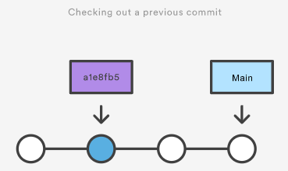
GitHub Management
When you have found a commit reference to the point in history you want to visit, you can utilize the git checkout command to visit that commit. Git checkout is an easy way to “load” any of these saved snapshots onto your development machine. During the normal course of development, the HEAD usually points to main or some other local branch, but when you check out a previous commit, HEAD no longer points to a branch—it points directly to a commit. This is called a “detached HEAD” state, and it can be visualized as the following:
Checking out an old file does not move the HEAD pointer. It remains on the same branch and same commit, avoiding a 'detached head' state. You can then commit the old version of the file in a new snapshot as you would any other changes. So, in effect, this usage of git checkout on a file, serves as a way to revert back to an old version of an individual file. For more information on these two modes visit the git checkout page

Slide 18
GitHub Management
Viewing an old revision:
This example assumes that you’ve started developing a crazy experiment, but you’re not sure if you want to keep it or not. To help you decide, you want to take a look at the state of the project before you started your experiment. First, you’ll need to find the ID of the revision you want to see.
git log --oneline
Let’s say your project history looks something like the following:
b7119f2 Continue doing crazy things
872fa7e Try something crazy
a1e8fb5 Make some important changes to hello.txt
435b61d Create hello.txt
9773e52 Initial import
You can use git checkout to view the “Make some import changes to hello.txt” commit as follows:
git checkout a1e8fb5
This makes your working directory match the exact state of the a1e8fb5 commit. You can look at files, compile the project, run tests, and even edit files without worrying about losing the current state of the project. Nothing you do in here will be saved in your repository. To continue developing, you need to get back to the “current” state of your project:
git checkout main
This assumes that you're developing on the default main branch. Once you’re back in the main branch, you can use either git revert or git reset to undo any undesired changes.

Slide 19
GitHub Management
Undoing the last commit:
In the previous section, we discussed different strategies for undoing commits. These strategies are all applicable to the most recent commit as well. In some cases though, you might not need to remove or reset the last commit. Maybe it was just made prematurely. In this case you can amend the most recent commit. Once you have made more changes in the working directory and staged them for commit by using git add, you can execute git commit --amend. This will have Git open the configured system editor and let you modify the last commit message. The new changes will be added to the amended commit.
Maintaing Codebase Practices:
Branch Frequently, Commit Often:
Deciding on a correct branching strategy is vital to streamlining the commit process. Whatever your strategy, communicate to the team how you want to branch. You also want to direct developers to use smaller, short-lived branches. Using this method has proven to minimize bad check-ins.
With short-term branches, you reduce check-out times, improve traceability, and expedite code reviews. By committing more frequently, you help to eliminate confusion and decrease the chance of a time-consuming merge.
It is also important not to include a large number of changes in a single branch. Even though this seems like an efficient way to develop, it can create problems later. To prevent regression, ensure that each check-in has a single purpose. This will make diagnosing bugs and tracing changes a lot easier.

Slide 20
GitHub Management
Make Small, Single-Purpose Commits:
By committing only small sections of code, everyone on your team can quickly understand what work has been completed. And if something goes wrong, smaller commits make it easier to revert bad check-ins, which helps you maintain a stable codebase.
It’s easier for developers to understand the submitted code when only related changes are checked in. Think of a commit like a wrapper around a set of changes. Everything inside the wrapper accomplishes one purpose. If you are fixing two separate bugs, there should be two separate commits.
When writing a commit message, start with a short summary of your change. Write your summary in present tense, limit the subject line to 50 characters, and always leave the second line blank. This separates your subject line from the message to ensure only the subject line displays.
Write Short, Detailed Commit Messages
Keep in mind that your team members will need to be able to read this message and understand exactly what you have done. Make sure that you provide enough detail to answer:
What changed from the last version?
How did it resolve the issue?
Why did you make the change?
Some bad examples are:
Address workitem xxxyyy.
Fixed a bug.
Refactored X and Y. Added files.
Who broke this code?????
Some better examples include:
Add search for username in group view.
Fix dynamic field init method to show status.
Small changes to text editor to enhance user experience.

Slide 21
GitHub Management
Test Code and Require Reviews:
If you’re hesitant about your commit passing a build or test, don’t do it. Bad commits make tracing bugs and resolving conflicts a nightmare. You should test your code often, and commit once.
To help protect the quality of your codebase, it is important to require code to not only pass a build, but also be reviewed. Using code reviews creates a quality gate that can promote knowledge sharing and code reuse.
Pick a code review tool that does not bottleneck development. When code is ready to be checked in, it should launch a code review.
Preserve History and Traceability:
When checking in a change, make sure all affected files and unit tests are included. This is especially important when working between branches. Providing related test cases and files with your commit ensures that others can use your check-in without breaking their builds.
If different projects or branches are governed by unique policies, keep them in separate code lines. While this may seem like an administrative burden, the right source code management tool makes this a simple task.
For security and audit purposes, make sure that your changes can be understood by other developers. It is important when using Git to not alter your local history.

Slide 22
Closing (3 mins)

